Slide 1

Object-Relational Mapping with Hibernate
Brian Sam-Bodden
Principal Partner
Integrallis Software, LLC.
August 1 - 5, 2005
Notes:
Title slide

Slide 2

Hibernate
Relational Persistence For Idiomatic Java
Provides
  Transparent persistence
  Object-querying capabilities
  Caching
Works with fine-grained POJO-based models
Supports most Databases
Created by Gavin King, now part of the JBoss Group

Slide 3
Hibernate
Relational Persistence For Idiomatic Java
Declarative programming
Uses Runtime Reflection
Query Language is SQL-like
  Leverages programmer’s knowledge
Mappings
  Typically defined as XML documents
But you never have to write XML if you don’t want to (XDoclet, JSE 1.5 Annots)

Slide 4
Hibernate
Core Concepts
Session Factory
  is a cache of compiled mappings for a single database.
  used to retrieve Hibernate Sessions
Session
  Short lived
    Temporary bridge between the app and the data storage
  Provides CRUD operations on Objects
  Wraps a JDBC Connection / J2EE Data Source
  Serves as a first level object cache
Notes:
Session Factory: thread-safe (immutable)
A Hibernate Session provides transaction-scoped identity.
Hibernate affords process-scoped identity through an optional second-level cache.

Slide 5
Architecture
Choices
How much you use depends on your needs
  Lightweight
    Basic persistence
  Fully Integrated
    Transactions
    Caching
    Connection Pooling

Slide 6
O/R Mappings
Hibernate Mapping (.hbm.xml) Files define:
  Column to Field Mappings
  Primary Key mapping & generation Scheme
  Associations
  Collections
  Caching Settings
  Custom SQL
  And many more settings…

Slide 7
HBM XML File
<hibernate-mapping
package="com.integrallis.techconf.domain">
<class name="Address">
<id name="Id" column="PK_ID" type="integer">
<generator class="identity" />
</id>
<property name="StreetAddress“ />
…
<property name="AptNumber" />
</class>
</hibernate-mapping>

Slide 8
O/R Mappings
Hibernate uses smart defaults
Mapping files can be generated:
  Manually
    Tedious, boring and error prone
    Total control of the mapping
  From POJOs
    XDoclet, Annotations
  From Database Schema
    Middlegen, Synchronizer, Hibernate Tools
Notes:
to minimize the amount of information needed in a mapping

Slide 9
Configuring Hibernate
Hibernate Session Factory configured via hibernate.cfg.xml
CFG file determines which mappings to load (.hbm.xml files)
In your application SessionFactory is a singleton
You request a Session as needed to work with persistent objects
Notes:
to minimize the amount of information needed in a mapping

Slide 10
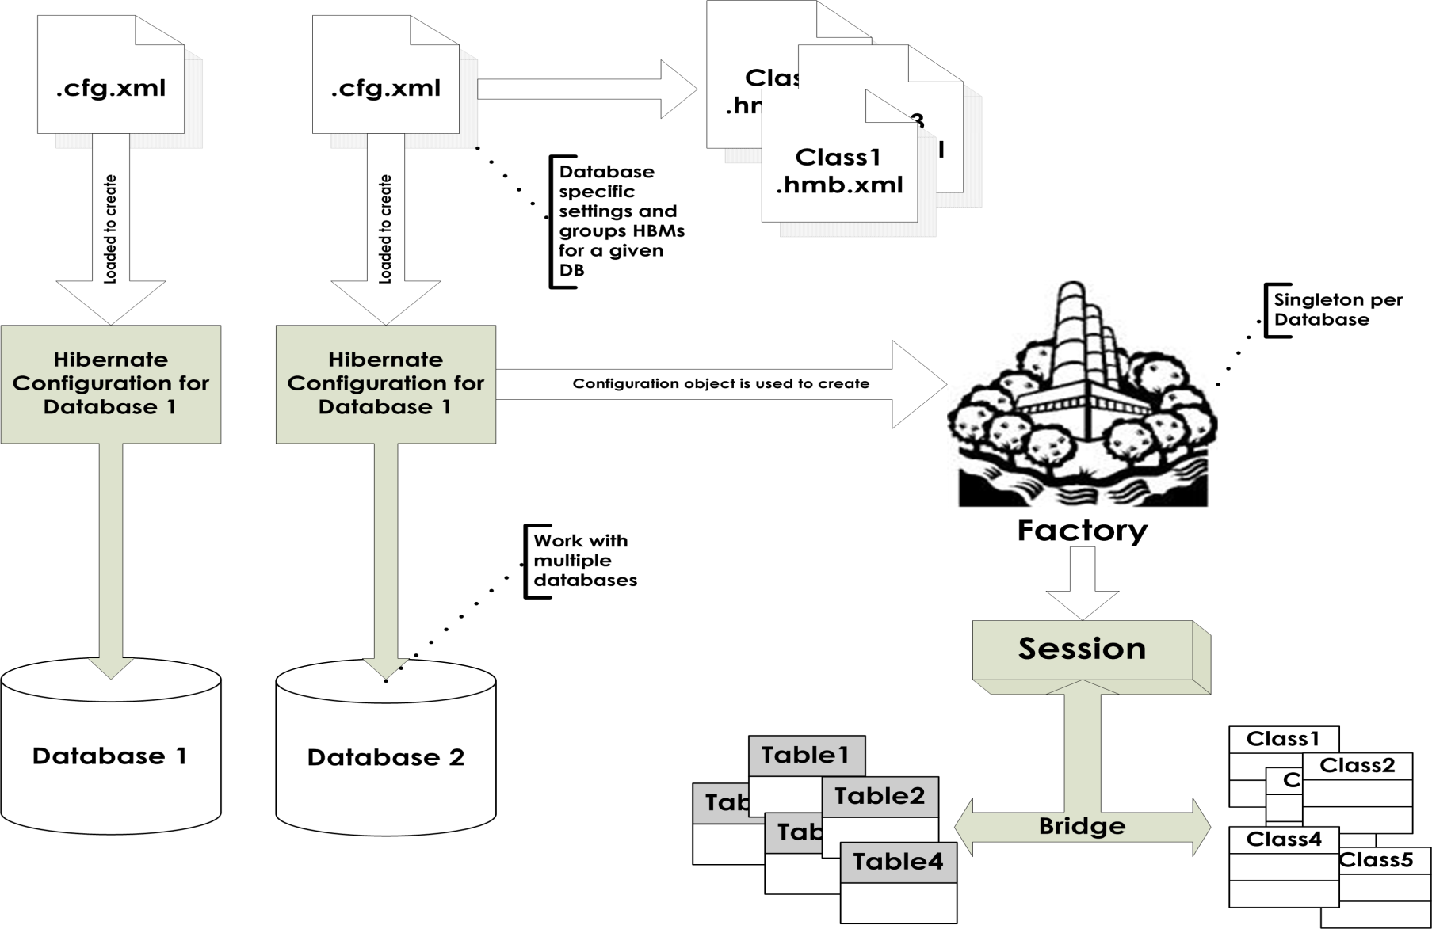
The Big Picture

Slide 11
Working with Persistent Objects
Saving an Object
Address address = new Address();
...
Session session = null;
Transaction tx = null;
try {
session = factory.openSession();
tx = session.beginTransaction();
session.save(address);
tx.commit();
…
} finally {
session.close();
}
POJO is created
Start a Session
Transaction is started
The object is saved
The transaction is committed
The session is closed

Slide 12
Working with Persistent Objects
Loading an Object
Address address = null;
Session session = null;
session = factory.openSession();
try {
address = (Address)
session.get(Address.class, id);
} finally {
session.close();
}
Start a Session
POJO is loaded
PK and Object Class are provided
The session is closed

Slide 13
Working with Persistent Objects
Deleting an Object
Session session = null;
Transaction tx = null;
try {
session = factory.openSession();
tx = session.beginTransaction();
session.delete(address);
tx.commit();
…
} finally {
session.close();
}
Start a Session
Transaction is started
The object is deleted
The transaction is committed
The session is closed

Slide 14
Working with Collections
Can represent a parent-child/one-many relationship using most of the available Java Collections
Persistence by reach-ability
No added semantics to your collections
Available Collection mappings are
  <set>, <list>, <map>, <bag>, <array> and <primitive-array>
In the database mappings are defined by a foreign key to the owning/parent entity
Notes:
Persistance by Reachability: Automatically persisted when referenced by a persistent object and deleted when unreferenced
A Hibernate-mapped collection is used just as a normal Java Collection

Slide 15
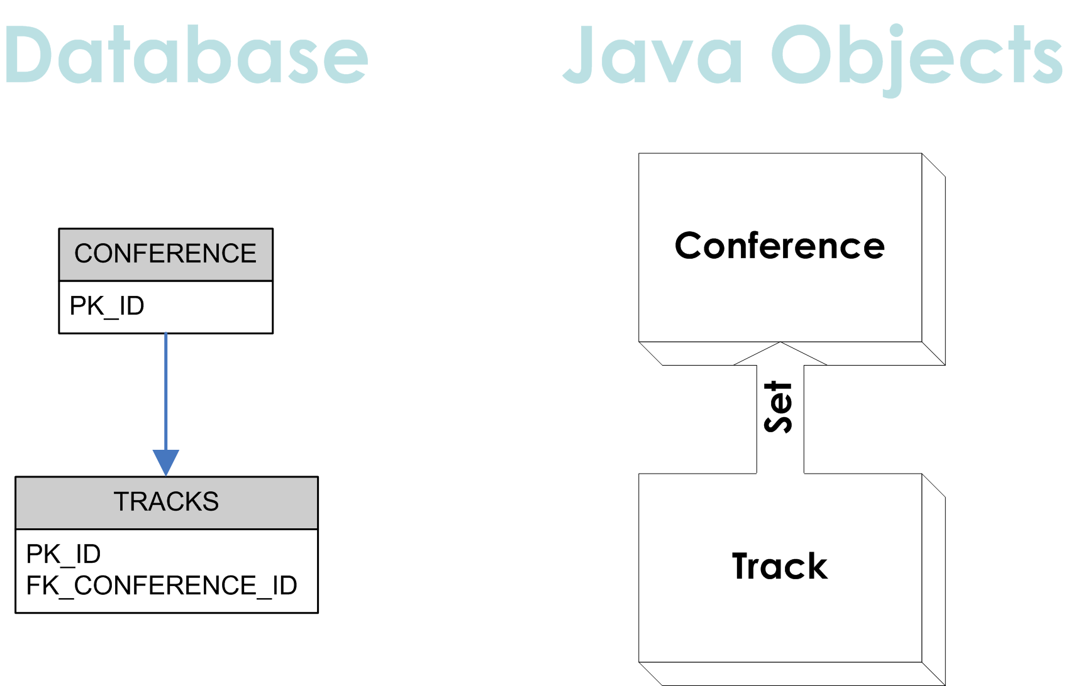
Working with Collections
A simple example

Slide 16
Working with Collections
A simple example
public class Conference implements Serializable {
...
// Tracks belonging to this Conference
private Set tracks;
public Set getTracks () { return tracks; }
public void setTracks (Set tracks) { this.tracks = tracks; }
// maintain bi-directional association
public void addTrack(Track track) {
if (null == tracks) tracks = new HashSet();
track.setConference(this);
tracks.add(track);
}

Slide 17
Working with Collections
A simple example
<hibernate-mapping package="com.integrallis.tcms.domain">
<class name="Conference">
<id column="PK_ID" name="Id“
type="integer">
<generator class="identity" />
</id>
...
<set name="Tracks" inverse="true"
cascade="all" lazy="false">
<one-to-many class="Track" />
<key column="FK_CONFERENCE_ID" />
Class/Table
How to generate PK
Other field mappings
Java Set for the Tracks
Class on the many side
Foreign Key on the many side

Slide 18
Association Mappings
Supported Associations
One-to-one
  Maintained with Foreign Keys in Database
One-to-many / Many-to-one
  Object on the ‘one’ side
  Collection on the many ‘side’
Many-to-Many
  Use a ‘mapping’ table in the database

Slide 19
Association Mappings
Some Details
Inverse attribute used for bi-directional associations
Lazy Loading
  Configured per relationship
  Uses dynamic proxies at Runtime
Cascading Styles
  “none” no operations are cascaded
  “all” all operations are cascaded
  Every operation in Hibernate has a corresponding cascade style

Slide 20
Hibernate Query Language
HQL
An objectified version of SQL
  Polymorphic Queries
  Object parameters in Queries
  Less verbose than SQL
Doesn’t hide the power of SQL
  SQL joins, Cartesian products
  Projections
  Aggregation (max, avg) and grouping
  Ordering
  Sub-queries
  …and more

Slide 21
Hibernate Query Language
HQL
Simplest HQL Query
  Return all Addresses
session = sessionFactory.openSession();
// query string – ‘Address’ refers to a Class not a Table
String queryString = "from Address";
// create, configure and execute the query
List addresses = session.createQuery(queryString).list();

Slide 22
Hibernate Query Language
HQL
A more elaborate HQL Query
  Return all Tracks in a Conference
Conference conference = …
session = sessionFactory.openSession();
// build a query string
String queryString = “from Tracks as t where t.Conference = :conf”;
// create, configure and execute the query
List addresses = session.createQuery(queryString)
.setObject(“conf”, conference)
.list();

Slide 23
Hibernate Query Language
HQL Parameters
Named parameters removed positional problems
May occur multiple times in the same query
Self-documenting
List tracks = new ArrayList();
tracks.add(“JSE");
tracks.add(“JEE");
Query q = session
.createQuery("from Sessions s where s.Track in (:trackList)");
q.setParameterList(“trackList", tracks);
List sessions = q.list();

Slide 24
Hibernate Query Language
HQL Parameters
Specify bounds upon your result set
The maximum number of rows
The first row you want to retrieve
Query query = session.createQuery("from Users");
query.setFirstResult(50);
query.setMaxResults(100);
List someUsers = query.list();

Slide 25
Query by Criteria
Same query using the Criteria API
  Return all Tracks for a given Conference
Conference conference = …
session = sessionFactory.openSession();
// create and expression to match the given conference
Expression exp = Expression.eq(“Conference", conference);
List addresses = session
.createCriteria(Tracks.class)
.add(exp)
.list();

Slide 26
Query by Example
Return all Address for a given Street Name
Address address = new Address();
Address.setStreetAddress(“Main Street”);
// create example object
Example example = Example.create(address)
.ignoreCase()
.enableLike(MatchMode.ANYWHERE);
// create, configure and execute the query
List matches = session.createCriteria(Address.class)
.add(example)
.list();

Slide 27
Conclusions
Why should you use Hibernate?
It’s a well designed product. Look at the source!
It covers 80% of your persistence needs and does a fine job on the other 20%
You get to work with POJOs, not coarse-grained EJBs
Performance is good! Boils down to the generated SQL
  If you don’t like it, you can always use custom SQL
Notes:
For cases when the generated SQL is not sufficient, you can tell Hibernate the exact SQL to use for insert, updates and deletes

Slide 28
Conclusions
Why should you use Hibernate?
Good separation of integration tier and the rest of the application
Avoid reinventing the well
Good community support, large pool of talent
Notes:
For cases when the generated SQL is not sufficient, you can tell Hibernate the exact SQL to use for insert, updates and deletes

