Slide 1
Developing Data-Driven
Web Applications using LINQ
Scott Guthrie
General Manager
scottgu@microsoft.com
http://weblogs.asp.net/scottgu

Slide 2
Download Slide + Samples
http://weblogs.asp.net/scottgu

Slide 3
Today’s Problem:
Data != Objects
Notes:
Goal: Why it is important
Action: talk on
Making data programming as simple as object programming (the plumber speech)
Blurb from LINQ Overview Doc:
After two decades, the industry has reached a stable point in the evolution of object oriented programming technologies. Programmers now take for granted features like classes, objects, and methods. In looking at the current and next generation of technologies, it has become apparent that the next big challenge in programming technology is to reduce the complexity of accessing and integrating information that is not natively defined using OO technology. The two most common sources of non-OO information are relational databases and XML.
Rather than add relational or XML-specific features to our programming languages and runtime, with the LINQ project we have taken a more general approach and are adding general purpose query facilities to the .NET Framework that apply to all sources of information, not just relational or XML data. This facility is called .NET Language Integrated Query (LINQ).
We use the term language integrated query to indicate that query is an integrated feature of the developer’s primary programming languages (e.g., C#, Visual Basic). Language integrated query allows query expressions to benefit from the rich metadata, compile-time syntax checking, static typing and IntelliSense that was previously available only to imperative code. Language integrated query also allows a single general purpose declarative query facility to be applied to all in-memory information, not just information from external sources.

Slide 4
Data Access In APIs Today
Queries in quotes
SqlConnection c = new SqlConnection(…);
c.Open();
SqlCommand cmd = new SqlCommand(
@"SELECT c.Name, c.Phone
FROM Customers c
WHERE c.City = @p0"
);
cmd.Parameters.AddWithValue("@po", "London");
DataReader dr = c.Execute(cmd);
while (dr.Read()) {
string name = dr.GetString(0);
string phone = dr.GetString(1);
DateTime date = dr.GetDateTime(2);
}
dr.Close();
Arguments loosely bound
Results loosely typed
Compiler cannot help catch mistakes
Notes:
Goal: show the limitations of the traditional data access model
Talking points: go through the bullets
Not say there is nothing wrong with ado.net

Slide 5
Data Access with LINQ
Classes describe data
public class Customer
{
public int CustomerId;
public string Name;
public string City;
public void Validate() {
// Todo: Add Business Validation
}
}
GridView1.DataSource = from customer in db.Customers
where customer.City == "London"
select customer;
GridView1.DataBind();
Encapsulated Business Validation
Query is natural part of the language
The compiler provides intellisense and type-checking
Notes:
Goal: to show the simplicity of the DLinq model
Talking points: go through the bullets

Slide 6
LINQ Architecture
C#
VB
Others…
.Net Language Integrated Query (LINQ)
LINQ enabled data sources
LINQ enabled ADO.NET
LINQ
To Objects
LINQ
To Datasets
LINQ
To SQL
LINQ
To Entities
LINQ
To XML
<book>
<title/>
<author/>
<price/>
</book>
Objects
Relational
XML
Notes:
©2005 Microsoft Corporation. All rights reserved.
This presentation is for informational purposes only. Microsoft makes no warranties, express or implied, in this summary.

Slide 7
LINQ Basics
Query Operators can be used against any .NET collection (IEnumerable<T>)
  Built-in examples: Select, Where, GroupBy, Join, etc.
  Extensibility model supports adding/replacing them
Query Expressions can operate on information sources and apply query operators against them to return IEnumerable<T> sequences

Slide 8
Searching/Sorting an Array
Array implements IEnumerable<T>
string [] cities = { “Auckland”, “Oslo”, “Sydney”,
“Seattle”, “Paris”, “Los Angeles” };
IEnumerable<string> places = from city in cities
  where city.Length > 5
  orderby city descending
  select city;
GridView1.DataSource = places;
GridView1.DataBind();
LINQ Query Expression using Query Operators
IEnumerable<string>
sequence result can be used w/ databinding

Slide 9
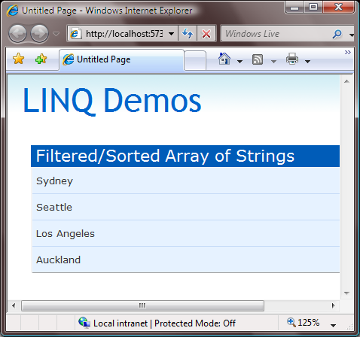
Searching/Sorting an Array

Slide 10
Custom City Class
public class City
{
public string Name;
public string Country;
public int DistanceFromSeattle;
}
List<City> locations = GetLocations();

Slide 11
Searching/Sorting City Collection
Collection implements IEnumerable<T>
List<City> locations = GetLocations();
IEnumerable<City> places = from city in locations
where city.DistanceFromSeattle > 1000
orderby city.Country, city.Name
select city;
GridView1.DataSource = places;
GridView1.DataBind();
IEnumerable<City>
return sequence determined by select statement

Slide 12
GridView Declaration
<asp:GridView ID="GridView1" AutoGenerateColumns="false" runat="server">
<Columns>
<asp:BoundField HeaderText="Country" DataField="Country" />
<asp:BoundField HeaderText="City" DataField="Name" />
<asp:BoundField HeaderText=“Dist” DataField="DistanceFromSeattle“/>
</Columns>
</asp:GridView>

Slide 13
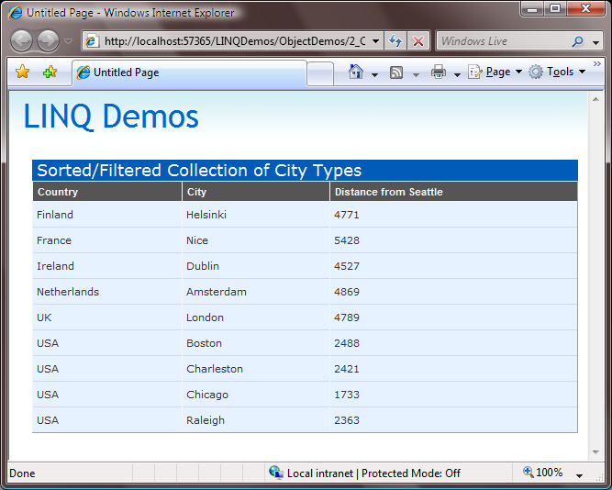
Searching/Sorting City Collection

Slide 14
Projections
Sometimes you want to modify or transform the data you return from a query
LINQ enables powerful “data shaping” scenarios using projections
Can optionally be used in conjunction with new “anonymous type” compiler support

Slide 15
Projections w/ Anonymous Types
List<City> cities = CityUtilityHelper.GetCities();
var places = from city in cities
where city.DistanceFromSeattle > 1000
select new {
City = city.Name,
Country = city.Country,
DistanceInKm = city.DistanceFromSeattle * 1.61
};
GridView1.DataSource = places;
GridView1.DataBind();
Anonymous type used to custom shape data results and apply miles->kilometer conversion

Slide 16
Projections w/ Anonymous Types
<asp:GridView ID="GridView1" AutoGenerateColumns="false" runat="server">
<Columns>
<asp:BoundField HeaderText="Country" DataField="Country" />
<asp:BoundField HeaderText="City" DataField=“City" />
<asp:BoundField HeaderText="Dist (KM)" DataField="DistanceInKm" />
</Columns>
</asp:GridView>

Slide 17
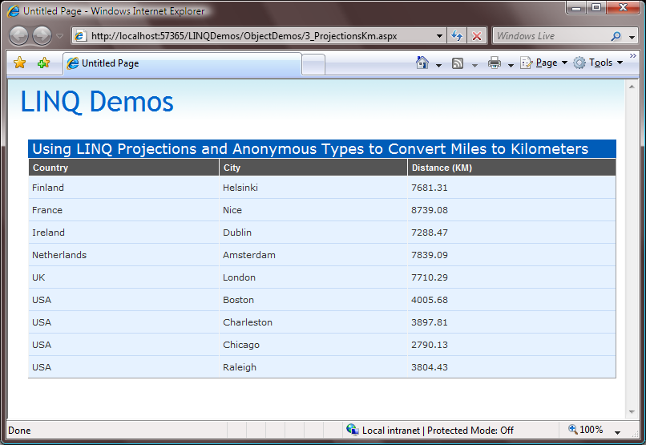
Projections w/ Anonymous Types

Slide 18
LINQ for SQL
Maps .NET classes to relational SQL data
Translates LINQ queries to SQL execution
Supports change tracking for insert, update, delete operations
Supports entity-level validation rules
Built on top of ADO.NET and integrates with connection-pooling and transactions

Slide 19
Associations
Associations express relationships between tables and classes
Typically expressed using primary key / foreign keys in the database
Enable flexible relational querying and manipulation without having to write any SQL code

Slide 20
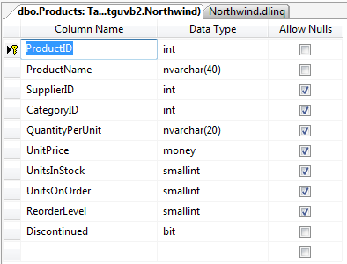
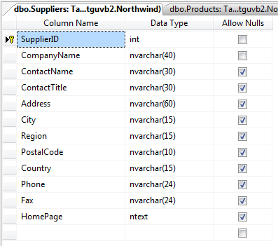
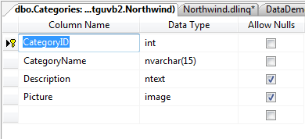
PK/FX Relationships in Database
Products Table
Suppliers Table
Categories Table
Foreign Key Relationships
to the Suppliers and Categories Tables

Slide 21
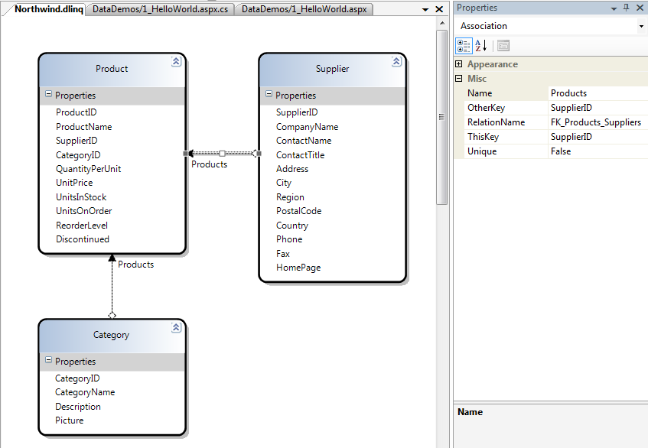
Associations in DLINQ Designer

Slide 22
Code Associations in Model
public partial class Product {
public int ProductID;
public string ProductName;
public Nullable<int> SupplierID;
public Nullable<int> CategoryID;
public Supplier Supplier;
public Category Category;
}
public partial class Supplier {
public int SupplierID;
public string CompanyName;
public EntitySet<Product> Products;
}
public partial class Category {
public int CategoryID;
public EntitySet<Product> Products;
}

Slide 23
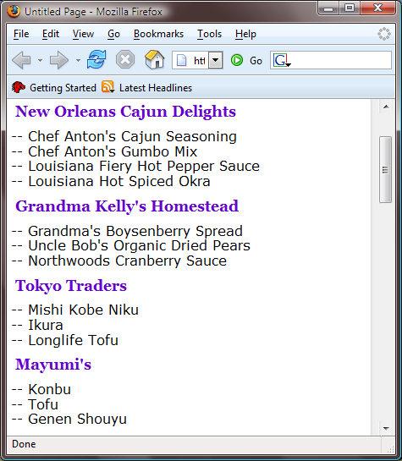
List Suppliers and Their Products
Supplier.CompanyName
Product.ProductName

Slide 24
List Suppliers and Products
NorthwindDataContext db = new NorthwindDataContext();
var suppliers = from s in db.Suppliers
where s.Products.Count > 2
select s;
foreach (Supplier supplier in suppliers) {
Response.Write("<h3>" + supplier.CompanyName + "</h3>");
foreach (Product product in supplier.Products) {
Response.Write("-- ");
Response.Write(product.ProductName);
Response.Write("<br/>");
}
}

Slide 25
List Suppliers and Products
NorthwindDataContext db = new NorthwindDataContext();
SupplierList.DataSource = from s in db.Suppliers
where s.Products.Count > 2
select s;
SupplierList.DataBind();

Slide 26
List Suppliers and Products
<asp:Repeater ID="SupplierList" runat="server">
<ItemTemplate>
<h3> <%# Eval("CompanyName") %> </h3>
<asp:Repeater DataSource='<%# Eval("Products")%>' runat="server">
<ItemTemplate>
-- <%# Eval("ProductName") %> <br />
</ItemTemplate>
</asp:Repeater>
</ItemTemplate>
</asp:Repeater>

Slide 27
List Suppliers and Their Products

Slide 28
LINQ for SQL Architecture
from c in db.Customers
where c.City == "London"
select
new { c.Name, c.Phone }
Application
LINQ Query
Objects
SubmitChanges()
LINQ for SQL
(ADO.NET)
Services:
- Change tracking
- Concurrency control
- Object identity
SQL Query
Rows
SQL or Stored Procs
select Name, Phone
from customers
where city = 'London'
SQLServer
Notes:
Talk about box between dlinq and app …
Goal: to give an overview of the flow of query and data in the system
Talking points: just go through the flow

Slide 29
Update a Specific Product
NorthwindDataContext db = new NorthwindDataContext();
Product product = db.Products.Single(p => p.ProductName== "Chai");
product.UnitsInStock = 11;
product.ReorderLevel = 10;
product.UnitsOnOrder = 2;
db.SubmitChanges();

Slide 30
Insert Supplier w/ 2 Products
NorthwindDataContext db = new NorthwindDataContext();
Supplier supplier = new Supplier();
supplier.CompanyName = "Scott Guthrie";
supplier.HomePage = "http://weblogs.asp.net/scottgu";
Product product1 = new Product();
product1.ProductName = "LINQ Talk";
product1.UnitPrice = new Decimal(99.9);
Product product2 = new Product();
product2.ProductName = "ASP.NET Tips/Tricks Talk";
product2.UnitPrice = new Decimal(101.99);
supplier.Products.Add(product1);
supplier.Products.Add(product2);
db.Suppliers.Add(supplier);
db.SubmitChanges();

Slide 31
Delete Supplier
NorthwindDataContext db = new NorthwindDataContext();
var supplier = db.Suppliers.FirstOrDefault(s=>s.CompanyName == “ABC");
if ((supplier != null) && (supplier.Products.Count == 0))
{
db.Suppliers.Remove(supplier);
db.SubmitChanges();
}

