Slide 1
Notes:
AUDIO
Registrazione: Natalia
Editing: Tiziana
Note: ok
GRAFICA
Editing: Tiziana (08.06.05)
Note: ok

Slide 2
Distributed Transactions
begin transaction
update Account1@1
set Balance=Balance + 500.000
where AccNum=45;
update Account2@2
set Balance=Balance - 500.000
where AccNum=35;
commit work
end transaction

Slide 3
Distributed Transactions
CLIENT
45 + 500.000
35 - 500.000
Branch1
Branch2

Slide 4
ACID Properties of Distributed Execution
Isolation
  If each sub-transaction is two-phase, the transaction is globally serializable
Durability
  If each sub-transaction handles logs correctly, data are globally persistent
Consistency
  If each sub-transaction preserves local integrity, data are globally consistent
Atomicity
  It is the main problem of distributed transactions

Slide 5
Faults in a Distributed System
Node failures
Message losses
Network partitioning
MSG

Slide 6
Distributed Protocols and Message Losses
A: SEND(B,MSG)
B: RECEIVE(MSG) SEND(A,ACK)
A: RECEIVE(ACK)

Slide 7
Two-phase Commit Protocol
Protocol that guarantees atomicity of distributed sub-transactions
Protagonists:
  A coordinator (Transaction Manager, TM)
  Several participants (Resource Manager, RM)
Similar to a marriage
  Phase one: the decision is declared
  Phase two: the marriage is ratified

Slide 8
New Log Records
In the coordinator’s log
  prepare: participants’ identity
  global commit/abort: decision
  complete: end of protocol
In the participant’s log
  ready: availability to participate to commit
  local commit/abort: decision received

Slide 9
Diagram of the Two-phase Commit Protocol
PREPARE
GLOBAL
DECISION
COMPLETE
coordinator
t
PREPARE
MSG
DECISION
ACK
participant
t
READY
LOCAL
DECISION

Slide 10
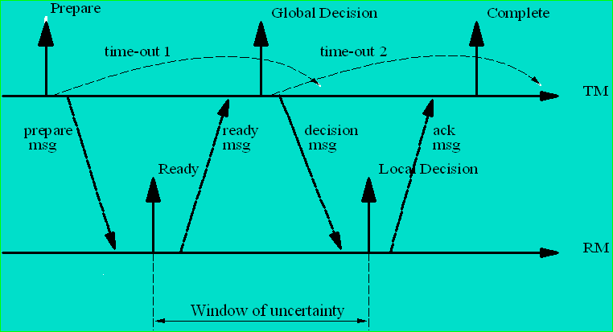
Protocol with Time-out and Window of Uncertainty

Slide 11
Phase 1
C: WRITE-LOG(PREPARE)
SET TIME-OUT
SEND (Pi,PREPARE)
Pi: RECEIVE(C,PREPARE)
IF OK THEN WRITE-LOG(READY)
READY=YES
ELSE READY=NO
SEND(C,READY)

Slide 12
Phase 2
C: RECEIVE(Ci,MSG)
IF TIME-OUT OR ONE(MSG)=NO
THEN WRITE-LOG(GLOBAL-ABORT)
DECISION=ABORT
ELSE WRITE-LOG(GLOBAL-COMMIT)
DECISION=COMMIT
SEND(Pi,DECISION)
Pi: RECEIVE(C,DECISION)
IF COMMIT THEN WRITE-LOG(COMMIT)
ELSE WRITE-LOG(ABORT)
SEND (C,ACK)
C: RECEIVE(Pi,ACK)
WRITE-LOG(COMPLETE)

Slide 13
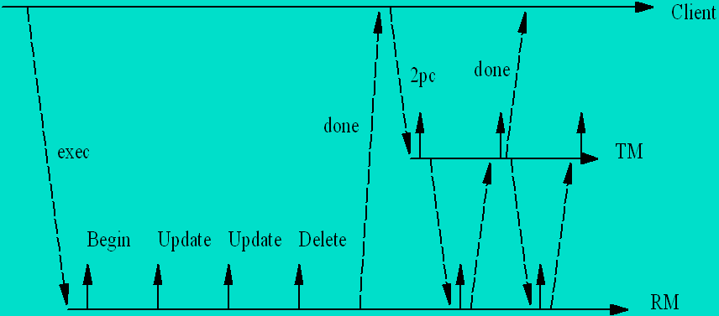
Protocol in the Context of a Complete Transaction

Slide 14
Complexity of the Protocol
Must be able to handle all possible failures:
  Failure of the coordinator
  Failure of one or more participants
  Message losses

Slide 15
Recovery of Participants
Performed by the warm restart protocol. Depends on the last record written in the log:
  If it is an action or abort record, the actions are undone; when it is a commit, the actions are redone; recovery doesn’t depend on the protocol
  If it is a ready, the failure has occurred during the two-phase commit. The participant is in doubt about the result of the transaction
During the warm restart protocol, the identifier of the transactions in doubt are collected. For each of them the final transaction outcome must be requested to the TM (remote recovery request)

Slide 16
Recovery of the Coordinator
When the last record in the log is a prepare, the failure of the TM might have placed some RMs in a blocked situation. Two recovery options:
  Write global abort on the log, and then carry out the second phase of the two-phase commit protocol
  Repeat the first phase, trying to reach a global commit
When the last record is a “global decision”, some RMs may have been left in a blocked state. The TM must then repeat the second phase of the protocol

Slide 17
Message Loss and Network Partitioning
The loss of a prepare or ready message are not distinguishable by the TM. In both cases, the TM reaches time-out and a global abort decision is made
The loss of a decision or ack message are also indistinguishable. In both cases, the TM reaches time-out and the second phase is repeated
A network partitioning does not cause further problems: global commit is reached only if the TM and all the RMs belong to the same partition

Slide 18
Recovery of the 2PC Protocol
PREPARE
GLOBAL
DECISION
COMPLETE
coordinator
t
PREPARE
MSG
DECISION
ACK
participant
t
READY
LOCAL
DECISION

Slide 19
Presumed Abort Protocol
An optimization used by most DBMSs
  If a TM receives a “remote recovery” request from an in-doubt RM and it does not know the outcome of that transaction, the TM returns a global abort decision as default
As a consequence, if prepare and global abort are lost, the behavior is anyhow correct => it is not necessary to write them synchronously (force) onto the log
Furthermore, the complete record can be omitted
In conclusion the records to be forced are ready, global commit and local commit

Slide 20
Read-only Optimization
When a participant is found to have carried out only read operations (no write operations)
  It responds read-only to the prepare message and suspends the execution of the protocol
  The TM ignores all read-only RMs in the second phase of the protocol

Slide 21
Blocking, Uncertainty, Recovery Protocols
An RM in a “ready” state loses its autonomy and awaits the decision of the TM. A failure of the TM leaves the RM in an uncertain state. The resources acquired by using locks are blocked
The interval between the writing on the RM’s log of the “ready” record and the writing of the commit or abort record is called the window of uncertainty. The protocol is designed to keep this interval to a minimum
Recovery protocols are performed by the TM or RM after failures; they recover a correct final state which depends on the global decision of the TM

Slide 22
Four-phase Commit Protocol
The TM process is replicated by a backup process, located on a different node.
  The TM first informs the backup of its decisions and then communicates with the RMs
The backup can replace the TM in case of failure
  When a backup becomes TM, it first activates another backup
  Then, it continues the execution of the commit protocol

Slide 23
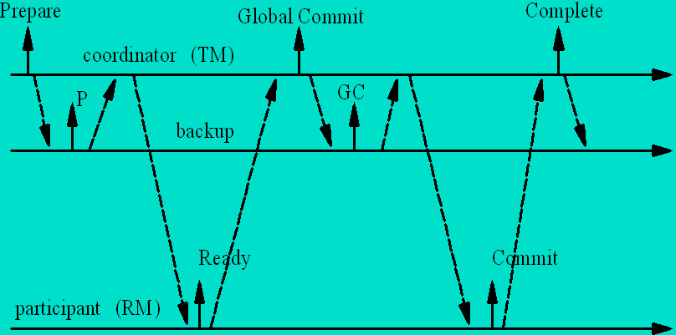
Diagram of the Four-phase Commit Protocol

Slide 24
Three-phase Commit Protocol
Idea: thanks to a third phase, each participant can become a TM
The “elected” participant looks at its log:
  If the last record is ready, then it can impose a global abort
  If the last record is pre-commit, it can impose a global commit
Shortcomings:
  It lengthens the window of uncertainty
  It is not resilient to network partitioning

Slide 25
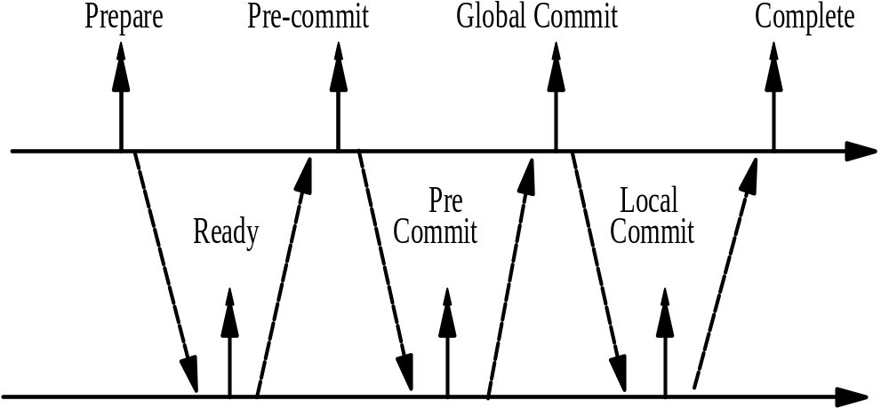
Diagram of the Three-phase Commit Protocol

Slide 26
Paxos Commit Protocol
Idea: combine a “consensus protocol” with a commit protocol so as to guarantee one decision even in the presence of partitions.
Paxos consensus protocol: with a network that cannot fail more than F times, establish one “initiator” and 2F+1 “acceptors”; the protocol guarantees consensus with a majority (F+1) of acceptors. Requires 3 phases.
Paxos commit protocol (Gray-Lamport, ACM-TODS 2007) sets some RM (out of N) as acceptors and guarantees commit/rollback decision with N(F+3) -3 messages.
The idea: acceptors have to be co-ordinated to reach consensus, a lot of messages are saved by making RM and acceptors coincident.
Two-phase commit is a special case of Paxos commit with F=0 (coordinator=acceptor).

Slide 27
Paxos Commit (base)
: Writes on log
L
AC1
AC2
RM0
RM1
RM2
RM3
RM4
AC0
T₁

Slide 28
Standardization of the Protocol
Standard X-Open Distributed Transaction Processing (DTP):
  TM interface
    Defines the services of the coordinator offered to a client in order to execute commit of heterogeneous participants
  XA interface
    Defines the services of passive participants that respond to calls from the coordinator (offered by several commercial DBMSs)

Slide 29
Features of X-Open DTP
RMs are passive: the respond to remote procedure calls from the TMs
Protocol: two-phase commit with optimizations (presumed abort and read-only)
The protocol supports heuristic decisions: after a failure, an operator can impose a heuristic decision (abort or commit)
  When heuristic decisions raise inconsistencies, the client processes are notified

Slide 30
TM Interface
tm_init and tm_exit initiate and terminate the client-TM dialogue
tm_open and tm_term open and close a session with the TM
tm_begin begins a transaction
tm_commit requests a global commit
tm_abort requests a global abort

Slide 31
XA Interface
xa_open and xa_close open and close a TM-RM dialog
xa_start and xa_end activate and complete a new transaction
xa_precomm requests that the RM carry out the first phase of the commit protocol
xa_commit and xa_abort communicate the “global decision” to the RM
xa_recover initiates an RM recovery; the RM responds to the request with three sets of transactions:
  Transactions in doubt
  Transactions decided by a heuristic commit
  Transactions decided by a heuristic abort
xa_forget allows an RM to forget transactions decided in a heuristic manner

