Slide 1
DB server technology

Slide 2
A.1 Anomalies research
Indicate whether the following schedules can produce anomalies; the symbols ci and ai indicate the result (commit or abort) of the transaction.
r1(x); w1(x); r2(x); w2(y); a1; c2

Slide 3
Dirty read:
r1(x); w1(x); r2(x); w2(y); a1; c2

Slide 4
A.2 Anomalies research
Indicate whether the following schedules can produce anomalies; the symbols ci and ai indicate the result (commit or abort) of the transaction.
r1(x); w1(x); r2(y); w2(y); a1; c2

Slide 5
No anomaly

Slide 6
A.3 Anomalies research
Indicate whether the following schedules can produce anomalies; the symbols ci and ai indicate the result (commit or abort) of the transaction.
r1(x); r2(x); r2(y); w2(y); r1(z); a1; c2

Slide 7
No anomaly

Slide 8
A.4 Anomalies research
Indicate whether the following schedules can produce anomalies; the symbols ci and ai indicate the result (commit or abort) of the transaction.
r1(x); r2(x); w2(x); w1(x); c1; c2

Slide 9
Update loss
r1(x); r2(x); w2(x); w1(x); c1; c2

Slide 10
A.5 Anomalies research
Indicate whether the following schedules can produce anomalies; the symbols ci and ai indicate the result (commit or abort) of the transaction.
r1(x); r2(x); w2(x); r1(y); c1; c2

Slide 11
No anomaly

Slide 12
A.6 Anomalies research
Indicate whether the following schedules can produce anomalies; the symbols ci and ai indicate the result (commit or abort) of the transaction.
r1(x); w1(x); r2(x); w2(x); c1; c2

Slide 13
No anomaly

Slide 14
B.1 Classify the following schedule as Non-VSR, VSR or CSR: r1(x); r2(y); w3(y); r5(x); w5(u); w3(s); w2(u); w3(x); w1(u); r4(y); w5(z); r5(z)

Slide 15
S: w3
U: w5; w2; w1
X: r1; r5; w3
Y: r2; w3; r4
Z: w5; r5
1
4
2
3
5
The graph is NOT cyclic:
the schedule is CSR
(and then also VSR)

Slide 16
Suppose to add the schedule r2(u); w2(s) as a prefix or as a suffix of the previous schedule, classify the two resulting schedules.
As prefix: r2(u); w2(s); r1(x); r2(y); w3(y); r5(x); w5(u); w3(s); w2(u); w3(x); w1(u); r4(y); w5(z); r5(z)

Slide 17
S: w2; w3
U: r2; w5; w2; w1
X: r1; r5; w3
Y: r2; w3; r4
Z: w5; r5
1
4
2
3
5
The graph is cyclic:
the schedule is NOT CSR.
Is it VSR?

Slide 18
S: w2; w3
U: r2; w5; w2; w1
X: r1; r5; w3
Y: r2; w3; r4
Z: w5; r5
The schedule T2, T5, T1, T3, T4
has the same reads-from and final write
It is VSR

Slide 19
Definition: a write w_{i}(X) is said to be blind if it is not the last action of resource X and the following action on X is a write w_{j}(X)
Property: each schedule S ∈VSR and S∉CSR has, in its conflict graph, cycles of arcs due to couples of blind writes. These can be swapped without modifying the reads-from and final write relationships.
Once the graph is acyclic it is possible to find a serial schedule view-equivalent to the initial one.

Slide 20
S: w2; w3
U: r2; w5; w2; w1
X: r1; r5; w3
Y: r2; w3; r4
Z: w5; r5
1
4
2
3
5
The graph can become acyclic swapping the two blind writes w5 and w2
S: w2; w3
U: r2; w2; w5; w1
X: r1; r5; w3
Y: r2; w3; r4
Z: w5; r5
1
4
2
3
5

Slide 21
Now as a suffix: r1(x); r2(y); w3(y); r5(x); w5(u); w3(s); w2(u); w3(x); w1(u); r4(y); w5(z); r5(z); r2(u); w2(s)

Slide 22
S: w3; w2
U: w5; w2; w1; r2
X: r1; r5; w3
Y: r2; w3; r4
Z: w5; r5
1
4
2
3
5
The graph is cyclic:
the schedule is NOT CSR.
Is it VSR?

Slide 23
S: w3; w2
U: w5; w2; w1; r2
X: r1; r5; w3
Y: r2; w3; r4
Z: w5; r5
It is not possible to decide whether T2 is to be placed before or after T3, it is not VSR

Slide 24
S: w3; w2
U: w5; w2; w1; r2
X: r1; r5; w3
Y: r2; w3; r4
Z: w5; r5
Alternatively, just consider the three highlighted operations (relative to U resource). No serial schedule can preserve the relationship “r2 reads from w1” indicated by the red arrow (w2 and r2 are contiguous in all serial schedule).

Slide 25
B.2 Classify the following schedule: r1(x); r4(x); w4(x); r1(y); r4(z); w4(z); w3(y); w3(z); w2(t); w2(z); w1(t); w5(t)
If possible, add, remove or move one action in order to change the class of the schedule.

Slide 26
T: w2; w1; w5
X: r1; r4; w4
Y: r1; w3
Z: r4; w4; w3; w2
1
5
3
2
4
The graph is cyclic (1,4,2 – 1,3,2 – 1,4,3,2).
2,1 is the only arc common to all the three cycles
The schedule is not CSR – Is it VSR?

Slide 27
T: w2; w1; w5
X: r1; r4; w4
Y: r1; w3
Z: r4; w4; w3; w2
The schedule T1, T4, T3, T2, T5
Is view-equivalent
It is VSR

Slide 28
Adding w1(y) at the end, the schedule is no longer VSR
Swapping w1(t) and w2(t) (a couple of blind writes) the schedule becomes CSR.
Note that this swapping does not modify the reads-from and final write relationships. This confirms that the initial schedule was VSR.

Slide 29
B.3 Classify the following schedule.
r4(x); r2(x); w4(x); w2(y); w4(y); r3(y); w3(x); w4(z); r3(z); r6(z); r8(z); w6(z); w9(z); r5(z); r10(z)

Slide 30
X: r4; r2; w4; w3
Y: w2; w4
Z: w4; r3; r6; r8; w6; w9; r5; r10
The graph is acyclic: the schedule is CSR (and then also VSR). The graph suggests the serial schedule 2,4,3,8,6,9,5,10
(built choosing and deleting nodes without incoming arcs)
3
8
2
9
6
4
5
10

Slide 31
B.4 Classify the following schedule:
w4(x); r2(x); w2(y); w4(y); w3(x); w4(z); r3(z); r6(z); r8(z); w9(z); w5(z); r10(z)

Slide 32
X: w4; r2; w3
Y: w2; w4
Z: w4; r3; r6; r8; w9; w5; r10
The graph is cyclic (4, 2): the schedule is not CSR. It is neither VSR (2 and 4 are not serializable: r2(x) reads-from w4(x), and w4(y) is a final write).
And there are no couples of blind writes!
3
8
2
9
4
5
6
10

Slide 33
C.1
Verify whether the following sequence of operations made by three transactions on three resources A, B and C is consistent with the two-phase locking: r1(A), r2(B), w1(C), r2(A), r1(B), w2(C), r3(C), w2(B), r3(B), w1(A), w3(A)

Slide 34
It is necessary to impose temporal constraints upon the lock and unlock requests, when such requests are in wait status. Numbering the 11 instants in which the actions happen it is possible to write some inequalities.
This approach is needed because the non-strict-2PL does not allow to know the exact moment each lock is released.

Slide 35
Instant A B C
1 r1
2 r2
3 w1
4 r2
5 r1
6 w2
7 r3
8 w2
9 r3
10 w1
11 w3
We build a table dividing actions for resources they are relative

Slide 36
Instant A B C
1 r1
2 r2
3 w1
4 r2
5 r1
6 w2
7 r3
8 w2
9 r3
10 w1
11 w3
The behaviour of T2 implies the following constraints
4 < U^{r}₂^{A} < L^{w}₁^{A}
U^{r}₁^{B} < L^{w}₂^{B} < 8

Slide 37
Instant A B C
1 r1
2 r2
3 w1
4 r2
5 r1
6 w2
7 r3
8 w2
9 r3
10 w1
11 w3
4 < U^{r}₂^{A} < L^{w}₁^{A}
U^{r}₁^{B} < L^{w}₂^{B} < 8
T1 can not acquire A
Neither release B

Slide 38
Instant A B C
1 r1
2 r2
3 w1
4 r2
5 r1
6 w2
7 r3
8 w2
9 r3
10 w1
11 w3
4 < U^{r}₂^{A} < L^{w}₁^{A}
U^{r}₁^{B} < L^{w}₂^{B} < 8
T2 cannot release A
Neither acquire B

Slide 39
Instant A B C
1 r1
2 r2
3 w1
4 r2
5 r1
6 w2
7 r3
8 w2
9 r3
10 w1
11 w3
4 < U^{r}₂^{A} < L^{w}₁^{A}
U^{r}₁^{B} < L^{w}₂^{B} < 8
The 2PL imposes not to acquire other locks after the first release:
L^{w}₁^{A} < U^{r}₁^{B}
L^{w}₂^{B} < U^{r}₂^{A}
UA < LA < UB < LB < UA
No assignment exists which satisfies the constraints: the schedule is not in 2PL

Slide 40
Instant A B C
1 r1
2 r2
3 w1
4 r2
5 r1
6 w2
7 r3
8 w2
9 r3
10 w1
11 w3
Note that the schedule is NOT serializable

Slide 41
C.2
Verify whether the following sequence of operations made by three transactions on three resources A, B and C is consistent with the two-phase locking: r1(A), r2(B), w1(C), r2(A), r1(B), w2(C), r3(C), w2(B), r3(B), w2(A), w3(A)

Slide 42
Instant A B C
1 r1
2 r2
3 w1
4 r2
5 r1
6 w2
7 r3
8 w2
9 r3
10 w2
11 w3
T1 can acquire all locks at the beginning and it can release each resource just after the use.
T3 can acquire all locks just before using the resource and it can release all at the end.
T2 must release (C) between 6 and 7, and cannot acquire (B) before 6, but all this is possible.

Slide 43
C.3 Consider the following schema, where the identifier of a transaction represents its timestamp:
r4(x); r2(x); w4(x); w2(y); w4(y); r3(y); w3(x); w4(z); r3(z); r6(z); r8(z); w6(z); w9(z); r5(z); r10(z)
Initially RTM = WTM = 0 for each resource.
Indicate the actions of the scheduler.

Slide 44
 | X |  | Y |  | Z |  | T killed
 | RTM | WTM | RTM | WTM | RTM | WTM
R4(x) | 4 | 0 | 0 | 0 | 0 | 0
R2(x) | 4
W4(x) |  | 4
W2(y) |  |  |  | 2
W4(y) |  |  |  | 4
R3(y) |  |  |  |  |  |  | 3 ( 3 < WTM(y)=4 )
W3(x) |  |  |  |  |  |  | (already killed)
W4(z) |  |  |  |  |  | 4
R3(z) |  |  |  |  |  |  | (already killed)
R6(z) |  |  |  |  | 6
R8(z) |  |  |  |  | 8
W6(z) |  |  |  |  |  |  | 6 ( 6 < RTM(z)=8 )
W9(z) |  |  |  |  |  | 9
R5(z) |  |  |  |  |  |  | 5 ( 5 < WTM(z)=9 )
R10(z) |  |  |  |  | 10

Slide 45
 | X |  | Y |  | Z |  | T killed
 | RTM | WTM(i) | RTM | WTM(i) | RTM | WTM(i)
R4(x) | 4 (0) | 0 | 0 | 0 | 0 | 0
R2(x) | 4 (0)
W4(x) |  | 0, 4
W2(y) |  |  |  | 0, 2
W4(y) |  |  |  | 0, 2, 4
R3(y) |  |  | 3 (2)
W3(x) |  |  |  |  |  |  | 3 ( 3<RTM(x)=4 )
W4(z) |  |  |  |  |  | 0, 4
R3(z) |  |  |  |  |  |  | (already killed)
R6(z) |  |  |  |  | 6 (4)
R8(z) |  |  |  |  | 8 (4)
W6(z) |  |  |  |  |  | 0, 4, | 6 ( 6<RTM(z)=8 )
W9(z) |  |  |  |  |  | 0, 4, 9
R5(z) |  |  |  |  | 8 (4)
R10(z) |  |  |  |  | 10(9)

Slide 46
C.4 Consider the following schema, where the identifier of a transaction represents its timestamp:
w4(x); r2(x); w2(y); w4(y); w3(x); w4(z); r3(z); r6(z); r8(z); w9(z); w5(z); r10(z)
Initially RTM = WTM = 0 for each resource.
Indicate the actions of the scheduler.

Slide 47
 | X |  | Y |  | Z |  | T killed
 | RTM | WTM | RTM | WTM | RTM | WTM
W4(x) | 0 | 4 | 0 | 0 | 0 | 0
R2(x) |  |  |  |  |  |  | 2 ( 2 < WTM(x)=4 )
W2(y) |  |  |  |  |  |  | (already killed)
W4(y) |  |  |  | 4
W3(x) |  |  |  |  |  |  | 3 ( 3 < WTM(x)=4 )
W4(z) |  |  |  |  |  | 4
R3(z) |  |  |  |  |  |  | (already killed)
R6(z) |  |  |  |  | 6
R8(z) |  |  |  |  | 8
W9(z) |  |  |  |  |  | 9
W5(z) |  |  |  |  |  |  | 5 ( 5 < WTM(z)=9 )
R10(z) |  |  |  |  | 10

Slide 48
 | X |  | Y |  | Z |  | T killed
 | RTM | WTMi | RTM | WTMi | RTM | WTMi
W4(x) | 0 | 0, 4 | 0 | 0 | 0 | 0
R2(x) | 2 (0)
W2(y) |  |  |  | 0, 2
W4(y) |  |  |  | 0, 2, 4
W3(x) |  | 0, 3, 4 | [a real system would probably kill T3 now]
W4(z) |  |  |  |  |  | 0, 4
R3(z) |  |  |  |  | 3 (0)
R6(z) |  |  |  |  | 6 (4)
R8(z) |  |  |  |  | 8 (4)
W9(z) |  |  |  |  |  | 0, 4, 9
W5(z) |  |  |  |  |  |  | 5 (5< RTM(z)=9 )
R10(z) |  |  |  |  | 10(9)

Slide 49
D.1
Assume that l^{r}_{i}^{j} (l^{w}_{i}^{j} ) represents a read (write) lock request by transaction i on resource j. Consider the following sequence:
l^{r}₁^{A} ; l^{r}₂^{A} ; l^{w}₃^{B} ; l^{r}₄^{C} ; l^{w}₂^{D} ; l^{w}₃^{A} ; l^{w}₁^{C} ; l^{w}₅E ; l^{r}₅^{D} ; l^{r}₄E
Verify whether this sequence generates a deadlock.

Slide 50
lrA1; lrA2; lwB3; lrC4; lwD2; lwA3; lwC1; lwE5; lrD5; lrE4
1
4
5
3
2
The acyclicity of the graph guarantees the absence of deadlocks

Slide 51
D.2 Verify that the following lock requests generate a deadlock.
Indicate which transaction can be killed in order to remove the deadlock.
lrA1; lrA2; lwB3; lwA3; lrC4; lwA2; lrB1; lwE5; lrB5; lrE4

Slide 52
lrA1; lrA2; lwB3; lwA3; lrC4; lwA2; lrB1; lwE5; lrB5; lrE4
1
5
2
3
4
The graph is cyclic. There is a deadlock involving transactions 1, 2 e 3.
It can be removed by killing T3.

Slide 53
E.1 Consider the following waiting conditions:
Node 1: E4 -> t1, t1 -> t2, t2 -> E2
Node 2: E1 -> t2, t2 -> t4, t4 -> E3
Node 3: E2 -> t4, t4 -> t3, t3 -> E4
Node 4: E3 -> t3, t3 -> t1, t1 -> E1
Indicate whether there is a deadlock.

Slide 54
Each node state:
Node 1
E4
t1
t2
E2
Node 2
E1
t2
t4
E3
Node 3
E2
t4
t3
E4
Node 4
E3
t3
t1
E1

Slide 55
Now consider any waiting condition where a sub-transaction ti, activated by a remote DBMS, also waits because of the lock situation for another transaction tj, which in turn waits for a remote sub-transaction. The waiting situation is summarized by using a wait sequence:
EXT -> ti -> tj -> EXT

Slide 56
EXT -> ti -> tj -> EXT
The algorithm is distributed.
It communicates to other instances of the same algorithm the waiting sequences.
The message is sent only “ahead”. That is, it is sent towards the DBMS where the sub-transaction for which tj is waiting is activated. The message is sent only if (for example) i>j

Slide 57
Node 1
E4
t1
t2
E2
Node 2
E1
t2
t4
E3
Node 3
E2
t4
t3
E4
Node 4
E3
t3
t1
E1

Slide 58
From Node 3 to Node 4
Node 3
E2
t4
t3
E4
Node 4
E3
t3
t1
E1
It becomes
Node 4
E2
t4
t3
t1
E1
E2
t4
t1
E1

Slide 59
Node 4
E2
t4
t3
t1
E1
E2
t4
t1
E1
from Node 4 to Node 1
Node 1
E4
t1
t2
E2
That becomes
Node 1
E2
t4
t1
t2
E2
E2
t4
t2
E2

Slide 60
Node 1
E2
t4
t2
E2
From Node 1 to Node 2
Node 2
E1
t2
t4
E3
That becomes
Node 2
t4
t2
t4
E3
t4 is t4:
Node 2
t2
t4
E3
THERE EXISTS A CYCLE:
THERE IS A DEADLOCK

Slide 61
E.2 Consider the following waiting conditions:
Node 1: E₂->t₁, t₁->t₂, E₃->t₂, t₂->t₃,
t₃->E₂, E₂->t₄, t₄->t₃
Node 2: E₁->t₃, t₃->t₅, t₅->t₆, t₆->E₃, E₃->t₇,
t₇->t₆, t₉->t₄, t₄->E₁, t₁->E₁
Node 3: E₂->t₆, t₆->t₈, t₈->t₂, t₂->E₁, t₇->E₂
Indicate whether there is a deadlock.
tm->tn indicates a local waiting (t_{m} waits that t_{n} release a resorce), t_{m}->E_{n} indicates that t₄ waits the execution of a transaction on node n and E_{m}->t_{n} indicates that t_{n} was invocated by a transaction on node n

Slide 62
We simulate the execution - asynchronous and distributed – of the algorithm.
Each node decides to send detected waiting conditions (from remote to remote)
E_{h} -> t_{i} -> t_{m} -> t_{n} -> t_{p} -> t_{j}-> E_{k}
Is translated into the message
E_{h} -> t_{i} -> t_{j}-> E_{k}
To be sent to node k if and only i > j.

Slide 63
NODE 1
NODE 2
NODE 3
9
E₁
4
E₂
4
7
E₂
1
E₁
3
E₂
2
E₁
7
E₃
2
E₃
8
6
E₃
1
E₂
6
E₂
5
3
E₁
E₂->t₄->t₃->E₂
to be sent to node 2
E₃->t₇->t₆->E₃
to be sent to node 3
E₂->t₆->t₂->E₁
to be sent to node 1

Slide 64
NODE 1
NODE 2
NODE 3
9
E₁
4
E₂
4
7
E₂
1
E₁
3
E₂
2
E₁
7
E₃
2
E₃
8
6
E₃
1
E₂
6
E₂
5
6
E₂
E₁
3
E₂->t₆->t₃->E₂
to be sent to node 2
The incoming message does not determine new waiting conditions
The incoming message does not determine new waiting conditions

Slide 65
NODE 1
NODE 2
NODE 3
9
4
E₂
4
E₁
7
E₂
3
E₂
1
E₁
2
E₁
7
E₃
2
E₃
8
6
E₃
1
E₂
6
E₂
5
6
E₂
3
E₁
THERE EXISTS A CYCLE:
THERE IS A DEADLOCK

Slide 66
F.1 Describe the warm restart, indicating the progressive construction of the sets UNDO e REDO and the recovery actions, given the following situation on the log:
Dump, b(t1), b(t2), b(t3), i(t1,o1,a1), d(t2,o2,b2), b(t4), u(t4,o3,b3,a3), u(t1,o4,b4,a4), c(t2), ckpt(t1,t3,t4), b(t5), b(t6), u(t5,o5,b5,a5), a(t3), ckpt(t1,t4,t5,t6), b(t7), a(t4), u(t7,o6,b6,a6), u(t6,o3,b7,a7), b(t8), a(t7), failure

Slide 67
Trace back the log until the most recent checkpoint is reached and initialise UNDO and REDO sets
Dump, b(t1), b(t2), b(t3), i(t1,o1,a1), d(t2,o2,b2), b(t4), u(t4,o3,b3,a3), u(t1,o4,b4,a4), c(t2), ckpt(t1,t3,t4), b(t5), b(t6), u(t5,o5,b5,a5), a(t3), ckpt(t1,t4,t5,t6), b(t7), a(t4), u(t7,o6,b6,a6), u(t6,o3,b7,a7), b(t8), a(t7), guasto
UNDO={t1,t4,t5,t6}
REDO={}

Slide 68
The log is then traced forward, adding to the UNDO set all the transactions with a begin record, and moving from UNDO to REDO all the transactions with a commit
…
ckpt(t1,t4,t5,t6), b(t7), a(t4), u(t7,o6,b6,a6), u(t6,o3,b7,a7), b(t8), a(t7), failure
UNDO={t1,t4,t5,t6,t7,t8}
REDO={}

Slide 69
The log is traced back undoing all the transactions in the UNDO set (with compensating actions), until the first action of the “oldest” transaction is reached
UNDO={t1,t4,t5,t6,t7,t8} REDO={}
Actions:
o3=b7
o6=b6
o5=b5
o4=b4
o3=b3
delete(o1)
Dump, b(t1), b(t2), b(t3), i(t1,o1,a1), d(t2,o2,b2), b(t4), u(t4,o3,b3,a3), u(t1,o4,b4,a4), c(t2), ckpt(t1,t3,t4), b(t5), b(t6), u(t5,o5,b5,a5), a(t3), ckpt(t1,t4,t5,t6), b(t7), a(t4), u(t7,o6,b6,a6), u(t6,o3,b7,a7), b(t8), a(t7), failure

Slide 70
Finally, the REDO actions are applied in the order in which they are recorded in the log.
In this exercise REDO set is empty
REDO={}
UNDO={t1,t4,t5,t6,t7,t8}

Slide 71
F.2 Describe the warm restart, indicating the progressive building of the sets UNDO e RED, given the following situation on the log:
Dump, b(t1), u(t1,o1,b1,a1), b(t2), b(t3), u(t3,o3,a3,b3), i(t2,o2,a2), c(t2), ckpt(t1,t3), c(t3), b(t4),
u(t4,o2,b4,a4), u(t4,o3,b5,a5), b(t5), i(t5,o6,a6), a(t1), c(t4), u(t5,o7,b7,a7), d(t5,o1,b8), failure

Slide 72
Dump, b(t1), u(t1,o1,b1,a1), b(t2), b(t3), u(t3,o3,a3,b3), i(t2,o2,a2), c(t2), ckpt(t1,t3), c(t3), b(t4), u(t4,o2,b4,a4), u(t4,o3,b5,a5), b(t5), i(t5,o6,a6), a(t1), c(t4), u(t5,o7,b7,a7), d(t5,o1,b8), failure
Trace back the log until the most recent checkpoint is reached and initialise UNDO and REDO sets
UNDO={t1,t3}
REDO={}

Slide 73
The log is traced forward, adding to the UNDO all the transactions with a begin, and moving from UNDO to REDO all the transactions with a commit
ckpt(t1,t3), c(t3), b(t4), u(t4,o2,b4,a4), u(t4,o3,b5,a5), b(t5), i(t5,o6,a6), a(t1), c(t4), u(t5,o7,b7,a7), d(t5,o1,b8), failure
UNDO={t1,t3} REDO={}
UNDO={t1} REDO={t3}
UNDO={t1,t4} REDO={t3}
UNDO={t1,t4,t5} REDO={t3}
UNDO={t1,t5} REDO={t3,t4}

Slide 74
G.1 Apply the warm restart protocol after the failure of a node, assuming a two-phase commit protocol, having the following input (where r(ti) indicates the presence of a ready record): b(t1), b(t2), b(t3), i(t1,o1,a1), d(t2,o2,b2) b(t4), r(t1), u(t4,o3,b3,a3), c(t1), Ckpt(t2,t3,t4), b(t5), b(t6), u(t5,o5,b5,a5), r(t5), b(t7), u(t7,o6,b6,a6), b(t8), u(t6,o1,b7,a7), a(t7), r(t6), failure

Slide 75
b(t1), b(t2), b(t3), i(t1,o1,a1), d(t2,o2,b2) b(t4), r(t1), u(t4,o3,b3,a3), c(t1), Ckpt(t2,t3,t4), b(t5), b(t6), u(t5,o5,b5,a5), r(t5), b(t7), u(t7,o6,b6,a6), b(t8), u(t6,o1,b7,a7), a(t7), r(t6), failure
Analysing the log forward from the last checkpoint, we identify two transactions with e ready record (t5 and t6).
The recovery manager has to identify the transaction manager for each of them and ask for the decision.
WE SUPPOSE a commit for both

Slide 76
Trace back the log until the most recent checkpoint is reached and initialise UNDO and REDO sets, then the log is traced forward, adding to the UNDO all the transactions with a begin, and moving from UNDO to REDO all the transactions with a commit
b(t1), b(t2), b(t3), i(t1,o1,a1), d(t2,o2,b2) b(t4), r(t1), u(t4,o3,b3,a3), c(t1), Ckpt(t2,t3,t4), b(t5), b(t6), u(t5,o5,b5,a5), r(t5), b(t7), u(t7,o6,b6,a6), b(t8), u(t6,o1,b7,a7), a(t7), r(t6), failure
UNDO={t2,t3,t4,t7,t8}
REDO={t5,t6}

Slide 77
The log is traced back undoing all the transactions in the UNDO set (with compensating actions), until the first action of the “oldest” transaction is reached
UNDO={t2,t3,t4,t7,t8}
REDO={t5,t6}
b(t1), b(t2), b(t3), i(t1,o1,a1), d(t2,o2,b2) b(t4), r(t1), u(t4,o3,b3,a3), c(t1), Ckpt(t2,t3,t4), b(t5), b(t6), u(t5,o5,b5,a5), r(t5), b(t7), u(t7,o6,b6,a6), b(t8), u(t6,o1,b7,a7), a(t7), r(t6), failure

Slide 78
Finally, the REDO actions are applied in the order in which they are recorded in the log.
REDO={t5,t6}
UNDO={t2,t3,t4,t7,t8}
b(t1), b(t2), b(t3), i(t1,o1,a1), d(t2,o2,b2) b(t4), r(t1), u(t4,o3,b3,a3), c(t1), Ckpt(t2,t3,t4), b(t5), b(t6), u(t5,o5,b5,a5), r(t5), b(t7), u(t7,o6,b6,a6), b(t8), u(t6,o1,b7,a7), a(t7), r(t6), failure

Slide 79
b(t1), b(t2), b(t3), i(t1,o1,a1), d(t2,o2,b2) b(t4), r(t1), u(t4,o3,b3,a3), c(t1), Ckpt(t2,t3,t4), b(t5), b(t6), u(t5,o5,b5,a5), r(t5), b(t7), u(t7,o6,b6,a6), b(t8), u(t6,o1,b7,a7), a(t7), r(t6), failure
Final state
{o1:a7, o2:b2, o3:b3, o5:a5, o6:b6}

Slide 80
G.2
Apply the warm restart protocol after the failure of a node, having the following input (where r(ti) indicates the presence of a ready record, lc(t1), la(t1) indicate local commit or local abort):
b(t1), b(t2), u(t1,o1,b1,a1), u(t2,o2,b2,a2), b(t3), c(t2), ckpt(t1,t3), b(t4), r(t1), b(t5), i(t3,o3,a3), lc(t1), d(t4,o4,b4), d(t5,o1,b5), r(t5), u(t4,o6,b6,a6), a(t3), b(t6), u(t6,o7,b7,a7), c(t6), r(t4)

Slide 81
b(t1), b(t2), u(t1,o1,b1,a1), u(t2,o2,b2,a2), b(t3), c(t2), ckpt(t1,t3), b(t4), r(t1), b(t5), i(t3,o3,a3), lc(t1), d(t4,o4,b4), d(t5,o1,b5), r(t5), u(t4,o6,b6,a6), a(t3), b(t6), u(t6,o7,b7,a7), c(t6), r(t4)
Analysing the log forward from the last checkpoint, we identify two transactions with a ready record (t4 and t5).
The recovery manager has to identify the transaction manager for each of them and ask for the decision.
WE SUPPOSE a commit for both

Slide 82
b(t1), b(t2), u(t1,o1,b1,a1), u(t2,o2,b2,a2), b(t3), c(t2), ckpt(t1,t3), b(t4), r(t1), b(t5), i(t3,o3,a3), lc(t1), d(t4,o4,b4), d(t5,o1,b5), r(t5), u(t4,o6,b6,a6), a(t3), b(t6), u(t6,o7,b7,a7), c(t6), r(t4)
Trace back the log until the most recent checkpoint is reached and initialise UNDO and REDO sets, then the log is traced forward, adding to the UNDO all the transactions with a begin, and moving from UNDO to REDO all the transactions with a commit
UNDO={t3}
REDO={t1,t4,t5,t6}

Slide 83
The log is traced back undoing all the transactions in the UNDO set (with compensating actions), until the first action of the “oldest” transaction is reached
UNDO={t3}
REDO={t1,t4,t5,t6}
b(t1), b(t2), u(t1,o1,b1,a1), u(t2,o2,b2,a2), b(t3), c(t2), ckpt(t1,t3), b(t4), r(t1), b(t5), i(t3,o3,a3), lc(t1), d(t4,o4,b4), d(t5,o1,b5), r(t5), u(t4,o6,b6,a6), a(t3), b(t6), u(t6,o7,b7,a7), c(t6), r(t4)

Slide 84
Finally, the REDO actions are applied in the order in which they are recorded in the log.
REDO={t1,t4,t5,t6}
UNDO={t3}
b(t1), b(t2), u(t1,o1,b1,a1), u(t2,o2,b2,a2), b(t3), c(t2), ckpt(t1,t3), b(t4), r(t1), b(t5), i(t3,o3,a3), lc(t1), d(t4,o4,b4), d(t5,o1,b5), r(t5), u(t4,o6,b6,a6), a(t3), b(t6), u(t6,o7,b7,a7), c(t6), r(t4)

Slide 85
b(t1), b(t2), u(t1,o1,b1,a1), u(t2,o2,b2,a2), b(t3), c(t2), ckpt(t1,t3), b(t4), r(t1), b(t5), i(t3,o3,a3), lc(t1), d(t4,o4,b4), d(t5,o1,b5), r(t5), u(t4,o6,b6,a6), a(t3), b(t6), u(t6,o7,b7,a7), c(t6), r(t4)
Final state
{o1:deleted; o2:a2; o3:deleted; o4:deleted; o6:a6; o7:a7}

Slide 86
H.1
Build a B+ tree with F=3 to contain the values: lim, cip, cil, tas, mel, agr, ace, fic, pit, cot, noc, ole, aga, euf, dra.
Build also the B tree for the same set of values.

Slide 87
The first idea is to build the tree in this trivial way.
But one node is empty (it contains 3 NULL)
OLE
CIL
DRA
LIM
ACE
AGA
AGR
DRA
EUF
FIC
OLE
PIT
TAS
CIL
CIP
COT
LIM
MEL
NOC
Blue arcs represent pointers to tuples corresponding to the keys contained in the tree.

Slide 88
Intermediate nodes are now balanced
LIM
CIL
DRA
OLE
ACE
AGA
AGR
DRA
EUF
FIC
OLE
PIT
TAS
CIL
CIP
COT
LIM
MEL
NOC

Slide 89
Suppose now to add the value “bet”: a split is needed.
CIL
DRA
ACE
AGA
AGR
CIL
CIP
COT
DRA
EUF
FIC
AGR
CIL
DRA
ACE
AGA
AGR
BET
CIL
CIP
COT
DRA
EUF
FIC

Slide 90
Consider now the B-tree. Note that 15 = 3*(4+1)
Also nodes that are not leaves have pointers to tuples.
CIL
EUF
NOC
ACE
AGA
AGR
OLE
PIT
TAS
FIC
LIM
MEL
CIP
COT
DRA

Slide 91
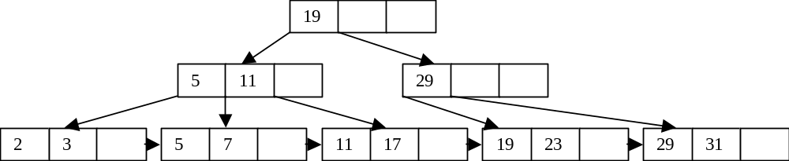
H2. B+ tree
Consider the tree:
Execute the following operations:
Insert 9, Insert 10, Insert 8, Delete 23, Delete 19.

Slide 92
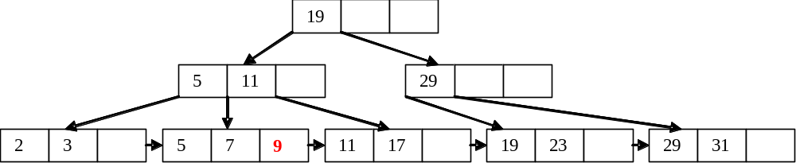
Insert 9:

Slide 93
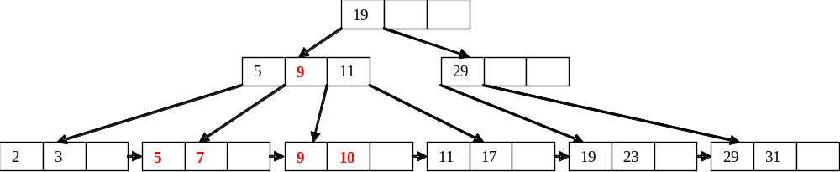
Insert 10:

Slide 94

Insert 8:

Slide 95
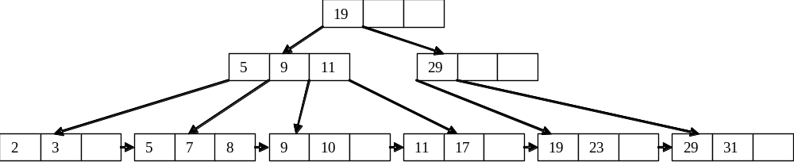
Delete 23:
Underflow!!!

Slide 96
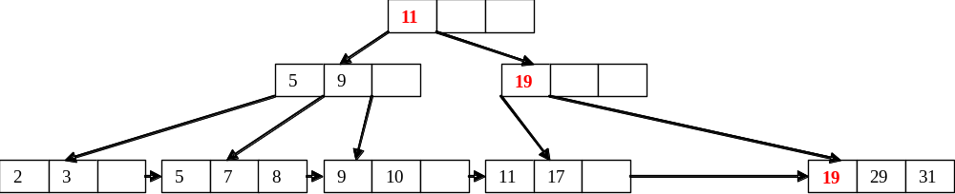
Delete 23:

Slide 97
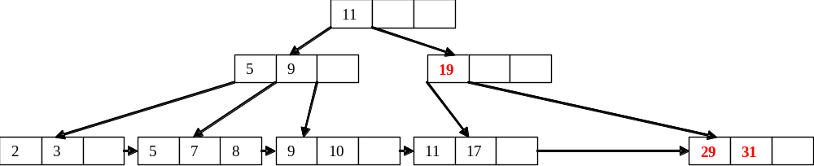
Delete 19:

Slide 98
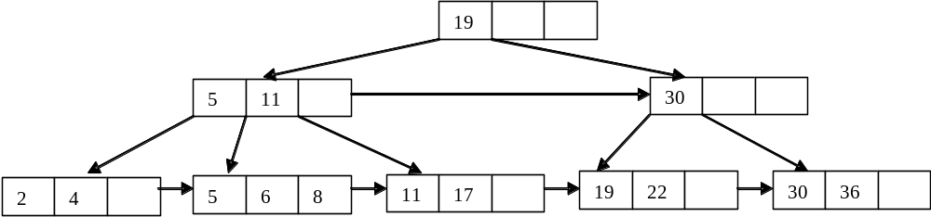
H3. B+ tree
Given the tree:
Build the tree

Slide 99
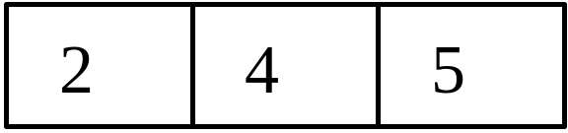
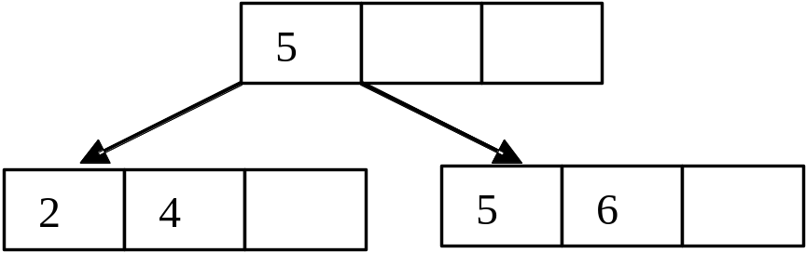
ins 2, ins 4, ins 5:
ins 6:

Slide 100
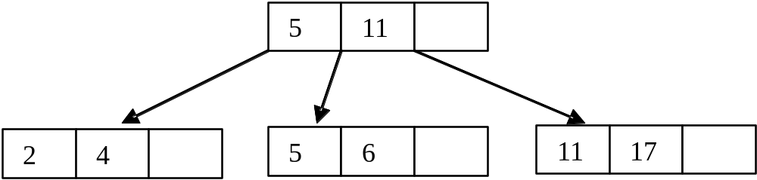
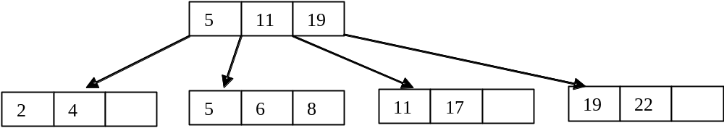
ins 11, ins 17:
ins 8, ins 19, ins 22:

Slide 101
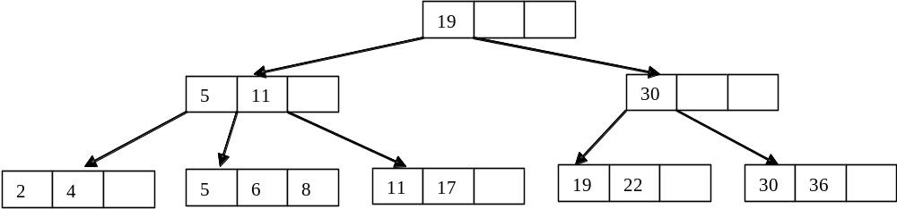
ins 30, ins 36:
Note the the solution is not unique.

Slide 102
I.1 p1 p2 p3
Given the
following
hierarchy: r1 r2 r3 r4 r5 r6 r7 r8
And the following LOG:
A B C D E
b(t1), b(t2), b(t3), u(t1,r1,b1,a1), u(t1,r4,b2,a2),
F G H I
u(t2,r6,b3,a3), u(t2,r5,b4,a4), c(t1), u(t2,r1,b5,a5),
L M N O
u(t3,r4,b6,a6), c(t2), u(t3,r1,b7,a7), c(t3)

Slide 103
Is it possible that the log be obtained from a system implementing a Strict-2PL concurrency control policy with hierarchical locking?
It is necessary to trace the log and lock each resource immediately before actions and unlock it only after the commit (or abort).
We use a table of resources to verify the compatibility between the requests and state of the resources.

Slide 104
A, B, C) p1 r1 r2 r3 p2 r4 r5 p3 r6 r7 r8
no richieste - - - - - - - - - - -
D) u(t₁,r1,b1,a1)
IXL(t₁,p1) ix₁
XL(t₁,r1) ix₁ x₁
E) u(t₁,r4,b2,a2)
IXL(t₁,p2) ix₁ x₁ ix₁
XL(t₁,r4) ix₁ x₁ ix₁ x₁
F) u(t₂,r6,b3,a3)
IXL(t₂,p3) ix₁ x₁ ix₁ x₁ ix₂
XL(t₂,r6) ix₁ x₁ ix₁ x₁ ix₂ x₂

Slide 105
p1 r1 r2 r3 p2 r4 r5 p3 r6 r7 r8
G) u(t₂,r5,b4,a4)
IXL(t₂,p2) ix₁ x₁ ix_{1,2} x₁ ix₂ x₂
XL(t₂,r5) ix₁ x₁ ix_{1,2} x₁ x₂ ix₂ x₂
H) c(t₁)
UXL(t₁,r1) ix₁ x₁ ix_{1,2} x₁ x₂ ix₂ x₂
UXL(t₁,r4) ix₁ ix_{1,2} x₁ x₂ ix₂ x₂
UIXL(t₁,p1) ix₁ ix_{1,2} x₂ ix₂ x₂
UIXL(t₁,p2) ix_{1,2} x₂ ix₂ x₂
I) u(t₂,r1,b5,a5)
IXL(t₂,p1) ix₂ ix₂ x₂ ix₂ x₂
XL(t₂,r1) ix₂ x₂ ix₂ x₂ ix₂ x₂

Slide 106
p1 r1 r2 r3 p2 r4 r5 p3 r6 r7 r8
L) u(t₃,r4,b6,a6)
IXL(t₃,p2) ix₂ x₂ ix_{2,3} x₂ ix₂ x₂ XL(t₃,r4) ix₂ x₂ ix_{2,3} x₃ x₂ ix₂ x₂
M) c(t₂)
UXL(t₂,r1) ix₂ x₂ ix_{2,3} x₃ x₂ ix₂ x₂
UXL(t₂,r5) ix₂ ix_{2,3} x₃ x₂ ix₂ x₂
UXL(t₂,r6) ix₂ ix_{2,3} x₃ ix₂ x₂
UIXL(t₂,p1) ix₂ ix_{2,3} x₃ ix₂ UIXL(t₂,p2) ix_{2,3} x₃ ix₂
UIXL(t₂,p3) ix₃ x₃ ix₂

Slide 107
p1 r1 r2 r3 p2 r4 r5 p3 r6 r7 r8
N) u(t₃,r1,b7,a7)
IXL(t₃,p1) ix₃ ix₃ x₃
XL(t₃,r1) ix₃ x₃ ix₃ x₃
O) c(t₃)
UXL(t₃,r1) ix₃ x₃ ix₃ x₃
UXL(t₃,r4) ix₃ ix₃ x₃
UIXL(t₃,p1) ix₃ ix₃
UIXL(t₃,p2) ix₃
NO conflicts: the log is 2PL

Slide 108
I.2 p1 p2 p3
With the same
hierarchy: r1 r2 r3 r4 r5 r6 r7 r8
But the following LOG:
A B C D
b(t₁), b(t₂), u(t₁,r4,b1,a1), u(t₁,r2,b2,a2),
E F G H I
u(t₂,r6,b3,a3), u(t₂,r3,b4,a4), u(t₂,r2,b5,a5), c(t₁), c(t₂)

Slide 109
A, B) p1 r1 r2 r3 p2 r4 r5 p3 r6 r7 r8
no requests - - - - - - - - - - -
C) u(t₁,r4,b1,a1)
IXL(t₁,p2) ix₁
XL(t₁,r4) ix₁ x₁
D) u(t₁,r2,b2,a2)
IXL(t₁,p1) ix₁ ix₁ x₁
XL(t₁,r2) ix₁ x₁ ix₁ x₁
E) u(t₂,r6,b3,a3)
IXL(t₂,p3) ix₁ x₁ ix₁ x₁ ix₂
XL(t₂,r6) ix₁ x₁ ix₁ x₁ ix₂ x₂

Slide 110
p1 r1 r2 r3 p2 r4 r5 p3 r6 r7 r8
F) u(t₂,r3,b4,a4)
IXL(t₂,p1) ix_{1,2} x₁ ix₁ x₁ ix₂ x₂
XL(t₂,r3) ix_{1,2} x₁ x₂ ix₁ x₁ ix₂ x₂
G) u(t₂,r2,b5,a5)
XL(t₂,r2) ix_{1,2} x₁ x₂ ix₁ x₁ ix₂ x₂
t₁ did not do the commit, then, if t₂ obtained the lock the log is not generated by a 2PL Strict
To finish t₁ needs only the commit, then it can have unlocked r2 immediately before G): the log is 2PL NON Strict

Slide 111
L
Consider the data base:
Production(SerialNumber,PartType,
Model,Quantity,Machine)
Pickup(SerialNumber,Lot,Client,
SalesPerson,Amount)
Client(Name,City,Address)
SalesPerson(Name,City,Address)

Slide 112
Design the horizontal fragmentation of the table Production and Pickup depending on the PartType value (‘Keyboard’, ‘Screen’, ‘CPU-box’ e ‘Cable’), assuming four Production centres (one for each component) located in Milan, Turin, Rome and Naples, and of Client and SalesPerson on three Cities: Milan, Turin, Rome.

Slide 113
The distributed DB contains the following tables
ProductionMiKbr(SerialNumber,PartType,
Model,Quantity,Machine) ProductionToScr(SerialNumber,PartType,
Model,Quantity,Machine)
ProductionRmCpu(SerialNumber,PartType,
Model,Quantity,Machine)
ProductionNaCbl(SerialNumber,PartType,
Model,Quantity,Machine)
Production = ProductionMiKbr ∪ ProductionToScr ∪ ProductionRmCpu ∪ ProductionNaCpl

Slide 114
PickupMiKbr(SerialNumber,Lot,Client, SalesPerson,Amount) PickupToScr(SerialNumber,Lot,Client, SalesPerson,Amount)
PickupRmCpu(SerialNumber,Lot,Client, SalesPerson,Amount)
PickupNaCbl(SerialNumber,Lot,Client, SalesPerson,Amount)
Pickup = PickupMiKbr ∪ PickupToScr ∪ PickupRmCpu ∪ PickupNaCpl

Slide 115
ClientMi(Name,City,Address)
ClientTo(Name,City,Address)
ClientRm(Name,City,Address)
Client = ClientMi ∪ ClientTo ∪ ClientRm

Slide 116
SalesPersonMi(Name,City,Address)
SalesPersonTo(Name,City,Address)
SalesPersonRm(Name,City,Address)
SalesPerson = SalesPersonMi ∪ SalesPersonTo ∪ SalesPersonRm

Slide 117
Express the following queries at transparency levels of fragmentation, allocation and language:
Determine the available quantity of the product ’77Y6878’

Slide 118
Transparency of fragmentation
SELECT Quantity
FROM Production
WHERE SerialNumber=’77Y6878’

Slide 119
Transparency of allocation
SELECT Quantity
FROM ProductionMiKbr
WHERE SerialNumber=’77Y6878’
IF :empty then
(SELECT Quantity
FROM ProductionToScr
WHERE SerialNumber=’77Y6878’
UNION
SELECT Quantity
FROM ProductionRmCpu
WHERE SerialNumber=’77Y6878’
UNION
SELECT Quantity
FROM ProductionNaCbl
WHERE SerialNumber=’77Y6878’)

Slide 120
Transparency of language
SELECT Quantity
FROM ProductionMiKbr@Milan
WHERE SerialNumber=’77Y6878’
IF :empty then
(SELECT Quantity
FROM ProductionToScr@Turin
WHERE SerialNumber=’77Y6878’
UNION
SELECT Quantity
FROM ProductionRmCpu@Rome
WHERE SerialNumber=’77Y6878’
UNION
SELECT Quantity
FROM ProductionNaCbl@Naples
WHERE SerialNumber=’77Y6878’)

Slide 121
Determine the clients who have bought a lot from the SalesPerson ‘Bianchi’, who has an office in Rome

Slide 122
Transparency of fragmentation
SELECT Client
FROM Pickup
WHERE SalesPerson=‘Bianchi’

Slide 123
Transparency of allocation
SELECT Client FROM PickupMiKbr
WHERE SalesPerson=‘Bianchi’
union
SELECT Client FROM PickupToScr
WHERE SalesPerson=‘Bianchi’
union
SELECT Client FROM PickupRmCpu
WHERE SalesPerson=‘Bianchi’
union
SELECT Client FROM PickupNaCbl
WHERE SalesPerson=‘Bianchi’

Slide 124
Transparency of language
SELECT Client FROM PickupMiKbr@Milan
WHERE SalesPerson=‘Bianchi’
union
SELECT Client FROM PickupToScr@Turin
WHERE SalesPerson=‘Bianchi’
union
SELECT Client FROM PickupRmCpu@Rome
WHERE SalesPerson=‘Bianchi’
union
SELECT Client FROM PickupNaCbl@Naples
WHERE SalesPerson=‘Bianchi’

Slide 125
Determine the machines used for the production of the parts type ‘Keyboard’ sold to the Client ‘Rossi’

Slide 126
Transparency of fragmentation
SELECT Machine
FROM Production P1 JOIN Pickup P2
ON (P1.SerialNumber=P2.SerialNumber)
WHERE Client = ‘Rossi’ AND
PartType = ‘Keyboard’

Slide 127
Transparency of allocation
This time the query is easier because only one fragment is totally dedicated to components of type ‘Keyboard’
SELECT Machine
FROM ProductionMiKbr P1
JOIN PickupMiKbr P2
ON (P1.SerialNumber=P2.SerialNumber)
WHERE Client = ‘Rossi’

Slide 128
Transparency of language
Also this query is easier because only one fragment is totally dedicated to components of type ‘Keyboard’
SELECT Machine
FROM ProductionMiKbr@Milan P1
JOIN PickupMiKbr@Milan P2
ON (P1.SerialNumber=P2.SerialNumber)
WHERE Client = ‘Rossi’

Slide 129
Update the Address of SalesPerson ‘Rossi’, moving from ‘via Po 45’ in ‘Milan’ to ‘Viale Trastevere 150’ in Rome’ (ignore the moving of related data in other tables)

Slide 130
Transparency of fragmentation
UPDATE SalesPerson
SET City = ‘Rome’,
Address=‘VialeTrastevere 150’
WHERE Name = ‘Rossi’

Slide 131
Transparency of allocation
Delete followed by an Insert
DELETE FROM SalesPersonMi
WHERE Name = ‘Rossi’
Insert INTO SalesPersonRm
VALUES(‘Rossi’, ‘Rome’,
‘Viale Trastevere 150’)

Slide 132
Transparency of language
Delete followed by an Insert
DELETE FROM SalesPersonMi@Milan
WHERE Name = ‘Rossi’
Insert INTO SalesPersonRm@Rome
VALUES(‘Rossi’, ‘Rome’,
‘Viale Trastevere 150’)

Slide 133
Calcolate the sum of amounts of the orders received in Milan, Turin, Rome and Naples (note that the aggregate functions are also distributable)

Slide 134
Transparency of fragmentation
SELECT SUM(Amount)
FROM Pickup

Slide 135
Transparency of allocation
We need to identify the contribute of each fragment.
To do a sum of sums it is necessary to use a view.

Slide 136
Transparency of allocation
CREATE VIEW TotalAm(Tot) AS
SELECT SUM (Amount)
FROM PickupMiKbr
UNION ALL
SELECT SUM (Amount)
FROM PickupToScr
UNION ALL
SELECT SUM (Amount)
FROM PickupRmCpu
UNION ALL
SELECT SUM (Amount)
FROM PickupNaCbl
SELECT SUM(Tot)
FROM TotalAm

Slide 137
Transparency of language
CREATE VIEW TotalAm(Tot) AS
SELECT SUM (Amount)
FROM PickupMiKbr@Milan
UNION ALL
SELECT SUM (Amount)
FROM PickupToScr@Turin
UNION ALL
SELECT SUM (Amount)
FROM PickupRmCpu@Rome
UNION ALL
SELECT SUM (Amount)
FROM PickupNaCbl@Naples
SELECT SUM(Tot)
FROM TotalAm

