Slide 1
Adobe Flash Platform
Human Computer Interaction
a.a. 2010/2011
26/10/2010
Stefano Vaghi – stefano.vaghi@usi.ch

Slide 2
Index
Adobe Flash Platform
Adobe Flash
Adobe Flash Catalyst
Adobe Flash Player
Adobe Flex
Adobe AIR
Adobe Flash Platform Services
Adobe Flash Media Server family
Adobe LiveCycle Data Services
Resources

Slide 3
Index
Adobe Flash Platform
Adobe Flash
Adobe Flash Catalyst
Adobe Flash Player
Adobe Flex
Adobe AIR
Adobe Flash Platform Services
Adobe Flash Media Server family
Adobe LiveCycle Data Services
Resources

Slide 4

Adobe Flash Platform
The Adobe Flash Platform is an integrated set of technologies surrounded by an established system of support programs, business partners, and user communities.
It provide everything to create and deliver compelling applications, content, and video to the widest possible audience across screens and devices.
Notes:
It enables the most compelling and popular experiences on the web, including real-time visualizations, web-enabled desktop applications, and more.

Slide 5
Adobe Flash Platform - Features
LEADERSHIP: AFP offers innovative features that enable you to create innovative applications, content, and video
POPULARITY: AFP has a reach of over 98% of Internet-enabled desktops and is used by over one million web developers
INNOVATION: AFP is more than just a browser plug-in or animation tool
INTEGRATION: AFP reduce technology incompatibilities by using its integrated system to build projects from prototype to deployment
CONSISTENCY: AFP allows you to create applications, content and videos that run consistently across OS and devices

Slide 6





Adobe Flash Platform - Technologies
TOOLS: Adobe Flash Professional, Adobe Flash Catalyst, Adobe Flash/Flex Builder
FRAMEWORKS: Adobe Flex
RUNTIMES: Adobe Flash Player, Adobe AIR
SERVICES: Adobe Flash Platform Services
SERVERS: Adobe Flash Media Server family, Adobe LiveCycle Data Services
Notes:
Adobe FlashProfessional: The industry-leading authoring environment for creating immersive experiences across desktops and devices.
Adobe Flash Catalyst: A professional interaction design tool for rapidly creating expressive interfaces and interactive content without writing code.
Adobe Flash Builder(previously Adobe Flex Builder): An IDE that enables developers to rapidly build cross-platform rich Internet applicationsand content.
---
Adobe Flex: A free, open source framework for building and maintaining expressive web applications that deploy consistently on major browsers, desktops, and operating systems. The Flex framework is the foundation of Flash Catalyst and Flash Builder software, and enables a highly productive design and development workflow.
---
Adobe Flash Player: A cross-platform browser plug-in that delivers breakthrough experiences to over 98% of Internet-enabled desktops.
Adobe AIR: A cross-platform runtime for building rich Internet applications that can be deployed outside the browser and integrate with the native operating system.
---
Adobe Flash Platform Services: A set of services that allow developers to add social and collaborative capabilities to applications, while enabling developers and businesses to more easily distribute and monetize their applications.
---
Adobe Flash Media Server family: Adobe’s family of media server products that utilize a completely integrated workflow to help you deliver, protect, and monetize your media assets.
Adobe LiveCycle®Data Services: A J2EE server framework for building data-driven applications that integrate with your IT systems and business processes.

Slide 7
Index
Adobe Flash Platform
Adobe Flash
Adobe Flash Catalyst
Adobe Flash Player
Adobe Flex
Adobe AIR
Adobe Flash Platform Services
Adobe Flash Media Server family
Adobe LiveCycle Data Services
Resources

Slide 8

Adobe Flash
Adobe Flash is a multimedia platform that is popular for adding animation and interactivity to web pages. It is currently developed and distributed by Adobe Systems.
Adobe Flash is a authoring environment for creating engaging interactive experiences.
Deliver to audiences across platforms and devices.

Slide 9
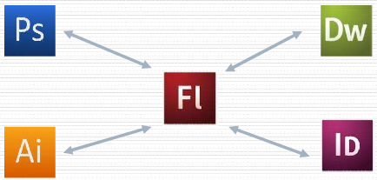
Adobe Flash
Originally introduced in 1996 by Macromedia, now is currently developed and distributed by Adobe Systems.
Last releases are called “CS3”, ”CS4” and “CS5”
It belongs to a collection of graphic design, video editing, and web development applications made by Adobe: Creative Suite

Slide 10
Adobe Flash
Flash is used to create animation and various web page Flash components, to integrate video into web pages and to develop Rich Internet Applications (RIA).
Flash can manipulate vector and raster graphics and supports streaming of audio and video.
It contains a scripting language called ActionScript.
Several software products, systems and devices are able to manage and display Flash contents.

Slide 11
Adobe Flash
Adobe Flash movies are graphics, text, animation, and applications for web sites.
Web designers use Flash to create navigation controls, animated logos, long-form animations with synchronized sound, and even complete web sites.
Flash provides a variety of methods for creating original artwork and importing artwork from other applications.
Flash allows you to animate objects and change their shape, size, color, opacity, rotation, and other properties.

Slide 12

Formats
Authoring (editable flash file) .fla and .as
Flash Player (flash movie file format) .swf
Html .html
Windows projector.exe
Mac projector.hqx
Images .gif/.jpeg/.png
Quick time .mov
Flash Video .flv

Slide 13
Different kind of projects
LINEAR PRESENTATION: simple animations as cartoons, banner,…
INTERACTIVE PRESENTATION: it provides the user control over the information is presented, the flow or the experience altogether.
DATA-DRIVEN PRESENTATION: movies that loads external data to deliver the presentation to the user.
DATA-DRIVEN APPLICATION: RIA application enable the user to accomplish some tasks or transations.
  Sample: https://acrobat.com/features_ooa_documents.html

Slide 14
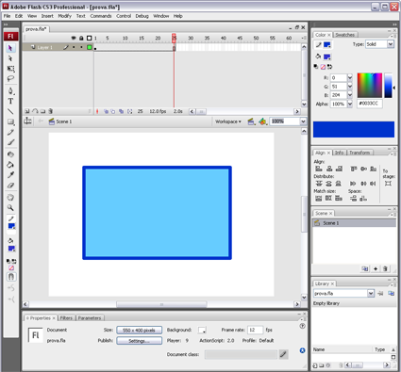
Working area
1. The menu bar on the top organize commands under menus.
2. The Tools panel contains tools for creating and editing images, artwork, page elements, and so on. Related tools are grouped together.
3. The Document window (called “Stage”) displays the file you’re working on.
4. Panels help you monitor and modify your work.
5. The Property inspector displays information that’s useful to what you’re doing at the time.
6. The Timeline organizes and controls a document’s content over time in layers and frames.
1
4
6
2
3
5

Slide 15
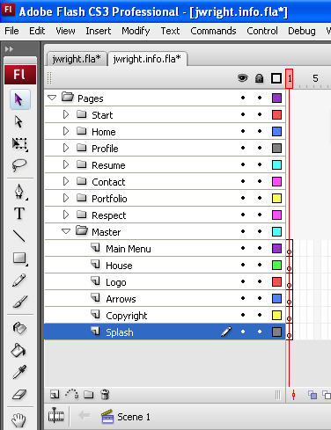
About Layers
Layers help you organize the artwork in your document. You can draw and edit objects on a specific layer without affecting objects on another layer.
When you open Flash, there is only one layer.
You can add more layers to organize the artwork, animation, and other elements in the document.
You can also hide, lock, rename or rearrange layers. The number of layers you can create is unlimited.
Layers characterizes a lot of Adobe Software

Slide 16
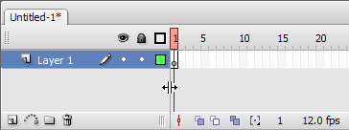
About Timeline
The Timeline organizes and controls a document’s content over time in layers and frames.
Like films, Flash document divides length of time into frames. Layers are like multiple filmstrips stacked on top of one another, each containing a different image that appears on the Stage.
The major components of the Timeline are layers (1), frames (2), and the playhead (3).
3
1
2

Slide 17
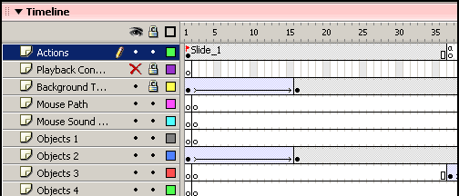
About Frames
In the Timeline, you work with frames to organize and control your document’s content. You place frames in the Timeline in the order you want the objects in the frames appear in your finished content.
A keyframe is a frame in which you define a change to an object’s properties for an animation or include ActionScript code to control some aspect of your document.
You can also arrange keyframes in the Timeline to edit the sequence of events in an animation. Flash can animate the frames between keyframes in order to produce fluid animations. Because keyframes let you produce animation without drawing each individual frame, they make creating animation easier.

Slide 18
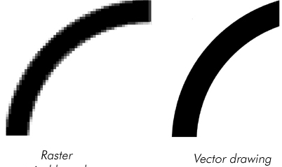
About Drawing
Using Flash, you can create and animate vector graphics.
Flash also imports and manipulates vector and bitmap graphics that were created in other applications.
Vector graphics describe images by using lines and curves, called vectors, that also include color and position properties.
When you edit a vector graphic, you modify the properties of the lines and curves that describe its shape. Move, resize, reshape, and change the color of a vector graphic without changing the quality of its appearance.
Vector graphics are resolution independent: they can be displayed on output devices of varying resolutions without losing any quality.
Notes:
A raster image is composed of pixels with each pixel having a specific value.
A vector image is composed of instructions on how to form shapes with specific values and does not use pixels. Vector is math-based. That is why a vector image can be scaled to any size and will still retain its sharpness, whereas as raster image has a set resolution and if it is enlarged it becomes blurry.

Slide 19
Index
Adobe Flash Platform
Adobe Flash
Adobe Flash Catalyst
Adobe Flash Player
Adobe Flex
Adobe AIR
Adobe Flash Platform Services
Adobe Flash Media Server family
Adobe LiveCycle Data Services
Resources

Slide 20
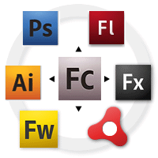
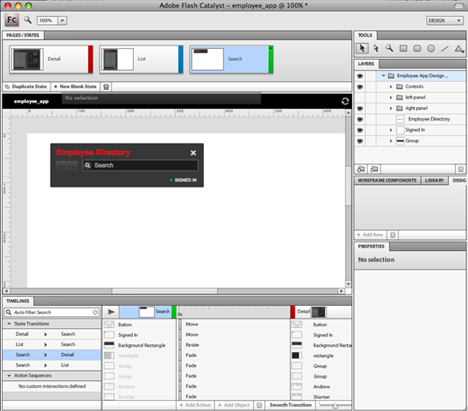
Adobe Flash Catalyst
Adobe Flash Catalyst is a new professional interaction design tool for rapidly creating expressive interfaces and interactive content without writing code.
It is possible to create interactive portfolios, product guides, microsites, site navigation, interfaces for RIAs and more.

Slide 21
Adobe Flash Catalyst
Catalyst can import Photoshop, Illustrator, or Fireworks files keeping all their features.
Create and edit behaviors (mouse events handling etc.) without writing code.
Create UIs to handle dynamic data.
Compatible with Flex Builder (renamed to "Flash Builder"): designers use Flash Catalyst to create the user interface, then provide the same project file to developers who use Flash Builder to add functionality and integrate with servers and services.
Publish a finished project as a SWF file ready for distribution

Slide 22
Index
Adobe Flash Platform
Adobe Flash
Adobe Flash Catalyst
Adobe Flash Player
Adobe Flex
Adobe AIR
Adobe Flash Platform Services
Adobe Flash Media Server family
Adobe LiveCycle Data Services
Resources

Slide 23

Adobe Flash Player
Adobe Flash Player is a software for viewing animations and movies using computer programs such as a web browser. Flash player is a widely distributed proprietary multimedia and application player created by Macromedia and now by Adobe.
Nowdays, Adobe Flash Player is the standard for delivering high-impact, rich web content. Designs, animation, and application user interfaces are deployed immediately across browsers and platforms.
Flash Player runs SWF files.

Slide 24
Adobe Flash Player
It uses vector graphics to minimize file size and create files that save bandwidth and loading time. Flash is a common format for games, animations, and GUIs embedded into web pages.
The Flash Player is available as a plugin for different web browsers on selected platforms.
Flash Player 10.1 is optimized for high performance on mobile screens and designed to take advantage of native device capabilities, enabling richer and more immersive user experiences thanks to multitouch and gesture events.
Access to the various settings panels necessary to manage the application's settings can be achieved through a web-based "Settings Manager" page located on the "support" section of the Adobe website

Slide 25
Index
Adobe Flash Platform
Adobe Flash
Adobe Flash Catalyst
Adobe Flash Player
Adobe Flex
Adobe AIR
Adobe Flash Platform Services
Adobe Flash Media Server family
Adobe LiveCycle Data Services
Resources

Slide 26

Adobe Flex
Adobe Flex is a framework for the development and deployment of cross-platform rich Internet applications based on the Adobe Flash platform.
The initial release in March 2004 by Macromedia included a Software Development Kit and an IDE
Adobe acquired Flex in 2005

Slide 27
Adobe Flex
It provides a standards-based language and programming model that supports common design patterns. MXML (XML by Macromedia) is used to describe UI layout and behaviors, and ActionScript 3 is used to create client logic.
Flex also includes a rich component library with more than 100 proven, extensible UI components for creating rich Internet applications (RIAs), as well as an interactive Flex application debugger.
RIAs created with Flex can run in the browser using Adobe Flash Player or on the desktop on Adobe AIR. This enables Flex applications to run consistently across all major browsers and on the desktop.

Slide 28
Adobe Flex
Adobe Flex Builder accelerates Flex application development.
It is an Eclipse based development tool enabling intelligent coding, interactive step-through debugging, and visual design of the user interface layout, appearance, and behavior of RIAs.
Flex Builder includes the complete Flex framework, including compilers, a component library, and debuggers.
You can get the complete Flex framework separately from Flex Builder by downloading the Free Adobe Flex SDK. Developers can create complete RIAs using the Free Adobe Flex SDK.
The Flex SDK is also available as open source in the Open Source Flex SDK project.

Slide 29

Adobe Flex – Flash Builder
Adobe has decided to rename the current release as Adobe Flash Builder. This name change will create a clear distinction between Flex framework and the commercial IDE.
http://www.picnik.com
http://www.tweetdeck.com/

Slide 30
Index
Adobe Flash Platform
Adobe Flash
Adobe Flash Catalyst
Adobe Flash Player
Adobe Flex
Adobe AIR
Adobe Flash Platform Services
Adobe Flash Media Server family
Adobe LiveCycle Data Services
Resources

Slide 31

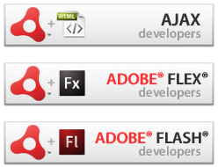
Adobe AIR
Adobe AIR is a cross-operating system runtime that lets developers combine HTML, Ajax, Adobe Flash and Adobe Flex technologies to deploy rich Internet applications (RIAs) on the desktop.
AIR allows developers to use familiar tools such as Adobe Dreamweaver, Flex, Flash Professional, or any text editor to build their applications.

Slide 32
Adobe AIR
Develop Adobe AIR Applications with JavaScript and HTML: Adobe AIR has full support for developing applications with web technologies such as HTML, JavaScript, CSS, XHTML and more.
Develop Adobe AIR Applications with Adobe Flex: Adobe Flex and Flex Builder have full support for authoring AIR applications.
Develop Adobe AIR Applications with Adobe Flash Professional: leverage the rich graphics and scripting capabilities of Adobe Flash Professional to build content for Adobe AIR.

Slide 33
Adobe AIR
AIR is intended to be a versatile runtime environment that allows existing Flash, Actionscript or HTML and JavaScript code to be used to construct a more traditional desktop-like program.
Adobe positions it as a browser-less runtime for rich Internet applications that can be deployed onto the desktop.
This provides access to local storage and file systems

Slide 34
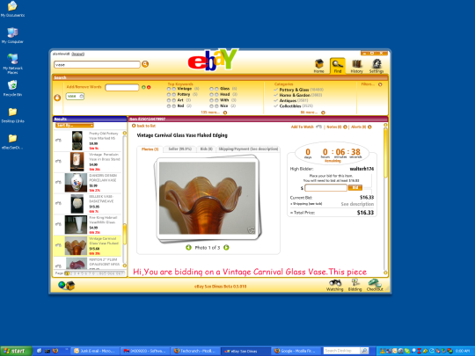
Adobe AIR
AIR applications can operate offline, and then activate further functionality or upload data when an active Internet connection becomes available. One example is eBay Desktop, which allows sellers to complete a listing offline and then upload it to eBay when they are connected to the Internet

Slide 35
Index
Adobe Flash Platform
Adobe Flash
Adobe Flash Catalyst
Adobe Flash Player
Adobe Flex
Adobe AIR
Adobe Flash Platform Services
Adobe Flash Media Server family
Adobe LiveCycle®Data Services
Resources

Slide 36

Adobe Flash Platform Services
Adobe Flash Platform Services enable developers to add social and collaborative capabilities to applications.
The Promotion service offers free and paid methods for promoting applications to social networks, mobile devices, and desktops. It also enables to track distribution and user engagement with their applications.
The Collaboration service enables developers to easily add real-time collaboration and social capabilities to their applications.
The Social service enables developers to easily integrate leading social networks such as Facebook, Twitter, and MySpace with their applications.

Slide 37
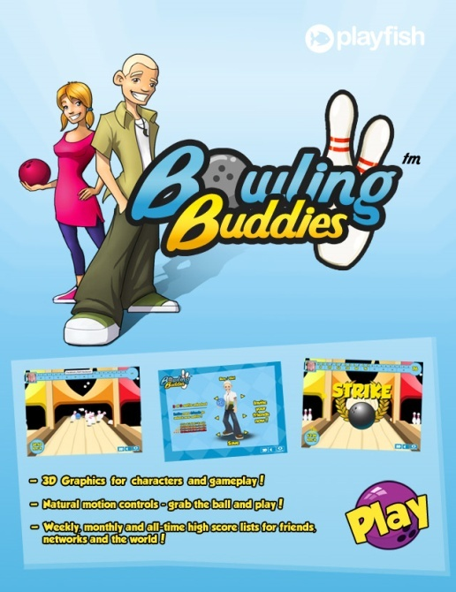
Adobe Flash Platform Services
Playfish is a social games company that has built five of the ten most popular games on Facebook and logs more than 25 million active users each month. The game "Bowling Buddies" features stylish 3D graphics, easy controls, customized characters, and multiplayer challenges.
http://www.facebook.com/bowlingbuddies

Slide 38
Index
Adobe Flash Platform
Adobe Flash
Adobe Flash Catalyst
Adobe Flash Player
Adobe Flex
Adobe AIR
Adobe Flash Platform Services
Adobe Flash Media Server family
Adobe LiveCycle Data Services
Resources

Slide 39

Adobe Flash Media Server family
Flash Media Server (FMS) is a proprietary data and media server from Adobe Systems.
This server works with the Flash Player to create media driven, multiuser RIAs (Rich Internet Applications).
  Video on Demand, streaming video stored on the server to the flash client.
  Live Video, a server-side application which allows user to broadcast their videos from a webcam on website with live stream Flash video player to other users or to the server for recording and on demand viewing later.
  Real Time Communication, an application which requires collaboration between multiple clients, such as a chat room or multiplayer game.
Notes:
È un prodotto software che eroga servizi server per la creazione di applicazioni in real time.

Slide 40
Index
Adobe Flash Platform
Adobe Flash
Adobe Flash Catalyst
Adobe Flash Player
Adobe Flex
Adobe AIR
Adobe Flash Platform Services
Adobe Flash Media Server family
Adobe LiveCycle Data Services
Resources

Slide 41

Adobe LiveCycle Data Services
LiveCycle Data Services is a high performance, scalable, and flexible framework that simplifies development of Flex and AIR applications.
It includes functionality for messaging, remoting, data management.
With LiveCycle Data Services, information can be synchronized across clients and applications, providing a framework for conflict resolution in real time.

Slide 42
Index
Adobe Flash Platform
Adobe Flash
Adobe Flash Catalyst
Adobe Flash Player
Adobe Flex
Adobe AIR
Adobe Flash Platform Services
Adobe Flash Media Server family
Adobe LiveCycle Data Services
Resources

Slide 43
Resources
Adobe Flash Platform
  http://www.adobe.com/flashplatform/
  http://www.adobe.com/flashplatform/pdfs/platform_overview.pdf
  http://labs.adobe.com/technologies/flash/
  http://www.adobe.com/devnet.html
Adobe Flash
  http://www.adobe.com/products/flash/
  http://www.slideshare.net/search/slideshow?q=adobe+flash+introduction&type=presentations&searchfrom=basic&lang=**
  http://www.slideshare.net/jeethukarthik/an-introduction-to-the-flash-platform
  http://www.slideshare.net/tbisaacs/flash-flex-air-a-brief-survey
  http://onflash.org/ted/2010/02/flash-open-interactive-medium.php

Slide 44
Resources
Adobe Flash Catalyst
  http://labs.adobe.com/technologies/flashcatalyst/
  http://en.wikipedia.org/wiki/Adobe_Flash_Catalyst
Adobe Flash Player
  http://labs.adobe.com/technologies/flashplayer10/
  http://en.wikipedia.org/wiki/Flash_player
  http://www.adobe.com/products/flashplayer/
Adobe Flex
  http://www.adobe.com/products/flex/
  http://opensource.adobe.com/wiki/display/flexsdk/Flex+SDK
  http://en.wikipedia.org/wiki/Adobe_Flex
  http://en.wikipedia.org/wiki/Flash_Builder
  http://flex.org

Slide 45
Resources
Adobe AIR
  http://www.adobe.com/products/air/
  http://en.wikipedia.org/wiki/Adobe_Integrated_Runtime
  http://labs.adobe.com/technologies/air/
Adobe Flash Platform Services
  http://www.adobe.com/flashplatform/services/
Adobe Flash Media Server family
  http://www.adobe.com/products/flashmediaserver/
  http://en.wikipedia.org/wiki/Adobe_Flash_Media_Server
Adobe LiveCycle Data Services
  http://www.adobe.com/products/livecycle/dataservices/
  http://en.wikipedia.org/wiki/Adobe_LiveCycle#LiveCycle_Data_Services_ES2

