Slide 1
MPEG-4

Slide 2
MPEG-4
MPEG-4, or ISO/IEC 14496 is an international standard describing coding of audio-video objects
the 1st version of MPEG-4 became an international standard in 1999 and the 2nd version in 2000 (6 parts); since then many parts were added and some are under development today
MPEG-4 included object-based audio-video coding for Internet streaming, television broadcasting, but also digital storage
MPEG-4 included interactivity and VRML support for 3D rendering
has profiles and levels like MPEG-2
has 27 parts

Slide 3
MPEG-4 parts
Part 1, Systems – synchronizing and multiplexing audio and video
Part 2, Visual – coding visual data
Part 3, Audio – coding audio data, enhancements to Advanced Audio Coding and new techniques
Part 4, Conformance testing
Part 5, Reference software
Part 6, DMIF (Delivery Multimedia Integration Framework)
Part 7, optimized reference software for coding audio-video objects
Part 8, carry MPEG-4 content on IP networks

Slide 4
MPEG-4 parts (2)
Part 9, reference hardware implementation
Part 10, Advanced Video Coding (AVC)
Part 11, Scene description and application engine; BIFS (Binary Format for Scene) and XMT (Extensible MPEG-4 Textual format)
Part 12, ISO base media file format
Part 13, IPMP extensions
Part 14, MP4 file format, version 2
Part 15, AVC (advanced Video Coding) file format
Part 16, Animation Framework eXtension (AFX)
Part 17, timed text subtitle format
Part 18, font compression and streaming
Part 19, synthesized texture stream

Slide 5
MPEG-4 parts (3)
Part 20, Lightweight Application Scene Representation (LASeR) and Simple Aggregation Format (SAF)
Part 21, MPEG-J Graphics Framework eXtension (GFX)
Part 22, Open Font Format
Part 23, Symbolic Music Representation
Part 24, audio and systems interaction
Part 25, 3D Graphics Compression Model
Part 26, audio conformance
Part 27, 3D graphics conformance

Slide 6
Motivations for MPEG-4
Broad support for MM facilities are available
  2D and 3D graphics, audio and video – but
Incompatible content formats
  3D graphics formats as VRML are badly integrated to
  2D formats as FLASH or HTML
  Broadcast formats (MHEG) are not well suited for the Internet
  Some formats have a binary representation – not all
  SMIL, HTML+, etc. solve only a part of the problems
Both authoring and delivery are cumbersome
Bad support for multiple formats

Slide 7
MPEG-4: Audio/Visual (A/V) Objects
Simple video coding (MPEG-1 and –2)
  A/V information is represented as a sequence of rectangular frames: Television paradigm
  Future: Web paradigm, Game paradigm … ?
Object-based video coding (MPEG-4)
  A/V information: set of related stream objects
  Individual objects are encoded as needed
  Temporal and spatial composition to complex scenes
  Integration of text, “natural” and synthetic A/V
A step towards semantic representation of A/V
Communication + Computing + Film (TV…)

Slide 8
Main parts of MPEG-4
1. Systems
– Scene description, multiplexing, synchronization, buffer management, intellectual property and protection management
2. Visual
– Coded representation of natural and synthetic visual objects
3. Audio
– Coded representation of natural and synthetic audio objects
4. Conformance Testing
– Conformance conditions for bit streams and devices
5. Reference Software
– Normative and non-normative tools to validate the standard
6. Delivery Multimedia Integration Framework (DMIF)
– Generic session protocol for multimedia streaming

Slide 9
Main objectives – rich data
Efficient representation for many data types
  Video from very low bit rates to very high quality
    24 Kbs .. several Mbps (HDTV)
  Music and speech data for a very wide bit rate range
    Very low bit rate speech (1.2 – 2 Kbps) ..
    Music (6 – 64 Kbps) ..
    Stereo broadcast quality (128 Kbps)
  Synthetic objects
    Generic dynamic 2D and 3D objects
    Specific 2D and 3D objects e.g. human faces and bodies
    Speech and music can be synthesized by the decoder
  Text
  Graphics

Slide 10
Main objectives – robust + pervasive
Resilience to residual errors
  Provided by the encoding layer
  Even under difficult channel conditions – e.g. mobile
Platform independence
Transport independence
  MPEG-2 Transport Stream for digital TV
  RTP for Internet applications
  DAB (Digital Audio Broadcast) . . .
  However, tight synchronization of media
Intellectual property management + protection
  For both A/V contents and algorithms

Slide 11
Main objectives - scalability
Scalability
  Enables partial decoding
  Audio - Scalable sound rendering quality
  Video - Progressive transmission of different quality levels
  - Spatial and temporal resolution
Profiling
  Enables partial decoding
  Solutions for different settings
  Applications may use a small portion of the standard
  “Specify minimum for maximum usability”

Slide 12
Main objectives - genericity
Independent representation of objects in a scene
Independent access for their manipulation and re-use
Composition of natural and synthetic A/V objects into one audiovisual scene
Description of the objects and the events in a scene
Capabilities for interaction and hyper linking
Delivery media independent representation format
Transparent communication between different delivery environments

Slide 13
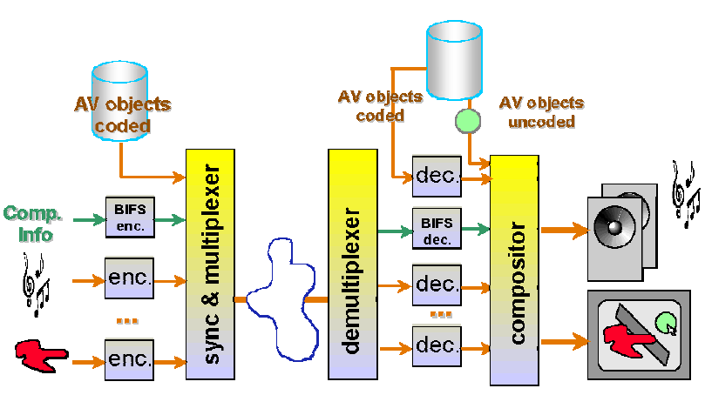
Object-based architecture

Slide 14
MPEG-4 as a tool box
MPEG-4 is a tool box (no monolithic standard)
Main issue is not a better compression
No “killer” application (as DTV for MPEG-2)
Many new, different applications are possible
Enriched broadcasting, remote surveillance, games, mobile multimedia, virtual environments etc.
Profiles
Binary Interchange Format for Scenes (BIFS)
  Based on VRML 2.0 for 3D objects
  “Programmable” scenes
  Efficient communication format

Slide 15
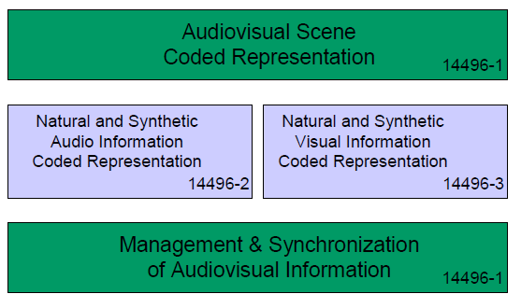
MPEG-4 Systems part

Slide 16
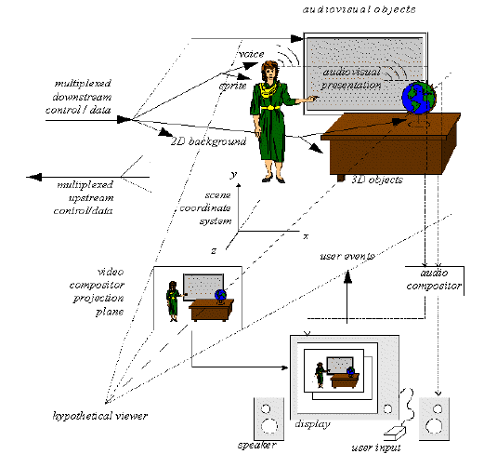
MPEG-4 scene, VRML-like model

Slide 17
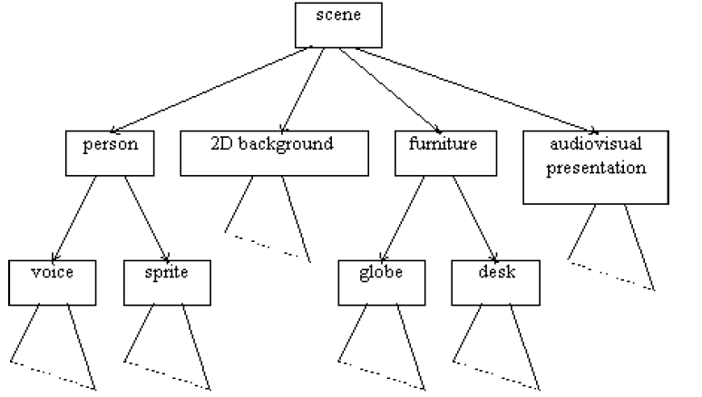
Logical scene structure

Slide 18
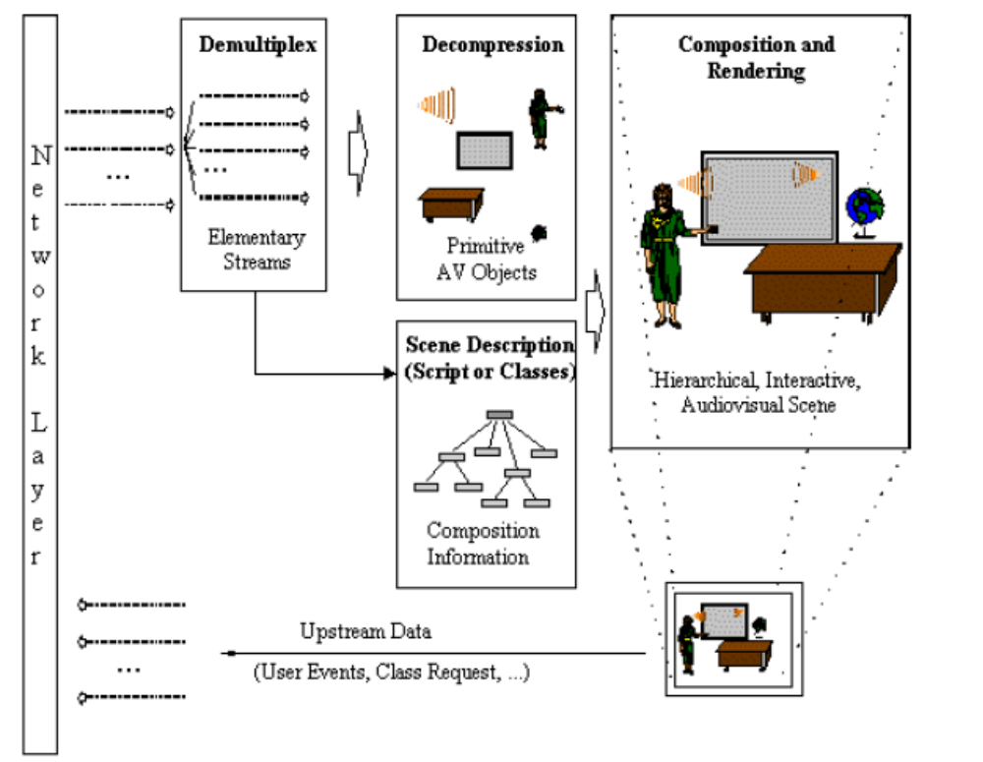
MPEG-4 Terminal Components

Slide 19
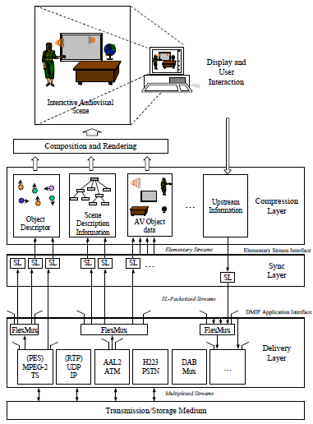
Digital Terminal Architecture

Slide 20
BIFS tools – scene features
3D, 2D scene graph (hierarchical structure)
3D, 2D objects (meshes, spheres, cones etc.)
3D and 2D Composition, mixing 2D and 3D
Sound composition – e.g. mixing, “new instruments”, special effects
Scalability and scene control
  Terminal capabilities (TermCab)
  MPEG-J for terminal control
Face and body animation
XMT - Textual format; a bridge to the Web world

Slide 21
BIFS tools – command protocol
Replace a scene with this new scene
  A replace command is an entry point like an I-frame
  The whole context is set to the new value
Insert node in a grouping node
  Instead of replacing a whole scene, just adds a node
  Enables progressive downloads of a scene
Delete node - deletion of an element costs a few bytes
Change a field value; e.g. color, position, switch on/off an object

Slide 22
BIFS tools – animation protocol
The BIFS Command Protocol is a synchronized, but non streaming media
Anim is for continuous animation of scenes
Modification of any value in the scene
– Viewpoints, transforms, colors, lights
The animation stream only contains the animation values
Differential coding – extremely efficient

Slide 23
Elementary stream management
Object description
  Relations between streams and to the scene
  Auxiliary streams:
    IPMP – Intellectual Property Management and Protection
    OCI – Object Content Information
Synchronization + packetization
– Time stamps, access unit identification, …
System Decoder Model
File format - a way to exchange MPEG-4 presentations

Slide 24
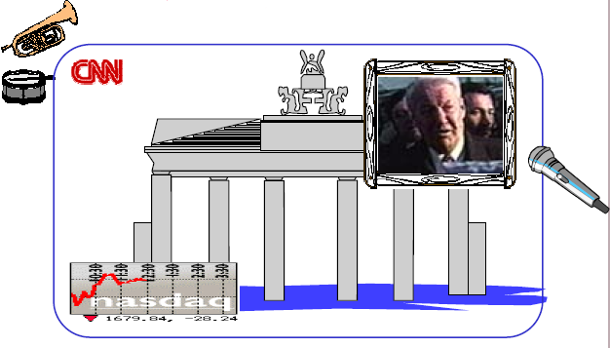
An example MPEG-4 scene

Slide 25
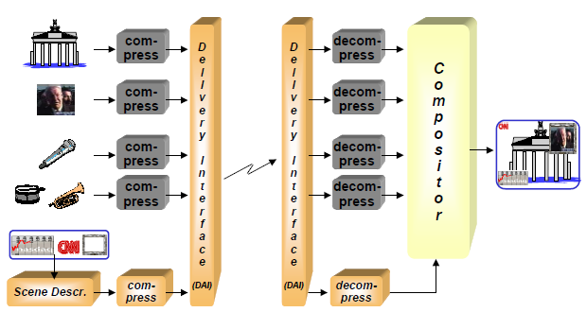
Object-based compression and delivery

Slide 26
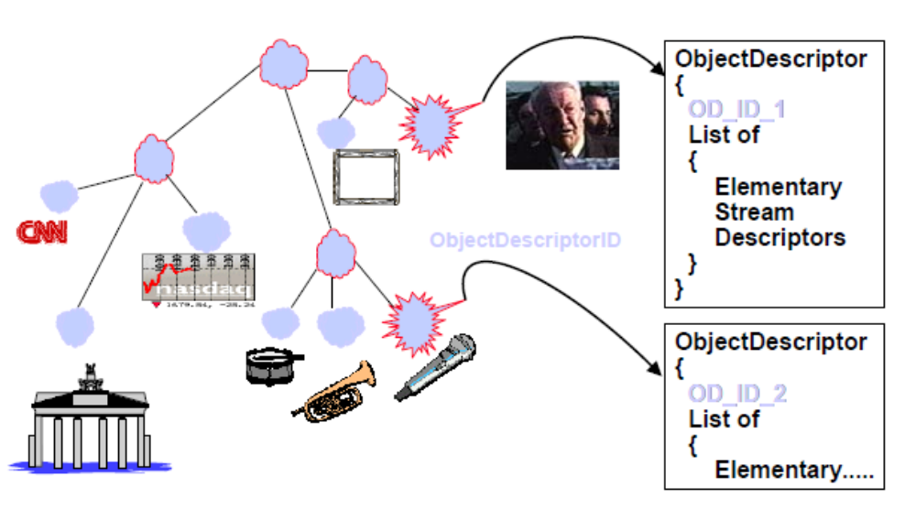
Linking streams into the scene (1)

Slide 27
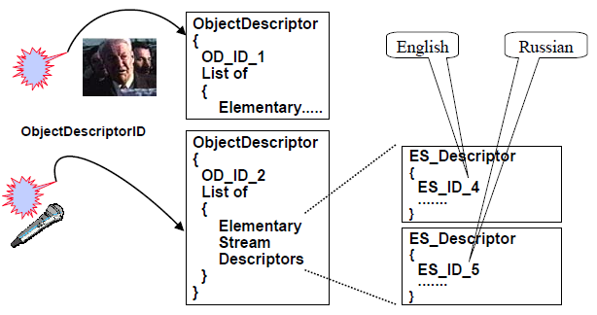
Linking streams into the scene (2)

Slide 28
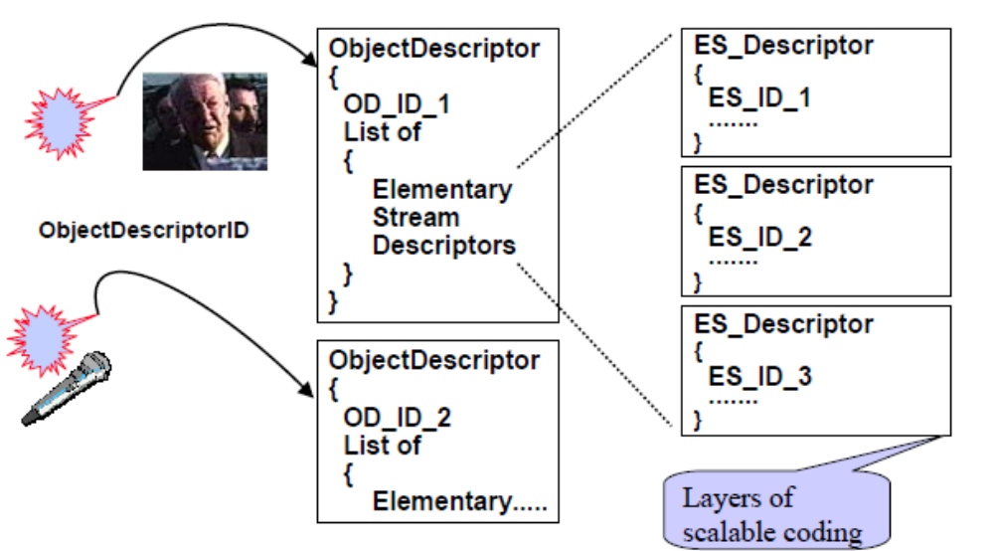
Linking streams into the scene (3)

Slide 29
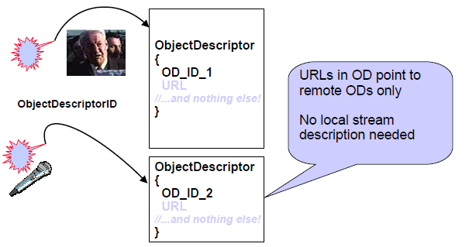
Linking streams into the scene (4)

Slide 30
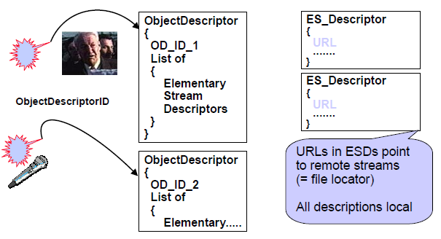
Linking streams into the scene (5)

Slide 31
Linking streams into the scene (6)
An object descriptor contains ES descriptors pointing to:
  Scalable coded content streams
  Alternate quality content streams
  Object content information
  IPMP information
ES descriptors have subdescriptors to:
  Decoder configuration (stream type, header)
  Sync layer configuration (for flexible SL syntax)
  Quality of service information (for heterogeneous nets)
  Future / private extensions
terminal may select suitable streams

Slide 32
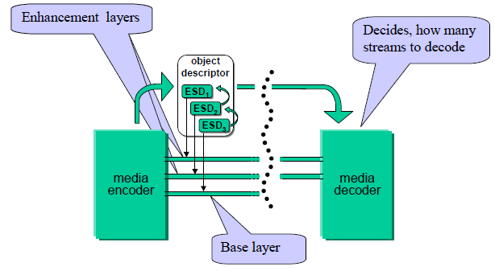
Describing scalable content

Slide 33
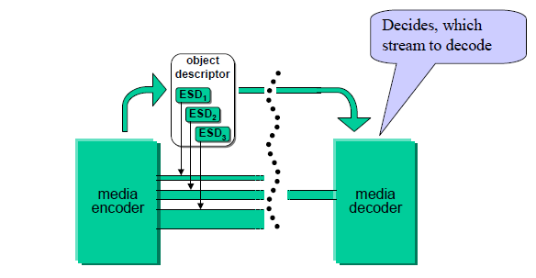
Describing alternate content versions

Slide 34
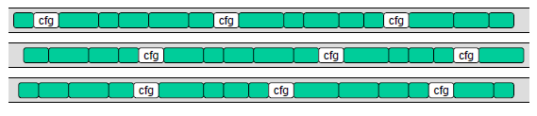
Decoder configuration info in older standards
cfg = configuration information (“stream headers”)

Slide 35
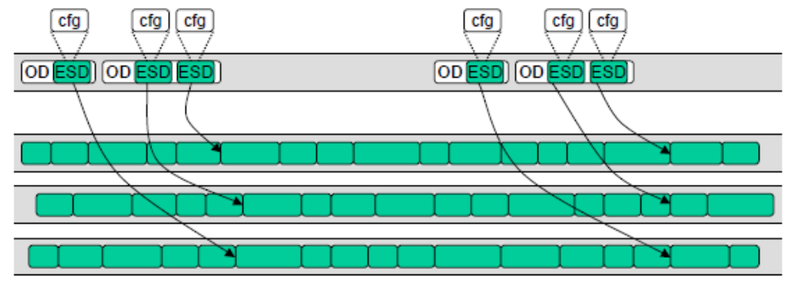
Decoder configuration information in MPEG-4
the OD (ESD) must be retrieved first
for broadcast ODs must be repeated periodically

Slide 36
The Initial Object Descriptor
Derived from the generic object descriptor
– Contains additional elements to signal profile and level (P&L)
P&L indications are the default way of content selection
– The terminal reads the P&L indications and knows whether it has the capability to process the presentation
Profiles are signaled in multiple separate dimensions
  Scene description
  Graphics
  Object descriptors
  Audio
  Visual
The “first” object descriptor for an MPEG-4 presentation is always an initial object descriptor

Slide 37
Transport of object descriptors
Object descriptors are encapsulated in OD commands
– ObjectDescriptorUpdate / ObjectDescriptorRemove
– ES_DescriptorUpdate / ES_DescriptorRemove
OD commands are conveyed in their own object descriptor stream in a synchronized manner with time stamps
– Objects / streams may be announced during a presentation
There may be multiple OD & scene description streams
– A partitioning of a large scene becomes possible
Name scopes for identifiers (OD_ID, ES_ID) are defined
– Resource management for sub scenes can be distributed
Resource management aspect
- If the location of streams is changed, only the ODs need modification. Not the scene description

Slide 38
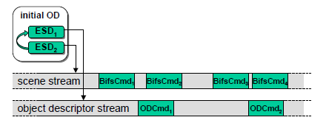
Initial OD pointing to scene and OD stream

Slide 39
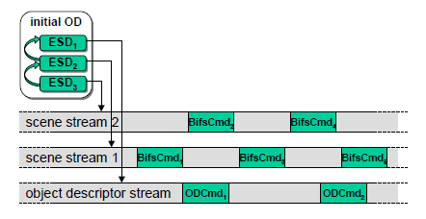
Initial OD pointing to a scalable scene

Slide 40
Auxiliary streams
IPMP streams
  Information for Intellectual Property Management and Protection
  Structured in (time stamped) messages
  Content is defined by proprietary IPMP systems
  Complemented by IPMP descriptors
OCI (Object Content Information) streams
  Meta data for an object (“Poor man’s MPEG-7”)
  Structured descriptors conveyed in (time stamped) messages
  Content author, date, keywords, description, language, ...
  Some OCI descriptors may be directly in ODs or ESDs
ES_Descriptors pointing to such streams may be attached to any object descriptor – scopes the IPMP or OCI stream
  An IPMP stream attached to the object descriptor stream is valid for all streams

Slide 41
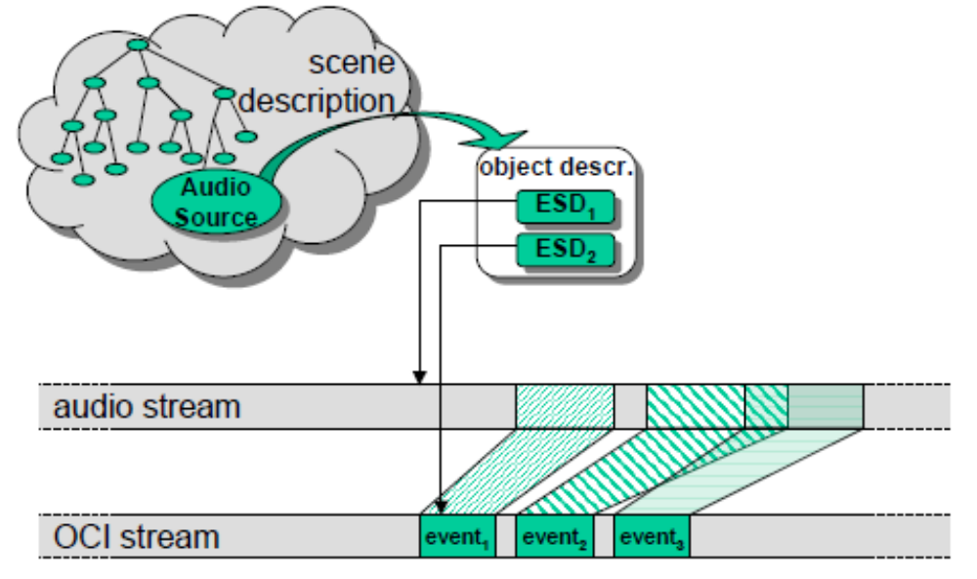
Adding an OCI stream to an audio stream

Slide 42
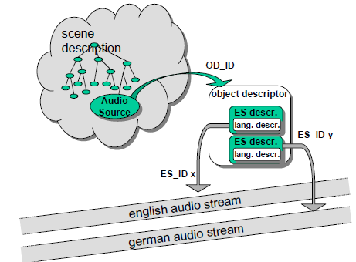
Adding OCI descriptors to audio streams

Slide 43
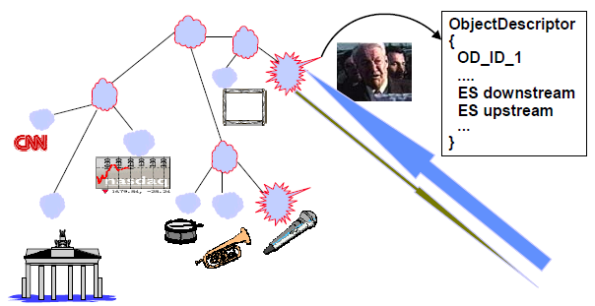
Linking streams to a scene – including “upstreams”

Slide 44
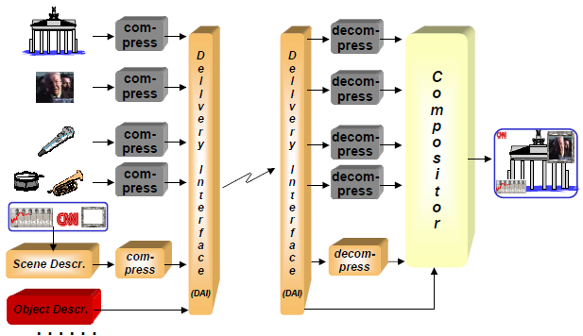
MPEG-4 streams

Slide 45
Synchronization of multiple elementary streams
Based on two well known concepts
Clock references
– Convey the speed of the encoder clock
Time stamps
– Convey the time at which an event should happen
Time stamps and clock references are
  defined in the system decoder model
  conveyed on the sync layer

Slide 46
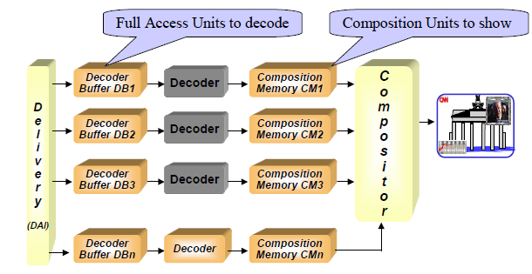
System Decoder Model (1)

Slide 47
System Decoder Model (2)
Ideal model of the decoder behavior
– Instantaneous decoding – delay is implementation’s problem
Incorporates the timing model
– Decoding & composition time
Manages decoder buffer resources
  Useful for the encoder
  Ignores delivery jitter
Designed for a rate-controlled “push” scenario
– Applicable also to flow-controlled “pull” scenario
Defines composition memory (CM) behavior
  A random access memory to the current composition unit
  CM resource management not implemented

Slide 48
Synchronization of elementary streams with time events in the scene description
How are time events handled in the scene description?
How is this related to time in the elementary streams?
Which time base is valid for the scene description?

Slide 49
Cooperating entities in synchronization
Time line (“object time base”) for the scene
Scene description stream with time stamped BIFS access units
Object descriptor stream with pointers to all other streams
Video stream with (decoding & composition) time stamps
Audio stream with (decoding & composition) time stamp
Alternate time line for audio and video

Slide 50
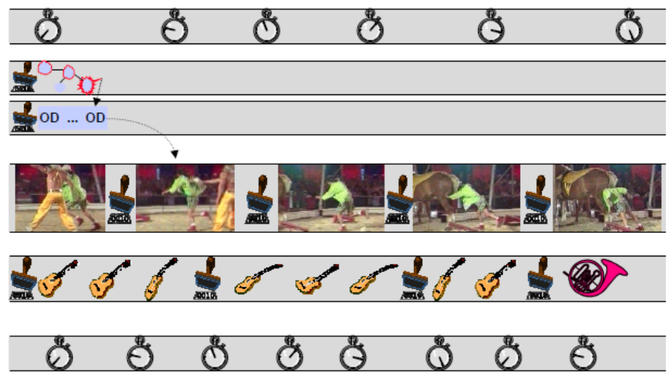
A/V scene with time bases and stamps

Slide 51
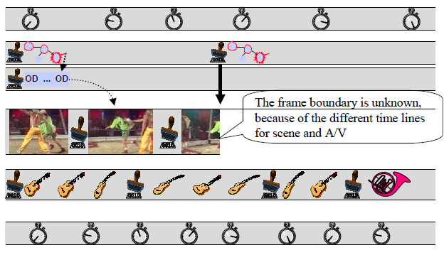
Hide the video at time T1

Slide 52
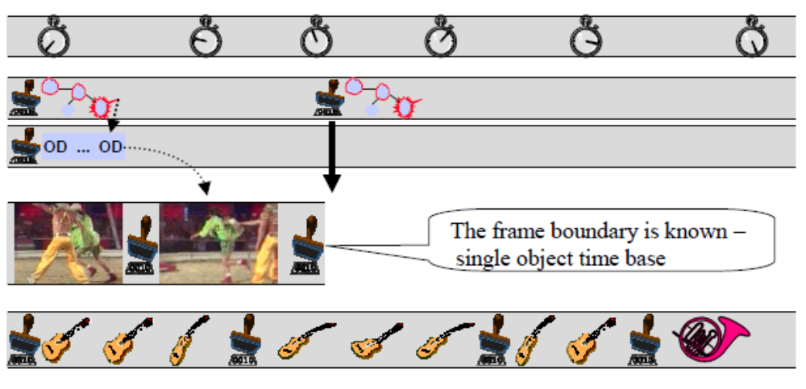
Hide the video on frame boundary

Slide 53
The Synchronization Layer (SL)
Synchronization layer (short: sync layer or SL)
  SL packet = one packet of data
  Consists of header and payload
  Defines a “wrapper syntax” for the atomic data: access unit
Indicates boundaries of access units
  AccessUnitStartFlag, AccessUnitEndFlag, AULength
Provides consistency checking for lost packets
Carries object clock reference (OCR) stamps
Carries decoding and composition time stamps (DTS, CTS)

Slide 54
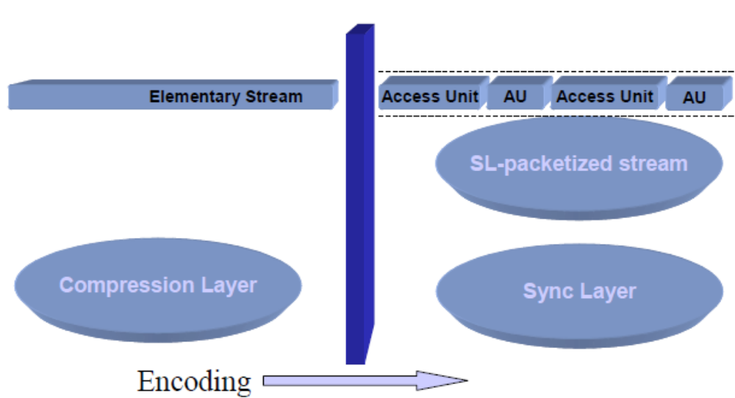
Elementary Stream Interface (1)

Slide 55
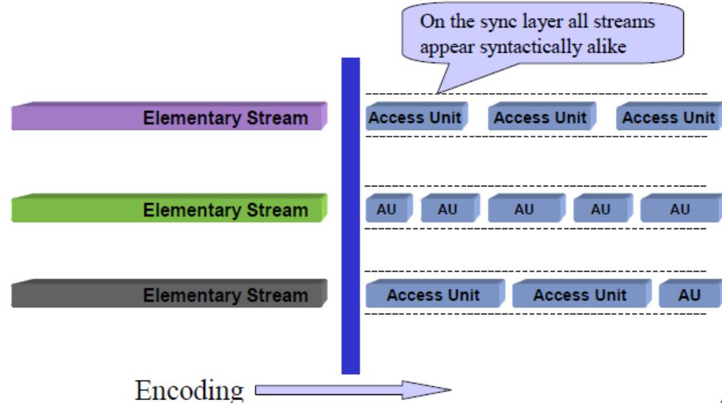
Elementary Stream Interface (2)

Slide 56
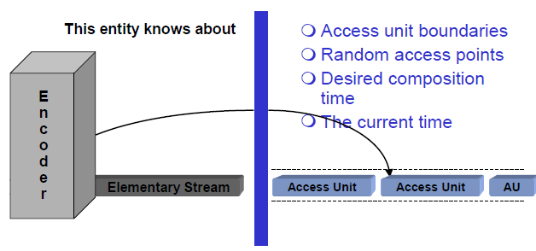
Elementary Stream Interface (3)

Slide 57
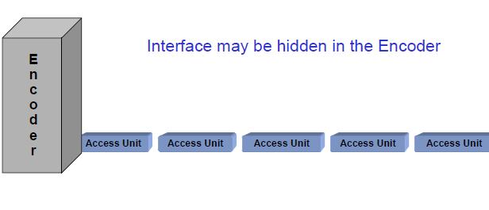
Elementary Stream Interface (4)

Slide 58
The sync layer design
Access units are conveyed in SL packets
Access units may use more than one SL packet
SL packets have a header to encode the information conveyed through the ESI
SL packets that don’t start an AU have a smaller header

Slide 59
How is the sync layer designed ?
As flexible as possible to be suitable for
  a wide range of data rates
  a wide range of different media streams
Time stamps have
  variable length
  variable resolution
Same for clock reference (OCR) values
  OCR may come via another stream
Alternative to time stamps exists for lower bit rate
  Indication of start time and
  duration of units (accessUnitDuration,compositionUnitDuration)

Slide 60
SLConfigDescriptor syntax example
class SLConfigDescriptor {
uint (8) predefined;
if (predefined==0) {
bit(1) useAccessUnitStartFlag;
bit(1) useAccessUnitEndFlag;
bit(1) useRandomAccessPointFlag;
bit(1) usePaddingFlag;
bit(1) useTimeStampsFlag;
uint(32) timeStampResolution;
uint(32) OCRResolution;
uint(6) timeStampLength;
uint(6) OCRLength;
if (!useTimeStamps) {
................
SDL-
Syntax Description
Language

Slide 61
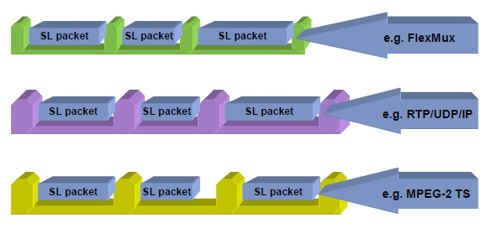
Wrapping SL packets in a suitable layer

Slide 62
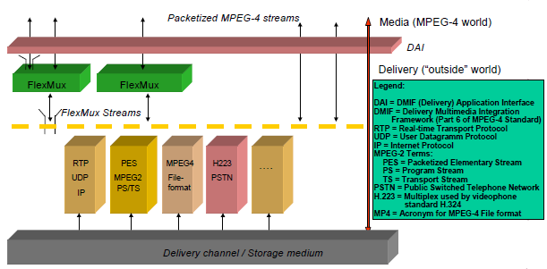
MPEG-4 Delivery Framework (DMIF)

Slide 63
The MPEG-4 Layers and DMIF
DMIF hides the delivery technology
  Adopts QoS metrics
Compression Layer
  Media aware
  Delivery unaware
Sync Layer
  Media unaware
  Delivery unaware
Delivery Layer
  Media unaware
  Delivery aware

Slide 64
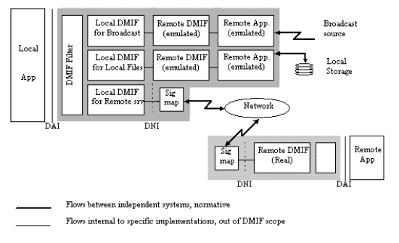
DMIF communication architecture

Slide 65
Multiplex of elementary streams
Not a core MPEG task
Just respond to specific needs for MPEG-4 content transmission
  Low delay
  Low overhead
  Low complexity
This prompted the design of the “FlexMux” tool
One single file format desirable
  This lead to the design of the MPEG-4 file format

Slide 66
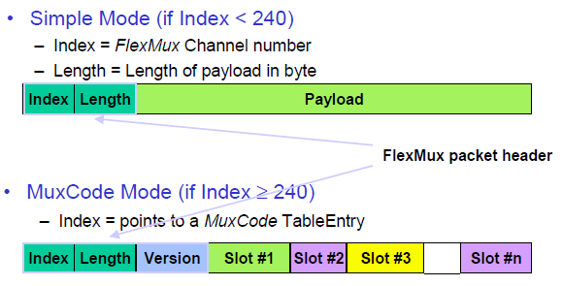
Modes of FlexMux

Slide 67
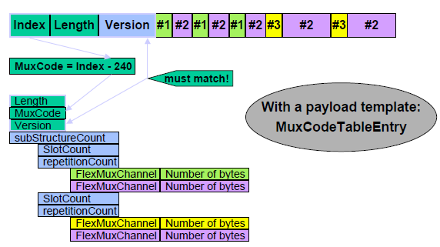
How to configure MuxCode mode ?

Slide 68
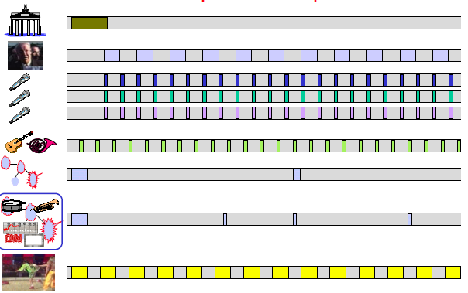
A multiplex example

Slide 69
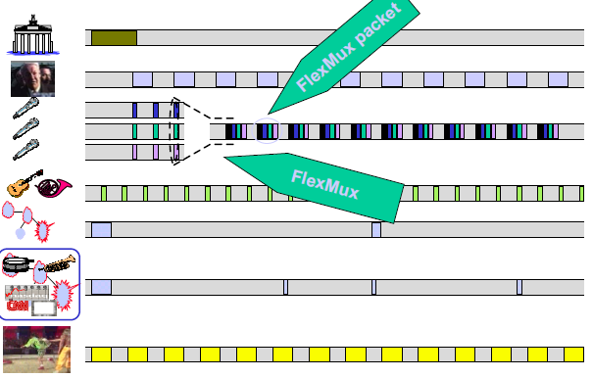
Multiplexing audio channels in FlexMux

Slide 70
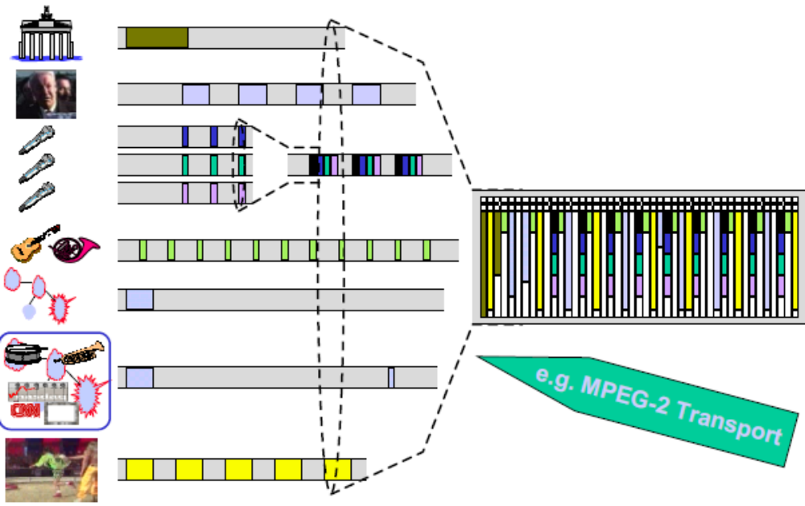
Multiplexing all channels to MPEG-2 TS

Slide 71
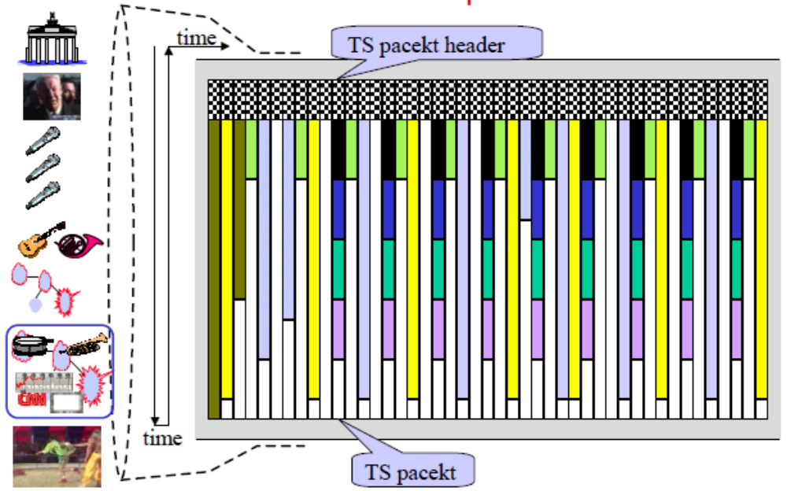
MPEG-2 Transport Stream

Slide 72
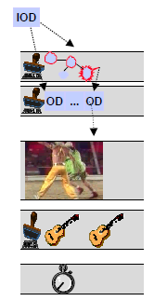
MPEG-4 content access procedure
Locate an MPEG-4 content item (e.g. by URL) and connect to it
– Via the DMIF Application Interface (DAI)
Retrieve the Initial Object Descriptor
This Object Descriptor points to an
BIFS + OD stream
– Open these streams via DAI
Scene Description points to other streams through Object Descriptors
- Open the required streams via DAI
Start playing!

Slide 73
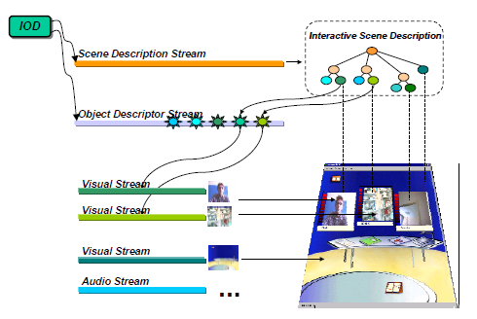
MPEG-4 content access example

