Slide 1
MySql DataBase
14 December 2018

Slide 2
Introduction and Objective
. Objective is MySQL connection (using python)
According to our project requirements …………
Install MySQL Drivers and packages
Test MySQL Connector and also Create Connection
Creating a Database and tables
Insert data/values Into Tables
Run the query

Slide 3
Install MySQL Drivers and packages
To set environments and packages from our python environment to connect database
Like(py_environment=MySQL_env)
To install wheel files.
1)pip install mysqlclient-1.3.12-cp35-cp35m-win_amd64.whl
2)pip install mysql_connector_python-8.0.6-cp35-cp35m- win_amd64.whl

Slide 4
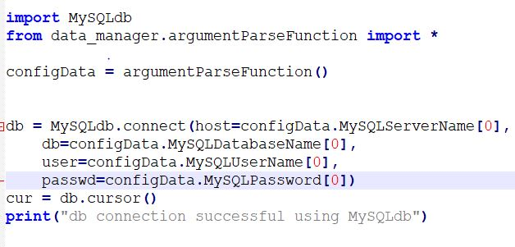
2.Test MySQL Connector and also Create Connection
Test MySQL Connector
Start by creating a connection to the database.
Use the username and password from your MySQL database:

Slide 5
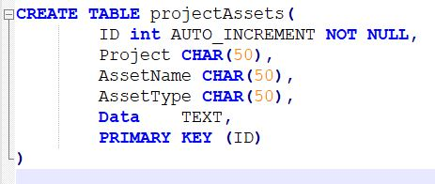
Creating a Database and tables
CreateTABLE_programTestLog.sql
CreateTABLE_projectAssets.sql
CreateTABLE_projects.sql
CreateTABLE_serviceAssets.sql

Slide 6
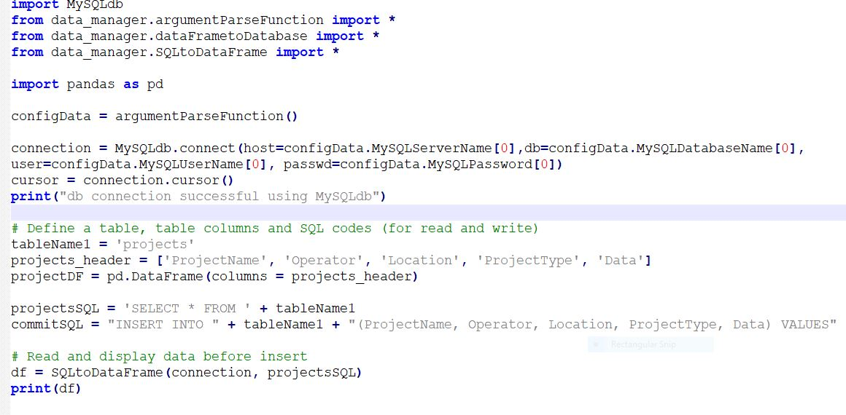
Insert data/values Into Tables

Slide 7
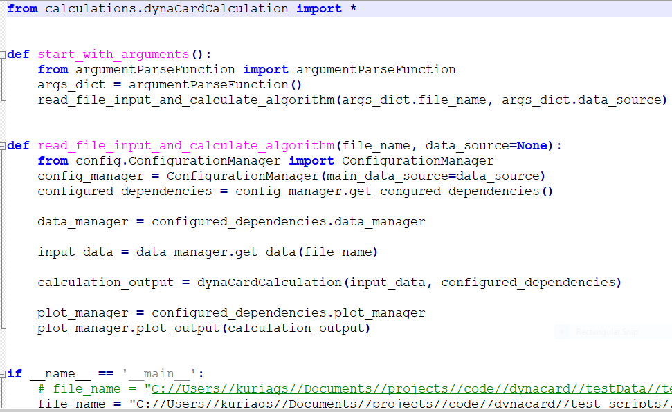
Run the query
Run the query

Slide 8
THANK YOU
For the opportunity to serve!

