Slide 1
Using Git and Dropbox
24 Dec 2018

Slide 2
Using Git and Dropbox together effectively?
Steps:
1.I created one folder(git-dropbox) on Desktop and initializing by using Git.
2. And I created also one folder(git) on dropbox and accessing to git to create inside the Files(project.git)
3. Git-remote-dropbox

Slide 3
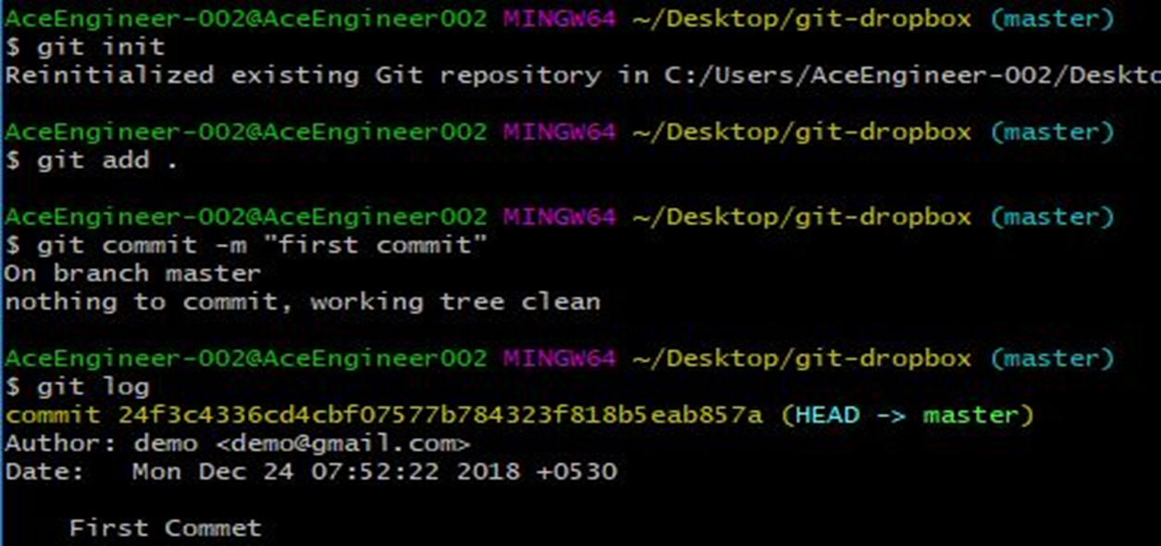
Step-1
Creating one folder(git-dropbox) on Desktop and initializing by using Git.

Slide 4
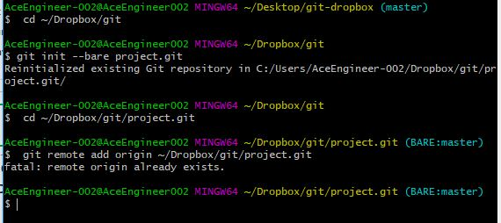
Step-2
Creating also one folder(git) on dropbox and accessing to git to create inside the Repositary Files(project.git).
Below picture, you can see the Error, because I already added git remote…..

Slide 5
Git-remote-dropbox
It is a transparent bidirectional bridge between Git and Dropbox.
In this we can use a Dropbox folder or a shared folder as a Git remote.
This Git remote helper makes Dropbox act like a true Git remote. It maintains all guarantees that are provided by a traditional Git remote while using Dropbox as a backing store.
It’s even safe to use with shared folders, so it can be used for collaboration(means unlimited private repos with unlimited collaborators)
With the remote helper, it’s possible to use Dropbox as a Git remote and continue using all the regular Git commands like (git clone, git pull, and git push,) and everything will just work as expected.
Above points I only understand the use of Git-remote-dropbox theoretically but not practically I can’t do . I searched on online there is no practical reference examples….
so could you help me this practically…..

Slide 6
Way Forward
High Level decision:
Our team is 5 members, Should we use:
https://bitbucket.org/ and keep repositories private?
Or should we use dropbox for now?
Prepare comparison slide
Bitbucket includes : integration with Trello/Jira, Built-in CD
Set-up Online repository for pushing code from local computers.
See references for good example(s)
Create instructions for team to follow

Slide 7
Way Forward (UPDATE or Relocate to another document)
I’m working on the practical example of Git-remote-Dropbox

Slide 8
References
This looks like what we want:
https://build-me-the-docs-please.readthedocs.io/en/latest/Using_Git/UsingAnOnlineGitRepository.html
Other references:
https://blog.geekforbrains.com/how-to-use-dropbox-and-git-for-private-repos-e1d304d5ff79

Slide 9
THANK YOU
For the opportunity to serve!

Slide 10
Document Revision History
01 | New document | 16 June 2016 |  | VA
Rev | Description | Date |  | Author | Checked | Approved
Document No: |  |  | Client Ref:
0173-PRE-0004-01 |  |  | n/a

