Slide 1
PETE 411
Well Drilling
Lesson 37
Coiled Tubing

Slide 2
Coiled Tubing
What is Coiled Tubing?
Uses of Coiled Tubing
Properties of Coiled Tubing
Drilling with Coiled Tubing
Buckling

Slide 3
Buckling of Coiled Tubing
Buckling Modes
Sinusoidal and Helical Buckling
Buckling in Horizontal or Inclined Sections
Buckling in Vertical Section
Buckling in Curved Wellbores
Prediction of Buckling Loads
“Lockup” of Tubulars

Slide 4
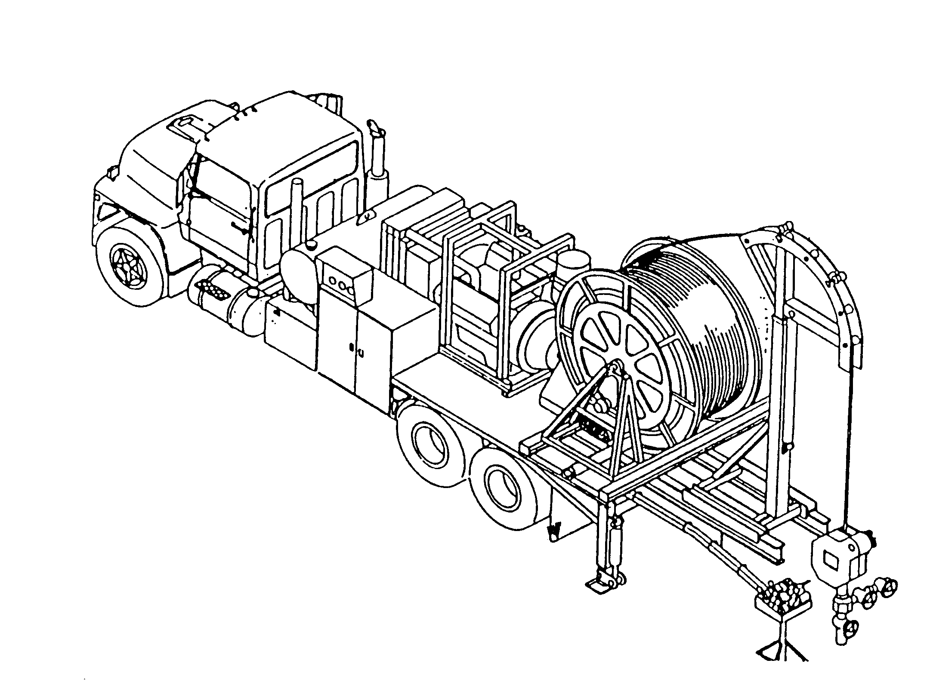
Truck-Mounted Coiled Tubing Reel Assembly

Slide 5
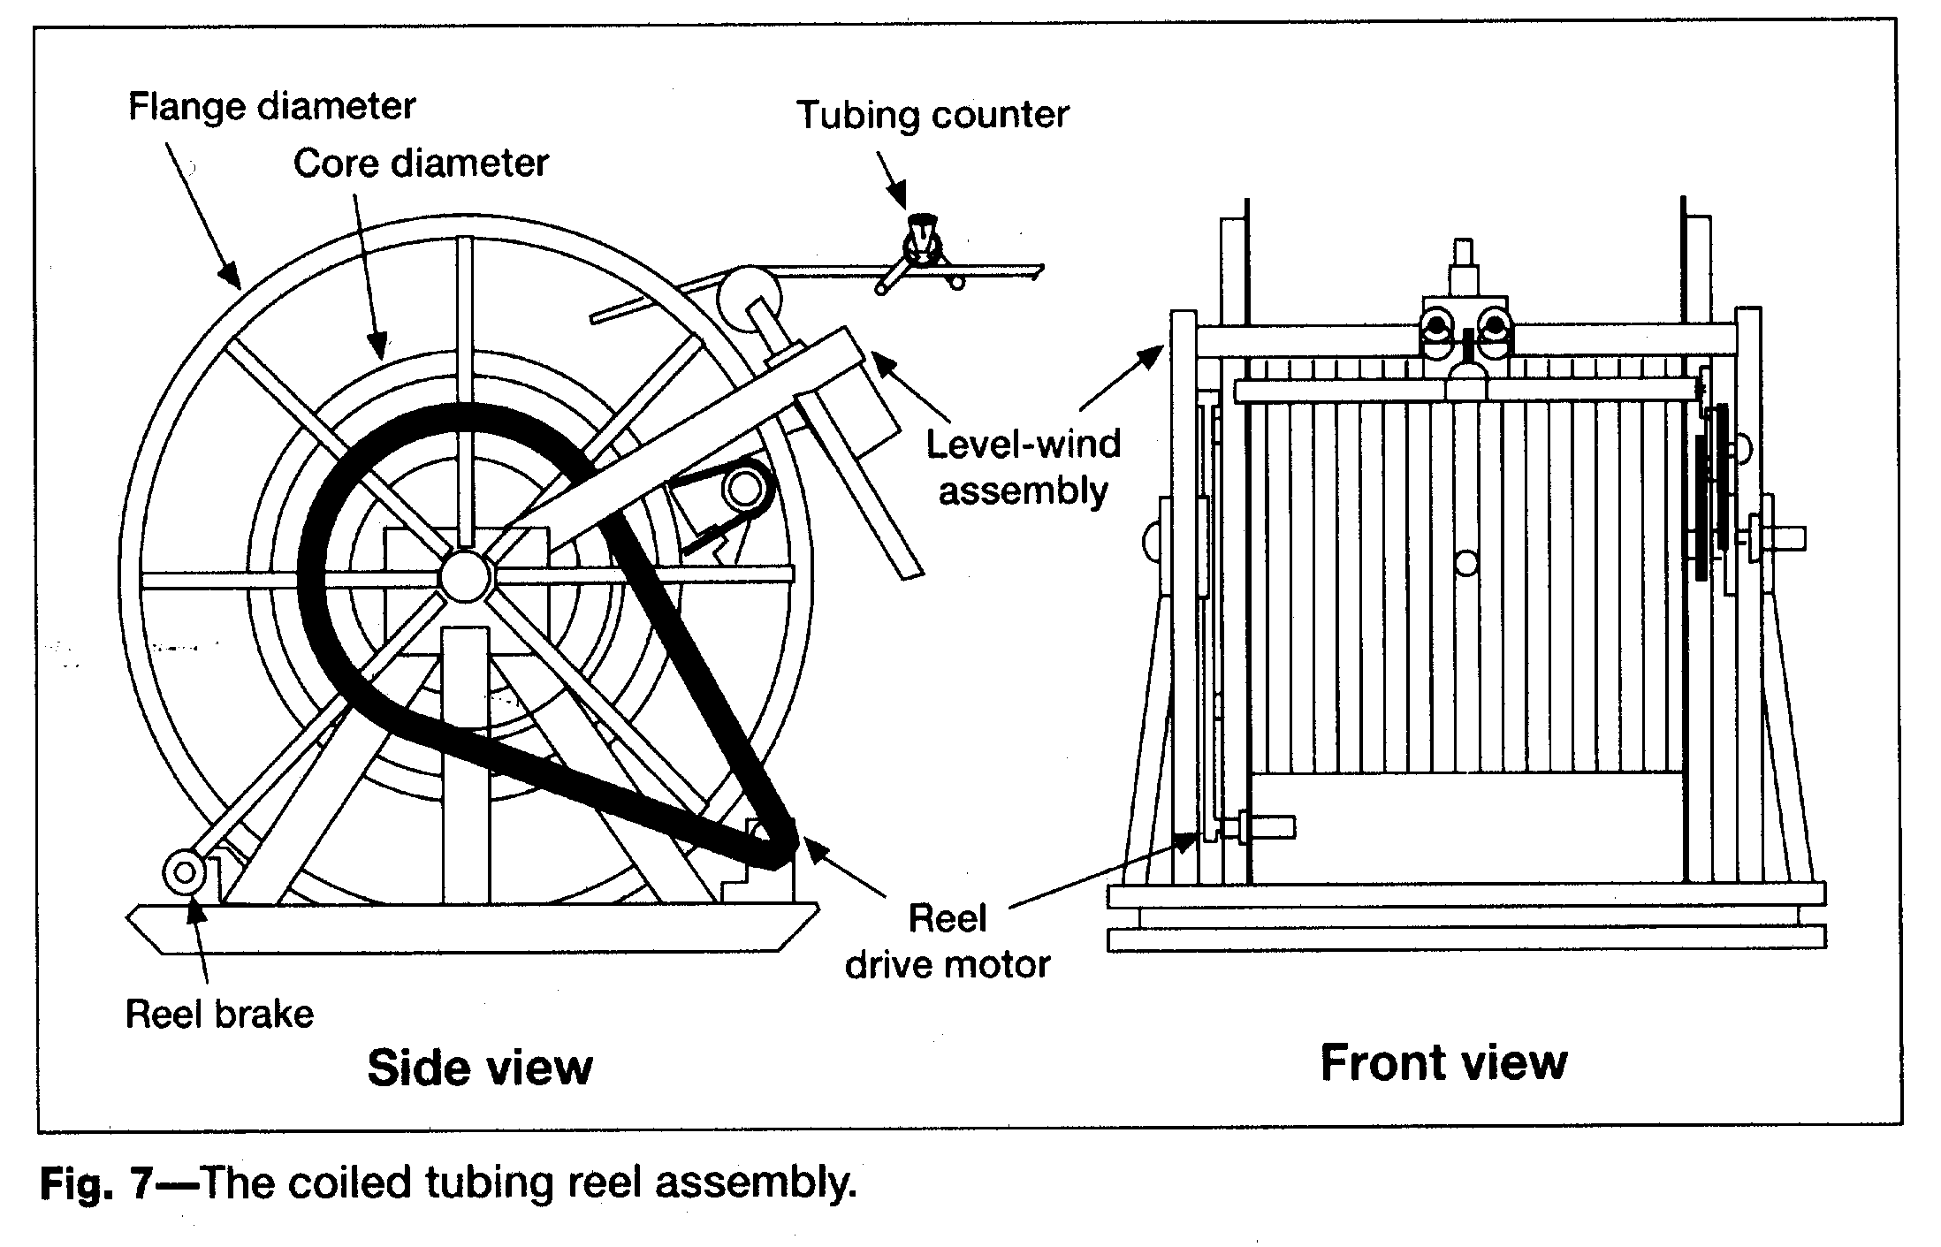
Coiled Tubing Reel Assembly

Slide 6
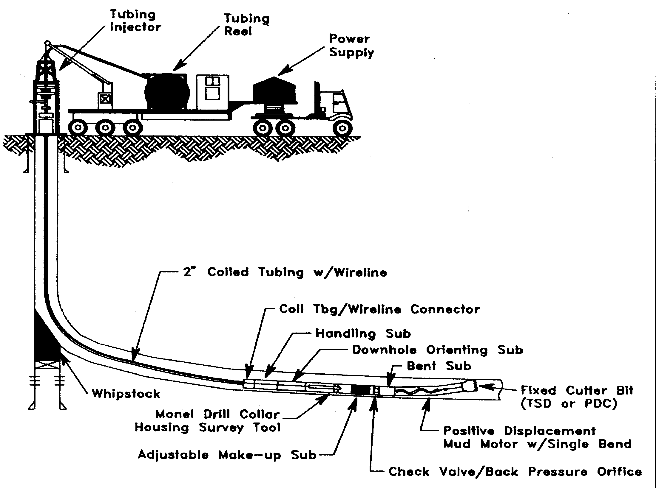

Slide 7
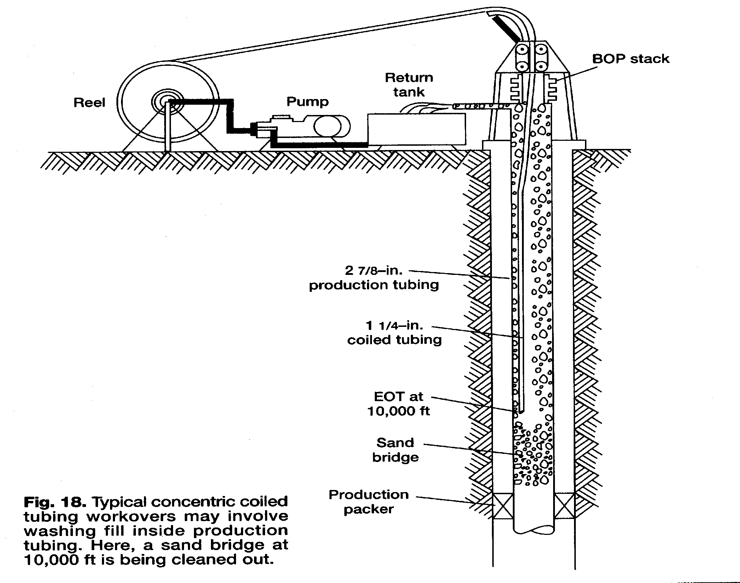

Slide 8
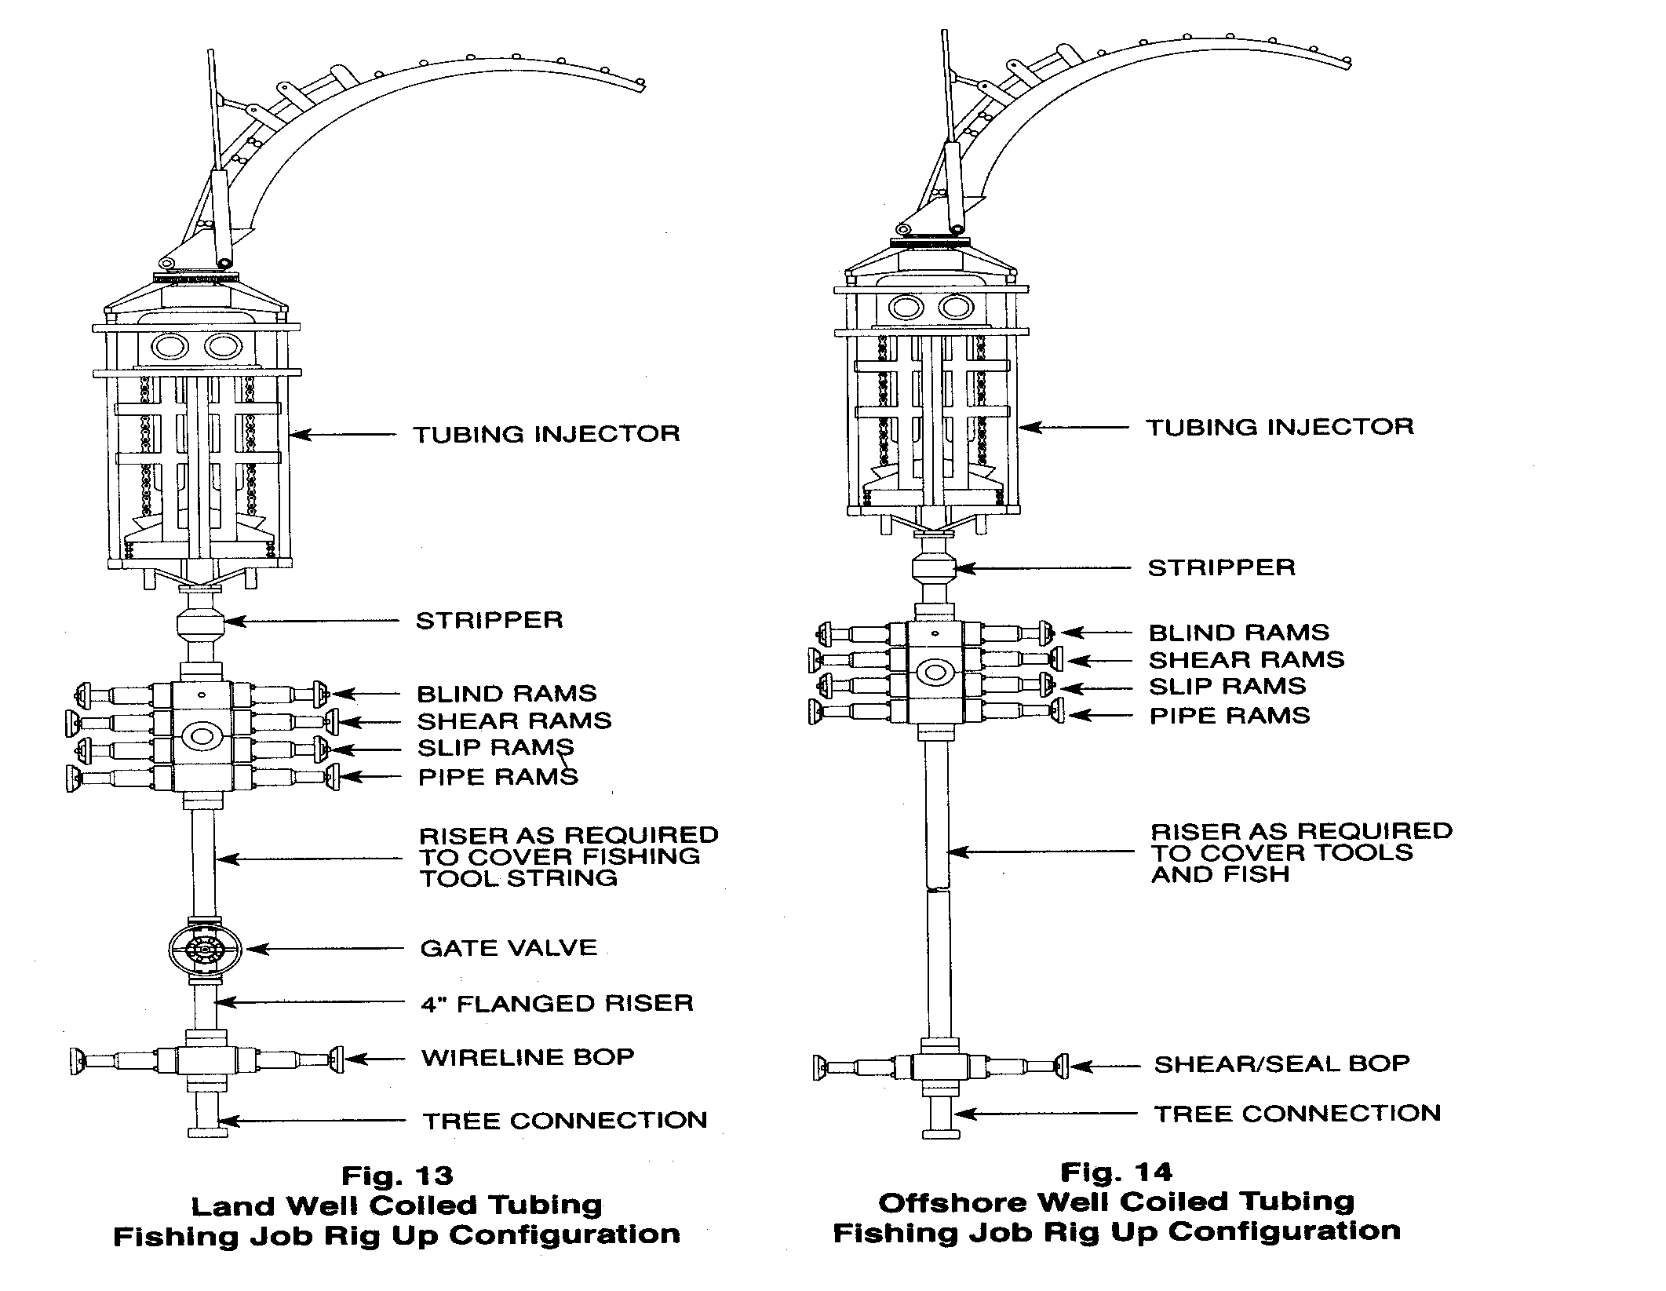

Slide 9
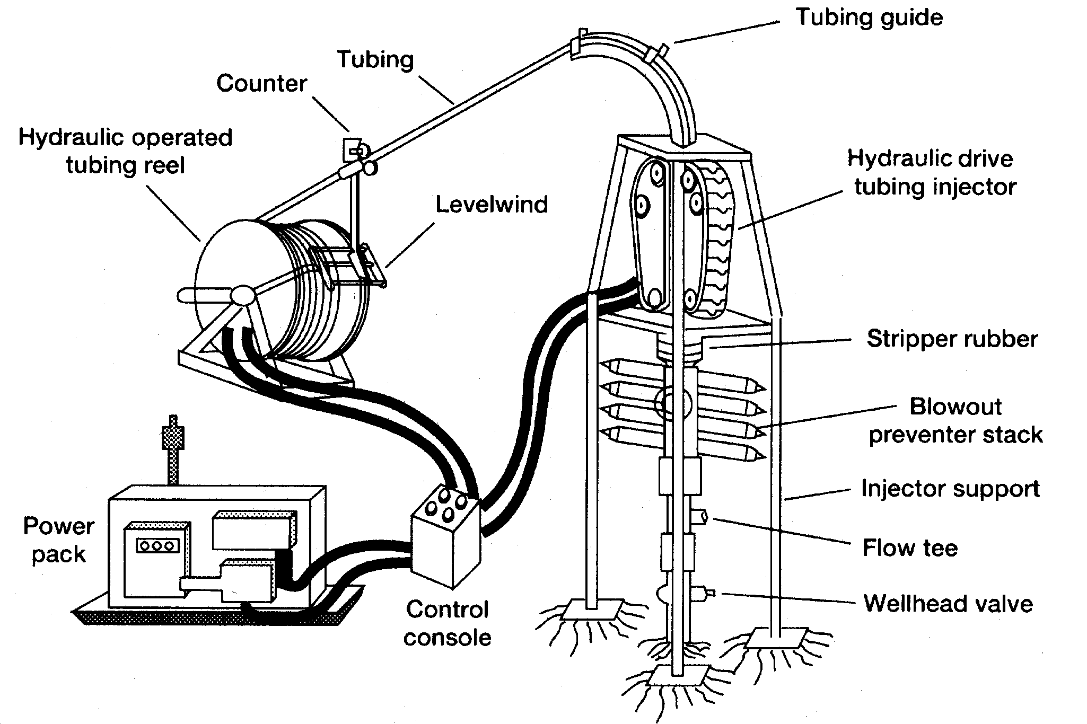
Hydraulic Coiled Tubing Unit

Slide 10
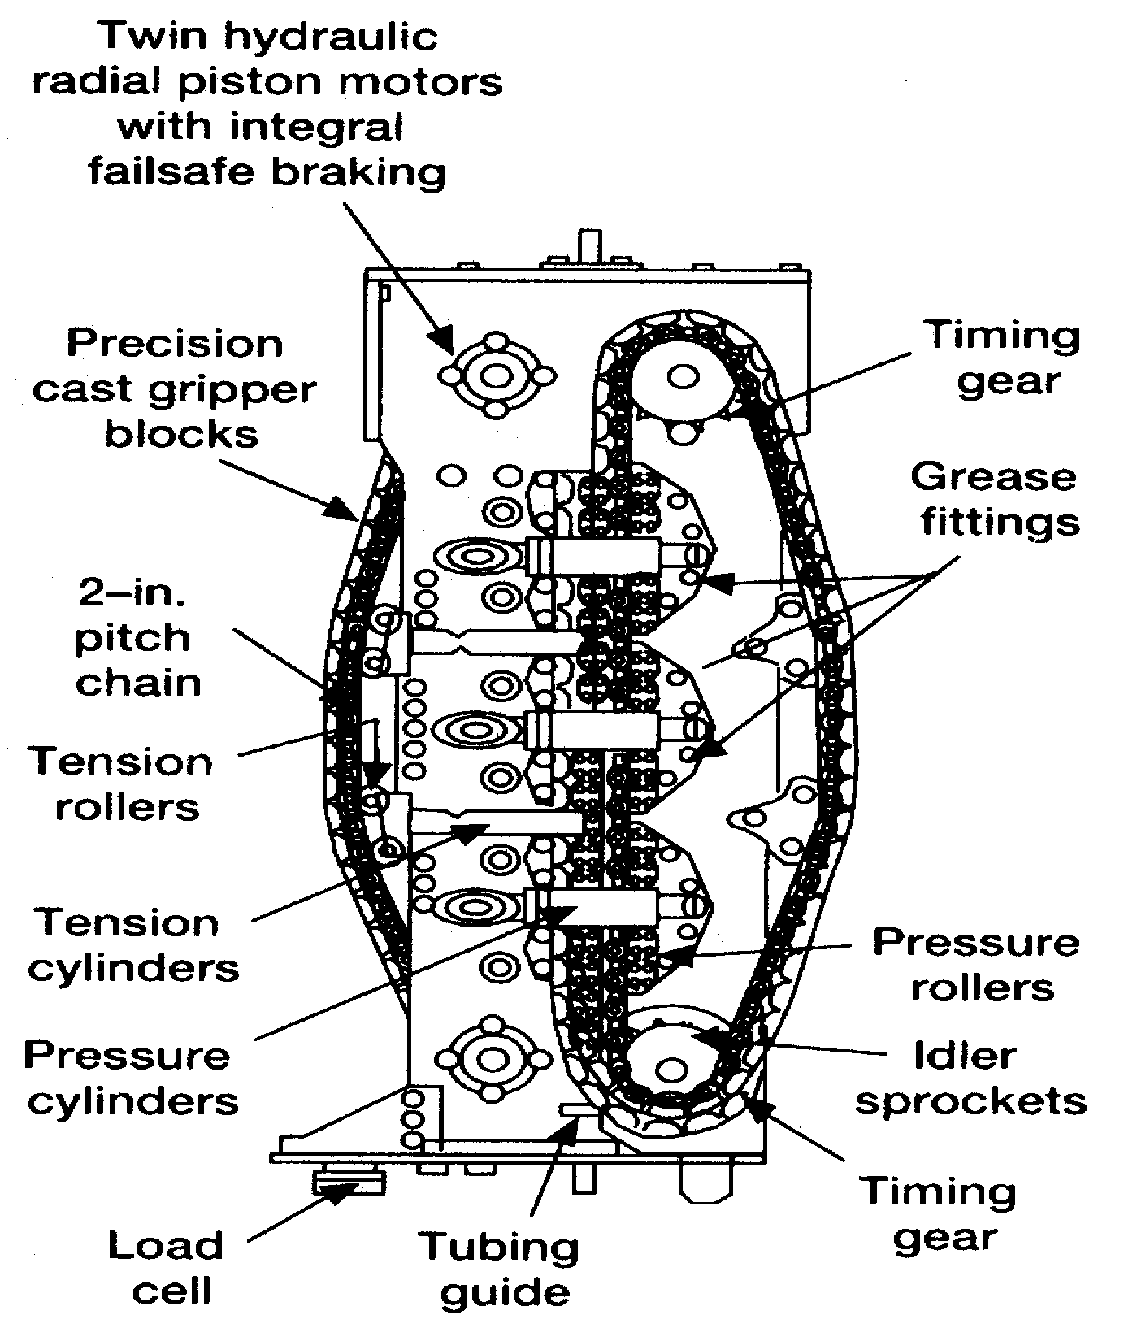
Cut-away view of the Injector Head Drive Assembly

Slide 11
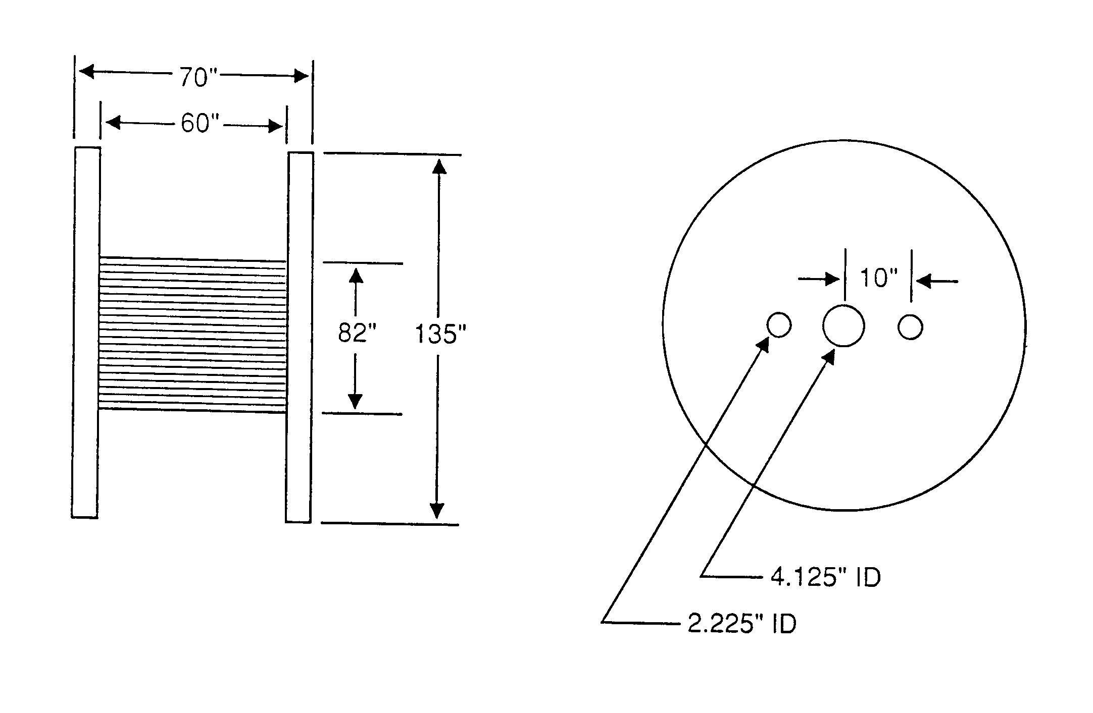

Slide 12
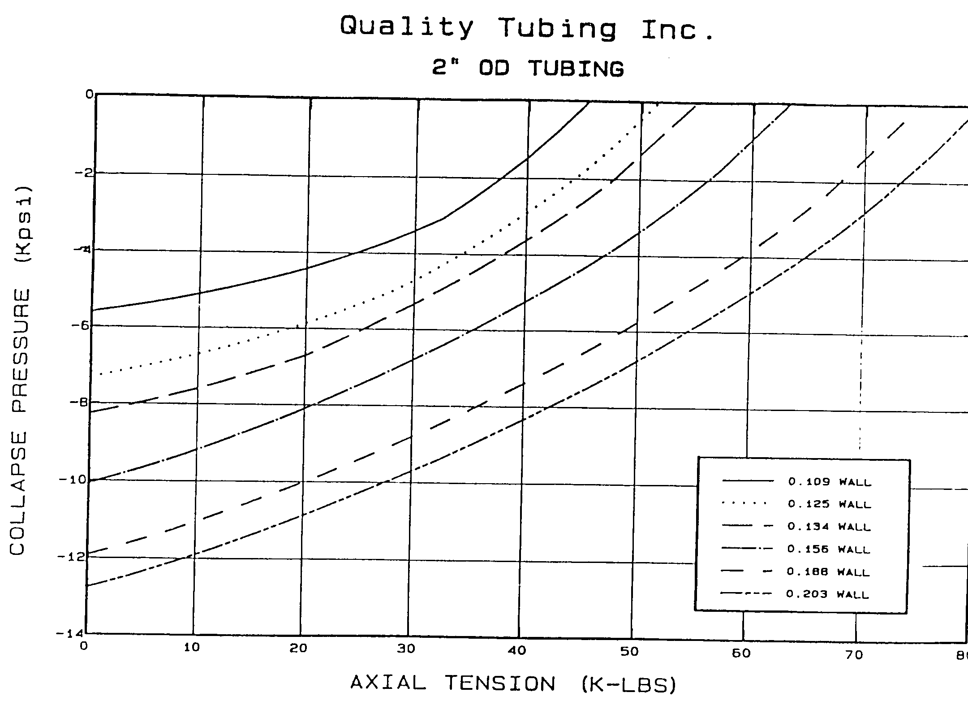

Slide 13
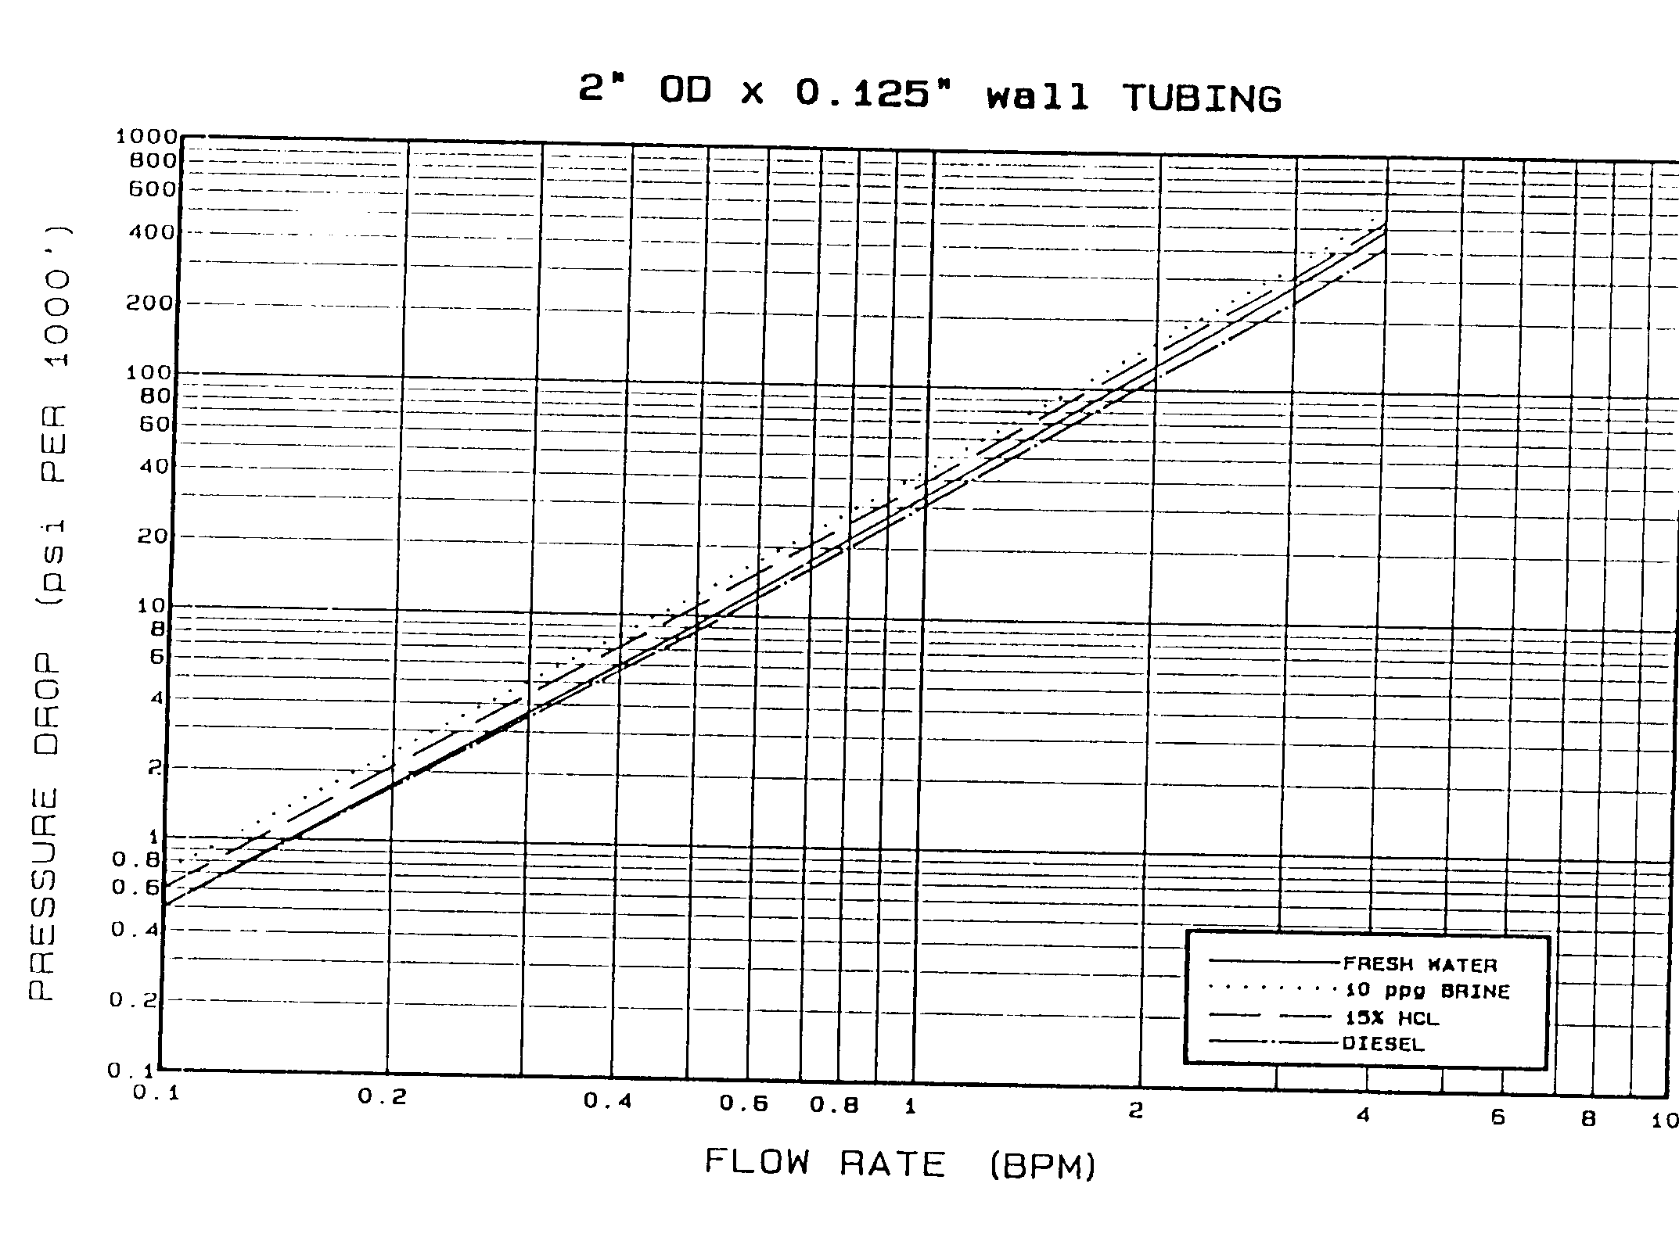

Slide 14
Some Applications of Coiled Tubing
Cementing
  Plug Cementing (e.g. P&A)
  Squeeze Cementing
Logging
Drilling
Producing
Fishing
Scale Removal
Ref: SPE Reprint Series NO. 38 “Coiled Tubing Technology”

Slide 15
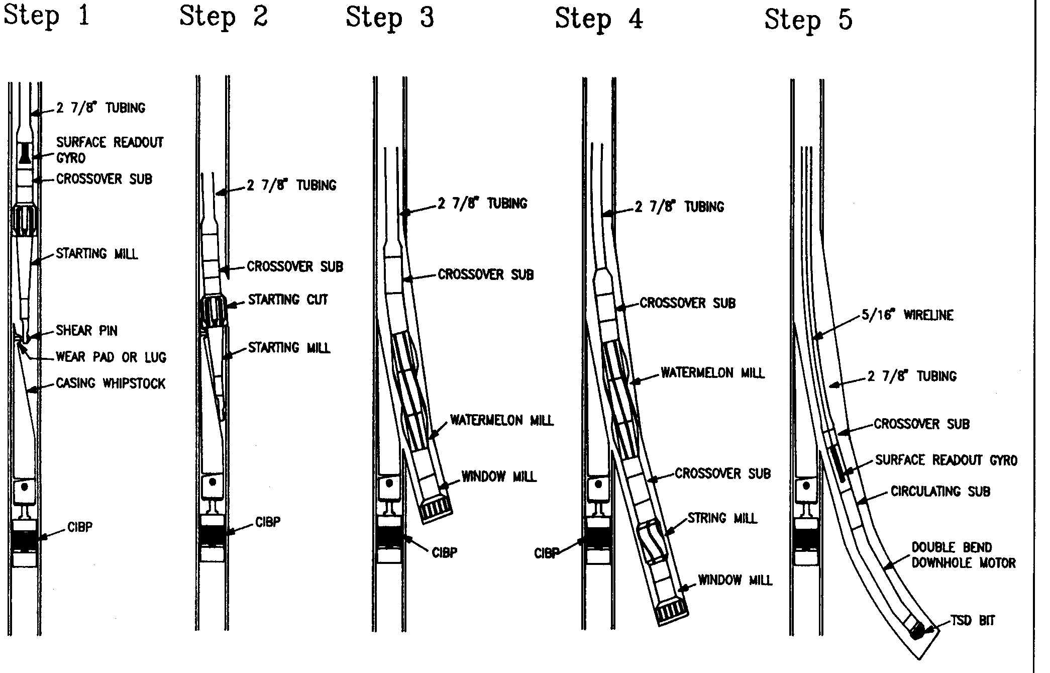
Sidetrack Procedure

Slide 16
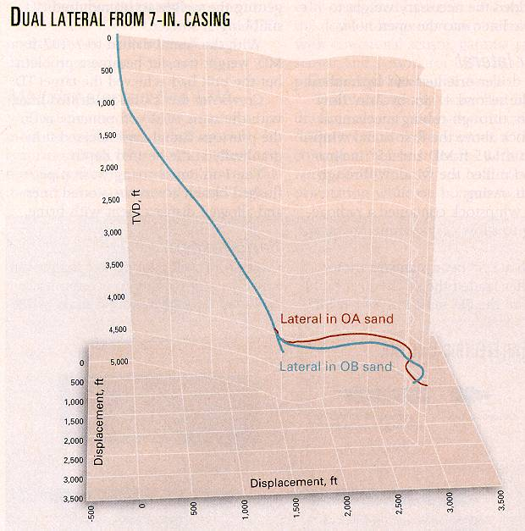
From OGJ
July 8, 2002
p.62
Coil Tubing Drilling on the North Slope

Slide 17
Coil Tubing Drilling on the North Slope
Drilling Rates routinely in excess of 250 ft/hr - drilling in sandstone
Laterals longer than 2,500 ft
Good incremental oil production
Used electrical umbilical for MWD
Used mud motors and 3 ¾-in PDC bits

Slide 18
Advantages
No rig required
No connections - fast tripping
Disadvantages
Fatigue life limit (cycles)
Pressure and tension
Diameter and ovality

Slide 19
Reference:
“Coiled Tubing Buckling Implication in Drilling and Completing Horizontal Wells” by Jiang Wu and H.C. Juvkam-Wold, SPE Drilling and Completion, March, 1995.

Slide 20
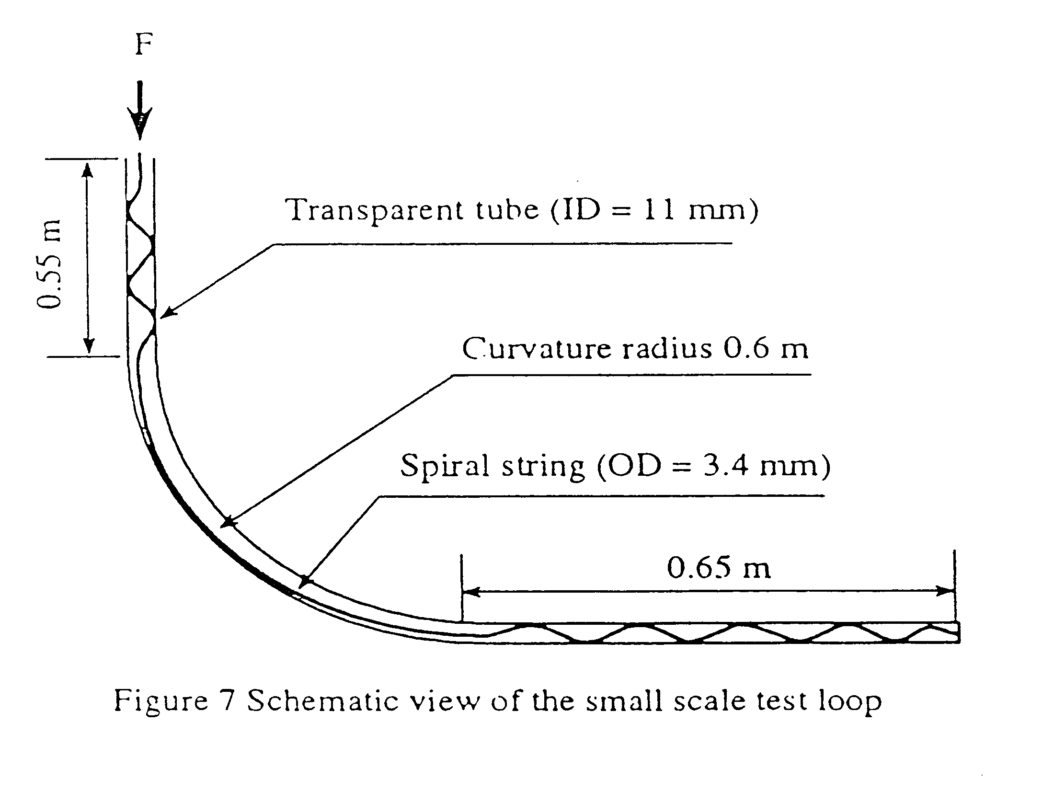

Slide 21
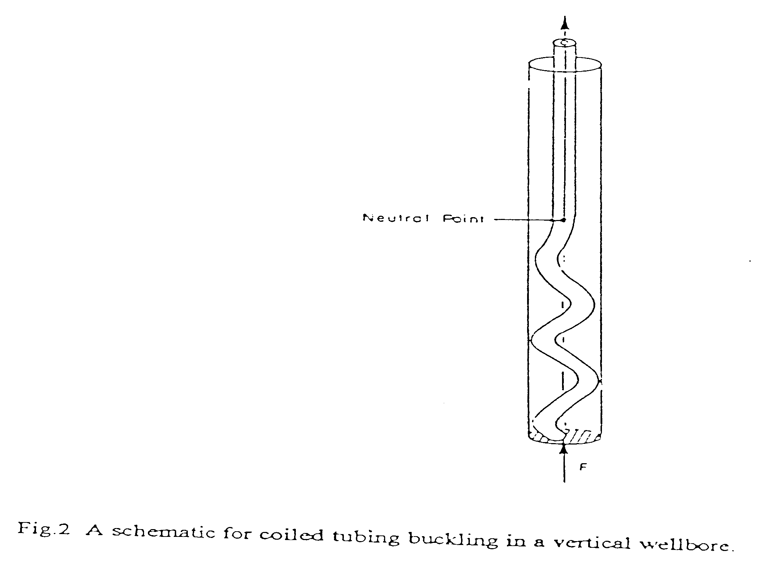

Slide 22
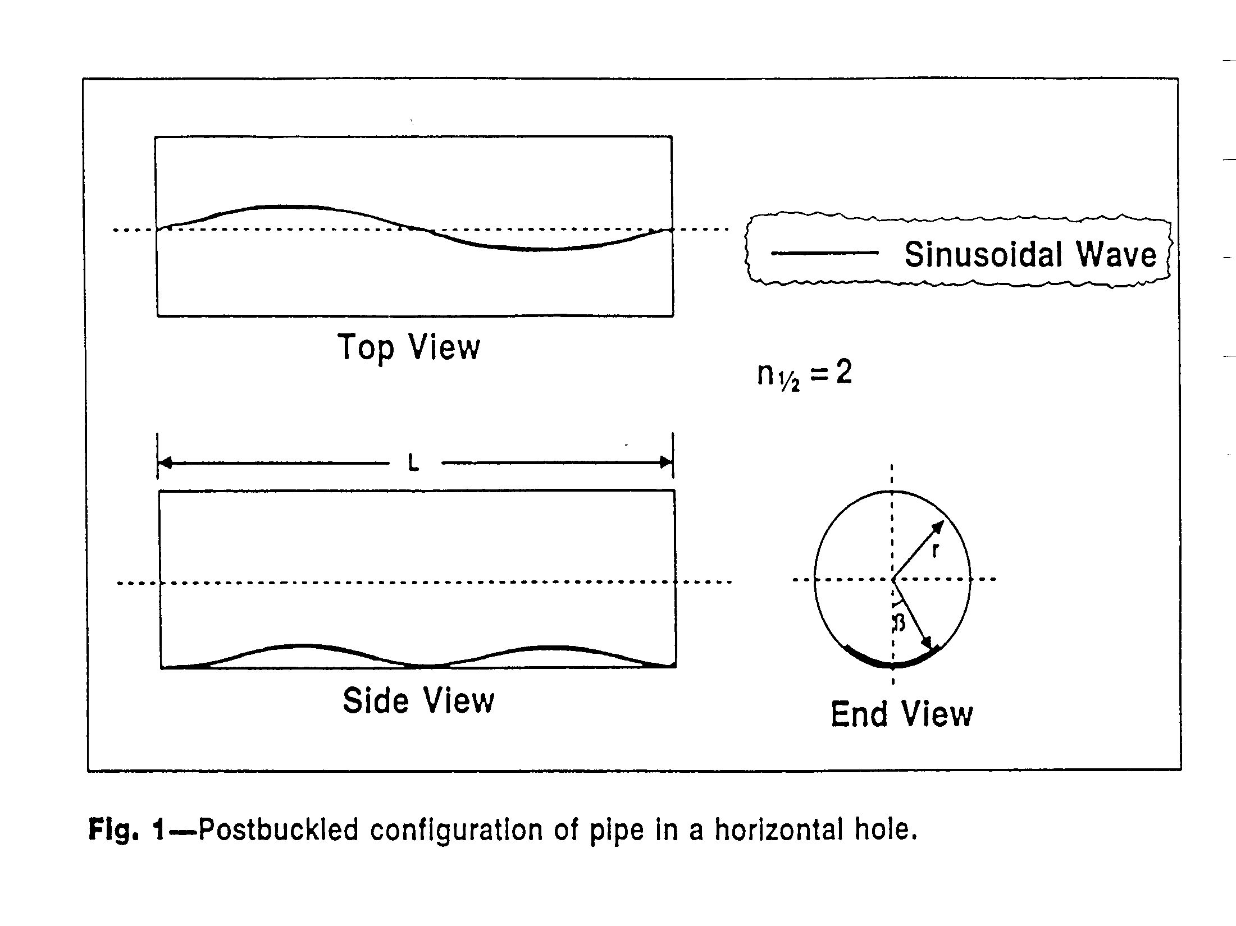

Slide 23
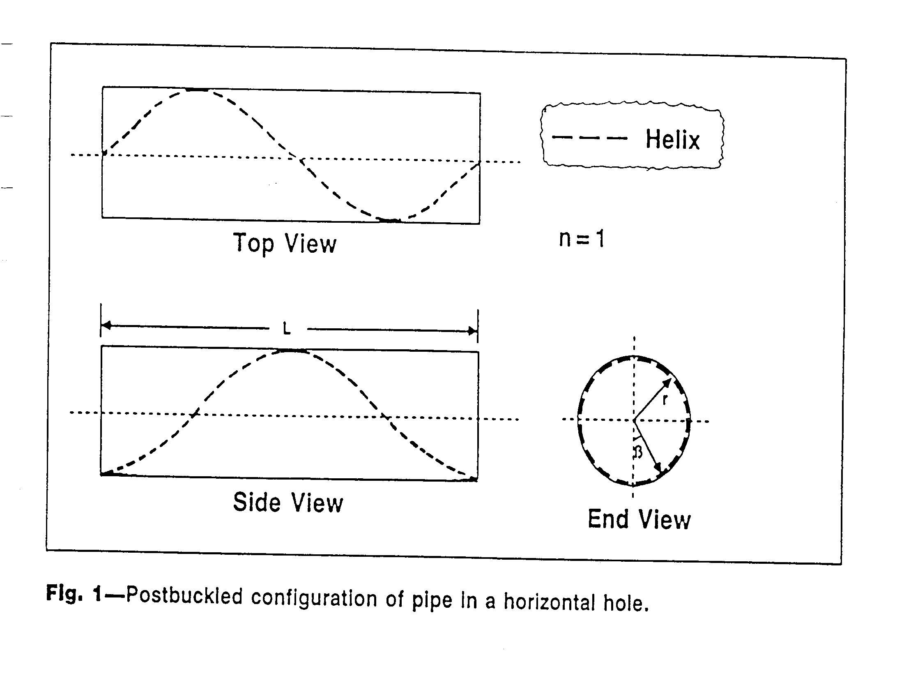

Slide 24
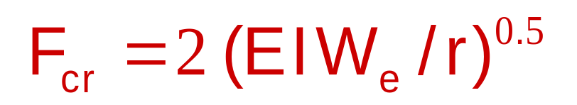
Sinusoidal Buckling in a Horizontal Wellbore
When the axial compressive load along the coiled tubing reaches the following sinusoidal buckling load F_{cr}, the intial (sinusoidal or critical) buckling of the coiled tube will occur in the horizontal wellbore.
r

Slide 25

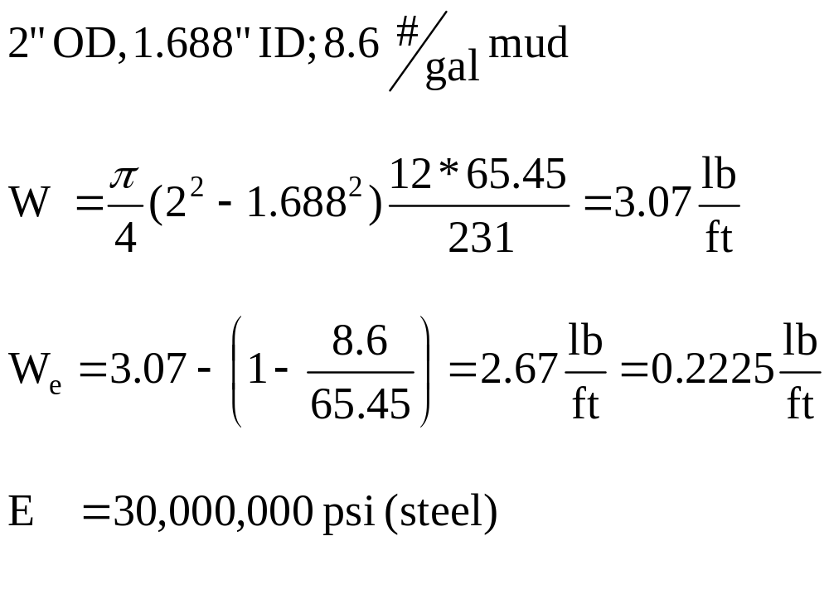
Consider:
*
in

Slide 26
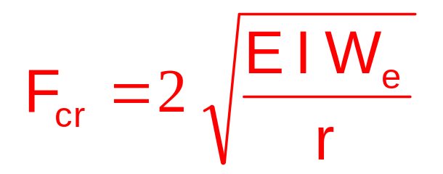
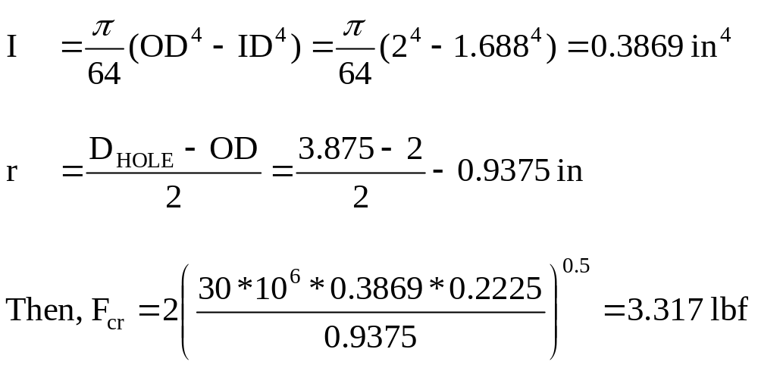
Consider:
=
,

Slide 27
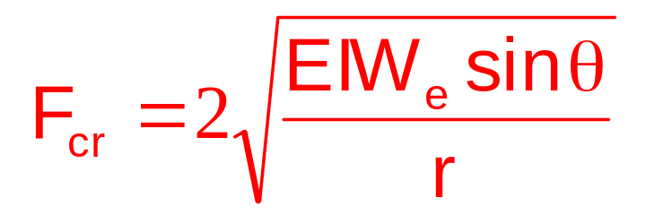
Sinusoidal Buckling Load
A more general Sinusoidal Buckling Load equation for highly inclined wellbores (including the horizontal wellbore) is:
θ

Slide 28
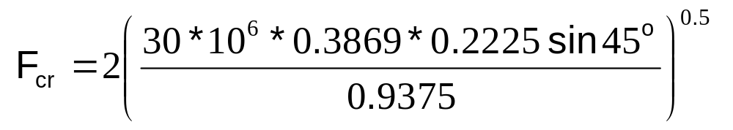
Sinusoidal Buckling Load
For the same 2” OD coiled tubing, at θ = 45º
F_{cr} = 2,789 lbf

Slide 29
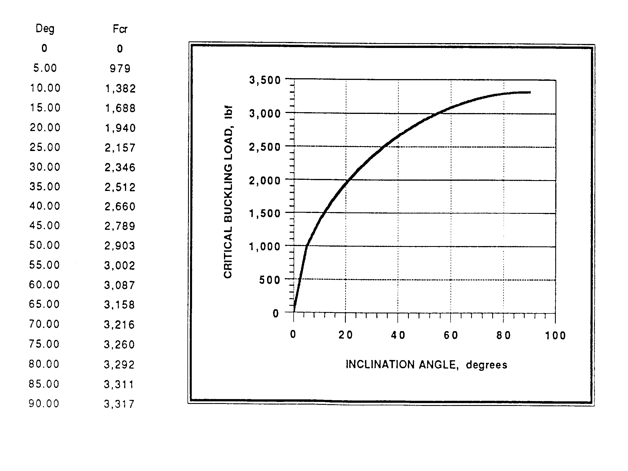

Slide 30
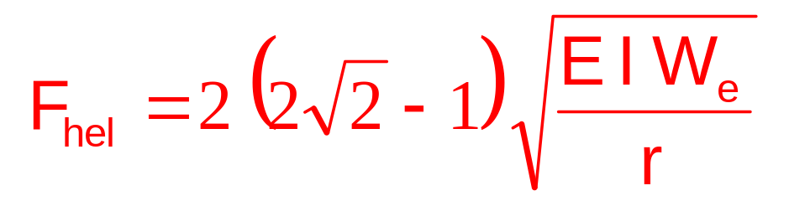
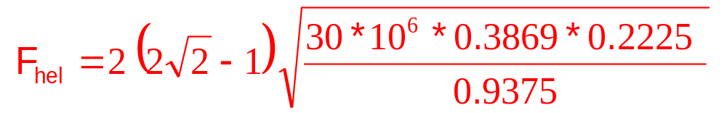
Helical Buckling in a Horizontal Wellbore
When the axial compressive load reaches the following helical buckling load F_{hel} in the horizontal wellbore, the helical buckling of coiled tubing then occurs:
F_{hel} = 6,065 lbf

Slide 31
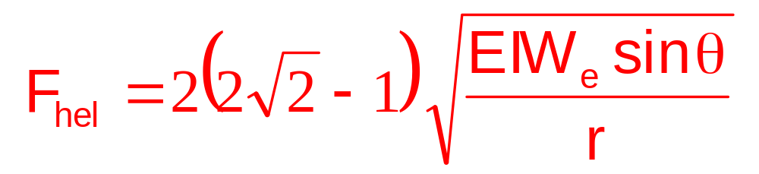
General Equation
A more general helical buckling load equation for highly inclined wellbores (including the horizontal wellbore) is:

Slide 32
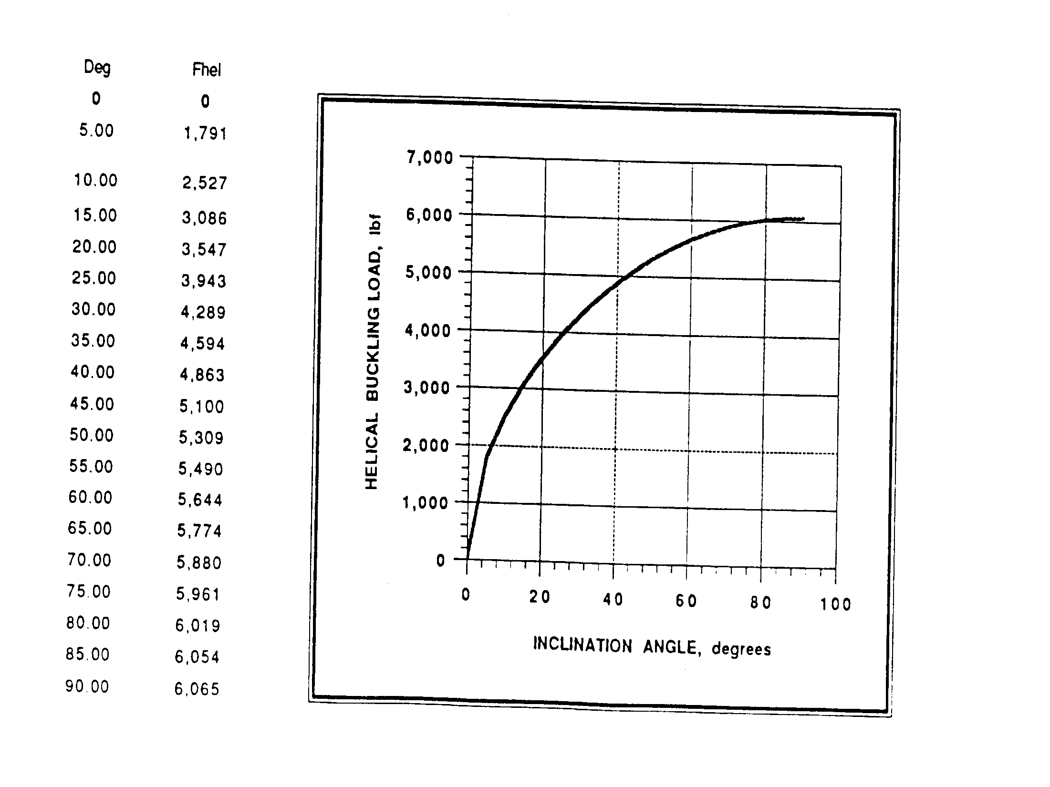

Slide 33
Buckling in Vertical Wellbores:
In a vertical wellbore, the buckling of coiled tubing will occur if the coiled tubing becomes axially compressed and the axial compressive load exceeds the buckling load in the vertical section.
This could happen when we “slack-off” weight at the surface to apply bit weight for drilling and pushing the coiled tubing through the build section and into the horizontal section.

Slide 34
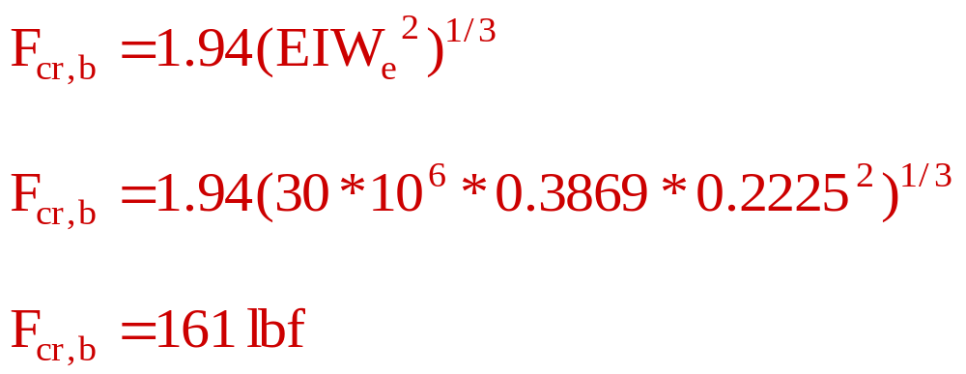
Buckling in Vertical Wellbores:
Lubinski derived in the 1950’s the following buckling load equation for the initial buckling of tubulars in vertical wellbores:

Slide 35
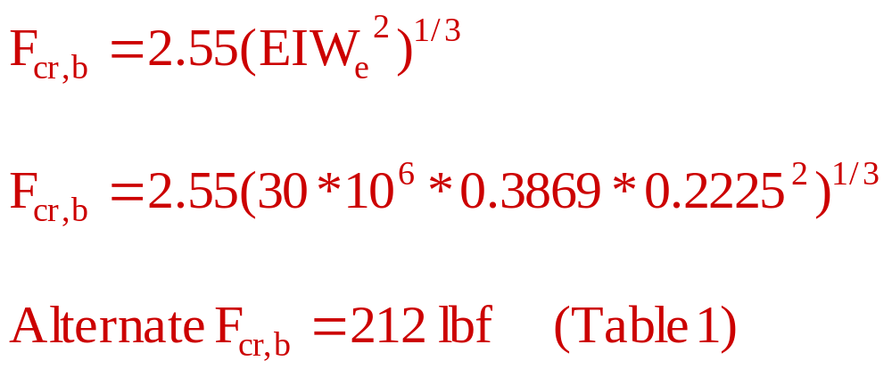
Buckling in Vertical Wellbores:
Another intitial buckling load equation for tubulars in vertical wellbores was also derived recently through an energy analysis:

Slide 36
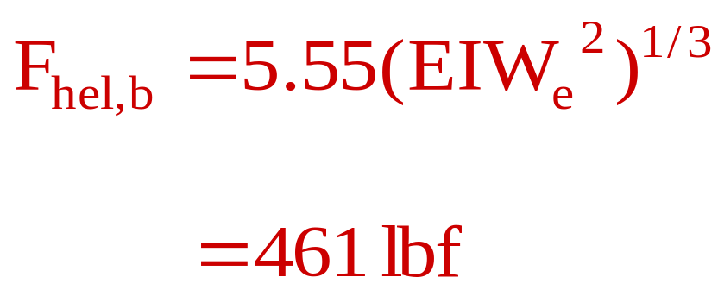
Helical Buckling in Vertical Wellbores:
A helical buckling load for weighty tubulars in vertical wellbores was also derived recently through an energy analysis to predict the occurrence of the helical buckling:

Slide 37
Helical Buckling in Vertical Wellbores:
This helical buckling load predicts the first occurrence of helical buckling of the weighty tubulars in the vertical wellbore. The first occurrence of helical buckling in the vertical wellbore will be a one-pitch helical buckle at the bottom portion of the tubular.

Slide 38
Helical Buckling in Vertical Wellbores:
The upper portion of the tubular in the vertical wellbore will be in tension and remain straight. When more tubular weight is slacked-off at the surface, and the helical buckling becomes more than one helical pitch, the above helical buckling load equation may be used for the top helical pitch of the helically buckled tubular

Slide 39
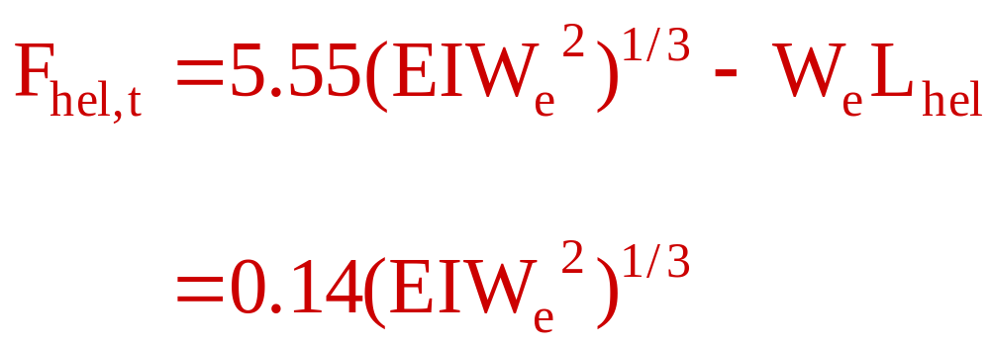
Helical Buckling in Vertical Wellbores:
The top helical buckling load F_{hel,t} is calculated by simply subtracting the tubular weight of the initial one-pitch of helically buckled pipe from the helical buckling load F_{hel,b}, which is defined at the bottom of the one-pitch helically buckled tubular:

Slide 40
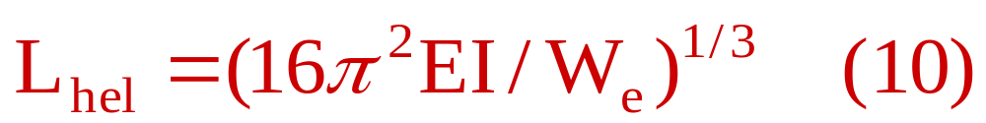
Helical Buckling in Vertical Wellbores:
Where the length of the initial one-pitch of helical buckling or the first order helical buckling is:

Slide 41
Helical Buckling in Vertical Wellbores:
From Table 1, it is also amazing to find out that the top helical buckling load, F_{hel,t}, is very close to zero. This indicates that the “neutral point”, which is defined as the place of zero axial load (effective axial load exclusive from the hydrostatic pressure force), could be approximately used to define the top of the helical buckling for these coiled tubings.

Slide 42
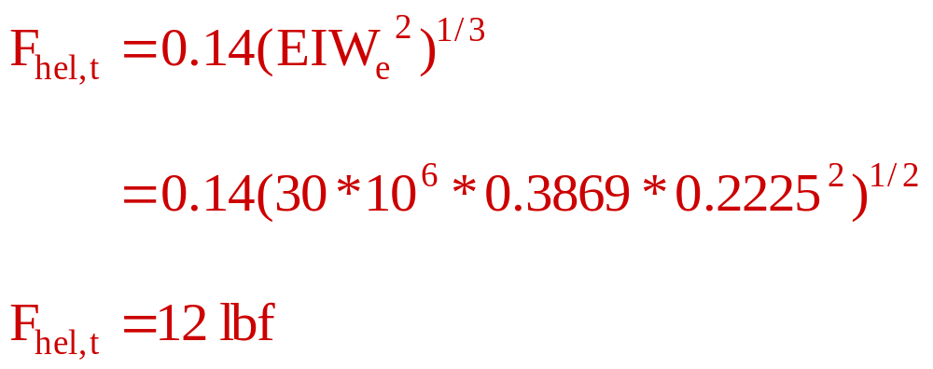
Helical Buckling in Vertical Wellbores:

Slide 43
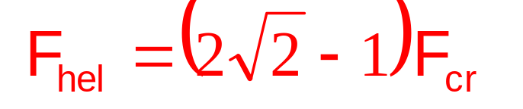
Buckling of 2” x 1.688” CT
Horizontal
Sinusoidal:
= 3,317 lbf
Helical:
= 6,065 lbf

Slide 44
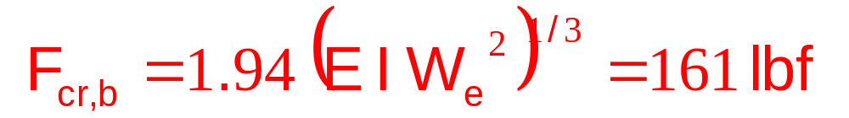
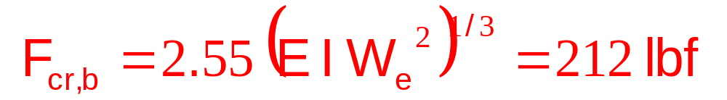
Buckling of 2” x 1.688” CT
Vertical
Sinusoidal, bottom:
or

Slide 45
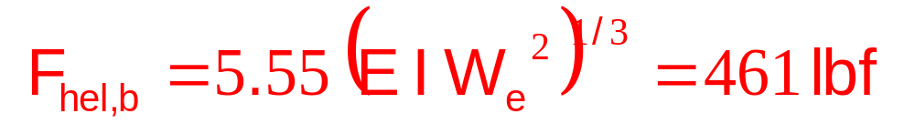
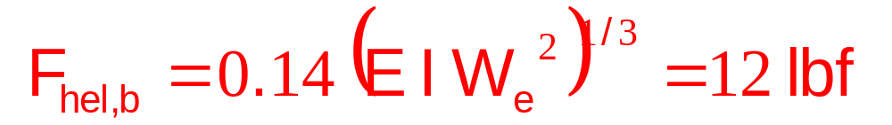
Buckling of 2” x 1.688” CT
Vertical
Helical, bottom:
Helical, top:

