Slide 2
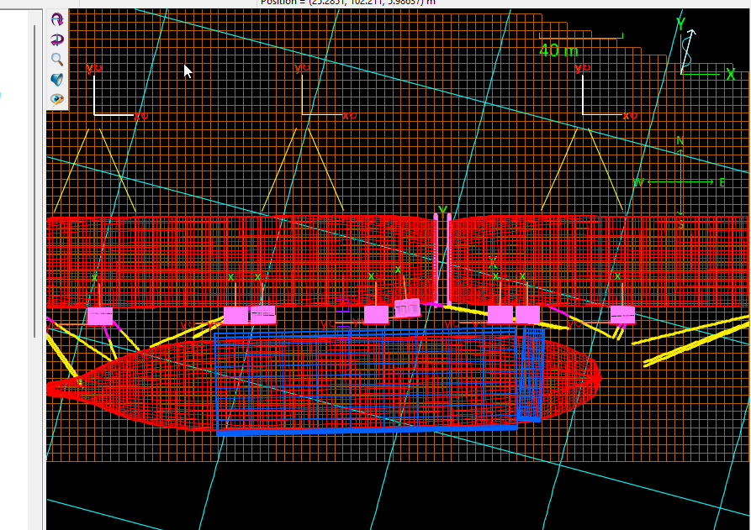
Layout
Wind Direction
Wind Sway Coeff
FST2: 75 deg = 0.07
LNGC: 255 deg = 0.97
100 Te
400 Te

Slide 3
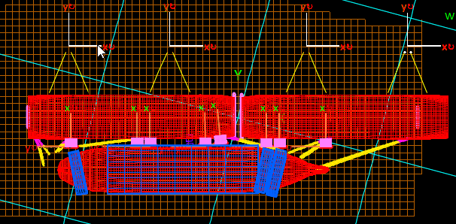
Port
Starboard
From Model Test
Transformation?

Slide 4
Transformation | Physical Reasoning
Physical:
LNGC rotated by 180 deg.
When LNGC by itself, we have nominal (OCIMF) coefficients
Port Berthing (Data Available):
Wind shielding local vessel directions are : 180 to 360
Only 180 to 360 deg data are factored (by shield factors) compared to OCIMF coeffs
0 to 180 deg, no change
Starboard Berthing:
Wind shielding local vessel directions are : 0 to 180
Factor 0 to 180 deg data
Unfactor: 180 to 360 data

Slide 5
Transformation | From Port Model test data to Starboard
LNGC rotated by 180 deg
The local angles are rotated by 180 deg
The Surge coefficients are multiplied by -1
The Sway coefficients are multiplied by -1

Slide 6
Case study (90 Beam Seas) , Sway Coeff
Port
-0.07
0.07
Starboard
From Model Test
1.0
-1.0

Slide 7
Case study (45 Beam Seas), Sway Coeff
Port
Starboard
From Model Test
-0.60 (Theoretical)
+0.48 (used)
0.60

Slide 8
Case study (0 deg Following Seas), Surge Coeff
Port
Starboard
From Model Test
0.625
-0.625

Slide 9
Case study (45 Beam Seas), Surge Coeff
Port
Starboard
From Model Test
-0.605 (Theoretical)
- 0.611 (used)
0.605

