Slide 1
Webinar 33
Rainflow Cycle Counting for Random Vibration Fatigue Analysis
By Tom Irvine

Slide 2
Introduction
Structures & components must be designed and tested to withstand vibration environments
Components may fail due to yielding, ultimate limit, buckling, loss of sway space, etc.
Fatigue is often the leading failure mode of interest for vibration environments, especially for random vibration
Dave Steinberg wrote:
The most obvious characteristic of random vibration is that it is nonperiodic. A knowledge of the past history of random motion is adequate to predict the probability of occurrence of various acceleration and displacement magnitudes, but it is not sufficient to predict the precise magnitude at a specific instant.

Slide 3
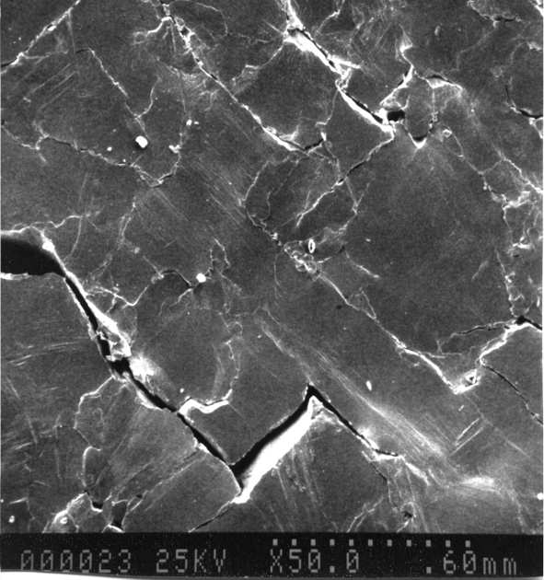
Fatigue Cracks
A ductile material subjected to fatigue loading experiences basic structural changes. The changes occur in the following order:
Crack Initiation. A crack begins to form within the material.
Localized crack growth. Local extrusions and intrusions occur at the surface of the part because plastic deformations are not completely reversible.
Crack growth on planes of high tensile stress. The crack propagates across the section at those points of greatest tensile stress.
Ultimate ductile failure. The sample ruptures by ductile failure when the crack reduces the effective cross section to a size that cannot sustain the applied loads.

Slide 4
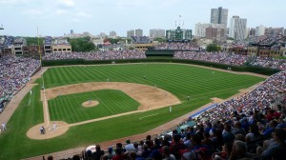
Some Caveats
Vibration fatigue calculations are “ballpark” calculations given uncertainties in S-N curves, stress concentration factors, non-linearity, temperature and other variables.
Perhaps the best that can be expected is to calculate the accumulated fatigue to the correct “order-of-magnitude.”

Slide 5

Rainflow Fatigue Cycles
Endo & Matsuishi 1968 developed the Rainflow Counting method by relating stress reversal cycles to streams of rainwater flowing down a Pagoda. ASTM E 1049-85 (2005) Rainflow Counting Method
Goju-no-to Pagoda, Miyajima Island, Japan

Slide 6
Sample Time History

Slide 7
Rainflow Cycle Counting
Rotate time history plot 90 degrees clockwise
Rainflow Cycles by Path
Path | Cycles | Stress Range
A-B | 0.5 | 3
B-C | 0.5 | 4
C-D | 0.5 | 8
D-G | 0.5 | 9
E-F | 1.0 | 4
G-H | 0.5 | 8
H-I | 0.5 | 6

Slide 8
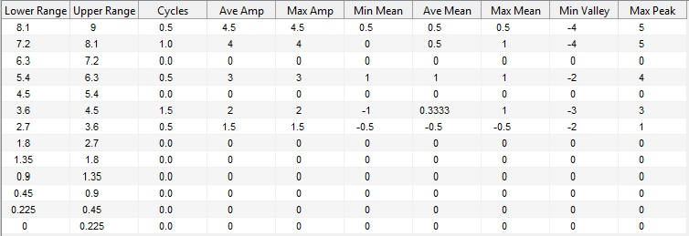
Rainflow Results in Table Format - Binned Data
Range = (peak-valley)
Amplitude = (peak-valley)/2
(But I prefer to have the results in simple amplitude & cycle format for further calculations)

Slide 9
Use of Rainflow Cycle Counting
Can be performed on sine, random, sine-on-random, transient, steady-state, stationary, non-stationary or on any oscillating signal whatsoever
Evaluate a structure’s or component’s failure potential using Miner’s rule & S-N curve
Compare the relative damage potential of two different vibration environments for a given component
Derive maximum predicted environment (MPE) levels for nonstationary vibration inputs
Derive equivalent PSDs for sine-on-random specifications
Derive equivalent time-scaling techniques so that a component can be tested at a higher level for a shorter duration
And more!

Slide 10
Rainflow Cycle Counting – Time History Amplitude Metric
Rainflow cycle counting is performed on stress time histories for the case where Miner’s rule is used with traditional S-N curves
Can be used on response acceleration, relative displacement or some other metric for comparing two environments

Slide 11
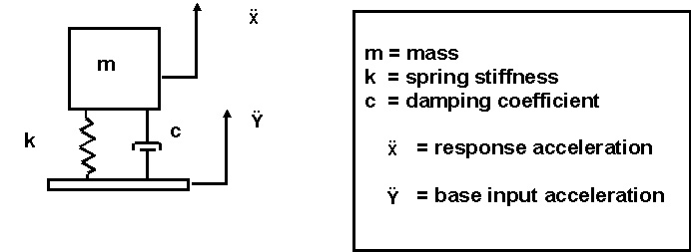
For Relative Comparisons between Environments . . .
The metric of interest is the response acceleration or relative displacement
Not the base input!
If the accelerometer is mounted on the mass, then we are good-to-go!
If the accelerometer is mounted on the base, then we need to perform intermediate calculations

Slide 12
Bracket Example, Variation on a Steinberg Example
Power Supply
Aluminum Bracket
Solder Terminal
0.25 in
4.7 in
2.0 in
5.5 in
6.0 in
Power Supply Mass | M = 0.44 lbm= 0.00114 lbf sec^2/in
Bracket Material | Aluminum alloy 6061-T6
Mass Density | ρ=0.1 lbm/in^3
Elastic Modulus | E= 1.0e+07 lbf/in^2
Viscous Damping Ratio | 0.05

Slide 13
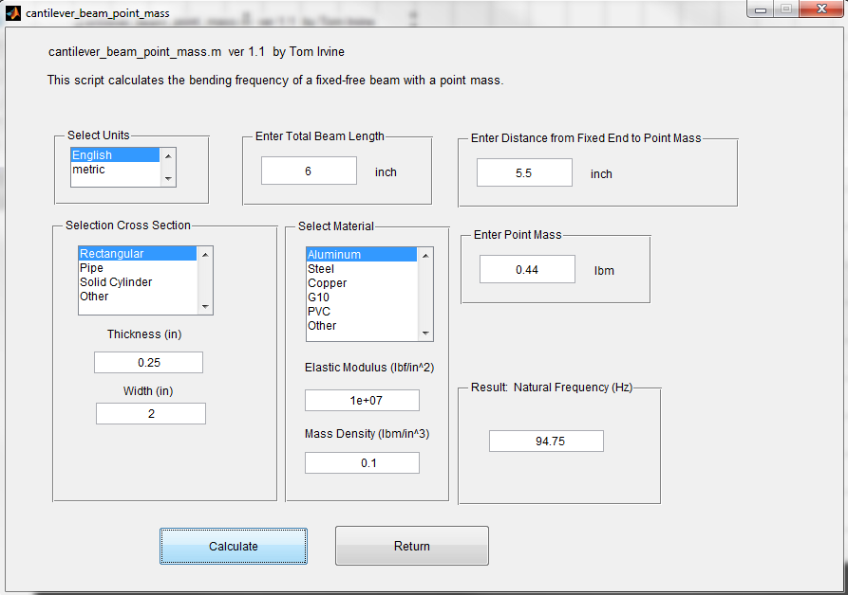
Bracket Natural Frequency via Rayleigh Method

Slide 14
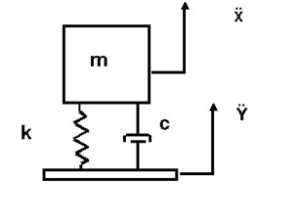
Bracket Response via SDOF Model
Treat bracket-mass system as a SDOF system for the response to base excitation analysis. Assume Q=10.

Slide 15
Base Input PSD
Base Input PSD, 6.1 GRMS
Frequency (Hz) | Accel (G^2/Hz)
20 | 0.0053
150 | 0.04
600 | 0.04
2000 | 0.0036
Now consider that the bracket assembly is subjected to the random vibration base input level. The duration is 3 minutes.

Slide 16
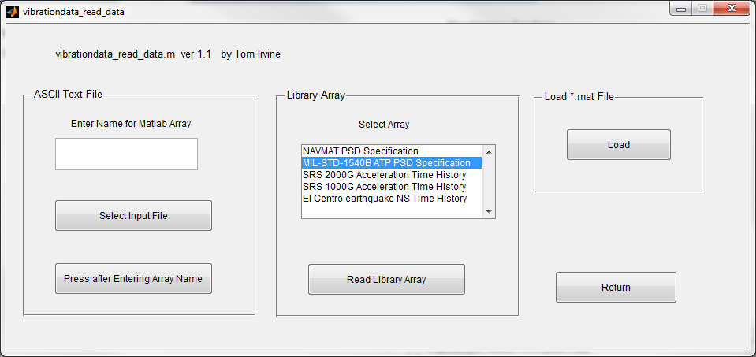
Base Input PSD
The PSD on the previous slide is library array: MIL-STD1540B ATP PSD

Slide 17
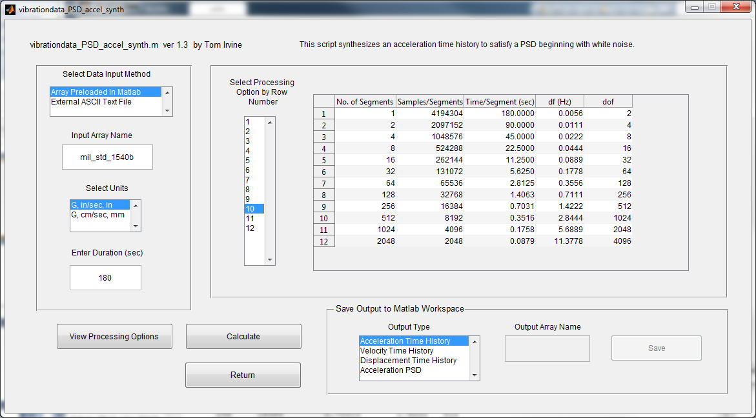
Time History Synthesis

Slide 18
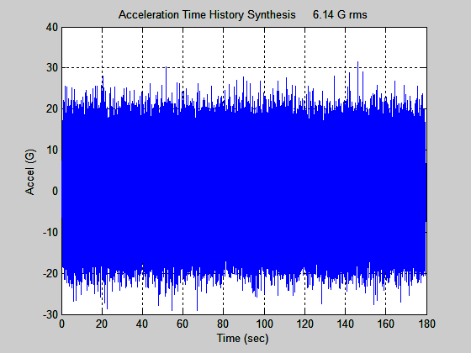
Base Input Time History
Save Time History as: synth
An acceleration time history is synthesized to satisfy the PSD specification
The corresponding histogram has a normal distribution, but the plot is omitted for brevity
Note that the synthesized time history is not unique

Slide 19
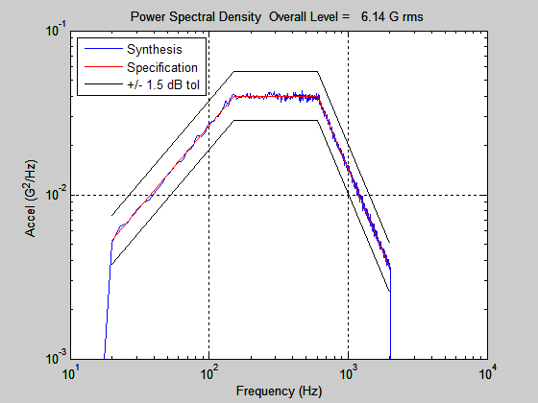
PSD Verification

Slide 20
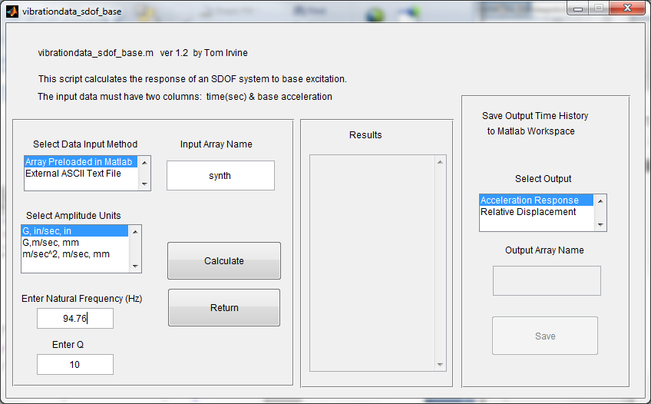
SDOF Response

Slide 21
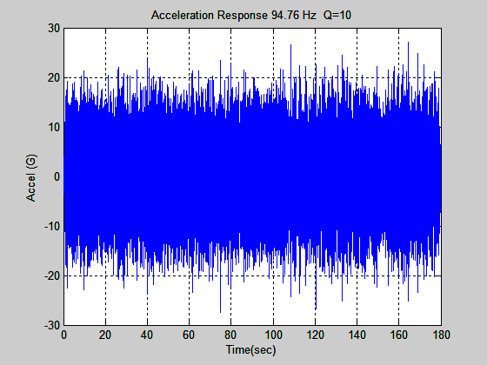
Acceleration Response
Save as: accel_resp
The response is narrowband
The oscillation frequency tends to be near the natural frequency of 94.76 Hz
The overall response level is 6.1 GRMS
This is also the standard deviation given that the mean is zero
The absolute peak is 27.49 G, which represents a 4.53-sigma peak
Some fatigue methods assume that the peak response is 3-sigma and may thus under-predict fatigue damage

Slide 22
Stress & Moment Calculation, Free-body Diagram
L
x
M_{R}
R
F
The reaction moment M _{R} at the fixed-boundary is:
The force F is equal to the effect mass of the bracket system multiplied by the acceleration level.
The effective mass m _{e} is:

Slide 23
Stress & Moment Calculation, Free-body Diagram
The bending moment at a given distance from the force application point is
where A is the acceleration at the force point.
The bending stress S _{b} is given by
The variable K is the stress concentration factor.
The variable C is the distance from the neutral axis to the outer fiber of the beam.
Assume that the stress concentration factor is 3.0 for the solder lug mounting hole.

Slide 24
Stress Scale Factor
= 0.0026 in^4
(Terminal to Power Supply)
= ( 3.0 )( 0.0013 lbf sec^2/in ) (4.7 in) (0.125 in) /(0.0026 in^4)
= 0.881 lbf sec^2/in^3
= 0.881 psi sec^2/in
= 340 psi / G
386 in/sec^2 = 1 G
≅ 0.34 ksi / G

Slide 25
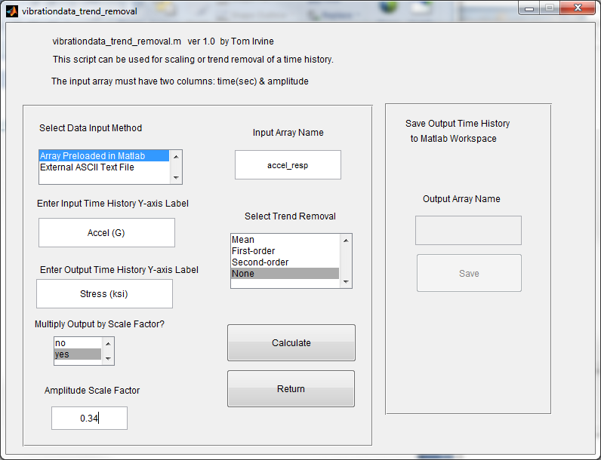
Convert Acceleration to Stress
vibrationdata > Signal Editing Utilities > Trend Removal & Amplitude Scaling

Slide 26

Stress Time History at Solder Terminal
Apply Rainflow Counting on the Stress time history and then Miner’s Rule in the following slides
Save as: stress
The standard deviation is 2.06 ksi
The highest absolute peak is 9.3 ksi, which is 4.53-sigma
The 4.53 multiplier is also referred to as the “crest factor.”

Slide 27
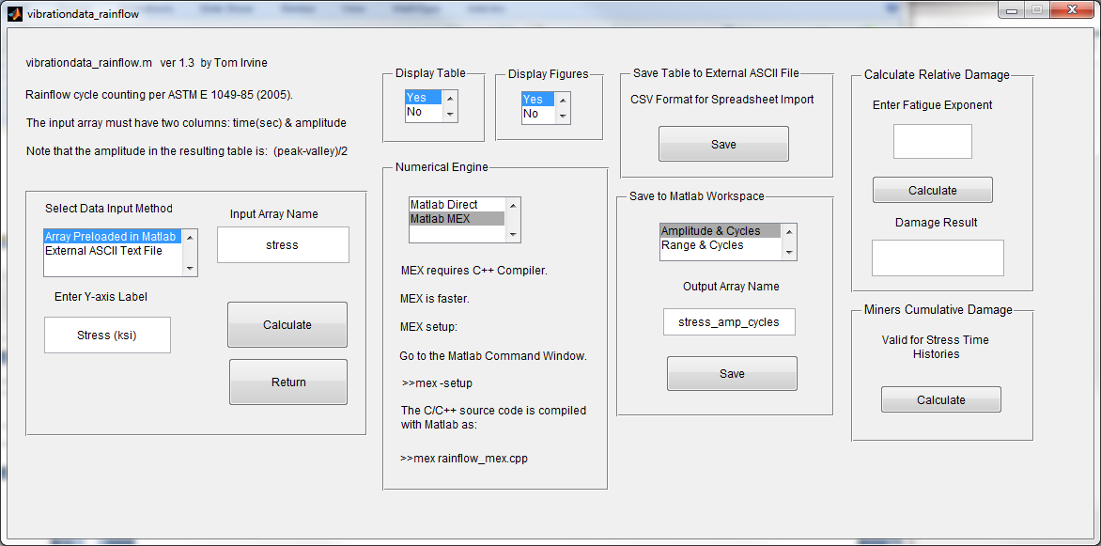
Rainflow Count, Part 1 - Calculate & Save
vibrationdata > Rainflow Cycle Counting

Slide 28
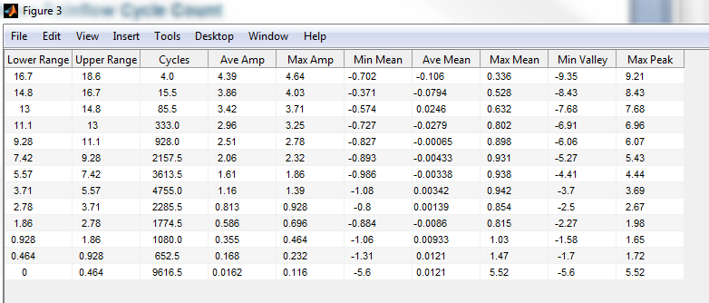
Stress Rainflow Cycle Count
Range = (Peak – Valley) Amplitude = (Peak – Valley )/2
But use amplitude-cycle data directly in Miner’s rule, rather than binned data!

Slide 29
S-N Curve
For N>1538 and S < 39.7
log₁₀ (S) = -0.108 log₁₀ (N) +1.95
log₁₀ (N) = -9.25 log₁₀ (S) + 17.99
The curve can be roughly divided into two segments
The first is the low-cycle fatigue portion from 1 to 1000 cycles, which is concave as viewed from the origin
The second portion is the high-cycle curve beginning at 1000, which is convex as viewed from the origin
The stress level for one-half cycle is the ultimate stress limit

Slide 30
Miner’s Cumulative Fatigue
Let n be the number of stress cycles accumulated during the vibration testing at a given level stress level represented by index i
Let N be the number of cycles to produce a fatigue failure at the stress level limit for the corresponding index.
Miner’s cumulative damage index R is given by
where m is the total number of cycles or bins depending on the analysis type
In theory, the part should fail when Rn (theory) = 1.0
For aerospace electronic structures, however, a more conservative limit is used Rn(aero) = 0.7

Slide 31
Miner’s Cumulative Fatigue, Alternate Form
Here is a simplified form which assume a “one-segment” S-N curve.
It is okay as long as the stress is below the ultimate limit with “some margin” to spare.
A is the fatigue strength coefficient
(stress limit for one-half cycle for the one-segment S-N curve)
b is the fatigue exponent

Slide 32
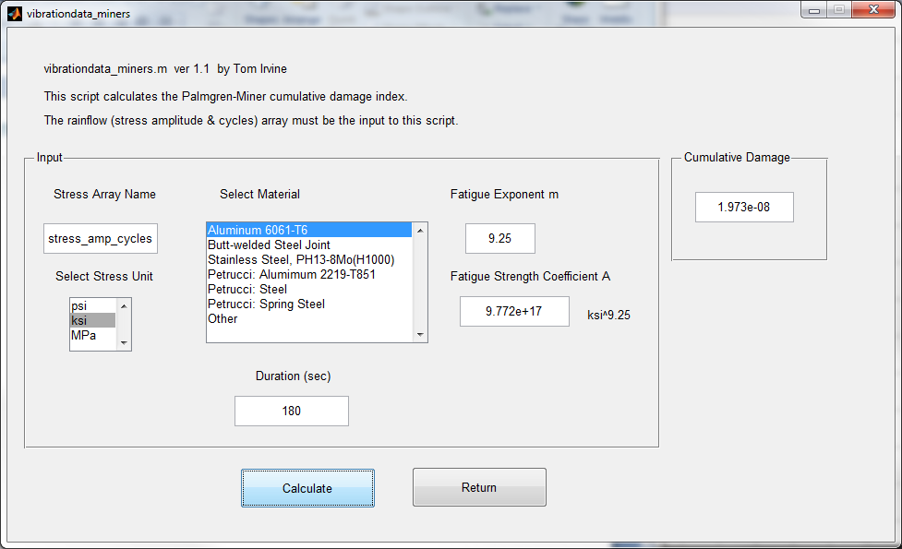
Rainflow Count, Part 2
vibrationdata > Rainflow Cycle Counting > Miners Cumulative Damage

Slide 33
SDOF System, Solder Terminal Location, Fatigue Damage Results for Various Input Levels, 180 second Duration, Crest Factor = 4.53
Input Overall Level (GRMS) | Input Margin (dB) | Response Stress Std Dev (ksi) | R
6.1 | 0 | 2.06 | 4.9E-07
8.7 | 3 | 2.9 | 1.2E-05
12.3 | 6 | 4.1 | 3.0E-04
17.3 | 9 | 5.8 | 7.3E-03
24.5 | 12 | 8.2 | 0.18
34.5 | 15 | 11.7 | 4.45
Cumulative Fatigue Results
Again, the success criterion was R < 0.7
The fatigue failure threshold is somewhere between the 12 and 15 dB margin
The data shows that the fatigue damage is highly sensitive to the base input and resulting stress levels

