Slide 1
GOM wells Data Analysis
Design Basis and Methodology
1 December 2017

Slide 2
Agenda
Introduction
Data gathering
Methods
Software
Pandas Module
GIS Python(Bokeh Module)
GIS python(Folium Module)
References

Slide 3
Introduction
Objective is to develop and identify oil and gas wells in Gulf of Mexico region
Major tasks to accomplish are:
Data gathering or scraping from the website.
Develops program and performing graphical analysis.
Present result to be available to public in the form of website?

Slide 4
Data Gathering
Gathering data from the Database that officially placed publicly.
https://www.data.boem.gov/
Search for Gulf of Mexico resource Evaluation.
https://www.boem.gov/Oil-and-Gas-Energy-Program/Resource-Evaluation/Geological-and-Geophysical-Data-Acquisition/GGData-Gulf-of-Mexico.aspx/
Collection of data for Gulf of Mexico wells.
Develops and analysis of different data based on client ,Water depth and by trends.

Slide 5
Block Data
Downloading csv files from the BOEM database.
Gathering of block data from pdf file from the internet.
http://www.noia.org/wp-content/uploads/2016/08/Deepwater-Gulf-of-Mexico-Report-2014.pdf
https://www.boem.gov/GoM-2011-National-Assessment/
Differentiating the resource evaluation based on the block number of lower tertiary wells

Slide 6
Methods
For accessing data from BOEM
Module | Description | Comments | Errors
Wget | supports the FTP and ( HTTP protocol-Preferred)
LWP | Using Perl and the LWP interface
FTP | Difficulty for starters

Slide 7
Software
Module | software | Description | Comments
pandas | Python | Reading the data using csv file
Bokeh | Python | Interactive python library for presenting data in web browsers
Geo Pandas | Python | Allows working on spatial data
Folium | Python | Allows working on spatial data

Slide 8
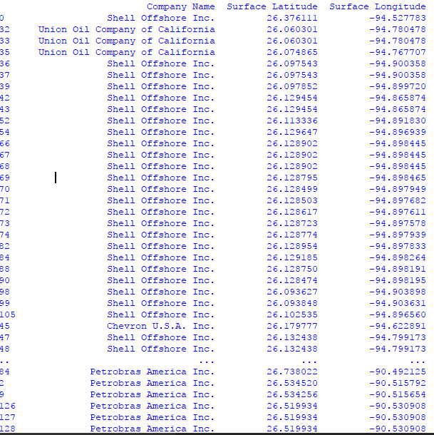
Pandas module
Identifying Lower tertiary wells based on block numbers by pandas module

Slide 9
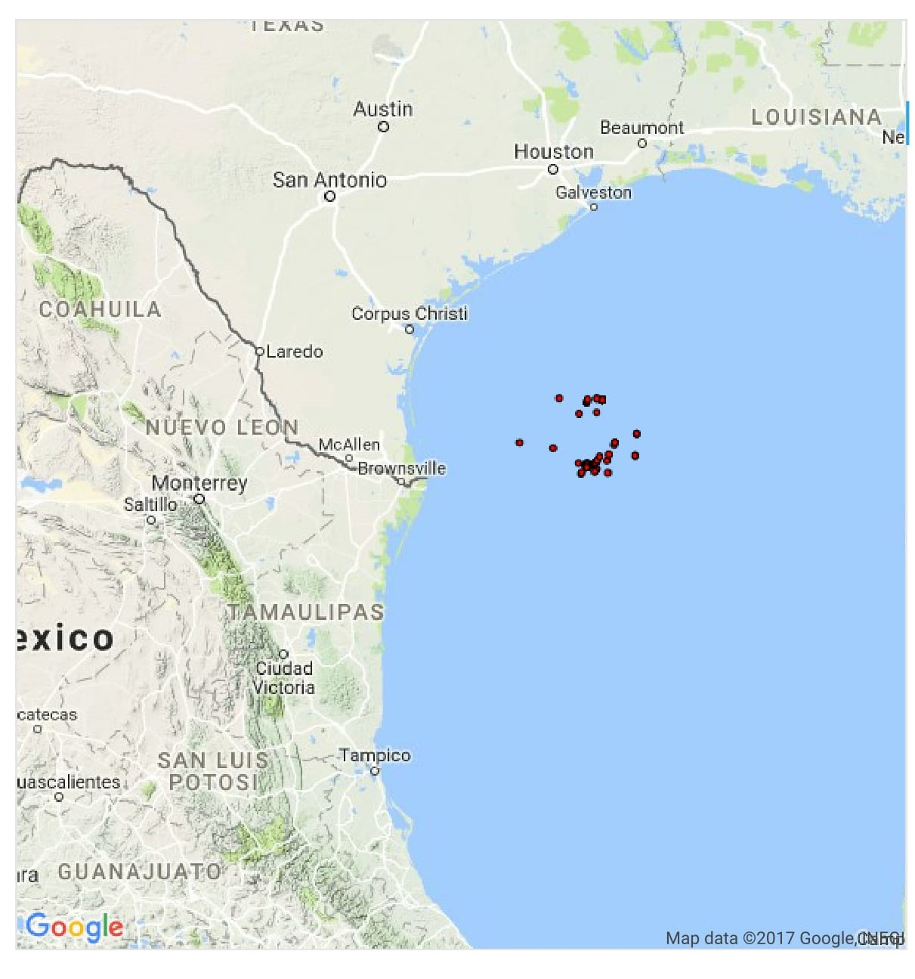
GIS Python
Identifying wells by using Bokeh module

Slide 10
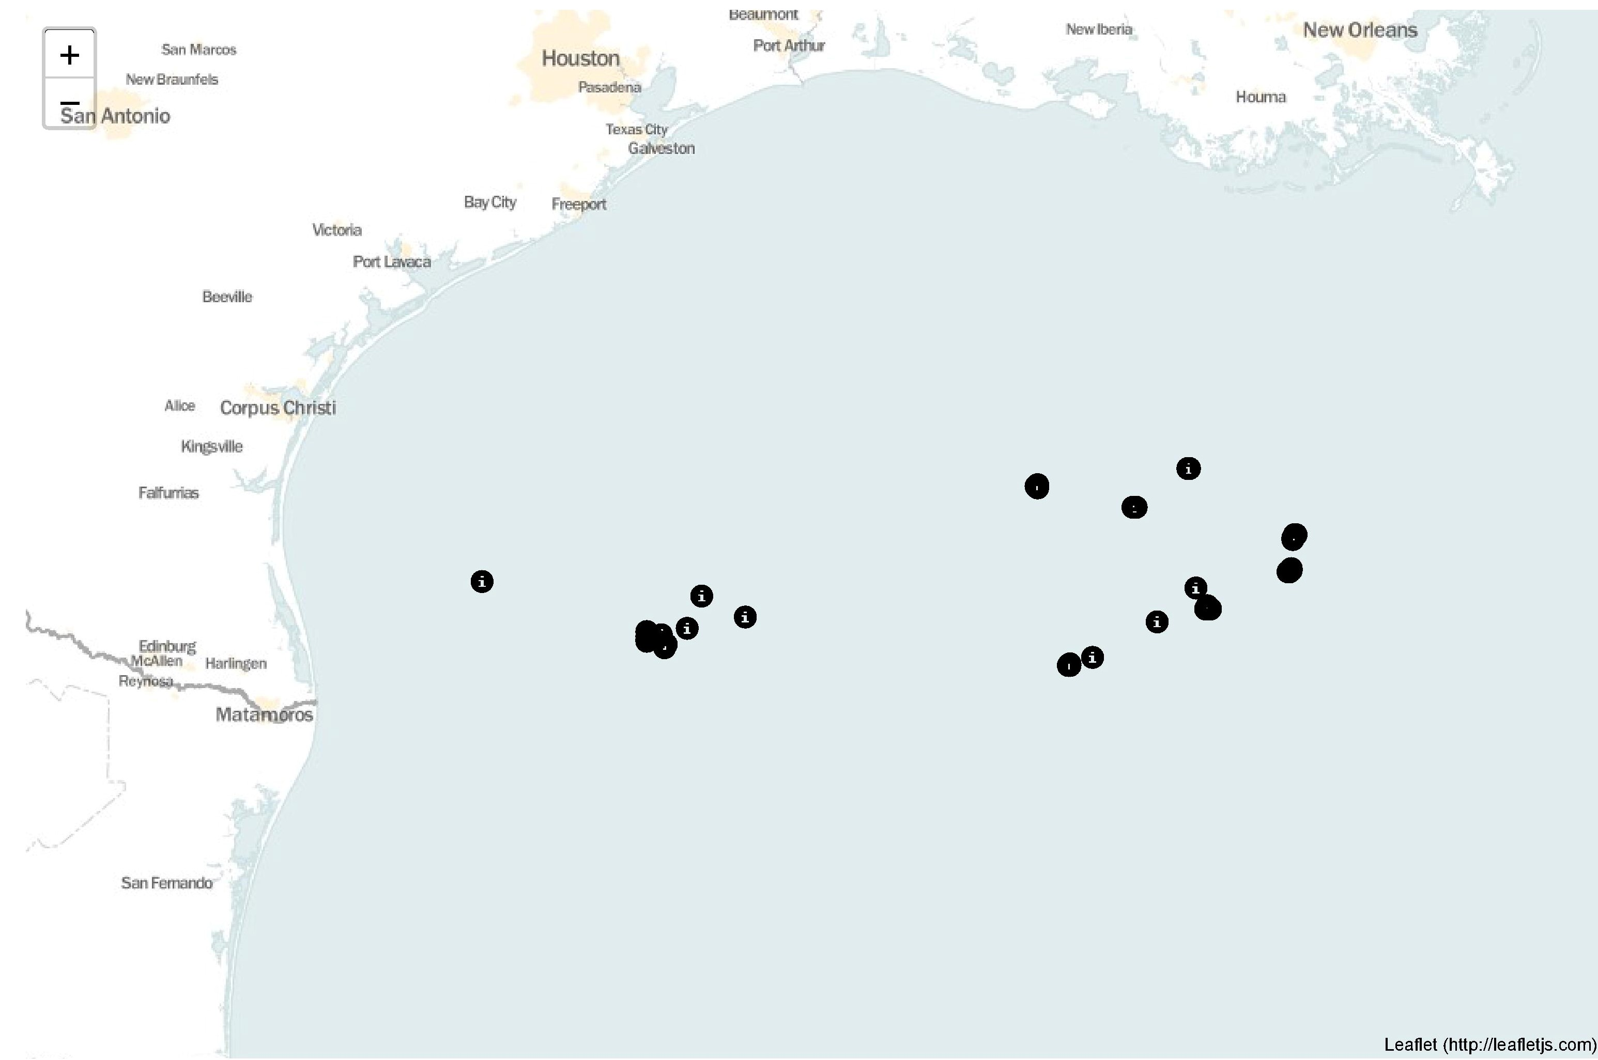
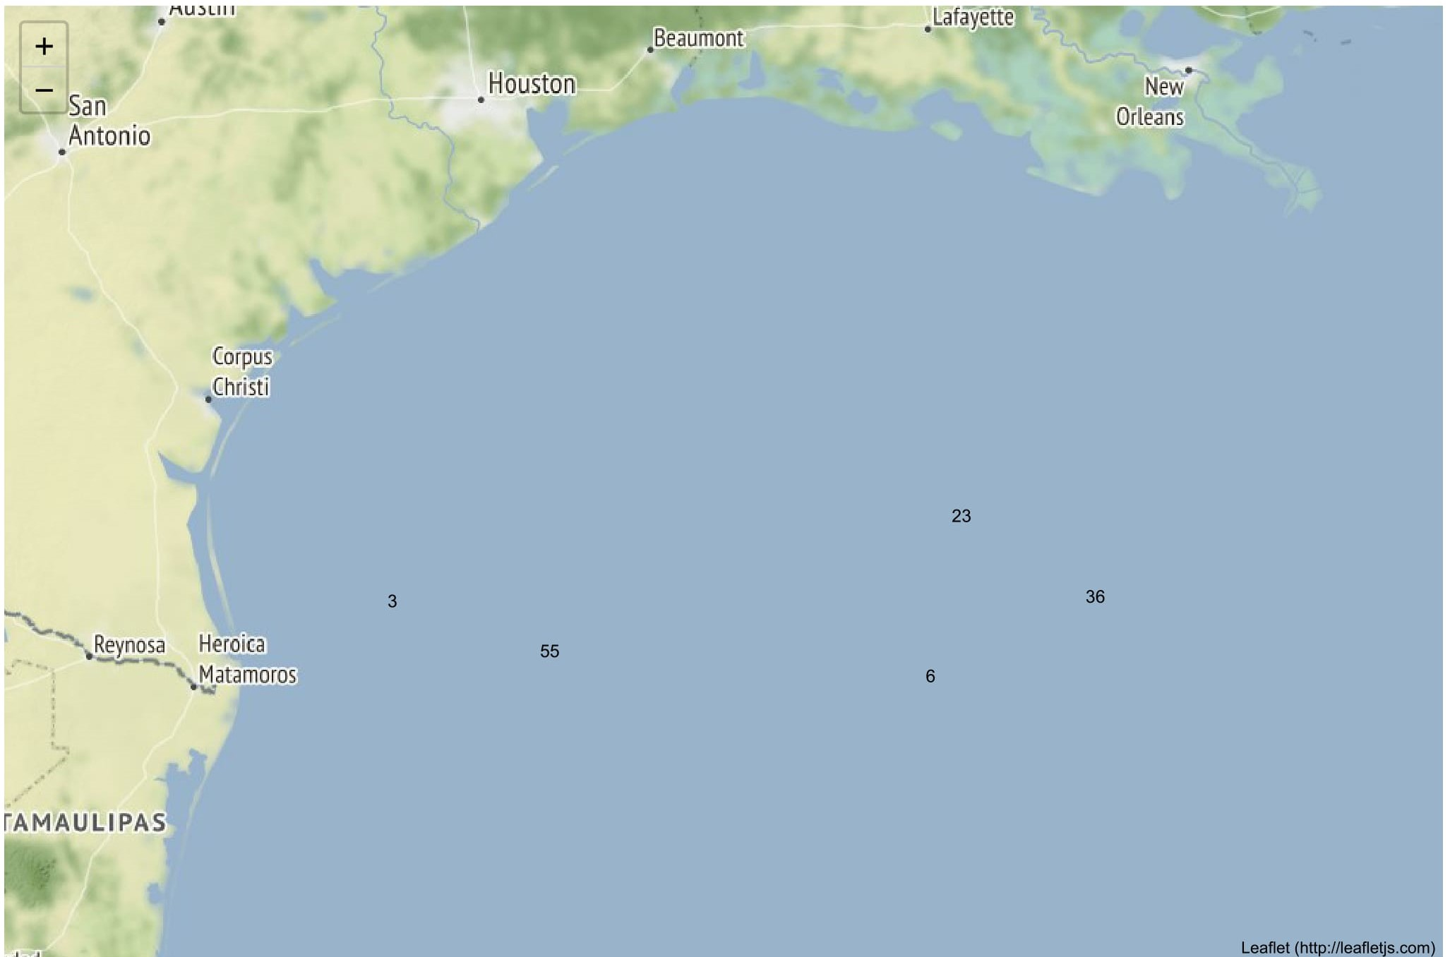
GIS Python2
Identifying wells by folium module using latitude and longitudinal data

Slide 11
References
https://www.youtube.com/watch?v=P60qokxPPZc
https://georgetsilva.github.io/posts/mapping-points-with-folium/
https://www.youtube.com/watch?v=Yd5oEIBFQ_E
https://www.youtube.com/watch?v=2u-KFbRX44I
https://gis.stackexchange.com/questions/230421/find-csv-lat-and-long-points-in-a-shapefile-polygon-with-geopandas-spatial-index

Slide 12
THANK YOU
For the opportunity to serve

