Slide 1
GOM wells Data Analysis
Design Basis and Methodology
1 December 2017

Slide 2
Agenda
Introduction
Data gathering
Methods
Software
Pandas Module
GIS Python(Bokeh Module)
GIS python(Folium Module)
References

Slide 3
Introduction
Objective is to develop and identify oil and gas wells in Gulf of Mexico region
Major tasks to accomplish are:
Data gathering or scraping from the website.
Develops program and performing graphical analysis.
Present result to be available to public in the form of website?

Slide 4
Data Gathering
Gathering data from the Database that officially placed publicly.
https://www.data.boem.gov/
Search for Gulf of Mexico resource Evaluation.
https://www.boem.gov/Oil-and-Gas-Energy-Program/Resource-Evaluation/Geological-and-Geophysical-Data-Acquisition/GGData-Gulf-of-Mexico.aspx/
Collection of data for Gulf of Mexico wells.
Develops and analysis of different data based on client ,Water depth and by trends.

Slide 5
Block Data
Downloading csv files from the BOEM database.
Gathering of block data from pdf file from the internet.
http://www.noia.org/wp-content/uploads/2016/08/Deepwater-Gulf-of-Mexico-Report-2014.pdf
https://www.boem.gov/GoM-2011-National-Assessment/
Differentiating the resource evaluation based on the block number of lower tertiary wells

Slide 6
Methods
For accessing data from BOEM
Module | Description | Comments | Errors
Wget | supports the FTP and ( HTTP protocol-Preferred)
LWP | Using Perl and the LWP interface
FTP | Difficulty for starters

Slide 7
Software
Module | software | Description | Comments
pandas | Python | Reading the data using csv file
Bokeh | Python | Interactive python library for presenting data in web browsers
Geo Pandas | Python | Allows working on spatial data
Folium | Python | Allows working on spatial data

Slide 8
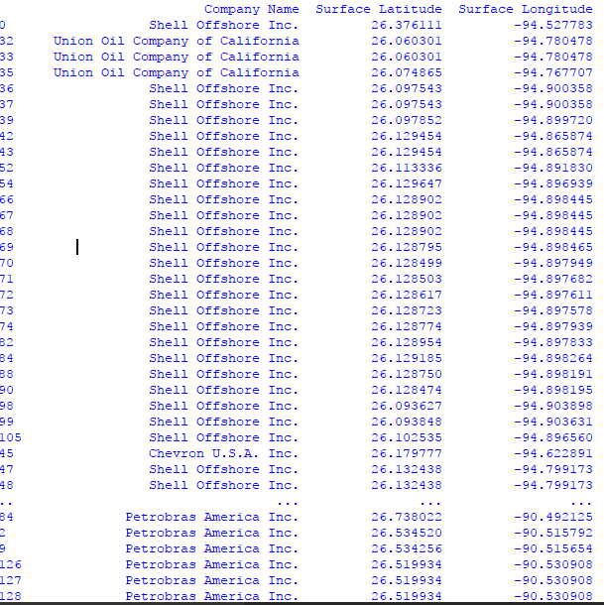
Pandas module
Identifying Lower tertiary wells based on block numbers by pandas module

Slide 9
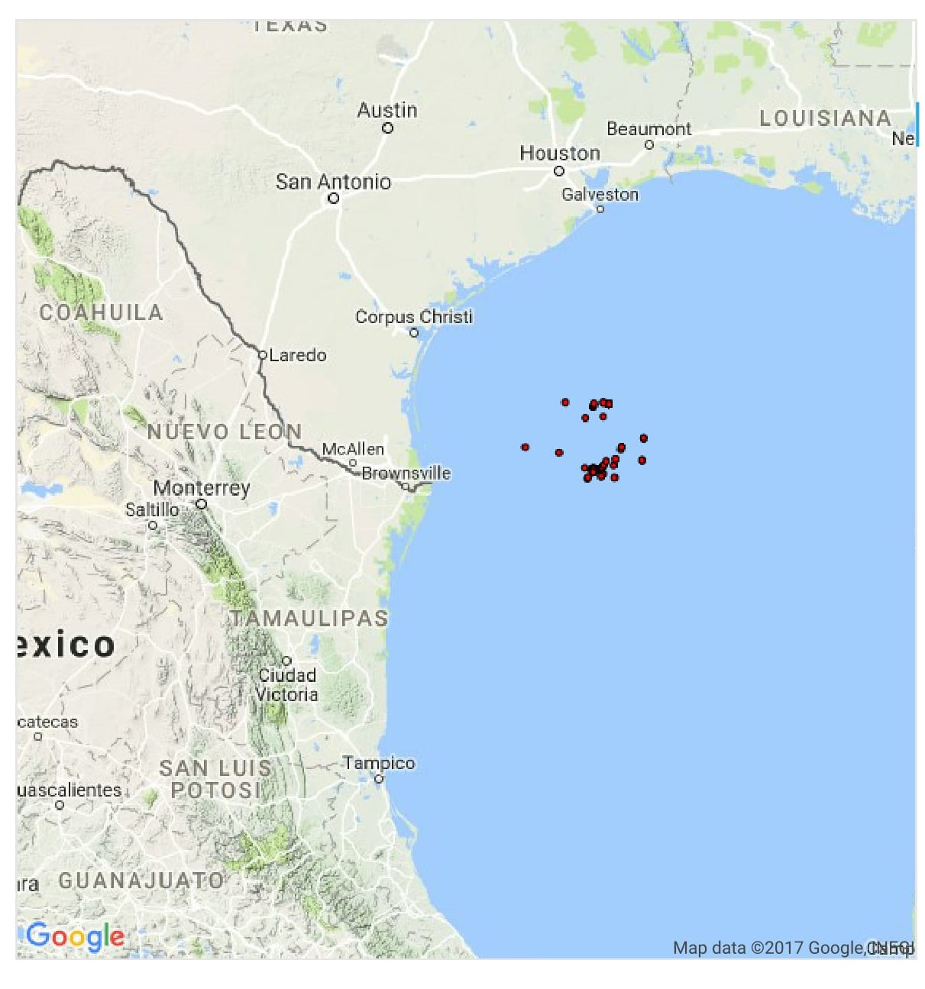
GIS Python
Identifying wells by using Bokeh module

Slide 10
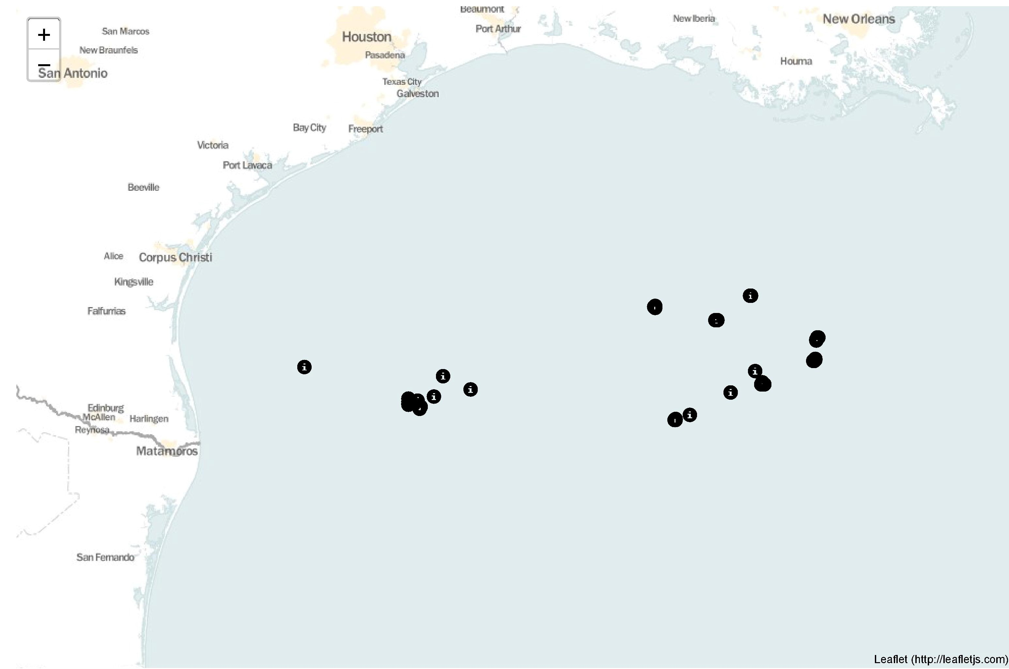
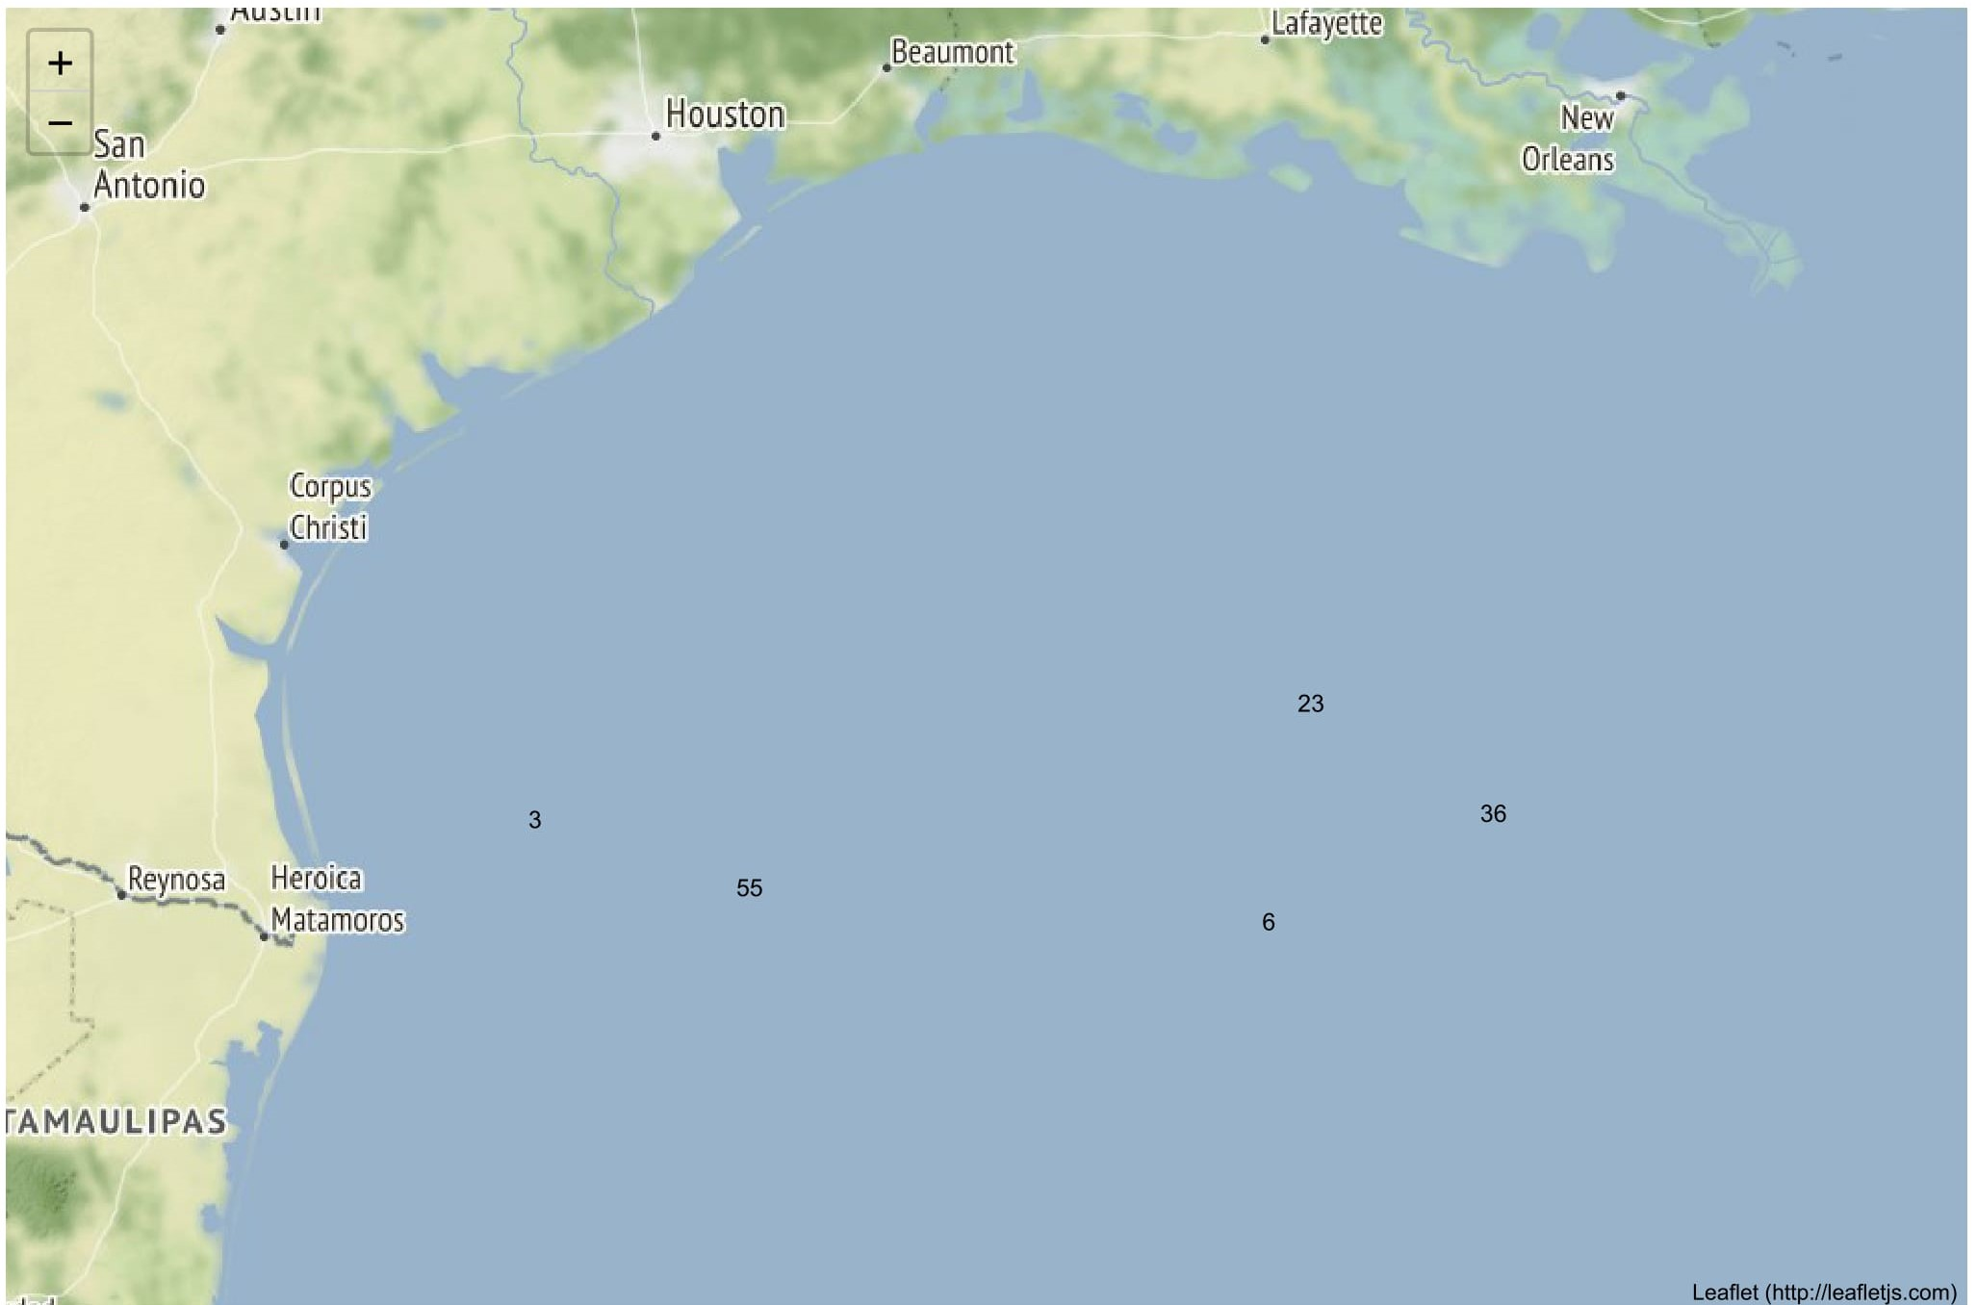
GIS Python2
Identifying wells by folium module using latitude and longitudinal data

Slide 11
Reserves
Reserves data has been collected from the database BOEM.
https://www.boem.gov/Reserves-Inventory-Program-Gulf-of-Mexico-OCS-Region/
And by block number differentiating the reserves

Slide 12
References
https://www.youtube.com/watch?v=P60qokxPPZc
https://georgetsilva.github.io/posts/mapping-points-with-folium/
https://www.youtube.com/watch?v=Yd5oEIBFQ_E
https://www.youtube.com/watch?v=2u-KFbRX44I
https://gis.stackexchange.com/questions/230421/find-csv-lat-and-long-points-in-a-shapefile-polygon-with-geopandas-spatial-index

Slide 13
THANK YOU
For the opportunity to serve

