Slide 1
Occidental Petroleum Corporation
Gulf Of Mexico Discoveries
WELLS DATA
5 October 2017

Slide 2
Agenda
Introduction
Company overview
Water depth analysis

Slide 3
Introduction
Shallow water drilling is the process of oil and gas drilling and production in less than 350 meters of water
Deep water drilling. With depths greater than 1500 meters
Classification of water depth
< 350 M (1150 ft.) – Shallow water
< 1500 M (4922 ft.) - Deep water
> 1500 M (4922 ft.) - Ultra deep water

Slide 4
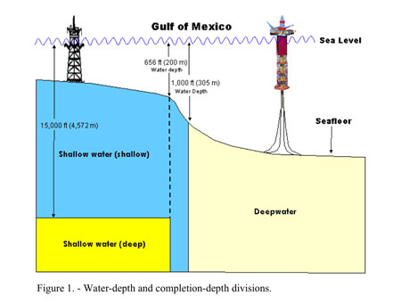
conitnue

Slide 5
Company overview
It Is operating with three different abbreviations in Gulf of Mexico Region.
Occidental Petroleum corporation.
OXY USA Inc.
OXY Petroleum, Inc.
They totally owned 106 wells In Gulf of Mexico region.
Company Name | Wells Owned
OXY USA Inc. | 97
OXY Petroleum, Inc. | 5
Occidental Petroleum corporation | 4

Slide 6
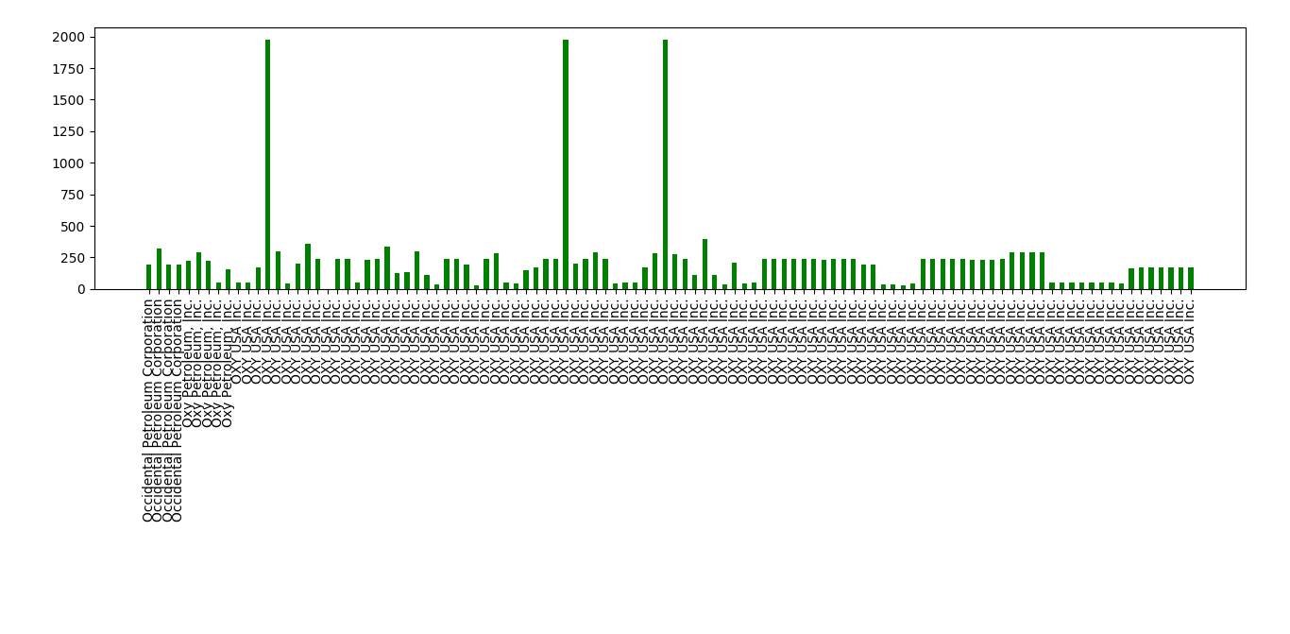
Water depth analysis
Based on this classification and most of the wells that this company operates in shallow water depth and in deep water depth are
< 350 M (1150 ft.) – 103 shallow water wells
< 1500 M (4922 ft.) - 3 Deep water wells
Any wells > 1500 m?
Also, the above plot is not clear. Can you send me a link to the data? I want to review it.

Slide 7
THANK YOU
For the opportunity to serve

