Slide 1
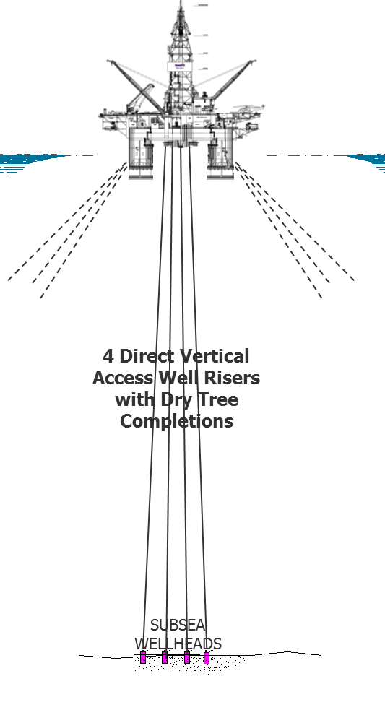
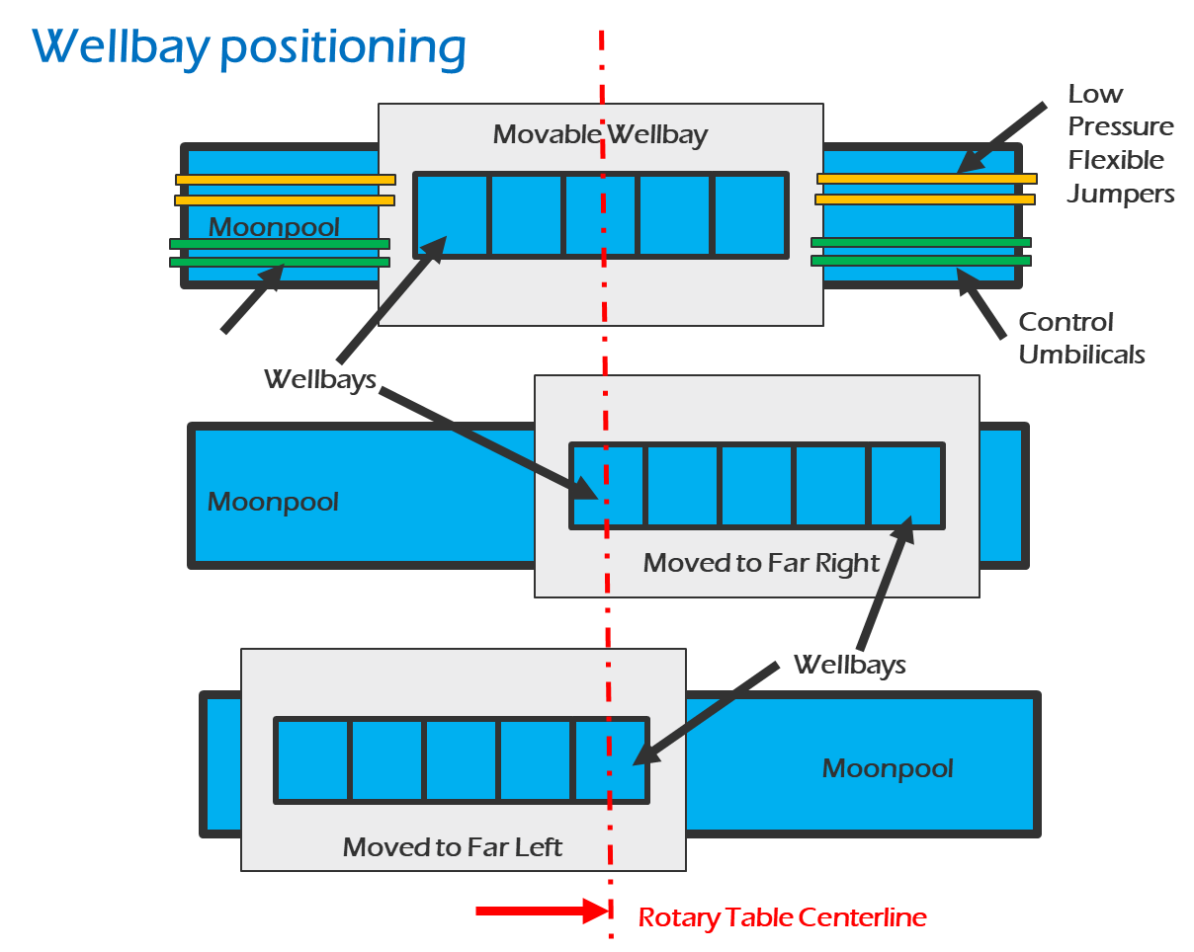
Developing the Gulf’s Lower Tertiary - An Innovative Solution to a New Set of Deepwater Challenges
Concepts for
follow-up WORLD OIL article
<15k here!
Frontier Production System
(FrPS)
4,000’+ WD
Conversion or Purpose Built
>15k here
Movable Wellbay
in FrPS Moonpool
© 2019 Frontier Deepwater Appraisal Solutions LLC

Slide 2
Can the Lower Tertiary’s promise be rediscovered?
OUTLINE for Article
Abstract
Basic state of the Lower Tertiary play (quick overview)
4(?) fields producing – Cas Chin, JSM, Stones, Julia (more?)
2(?) projects sanctioned – Shenandoah, Anchor
X projects in FEED – N. Platte, more?
Is the Wilcox a bust… What happened to our massive discoveries? (Case assessments)
JSM/Julia
Cascade Chinook
Stones
OUTLINE (cont’d)
“Rescue” Case Studies (D&RA of path forward strategies)
Stones (anonomously)
Path forward options… build strategy table
D&RA modeling introducing “rescure tool”
Cascade Chinook (anonomously)
2 cases are enough, right?
This is the “rescue tool” (FrPS)
Very brief re-introduction
Conclusion
Key theme – How much WILCOX OIP will be left behind by SS devs? How can FrPS change the recovery and economics?
Notes:
2

Slide 3
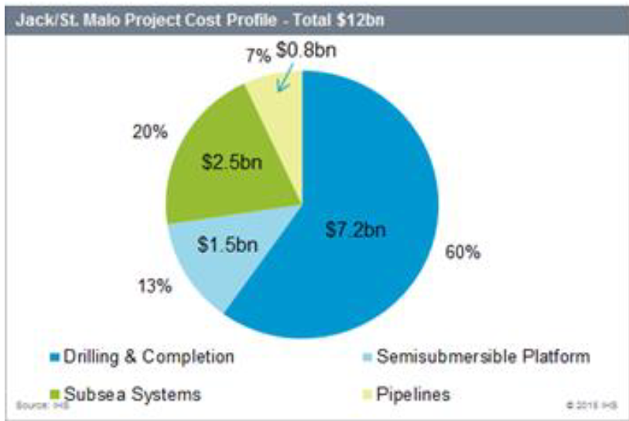
WHAT HAPPENED? Wilcox Discoveries poor perfermance
FIELD | Found | Reserves /OIP¹ | 1st Oil | Cum. Spent² | Cum. Net Oil Sales³ | Value by Yr10⁴ | Misc.
“The Star!” Jack-St. Malo WD~7000’ | 2004-2003 | 500Mn / 3-4Bn bbls | Dec 2014 | $8.5bn^{2a} >$13bn^{2b} | $14.6bn ➔ NPV_{10%} $9bn w/ 100kbopd | $0.5bn^{2a} ROI = ??? -$4bn^{2b} ROI = ??? | 170Mbopd FPSemi w/ >20 (43???) ss wells ~$1bn Appraisal cost incl. $125Mn well test
Cascade-Chinook WD~8200’ | 2002- | 100-150Mn / 2Bn bbls | Jan 2012 | ~$3.7bn | $___bn avg. __kbopd 2012-21 | Petrobras big loss*➔ Murphy win? | 80Mbopd FPS0 for 6+7 ss wells $0._bn Appraisal cost
Stones WD~9500’ WR508, | 2005 | 60Mn^{1a} / ~2Bbbl on 8 blks, 250Mboe per Shell | May 2016 (BSEE) | ~$5bn^{1a} | ~$0.0bn avg. 25kbopd 2016-25 | -$5bn | 50Mbopd FPS0 w/ 6 ss wells ~$1.5bn Appraisal
Barely keeping up with OPEX due to cost of MODU at field
* - I guess >$2Bn write-down when JV announced
NOTES – EIA/IHS Cost Study & web
Published OIP
a. Phase 1
2. By Yr10 – incl. Appraisal & CAPEX
a. Ph. 1 (incl. 5 appraisers, 1 test, 9 producers, & SS liquid boost)
b. Total field dev. (IHS)
NOTES –
3. Oil sold with $40/bbl NET Avg Oil Price over 10 producing yrs ($55 – 15/bbl SS OPEX)
a. Assumes gas sales add no value
4. By 10th year of production (no time value on sunk investment to 1st Oil; Net Sales Revenue is time valued)
Notes:
3

Slide 4
WHAT HAPPENED? Wilcox Discoveries poor perfermance
FIELD | Found | Reserves /OOIP¹ | 1st Oil | Cum. Spent² | Cum. Net Oil Sales³ | Rev. by Yr10⁴ | Misc.
Jack-St. Malo WD~7000’ WR | 2004-2003 | 500 Mbbl / 3-4 Bbbls per CVX | Dec 2014 | $8.5B^{2a} >$13B^{2b} | $14.6bn ➔ NPV_{10%} $9bn w/ 100kbopd | $0.5bn^{2a} ROI = ??? -$4bn^{2b} | 170Mbopd FPSemi w/ >20 (43???) ss wells ~$1bn Appraisal cost incl. $125Mn well test
Julia, 7000’ WR627+ | 2002 | 52 M^{1a} / ~6 Bbbls | Jul’16 | >$3bn^{1a} | ~$1.0bn avg. 17kbopd 2016-20 | -$3bn | Target 34k bopd, 6wells XOM quit spending after just 4 wells!
Cascade-Chinook WD~8200’ | 2002-2003 | 100-150M / >2 Bbbls | Jan 2012 | ~$3.7B | $___bn avg. __kbopd 2012-21 | Petrobras big loss*➔ Murphy win? | 80Mbopd FPS0 for 6+7 ss wells $0._bn Appraisal cost
Stones WD~9500’ | 2005 | 60Mbbl^{1a} BOEM’18 /~2B on WR508 ~8 Bbbls per Shell | May 2016 (BSEE) | ~$5B^{1a} | ~$0.0bn avg. 25kbopd 2016-25 | -$5bn | 50Mbopd FPS0 w/ 6 ss wells ~$1.5bn Appraisal
NOTES – EIA/IHS Cost Study & web
Published OIP
a. Phase 1
2. By Yr10 – incl. Appraisal & CAPEX
a. Ph. 1 (incl. 5 appraisers, 1 test, 9 producers, & SS liquid boost)
b. Total field dev. (IHS)
NOTES –
3. Oil sold with $40/bbl NET Avg Oil Price over 10 producing yrs ($55 – 15/bbl SS OPEX)
a. Assumes gas sales add no value
4. By 10th year of production (no time value on sunk investment to 1st Oil; Net Sales Revenue is time valued)
Notes:
4

Slide 5
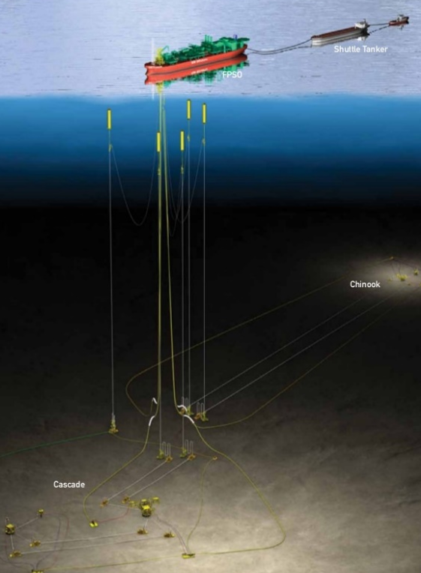
WHAT HAPPENED? Our huge Wilcox investment is failing. What should we do?
What are our options?
Stay the course with minimal well maintenance?
Previous investments are written off… so, milk the asset
Try to enhance system performance… hope we get lucky?
Sidetracks/recompletions… hope for a higher performing completions
Drill new subsea wells
Add subsea lift systems
Shut down… Walk away… abandon?
Farm down… minimize future loss/upside?
How much to farm down? Give up operatorship?
Sell out?
Commit to FrPS dry tree field “rescue”
Install over existing wells (tieback for direct well access)
Create new well center
Combo (keep 2-3 existing wells; drill 3-2 new wells)
Notes:
5

Slide 6
What should we do?
OPTIONS
UNCERTAINTIES
VALUE
ASSUME COSTS ARE KNOWN
1-1. Oil prices stay $50-60
1. Stay the Course
1-2. Oil prices go up
1-3. Prices go down
These apply to all below as well
TBD
2a. Do Sidetracks
2-1. New completions/ss kit perform well
2b. Add New SS wells
2-2. do OK
2C. Add SS lift
2-3. not so much?
3-1/-2/-3. How/cost to convince BOEM that abandonment is justified + cost to abandon
3. Shut down
4-1/-2/-3. How much to sell? How much can we get? Who will operate?
4. Farm out
5. SELL OUT
5-1/-2/-3. Who will buy? How much can we get? Can we make it look good?
6. Install FrPS
6-1/-2/-3. CAPEX? OPEX? Time to install? How long will production be interrupted? How will production be affected – good/as expected/bad? How much more will we recover?
Notes:
6

Slide 7
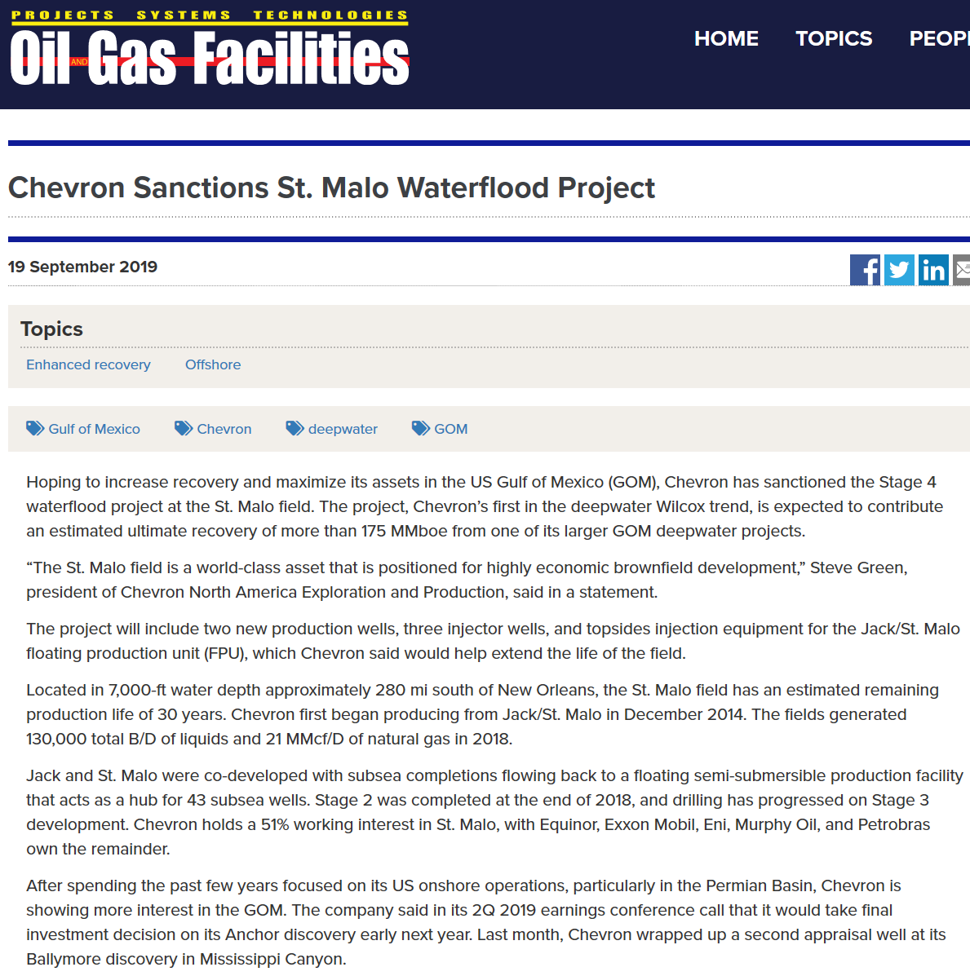













Important news from SPE Facilities website
Notes:
7

Slide 8
Interesting info from CVX presentationon JSM to API Delta section Aug’16
Notes:
8

Slide 9
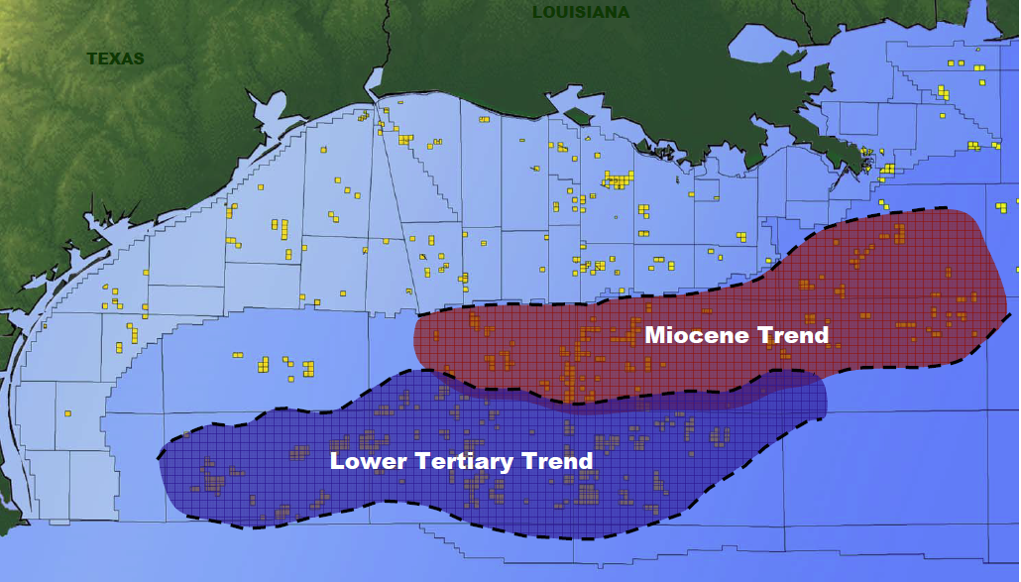
What is “killing” Lower Tertiary Subsea Developments?
Daunting subsalt reservoir uncertainty
Faulting and connectivity?
Reservoir drive mechanism??
Sand control & completion???
Tight rock needing enhanced recovery
Fluid quality & intervention frequency
FID for hub development requires many appraisal wells ($2+billion)
Very high drilling and completion costs
35,000’ wells requiring >200 days
20K MODU and intervention system with 20K back up?
20k subsea trees, controls and HIPPS
Massive CAPEX, OPEX and RISKEX
VERY EXPENSIVE SUBSEA WELL SYSTEMS MAINTENCE AND INTERVENTIONS
40 billion barrel resource?
As compared to Miocene successes, lack of reservoir information and understanding mean huge, riskier bets by Operators
Notes:
9

Slide 10
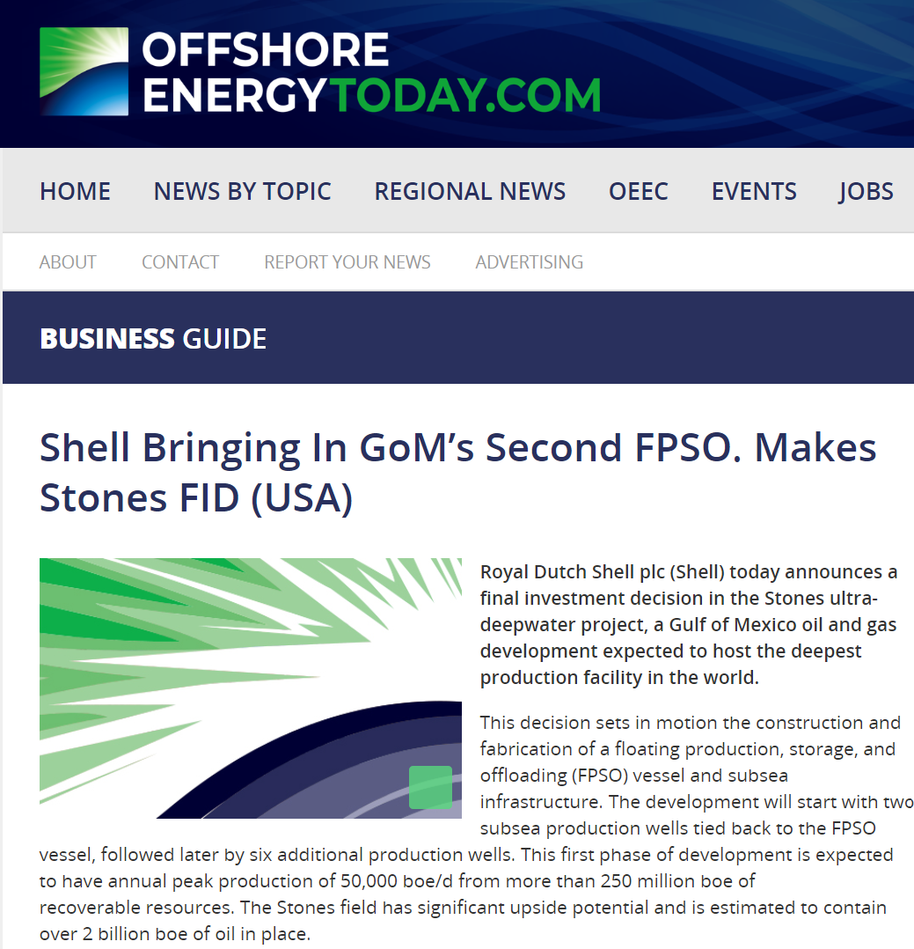
Published
2013

Slide 11
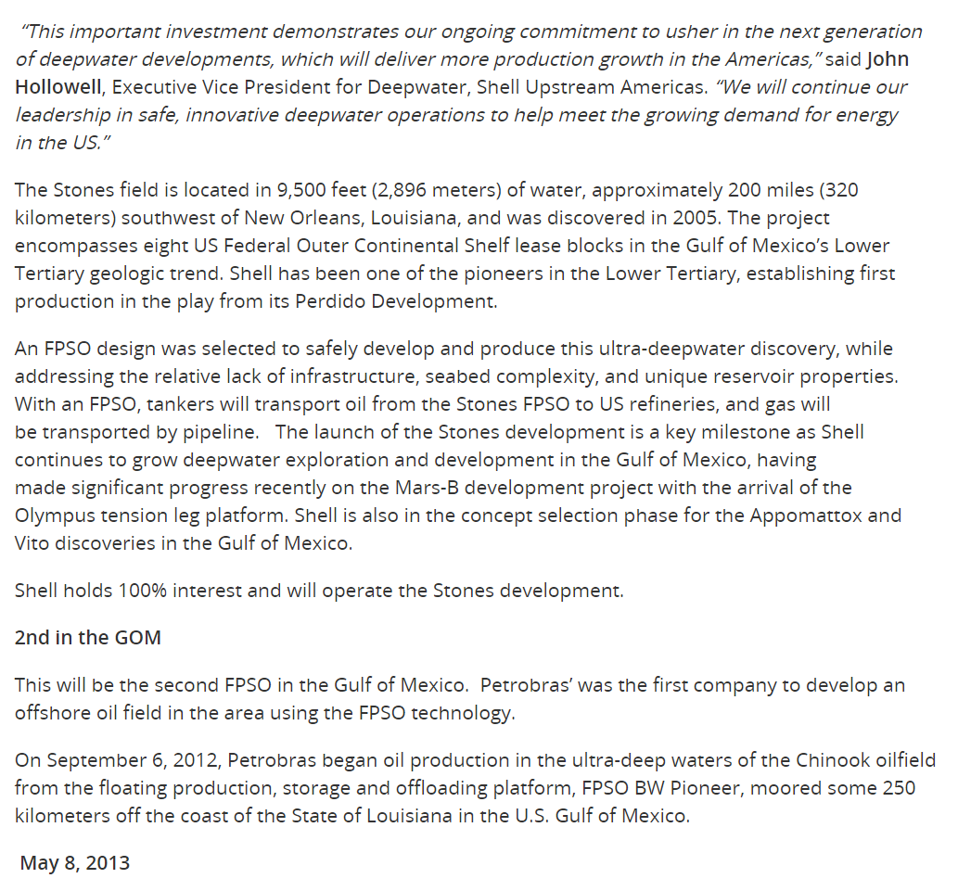
Published
2013

Slide 12
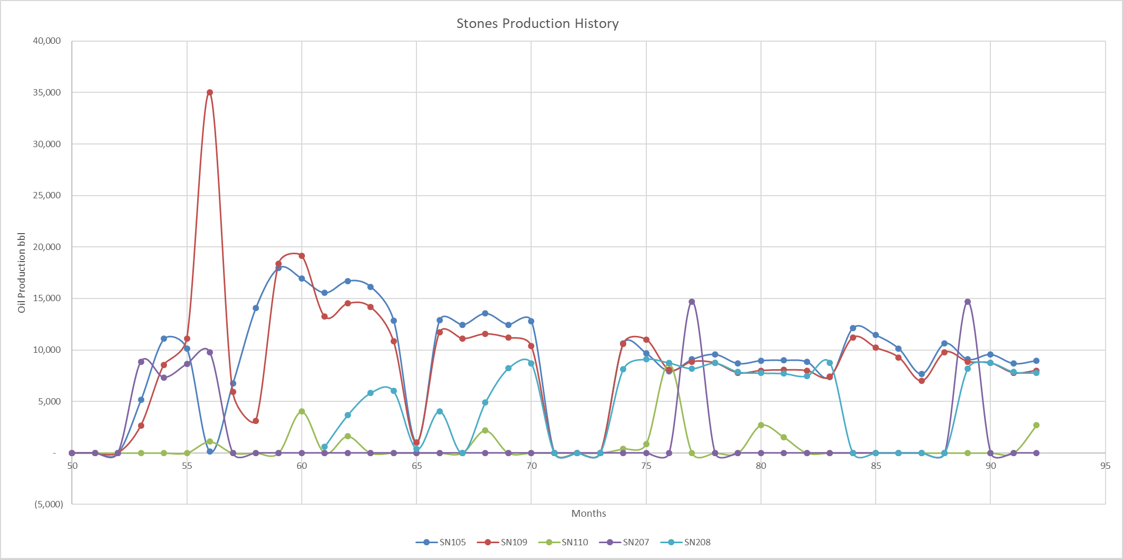
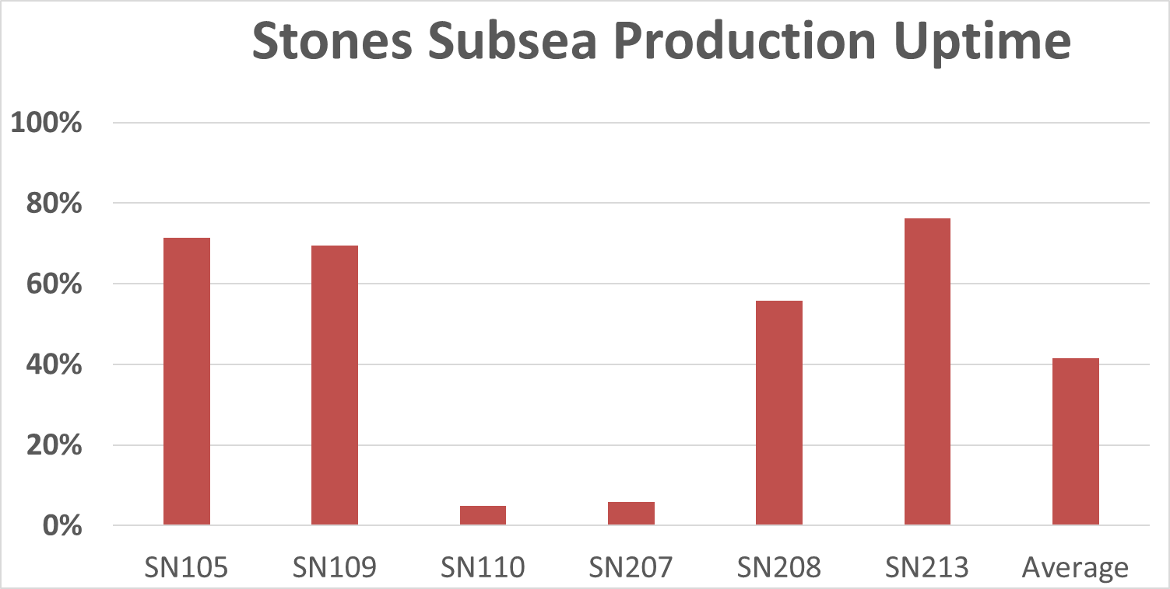
Stones Subsea Infrastructure Performing Poorly
STONES’ subsea well production and uptime is disappointing
Well completions are performing poorly
Large number of sidetracks and interventions costly @ $1.1MM per day
Subsea system uptime appears poor
DP Drillship Thalassa ongoing support cost prohibitive
BSEE Production Data
published BSEE production data
Average ~45%?
Notes:
12
5-6mins

Slide 13
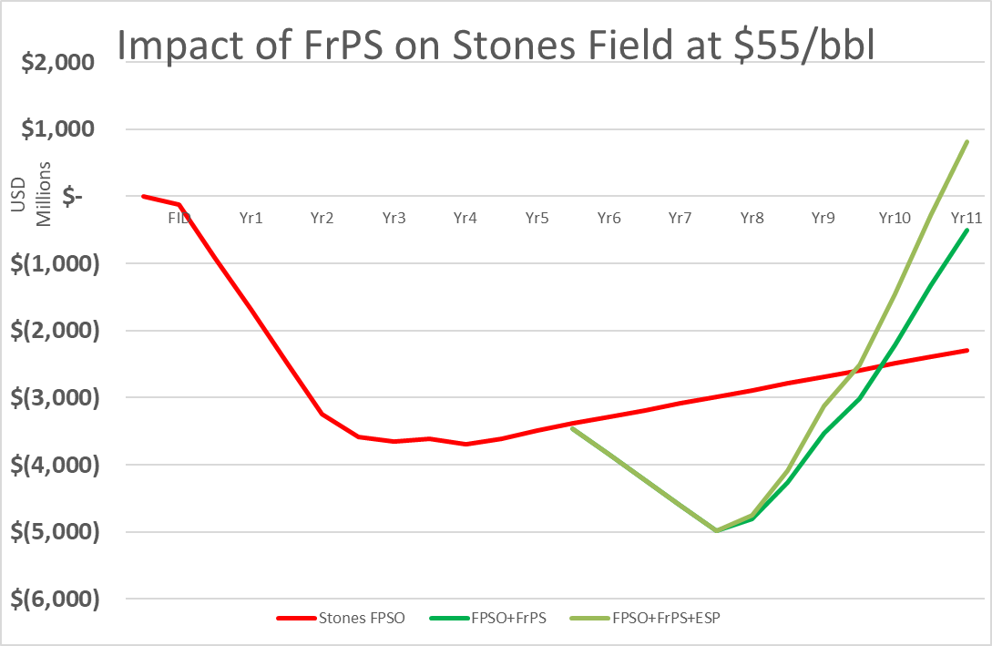
It is time to initiate a radical field “rescue”!
Field
breaks even
Green curves show existing production rate (BSEE data) increased by improved uptime and artificial lift
1st oil ~30mos after FID
FID for
FrPS “field rescue”
FrPS pays off!
FrPS FEED starts NOW
after subsea system failed to perform

Slide 14
Actual Production Data ends Aug Yr5
Assuming $55/bbl oil
Production Starts ~30mos after FID
Extrapolated

Slide 15
Assuming $75/bbl oil
Actual Production Data ends Aug Yr5
Production Starts ~30mos after FID
Extrapolated

Slide 16
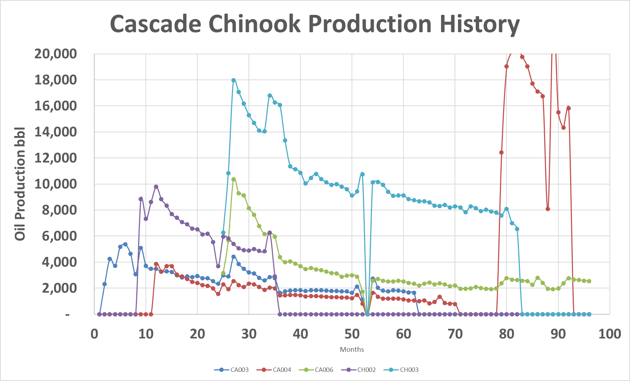
Cascade Chinook Subsea Development has not met expectations
Source: US government database

Slide 17
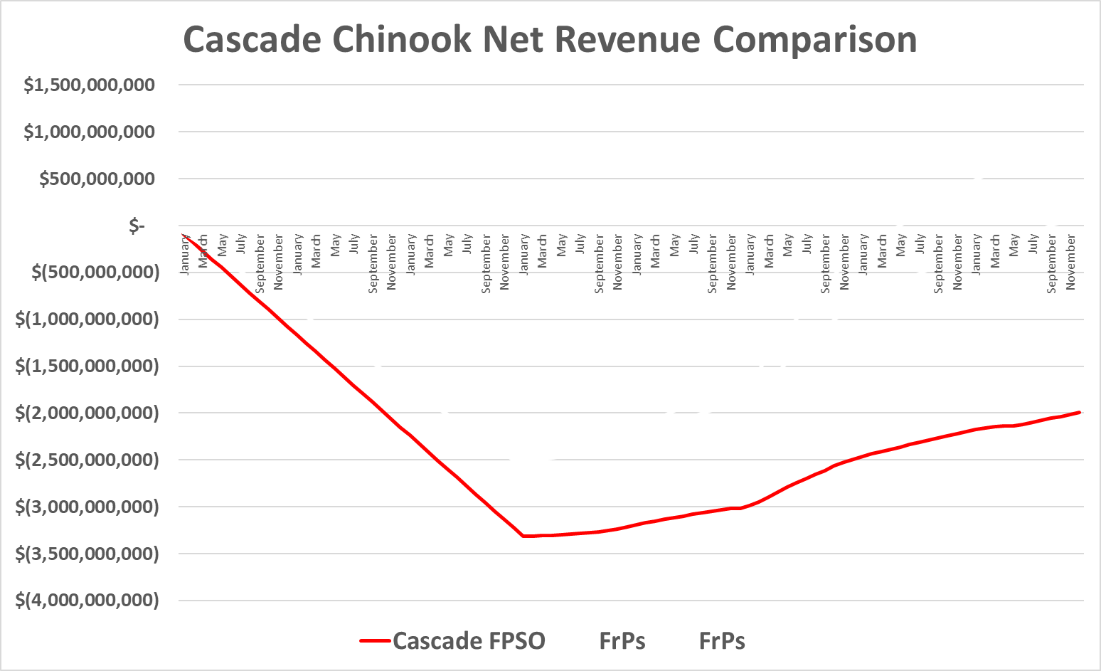

Subsea Lower Tertiary Concept Delivers Negative Economics
Lots of problems and red ink!
Based on published cost & BSEE production data
$55 bbl oil price (includes royalty and operating costs)
Too Many Appraisal Wells to Sanction Project
Cost Prohibitive Drilling and Completion
Risky Full Field Sanction Rather Than Phases
Excessive Operating Costs and Expensive Redrills
Complex and Less Dependable Subsea Equipment – 30 yr life???
Subsea Pumping Not as Effective

Slide 18
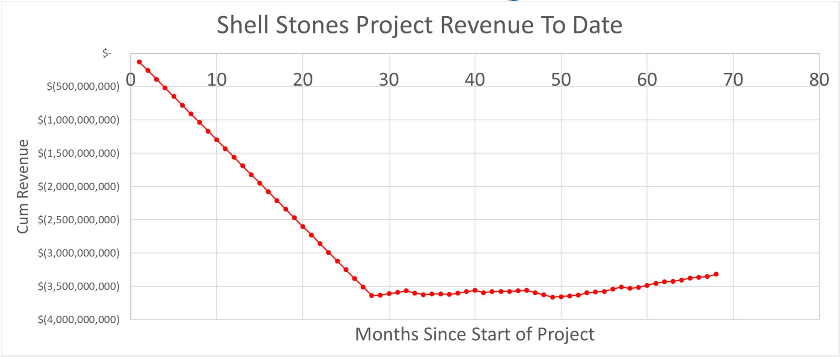
Lower Tertiary Problems Plague Shell STONES Subsea System
Problem: The STONES field is losing billions of dollars
Based on published BSEE production data
$55 bbl oil price (includes royalty & OPEX)
Drillship Thalassa @ $1.1MM loaded day rate
STONES field was brought onstream in 2016…11 years after discovery in 2005
Phase 1 was sanctioned in 2013 when oil & gas prices were $100 per bbl
SHELL has invested billions into STONES including 15 subsea wellbores plus sidetracks

Slide 19
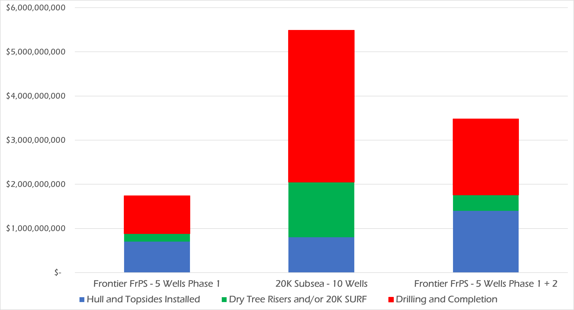

FrPS provides Game Changing Cost Reduction - Current Cost Comparison
CVX Anchor $5.7 Billion
One 20K Subsea Hub
10 subsea wells
2 – FrPS
10 Wells
1 – FrPS
5 wells

Slide 20
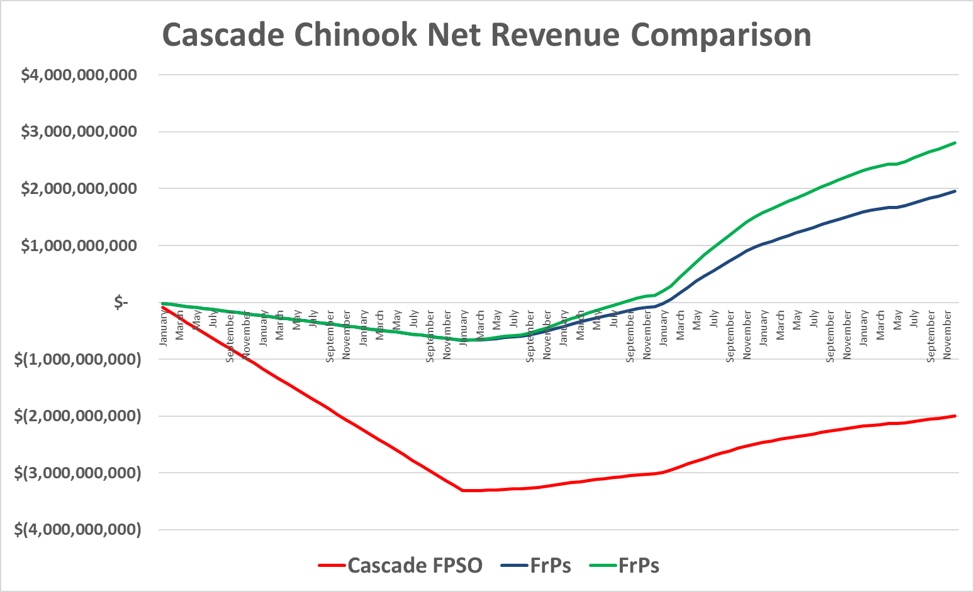

Dramatically Improve Performance and Reduce Risk with the FrPS
Fewer Appraisal Wells (2 to 3 not 5 or 6)
Earliest Dynamic Reservoir Performance Data
Dramatically Reduced Operating Costs
Low Cost Operations and Redrills
Best bottom hole locations and completions
Simple, Reliable, Maintainable Surface Kit
30 yr lifetime maintenance program costs are reasonable
with Downhole ESPs

Slide 21
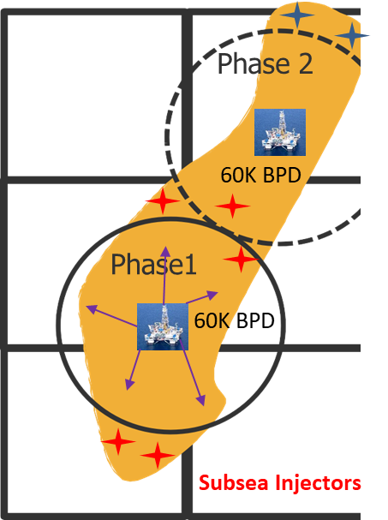
Why the FrPS with Movable Wellbay
is the Right Solution
Phased Approach Reduces Cost & Risk
50% of a Hub-style subsea development
Delivered in 3 years or less
Eliminates the need for drillship contract
Earliest dynamic reservoir information
Increases completion access and reserve recovery with direct vertical access
Safer hydraulic controlled equipment
Permanently moored with fully rated dual barrier risers
Eliminates the Macondo scenario
Standardized development scheme
Can be moved and reused over a wide range of water depths

