Slide 1
Typescript
TypeScript for Angular

Slide 2
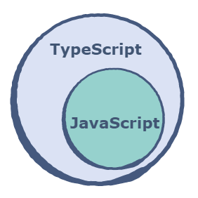
What is TypeScript?
TypeScript is JavaScript which is designed to scale web applications.
As an object-based scripting language, JavaScript is designed by Netscape in 1995. It has an open standard (ECMAScript) and a huge developer community.
TypeScript is an object-oriented language designed by Microsoft in 2012. It is a superset of JavaScript and can be used both a language and a set of tools. It provides optional static typing, which can help to catch errors as they appear making it ideal for large team collaborations.

Slide 3
Typescript for Angular
Angular is a modern framework built entirely in TypeScript, and as a result, using TypeScript with Angular provides a seamless experience.
The Angular documentation not only supports TypeScript as a first-class citizen, but uses it as its primary language.
With this in mind, Angular’s site will always be the most up-to-date reference for using Angular with TypeScript.

Slide 4
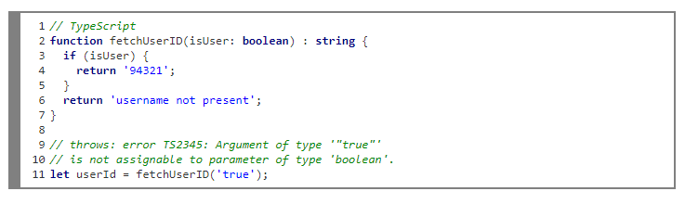
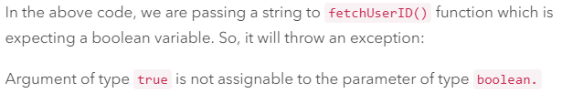
Typescript Advantages
TypeScript can point out compilation errors at the time of development.
It, as mentioned above, offers static typing which allows catching type errors at compile time and therefore gives a less painful development experience.
It is great for large team collaborations.
Perhaps the biggest feature that TypeScript provides is type-checking, which can prevent bugs such as the one below:
Errors & bugs

Slide 5
ES6 language features
ECMAScript 6, also known as ECMAScript 2015, is the latest version of the ECMAScript standard. ES6 is a significant update to the language, and the first update to the language since ES5 was standardized in 2009.
ES6 includes the following new features:
arrows
classes
template strings
default + rest + spread
let + const
modules
tail calls

Slide 6
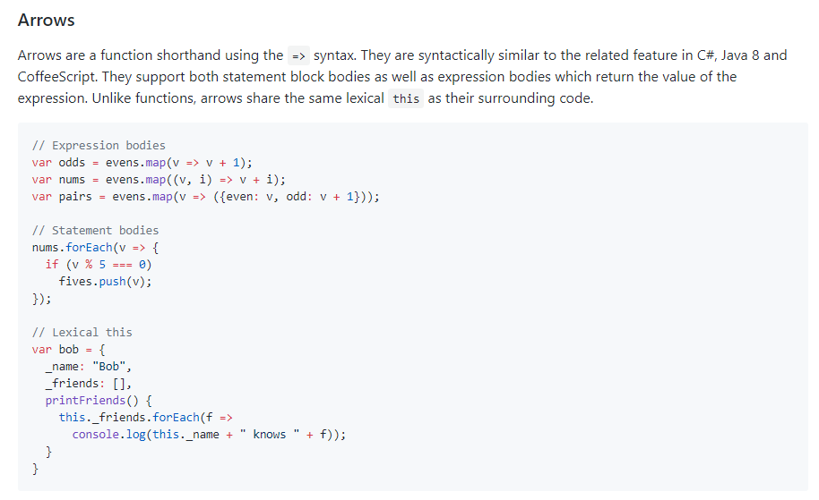

Slide 7
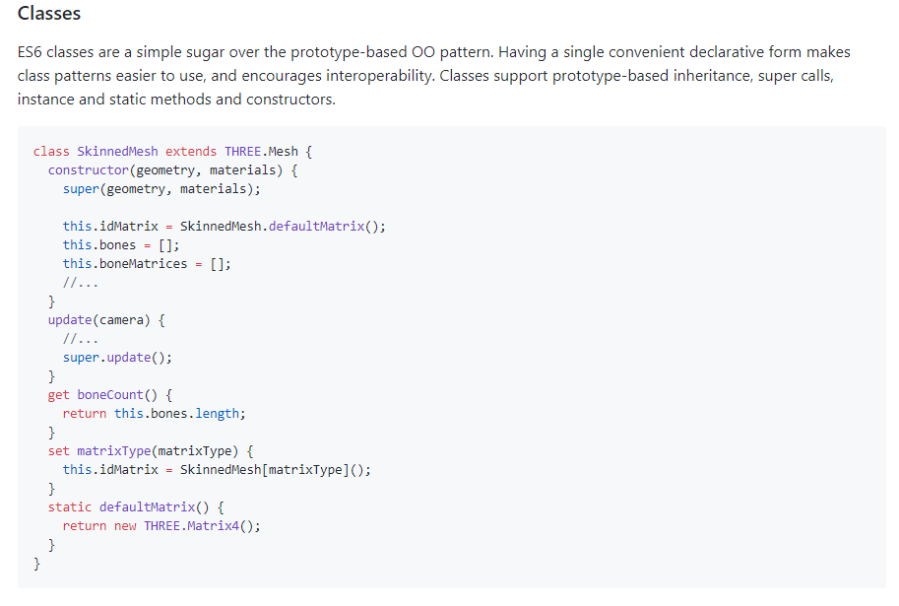

Slide 8
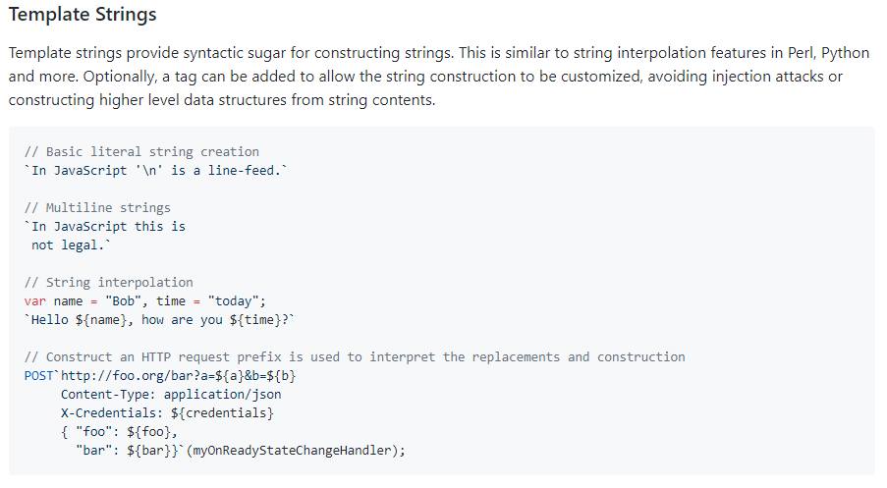

Slide 9
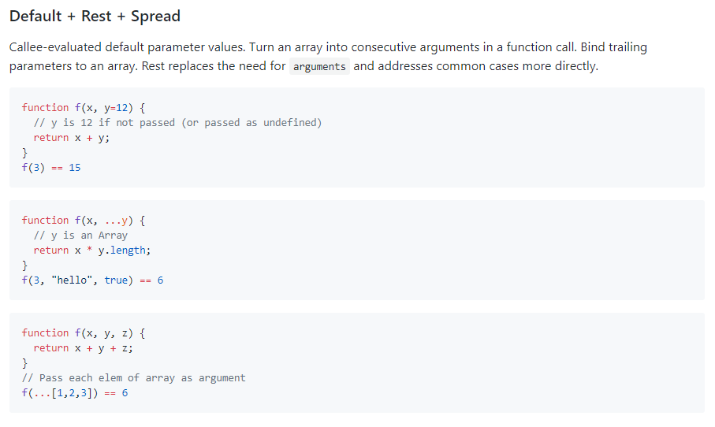

Slide 10
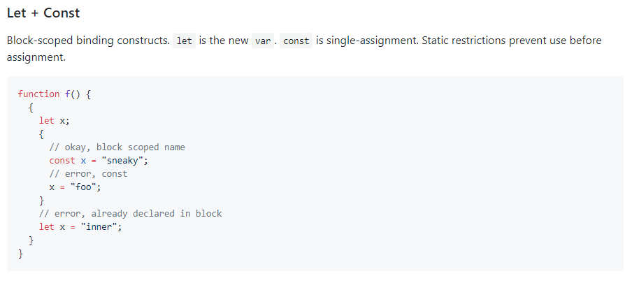

Slide 11
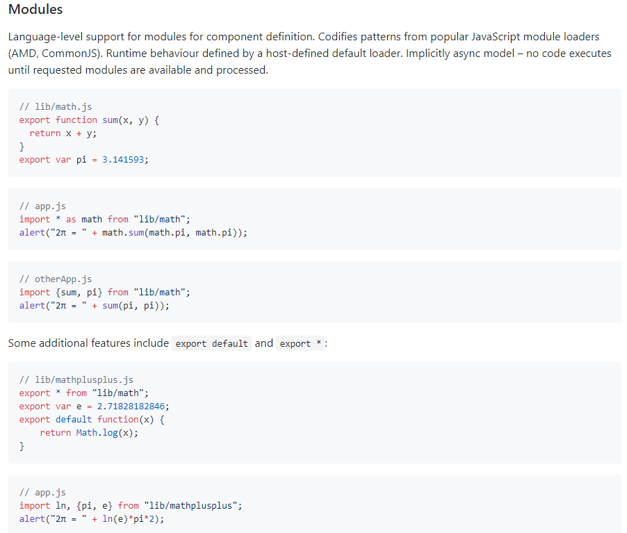

Slide 12
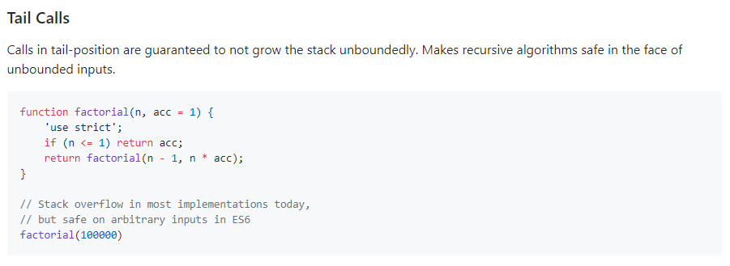

Slide 13
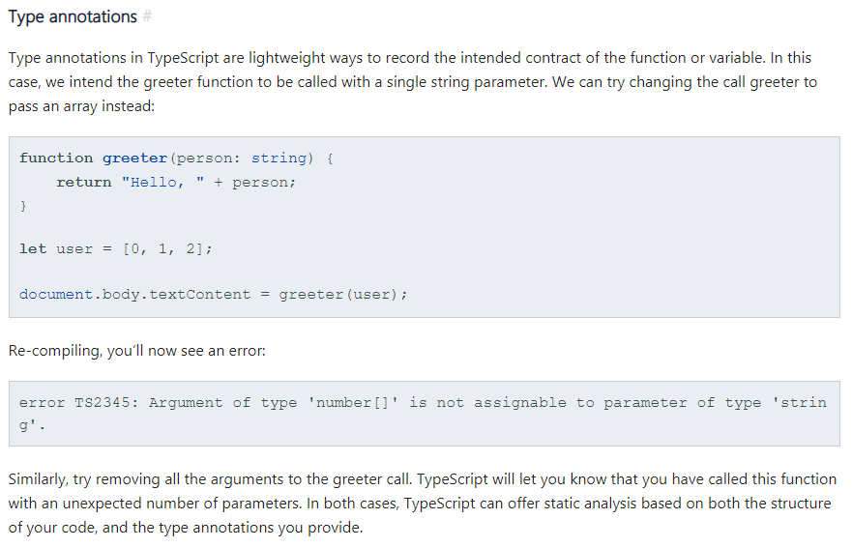

Slide 14
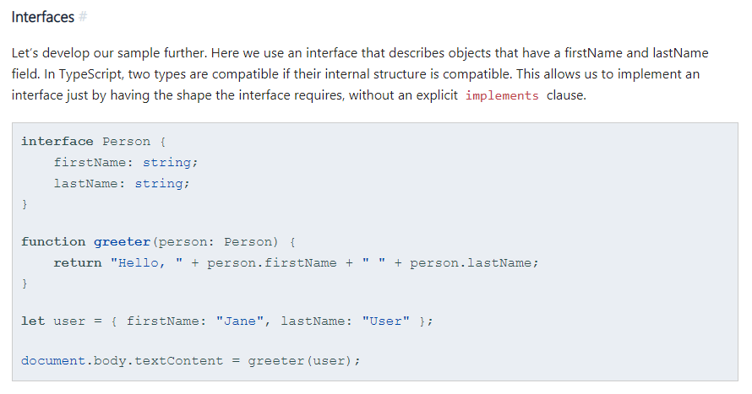

Slide 15
