Slide 1
Todo List App Hierarchy
Todo List App is the conceptual basis for many examples in this training.

Slide 2
We are going to create this Todo List App as part of this training, as part of this Application we will create below Pages, Components and Service
Pages
Home Page
Help Page
Components
Header Component
Add To do Component
To do List Component
To do List Item Component
Service
To do List Service

Slide 3
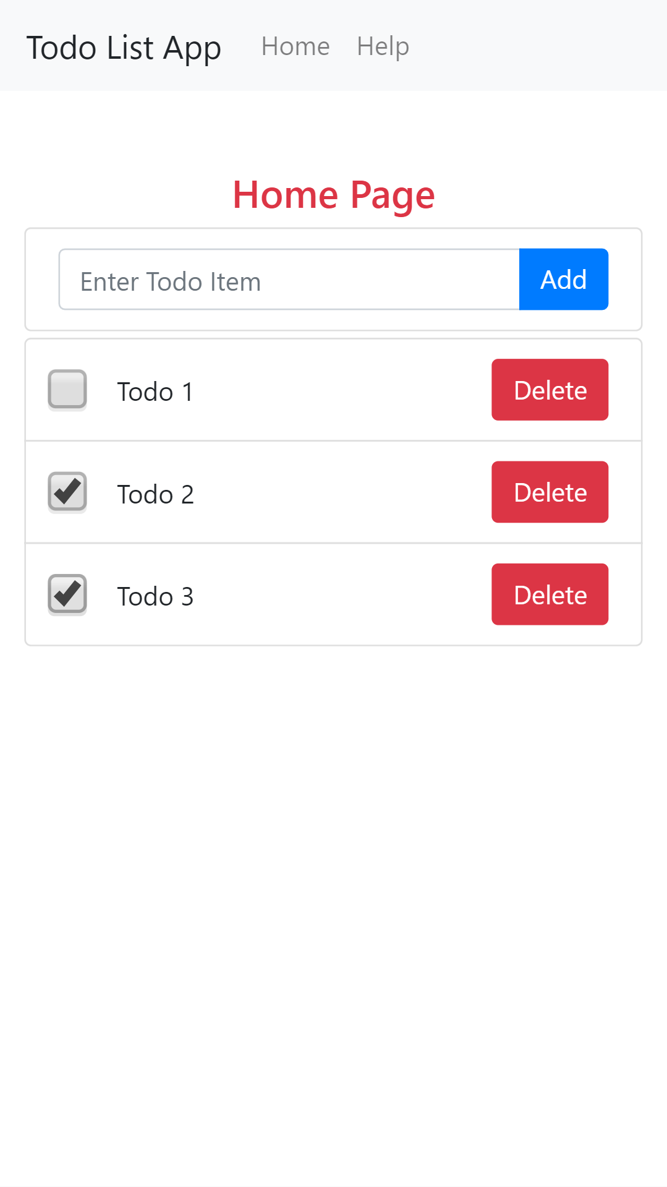
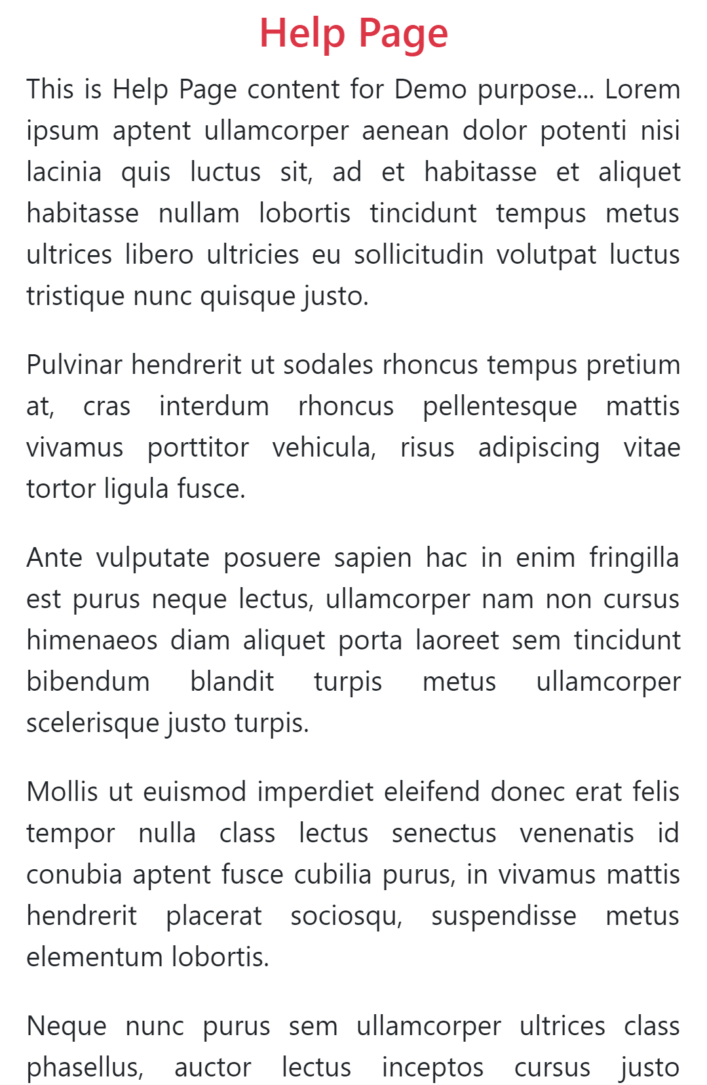

Slide 5
HeaderComponent
AppComponent
HomePageComponent
HelpPageComponent

Slide 6
HeaderComponent
HomePageComponent
AddTodoComponent
AppComponent
TodoListComponent
HelpPageComponent

Slide 7
HeaderComponent
HomePageComponent
AddTodoComponent
AppComponent
TodoListComponent
HelpPageComponent

Slide 8
HeaderComponent
HomePageComponent
AddTodoComponent
AppComponent
TodoListComponent
HelpPageComponent

Slide 9
HeaderComponent
HomePageComponent
AddTodoComponent
AppComponent
TodoListComponent
TodoListItemComponent
HelpPageComponent

Slide 10
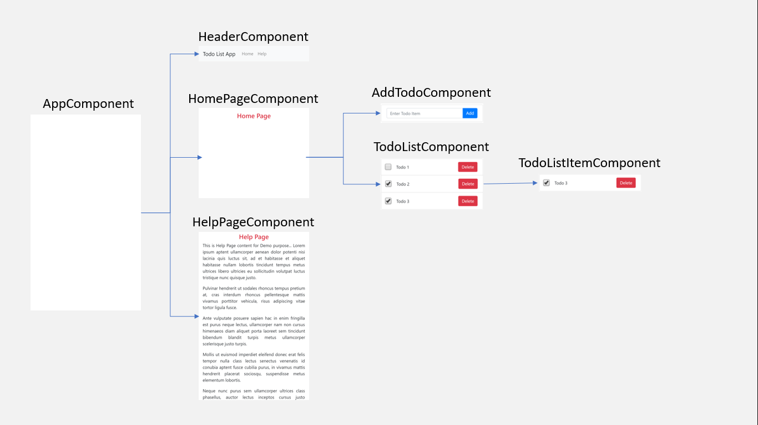

Slide 11
TodoListService
Dependency Injection

