Slide 1
Log-Based Attack Pattern Visualizer
Name - Budugu Vamshi
Enrollment number - 23STUCHH011066

Slide 2
OVERVIEW
Introduction
Pattern Visualization
Intrusion Detection
DFIR Tool
Visualizes suspicious attack patterns from authentication and system logs
Identifies intrusion behaviors such as repeated login failures
Lightweight and rule-based digital forensics assistive tool

Slide 3
Problem Statement
Volume Challenge
Time Constraint
Tool Gap
Security logs are large and difficult to interpret manually
Detecting attack patterns manually is time-consuming
Need simple tools for quick suspicious activity understanding

Slide 4





What Logs Contain
Timestamp
Identity
Source IP
Precise timing of each event occurrence
User or system identity information
Origin address of the connection
Event Type
System Source
Login success, failure, and other actions
Service or system generating the log

Slide 5
How Attackers Interact With Logs
Brute-Force
Unusual Hours
Unauthorized Access
Noise Generation
Repeated login attempts to crack passwords
Access attempts during off-peak times
Attempts to breach restricted systems
Creating false entries to hide traces

Slide 6
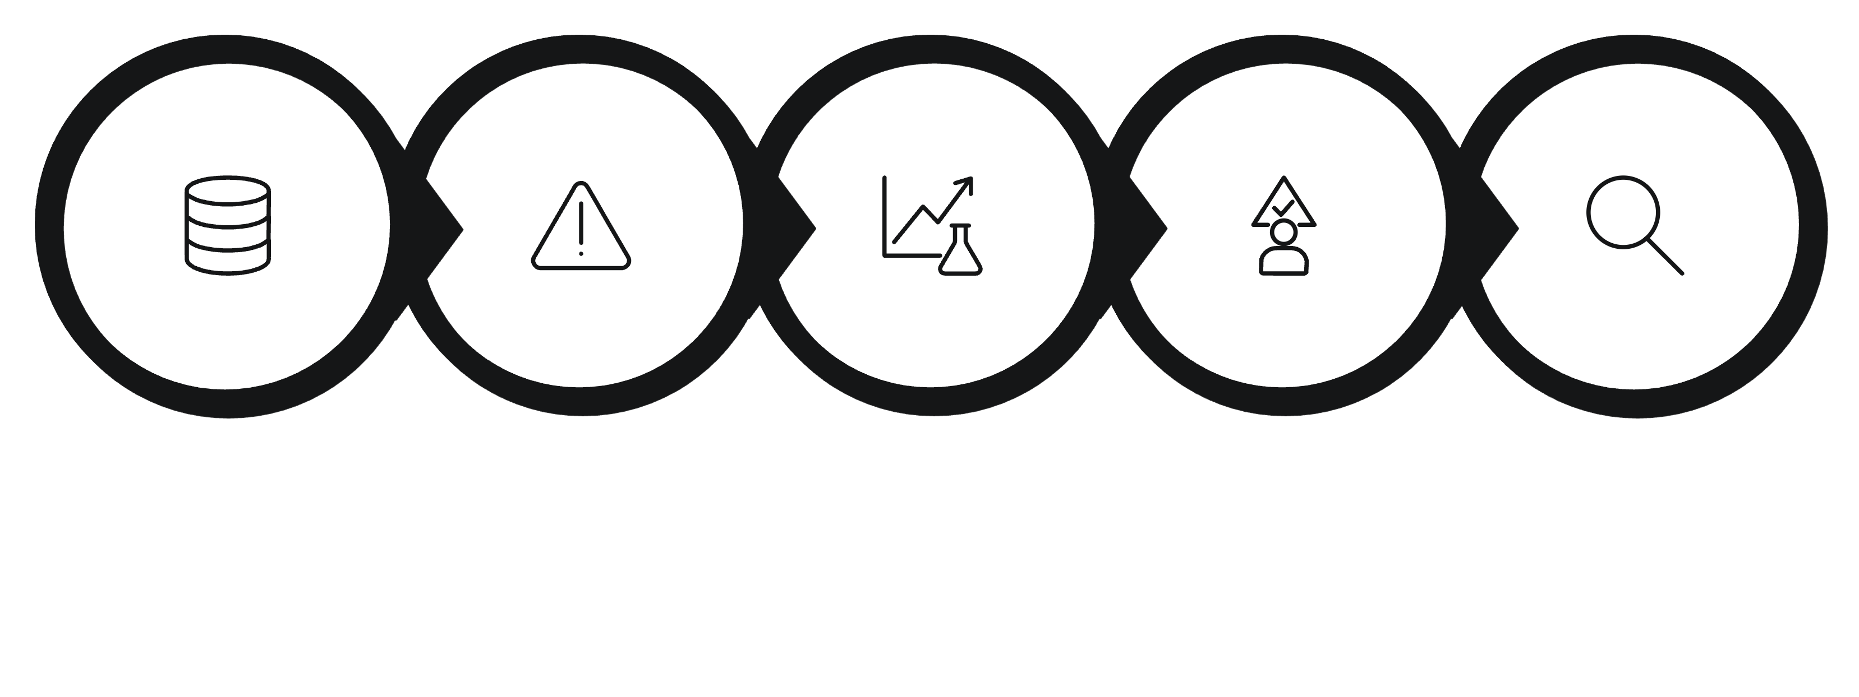





PROCESS
DFIR Response Process
Event Identification
Triage & Prioritization
Log Collection
Pattern Analysis
Investigation
A systematic approach to digital forensics and incident response

Slide 7

Project Workflow
Input Logs
Automated Pipeline
Parsing
The workflow transforms unstructured log data into clear visual patterns, enabling rapid threat identification and response.
Rule-Based Detection
Grouping Patterns
Streamlined process from raw logs to actionable insights

Slide 8
System Components
Log Parser
Visualization Module
Creates visual representations of attack patterns
Extracts structured data from raw log entries
Pattern Detector
Output Module
Applies rules to identify suspicious behaviors
Generates reports and actionable insights

Slide 9
Technology Stack
Core Language
Platform Support
Built with Python for flexibility and ease of use
Runs seamlessly on Linux, Windows, and macOS
Key Libraries
Lightweight Design
re (pattern matching)
datetime (temporal analysis)
collections (data structures)
matplotlib (visualization)
No external frameworks or specialized hardware required

Slide 10





SUMMARY
Methodology
Parse Logs
Extract structured data
Detect Patterns
Identify suspicious behaviors
Group Events
Cluster related activities
Generate Output
Create visual and textual reports

Slide 11
Limitations
Works only on static logs (no real-time monitoring).
Rule-based detection may produce false positives.
Visualization is simplified for demonstration purposes.
Does not replace professional security analysis tools.

Slide 12
Conclusion
The project demonstrates how attack patterns can be identified and visualized from logs.
It improves understanding of suspicious behavior using simple and explainable methods.
Focuses on clarity, simplicity, and reproducibility.

