Slide 1
Machine Learning: Using Graduation Dataset
SATYA SAI VAMSHI KRISHNA ARZA

Slide 2
PROJECT GOAL
The main goal of this project is to investigate the most important factors for a student’s admission to select the most accurate model to predict the student’s chances of admission using the Graduation Dataset.
In order to reach our Project Goal, we follow three important steps :
Data Cleaning
Data Exploration
Creating Predictive Models

Slide 3
DATA CLEANING
The dataset which we used for this project is known as Graduation dataset which is taken from Kaggle.
The dataset totally consists of around 500 observations and 9 variables.
The first column “Serial No” is removed as it is not used for predicting the target variable.
Out of the 9 variables eight of them are numerical variables, but the research variable which is given as numerical variables is actually a categorical variable as it only consists of 1’s and 0’s where “1” is indicated as “yes” and “0” is indicated as a “no”.

Slide 4
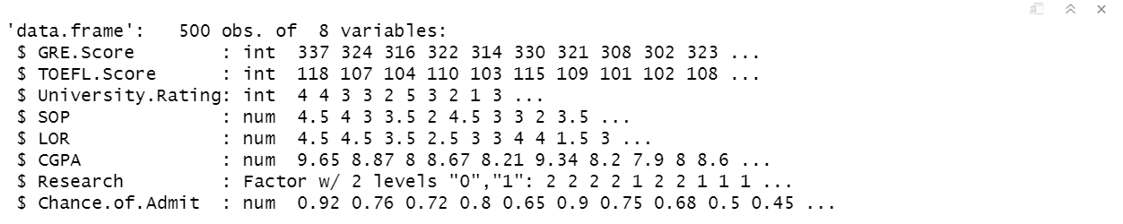
STRUCTURE OF DATASET

Slide 5
DATA EXPLORATION
There are no missing values in the given dataset
In order to check the association of variables with the target variable we use different plots and tests.
Corrplot and Cor.test are used in order to get the association between numeric variables.
For Categorical variables and numeric variables Boxplot and t.test is used to find the association between variables.

Slide 6
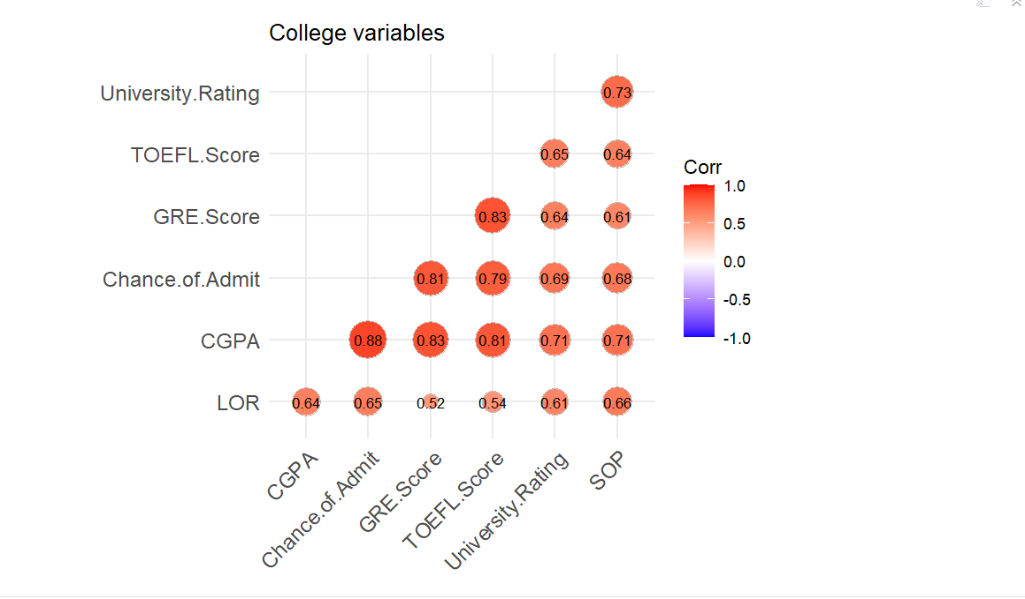
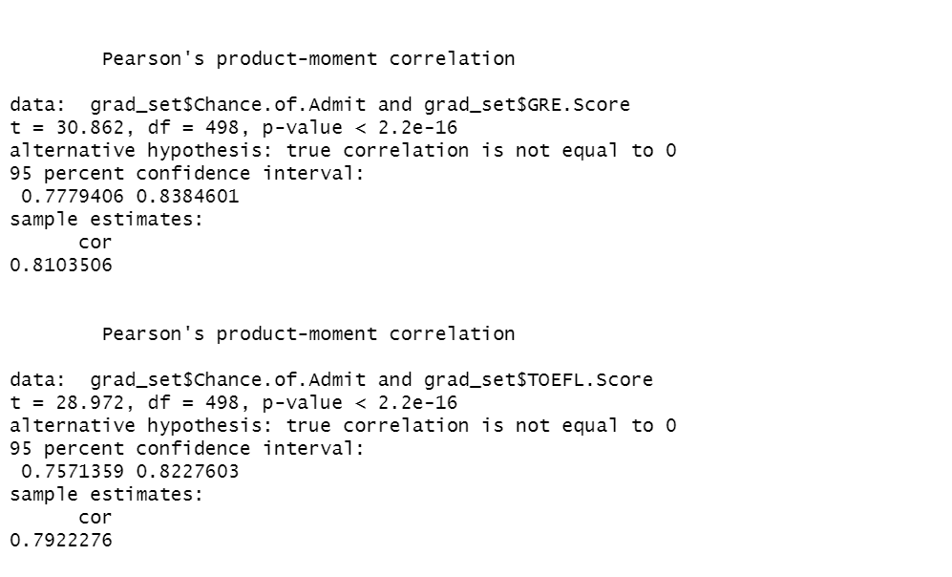
RELATIONSHIP BETWEEN NUMERIC VARIABLES

Slide 7
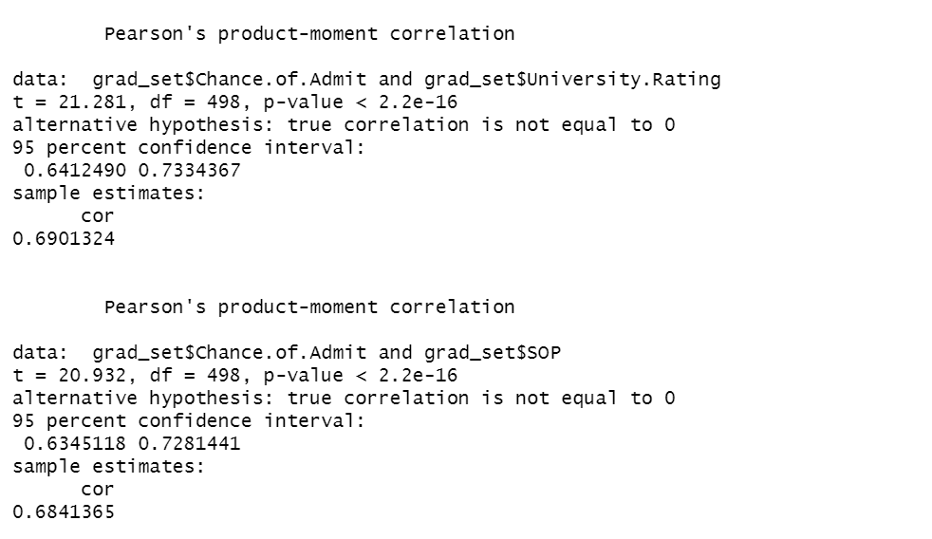
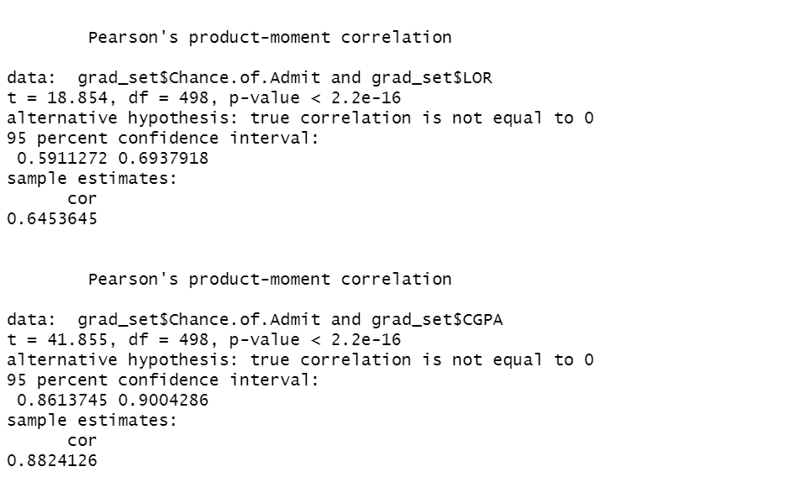

Slide 8
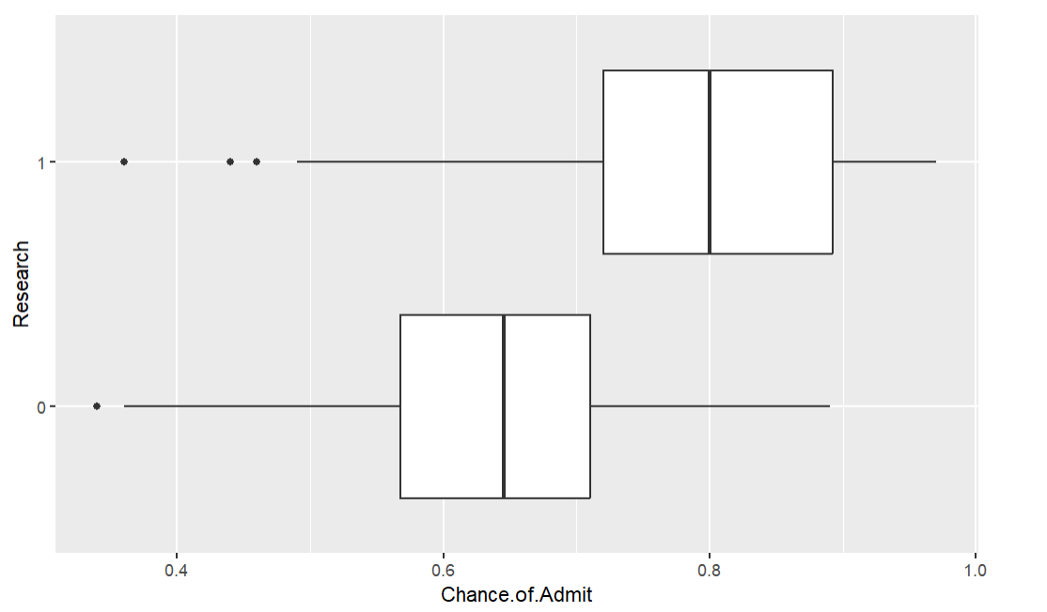
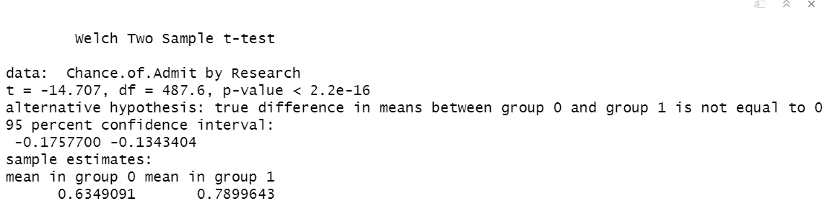
RELATION BETWEEN CATEGORICAL VARIABLES

Slide 9
CREATING PREDICTIVE MODELS
Next step is to partition the data set into training and test sets, this is done by splitting 80% for training and rest 20% for testing.
The models used for this are Linear Regression, Stepwise Regression, Regression Tree, Lasso, Ridge, Elastic, Gradient Boosting, Random Forest and SVM(Linear and Radial)
And for the last model which is a neural network model we scale the numeric variables using the “knnImpute” method. It basically scales and centers the data.

Slide 10
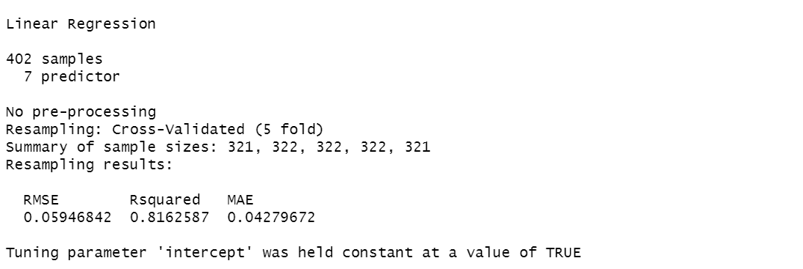
MULTIPLE LINEAR REGRESSION

Slide 11
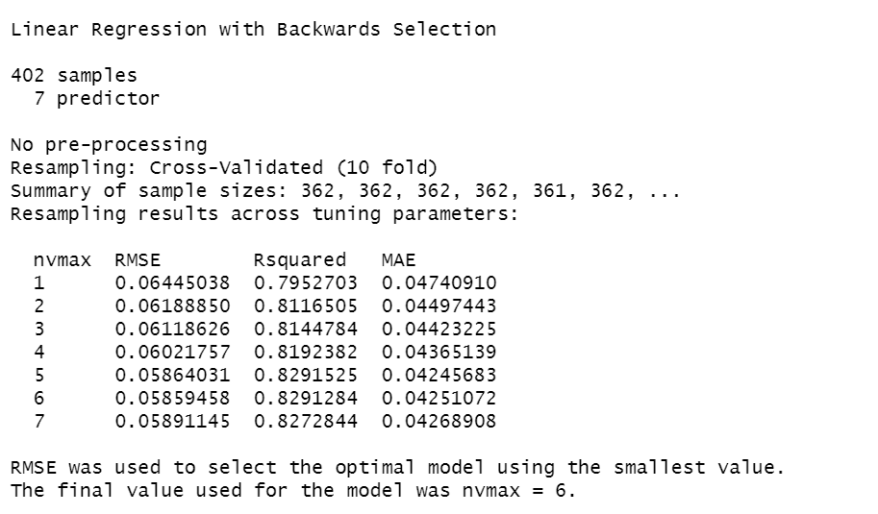
STEPWISE REGRESSION

Slide 12
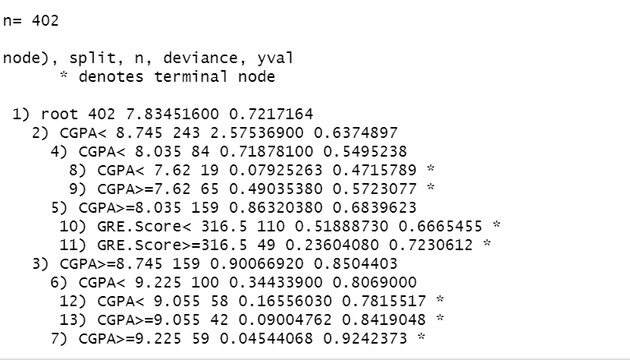
REGRESSION TREE

Slide 13
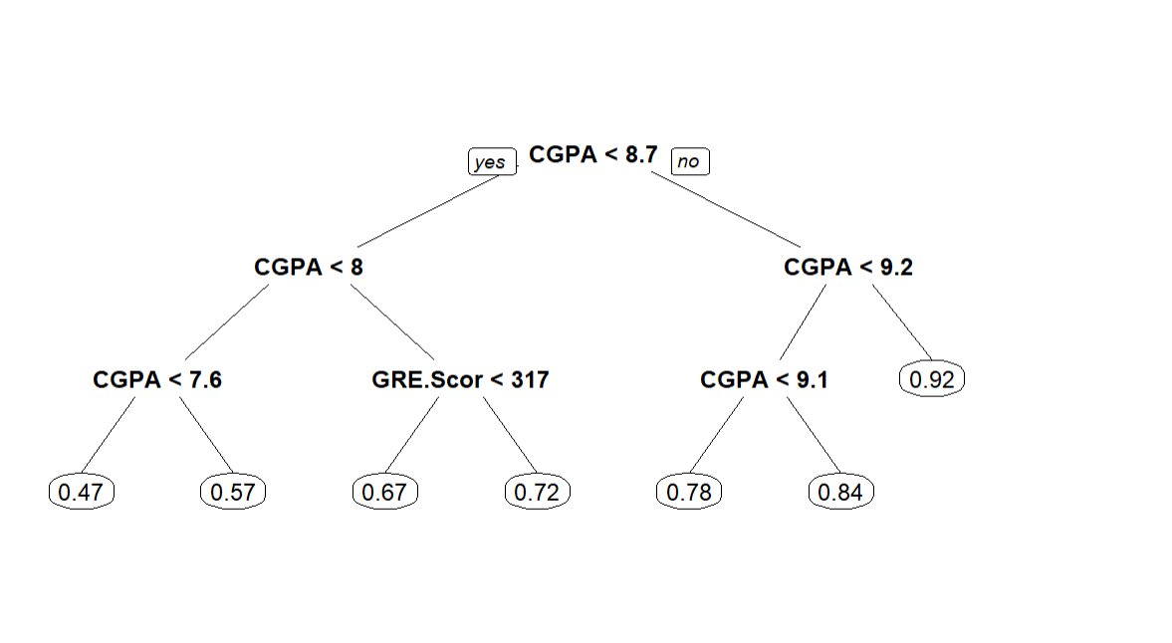
REGRESSION TREE GRAPH

Slide 14
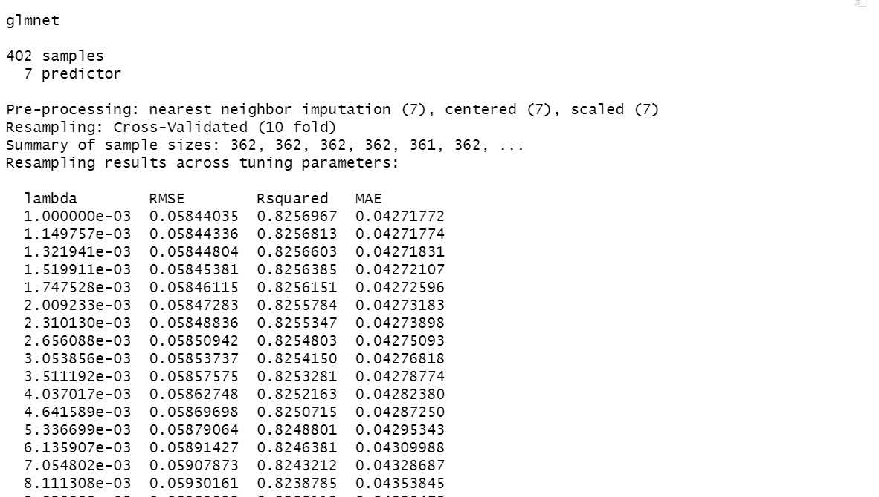
LASSO

Slide 15
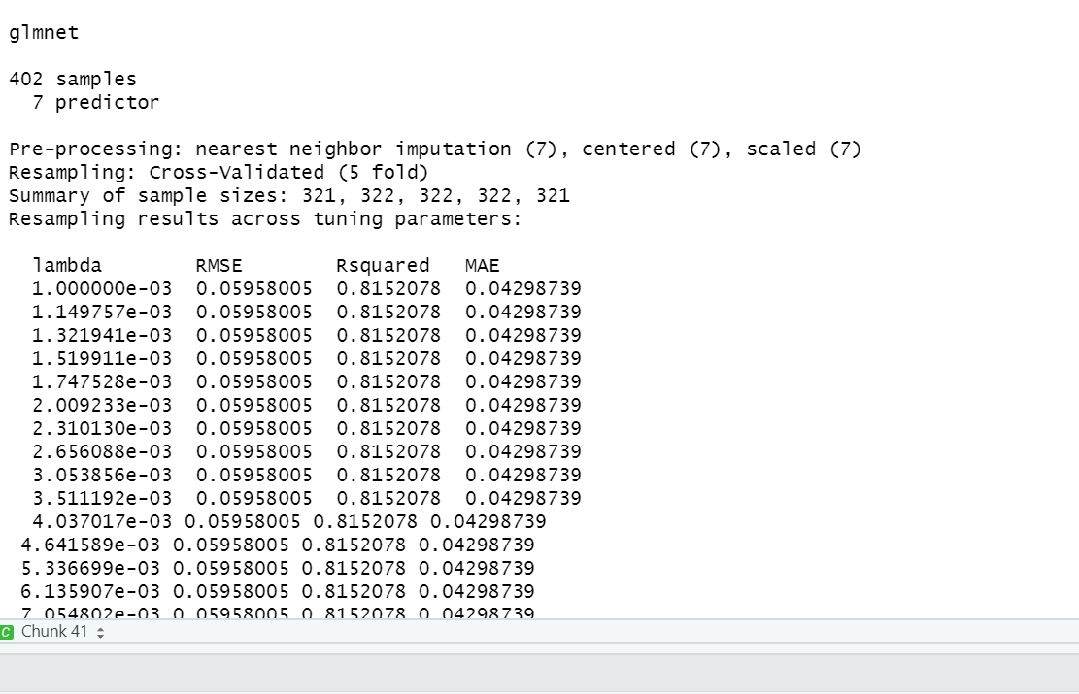
RIDGE

Slide 16
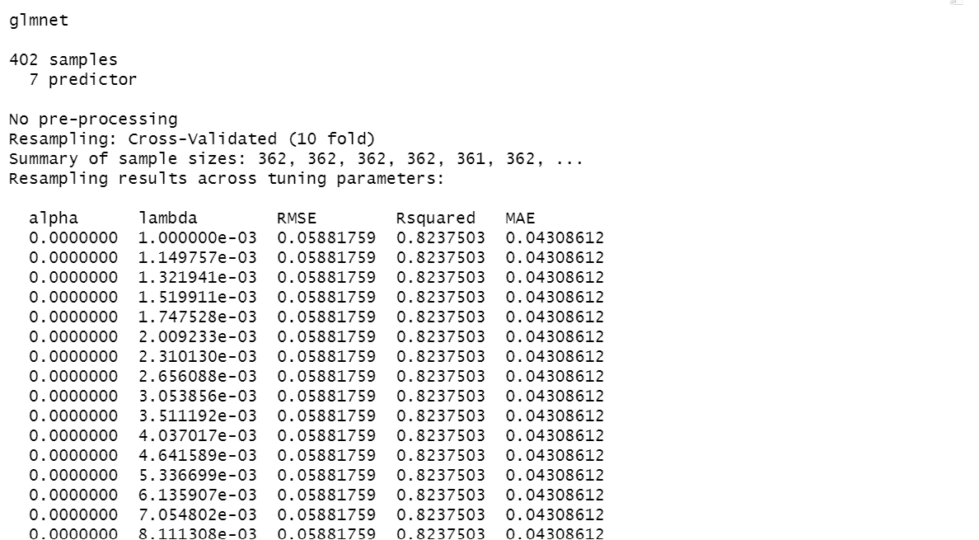
ELASTIC

Slide 17
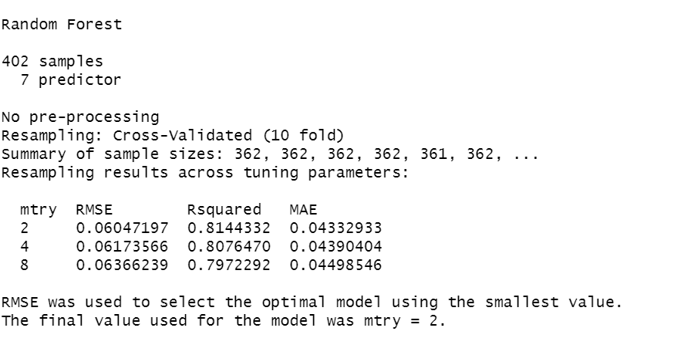
RANDOM FOREST

Slide 18
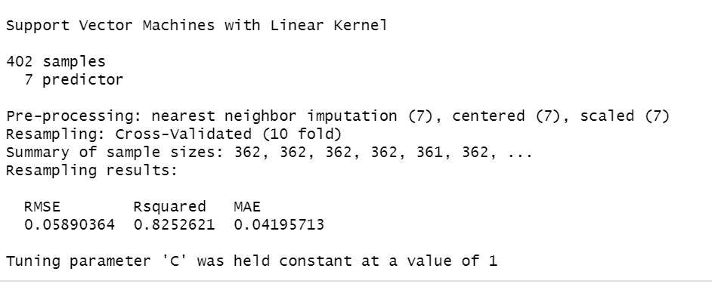
SVM(LINEAR)

Slide 19
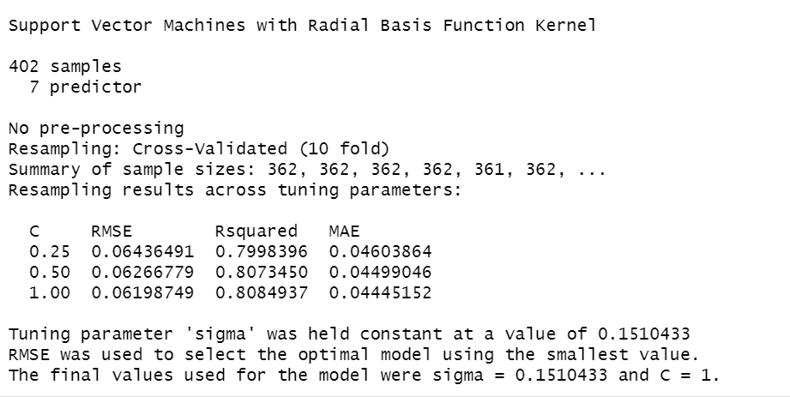
SVM(RADIAL)

Slide 20
CREATING PREDICTIVE MODELS(CONT)
Now, for the neural network model we further partition the training model which we created previously to 90% again into training and the rest 10% for validation purposes.
After training and fitting the model, we do tfruns to get the best hypertuned, parameters using that parameters we once again train the model and calculate the RMSE value.
And finally after comparing the RMSE vales of all the models, we can say that the model which has the least RMSE performs the best on the dataset.
In this we are using two hidden layers and two dropouts with no activation for final layer.

Slide 21
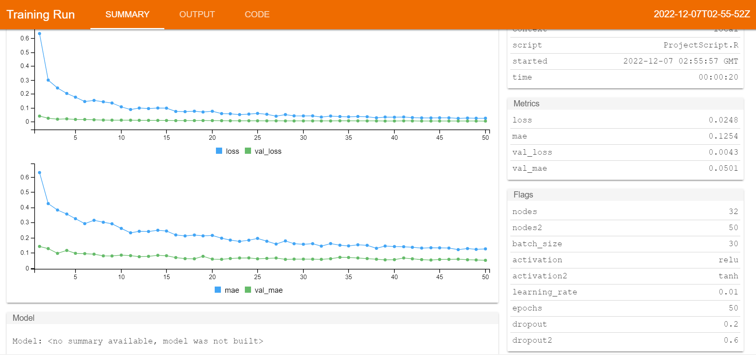
BEST HYPERTUNED MODEL
From the model we can see that the best hyper tuned parameters are nodes 32 and 50.
Activations to be used are “relu” and “tanh”.
Dropout rates to be used are 0.2 and 0.6, with a learning rate if 0.01
And finally, the epochs is 50 and batch size is 30
These are the hyperparameters used for next model tofind RMSE

Slide 22
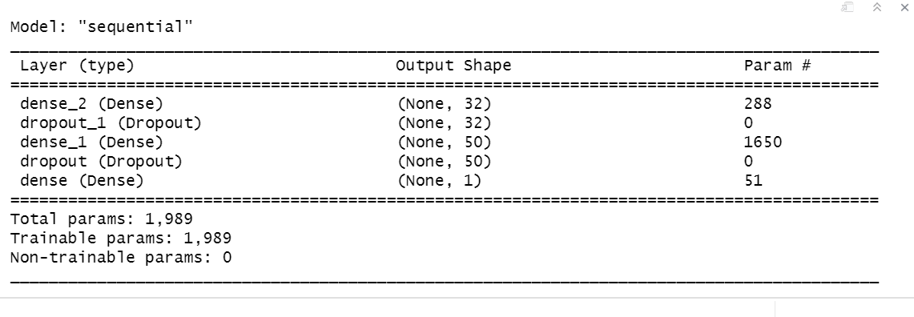

Slide 23
RESULTS
MODELS | RMSE
MULTIPLE LINEAR REGRESSION | 0.06374082
STEPWISE REGRESSION | 0.06357101
REGRESSION TREE | 0.07612620
LASSO | 0.06365759
RIDGE | 0.06335264
ELESTIC | 0.06355819
GRADIENT BOOSTING | 0.06506031
RANDOM FOREST | 0.06240536
SUPPORT VECTOR MACHINE(LINEAR) | 0.06444613
SUPPORT VECTOR MACHINE(RADIAL) | 0.06292008
NEURAL NETWORKS | 0.06585196

Slide 24
CONCLUSION
By looking at the above RMSE values we can conclude that RMSE value of Random forest is least, so it performs better on the dataset

Slide 25
Thank You

