Slide 1
Evaluating Community Detection
For Networks with Ground Truth Information
Slides are adapted from Chapter 3, Community Detection and Mining in Social Media. Lei Tang and Huan Liu, Morgan & Claypool, September, 2010 and slides from Qiang Yang, UST, Hong Kong

Slide 2
How to Compare Ground Truth to Identified Communities?
0, 1, 2
3, 4, 5
0, 2
1
3, 4, 5
Ground Truth
Identified Communities
How to measure the
quality of communities?
The number of communities after grouping can be different from the ground truth.
No clear community correspondence between clustering result and the ground truth.
Two directions that can help:
Looking at overlaps between ground truth and identified communities.
Looking at pairwise vertex memberships.
2
Notes:
Normalized mutual information considers all the possible community matching between the ground truth and the clustering result.
2

Slide 3

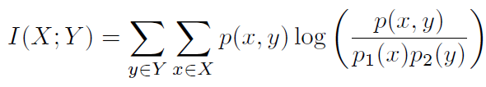

Overlaps between Ground Truth and Identified Communities
Normalized Mutual Information
Entropy: the information contained in a distribution.
Mutual Information: the shared information between two distributions.
Normalized Mutual Information (between 0 and 1).
Considering a partition as a distribution (probability of one node of belonging in one community), we can compute the matching between the community detection algorithm result and the ground truth.
JMLR03, Strehl
KDD04, Dhilon

Slide 4
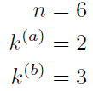
Normalized Mutual Information Formula
for Comparing Ground Truth and
Identified Communities with Example
Ground Truth (a)
Identified Communities (b)
0, 1, 2
3, 4, 5
0, 2
1
3, 4, 5
π^{b}
πª
Number of vertices
Number of Ground Truth Communities
Number of Identified Communities
Ground Truth
Identified Communities
Overlap Count Table
ID | Size ( )
h=1 | 3
h=2 | 3
ID | Size ( )
l=1 | 2
l=2 | 1
l=3 | 3
 | Identified Communities
Ground Truth |  | l=1 | l=2 | l=3
 | h=1 | 2 | 1 | 0
 | h=2 | 0 | 0 | 3
4

Slide 5



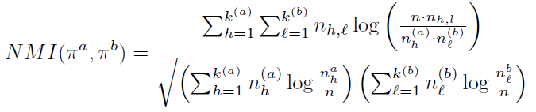
Normalized Mutual Information (NMI) Formula
Entropy:
Mutual Information:
Normalized Mutual Information:
5
Notes:
Pi_a, Pi_b denote different partitions.
n_h^a is the number of nodes in Partition a assigned to h-th community;
n_l^b is the number of nodes in Partition b assigned to l-th community;
n_h, l is the number of nodes assigned to h-th community in partitition a, and l-th community in partition b.
k^{(a)} is the number of communities in partition a,
k^{(b)} is the number of communities in partition b.
5

Slide 6
NMI Calculation
Number of vertices
Number of Ground Truth Communities
Number of Identified Communities
Identified
Communities
Ground Truth
Overlap Count Table
ID | Size ( )
h=1 | 3
h=2 | 3
ID | Size ( )
l=1 | 2
l=2 | 1
l=3 | 3
 | Identified Communities
Ground Truth |  | l=1 | l=2 | l=3
 | h=1 | 2 | 1 | 0
 | h=2 | 0 | 0 | 3
=0.8278
6

Slide 7
Pairwise Vertex Memberships to Compare Ground Truth and Identified Communities
Consider all the possible pairs of nodes and check whether they reside in the same community.
An error occurs if:
Two nodes belonging to the same ground truth community are assigned to different identified communities after clustering.
Two nodes belonging to different ground truth communities are assigned to the same identified community.
7

Slide 8
Confusion Matrix for Pairwise Vertex Memberships
0, 1, 2
3, 4, 5
0, 2
1
3, 4, 5
Ground Truth
Identified Communities
True Positive (TP)
 |  | Identified Communities
 |  | C(v_{i}) = C(v_{j}) | C(v_{i}) != C(v_{j})
Ground Truth | C(v_{i}) = C(v_{j}) | 4 | 2
 | C(v_{i}) != C(v_{j}) | 0 | 9
False Negative (FN)
True Negative (TN)
False Positive (FP)
C(v_{i}) refers to community that v_{i} is a member of
8

Slide 9
Metrics for Pairwise Vertex Memberships
Recall (R) is the proportion of vertex pairs in same ground truth communities that are also in the same identified communities.
R = TP/(TP+FN) = 0.6667
Precision (P) is the proportion of vertex pairs in the same identified communities that are also in same ground truth communities.
P = TP/(TP+FP) = 1.0
F-Measure (F) is the harmonic mean of precision and recall.
F = 2* (P*R)/(P+R) = 0.8
Specificity (S) is the proportion of vertex pairs not in the same ground truth communities that are also not in the same identified communities.
S=TN/(TN+FP) = 1.0
RAND Index (RI), also called the simple matching coefficient, measures both placing a vertex pair belonging to the same ground truth community in the same identified community, and placing a vertex pair not belonging to the same ground truth community in different identified communities, i.e., it accounts for both specificity and sensitivity of the clustering.
RI = (TP+TN)/(TP+FP+FN+TN) = 0.8667

