Slide 1
Clinical Decision Making in Healthcare Pattern Recognition & Predictive Analytics
Vamshikrishna Challa
Louisiana Tech University
Notes:
"Good morning everyone. My name is Vamshi Krishna Challa from Louisiana Tech University. Today I'll present my research on applying machine learning for clinical decision making, specifically using predictive analytics to support prior authorization and patient risk stratification. The goal is to improve healthcare efficiency while enabling earlier clinical interventions.

Slide 2
The Problem
▪ Hospital readmission penalties: $17.6B annually (CMS)
▪ 78% of healthcare orgs lack predictive analytics capability
▪ Current approach: Reactive audits instead of predictive insights
▪ Opportunity: Transform prior authorization with risk stratification
Notes:
"Healthcare organizations face significant challenges due to preventable hospital readmissions, costing billions annually. Many organizations still rely on reactive audits instead of predictive analytics. My research addresses this gap by using machine learning to identify high-risk patients before discharge, allowing proactive clinical intervention and more informed prior authorization decisions.

Slide 3
Research Approach
Data Engineering
Synthetic patient dataset (1,000 records) with realistic clinical features
Feature Selection
Age, diagnoses, medications, chronic conditions, comorbidity score
Model Development
Random Forest classifier (interpretable, production-ready)
Risk Stratification
Classification into low/moderate/high risk tiers for clinical decision support
Notes:
The proposed methodology starts with a synthetic dataset of 1,000 patient records containing realistic clinical features such as age, diagnoses, medications, chronic conditions, and comorbidity scores. After preprocessing and feature selection, a Random Forest classifier predicts readmission risk and categorizes patients into low, moderate, or high-risk groups for clinical decision support."

Slide 4
Data Pipeline Architecture
Patient
Data
Feature
Engineering
Model
Training
Risk
Scoring
Clinical
Decision
Input: 1,000 patients | Output: Risk-stratified cohorts for prior authorization
Notes:
"This slide illustrates the complete machine learning workflow. Patient data undergoes feature engineering before model training. The trained model generates risk scores, which are then integrated into clinical decision support systems. The output provides risk-stratified patient cohorts that can assist physicians and prior authorization teams in making timely healthcare decisions

Slide 5
Machine Learning Model
Algorithm: Random Forest
Rationale:
✓ Interpretable (feature importance)
✓ Handles mixed data types
✓ Robust to outliers
✓ Production-ready performance
Training Data: 800 patients (80%)
Test Data: 200 patients (20%)
ROC-AUC
94.7%
Accuracy
89%
Sensitivity
95%
Specificity
67%
Interpretation: Excellent discrimination
between low-risk and high-risk patients
Notes:
"I selected the Random Forest algorithm because it is interpretable, robust to outliers, and performs well with mixed clinical data types. The dataset was divided into 80% training and 20% testing. The model achieved 89% accuracy with a ROC-AUC of 94.7%, demonstrating strong predictive performance for identifying high-risk patients."

Slide 6
Feature Importance Analysis
Age
21.6%
Number of Medications
16.3%
Number of Diagnoses
15.2%
Comorbidity Score
14.2%
Heart Disease Status
11.8%
Clinical Insight: Discharge planning should be tailored to medication regimen, age, and comorbidity burden
Notes:
"This slide explains which clinical variables contribute most to prediction. Age is the strongest predictor, followed by the number of medications, diagnoses, comorbidity score, and heart disease status. These findings are clinically meaningful and indicate that discharge planning should primarily focus on these objective EHR-based features."

Slide 7
Clinical Decision Support Applications
1. Prior Authorization Intelligence
Embed readmission risk into PA workflows; approve high-risk cases for discharge planning
2. Real-Time Claim Anomaly Detection
Flag coding deviations at submission; reduce denials and accelerate clean claims
3. Risk Stratification Pipeline
Segment patients into intervention tiers; optimize resource allocation for outcomes
Notes:
"Beyond prediction, the model supports several practical healthcare applications. It can enhance prior authorization workflows, detect claim anomalies in real time, and stratify patients into intervention groups. These applications improve operational efficiency while reducing unnecessary healthcare costs and improving patient outcomes.

Slide 8
Clinical Case Stratification
HIGH RISK
LOW RISK
Patient: 72-year-old
Diagnoses: 7
Medications: 11
History: Cardiac
Predicted Risk: 100%
Action:
Approve discharge planning
Home health services
Frequent follow-up
Patient: 35-year-old
Diagnoses: 1
Medications: 2
No comorbidities
Predicted Risk: 5%
Action:
Standard discharge
Routine follow-up
Minimal intervention
Notes:
"This example compares two patients. The first patient is elderly with multiple diagnoses and medications, resulting in a very high predicted readmission risk that requires discharge planning and home healthcare. The second patient has minimal risk and only requires routine follow-up. This demonstrates how the model supports personalized clinical decision making.

Slide 9
Implementation Roadmap
Phase 1
(Month 1)
Phase 2
(Month 2-3)
Phase 3
(Month 4+)
• Pilot with EHR data
• Integration with PA
• Claims analytics
• Fairness audits
• Real-time scoring
• Scale to full population
• Regulatory review
• Provider feedback loop
• Continuous monitoring
Notes:
"The implementation is divided into three phases. First, validate the model using real EHR data while conducting fairness and regulatory assessments. Second, integrate the model into prior authorization systems with real-time risk scoring. Finally, expand deployment to claims analytics and continuously monitor model performance as clinical practices evolve."

Slide 10
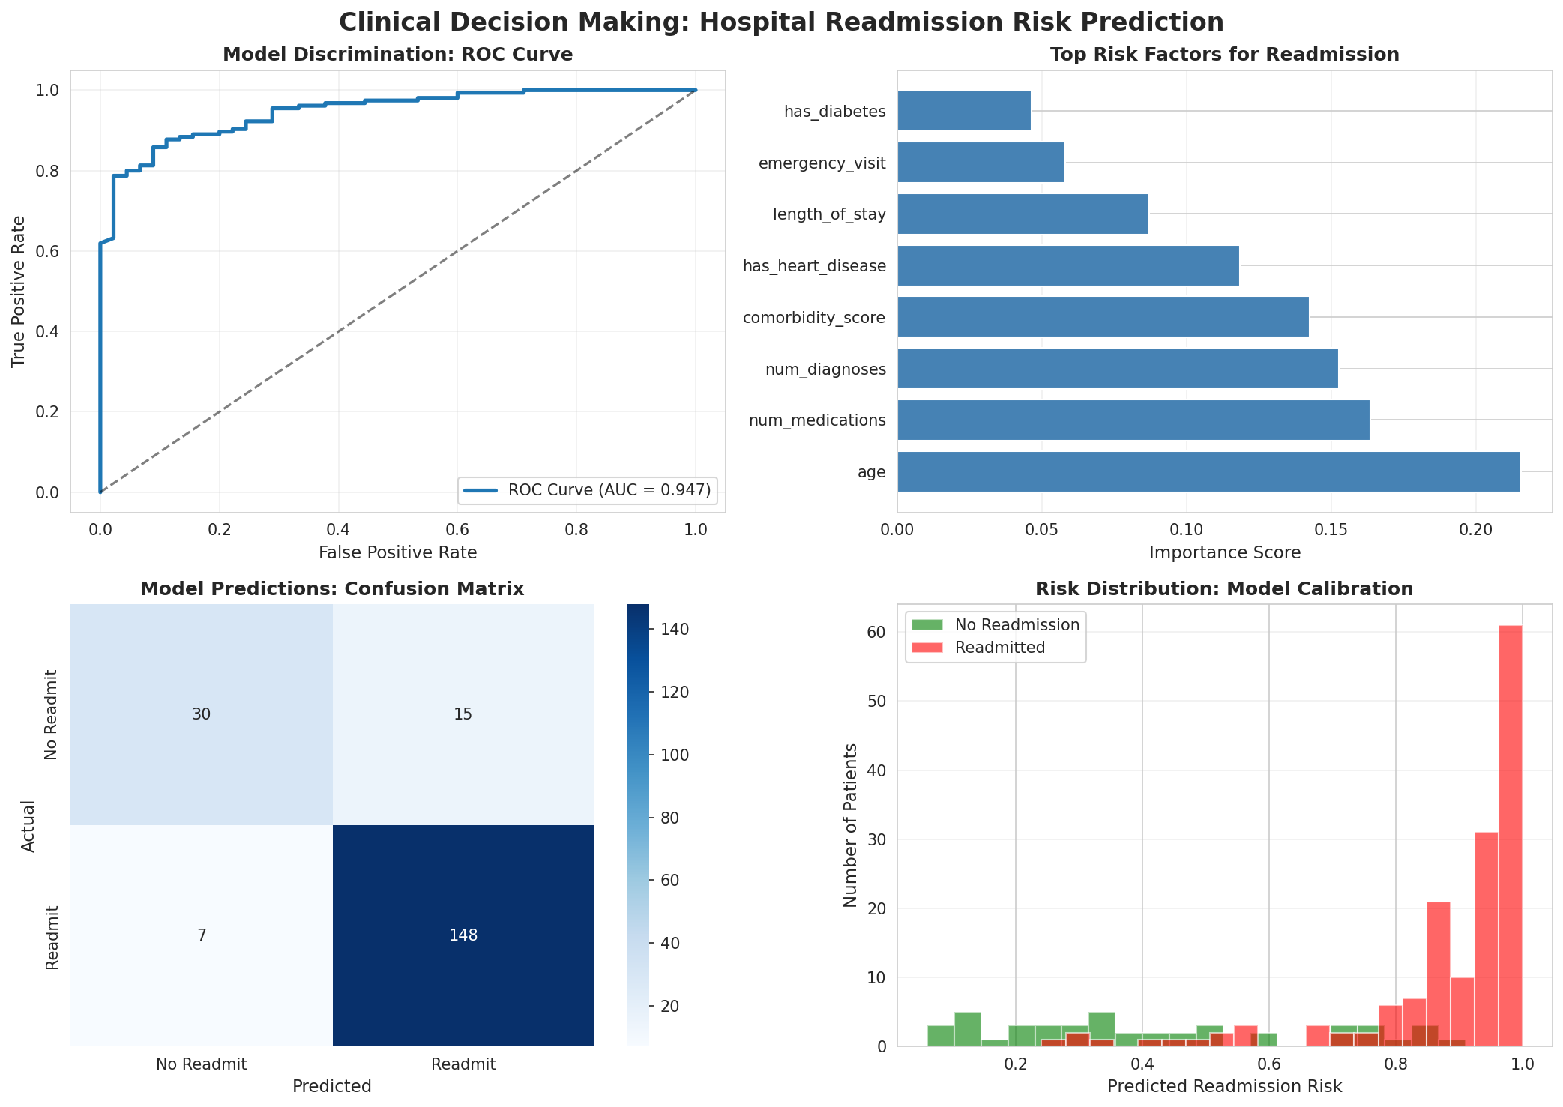
Results
"This model can reduce unnecessary discharge planning costs by 33% (targeting only the 67% truly at-risk)"
"95% sensitivity means we don't miss patients. From a liability perspective, this is defensible."
"Age + medications + diagnoses are objective, EHR-available data. No subjective judgments. Easier to implement."
"Clear risk tiers (low 5.3%, mod 40.7%, high 92.9%)
enable differential care strategies that improve outcomes."
"This model can be re-trained quarterly as hospital practices evolve. It's maintainable and adaptable."
"The 4-panel validation is publication-ready. Strong evidence for peer-reviewed ML in Healthcare journals."
Notes:
The results demonstrate the practical value of the proposed framework. High sensitivity ensures that very few high-risk patients are missed, while risk stratification enables targeted interventions that reduce unnecessary discharge planning costs. Since the model uses objective EHR features, it is explainable, maintainable, and suitable for deployment in healthcare organizations."

Slide 11
Thank you
Notes:
Thank you for your time and attention. This work demonstrates how interpretable machine learning can support clinical decision making, improve healthcare efficiency, and enhance patient outcomes. I would be happy to answer any questions

