Slide 1
Educational Performance Dashboard
Power BI Project
GORREPATI VAMSHI KRISHNA

Slide 2
Introduction
This project analyzes student performance data using Power BI and interactive dashboards.

Slide 3
Objective
Analyze performance, compare scores by gender, visualize trends, and build dashboards.

Slide 4
Dataset Information
Dataset: StudentsPerformance.csv
Contains gender, math, reading, writing scores and related attributes.

Slide 5
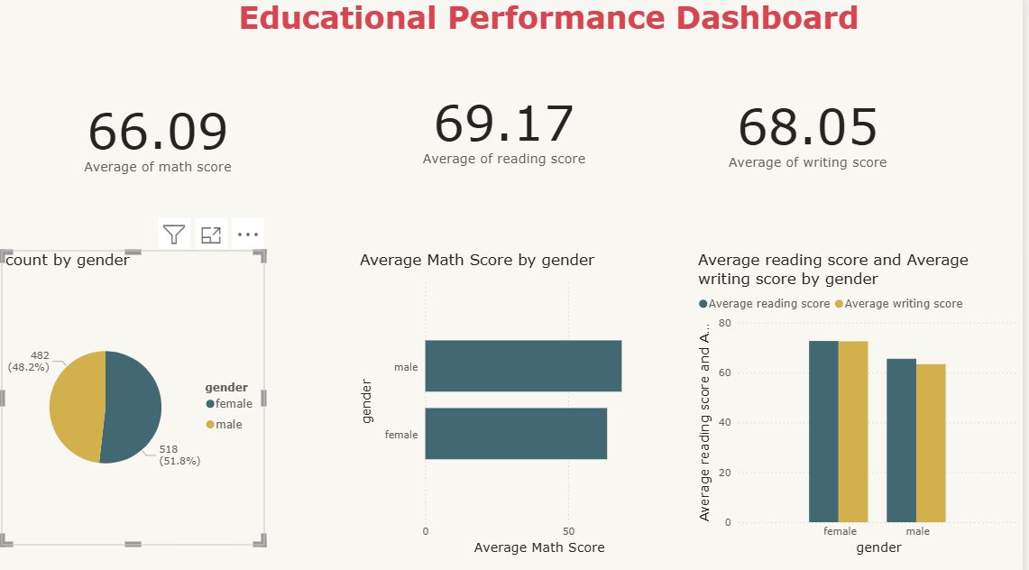
Dashboard Overview

Slide 6
Key Insights
Female students slightly outperformed males in reading and writing. Reading score average is highest.

Slide 7
Tools Used
Power BI Desktop, CSV Dataset, Data Visualization.

Slide 8
Conclusion
The dashboard provides meaningful insights into student performance and supports data-driven decisions.

