Slide 1
Human Resources Analytics Dashboard
Power BI Project
GORREPATI VAMSHI KRISHNA

Slide 2
Introduction
This project analyzes employee attrition, income, satisfaction and departmental distribution using Power BI.

Slide 3
Objective
Analyze attrition, employee distribution, job satisfaction and support HR decisions.

Slide 4
Dataset Information
Dataset: WA_Fn-UseC_-HR-Employee-Attrition.csv
Contains employee, department, income and attrition information.

Slide 5
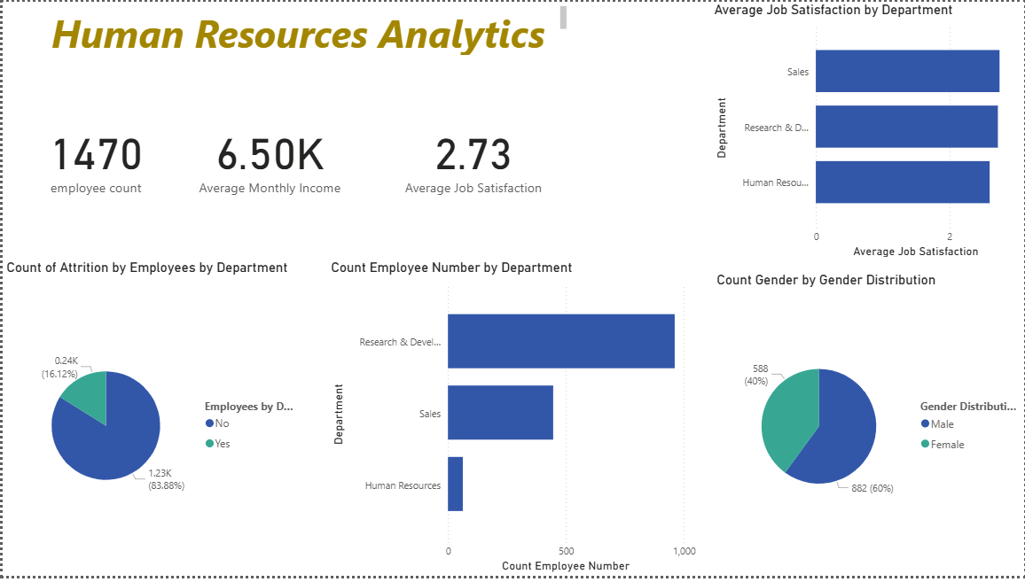
Dashboard Overview

Slide 6
Key Insights
Total Employees: 1470
Average Monthly Income: 6.50K
Average Job Satisfaction: 2.73
Research & Development has highest employee count.

Slide 7
Tools Used
Power BI Desktop, CSV Dataset, Data Visualization

Slide 8
Conclusion
The dashboard helps HR teams understand employee trends and make data-driven decisions.

