Slide 1
Cyberbullying Image Classification using Artificial Intelligence for Safer Online Platform

Slide 2
ABSTRACT
The impact of cyber bullying is immeasurable on the life of victims as its very subjective to how the person would tackle this. The message may be a bully for victims, but it may be normal for others. The ambiguities in cyber bullying messages create a big challenge to find the bully content. Some research has been reported to address this issue with textual posts. However, image-based cyber bullying detection is received less attention. This Project aims to develop a model that helps to prevent image-based cyber bullying issues on social platforms posts.
We proposed a transfer learning-based automated model to detect image-based cyber bully posts from the social platform. The transfer learning models are capable of extracting hidden contextual features from cyber bullying posts. Our experiment consists of two sets of datasets (i.e.) images consisting of cyber bullying and non cyber bullying images. The datasets can be useful for future researchers to extend the research. Finding the best-suited model to detect the bully images is a challenging task, hence experimented with both DL and transfer learning models to find the best model. The experimental outcomes confirmed that the transfer learning models are the better choice for predicting image-based cyber bullying posts.

Slide 3
INTRODUCTION
Cyberbullying refers to the act of using digital communication tools, such as social media, text messages, or emails, to harass, threaten, or intimidate individuals. It often involves sending hurtful or offensive messages, spreading rumors, sharing private information, or posting derogatory comments or images online. Cyberbullying can have severe emotional and psychological effects on the victims.
Cyberbullying was a growing concern in India, especially among teenagers and young adults. It was estimated that a significant portion of Indian youth had experienced some form of cyberbullying or online harassment.
India had cyber laws in place to address online harassment and cyberbullying. The Information Technology Act, 2000, was amended to include provisions related to cyberbullying and online harassment.
Detecting cyberbullying in images can be a challenging task, but deep learning (DL) image processing techniques can be used to help identify and address this issue.

Slide 4
LITERATURE REVIEW
Paper References | Paper Name | Type of Cyberbullying Approach | Accuracy
Kansara and Shekokar (2015) | A Framework for Cyberbullying Detection in Social Network | Text and images, BOVW and (SVM) classifier | -
Zhong et al. (2016) | Content-Driven Detection of Cyberbullying on the Instagram Social Network | Images with text, NLP, BoW, Word2Vec classifying | Overall: 68.55%, using captions: 95.00%
Ali et al. (2018) | Cyberbullying Detection: An Overview | Text, NLP and Machine Learning | -
Hitkul et al. (2019) | Maybe look closer? Detecting trolling-prone images on Instagram | Images, Transfer Learning and Machine Learning (Inception V3: 65.62% val_acc, VGG16: 61.81% test acc) | -
Talpur and O’Sullivan (2020) | Cyberbullying severity detection: A machine learning approach | Text, Machine Learning classifiers (SVM & Random Forest) | 89% to 91%

Slide 5
LITERATURE REVIEW
Paper References | Paper Name | Type of Cyberbullying Approach | Accuracy
Muneer and Fati (2020) | A comparative analysis of machine learning techniques for cyberbullying detection on Twitter | Text, Machine learning (Logistic Regression) | 90.57%
Chakravarthi et al. (2021) | Meme classification using deep learning | Images, Transfer Learning (resnet50: training 0.87, validation 0.92)
Lopez-Vizcaíno ´ et al. (2021) | Early detection of cyberbullying on social media networks | Text, Supervised Learning | -
Vishwamitra et al. (2021) | Towards Understanding and Detecting Cyberbullying in Real-world Images | Images based on text, Multimodal classification | 93.36%
Jadhav et al. (2023) | CYBERBULLYING DETECTION | Text, LSTM, CNN, LSTM | 66%
Arathi Unni et al. (2021) | Detecting the Presence of Cyberbullying using Machine Learning | Text, SVM, Logistic Regression, and Perceptron models | 94%

Slide 6
EXISTING SYSTEM
1.Frequency-Inverse Method:
Challenge: The frequency-inverse method relies heavily on textual content analysis. It may struggle with the nuances of language, such as sarcasm or context-specific meanings, leading to potential misinterpretations.
Limitation: This method may not effectively capture the subtleties of cyberbullying expressed through visual content in images, limiting its applicability to comprehensive cyberbullying detection.
2.Support Vector Machine (SVM):
Challenge: SVM models heavily depend on labeled training data. If the training data is biased or does not adequately represent the diversity of cyberbullying instances, the model may generalize poorly.
Limitation: SVM may not adapt well to the evolving tactics of cyberbullies, and its effectiveness can diminish over time as new cyberbullying behaviors emerge.

Slide 7
EXISTING SYSTEM
3.NLTK (Natural Language Toolkit):
Challenge: NLTK's effectiveness is influenced by language and cultural variations. It may not generalize well to different languages and cultural contexts, limiting its applicability in diverse online environments.
Limitation: NLTK primarily focuses on textual preprocessing, and its capacity to handle the complex semantics of cyberbullying scenarios, especially in multimodal content, may be limited.
4.Filtering:
Challenge: Determining what content to filter requires careful consideration and may raise ethical concerns. Automated filtering may inadvertently suppress legitimate expressions or be prone to biases.
Limitation: Filtering methods may struggle to keep pace with the dynamic nature of cyberbullying tactics, and an overreliance on filtering might lead to false positives or negatives.

Slide 8
OBJECTIVES
Primary goal is to create a model that aids in preventing concerns with image-based cyberbullying on social media sites.
Initially, the convolutional neural network based on deep learning is employed for model building. Later, this study makes use of transfer learning models.
The transfer learning-based model is the superior option for this problem, as demonstrated by the experimental results obtained with different hyper-parameter settings.
In the best scenario, the suggested model’s accuracy was adequate, showing that the system can identify the majority of posts that involve cyberbullying.

Slide 9
SCOPE AND APPLICATION OF THE PROJECT
SCOPE:
Development of a model for detecting image-based cyberbullying on social media platforms.
Exploration of transfer learning techniques to extract hidden contextual features from cyberbullying posts.
Addressing the ambiguity in cyberbullying messages by focusing on image-based content.
Creation of two datasets containing cyberbullying and non-cyberbullying images for future research.
Experimentation with deep learning and transfer learning models to find the most effective approach.
APPLICATIONS:
Integration into social media platforms for automated detection and flagging of image-based cyberbullying.
Use in educational institutions to monitor online interactions and identify cyberbullying among students.
Implementation in online forums and community platforms for content moderation.
Utilization by law enforcement agencies to investigate and address cases of cyberbullying.
Contribution to ongoing research in the field of image-based cyberbullying detection.

Slide 10
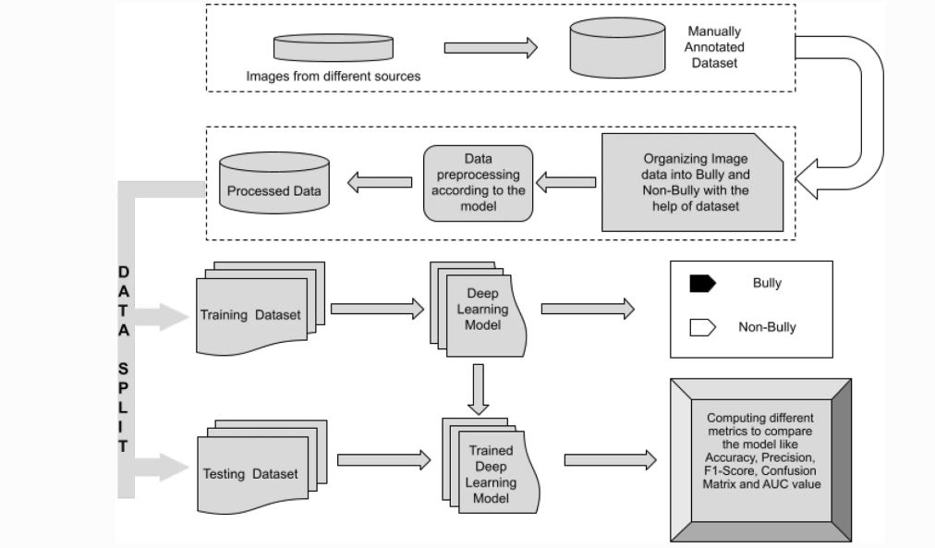
ARCHITECTURE DIAGRAM

Slide 11
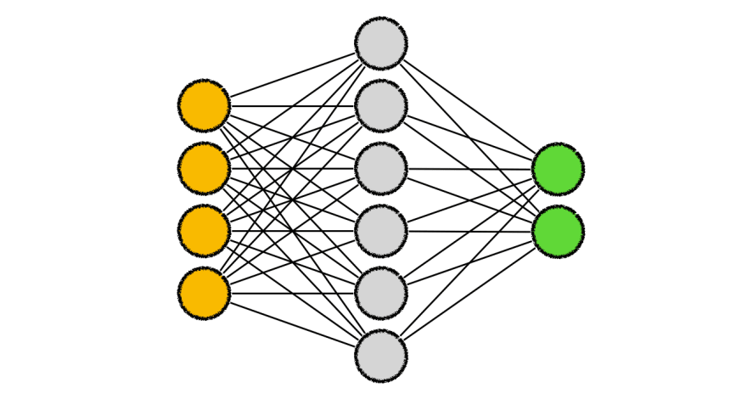

BLOCK DIAGRAM
DATA PREPROCESSING/DATA AUGUMENTATION
TRAINING DATA
TESTING DATA
Evaluation metrics
Cyber
bulling
Image DATASET
model
Output Prediction/
cyberbulling prediction
User input image

Slide 12
PROPOSED SYSTEM
MODULES:
• Data collection
• Data preprocessing
• Model training
• Model testing
• Flask framework
• Output prediction
The above points are methodology of this project in executing the cyberbullying image classification using the Transfer learning algorithm i.e., MoblieNet V2

Slide 13

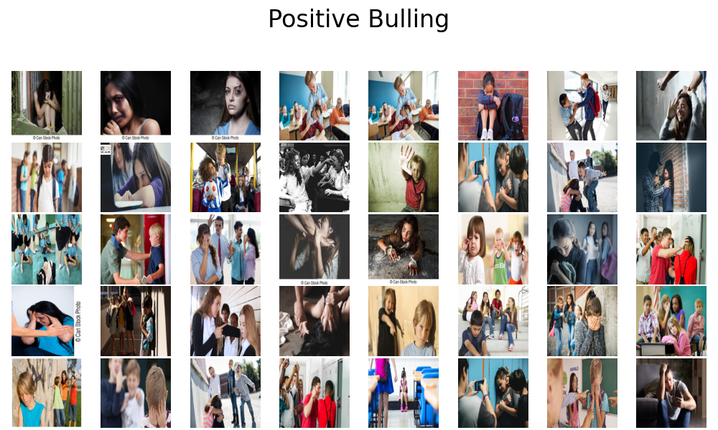
PROPOSED SYSTEM
DATA COLLECTION:
The information was gathered to allow the model to identify every day and cyberbullying cases. For example, if obscene photographs with human faces are present, the example of a commonplace human face is about as bullying. To avoid this example, a sufficient range of records instances were added in every category.

Slide 14
PROPOSED SYSTEM
DATA PREPROCESSING:
Before training the model, data preprocessing is performed on the collected images. This typically involves image augmentation techniques such as scaling, shifting, and rotation. These techniques help in increasing the diversity and variability of the dataset, enabling the model to learn and generalize better.
Convert to array and normalize to interval of [0,1]
Fetch images and class labels from files
Arrange format as per keras
Resize as per model
Append image
Append class label
Make labels into categories - either 0 or 1, for our model
Label binarize

Slide 15
PROPOSED SYSTEM
MODEL TRAINING:
The preprocessed images are used to train the model. Transfer learning is employed, which involves leveraging pre-trained convolutional neural network (CNN) models such as MobileNet. These pre-trained models have learned rich representations from a large dataset, and by utilizing transfer learning, the model can benefit from these learned features.
The MobileNetV2 architecture utilizes an inverted residual structure where the input and output of the residual blocks are thin bottleneck layers.
It also uses lightweight convolutions to filter features in the expansion layer. Finally, it removes non-linearities in the narrow layers.

Slide 16
PROPOSED SYSTEM
MODEL TESTING:
After training, the model is tested using a separate set of images. The performance of the model is evaluated based on various metrics such as accuracy, loss, and a confusion matrix.
Accuracy measures how well the model predicts the correct category (cyberbullying or non-cyberbullying). Loss indicates how well the model is able to minimize errors during training.
The confusion matrix provides insights into the true positives, true negatives, false positives, and false negatives, which helps evaluate the performance of the model in classifying different types of images.

Slide 17
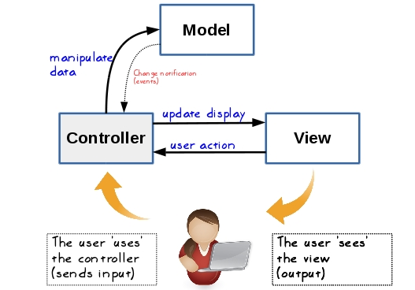
PROPOSED SYSTEM
FLASK FRAMEWORK:
Flask is a web framework for Python used to build web applications. In this system, Flask is utilized to develop a web interface or webpage where the model's output can be presented. The webpage can display the prediction results, visualize the metrics, and provide a user-friendly interface for interacting with the model.

Slide 18

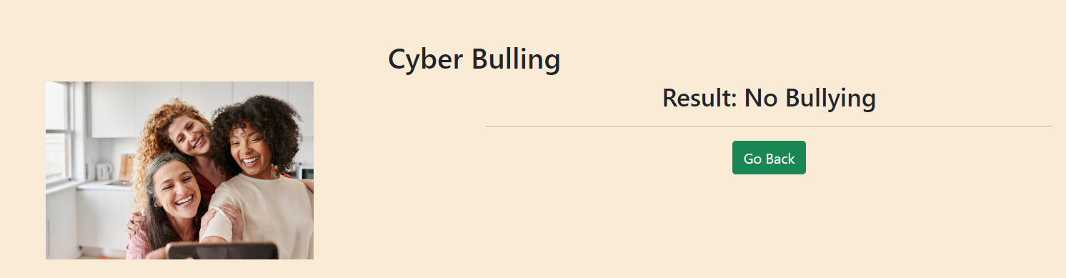
PROPOSED SYSTEM
PREDICTION:
Once the model is trained and the web interface is set up, the system can make predictions on new images. The model takes an image as input and classifies it as either a cyberbullying image or a normal image. The prediction is based on the learned features and patterns from the training phase.

Slide 19
REFERENCES
Chollet F (2017) Xception: Deep learning with depthwise separable convolutions. In Proceedings of the IEEE conference on computer vision and pattern recognition, pp. 1251–1258
He K, Zhang X, Ren S, Sun J (2016) Deep residual learning for image recognition. In Proceedings of the IEEE conference on computer vision and pattern recognition, pp. 770–778
Roy PK, Ahmad Z, Singh JP, Alryalat MAA, Rana NP, Dwivedi YK (2018) Finding and ranking high-quality answers in community question answering sites. Global J Flex Syst Manag 19(1):53–68
Bhat S, Koundal D (2021) Multi-focus image fusion using neutrosophic based wavelet transform. Appl Soft Comput 106:107307
Kumari K, Singh JP, Dwivedi YK, Rana NP (2021) Multi-modal aggression identification using convolutional neural network and binary particle swarm optimization. Future Gener Comput Syst 118:187–197.

Slide 20
REFERENCES
Aggarwal S, Gupta S, Alhudhaif A, Koundal D, Gupta R, Polat K (2021) Automated COVID-19 detection in chest x-ray images using fine-tuned deep learning architectures. Expert Syst 39:e12749
Yadav, M. Kumar, and D. Yadav, ‘‘Cyberbullying detection from tweets using deep learning,’’ Kybernetes, vol. 51, no. 9,pp. 2695–2711, Sep. 2022.
Bozyiğit, S. Utku, and E. Nasibov, ‘‘Cyberbullying detection: Utilizing social media features,’’ Expert Syst. Appl., vol. 179, Oct. 2021, Art. no. 115001, doi: 10.1016/j.eswa.2021.115001.
H.-S. Lee, H.-R. Lee, J.-U. Park, and Y.-S. Han, ‘‘An abusive text detection system based on enhanced abusive and non-abusive word lists,’’ Decis. Support Syst., vol. 113, pp. 22–31, Sep. 2018, doi: 10.1016/j.dss.2018.06.009.
Y. Fang, S. Yang, B. Zhao, and C. Huang, ‘‘Cyberbullying detection in social networks using bi-GRU with self-attention mechanism,’’ Information, vol. 12, no. 4, p. 171, Apr. 2021, doi: 10.3390/info12040171.

Slide 21
THANK YOU

