Slide 1

CHICAGO TRAFFIC CRASH ANALYSIS AND MODELING
DATA 606 – Capstone in Data Science
Vamshi Konapuram(JE18938)

Slide 2
Agenda
Abstract
Introduction
Dataset
Workflow
Exploratory Data Analysis
Machine Learning Models
Model Performance
Conclusion

Slide 3
Abstract
Objective: To analyze a variety of factors influencing crash frequency and severity in Chicago. The study aims to provide insights into the patterns of traffic accidents and inform policy for improved safety measures.
Key Focus: The study examines:
Temporal patterns in crashes, including long-term and seasonal trends.
Spatial analysis to identify accident hotspots.
The impact of infrastructure, road conditions, and human behavior on accident rates.
Outcome: This comprehensive analysis aims to enhance road safety and reduce traffic-related injuries and fatalities in Chicago.

Slide 4
Introduction
Problem Statement: Traffic accidents are a significant public health and safety concern, particularly in metropolitan areas like Chicago. High population density, complex road networks, and heavy traffic volumes contribute to a high rate of accidents, making it essential to understand the underlying factors to improve safety measures.
Purpose of the Study: This project provides a comprehensive analysis of Chicago's traffic crash data, focusing on temporal and spatial factors that influence crash frequency and severity. By examining long-term trends, seasonal variations, and peak accident times, the study aims to provide actionable insights to stakeholders involved in traffic safety management.

Slide 5
Dataset
Dataset Overview: The Traffic Crashes dataset from the City of Chicago includes detailed records of traffic incidents, capturing crash location, date, and time, along with conditions like weather, road surface, and traffic control. It also provides data on crash types, contributing factors, damage, and injuries, enabling analysis of traffic safety and patterns.
Data Description:
Data Source : Chicago Data Portal. 🔗
Data Size : 472 MB
Data Shape
Number of columns = 47
Number of rows = 872078
Time period (2014 - 2024)

Slide 6
Dataset
Column Name | Description
crash_date | The date when the crash occurred.
address | The street address where the crash occurred.
posted_speed_limit | The speed limit posted on the street where the crash occurred.
weather_condition | The weather condition at the time of the crash (e.g., clear, rain, snow).
alignment | The alignment of the road where the crash occurred (e.g., straight, curve).
road_defect | Any defects present in the road at the time of the crash (e.g., potholes).
num_units | The number of units (vehicles or persons) involved in the crash.

Slide 7
Workflow
Data Cleaning & Processing:
Descriptive Statistics:
Geospatial Analysis:
Visualizations:

Slide 8
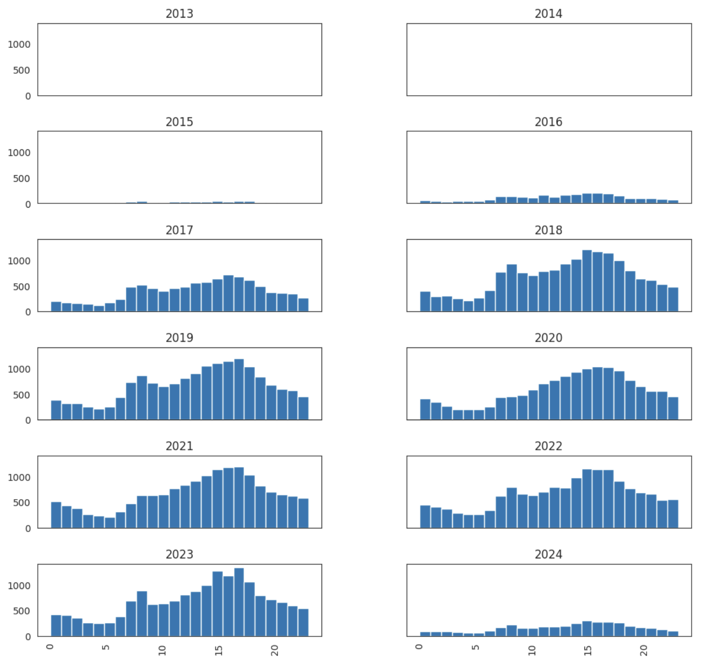
Exploratory Data Analysis
Crash Analysis
that has Injuries

Slide 9
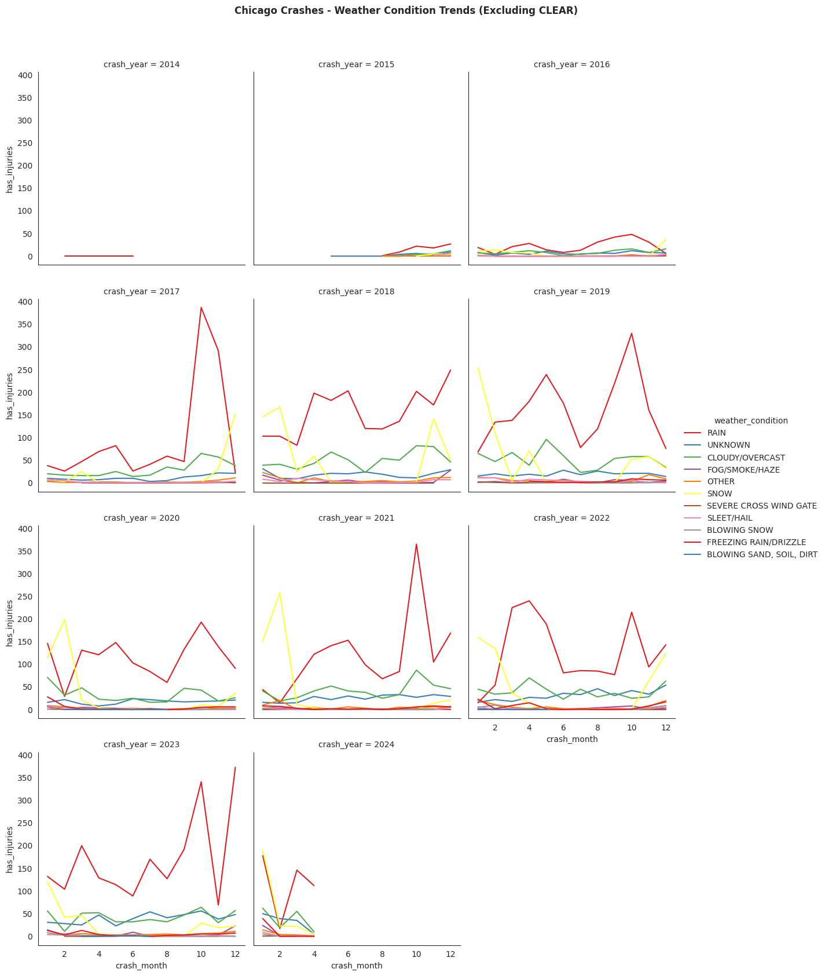
EDA
Weather conditions
excluding CLEAR

Slide 10
Machine Learning Models
We used number of classification techniques, such as
SGD Classifier
ADA Boost
Gradient Boost
Random Forest, and Bagging
Model | Accuracy | F1 Score | Recall | Precision | Balanced Accuracy | ROC AUC
SGD Classifier | 74% | 0.43 | 0.71 | 0.74 | 0.73 | 0.82
ADA Boost | 80% | 0.46 | 0.63 | 0.36 | 0.73 | 0.82
Gradient Boost | 89% | 0.40 | 0.28 | 0.71 | 0.63 | 0.82
Random Forest | 81% | 0.45 | 0.58 | 0.37 | 0.71 | 0.81
Bagging | 84% | 0.44 | 0.47 | 0.41 | 0.69 | 0.79

Slide 11
Machine Learning Models

Slide 12
Machine Learning Models
Best Performing Model - Gradient Boost:
Accuracy on Test Set: 89%
F1 Score: 0.40
Validation Set Performance:
Recall: 0.28
Precision: 0.71
Balanced Accuracy: 0.63
ROC AUC: 0.82

Slide 13
Conclusion
This project provides a detailed analysis of Chicago’s traffic crash data, identifying key temporal and spatial patterns to inform targeted safety measures. Findings reveal peak crash times, notably midday and late afternoons on Fridays, as well as accident hotspots across the city. Statistical tests confirmed significant correlations, and the Gradient Boost model achieved high predictive accuracy, supporting proactive crash management. These insights offer real-world applications for policymakers in urban planning and traffic safety, suggesting targeted interventions to reduce crashes. Ultimately, this data-driven approach aims to enhance road safety in Chicago, with broader applications for other cities facing similar challenges.
Goal: The insights from this study will help inform traffic safety policies, reduce accident rates, and enhance urban planning for road safety.

Slide 14

Thank you

