Slide 1
Apple: Case Study Presentation
Here we go…

Slide 2

Main Objective
 Product Analysis
Historical sales data for a product for 4 different cities, from 2015-2023.

Slide 3




Case Objective
+ Appendix
Assume in 2024 you only have 1M units of new supply available to allocate across the 4 cities.
04
Are there any other pieces of information you are interested in obtaining, if available, for your forecast?
03
Provide a projection for overall unit sales and revenue for 2024, by city and by month. Assume no discounts occur.
02
The product sells for $250.Which city had the most significant price discount and when did this occur?
01

Slide 4
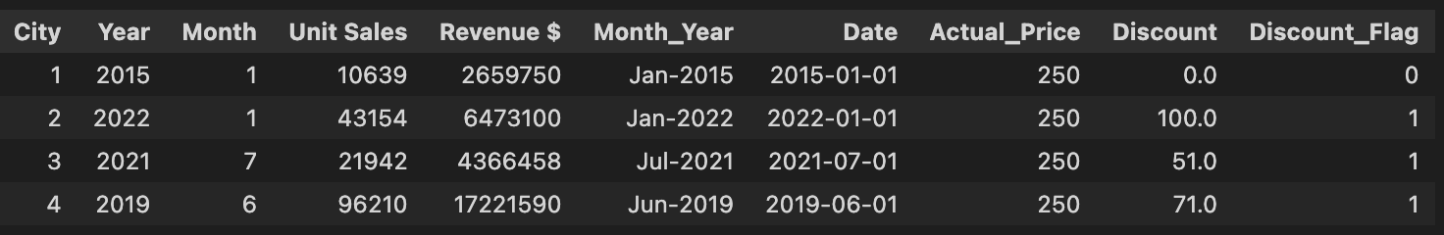
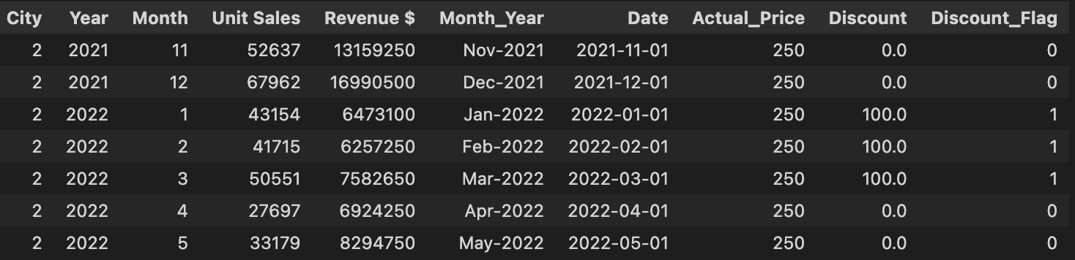
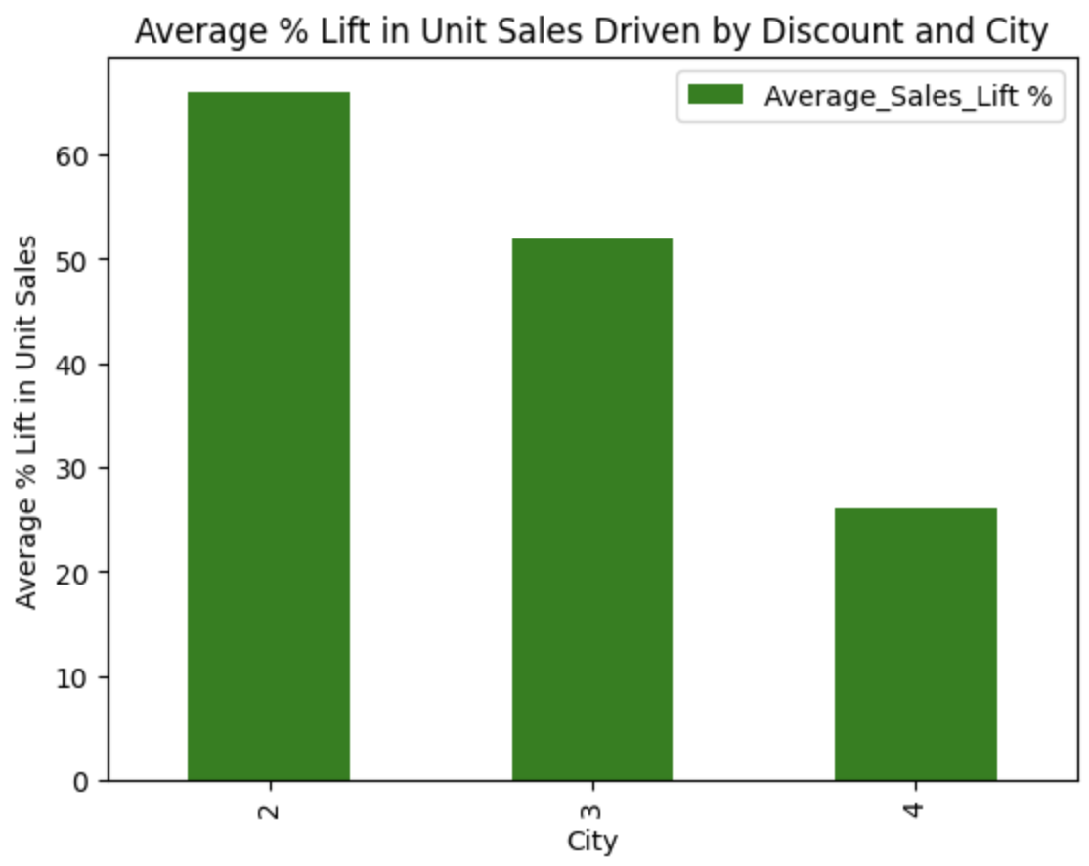
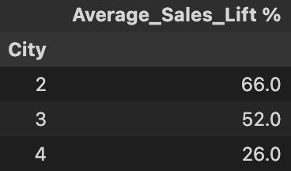
Q1: Significant Price Discount
The Apple product was highly discounted by $100 in City-2 starting Jan-2022 and lasted for 3-months.
The Average % lift in Sales driven by discounts. (Lift Calc = Prior unit sales <–> Avg unit sales in discount period )
Notes:
Average Sales Lift per City:
City 2: Average sales lift of approximately (66.24% increase).
City 3:(52.34% increase).
City 4:(25.68% increase)

Slide 5
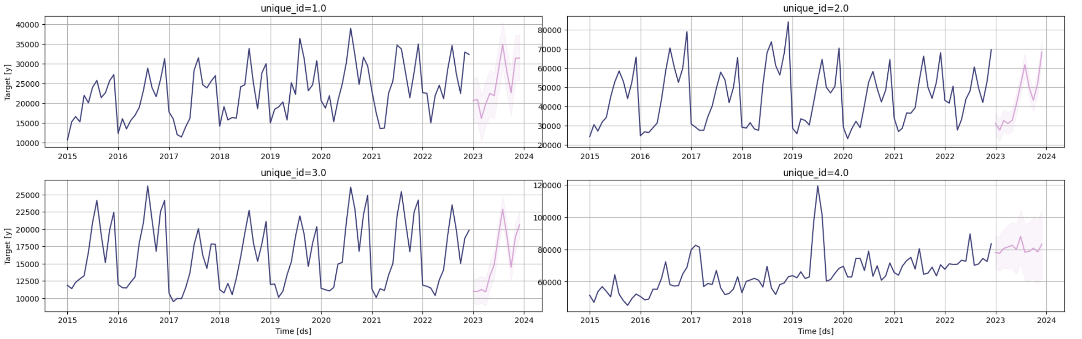
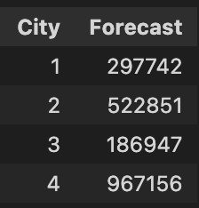
Q2 : Sales Projection for 2024 broken by City (Unique_id)
The best model selected for 2024 projections : AutoArima
Exogenous/Co-variates : Discount, Seasonal Features (Recent 2-3 Years)
Back-testing/Forward walk validation: 2 Years. The annual forecast for 2024 →

Slide 6
Baseline Models Projection performance for 2024
Take away:
The clear increase in forecasting performance by using better sophisticated model.
Historical Naïve
Seasonal Naive
Exponential Smoothing
Auto-Arima (without exogenous features)

Slide 7
Q3 : Potential Exogenous Vars for the Model
Seen a performance bump in forecasting metrics with exogenous variables compared without them
Some other variables*:
Economic Indicators : CSI(Consumer Sentiment Index), GDP, Inflation, Jobs index…etc.
Demo-graphic : (population density, and urbanization rates and product demand)
Marketing spent / Promotional Events
Product Reviews Sentiment Polarity
Newer versions/Predecessors/Competitors
Major Supply Chain factors*

Slide 8
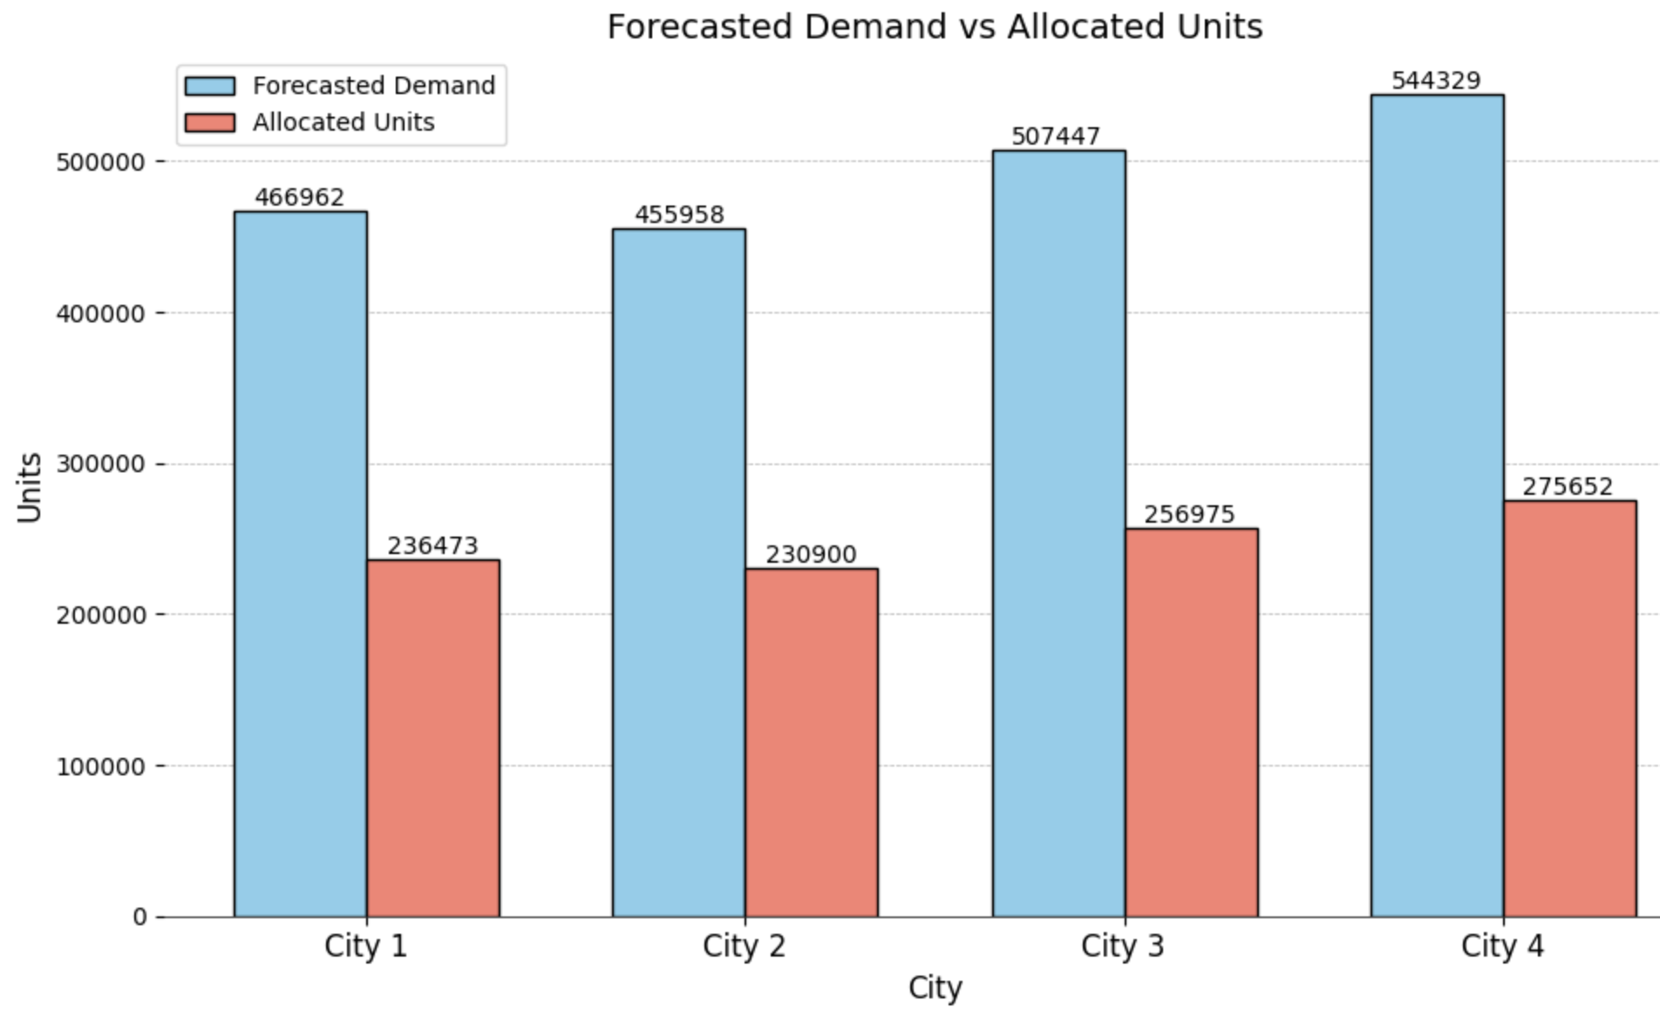
Q4 : 1-Mil Units Distribution
The total annual forecasted unit sales for 2024 : 1,974,696
High Demand: Total forecasted demand is nearly double the supply.
Maximized Revenue: All units sold at full price; no discounts needed.
Fair Distribution: Allocation based on forecasted demand proportions ensures equity.
* Different strategy if it’s the other way round. Optimizing for max revenue lift and unit sales with targeted discounts.

Slide 9
Appendix

Slide 10
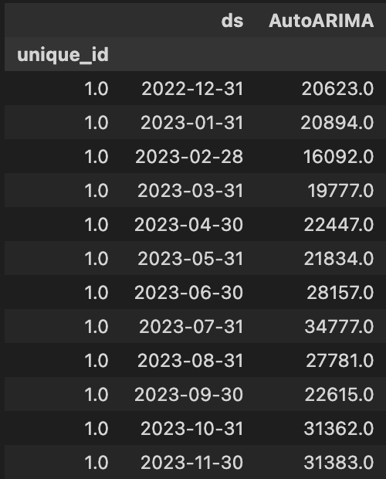
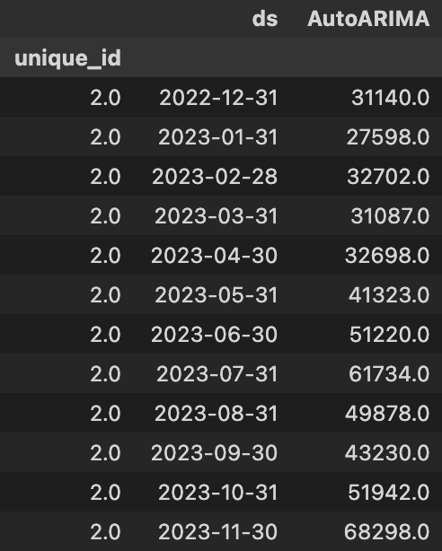
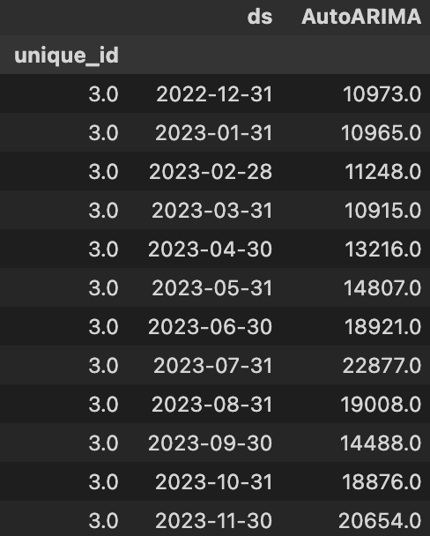
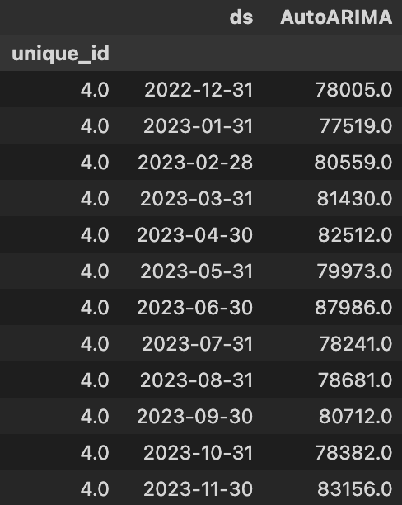
Projections for 2024 by City (Unique_id)

Slide 11
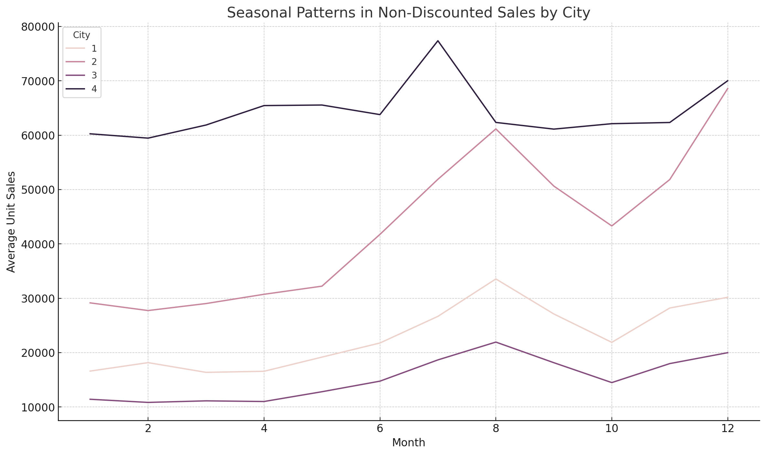
Seasonal monthly sales growth averaged by city
The seasonal sales patterns for the Apple product show clear spikes around mid-year (June-July) and end-of-year (November-December) across all cities.
The mid-year increase is likely driven by educational purchases and mid-year promotions.
while the end-of-year surge is influenced by the holiday season and year-end bonuses.
City 4 consistently shows the highest sales, indicating a larger market or higher demand.

Slide 12
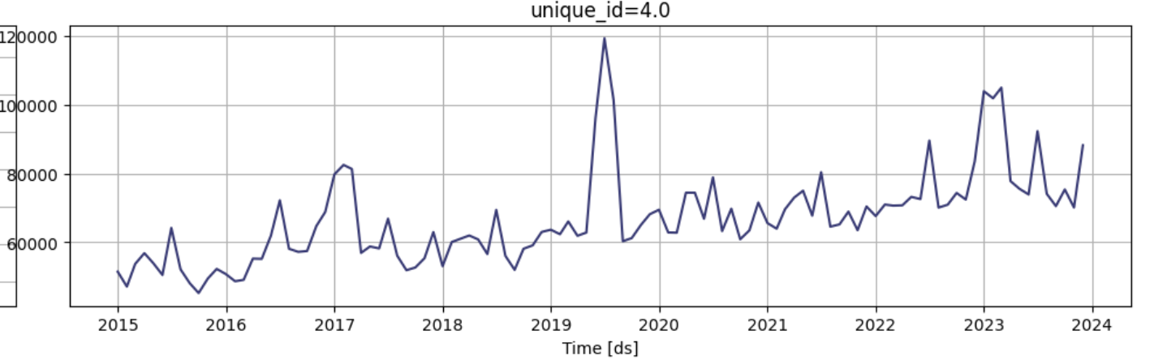
City-4 Unique Behavior
The pattern of City-4 is distinct compared to the rest of the cities.
The seasonal patterns and correlation for rest of the cities is far greater compared to City-4.
This indicates that the City-4 might have slightly different underlying factors influencing the Unit Sales .
City-4 is highly volatile when driven by discount.
City-4

