Slide 1
DeepShield: A Multi-Head, Explainable Audio Deepfake Detection and Risk-Aware Trust Gateway System
Name of Inventor(s)
Laksh Baweja
Hamsini Goel
Mohith
Dinesh Kumar

Slide 2
Inventor Name |  | Email ID | Mobile Number | College Address
First Name | Second Name
Laksh | Baweja | lb4397@srmist.edu.in | 8700390109 | SRM Institute of Science and Engineering, KTR
Hamsini | Goel | hg7964@srmist.edu.in | 9599752976
Mohith |  | mb5231@srmist.edu.in | 8328293949
Dinesh | Kumar | dk4672@srmist.edu.in | 6369181238

Slide 3
Table of Content
Title | Slide No.
Recommendation Summary | Slide 4
Opportunity Review (significance, current solutions, proposed engine, why it works) | Slide 5
Independent and Dependent Claims (incl. new claims 14–15) | Slide 10
Main Patentable Points (ranked by evidence) | Slide 13
Novelty Map | Slide 14
Prior Art Comparison and Difference from Closest Prior Art | Slide 15
System Architecture & Module Description | Slide 17
Inference-time Add-ons (module description) | Slide 22
Evaluation Protocol | Slide 23
Technical Effect (evidence) | Slide 24
Sample Results and Results Summary | Slide 27
Limitations and Next Experiments | Slide 29

Slide 4
Recommendation Summary
Summary of the Invention | Representative Drawing | Evaluation Opinion
An audio deepfake screening system that goes beyond a binary real/fake call.
A two-channel (Mel-spectrogram + MFCC) picture of each 3-second window is read by a compact residual CNN with Squeeze-and-Excitation attention, giving one shared 128-number embedding.
From that one embedding, four heads run in parallel: spoof score, attack-type, MC-dropout uncertainty and open-set novelty.
A risk-aware gateway combines them to route each clip to Pass, Review, Block or Unknown-pattern review, with a plain-language rationale.
1 Audio input
any format → 16 kHz, 3-s windows
Prior-art opinion
Each component (Mel/MFCC features, ResNet + SE, MC-dropout uncertainty, Mahalanobis out-of-distribution scoring, reject-option review) is individually known.
What is new
The combination: four heads computed from one shared embedding and routed jointly by a gateway calibrated to a human-review budget.
Evidence so far (verified)
A review lane at ~15% genuine workload halves both error types on never-seen generators. The heads' extra value over a score-only review rule is small but consistent (9 of 9 unseen families). New (Oct 2026): a claimed-speaker check on the same embedding lifts accuracy 80.6% → 89.1% on unseen speakers, without retraining.
Assessment
Inventors proposed Class A1. Current evidence supports a narrower combination claim; the inventive step is at risk until the heads' contribution is shown at equal workload (round 3, ready to run). The speaker check is a new dependent-claim candidate; SASV prior art must be searched.
2 Robustness augmentation
training: MP3 · noise · reverb · 8 kHz phone
3 Dual-channel features
Mel(64) + MFCC(64) → 2×64×94
4 Residual CNN + SE attention
3 residual blocks · 341K parameters
5 Shared 128-d embedding
one representation feeds all heads
6 Four parallel heads
spoof · attack-type · uncertainty · novelty
7 Risk-aware gateway
Pass / Review / Block / Unknown
8 Explanation layer
deterministic rationale (+ per-channel CAM*)
Drawing: red = novel blocks · dashed = proposed · *code exists, not evaluated
9 Continual-learning loop
proposed, not yet built

Slide 5
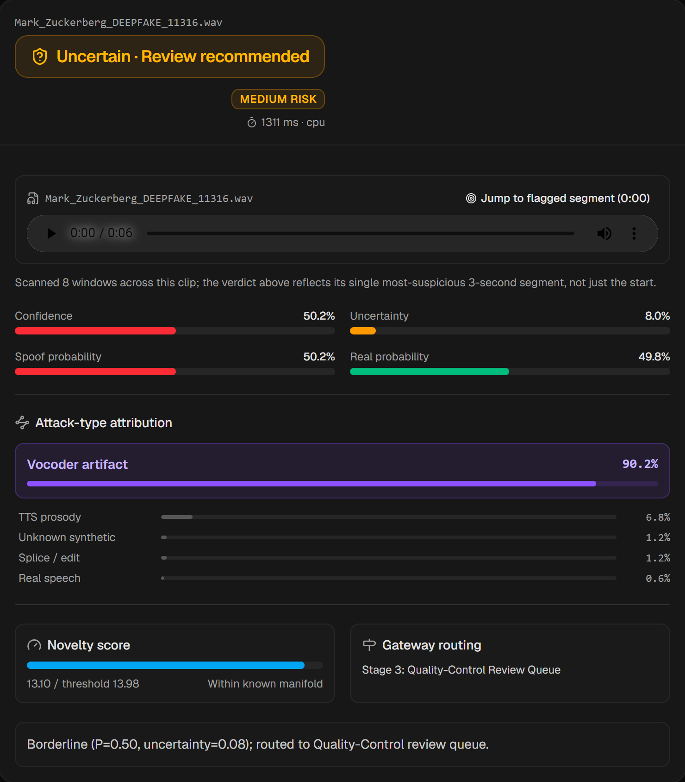
Opportunity Review: Significance
What is the idea?
Instead of asking only “is this audio fake?”, the system answers five questions:
Is it fake? · What kind of fake? · How confident are we?
Have we seen anything like this before? · Why did we decide this?
Why is it useful?
Voice cloning improves every few months. A detector trained on today’s generators can fail on tomorrow’s, so a deployable system must recognise when it is unsure and hand the case to a person, and give a defensible reason for every block.
Significance
Routes doubtful audio to human review instead of silently calling it “real”
A reviewer sees the decision, scores, attack family, the most suspicious 3 s and a one-line reason
Tested against MP3 compression, additive noise, reverberation and 8 kHz telephone audio
Runs on a laptop CPU (~341K parameters) in well under a second per clip
Pain point addressed: voice-fraud calls and contested audio evidence
Live system: an AI-generated clip routed to human review because uncertainty is high

Slide 6
Opportunity Review: Current Solutions & Pain Points
What are the current solutions?
Single-channel spectrogram CNN detectors
SE-ResNet / LCNN classifiers adapted from image recognition
Static single-threshold binary classifiers (one probability, one cut-off)
Closed-set classifiers that assume a fixed list of generators
Self-supervised front-ends (wav2vec 2.0 / WavLM) with a binary head
Generic Grad-CAM / SHAP saliency for explanation
Pain points of current solutions
Output is only real/fake: no attack family, no confidence, no reason
Closed-set training: unseen generators are often silently classified as real
Accuracy on random splits is inflated. DeepShield’s own earlier 97.7% fell to 93.2% once recordings, sentences and speakers were kept apart (28% of random-split validation clips had a copy in training)
Compression, noise, reverberation and device variation are rarely tested
Generic saliency maps do not say why audio is synthetic
Key gaps
No joint attribution, novelty and uncertainty routing
No human-review lane with a controlled workload
No defensible, per-decision explanation

Slide 7
Opportunity Review: Proposed Engine and Build Status
Module | What it does | Status
Robustness-aware augmentation | MP3 32–128 kbps, noise 0–20 dB SNR, synthetic reverb, 8 kHz telephone band | Implemented & evaluated
Dual-channel feature grid | Mel(64) + MFCC(64) stacked → 2 × 64 × 94 per 3-s window | Implemented & evaluated
Residual CNN + SE attention | 3 residual blocks, 32→64→128 channels, SE after block 2; 341,254 parameters | Implemented & evaluated
Shared 128-d embedding | Global-pooled output read by every head | Implemented & evaluated
Four parallel heads | Spoof score · attack-type (5 classes) · MC-dropout uncertainty · Mahalanobis novelty | Implemented & evaluated
Risk-aware gateway | Novelty → uncertainty → probability bands; uncertainty threshold calibrated to a review budget | Implemented & evaluated
Explanation layer | Deterministic rationale (live). Per-channel Mel-vs-MFCC CAM disagreement map | Rationale live; CAM code not evaluated
Continual-learning loop | Reviewer-confirmed + high-novelty samples → periodic fine-tune | Proposed, not built
Advantages: answers “what kind of fake” as well as “is it fake”; flags unfamiliar inputs; confidence from MC-dropout; review workload is a tunable parameter; every decision carries a deterministic reason.

Slide 8
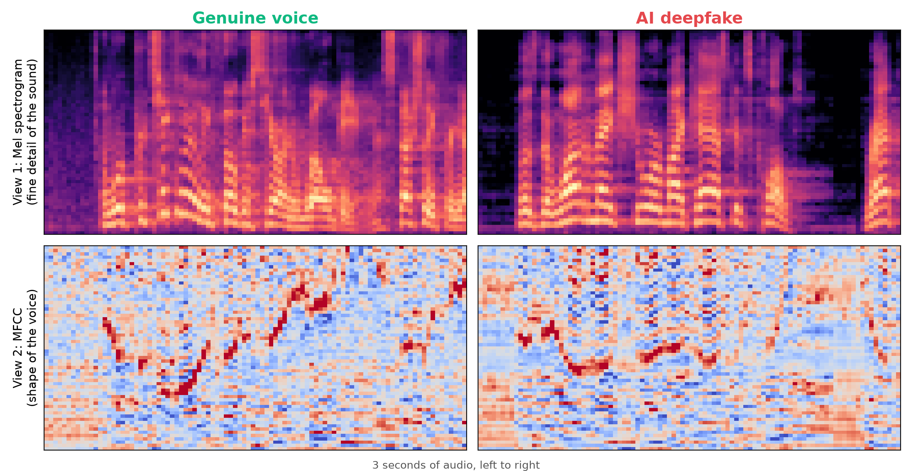
Opportunity Review: Why the New Engine Works
Dual-channel fusion. The Mel channel exposes fine spectral artefacts left by vocoders; the MFCC channel summarises the vocal-tract envelope. Stacking them lets one network reason across both.
One shared embedding. All heads judge the same 128-d representation, so their outputs are consistent and inference stays cheap.
Uncertainty by repeated stochastic passes. Dropout is kept active at inference and the spoof head is queried N times; the spread of answers is the uncertainty. Wrong verdicts average 0.37 vs 0.17 for correct ones.
Genuine-only novelty boundary. A Gaussian is fitted to embeddings of authentic speech only. On seen generators novelty carries no signal (AUC 0.55), but on never-seen generators it does (AUC 0.60–0.78), which is the intended open-set effect.
Review lane with a fixed budget. Doubtful clips go to people; the threshold is set so ≤15% of genuine validation audio is reviewed.
Removed from this version: the earlier claim about “invariant cues” (breath, jitter/shimmer, glottal periodicity) is not implemented and is moved to future work.
The two channels for a genuine clip (left) and an AI-generated clip (right). Note the unnaturally clean silences in the fake.

Slide 9
Recommendation
1) What is the core technology in this idea?
A dual-channel (Mel + MFCC) residual CNN with SE attention producing one shared embedding, read in parallel by four heads (spoof, attack-type, uncertainty, novelty), with a risk-aware gateway and explanation layer on top.
2) What complex problem is solved?
Screening speech audio when new voice generators keep appearing: the system must still catch most fakes, avoid accusing genuine speakers, and say “I am not sure” in a controlled number of cases.
3) Why could it be game-changing?
It turns a one-number classifier into a trust workflow: detect, attribute, estimate confidence, flag the unfamiliar, explain, and route to people with a predictable workload.
4) What is the breakthrough, and how strong is the evidence?
The jointly routed gateway. Verified: a ~15% review lane halves both error types on unseen generators. Not yet shown strongly: that the uncertainty/novelty heads beat a score-only review rule at the same workload.

Slide 10
Independent Claims
In order of relevancy. Novel features highlighted in red.
Abstract
A speech-audio screening method and system that detects synthetic speech, attributes the generator family, estimates its own uncertainty, flags inputs unlike authentic speech, and routes each input to automatic pass, automatic block or human review, with a deterministic explanation, all from one shared dual-channel embedding.
Use cases
Voice-fraud screening of calls and voice notes
Call-centre and voice-biometric authentication
Forensic triage of recorded evidence
Compliance workflows with a human review queue
Claim 1 (method)
A computer-implemented method for screening speech audio, comprising:
(a) dividing the audio into fixed-length windows and forming, for each window, a two-channel time–frequency array whose first channel is a log-power Mel spectrogram and whose second channel is a matrix of Mel-frequency cepstral coefficients;
(b) processing the array with a residual convolutional network having channel attention to obtain a single shared embedding;
(c) computing from that same shared embedding, in parallel, a spoof probability, an attack-family attribution, a predictive-uncertainty estimate obtained from repeated stochastic forward passes, and a novelty score measuring the distance of the embedding from a distribution fitted only on embeddings of authentic speech;
(d) routing the audio to one of automatic pass, automatic block, human review or unknown-pattern review as a joint function of the spoof probability, the uncertainty estimate and the novelty score, wherein the novelty and uncertainty conditions take precedence over the spoof-probability thresholds; and
(e) outputting the routing decision together with an explanation generated from the head outputs.
Claim 2 (system)
A system comprising one or more processors and memory storing instructions that implement a feature module, the residual network, the four heads and a gateway module configured to perform step (d) of claim 1.

Slide 11
Dependent Claims (1 of 2)
Status in brackets: [E] implemented & evaluated · [C] code only · [P] proposed
Claim 3: The method of claim 1, wherein the novelty score is a Mahalanobis distance from a Gaussian fitted on authentic-speech embeddings, with the threshold at a percentile (97.5th) of authentic training distances, checked before any probability threshold. [E]
Claim 4: The method of claim 1, wherein the uncertainty estimate is the standard deviation of the spoof probability over N stochastic passes with dropout applied to the shared embedding and kept active at inference, the dropout masks being drawn from a fixed seed so that the same input always receives the same route. [E]
Claim 5: The method of claim 1, wherein the uncertainty threshold is calibrated on held-out validation data so that at most a target fraction (e.g. 15%) of authentic inputs is routed to human review. [E]
Claim 6: The method of claim 1, wherein the routing uses a combined risk score: a weighted combination of the spoof-probability margin, the uncertainty estimate and the novelty score, with the weights fitted on validation data. [C: implemented in the demo for retrained models; equal-workload evaluation built into round 3, not yet run]
Claim 7: The method of claim 1, wherein the audio is scanned in overlapping windows at a fixed hop (0.5 s), the spoof probability of the recording is the mean of the most suspicious fraction (one third) of window probabilities, and the time offset of the most suspicious window is reported to the reviewer. [E: laptop, 800 In-the-Wild clips; the round-2 evaluation itself scored the first 3 s]
Claim 8: The method of claim 1, wherein audio shorter than a minimum duration (e.g. 2 s) is routed to human review instead of receiving an automatic decision. [E: demo clips]
Claim 9: The method of claim 1, wherein the attack-family head classifies among real, vocoder artefact, TTS prosody, splice/edit and unknown-synthetic, trained jointly with the spoof head. [E; splice/edit trained only in round 3, not yet run]

Slide 12
Dependent Claims (2 of 2)
Status in brackets: [E] implemented & evaluated · [C] code only · [P] proposed
Claim 10: The method of claim 1, wherein the explanation is a deterministic template assembled from the head outputs, never generated free-form. [E]
Claim 11: The method of claim 1, further comprising per-channel activation maps computed separately for the Mel and MFCC channels, whose disagreement map is shown to the reviewer. [C]
Claim 12: The method of claim 1, further comprising training with randomised MP3 re-encoding, additive noise at controlled SNR, reverberation and 8 kHz band-limiting. [E]
Claim 13: The method of claim 1, further comprising queuing reviewer-confirmed and high-novelty samples for periodic fine-tuning with versioned model releases. [P]
Claim 14: The method of claim 1, wherein a claimed identity accompanies the audio, and the distance between the recording's shared embedding and stored embeddings of verified genuine recordings of that identity is fused with the spoof probability before routing, without a separate speaker-recognition model. [E: unseen speakers 80.6% → 89.1%; enrolled and test clips may share recording sessions]
Claim 15: The method of claim 1, wherein the spoof probability is replaced by the output of a linear layer applied to the frozen shared embedding and fitted on labelled recordings from the deployment domain, adapting the screen to that domain without retraining the network. [E: unseen speakers 80.3% → 91.8%; likely not inventive alone]

Slide 13
Main Patentable Points (ranked by evidence)
# | Patentable point | Evidence from our evaluation | Strength
1 | Joint routing from one embedding using spoof score, uncertainty and novelty | Review lane at ~15% workload halves errors on unseen generators. Over a score-only review rule at equal workload: current rules no better; a fitted combination is better in 9/9 families but by a small margin (error-spotting AUC 0.79 → 0.81). | Moderate–weak
2 | Workload-calibrated review threshold | Calibrated on validation to ≤15%; achieved 13.8% on test, 14.4% on unseen generators. Calibration as such is a known technique. | Moderate
3 | Genuine-only novelty boundary checked first | No signal on seen generators (AUC 0.55); real signal on unseen ones (0.60–0.78). Flags 0–31% of unseen fakes at the current threshold. | Moderate–weak
4 | Attack-family attribution trained jointly with detection | 91.0% correct on test fakes; classes are coarse and the splice/edit class has no training data. | Moderate
5 | Per-channel (Mel vs MFCC) disagreement explanation | Code exists; never evaluated or shown to users. | None yet
6 | Claimed-speaker distance on the detector's own embedding, fused into routing (claim 14) | Unseen speakers: accuracy 80.6% → 89.1%, fakes passed 21.0% → 6.0%. Close prior art: SASV 2022. Session overlap not yet ruled out. | Moderate (pending)
7 | Domain reference bank on the frozen embedding (claim 15) | Unseen speakers: 80.3% → 91.8%. Large practical gain, but a linear probe on frozen features is standard practice. | Weak (as a claim)
Recommendation to the patent team: lead with point 1 as a combination claim and support it with point 2; add point 6 as a dependent claim after a SASV prior-art search. Points 3 and 5 need the experiments on the limitations slide.

Slide 14
Novelty Map: what is new, and why
Block | Closest known technique | Novel here? | Why / why not
Mel + MFCC two-channel input | Common hand-crafted front-ends in ASVspoof systems | No | Established; chosen for complementary cues
Residual CNN + SE attention | ResNet / SE-Net (image recognition), widely used in anti-spoofing | No | Established backbone, deliberately compact
MC-dropout uncertainty | Gal & Ghahramani, 2016 | No (alone) | Known estimator; new in how it drives routing
Mahalanobis novelty score | Lee et al., 2018 (out-of-distribution detection) | No (alone) | Known; new in being fitted on authentic speech only and checked first in routing
Human-review lane / reject option | Selective classification (Geifman & El-Yaniv, 2017) | No (alone) | Known; DeepShield sets it by a review budget
Four heads on one shared embedding + jointly routed gateway | No single reference combining all four signals in one routing function (per inventors’ search) | Candidate | Integrated combination; effect modest so far (see Technical Effect)
Per-channel disagreement explanation | Grad-CAM (Selvaraju et al., 2017) applied per input channel | Candidate | Specific to the two-channel design; not yet evaluated
Claimed-speaker check on the shared embedding | Spoofing-aware speaker verification (SASV 2022): fuses a speaker-verification score with a countermeasure score | Candidate (narrow) | No separate speaker model; distance feeds the review gateway
Domain reference bank | Linear probing / domain adaptation on frozen features | No | Standard technique; valuable in practice
Academic references are well-known papers named for orientation; a formal prior-art search is still required.

Slide 15
Prior Art Comparison
Prior-art reference | Difference from DeepShield
Single-channel spectrogram CNN detectors (US 12,462,813 B1, cited by the inventors)* | DeepShield fuses Mel + MFCC into one 2 × 64 × 94 input and adds attribution, uncertainty and novelty heads
Static single-threshold binary classifiers (US 12,592,239 B2, cited by the inventors)* | DeepShield routes on spoof score, uncertainty and novelty together, with a budgeted human-review lane
Closed-set generator classifiers (ASVspoof 2019 LA challenge systems) | DeepShield adds a novelty score fitted on authentic speech only and an Unknown-pattern route
Selective classification / reject option (Geifman & El-Yaniv, 2017) | DeepShield’s review decision uses head signals beyond the classifier’s own confidence
Generic Grad-CAM / SHAP saliency (Selvaraju et al., 2017; Lundberg & Lee, 2017) | DeepShield adds a deterministic rationale and proposes a Mel-vs-MFCC disagreement map
Spoofing-aware speaker verification (SASV 2022 challenge systems) | DeepShield measures the claimed-speaker distance on the detector's own embedding (no speaker-recognition model) and feeds it into the budgeted review gateway
* Patent numbers as cited in the inventors’ draft; not independently verified. To be confirmed by the patent team’s search.

Slide 16
Difference from Closest Prior Art
Feature | Proposed (DeepShield) | Prior art
Output | Spoof score + attack family + uncertainty + novelty from one shared embedding | Single real/fake probability
Unseen generators | Novelty and uncertainty can divert doubtful inputs to review | Closed set; often silently classified as real
Decision routing | Joint function of three signals; novelty checked first; review budget calibrated | Fixed threshold on one score
Workload control | Genuine review rate set in advance (≤15% on validation) | Not addressed
Explainability | Deterministic rationale; per-channel disagreement map (proposed) | Generic saliency, or none
Summary of deficiencies in prior approaches
A bare real/fake score fails silently on unseen generators and degraded audio, gives no usable confidence, no workload control and no specific explanation. DeepShield addresses each of these structurally; the size of the gain attributable to the extra heads is still being established.

Slide 17
System Architecture & Module Description

Slide 18
6. Systems and Methods: End-to-End Pipeline
Novel block
Established
Audio input
any format → 16 kHz
Windowing
3-s windows every 0.5 s
Augmentation
training only
Dual-channel grid
Mel + MFCC, 2×64×94
Residual CNN + SE
341K parameters
Shared embedding
128-d
Spoof score
P(fake)
Attack-type
5 families
Uncertainty
MC-dropout, N passes
Novelty
Mahalanobis, genuine-only
Risk-aware gateway
joint routing · novelty → uncertainty → bands · review budget
Explanation layer
rationale (+ per-channel CAM*)
Pass
Human review
Unknown pattern
Block
Continual learning
proposed
Overlapping windows (0.5 s hop) are scored; the clip score is the mean of the most suspicious third, and the most suspicious window's offset is shown to the reviewer. *Code exists, not evaluated.

Slide 19
6. Systems and Methods: Gateway Decision Logic
Novel block
Established
Audio shorter than 2 s?
yes
Review: too short to judge
Thresholds as deployed in the demo (round-2 model). The uncertainty threshold was set on validation data for ≤15% genuine review.
no
Novelty score > threshold (97.5th pct. of genuine)?
yes
Unknown pattern → human review
no
Uncertainty > calibrated threshold (0.445)?
yes
High uncertainty → human review
no
Spoof probability < 0.30?
yes
Pass (automatic clearance)
no
Spoof probability > 0.70?
yes
Block (automatic termination)
Otherwise (0.30–0.70): quality-control review

Slide 20
6. Each Module Description: Supporting Front End (Stages 1–5)
Stage | Implementation | Purpose
1 Audio input & windowing | Decode any format to mono 16 kHz; 3-s windows every 0.5 s (zero-padded if shorter), up to 120 over the first 60 s; clip score = mean of the most suspicious third | One standard input; long recordings fully covered
2 Robustness augmentation | Training only: random MP3 (32/64/128 kbps), Gaussian noise at 0/10/20 dB SNR, synthetic room response, 8 kHz band-limiting, or none | Survive compression, noise, reverberation and telephone audio
3 Dual-channel features | Log-power Mel spectrogram (64 bands, n_fft 1024, hop 512) and 64 MFCCs stacked → 2 × 64 × 94 | Artefact view + vocal-tract view in one input
4 Backbone | Conv 2→32; residual blocks 32→32, 32→64 (stride 2) + SE attention, 64→128 (stride 2); 341,254 parameters in total | Proven, compact feature learner; CPU real-time
5 Shared embedding | Global average pool → 128-d vector feeding all heads and the novelty scorer | One representation, consistent heads
These stages use established techniques (see Novelty Map). They are the foundation the novel stages operate on.

Slide 21
6. Each Module Description: Novel Stages (6–9)
Novel block
Established
Stage | Implementation | Why it matters
6 Four parallel heads | Spoof head (MLP, BCE loss); attack-type head (5 classes, cross-entropy, weight 0.4, trained jointly); uncertainty = std of P(fake) over N passes with dropout p = 0.35 on the embedding (N = 20, fixed seed); novelty = Mahalanobis distance to a Gaussian of genuine training embeddings | Several independent views of the same evidence
7 Risk-aware gateway | Order: minimum duration → novelty → uncertainty → probability bands (0.30 / 0.70). Uncertainty threshold calibrated on validation for ≤15% genuine review (0.445 for the round-2 model) | Doubtful cases go to people; workload is a parameter
8 Explanation layer | Deterministic sentence from the head outputs (live). Per-channel Grad-CAM disagreement map (code only) | Defensible, reproducible reasons
9 Continual learning | Reviewer-confirmed and high-novelty samples queued for periodic fine-tuning (not built) | Keeps pace with new generators

Slide 22
6. Module Description: Add-ons (10–11)
Novel block
Established
10 Claimed-speaker check
distance to the closest of ≥3 enrolled genuine recordings (scaled L2 + cosine), fused with the spoof logit by a fitted logistic model
Shared 128-d embedding
mean over windows
Risk-aware gateway
uses the fused / bank probability
11 Domain reference bank
logistic layer on the frozen embedding, fitted on labelled deployment audio
Stage | Implementation | Why it matters
10 Claimed-speaker check | POST /api/enroll stores verified genuine recordings per identity; a prediction with claimed_speaker computes the distance on the detector's own embedding and fuses it with the spoof logit (weights fitted on labelled clips; ≥3 enrolled clips required) | Catches fakes of a known person that the detector alone passes; no extra model
11 Domain reference bank | Standardise + logistic regression on the clip embedding, fitted on a few hundred labelled clips of the target audio; replaces the spoof probability; the detector's own score is still reported | Adapts to a new audio domain without retraining

Slide 23
Evaluation Protocol
Item | Detail
Data | 11 public datasets; 40,000-clip pool (20,000 genuine / 20,000 fake) + 4,000 external clips
Generators | 40+ systems: WaveFake vocoders, Fake-or-Real TTS, 8 modern TTS (OpenAI, XTTS, VALL-E…), MLAAD, 2025–26 commercial (ElevenLabs, Gemini, Cartesia…)
Genuine speech | Fake-or-Real, LJ Speech, LibriTTS, VCTK (110 speakers), AccentDB (Indian-accent English), Common Voice
Split | Grouped: no recording, sentence or speaker in two splits; 27,363 train / 5,989 val / 6,648 test
Unseen generators | Leave-one-family-out: 9 families held out of training and validation entirely
External test | In-the-Wild: 2,000 genuine + 2,000 deepfakes of public figures, never trained on
Robustness | 1,000 test clips re-tested under 8 degradations
Laptop checks (Oct 2026) | 800 further In-the-Wild clips (54 speakers, split by speaker) for windowing and add-ons; demo speakers held out
Why this protocol
The students’ original 97.73% came from a random split in which 28% of validation clips had a copy of the same recording or sentence in training. Under the grouped split the same model design scores 93.2%.
Leave-one-family-out simulates a generator released after training, the threat the gateway is designed for.
In-the-Wild measures performance on real internet audio from a different source than any training data.
Compute
Kaggle GPU (T4); full run about 1.8 h. Notebooks and results are in the deliverables folder.

Slide 24
Technical Effect: Gateway vs Detector Alone vs Simple Review Rule
Reading: adding a review lane at ~14% genuine workload (27.5% on In-the-Wild) roughly halves both error types versus the detector alone. But a simple rule that reviews the clips whose spoof score is closest to 0.5, at the same workload, does as well or slightly better than the current gateway rules. The measured benefit therefore comes mainly from the review lane itself, not yet from the extra heads.
Simple review rule = review the clips with the smallest |logit P(fake)| until the genuine review rate matches the gateway’s.

Slide 25
Technical Effect: Do the Extra Heads Add Information?
Held-out (never-seen) family | Score margin only | Score + uncertainty + novelty | Genuine auto-blocked: margin → combined
Conformer-FastSpeech2 | 0.846 | 0.868 | 3.1% → 2.7%
Fake-or-Real TTS | 0.571 | 0.609 | 7.2% → 6.0%
HiFi-GAN | 0.794 | 0.830 | 4.8% → 4.4%
MelGAN family | 0.813 | 0.819 | 3.8% → 3.5%
MLAAD open TTS | 0.779 | 0.793 | 1.1% → 0.7%
Modern TTS (OpenAI, XTTS…) | 0.812 | 0.822 | 2.3% → 1.6%
Parallel WaveGAN | 0.820 | 0.835 | 4.9% → 4.8%
2025–26 commercial TTS | 0.855 | 0.893 | 2.3% → 1.9%
WaveGlow | 0.846 | 0.848 | 4.5% → 4.6%
Mean | 0.790 | 0.810 | 3.8% → 3.4%
What we measured
How well each signal spots the detector’s wrong verdicts (AUC; 0.5 = chance, 1.0 = perfect).
The combination’s weights were fitted only on the familiar-generator test set, then applied unchanged to each never-seen family. No unseen data was used to fit it.
Finding
The heads do carry extra information on never-seen generators: better in 9 of 9 families, but the gain is small (mean 0.79 → 0.81). Fakes passed at equal workload: 17.0% → 17.4% (no gain); genuine auto-blocked 3.8% → 3.4%.
On familiar generators the heads add nothing over the score margin (0.853 vs 0.850).

Slide 26
Technical Effect: Add-ons Without Retraining (Oct 2026)
Protocol
Frozen round-2 model. 741 clips / 50 speakers, 2-fold cross-validation by speaker; the 4 demo speakers (39 clips) and the 24 demo clips never used for fitting. Speaker check: 5 enrolled genuine clips per speaker, scored on that speaker's other clips (479).
Finding
Both add-ons cut the error rate roughly in half on unseen speakers. The speaker check trades errors: fakes passed 21.0% → 6.0%, genuine flagged 15.0% → 24.0%.
Caveats
One source (In-the-Wild); enrolled and test clips may come from the same recording session
Overlapping windows alone: accuracy 79.0% → 79.8% (no real gain), but no blind spots and deterministic routes
A perturbation-stability signal was tested and did not help at equal workload; not claimed
Detector-alone accuracy on the speaker-check subset is 80.6% (the first group of bars uses all 741 clips for the detector and the bank). EER: lower is better.

Slide 27
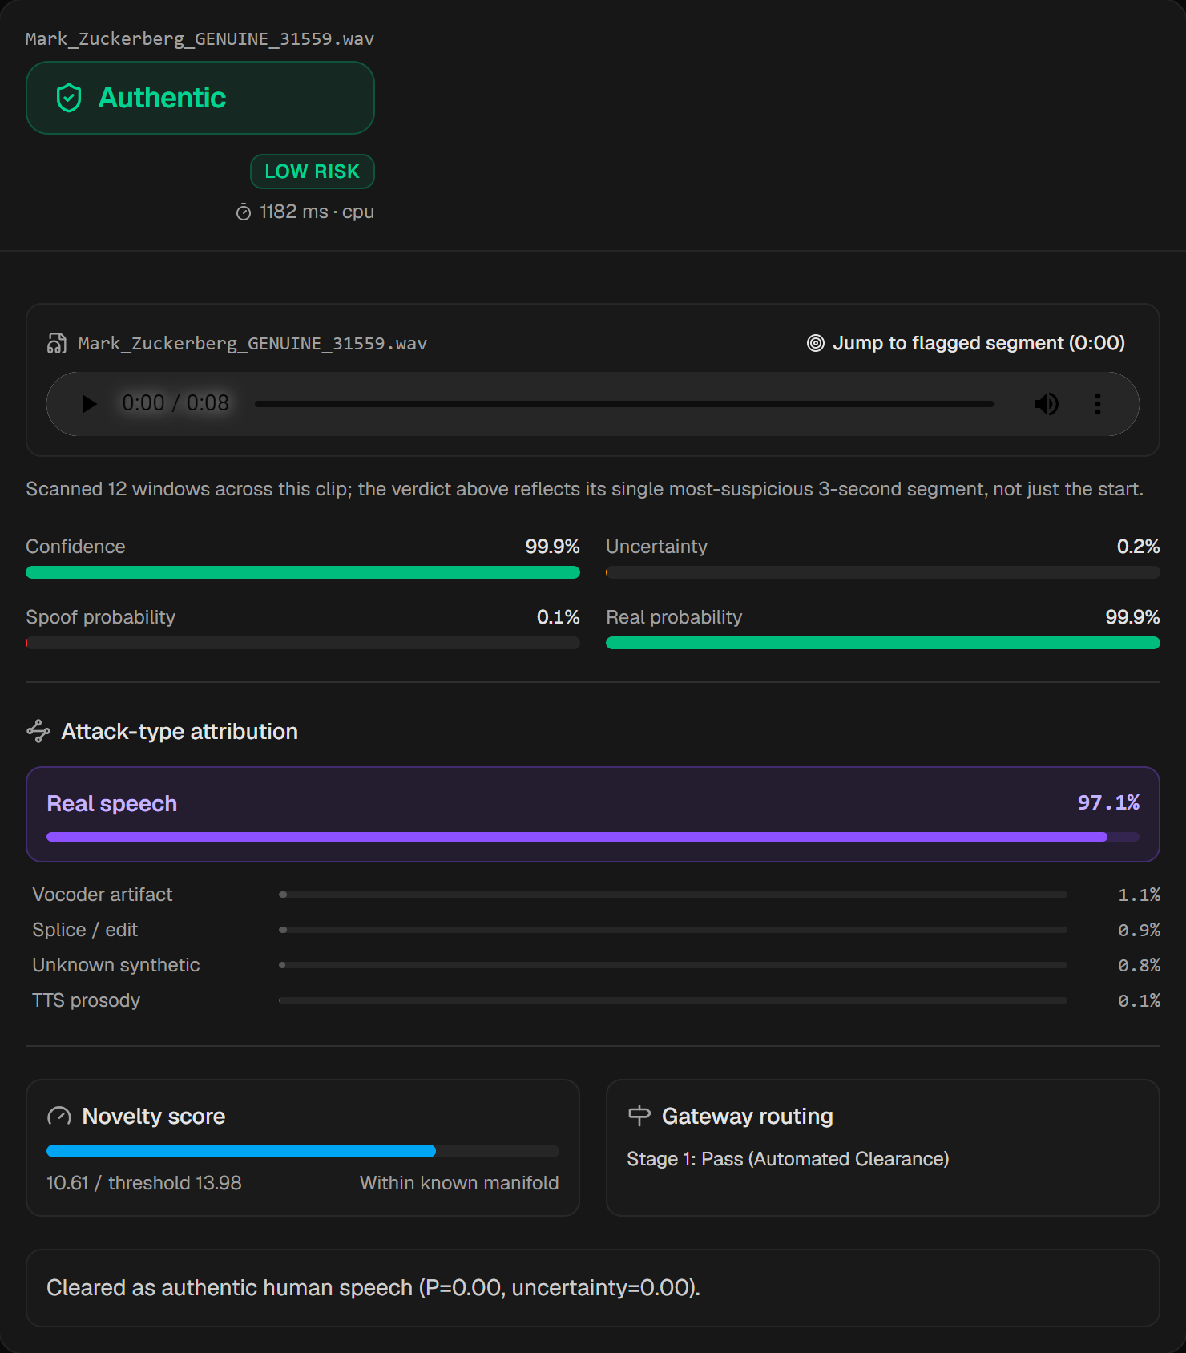
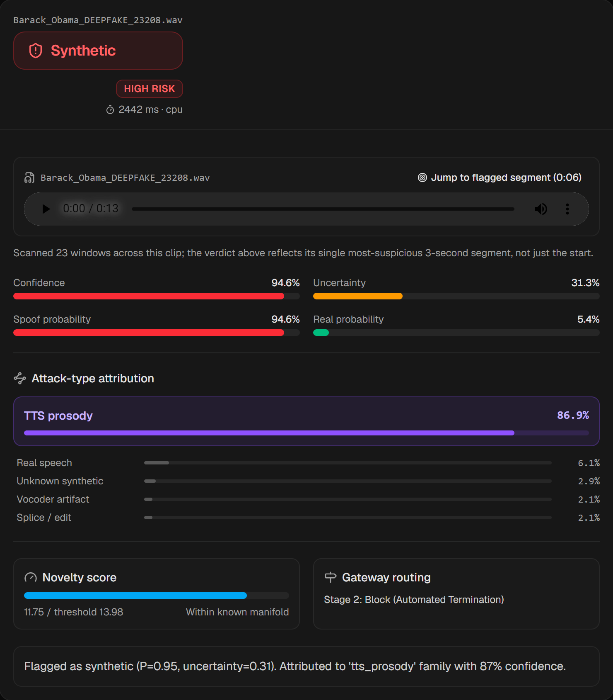
Sample Results: Live Inference (laptop CPU)
Genuine (Mark Zuckerberg interview) → Stage 1 Pass
AI-generated (Barack Obama) → Stage 2 Block, P = 0.95
AI-generated (Zuckerberg) → Stage 3 review, borderline P = 0.50
Round-2 model with the reference bank; clips from the In-the-Wild dataset (never used in training or fitting). Each card shows the verdict, risk level, P(fake), uncertainty, attack-type distribution, novelty vs threshold, gateway route and the rationale.

Slide 28
Results Summary (round-2 model)
Held-out family | Seen EER | Unseen EER | Unseen fakes passed | Flagged novel
2025–26 commercial TTS | 6.9% | 11.4% | 20.1% | 30.8%
Modern TTS (OpenAI, XTTS…) | 10.1% | 25.8% | 65.2% | 9.4%
MLAAD open TTS | 7.5% | 18.4% | 41.3% | 12.9%
Fake-or-Real TTS | 11.1% | 40.5% | 66.5% | 14.3%
Conformer-FastSpeech2 | 7.1% | 10.4% | 19.8% | 0.4%
MelGAN family | 7.9% | 14.7% | 34.7% | 7.7%
HiFi-GAN | 7.1% | 10.5% | 13.8% | 0.0%
WaveGlow | 11.9% | 9.4% | 5.3% | 0.0%
Parallel WaveGAN | 7.0% | 8.2% | 7.4% | 23.8%
Headline metric | Value
Clean test accuracy (6,648 clips) | 93.2%
Clean test ROC-AUC / EER | 0.978 / 6.8%
Genuine flagged fake / fakes passed | 7.0% / 6.5%
In-the-Wild accuracy / EER | 73.4% / 25.8%
Attack-type accuracy (test fakes) | 91.0%
Uncertainty AUC for spotting errors | 0.81
Random-split accuracy (for comparison) | 95.8% (28% leakage)
Robustness (EER, 1,000 test clips)
Clean 7.4% · MP3 32 kbps 9.0% · MP3 128 kbps 7.5% · Telephone 8 kHz 10.6% · Reverb 11.8% · Noise 20 dB 13.6% · 10 dB 19.1% · 0 dB 21.2%
EER = equal error rate (lower is better). Seen = the other families on the same genuine test audio. Strong generalisation to unseen vocoders; unseen modern and Fake-or-Real TTS remain the weakest cases (most of their fakes pass when the family is never seen).

Slide 29
Limitations, Not Yet Reduced to Practice, and Next Experiments
Limitations (measured)
Never-seen modern TTS: about 2 in 3 fakes pass when the family was never seen
Heavy noise: EER rises from 7% (clean) to 21% at 0 dB SNR
Clips under 2 s are unreliable; routed to review by design
LibriTTS genuine speech: 26% false alarms (other genuine sources 0.4–8%)
Partial deepfakes: 1.8 s of TTS spliced into genuine speech scores 0.00 with the detector alone; the reference bank sends it to review (0.66). One example; voice conversion not tested
Not yet reduced to practice
Continual-learning loop (claim 13)
Per-channel disagreement explanation (claim 11): code only
Combined risk-score routing (claim 6): implemented, evaluation pending round 3
Claimed-speaker check (claim 14): not yet tested with enrollment from separate sessions
Experiments that would strengthen the filing
Run round 3 (built and smoke-tested): random crops, 3,000 spliced fakes, ensemble, and the equal-workload comparison of the combined risk score against the score-only rule on test, In-the-Wild and every unseen family
Speaker check with enrollment and test audio from different sessions
Evaluate the per-channel disagreement map with reviewers, or drop claim 11
Add a voice-conversion / splicing test set to support the attack-type claim
Formal prior-art search: selective classification + OOD detection for anti-spoofing, and SASV (claim 14)
Bottom line for the patent team
The integrated system is built and works; the inventive step currently rests on a modest measured effect. Filing is defensible as a combination claim, but the experiments above should come first if time allows.

Slide 30
THANK YOU

