Slide 1

DeepShield
Telling real human voices from AI-generated ones, with a human safety net for the hard cases
Senior management briefing · live demo
Notes:
Good morning. Today I'll show you DeepShield, a system that listens to a voice recording and tells us whether it is a real person or an AI-generated voice. I'll keep it simple: first the problem, then how the system works block by block, then what our tests show, and finally a live demo on this laptop.

Slide 2




Anyone's voice can now be copied by AI
Modern AI tools can clone a voice from a short recording and make it say anything. To a listener, the result often sounds completely real.
Fraud calls
A ‘manager’ or ‘family member’ asking for an urgent payment
The challenge
New voice-cloning tools appear every few months. A detector that only knows yesterday's tools will be fooled by tomorrow's, so it must also know when it is unsure.
Account takeover
Fooling voice-based verification at banks and call centres
Fake evidence
Doctored recordings used to mislead or defame
Notes:
The problem is simple to state. AI can now copy a person's voice and make it say anything, and it sounds real. That opens the door to fraud calls, fooling voice verification, and fake recordings used as evidence. The hard part is that new cloning tools keep coming out, so a useful detector has to cope with tools it has never seen, and be honest when it is not sure.

Slide 3








DeepShield answers five questions, not just one
Is it fake?
What kind of fake?
How sure are we?
Seen it before?
Why?
Real voice or AI voice
Which family of AI tool made it
Confidence in its own answer
Is this unlike anything it knows
A plain-English reason
…and then makes one of three decisions:
Pass
Human review
Block
Clearly a real voice: no action needed
Unsure or unfamiliar: a person checks it
Clearly AI-generated: stop it
Notes:
Most detectors only say 'real' or 'fake'. DeepShield asks five questions: is it fake, what kind of fake, how sure are we, have we seen anything like it before, and why. Then, like a traffic light, it makes one of three decisions: green means pass, red means block, and amber means a human should check it. That amber lane is the important part: when the system is unsure, it says so instead of guessing.

Slide 4
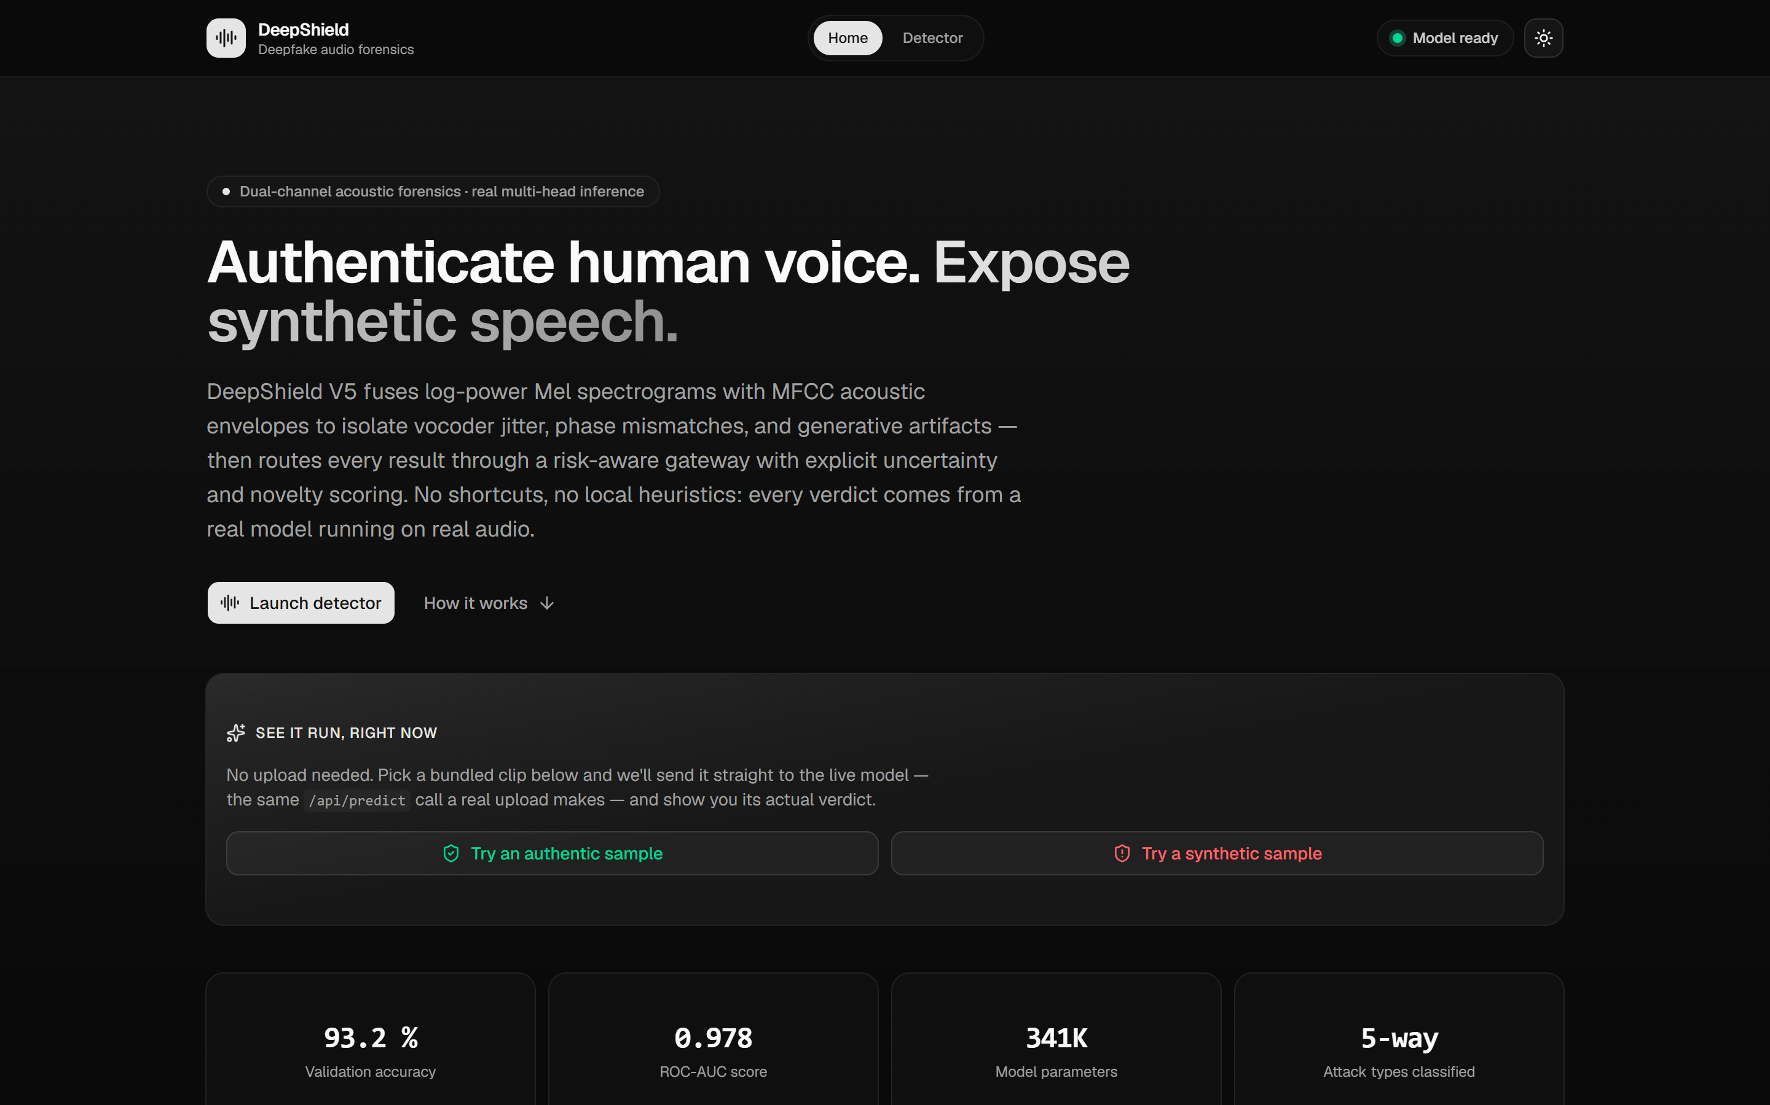
What you will see in the live demo
1
Runs entirely on this laptop: no internet needed, no audio stored
2
Upload a recording, or record from the microphone
3
Result in under a second, with the decision and the reason
Notes:
This is the application the student team built. It runs completely on this laptop, so nothing is uploaded to the internet and no audio is stored. You upload a recording or speak into the microphone, and within a second you get the decision and the reason behind it. I'll show it live in a few minutes.

Slide 5





How it works: six steps from recording to decision
Voice recording in
Decision + reason out
1. Prepare
2. Two views of sound
3. Pattern recogniser
4. Four specialists
5. Risk gateway
6. Explanation
Clean up and cut into 3-second pieces
Turn sound into two pictures
AI reads the pictures → 128-number ‘voice fingerprint’
Fake? Type? Sure? Familiar?
Pass / Review / Block
Reason in plain English
Proven building blocks, chosen for the job
DeepShield's own design: the patent candidate
Steps 1–3 use well-established techniques. What is new is steps 4–6: several specialists judging the same fingerprint, and a gateway that combines their opinions into a safe decision.
Notes:
Here is the whole system in six steps, left to right. One: prepare the recording. Two: turn the sound into two kinds of pictures. Three: an AI pattern recogniser reads those pictures and boils them down to a 128-number 'voice fingerprint'. Four: four specialists each look at that fingerprint and answer one question. Five: a risk gateway combines their answers into pass, review or block. Six: it writes the reason in plain English. Steps one to three are well-known techniques we chose carefully. Steps four to six, shown in red, are DeepShield's own design and the focus of the patent.

Slide 6



Step 1: Prepare the recording
What it does
How we made it robust
Converts any audio file to one standard format (16,000 samples per second)
Cuts long recordings into 3-second pieces and checks each one
Flags the most suspicious piece, so a fake sentence hidden in a long call is not missed
Clips shorter than 2 seconds go to human review: too little speech to judge safely
During training, the system practised on recordings deliberately degraded the way real calls are:
Compression
Background noise
like MP3 / messaging apps
street, office, hum
Echo
Phone line
large or empty rooms
narrow, muffled audio
Why: real-world audio is messy. A detector trained only on clean studio recordings breaks as soon as it hears a phone call.
Notes:
The first step is housekeeping. Every recording is converted to the same format and cut into three-second pieces, and the system looks for the most suspicious piece, so one fake sentence in a long call isn't missed. Very short clips, under two seconds, go straight to a human, because there simply isn't enough speech to judge. During training we deliberately degraded recordings with compression, noise, echo and phone-line effects, like practising in the rain before match day, so it copes with real calls.

Slide 7
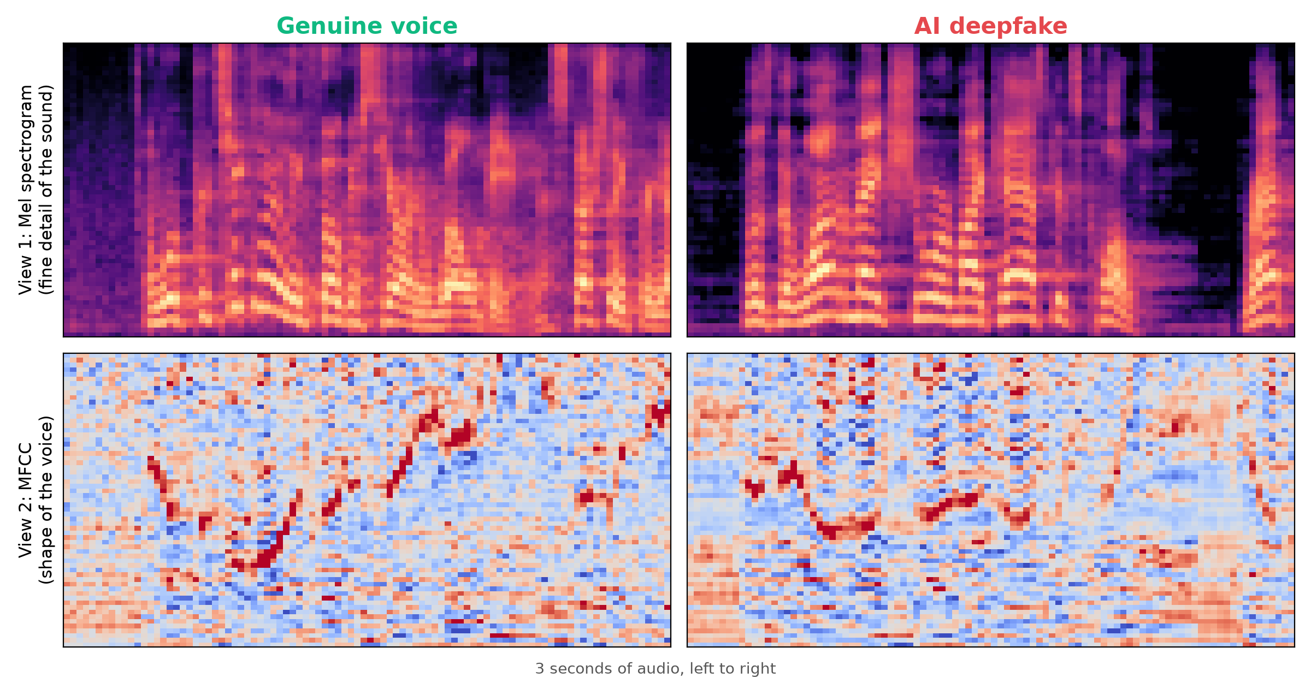
Step 2: Look at the sound in two different ways
View 1: Mel spectrogram
A detailed picture of the sound. Good at spotting the tiny digital ‘fingerprints’ that AI voice tools leave behind.
View 2: MFCC
A picture of the shape of the voice: how a human throat and mouth form sounds. Good at spotting voices no human body could make.
Why two views: like checking a banknote under normal light and under UV light. Each view catches things the other misses, and the AI sees both together.
Notes:
The computer can't 'hear', so we turn each three-second piece into pictures. The top pictures show the fine detail of the sound; the bottom pictures show the shape of the voice. On the left is a real voice, on the right an AI voice. Notice the AI voice has perfectly black, unnaturally clean silences between words; real recordings always have some background. Using two views is like checking a banknote under normal light and under UV: each one catches tricks the other misses.

Slide 8


Step 3: The AI builds a ‘voice fingerprint’
Two pictures of the sound
ResNet-style network with attention
Voice fingerprint: 128 numbers that summarise the clip
About 341,000 learned settings · runs on a normal laptop
Residual network (ResNet)
Attention (‘Squeeze-and-Excitation’)
One shared fingerprint
A proven design for reading image-like data. Its ‘shortcut’ connections let it learn deep patterns without losing fine detail.
Works like a highlighter: it learns which features matter most for spotting fakes and turns those up.
Every specialist in the next step reads the same fingerprint, so their answers are consistent and the system stays fast.
Notes:
Next, an AI pattern recogniser studies the two pictures. It's a residual network, the same family of design used widely for image recognition, with an 'attention' part that works like a highlighter on the most useful clues. It's deliberately compact, about 341,000 learned settings, so it runs on a normal laptop in a fraction of a second. Its output is a 'voice fingerprint': 128 numbers that summarise the clip. Everything after this works from that fingerprint.

Slide 9
Step 4: Four specialists judge the same fingerprint
Fake score
Attack type
How likely is this to be AI-generated? (0–100%)
Which family of AI tool made it?
The core detector, trained on tens of thousands of real and AI voices.
Tells investigators what they are dealing with: 91% correct in tests.
Uncertainty
Novelty
How sure is the system about its own answer?
Is this unlike the real voices it has learned?
It asks itself the question many times with small random variations. If the answers disagree, it is unsure.
Measures how far the fingerprint sits from known genuine voices: a warning sign for new tricks.
On AI tools it has never seen, uncertainty and novelty add warning signs that the fake score alone misses.
Notes:
This is where DeepShield differs from ordinary detectors. Instead of one answer, four specialists look at the same fingerprint. The fake score says how likely it is to be AI. The attack-type specialist says which family of AI tool made it, which is useful for investigators. The uncertainty specialist checks how sure the system is: it asks itself the same question many times with small variations, and if the answers disagree, it's unsure. The novelty specialist checks whether this voice looks unlike the real voices it has learned. On AI tools it has never seen, uncertainty and novelty pick up warning signs the fake score alone misses. The gain is modest so far, and making better use of it is part of our next steps.

Slide 10
Step 5: The risk gateway decides what happens next
Fake score
Pass
Automatic clearance
Attack type
Risk gateway
Human review
Unfamiliar or unsure? → a person checks it
Clearly real → pass
Clearly AI → block
~15% of genuine calls
Uncertainty
Novelty
Block
Automatic stop
Why: a system that always guesses ‘real’ or ‘fake’ will be confidently wrong on new tricks. The gateway sends the hard cases to people, and we tuned it so only about 15% of genuine calls need a human look.
Notes:
The risk gateway is the decision maker. It takes all four specialists' answers together. If the voice looks unfamiliar or the system is unsure, it goes to a person. If it's clearly real, it passes; if it's clearly AI, it's blocked. We tuned the gateway so that only about fifteen percent of genuine calls need a human look, which is a manageable workload, and in exchange both kinds of mistakes are roughly halved. I'll show the numbers shortly.

Slide 11
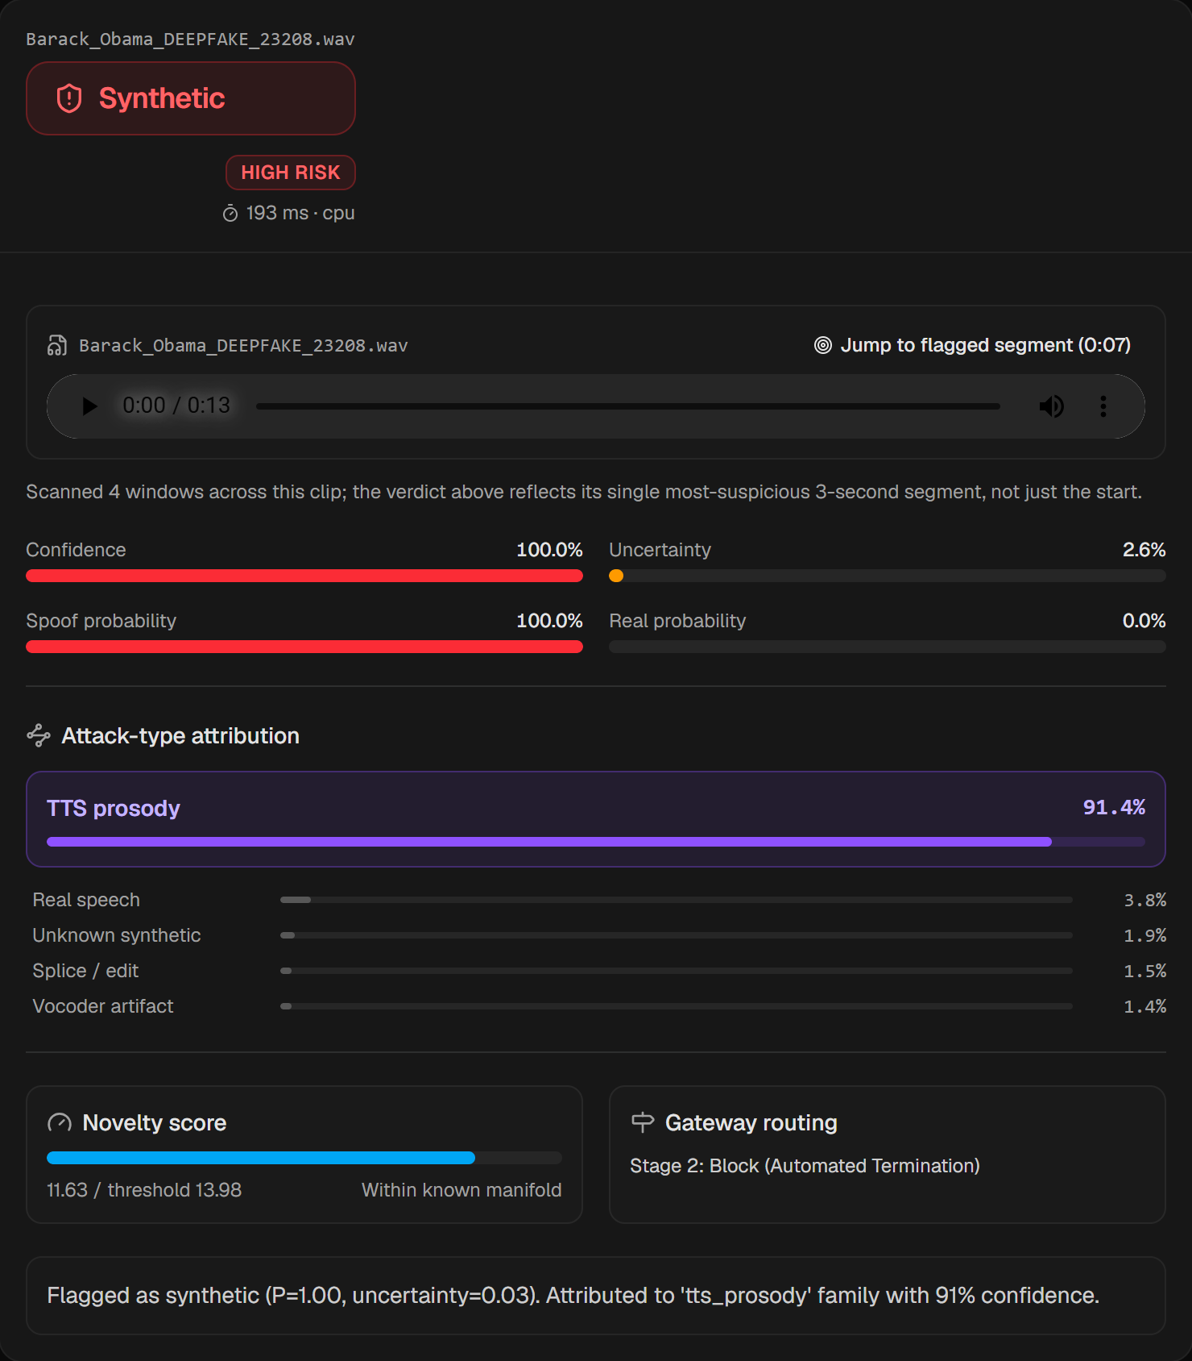
Step 6: Every decision comes with a reason
What a reviewer sees (real screenshot)
1
Decision
Block, Pass or Review, plus a Low / Medium / High risk label
2
Scores
Fake probability, confidence and uncertainty as simple bars
3
Attack type
Which family of AI tool most likely made it
4
Where
Jumps to the most suspicious 3 seconds of the recording
5
Reason
One sentence built from the actual scores, never invented
Notes:
Finally, every decision comes with an explanation a reviewer can act on. This is a real screenshot: an AI-generated Obama clip, blocked. It shows the decision and risk level, the scores as simple bars, which family of AI tool most likely made it, the most suspicious part of the recording, and a one-line reason. The reason is built directly from the scores. It is never made up, which matters if a decision is ever challenged.

Slide 12


How we tested it: strictly and honestly
11
44,000
40+
public datasets
audio clips used
different AI voice tools
No cheating
Never-seen AI tools
The same recording, sentence or speaker never appears in both training and testing. (The earlier 97.7% figure was inflated by exactly this; the honest figure is 93%.)
We hid one family of AI voice tools during training, then tested on it. Repeated for 9 families, including 2025–26 commercial voices.
Real-world clips
Messy audio
4,000 genuine and deepfake clips of public figures from the internet, never used for training.
Re-tested with compression, noise, echo and phone-line audio.
Notes:
We tested this carefully. We used eleven public datasets, about 44,000 clips, and over forty different AI voice tools. First, no cheating: the same recording or speaker never appears in both training and testing. The students' earlier 97.7% figure was inflated by exactly that; the honest figure is 93%. Second, we hid entire families of AI tools during training and tested on them, to simulate tomorrow's tools. Third, we tested on 4,000 real-world clips of public figures from the internet. Fourth, we tested on messy audio.

Slide 13
Results at a glance
93%
91%
4 in 5
73%
correct on the strict test
correct on the type of AI tool
brand-new commercial AI voices caught
correct on real-world internet clips
6,648 clips never seen in training
helps investigators
2025–26 tools it never trained on
the hardest test; room to improve
On the strict test: about 7 in 100 genuine recordings are wrongly flagged and about 7 in 100 fakes slip through, before the risk gateway. The gateway cuts both (next slide).
Notes:
Here are the headline results. On the strict test it is correct 93% of the time, and it identifies the type of AI tool 91% of the time. Encouragingly, it catches about four out of five of the newest commercial AI voices even though it never trained on them. Real-world internet clips are the hardest test, at 73%, and that's where we have room to improve. On its own, the detector wrongly flags about seven genuine recordings in a hundred and misses about seven fakes in a hundred. The gateway improves both, as the next slide shows.

Slide 14
Sending doubtful cases to a person halves both kinds of mistake
The cost: about 15% of genuine recordings go to a human for a quick check (27% on the hardest real-world clips).
Notes:
This is the most important practical result. Grey bars are the detector on its own; teal bars are with DeepShield's gateway, which sends doubtful cases to a person. On the left: fakes wrongly let through. On the strict test it drops from 6.5% to 2.8%; on AI tools it has never seen, from 30% to 19%; on real-world clips, from 35% to 16%. On the right: genuine voices wrongly blocked, which also roughly halves. The price is that about fifteen percent of genuine recordings get a quick human check. That's the trade-off: a small, predictable review workload for far fewer mistakes. To be precise: most of this gain comes from having a human review lane at all. The four specialists add a smaller extra benefit on never-seen AI tools, and improving that is part of the next steps.

Slide 15
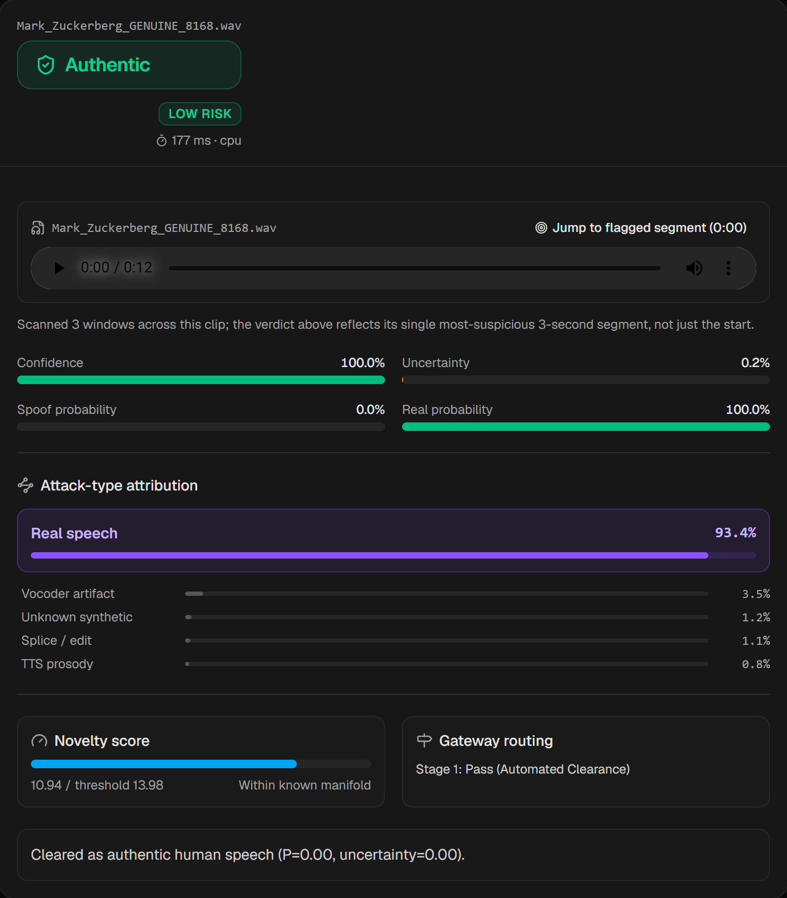
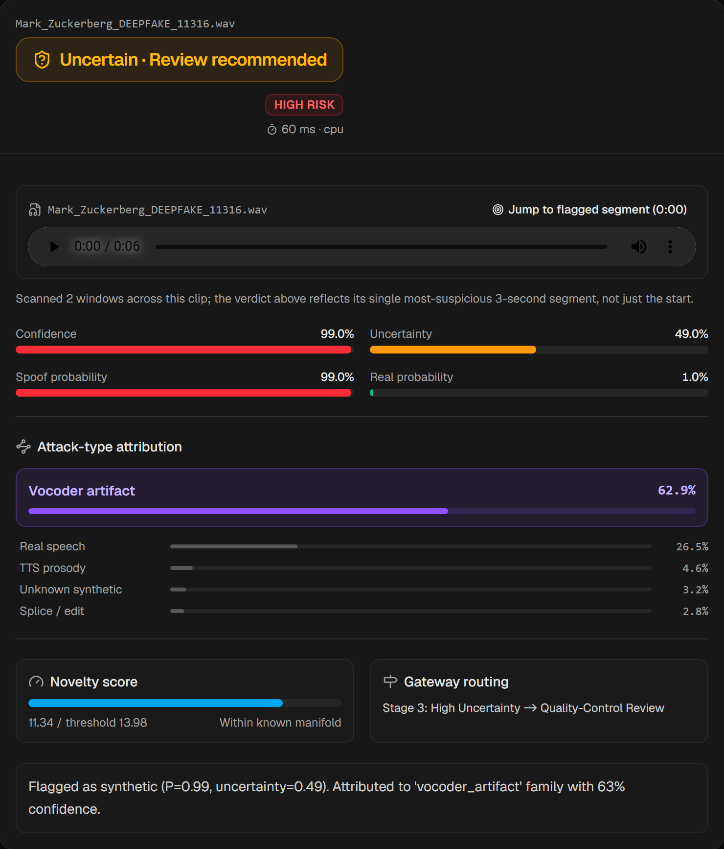
Live demo: three real cases
Genuine voice → Pass
AI voice → Block
Unsure → Human review
Real Mark Zuckerberg interview clip. Low risk, cleared automatically.
AI-generated Barack Obama clip. Fake score 100%, blocked.
AI-generated Zuckerberg clip. Flagged, but uncertainty is high, so a person checks it.
Notes:
Now let me switch to the live system. [Switch to the browser: double-click start_demo.bat if it isn't already open, then go to http://localhost:8080 and click Detector.] I'll upload three clips from the folder demo\clips\in_the_wild. First, a genuine Zuckerberg interview: it passes. Second, an AI-generated Obama clip: it's blocked. Third, an AI-generated Zuckerberg clip where the system is unsure, so instead of guessing it sends it to a human. That third case is the whole point of DeepShield. If the live system has any problem, these screenshots show the same three results.

Slide 16




What it does not do yet, and what comes next
Honest limitations
Next steps
Brand-new AI voice tools still get through more often (about 1 in 3 in our hardest tests)
Keep adding new AI voice tools and varied real voices to training
Heavy background noise reduces accuracy
Make better use of the specialists' warning signs, and learn from reviewers' decisions
Clips under 2 seconds cannot be judged; they go to review
Pilot on real call-centre or fraud-team audio
Edited real recordings (spliced or voice-converted) have not been tested yet
File the patent on the multi-specialist risk gateway
No detector is perfect. DeepShield's value is that it knows when it is unsure and asks a human.
Notes:
To be transparent about the limits: brand-new AI tools still get through more often than we'd like, heavy noise hurts accuracy, very short clips can't be judged, and we haven't yet tested edited real recordings. Next steps are to keep adding new AI tools and varied voices, learn from reviewers' decisions, pilot on real call-centre audio, and file the patent on the risk gateway. The key message: no detector is perfect, but DeepShield knows when it's unsure and asks a person.

Slide 17
Thank you
Questions, and a try-it-yourself demo on this laptop
Notes:
Thank you. I'm happy to take questions, and anyone who wants to can try the demo with their own recording.

Slide 18
Cheat sheet: the models and why (1 of 2)
Block | What we use | Why we chose it | In plain words
Prepare | 16 kHz audio, 3-second windows; training with MP3, noise, echo and phone-line effects | Real calls are compressed and noisy | Practise in the rain before match day
Two views | Mel spectrogram + MFCC, stacked as two channels | One shows machine artefacts, the other the human voice shape | Banknote under normal light and UV
Pattern recogniser | Compact ResNet-style CNN (3 residual blocks, ~341K settings) | Proven for image-like data; fast on a laptop | An expert examiner
Attention | Squeeze-and-Excitation | Boosts the most useful clues | A highlighter
Voice fingerprint | 128-number shared embedding | One analysis read by every specialist | A summary card
Notes:
Reference table: each building block, the technique used, why it was chosen, and a plain-English comparison. Use it if someone asks a technical question.

Slide 19
Cheat sheet: the models and why (2 of 2)
Block | What we use | Why we chose it | In plain words
Fake score | Classifier head (real vs AI) | The core detection signal | The main verdict
Attack type | 5-way classifier head trained jointly | Tells investigators what made the fake | Which forger’s style
Uncertainty | Monte-Carlo dropout (re-asks the model many times) | Spots answers it shouldn’t trust | Second opinions from the same expert
Novelty | Mahalanobis distance from genuine-voice fingerprints | Warns about unfamiliar audio | ‘I haven’t seen this before’
Risk gateway | Rules combining all four; thresholds tuned so ~15% of genuine audio is reviewed | Safe decisions with a predictable workload | Traffic light with a human lane
Explanation | Template-based sentence from the actual scores | Never invents a reason | A short written verdict
Notes:
Second half of the reference table, covering the four specialists, the risk gateway and the explanation.

