Slide 1

Driver Drowsiness Detection using Convolutional Neural Networks
TEAM :
VAMSHI ACHAVELLI
SASANK KOPPARTHI
JASHWANTH MUTYALA

Slide 2
Introduction
Driver sleepiness is the primary factor that led to traffic accidents. To minimize collisions on the side of the road, it is essential and challenging to identify driver drowsiness (DDD) or fatigue.
To increase safety and stop these events, we'll develop a drowsiness detection system. When the system notices the driver is drowsy, it will alert (alarm) the driver.
We'll take pictures with a webcam to utilize as input. We'll make use of OpenCV's cv2 technique.
Since the OpenCV object detection method only accepts grayscale images as input, the image must be transformed to grayscale in order to identify the face in it.

Slide 3
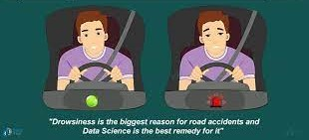
It generates a list of detections with the height, the width of the object’s border-box, along with x, y, and coordinates. Now that the faces have been iterated, we may create boundary boxes for each of them.
The model can then be applied to the image to get a prediction. If the prediction is closer to 0, we display "Open" on the screen. In the absence of this, we display "Closed" (i.e., it's nearer 1).

Slide 4
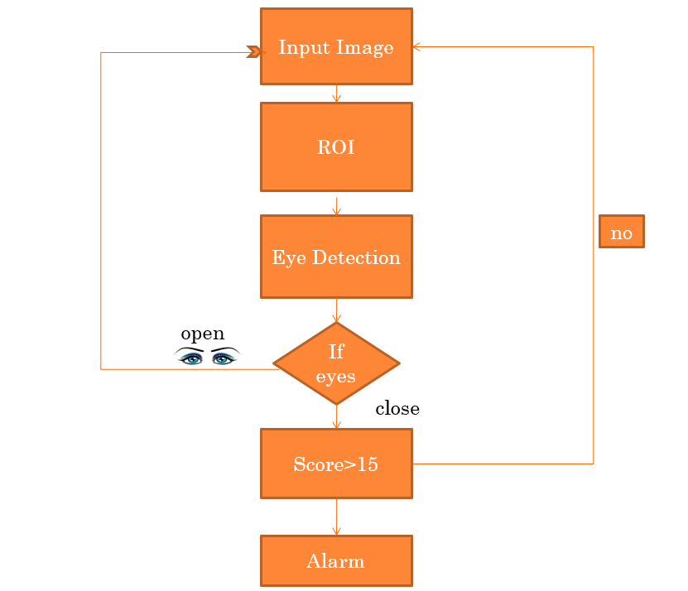

Slide 5
Dataset Description
We are getting facial data from
UMass Amherst open eye face data: More than 13,000 photos of faces were gathered from the internet for the data collection. The name of the individual pictured has been written on each face.
Nanjing University closed eye face: This dataset includes 2423 subjects, including 1192 subjects with both eyes closed which were obtained directly from the Internet and 1231 subjects with both eyes open which were chosen from the Labeled Face in the Wild (LFW [2]) database.

Slide 6
Algorithm Used.
The model we used is built using Convolutional Neural Networks (CNN).
A type of deep neural network called a convolutional neural network does exceptionally well at classifying images.
There are three layers that make up a CNN: an input layer, an output layer, and a hidden layer with many layers.

Slide 7
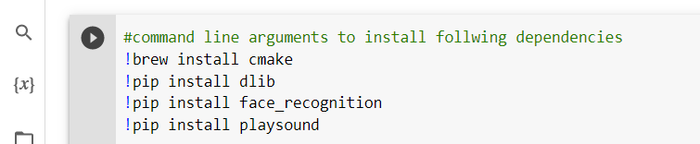
Data pre-preprocessing: The following dependencies are required to pre-process the datasets. 1. CMAKE: needed for the face recognition 2. DLIB: needed for the face 3. FACE_RECOGNITION: necessary for identifying the coordinates of the eyes in a face.
Data Preparation

Slide 8
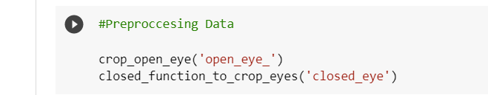
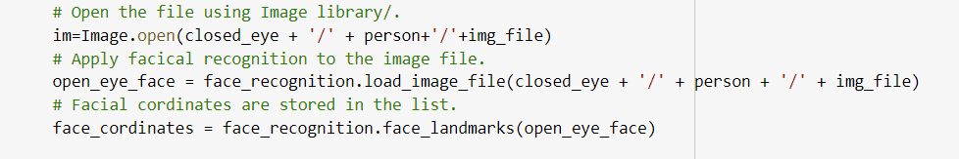
Calling the appropriate functions: We need two different functions to pre-process the data because we are using two distinct datasets. The only difference between the internal code and the external code is how we loop through the files in their respective folders. The coordinates are obtained by utilizing this snippet after each image has been fetched from its folder.

Slide 9
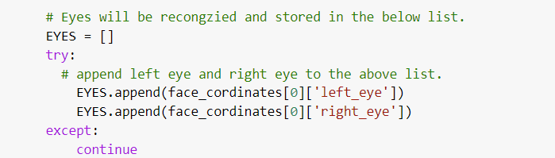
Let's make a list to record the values of the coordinates after we have identified them for each eye. Pre-processing is skipped if the library is unable to identify the face. Let's define the boundaries for each eye so that we can remove it from the face. We are extending the range by a cushion to ensure that the entire eye is photographed.

Slide 10
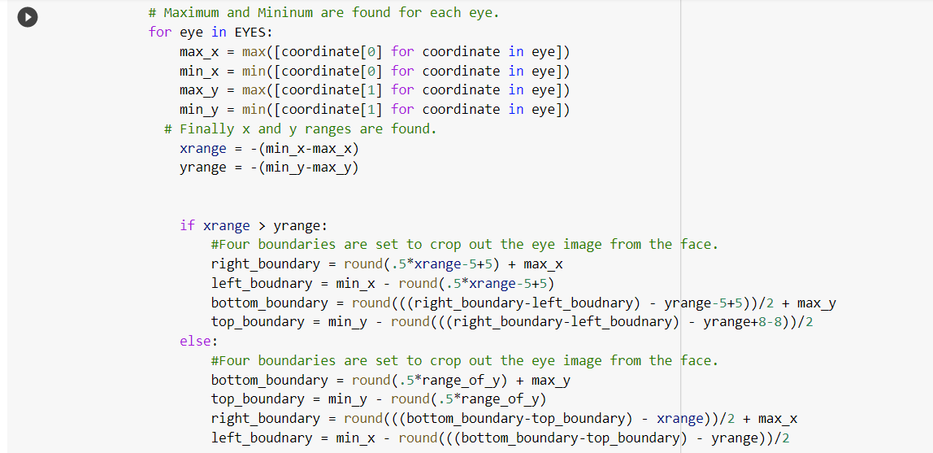
Adding a buffer zone around the coordinates

Slide 11
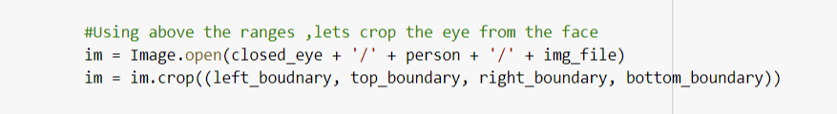
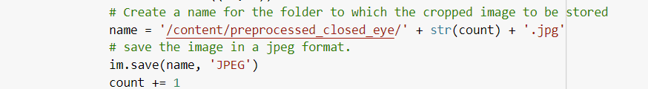
Now, we remove the eye from the face using the PIL image library's crop feature
Let's adjust the image now so that it has a standard size across the board for all images sent to the neural network..
In order to send it to training, we now create a folder, put it in that folder, and save it.
Above all steps are same for the closed_eye_data.

Slide 12
Input:
Open Eye Dataset Closed Eye Dataset
Output:
Open Eye Dataset Closed Eye Dataset

Slide 13
Project
https://colab.research.google.com/drive/11rpBIkNeHMbT21MJ7IpBAILJHI_sHH9J

Slide 14
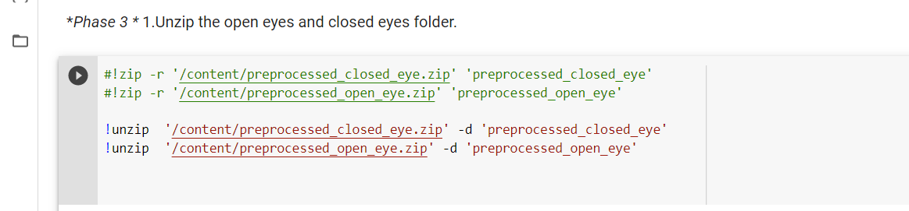
The current version of the code :
1. Zipped files contain images; thus, we must unzip them.

Slide 15
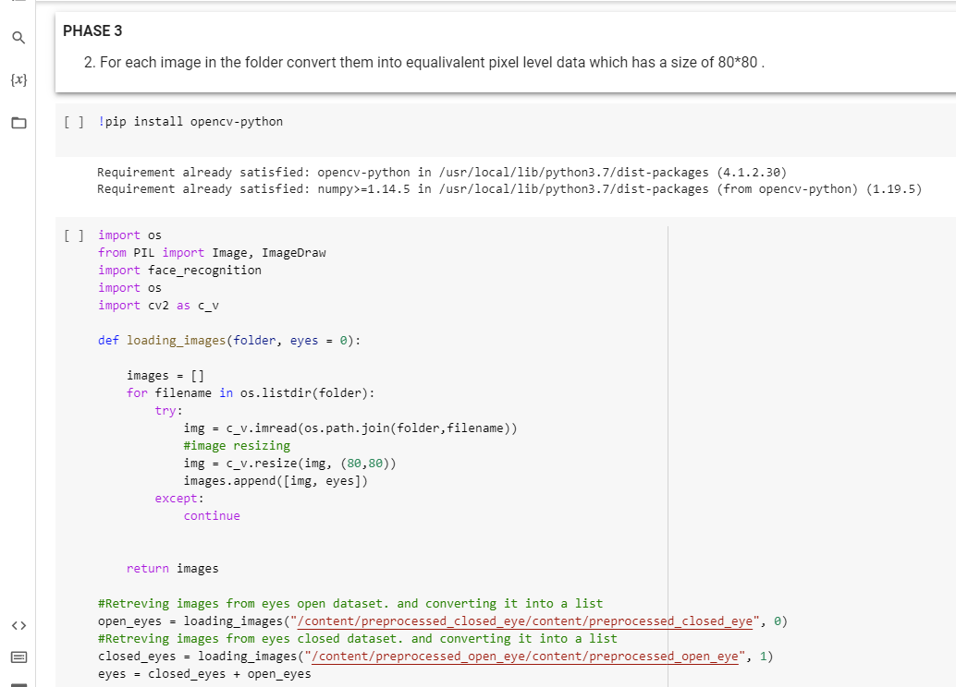
2. Each image should be transformed into an equivalent pixel array.

Slide 16
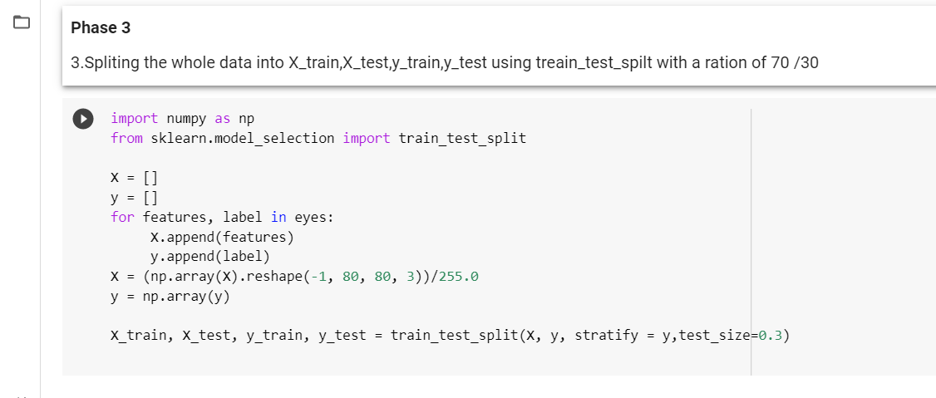
3. Divide the data into train and test splits.

Slide 17
Current Model architecture:
Instead of creating the entire image, this layer creates chunks of pixels, which makes modeling faster. This may be denser than the original images, depending on how many filters you apply, but it will allow the model to learn more complex associations with less input. 32 filters were applied in total. Two 3x3s pooled together, then three 3x3s pooled together, were the greatest layouts for me.

Slide 18
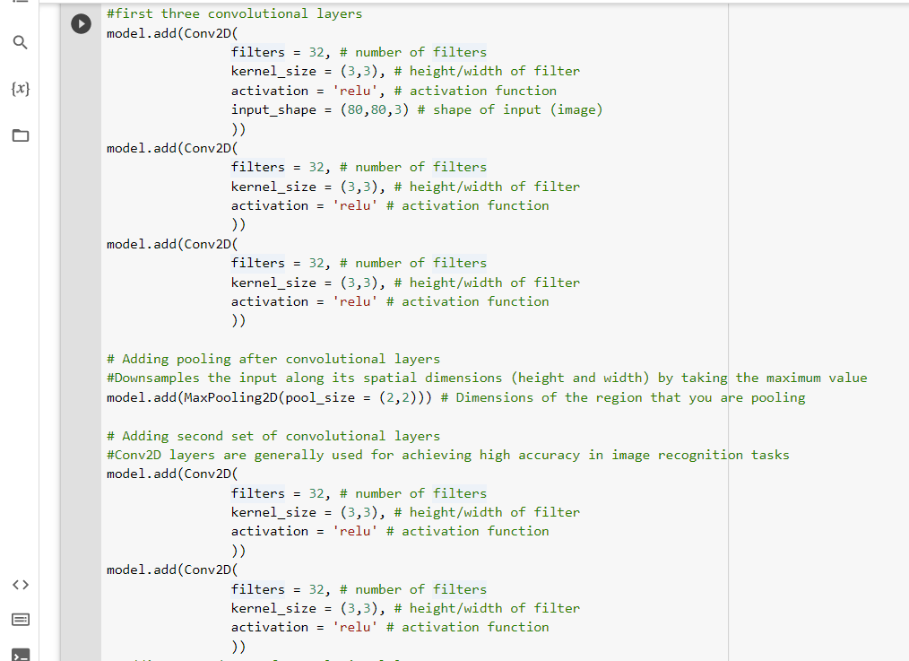

Slide 19
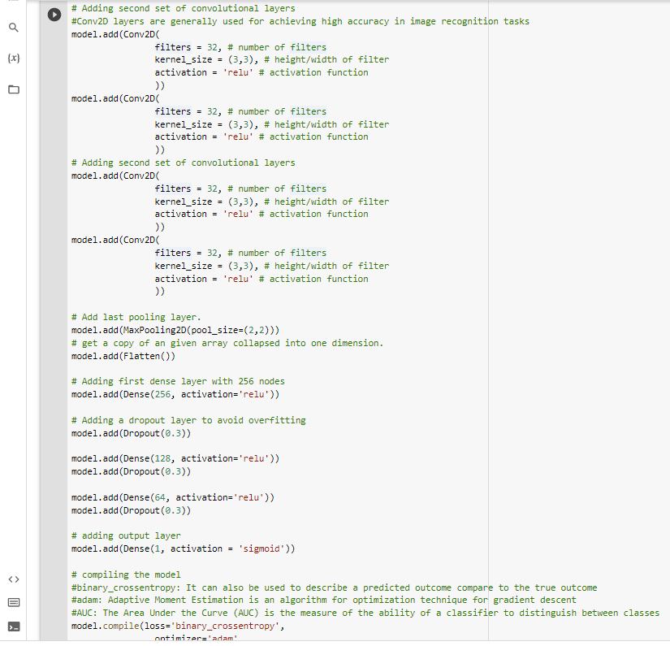

Slide 20
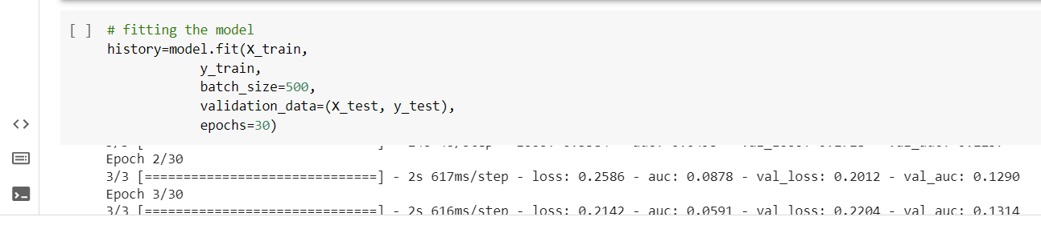
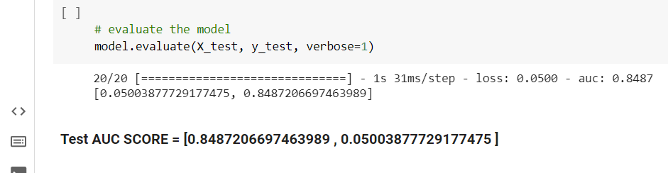

Slide 21
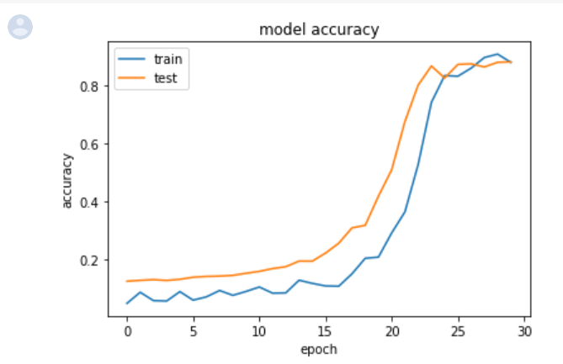
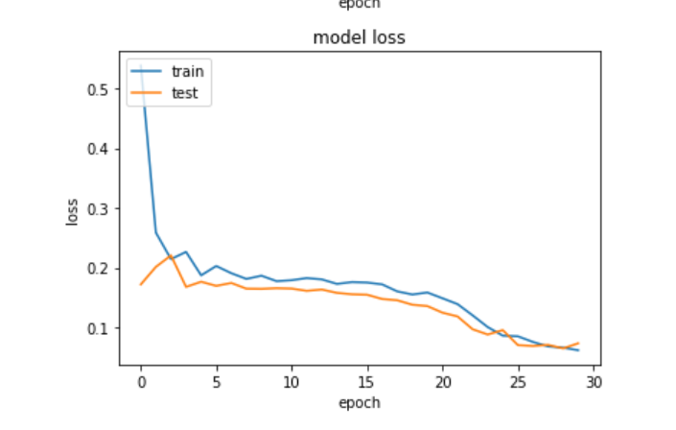
Accuracy Plot

Slide 22
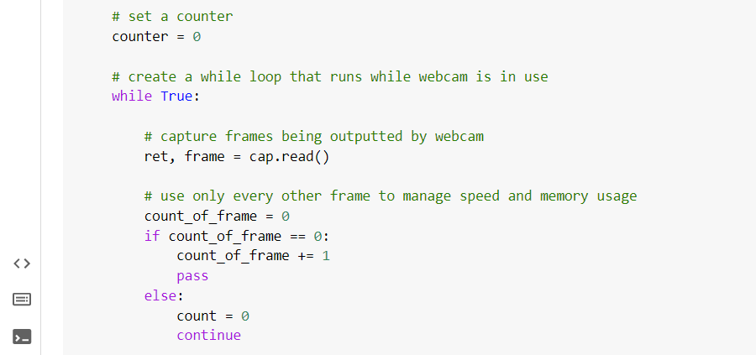
Frame

Slide 24
How are you going to assess your outcomes?
We will currently display the results with an accuracy that is almost 80%.

Slide 25
Time Line
S.N0 | Task Description | Time
1 | Data Preprocessing | September 24th
2 | Algorithm Implementation | October 1st
3 | Code Development | October 29th
4 | Testing and improve the accuracy | November 12th

Slide 26
References
Qaisar Abbas, “Hybrid Fatigue: A Real-time Driver Drowsiness Detection using Hybrid Features and Transfer Learning” International Journal of Advanced Computer Science and Applications (IJACSA), 11(1), 2020. http://dx.doi.org/10.14569/IJACSA.2020.0110173.
Sahayadhas, A.; Sundaraj, K.; Murugappan, M. Detecting Driver Drowsiness Based on Sensors: A Review. Sensors 2012, 12, 16937-16953.
Rateb Jabbar; Mohammed Shinoy; Mohamed Kharbeche; Moez Krichen; Kamel Barkaou : Driver Drowsiness Detection Model Using Convolutional Neural Networks Techniques for Android Application https://ieeexplore.ieee.org/document/9089484

Slide 27
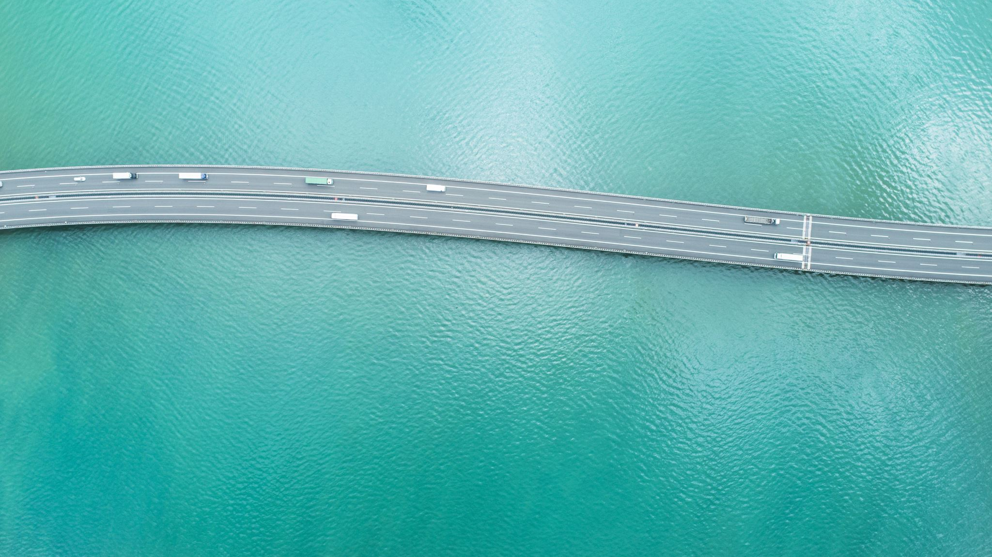
THANK YOU

