Slide 1

Validating Medical Documents
WITH PRIVACY AND RELEASE CONTROL
REVIEW ON SECURE VALIDATION IN HEALTH SYSTEM
BY:
BATCH-9

Slide 2
INTRODUCTION
Medical Document Validation Is Crucial To Ensure The Accuracy, Authenticity, And Integrity Of Patient Records.
In Healthcare, These Documents, Such As Prescriptions, Test Results, And Treatment Plans, Guide Critical Decisions, And Any Errors Or Tampering Can Lead To Misdiagnosis, Incorrect Treatments, And Even Legal Issues.
Validating These Records Ensures Trust Between Healthcare Providers, Patients, And Insurance Companies, While Also Protecting Sensitive Patient Information.
It Plays A Key Role In Maintaining Compliance With Regulations Like HIPAA And GDPR, Helping To Prevent Fraud And Safeguard Privacy.

Slide 3
ABSTRACT
The Increasing Reliance On Digital Medical Records Has Brought New Challenges Related To Data Integrity, Privacy, And Secure Access. This Paper Explores The Importance Of Validating Medical Documents To Ensure Their Accuracy, Authenticity, And Protection Against Tampering.
It Highlights The Critical Role Privacy Plays In Safeguarding Sensitive Patient Information And Discusses Mechanisms For Release Control That Allow For Regulated Access To Medical Data.
By Implementing Robust Validation Processes, Encryption, And Access Control Measures, Healthcare Providers Can Prevent Fraud, Maintain Patient Trust, And Comply With Legal Standards Like Hipaa And Gdpr.
Emerging Technologies Such As Blockchain And Ai-based Validation Tools Are Examined For Their Potential To Enhance The Security And Reliability Of Medical Documentation Systems, Paving The Way For A More Secure And Efficient Healthcare Ecosystem.

Slide 4
EXISTING SYSTEM
In the current healthcare landscape, many medical institutions still rely on fragmented and sometimes manual processes for managing patient records.
Medical documents are stored in electronic health record (EHR) systems, but these systems often lack seamless integration across different providers, making it difficult to validate documents efficiently.
The validation process in existing systems typically includes verifying entries manually, which increases the risk of human error, tampering, or fraudulent activity.
Privacy and release control mechanisms are often inadequate in the existing systems.
While basic authentication methods are in place, they are frequently insufficient to guarantee patient confidentiality.
Data breaches remain a major concern, and the release of sensitive information is often poorly controlled, with limited or no ability for patients to regulate who can access their data.

Slide 5
ADVANTAGES AND DISADVANTAGES OF EXISTING SYSTEM
ADVANTAGE
Widespread Adoption:
Many healthcare providers already use Electronic Health Record (EHR) systems, which offer a centralized location for storing medical documents. These systems are widely accepted in the healthcare industry, making them accessible and familiar.
Basic Functionality:
Existing systems provide core functionalities such as storing patient data, accessing medical history, and sharing records within a network of healthcare providers. This allows for improved coordination of patient care compared to paper-based systems.
DISADVANTAGE
Manual Errors and Data Inconsistencies:
Many existing systems rely on manual data entry and validation processes, increasing the risk of human error, inaccurate information, and data inconsistency across different healthcare providers.

Slide 6
PROPOSED SYSTEM
Interoperability: Implement standardized data formats and protocols to ensure seamless data exchange between different healthcare providers and systems.
Blockchain Technology: Use blockchain to enhance data security, privacy, and integrity. Blockchain can also address issues like single points of failure and data breaches.
Advanced Encryption: Employ advanced encryption methods, such as homomorphic encryption and zero-knowledge proof, to protect sensitive patient data.
User-Friendly Interface: Design an intuitive and easy-to-use interface for both healthcare providers and patients, enabling efficient access and management of health records.
Real-Time Data Access: Enable real-time access to patient records, allowing healthcare providers to make informed decisions quickly.
Predictive Analytics: Integrate predictive analytics to help identify potential health issues and provide proactive care

Slide 7
HARDWARE REQUIREMENT
Server Hardware
Purpose: To host the application, database, and other services.
Specifications:
Processor: Multi-core processors (e.g., Intel Xeon or AMD EPYC) for high performance.
RAM: Minimum 16-32 GB (or more depending on the scale) for efficient data processing.
Storage: SSDs for faster data access (1 TB or more, scalable as needed).
Network Interface: Gigabit Ethernet for high-speed connectivity.
Network Infrastructure
Purpose: To facilitate secure communication between devices and the server.
Components:
Routers: For directing data traffic between the network and the internet.
Switches: To connect multiple devices within the local network.
Firewall: Hardware firewall for enhanced security against external threats.
Workstations/Client Devices
Purpose: For healthcare professionals to access the system.
Specifications:
Computers: Desktops or laptops with at least 8 GB of RAM and a modern processor (e.g., Intel i5 or AMD Ryzen 5).
Monitors: Dual monitors recommended for improved productivity.

Slide 8
Scanners
Purpose: To digitize paper-based medical documents for validation.
Specifications:
Type: High-speed document scanners with OCR capabilities.
Features: Duplex scanning and high resolution (at least 300 DPI).
Backup and Storage Solutions
Purpose: To securely store backups of medical documents and data.
Components:
NAS (Network Attached Storage): For centralized backup and data storage.
External Backup Drives: For off-site backup options
Security Hardware
Purpose: To enhance the security of the infrastructure.
Components:
Surge Protectors: To protect hardware from power surges.
Uninterruptible Power Supply (UPS): To provide backup power during outages.

Slide 9
SOFTWARE REQUIREMENT
Operating System
Server OS: Windows Server or Linux (e.g., Ubuntu Server, CentOS)
Client OS: Windows, macOS, or Linux for user workstations
Database Management System (DBMS)
Options:
SQL Database: PostgreSQL or MySQL
NoSQL Database: MongoDB (for unstructured data)
Web Server
Options: Apache or Nginx for hosting the application
Application Framework
Frontend: React, Angular, or Vue.js for user interface development
Backend: Node.js, Python Flask, or Django for server-side logic
Document Management System (DMS)
Software for organizing, storing, and retrieving medical documents
Examples: M-Files, DocuWare (if integrating third-party solutions)
Scanning and OCR Software
Examples: ABBYY FineReader or Tesseract for optical character recognition

Slide 10
Security Software
Options: Antivirus, anti-malware, and endpoint protection software
Firewall Software: For network security
Backup and Recovery Software
Tools for automated backups and data recovery
Examples: Veeam, Acronis, or built-in backup solutions in the OS
Compliance and Auditing Tools
Software for auditing access logs and ensuring regulatory compliance (e.g., HIPAA)
Example: Compliance management platforms like ComplyAssistant
User Management and Authentication
Identity and access management solutions for user authentication and role management
Example: Okta or Microsoft Active Directory

Slide 11
MODULES
Patient: A patient outsources her documents to the cloud server to provide convenient and reliable data access to the corresponding search doctors. To protect the data privacy, the patient encrypts the original documents under an access policy using attribute-based encryption. To improve the search efficiency, she also generates some keyword for each outsourced document. The corresponding index is then generated according to the keywords using the secret key of the secure kNN scheme. After that, the patient sends the encrypted documents, and the corresponding indexes to the cloud server, and submits the secret key to the search doctors.
Cloud server: A cloud server is an intermediary entity which stores the encrypted documents and the corresponding indexes received from patients, and then provides data access and search services to authorized search doctors. When a search doctor sends a trapdoor to the cloud server, it would return a collection of matching documents based on certain operations.

Slide 12
Doctor: An authorized doctor can obtain the secret key from the patient, where this key can be used to generate trapdoors. When she needs to search the outsourced documents stored in the cloud server, she will generate a search keyword set. Then according to the keyword set, the doctor uses the secret key to generate a trapdoor and sends it to the cloud server. Finally, she receives the matching document collection from the cloud server and decrypts them with the ABE key received from the trusted authority. After getting the health information of the patient, the doctor can also outsource medical report to the cloud server by the same way. For simplicity, we just consider one-way communication in our schemes.

Slide 13
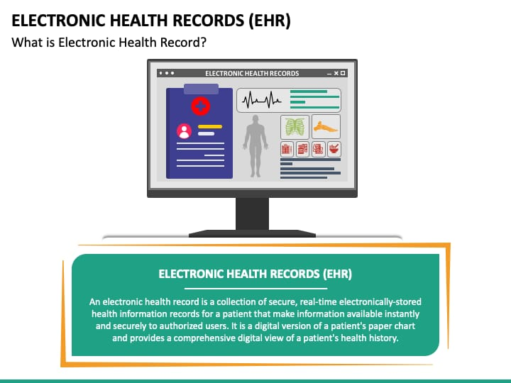
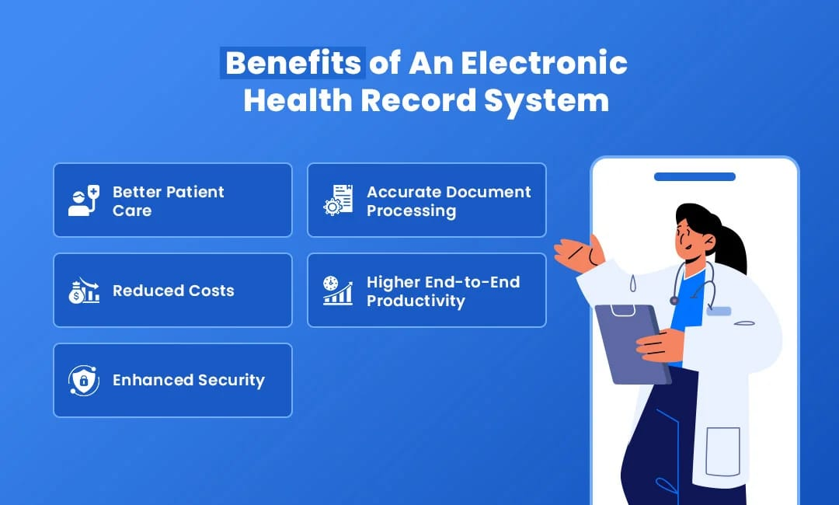
SCREENSHOT

Slide 14
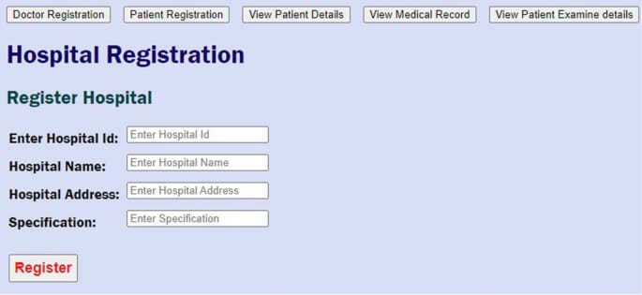
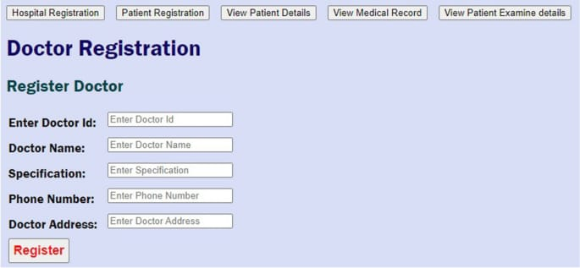
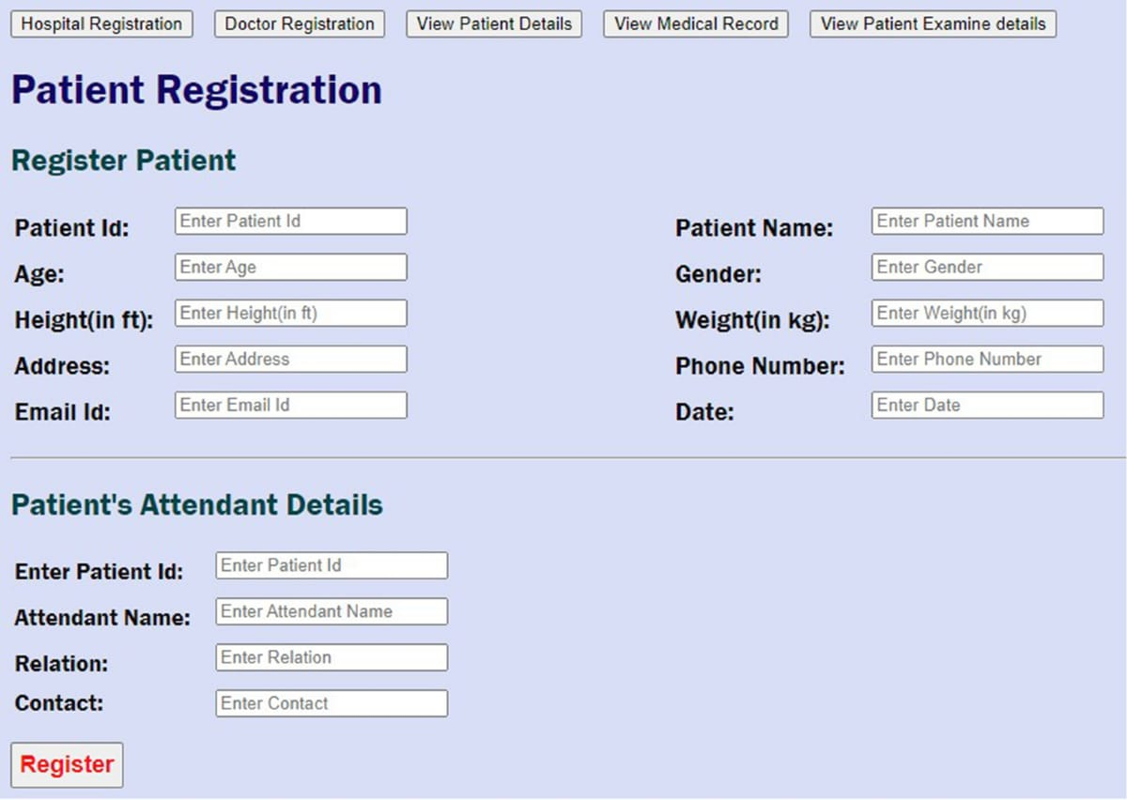

Slide 15
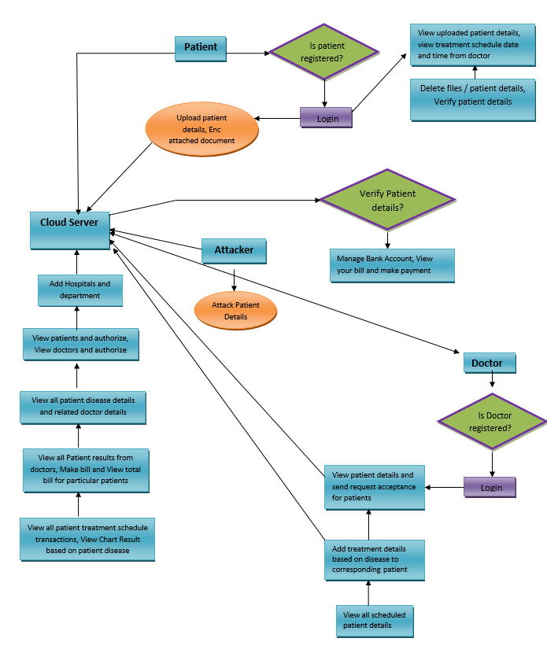
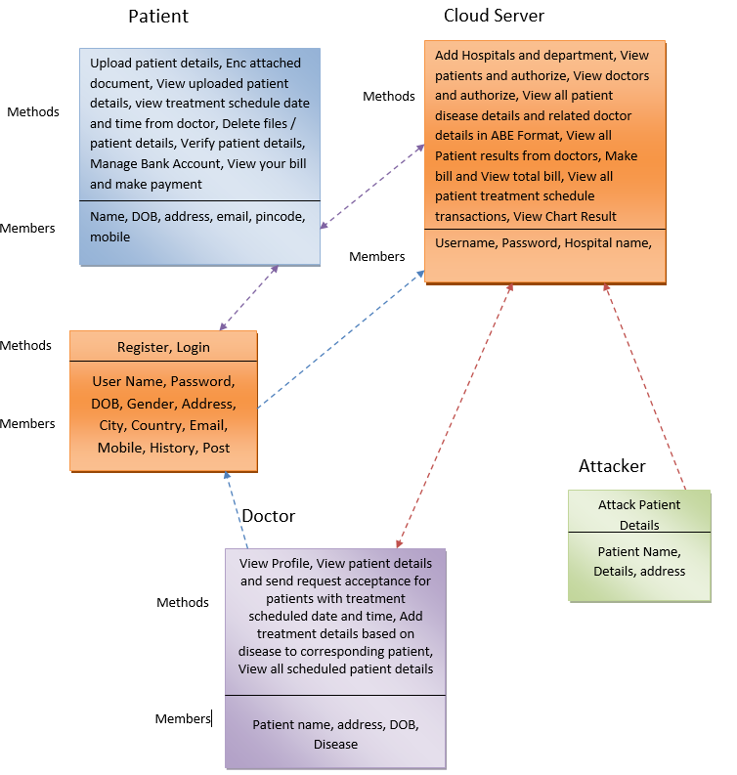
FLOW CHARTS

Slide 16
REFERENCE
[1] X. Chen, J. Li, J. Weng, J. Ma, and W. Lou, “Verifiable computation
over large database with incremental updates,” IEEE transactions
on Computers, vol. 65, no. 10, pp. 3184–3195, 2016.
[2] X. Chen, J. Li, X. Huang, J. Ma, and W. Lou, “New publicly
verifiable databases with efficient updates,” IEEE Transactions on
Dependable and Secure Computing, vol. 12, no. 5, pp. 546–556, 2015.
[3] X. Chen, X. Huang, J. Li, J. Ma, W. Lou, and D. S. Wong, “New
algorithms for secure outsourcing of large-scale systems of linear
equations,” IEEE transactions on information forensics and security,
vol. 10, no. 1, pp. 69–78, 2015.

Slide 17
[4] X. Chen, J. Li, J. Ma, Q. Tang, and W. Lou, “New algorithms for
secure outsourcing of modular exponentiations,” IEEE Transactions
on Parallel and Distributed Systems, vol. 25, no. 9, pp. 2386–2396,
2014.
[5] J. Wang, X. Chen, X. Huang, I. You, and Y. Xiang, “Verifiable
auditing for outsourced database in cloud computing,” IEEE transactions
on computers, no. 1, pp. 1–1, 2015.
[6] T. Jiang, X. Chen, and J. Ma, “Public integrity auditing for shared
dynamic cloud data with group user revocation,” IEEE Transactions
on Computers, vol. 65, no. 8, pp. 2363–2373, 2016.

Slide 18
CONCLUSION
The electronic health system represents a transformative shift in healthcare delivery, facilitating improved access to patient information and enhancing the quality of care. The integration of electronic health records (EHRs) streamlines data management, enabling healthcare providers to make informed decisions based on comprehensive patient histories. However, as the reliance on digital systems grows, so does the need for robust security and privacy measures to protect sensitive medical information.Effective validation of medical documents within these systems is essential to maintain data integrity and uphold patient confidentiality. By addressing the challenges of interoperability, compliance with regulations, and user training, the electronic health system can realize its full potential. Future advancements, such as incorporating artificial intelligence and blockchain technology, may further enhance the reliability and security of EHRs.Ultimately, the success of electronic health systems hinges on a commitment to safeguarding patient privacy while fostering collaboration among stakeholders, paving the way for a more efficient and effective healthcare landscape.

