Slide 1
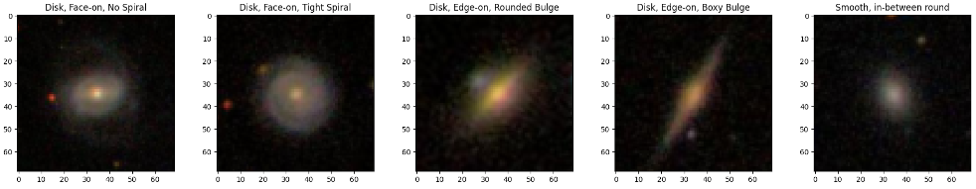
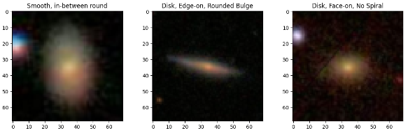
Stellar Image Classification with Convolutional Neural Networks and Transfer Learning
Vamshi Gadepally
MSCA 31009 - Machine Learning and Predictive Analytics

Slide 2
Table of Contents
Introduction and Problem Statement
Assumptions / Hypotheses about Galaxy 10 Dataset
Data and Transformations
Exploratory Data Analysis
Proposed Approaches (Models)
Model Evaluation
Results and Future Work
References

Slide 3
Introduction and Problem Statement
Context:
Galaxy classification is an important task in astronomy enabling astronomers to gain insights into the formation and properties of galaxies.
However manual classification of large numbers of galaxy images is time consuming and prone to human errors.
Problem Statement:
The accurate classification of images of galaxies into ten predefined categories using ML techniques, specifically Convolutional Neural Networks (CNNs) with Transfer Learning.
In this project we wish to evaluate and compare the performance of 4 models for our task of image classification. We will compare a standard CNN (built from scratch), a standard LeNet5 (not pre-trained), as well as pre-trained models VGG-16 and VGG-19 models with transfer learning applied.
GitHub Link:
https://github.com/vgade21/Machine-Learning-Predictive-Analytics-Project

Slide 4
Assumptions / Hypotheses about Galaxy 10 Dataset
Galaxy 10 Dataset:
Galaxy10 is a dataset containing 21785 64x64 pixels colored galaxy images separated in 10 classes. The images come from Sloan Digital Sky Survey and labels from Galaxy Zoo.
Assumptions on Data:
The images are representative of the overall distribution of galaxy images the labels in the Galaxy 10 Dataset are consistent and accurate.
Images in the dataset are of sufficient quality and have undergone necessary preprocessing steps to remove noise, artifacts and other distortions.
Hypotheses on Modelling:
Pre-trained CNN models initially trained on a large-scale dataset can effectively learn generic visual features that are transferable to the galaxy image classification task.
Combining the pre-trained model's generic visual features with task specific layers can improve the model's ability to differentiate between different galaxy types.

Slide 5
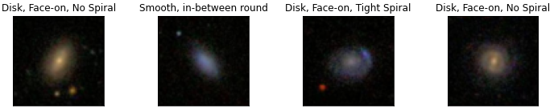
Data and Transformations
The data is stored in a Hierarchical Data Format (HDF5) format with multiple columns, but only two features are relevant:
“ans” – 10 broad classes based on the shape and structure of the Stellar object
eg: “Disk, Face-on, No Spiral”, “Smooth, Completely round”, “Smooth, Cigar shaped”, etc.
“images” – Colored Image of the Stellar object with shape (21785, 64, 64, 3)
Data Transformations:
To speed up model convergence during training phase the training images were normalized. That is, instead of pixel values ranging between 0-64 they were converted to range 0-1

Slide 6
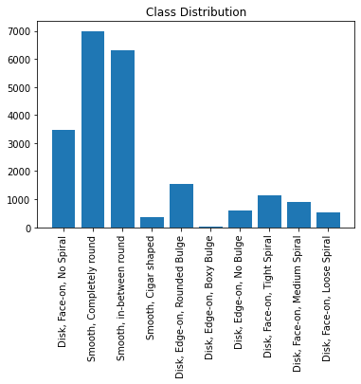
Exploratory Data Analysis
Possible Accuracy paradox:
We are dealing with a dataset that is imbalanced.
The class distribution ranges from a minimum of 17 images for the "Disk, Edge-on, Boxy Bulge" category to a maximum of 6997 images for the "Smooth, Completely round" category.
This class imbalance could mean accuracy alone is not reliable. This is referred to as the accuracy paradox, where a model with higher accuracy may have lower predictive power compared to a model with lower accuracy.
Hence, it is important to consider alternative evaluation metrics such as precision or recall to ensure a fair analysis of the model's performance.

Slide 7
Proposed Approaches (Models)
Models:
Baseline CNN model with standard architecture for image classification tasks.
LeNet5 model based on the original architecture, proposed by Yann LeCun et al. in 1998. We’re building a standard LeNet-5 architecture from scratch without utilizing any pre-trained models.
VGG-16 and VGG-19 models that are pre-trained (on the ImageNet dataset). We will use them as a starting point to modify or extend the architecture according to our specific needs (Transfer learning).
Check for Overfitting:
EarlyStopping has been implemented to ensure effective training of models. This feature allows the model to halt training based on the validation loss, acting as an indicator of overfitting.
By setting a patience of 10, training is stopped if the validation loss remains stagnant or increases after 10 consecutive epochs, indicating potential overfitting.
Examining the classification report for each CNN model, we can evaluate the presence of overfitting by analyzing the accuracy vs. iterations plot and the validation loss vs. iterations plot.

Slide 8
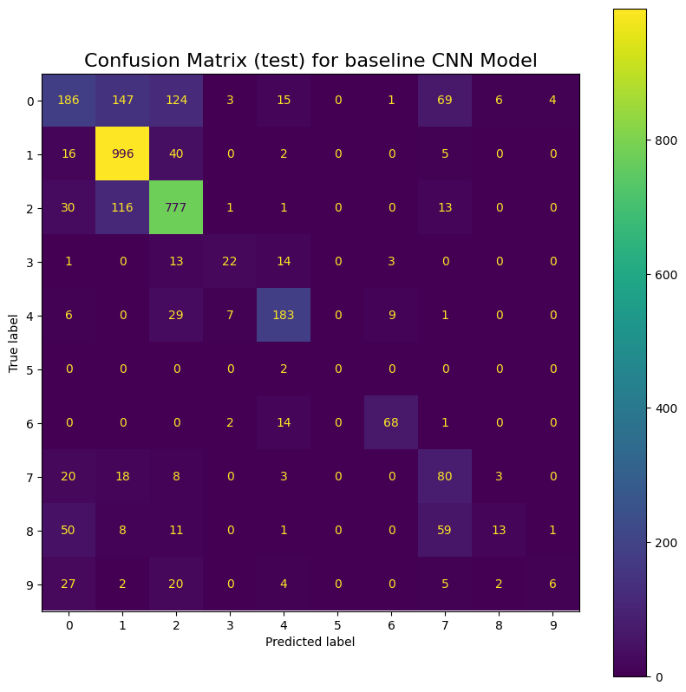
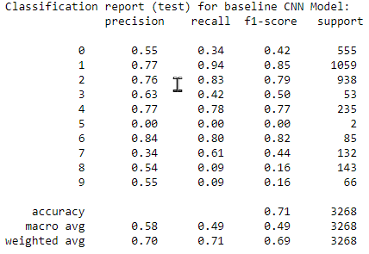
Model Evaluation
Baseline CNN model:
This model’s Classification report and Confusion matrix for the test data shows a high precision and recall for classifying image categories 1, 2, 4 and 6. We also observe high test accuracy and loss meaning the model made huge errors on a small portion of the data.

Slide 9
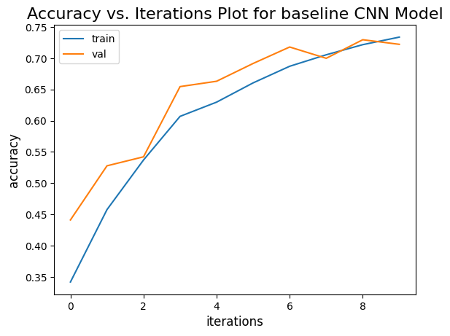
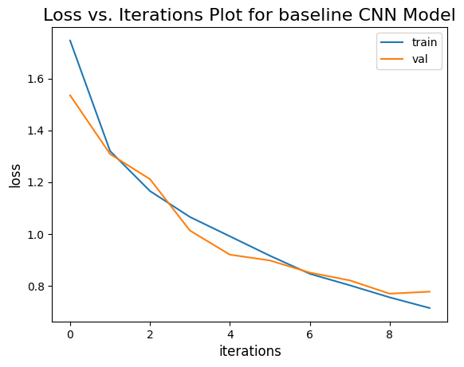
Model Evaluation
Baseline CNN model:
Checks for Overfitting with Training Data: Overfitting is not present

Slide 10
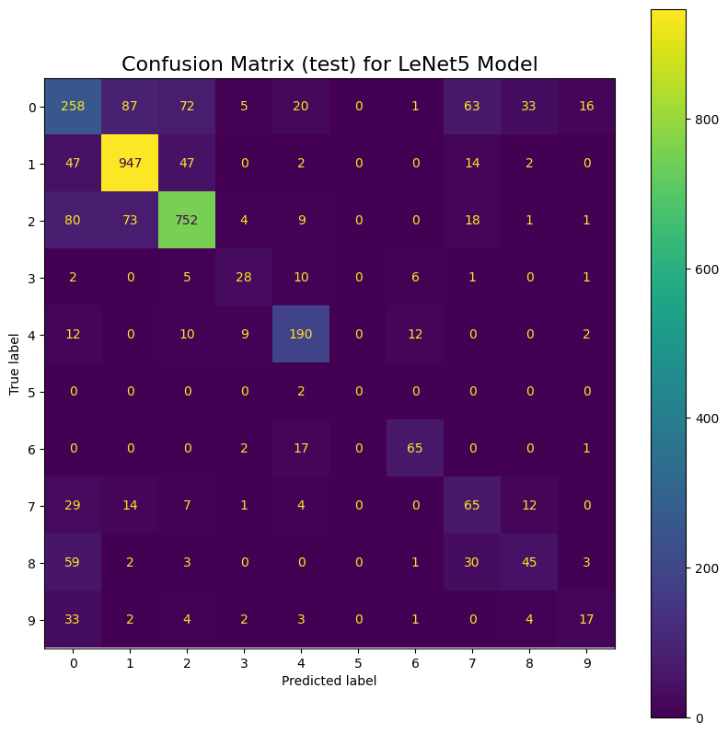
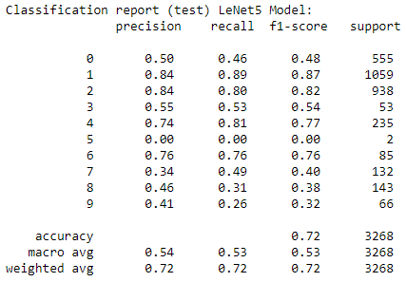
Model Evaluation
LeNet5 Model:
This model’s Classification report and Confusion matrix for the test data has a high precision and recall for classifying image categories 1, 2, 4 and 6. We observe a similar test accuracy and smaller loss for this model (relative to baseline CNN) meaning the number of errors made is similar, but the magnitude of errors is smaller.

Slide 11
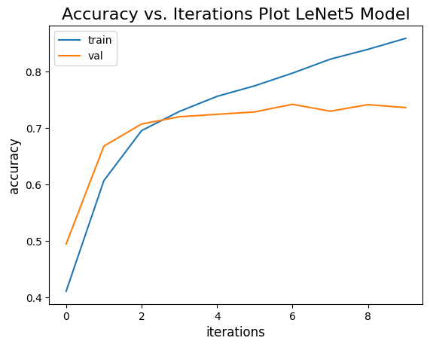
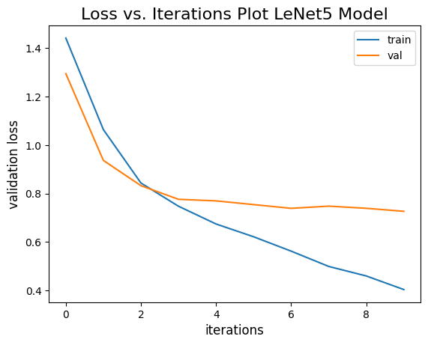
Model Evaluation
LeNet5 Model:
Checks for Overfitting with Training Data: Overfitting is present

Slide 12
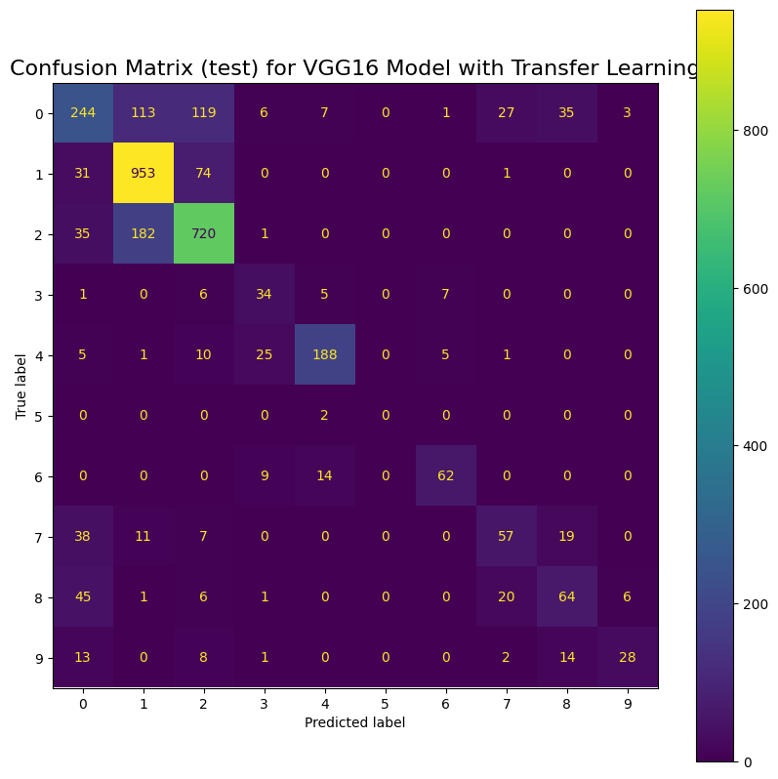
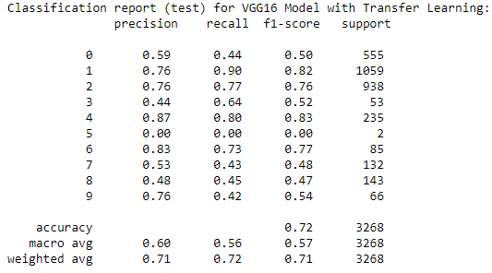
Model Evaluation
VGG16 Model with Transfer Learning:
This model’s Classification report and Confusion matrix for the test data has a high precision and recall for classifying image categories 1, 2, 4, 6 and 9. We observe a similar test accuracy and loss for this model (relative to LeNet5) so the number of errors and their magnitude is like LeNet5.

Slide 13
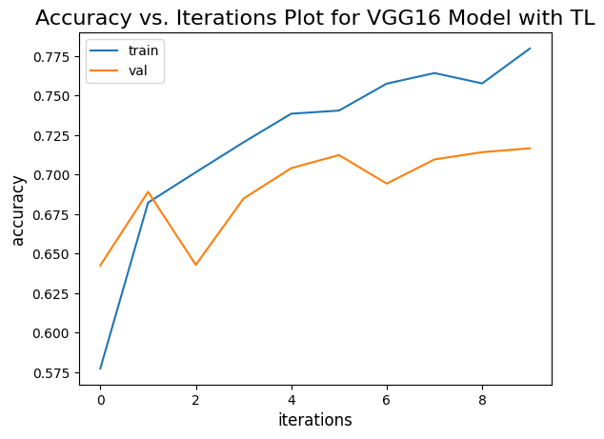
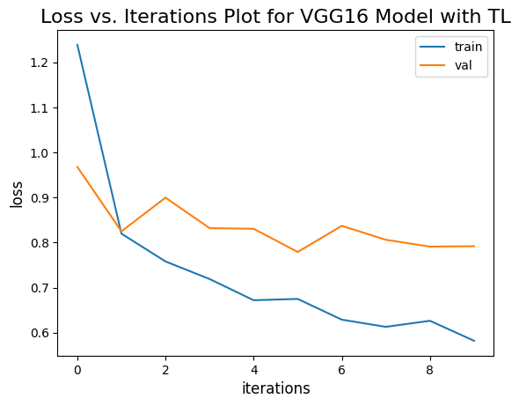
Model Evaluation
VGG16 Model with Transfer Learning:
Checks for Overfitting with Training Data: Overfitting is not present

Slide 14
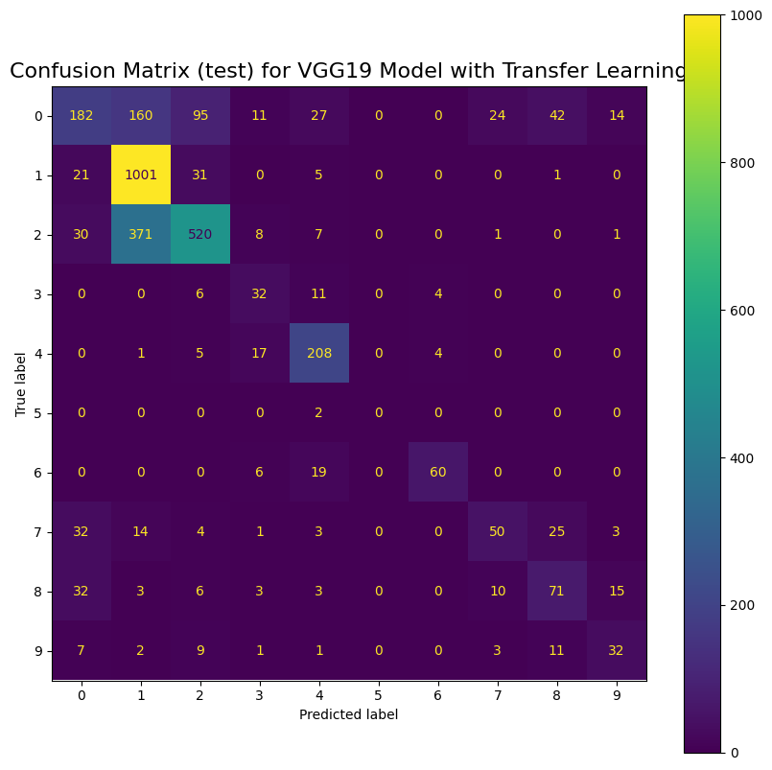
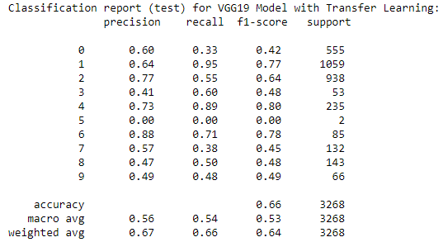
Model Evaluation
VGG19 Model with Transfer Learning:
This model’s Classification report and Confusion matrix for the test data has a high precision and recall for classifying image categories 2, 4 and 6. We observe a lower test accuracy and higher loss for this model (relative to VGG16) meaning this model made huge errors on a lot more of the data compared to VGG16.

Slide 15
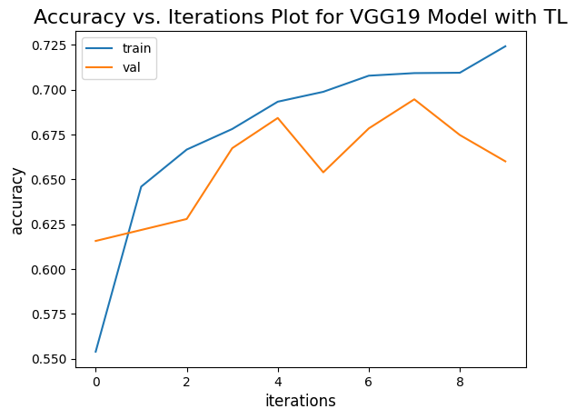
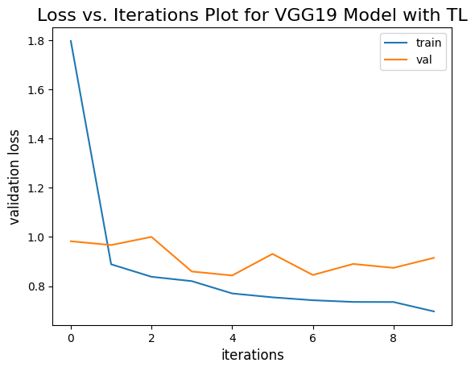
Model Evaluation
VGG19 Model with Transfer Learning:
Checks for Overfitting with Training Data: Overfitting is not present

Slide 16
Results and Future Work
Results:
As per the Test loss and Test accuracy metrics the LeNet5 Model had the best results: Test loss: 0.7906 (lowest) and Test accuracy: 0.7243 (highest)
As per the Precision and Recall the LeNet5 Model had the best results too: Test Precision: 0.72 (highest) and Test Recall: 0.72 (highest)
However, when checking for overfitting using the Accuracy / Validation Loss vs iterations plots (slides 11, 13, 15) the LeNet5 model exhibit overfitting. The base CNN model shows little to no overfitting while the VGG-16, VGG-19 models look good too.
Overfitting can be identified in the Accuracy vs. Iterations Plot if the training accuracy continues to increase while the validation accuracy plateaus or starts to decrease. Overfitting is detected in the Validation Loss vs. Iterations Plot if the training loss decreases over iterations, but the validation loss starts to increase or remains high.
Similarly, looking at Accuracy/Loss and Precision/Recall we see Train metrics are much lower than Test for LeNet5, which suggests that the model is overfitting. The other models are comparatively lower.

Slide 17
Results and Future Work
Conclusion:
Since our priority is to have a model that generalizes well to unseen data and avoids overfitting, VGG-16 (slide 12) would be a better choice.
Despite having the 2nd best performance metrics in terms of test loss, test accuracy, precision, and recall, the fact that it does not exhibit overfitting suggests that it may be more robust and less prone to making incorrect predictions on new, unseen data.
The VGG-16 model did well with predicting in terms of its ability to correctly classify images (slide 12). Not surprising classes 1, 2, 4, 6 and 9 were the most accurate since they had the most data and struggled to classify classes 3 and 5 since they were some of the classes with the least testing and training samples (the imbalance mentioned in slide 6).
Future Work:
We should use a more balanced dataset, where there was a more equal number of images per category would have minimized the high variability of accuracy among the 10 categories.
Implement a random search that can optimize the Network architecture parameters for each model. Due to computational limitations and long execution times, this methodology to optimize the parameters for every model was omitted.

Slide 18
References
Rosebrock, Adrian. “Keras Conv2D and Convolutional Layers”. 2022 PyImageSearch. 31 December 2018. https://pyimagesearch.com/2018/12/31/keras-conv2d-and-convolutional-layers/
Chen, B. “Early Stopping in Practice: an example with Keras and TensorFlow 2.0: A step to step tutorial to add and customize Early Stopping”. Towards Data Science. 28 July 2020. https://towardsdatascience.com/a-practical-introduction-to-early-stopping-in-machine-learning-550ac88bc8fd
Pinzon, Andres. “Convolutional Neuronal Network with Keras-Tuner on CIFAR 10”. Medium. 06 May 2020. https://medium.com/analytics-vidhya/convolutional-neuronal-network-with-keras-tuner-on-cifar-10-b4271ca4643d
Bangar, Siddhesh. “LeNet 5 Architecture Explained”. Medium. 22 June 2022. https://medium.com/@siddheshb008/lenet-5-architecture-explained-3b559cb2d52b
Leung, Henry. Bovy, Jo. “Welcome to astroNN’s documentation!”. 2017-2022 Henry Leung. 22 April 2022. https://astronn.readthedocs.io/en/latest/
Leung, Henry. “astroNN Documentation”. 11 May 2023. https://buildmedia.readthedocs.org/media/pdf/astronn/latest/astronn.pdf

