Slide 1


Risk Modeling for Renal Post- transplant Complications

Slide 2


Project Leadership
Mr. Sharath Manikonda (Project Sponsor)
Director, Innodatatics
https://www.linkedin.com/in/sharat-chandra
Mr. Sreekanth-pustala (Project Mentor)
Associate data scientist, Innodatatics
https://www.linkedin.com/in/sreekanth-pustala/

Slide 3

Team Members
Name: Gabbeta Vamshi
Linkedin: https://www.linkedin.com/in/gabbeta-vamshi-27a373159/

Slide 4

Contents
Project Overview and Scope
Project Goals and Objectives
CRISP-ML(Q) Methodology
Technical Stack
Project Architecture
Data Collection and Understanding
Data Dictionary
Exploratory Data Analysis (EDA) and Data Visualization
Model Building
Model Accuracy Comparison
Model Deployment Strategy
Screenshot of Output
Challenges
Future Scope
Notes:
Change

Slide 5
Project Overview and Scope
A key issue in the field of kidney transplantation is the analysis of transplant recipients’ survival. By means of the information obtained from transplant patients, it is possible to analyze in which cases a transplant has a higher likelihood of success and the factors on which it will depend. Survival Machine Learning models like Random Survival Forest, Elastic-Net based Cox and Standard Cox is build on the data and different performance metrics are compared to decide which model outperforms well. The best performance was achieved by the Semi-parametric method: Elastic-Net based Cox hence model is deployed on the same.
The scope of project includes: Research & Documentation on Problem statement, Data Collection, Data Cleaning, Building Machine Learning Models, comparison of results between them and Deployment of the model.

Slide 6
Project Goals and Objectives
The goal is to understand the Renal Post-transplant Complications & predict the graft survival using various ML techniques.
Objectives
For a given donor-recipient pair,
To minimize the Renal post-transplant complications
To predict the renal graft survival probability

Slide 7
Project Constraints
Constraints
Dataset is masked and incomplete, still it is difficult to acquire.
The research is limited to client-specific variables only (feature selection is restricted)
Model selection is restricted
Only 278 records randomly selected from recent 5 years
The model is built on few assumptions –
a) single transplant,
b) data provided is complete and true,
c) selected variables effect on prediction is accurate

Slide 8
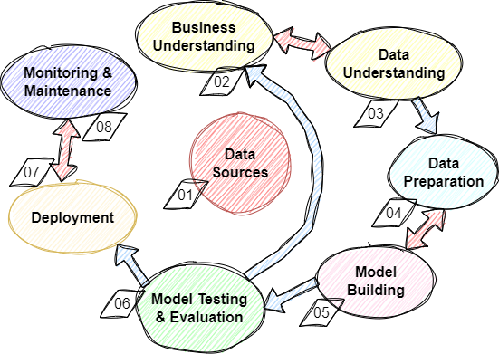
CRISP-ML(Q)
Cross
Industry
Standard
Process of
Machine
Learning applications with
Quality assurance

Slide 9
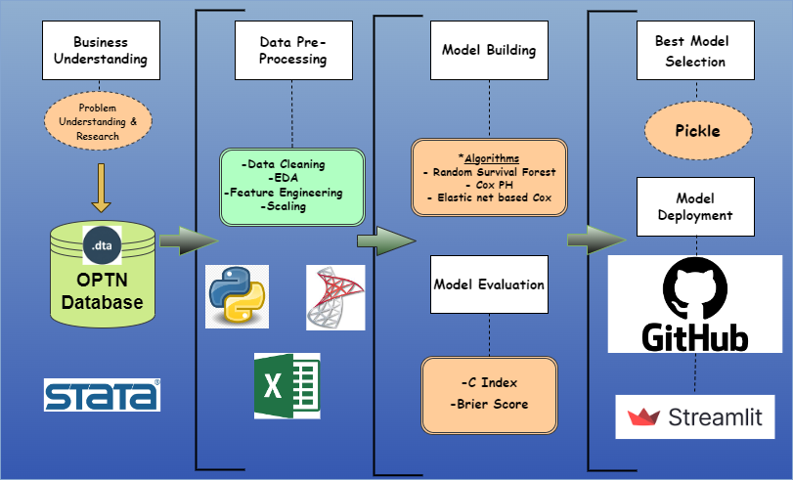
Project Architecture

Slide 10





Technical Stacks

Slide 11
Data Collection and Understanding
Specific variables with respect to Client requirements are collected from various resources.
Organ Procurement and Transplantation Network (OPTN) is the largest contributor of the database. The OPTN is maintained by the United Network for Organ Sharing (UNOS).
Total of 278 records randomly selected out between 2017 to 2022 database.
57 variables out of which 21 are numerical, and 36 are categorical
“Graft Survival Time” and “Graft Censoring Indicator” are the target variables.
The risks of this model are hugely limited with respect to data.
The relationship between the diseases and their effects on human body are not completely understood, which poses a series of risks involved.

Slide 12
Data Dictionary
Variable | Alias | Datatype | Range
Anepisodeofacuterejection | An episode of acute rejection | Categorical, NOMINAL | 0 = No, 1 = Yes lexicographical method
Anepisodeofchronicrejection | An episode of chronic rejection | Categorical, NOMINAL | 0 = No, 1 = Yes
Anepisodeofhyperacuterejection | An episode of hyperacute rejection | Categorical, NOMINAL | 0 = No, 1 = Yes
BloodUreaNitrogenlevel | Blood Urea Nitrogen level | Numeric, FLOAT | 5 to 30 mg/dL
Bodymassindex | Body mass index | Numeric, FLOAT | 18.5 to 25 kg/m^2

Slide 13
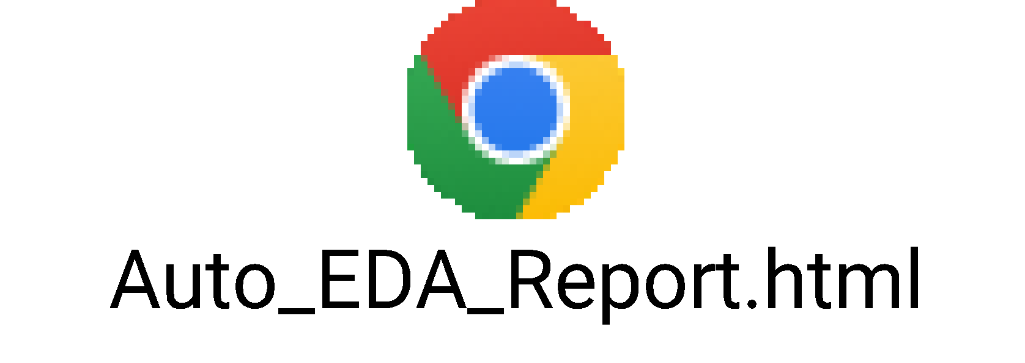
Exploratory Data Analysis [EDA] and Data Visualization
Exploratory data analysis (EDA) is a crucial step in data science, that involves examining and summarizing the main characteristics of a dataset, discovering patterns and relationships, and identifying any unusual or unexpected features.
EDA and Pre-processing techniques were carried out on the raw data
Null values or missing values were discarded during data collection stage.
Label-Encoding/dummy variable technique is used for conversion of categorical variables to numeric.
Auto EDA (Sweetviz) module is used for the EDA analysis purpose.
Notes:
EDA is used for seeing what the data can tell us before the modeling task.
Change

Slide 14
Model Building
Model is built, based on the best of the three models used. The first one is a Machine Learning model and other two of are Statistical models. These three models are further compared based on C-index and Brier score to decide the performance of the model.
Random Survival Forest (Ensemble technique)
Standard Cox model (Semi-parametric model)
Elastic-Net based Cox model (Semi-parametric model)

Slide 15
Introduction to Survival analysis
The survival analysis is a subfield of statistics, which models the time-to-event data, and its goal is to model the time until an event of interest happens. In the context of this project, the graft failure is the event of interest.
To estimate the likelihood of the event
Make use of the censored as well as the uncensored data
Cox analysis is to study effects of covariates on the timing of death, rather than who dies
A Cox analysis would be still be valid, even though if everyone died
The fundamental unit is not the individual recipient, but the “risk set” at each failure time / censored time

Slide 16
Methods of Survival Analysis
1. Parametric (assumes certain distribution for time-to-event) | + fast, easy to interpret, easy to accommodate censoring
 | - restrictive, may not fit if distribution is not guessed right
2. Semi-parametric (non-parametric baseline function, parametric dependence on risk factors) e.g. Cox Proportionate Hazards Model | + robust, fast, estimates impact factors averaged over time, easy to add L1/L2 regularization, easy to interpret
 | - Interaction and non-linear terms are not captured unless added to the regression
3. Tree-based algorithmic approach: Survival Classification and Regression Trees (CART), survival random forests | + flexible, accounts for non-linear and cross-term effects
 | - difficult to interpret, high number of model parameters to tune, can overfit
4. Gradient descent, boosting, survival SVM, neural networks etc. | + accounts for non-linear and cross-term effects
 | - overfitting, difficult to interpret, even higher number of model parameters to tune, “black box”

Slide 17
Random Survival Forest
Random Forest
Survival Tree
Random Survival Forest
Random Forest builds multiple decision trees and merges them together to get a more accurate and stable prediction. It is an Ensemble approach.
Random Survival Forest (RSF) is a machine learning model that relies on smaller predictive structures called survival trees. Survival tree method is a fully non-parametric approach for survival analysis, it can successfully model high-dimensional datasets.
RSFs can provide variable importance measures, which can be used to identify the most important predictors of the event of interest.

Slide 18
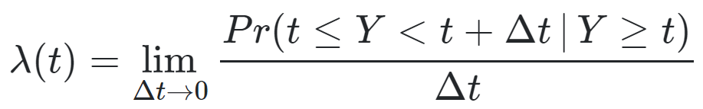
Cox model or Proportionality Hazard Model
A Cox model is a statistical technique for exploring the relationship between the survival of patient and the variables.
The purpose of the Cox model is to simultaneously explore the effects of several variables on graft survival
The Cox proportional hazards model is the most commonly used model in survival analysis.
The model assumes that the hazard rate (the probability of an event occurring at a given time) is constant over time, but can be influenced by the values of the explanatory variables.
Cox model can handle censored data
Cox model uses partial likelihood function

Slide 19
Elastic-Net Cox model
The elastic net based Cox model is a variant of the Cox proportional hazards model that combines the L1 penalty of the Lasso method with the L2 penalty of the Ridge method.
It address the issue of multicollinearity.
L1 penalty encourages sparsity, (selection of only a few important predictors)
L2 penalty helps to control the complexity of the model.
It extends the Cox model by adding regularization terms to the model, which helps to control overfitting and improve model stability.

Slide 20
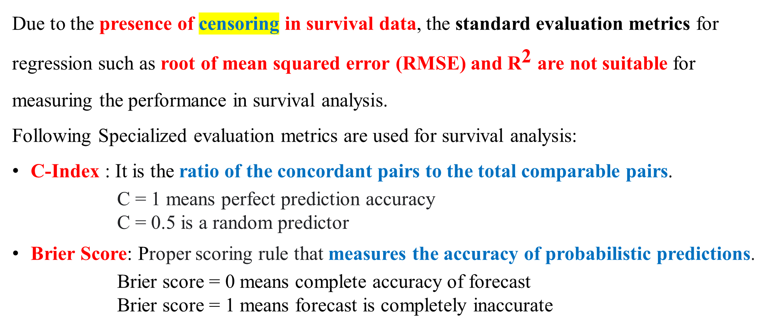
Evaluation Metric(s)

Slide 21
Model Accuracy Comparison
Model | C-index | Brier Score
RSF test | 0.90 | 0.036
RSF train | 0.96
Standard Cox test | 0.87 | 0.025
Standard Cox train | 0.94
Elastic-Net based Cox test | 0.88 | 0.022
Elastic-Net based Cox train | 0.90
Considering the above 3 models, the Elastic-net based Cox is giving better results with respect to c-index and brier score.

Slide 22
Model Deployment - Strategy
Plan is to create a web deployment in local environment.
We have used “Streamlit” for deployment.
The model was saved in “GSP_model.sav” format, so that it can be easily loaded in the web app.
“App.py” script with “graft survival prediction” function is created.
Web interface is created for getting user-input data from excel sheet.
“Button” for predicting the survival probability of the graft.
Results are analyzed for 3 timelines of 6 months, 2 years and 5 years after transplant.
A line plot is given to analyze the prediction for “survival probability” to “graft survival time (in days)”.

Slide 23
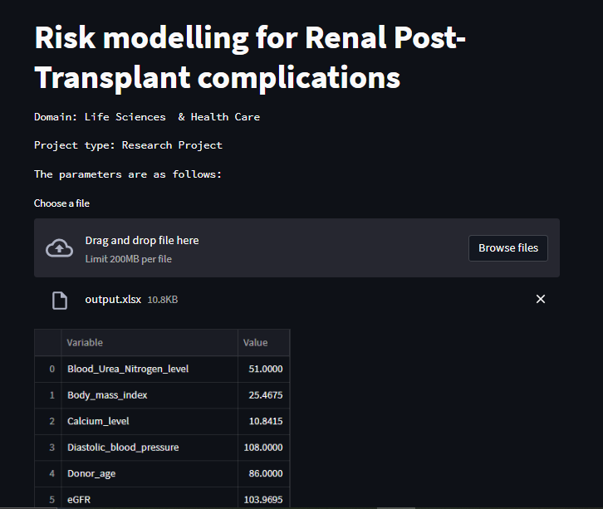
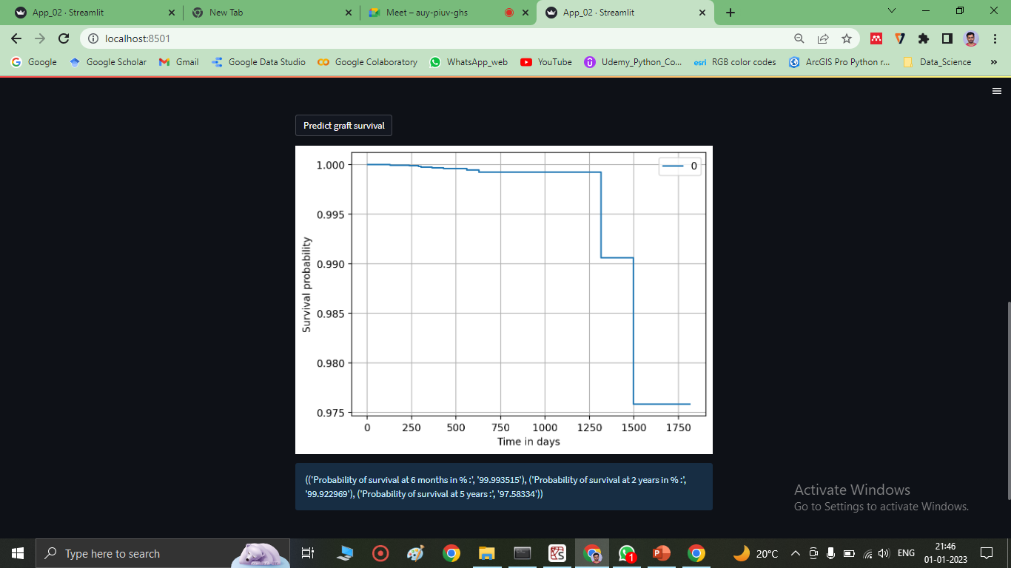
Screen shot of output

Slide 24
Challenges
Data Collection is itself a big task in such healthcare application projects
Model should be more robust to the new data, which can be achieve by combining more survival machine learning algorithms with the existing one.

Slide 25
Future Scope
We have considered the data for the recent five years.
Considering the humungous development in technology and surgery practices, it is recommended for further automation using MLOps (CI/CD/CT).
Other semi-parametric and ensemble models may yield better results. So there is scope for further research on these models.
The relationship between the variables should be considered while feature addition. Such that, the model is better trained.

Slide 26

Queries ?

Slide 27
PROJECT REFERENCES
https://www.sciencedirect.com/science/article/abs/pii/S0957417421006679
https://link.springer.com/article/10.1007/s40472-021-00336-z
https://www.ncbi.nlm.nih.gov/pmc/articles/PMC8290997/
https://link.springer.com/article/10.1186/s12911-015-0206-y
https://arxiv.org/abs/1705.10245
https://journals.plos.org/plosone/article?id=10.1371/journal.pone.0209068
https://dalspace.library.dal.ca/handle/10222/78655
https://scikit-survival.readthedocs.io/en/stable/user_guide/random-survival-forest.html
https://imbalanced-learn.org/dev/references/generated/imblearn.over_sampling.SMOTENC.html
https://lifelines.readthedocs.io/en/latest/Survival%20Regression.html
https://www.ncbi.nlm.nih.gov/pmc/articles/PMC8433864/
https://openai.com/blog/chatgpt/

