Slide 1

CMR Technical Campus Department of IT
Major Project Stage – II
Review - I
PROJECT TITLE : HYBRID AUTOENCODER DRIVEN ML MODEL FOR PERFORMANCE MONITORING IN 5G CELLULAR NETWORKS
Project Supervisor:​
Name:​Ravi Regulagadda
Designation: Assistant Professor
Presented By:
Batch : 9
1. H. No : 227R1A1257 Name : V. Poojitha
2. H. No : 227R1A1223 Name : J. Vamshi
3. H. No : 227R1A1215 Name : E. Greeshma
​

Slide 2
INDEX
Introduction and Overview
Existing System
Disadvantages of Existing System
Proposed System
Advantages of Proposed System
Hardware and Software Requirements
Novelty of the Project
System Architecture
Modules
UML Diagrams
Source Code
Results
Conclusion & Future Enhancement
References
GitHub link

Slide 3
INTRODUCTION AND OVERVIEW
The advent of fifth generation (5G) cellular networks marks a revolutionary leap in communication technology, promising ultra-low latency, enhanced bandwidth, and massive device connectivity.
With the exponential growth of mobile applications, IoT devices, and high-throughput services such as autonomous driving and augmented reality, 5G is positioned as the backbone of future digital ecosystems.
Historically, mobile networks have evolved from 1G analog voice systems through 4G LTE, each generation improving speed and efficiency but still facing critical challenges in spectrum utilization, energy efficiency, and dynamic resource management.
Despite these advances, traditional cellular systems struggle to meet the stringent requirements of real-time applications in terms of reliability, security, and scalability.
Conventional systems rely on static resource allocation, rule-based scheduling, and limited traffic prediction models.

Slide 4
EXISTING SYSTEM
Traditional 5G network monitoring is manual, labor-intensive, and largely reactive.
Engineers manually collect and analyze KPIs like signal strength, throughput, and latency.
Troubleshooting requires scanning large logs and traces across multiple systems.
Root cause analysis depends on expert knowledge and is time-consuming.
Issues are resolved after user impact, making the process slow and inefficient.

Slide 5
EXISTING SYSTEM DISADVANTAGES
Human Error and Bias
Time-Consuming and Slow
Reactive, Not Proactive
Lack of Scalability
Difficulty with Complex Patterns

Slide 6
PROPOSED SYSTEM
The system automates 5G network performance monitoring to overcome manual and reactive limitations.
It uses a hybrid ML model called DeepLatent-Forest with a two-phase architecture.
A deep autoencoder extracts compressed, noise-free latent features from high-dimensional network data.
A Random Forest classifier uses these latent features to accurately predict dropped connections.
Integrated with a Tkinter GUI, the system enables real-time, proactive, and user-friendly network monitoring.

Slide 7
PROPOSED SYSTEM ADVANTAGES
Proactive Problem Prediction
Enhanced Accuracy
Automated Feature Engineering
Dimensionality Reduction
Robustness to Noise

Slide 8
SYSTEM REQUIREMENTS
SOFTWARE COMPONENTS | HARDWARE COMPONENTS
Python version : Python 3.12.0 | Processor : Intel i5
Operating system : Windows | Memory : 1 TB (storage)
Frontend : Tkinter | RAM : 8 GB

Slide 9
NOVELITY
Proposes a hybrid DeepLatent-Forest model combining a deep autoencoder with Random Forest for 5G performance monitoring.
Uses unsupervised deep autoencoder–based feature extraction to handle high-dimensional and noisy 5G network data.
Enables proactive prediction of dropped connections instead of reactive fault detection.
Achieves higher accuracy and robustness compared to traditional ML classifiers like KNN, XGBoost, and CatBoost.
Integrates the model into a GUI-based, role-secured system, making advanced ML accessible for real-world network operations.

Slide 10
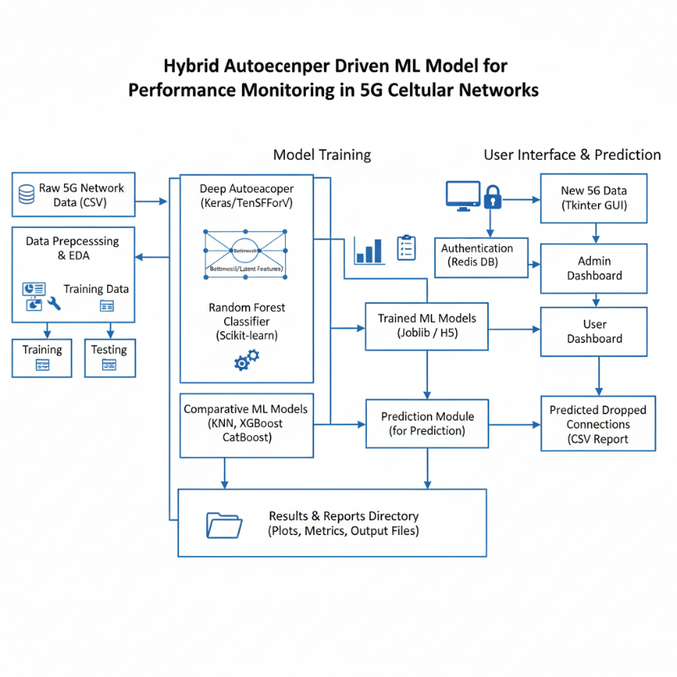
SYSTEM ARCHITECTURE

Slide 11
MODULES
Dataset Collection Module
Collects 5G network performance data such as signal strength and speed.
Stores data for preprocessing and model training.
Data Preprocessing Module
Cleans data, removes irrelevant columns, and handles missing values.
Encodes categorical features and applies feature scaling.
Exploratory Data Analysis Module
Analyzes data patterns related to dropped connections.
Visualizes correlations and class distributions.
Baseline Machine Learning Module
Trains KNN, CatBoost, and XGBoost models.
Provides baseline performance for comparison.

Slide 12
MODULES
Autoencoder Feature Extraction Module
Learns compact latent features from high-dimensional data.
Reduces noise and redundancy in network parameters.
Hybrid Deep Latent Forest Module
Combines autoencoder features with Random Forest classifier.
Improves accuracy in dropped connection prediction.
Model Evaluation Module
Calculates accuracy, precision, recall, and F1-score.
Generates confusion matrices for analysis.
Prediction Module
Predicts dropped connections for new 5G data.
Appends prediction results to the dataset.

Slide 13
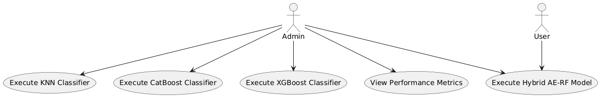
USE CASE DIAGRAM

Slide 14
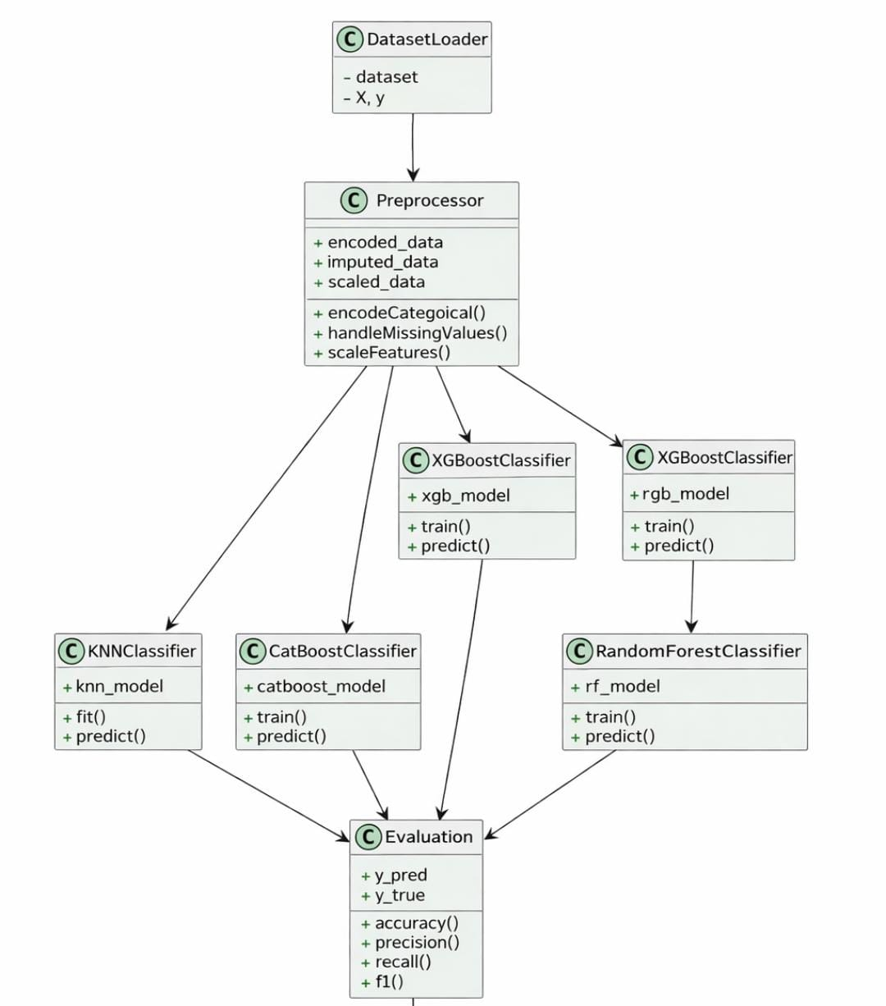
CLASS DIAGRAM

Slide 15
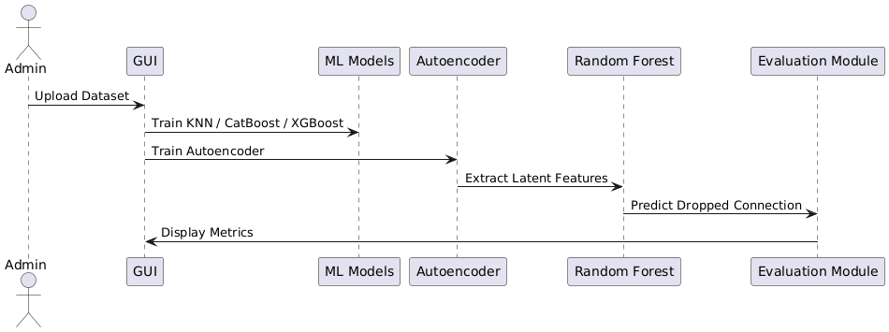
SEQUENCE DIAGRAM

Slide 16
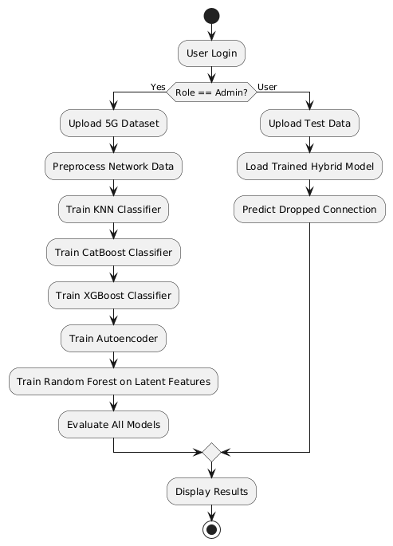
ACTIVITY DIAGRAM

Slide 17
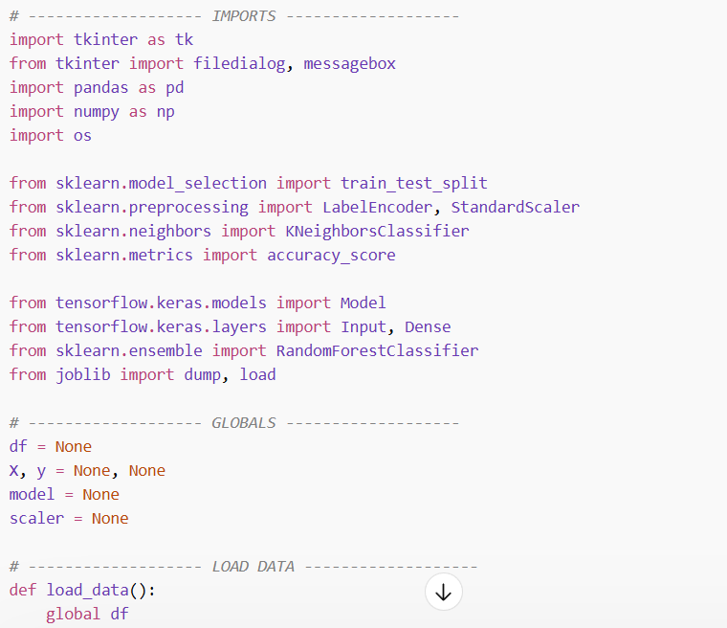
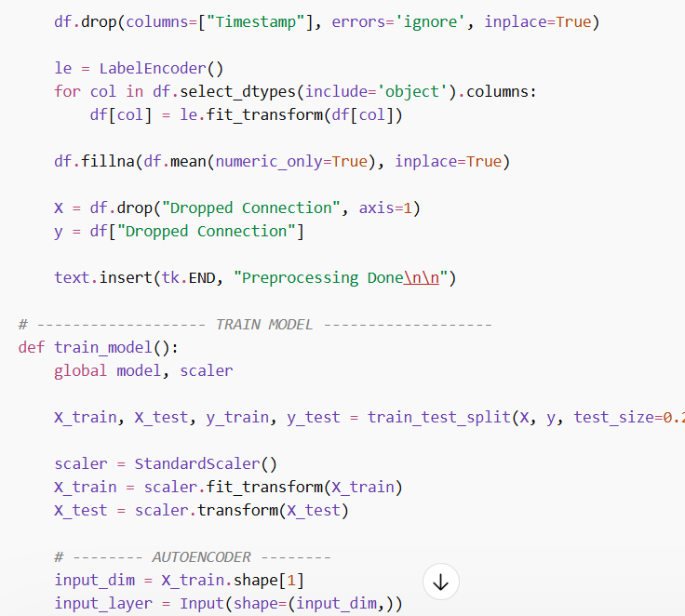
SOURCE CODE

Slide 18
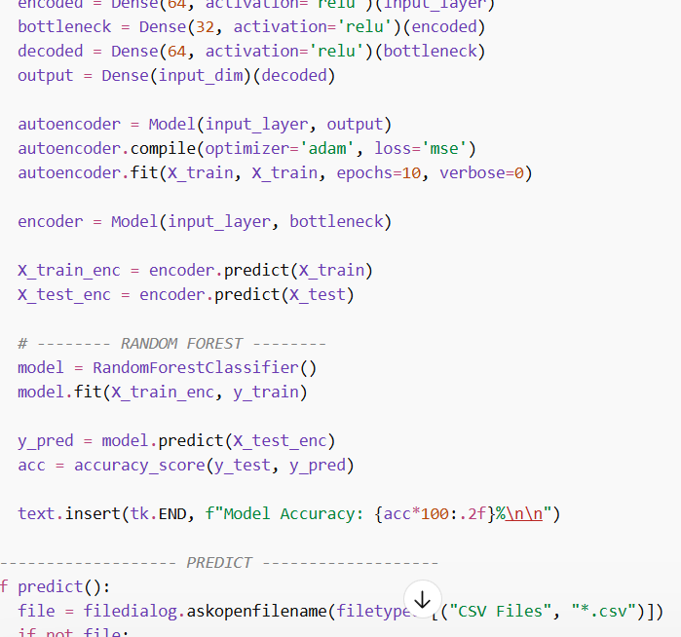
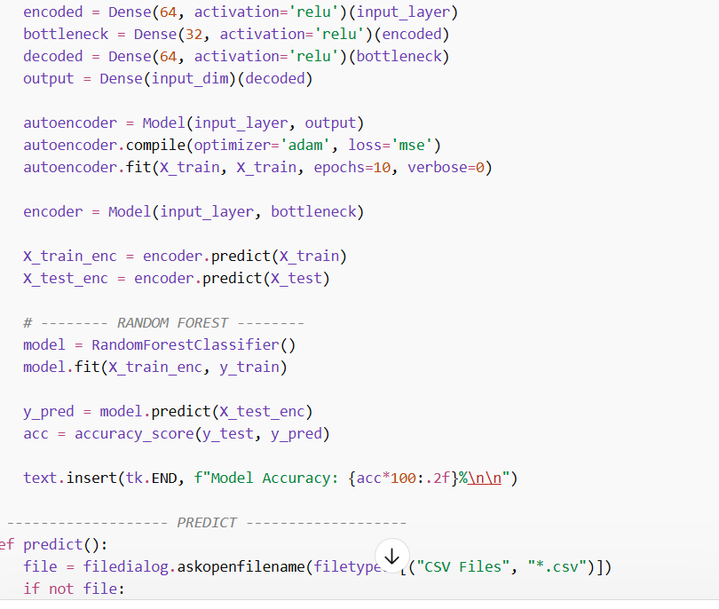

Slide 19
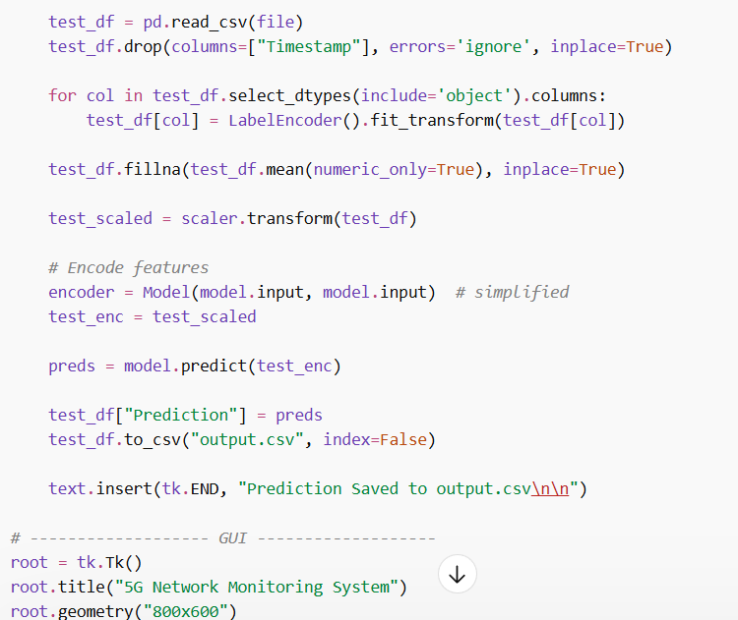
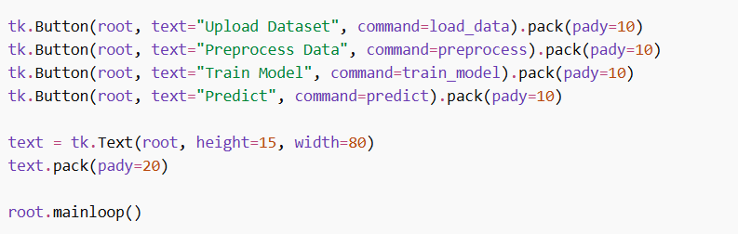

Slide 20
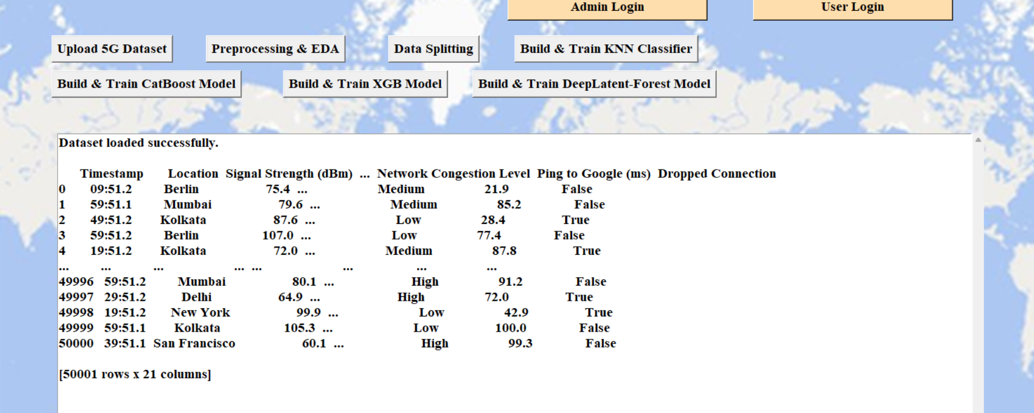
RESULTS

Slide 21
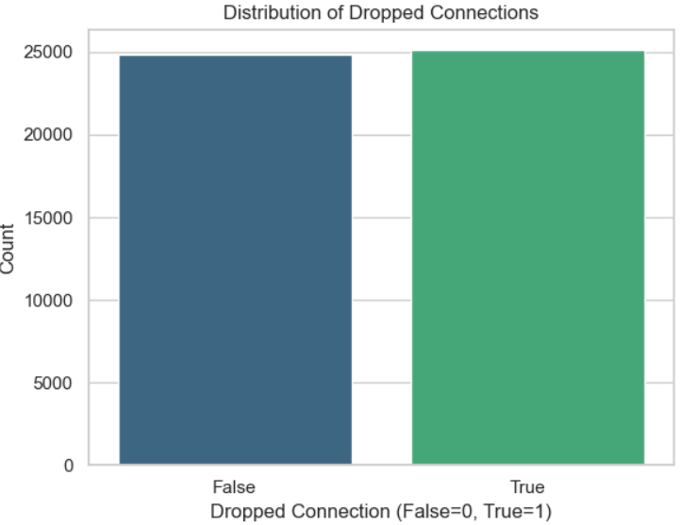
RESULTS

Slide 22
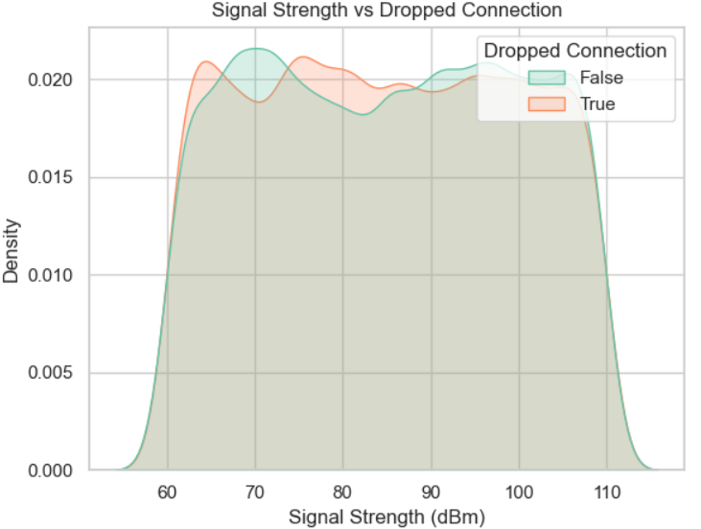
RESULTS

Slide 23
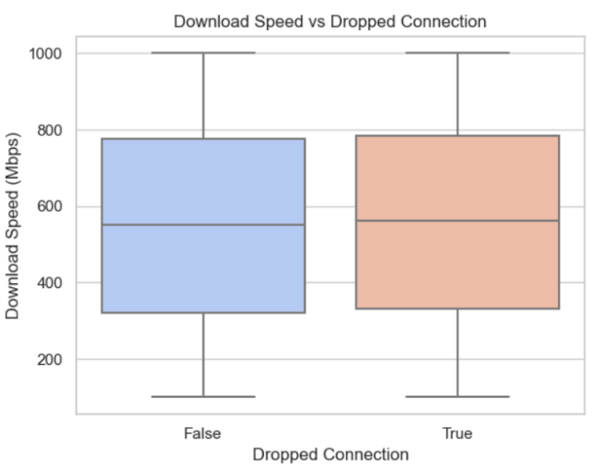
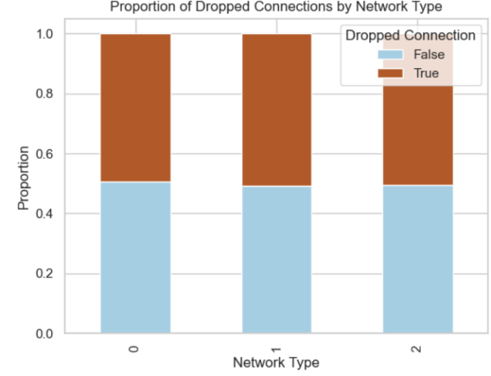
RESULTS

Slide 24
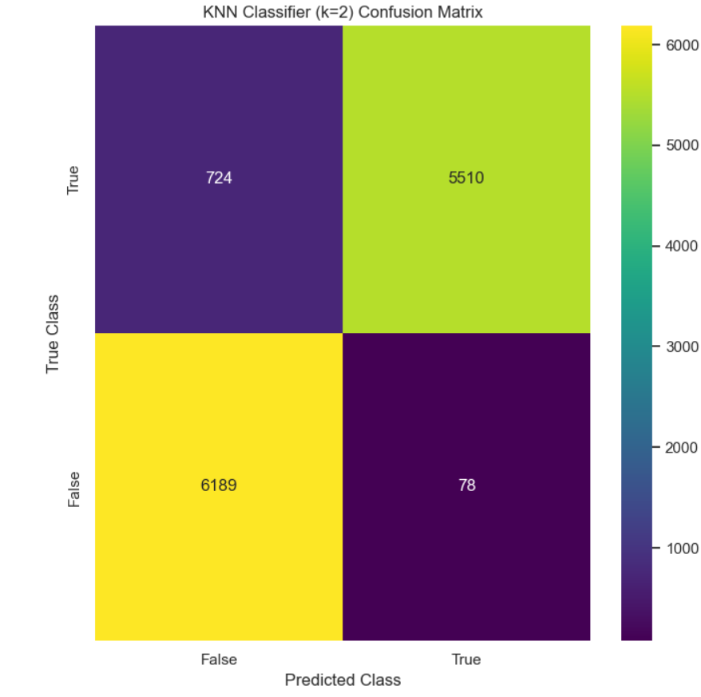
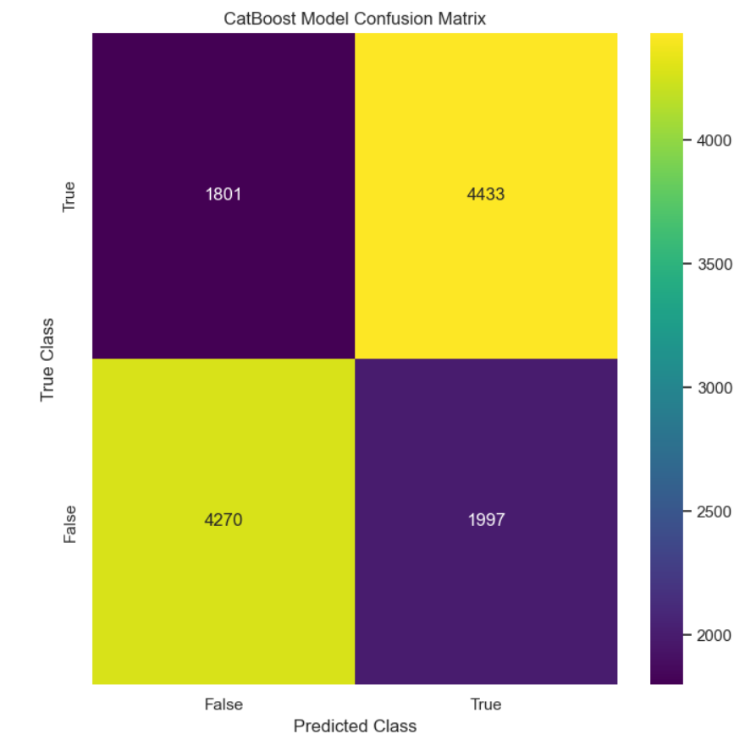
RESULTS

Slide 25
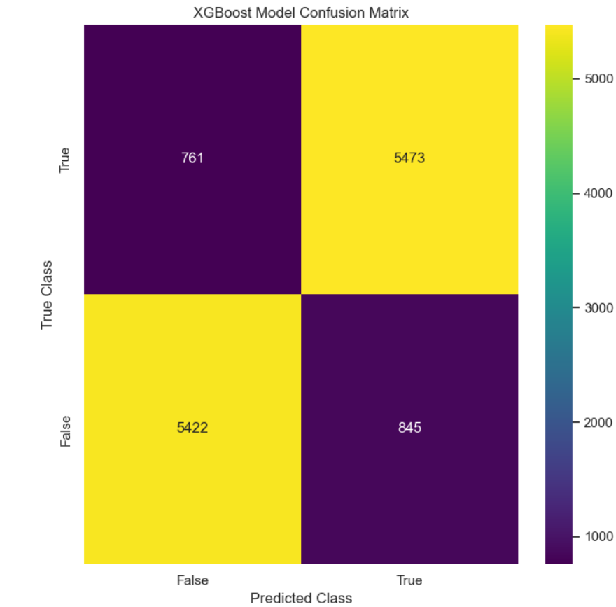
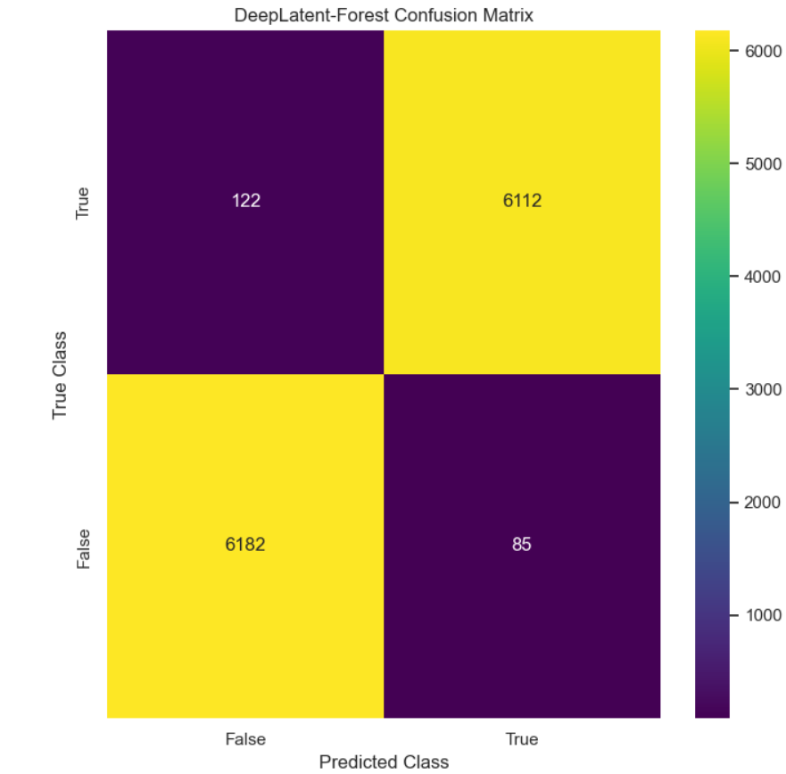
RESULTS

Slide 26
CONCLUSION AND FUTURE ENHANCEMENT
The project presented a Hybrid Autoencoder Driven Machine Learning framework for effective performance monitoring and dropped connection prediction in 5G cellular networks. By integrating traditional machine learning models such as KNN, CatBoost, and XGBoost with a proposed Deep Latent Forest approach, the system enabled a comprehensive comparative analysis of network performance prediction techniques. Extensive preprocessing and exploratory data analysis helped uncover key relationships among signal strength, throughput, latency, congestion, and mobility factors influencing connection stability. Experimental results demonstrated that baseline models, while capable of capturing basic patterns, struggled with complex and non-linear dependencies inherent in large-scale 5G data. In contrast, the proposed model achieved superior performance by learning compact and meaningful latent representations through an autoencoder and leveraging Random Forest classification for robust decision-making.

Slide 27
REFERENCE
Bouraqia, K.; Sabir, E.; Sadik, M.; Ladid, L. Quality of experience for streaming services: Measurements, challenges and insights. IEEE Access 2020, 8, 13341–13361.
Imoize, A.L.; Orolu, K.; Atayero, A.A.-A. Analysis of key performance indicators of a 4G LTE network based on experimental data obtained from a densely populated smart city. Data Brief 2020, 29, 105304.
Rajiullah, M.; Khatouni, A.S.; Midoglu, C.; Alay, Ö.; Brunstrom, A.; Griwodz, C. Mobile network performance during the COVID-19 outbreak from a testbed perspective. In Proceedings of the 14th International Workshop on Wireless Network Testbeds, Experimental evaluation & Characterization, London, UK, 25 September 2020.
Wang, S.; Wiart, J. Sensor-Aided EMF Exposure Assessments in an Urban Environment Using Artificial Neural Networks. Int. J. Environ. Res. Public Health 2022, 17, 3052.
Falkenberg, R.; Sliwa, B.; Piatkowski, N.; Wietfeld, C. Machine learning based uplink transmission power prediction for LTE and upcoming 5G networks using passive downlink indicators. In Proceedings of the 2018 IEEE 88th Vehicular Technology Conference (VTC-Fall), Chicago, IL, USA, 27–30 August 2022.

Slide 28
GITHUB LINK
https://github.com/vamshigoud23/IT-A_BATCH-9_MAJOR-PROJECT

Slide 29


