Slide 1
Customer Life Time Value (CLV) Predictions
Auto Insurance Company
Venkata Vamshi Krishna Gunji
Email: gvvamshikrishna@gmail.com or venkatavamshi.gunji@gmail.com

Slide 2
V
Slide 1
Model Building
Problem Statement and Business Overview
R2 Evaluation
Data Insights
Data Pre Processing and Feature Engineering
Conclusion and Recommendations
AGENDA

Slide 3
Over View
Objective
Company's Approach and Insight
Expected to create an analytical and modelling framework to predict the lifetime value of each customer based on the quantitative and qualitative features.
A major non-life insurance company wants to evaluate customer lifetime value based on each customer’s demographics and policy information including claim details.
The CLV is a profitability metric in terms of a value placed by the company on each customer and can be conceived in two dimensions: the customer`s present Value and potential future Value.

Slide 4
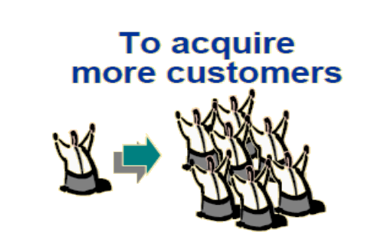
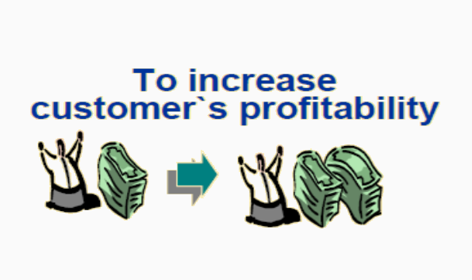
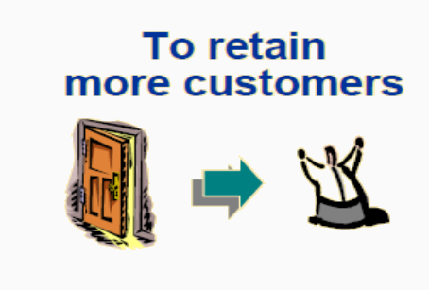
Business Strategies

Slide 5
Customer life cycle
More Efficient Customer Retention
Better Cross / Up selling
PROFIT
More Efficient acquisition of new customers
Recovery of Potential Valuable Customers
PROFIT
Faster Termination of Less Valuable Customer
TIME
Acquisition
Retention
Termination

Slide 6
CLV Helps to answer this……
More Efficient Customer Retention
Better Cross / Up selling
Do the Customer have high probability of cross-selling?
Do the Customer have high potential?
PROFIT
More Efficient acquisition of new customers
Recovery of Potential Valuable Customers
Do the Customer have low potential?
Do the new customer has same profile as valuable customer?
PROFIT
Faster Termination of Less Valuable Customer
TIME
Acquisition
Retention
Termination

Slide 7
DATA PRE-PROCESSING and Feature Engineering
Data Pre-Processing
Feature Engineering
Variables Extraction
Dataset was given with 9806 data points and 22 variables.
The missing value were replaced with the plots comparison.
Even the KNN Imputation was used to replace some of the NA values.
A new Features are been extracted based on the existing variables.
New Features are:
Present Value of Customer,
Clubbing the Various Levels into one level
By using Hetcor function the variables which are highly corelated are been removed.
And using the Step Aic and VIF some of the variables are been removed.

Slide 8
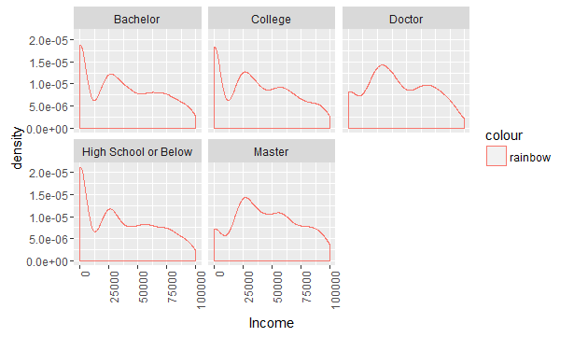
Feature Engineering
Monthly Premium Amount
Present Value of Customer
=
*
-
Total Amount Claim
Months since policy Inception
Bachelor
College
High School or Below
Doctor
Master

Slide 9

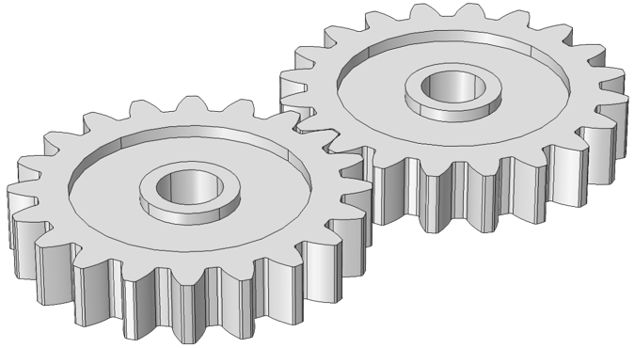
Demo graphs of the Final Data Frame
Initial Data Frame with 9806 data points and 22 feature variables
Feature engineered Data Frame With
9483 by 10 feature variables
Transformation
Customer Centric | Business Centric | Customer Demo graphs
Income | Sales Channel | Education
Employment status | Monthly Premium Value | Marital Status
No. of Policies | Policy & Offers | Location
Vehicle Class | Coverage | Gender
Hopmonk Dataset Summary:
Total Observations : 9483
Total variables : 10
Split : 70-30
Target Variable : Customer Life Time Value
Scaling : Based on the model
Evaluation Metric : R2

Slide 10
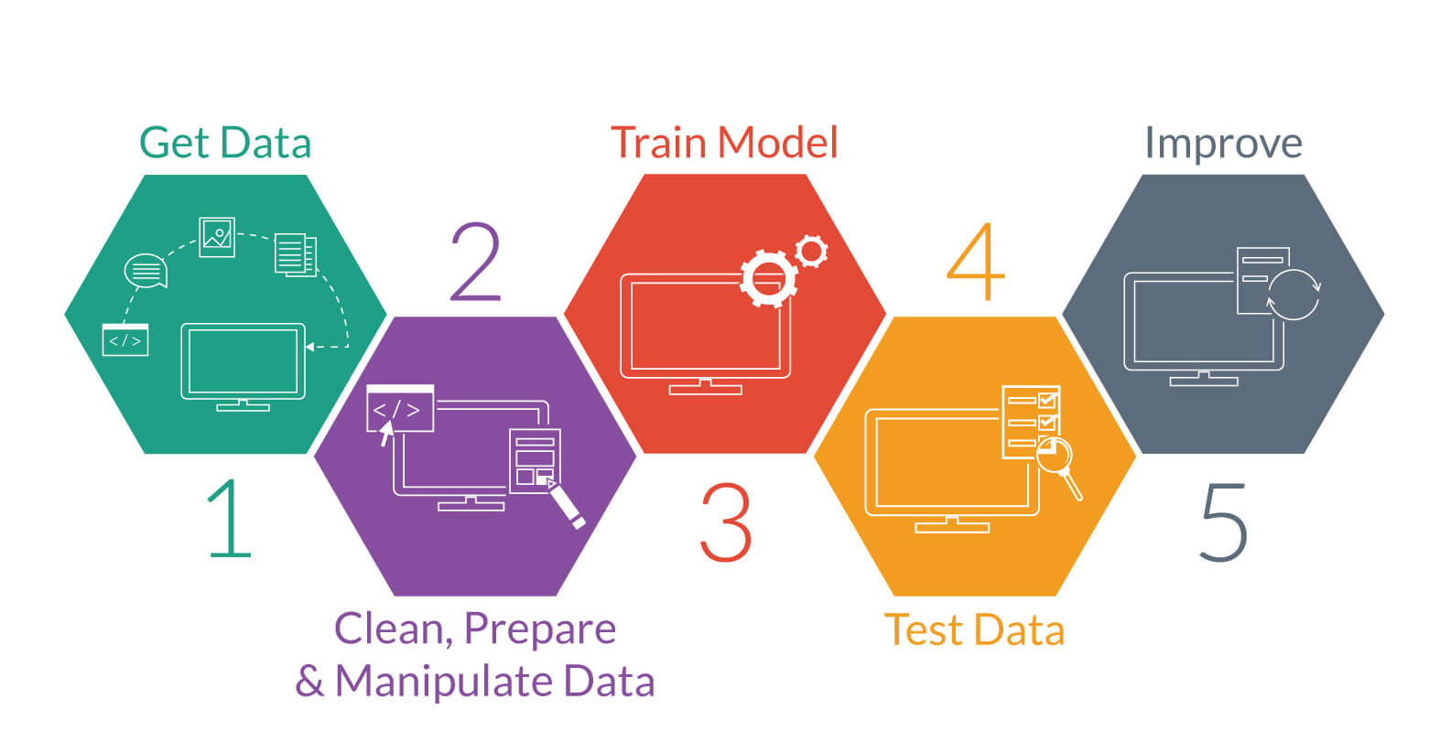
Model Building

Slide 11
Simple Linear Regression
Simple Linear Regression and StepAIC:
The R2 were computed based on the simple linear regression and Step AIC.
The Adjusted R2 was Around 0.34 so the model is doing well over predicting the target variable.
The R2 is less because data is spread widely across the linear regression line.
Did the transformation on the target variable such Log(x), x2, Sqrt(x), and 1/x.
The model gave optimum values over the transformation of 1/x over other transformation.

Slide 12
Decision Tree
The various values of R2 were taken by tuning the Cp values and minsplit.
Even the R2 were not generalising well on the Test data so going for the other model.

Slide 13
Random Forest
As my R2 where varying on my Train and Validation dataset a lot this is mainly due to Overfitting in order to avoid that going for other model.

Slide 14
XG BOOST
XG Boost:
XG Boost was giving stable R2 value over the train and test dataset.
The tuning parameters were tuned in order to get the various R2 value.
Even my final model was tested over the unseen test dataset which showed a R2 value of around 66.47.

Slide 15
R2 COMPARISON ON VARIOUS MODELS
Final Model :XG Boost

Slide 16
Data Insights

Slide 17
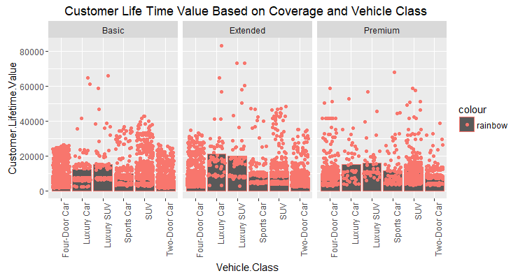
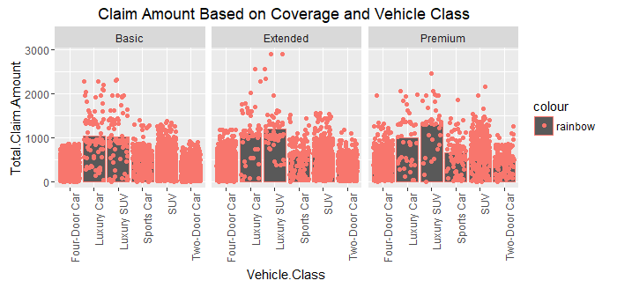
Data Insights

Slide 18
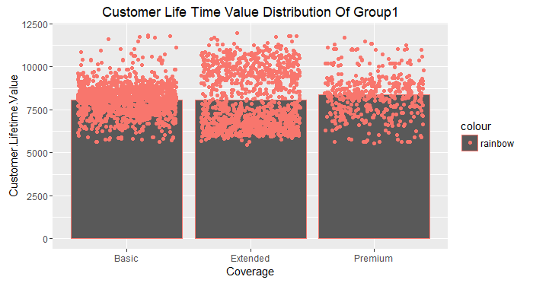
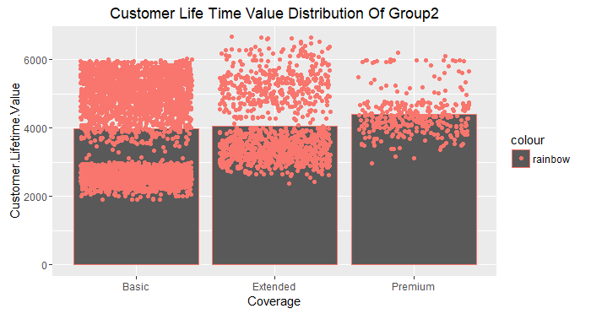
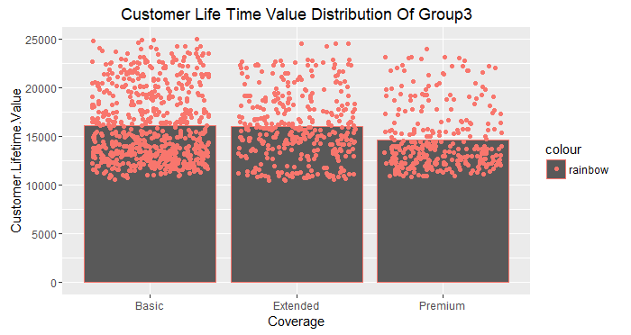
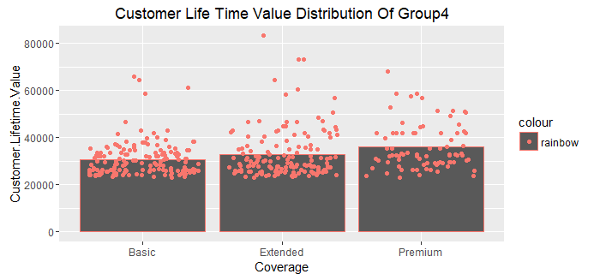
Data Insights After Clustering
Mean CLV is 8000
Mean CLV is 4000
Mean CLV is 15000
Mean CLV is 30000

Slide 19
Conclusion and Recommendations
As the Customer who is using Four Door Car and Two Door car more inclined to coverages and even the Loss incurred by them is more.
After Clustering we can easily segregate the customers into 4 groups and they where clearly different with other groups.
Group 4 Customers are the most profitable customer in comparison with the customer life time value but the no. of customer count is less.
Even Group 3 Can be Bought in to Group 4 by giving offers to them and even new attracting policies.
Concluding that XG Boost Model is stable in order to predict the CLTV.

Slide 20
THANK You

