Slide 1
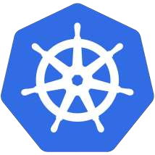
Kubernetes
An Introduction

Slide 2
What is Kubernetes?
Kubernetes is a portable, extensible, open-source platform for managing containerized workloads and services, that facilitates both declarative configuration and automation. It has a large, rapidly growing ecosystem. Kubernetes services, support, and tools are widely available.

Slide 3
Decouples Infrastructure and Scaling
All services within Kubernetes are natively Load Balanced.
Storage Orchestration
Can scale up and down dynamically.
self-healing is enabled. (Example: 3 healthy instance of application)
Secret and Configuration Management

Slide 4
Kubernetes Cluster
Control Plane
Nodes

Slide 5
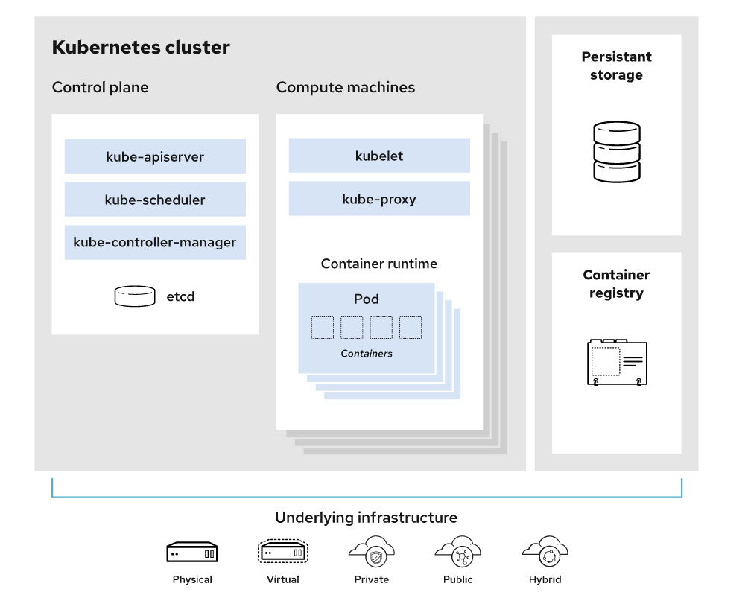

Slide 6
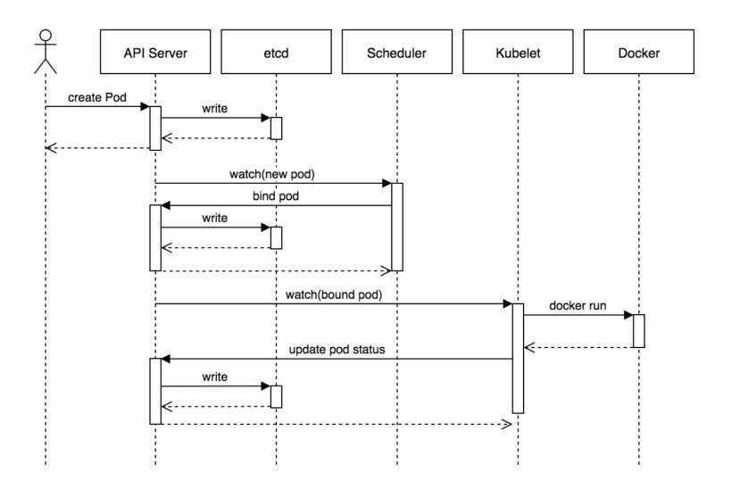


Slide 7

Core Objects and API
Namespaces
Pods
Services
Labels
Selectors
Concepts and Resources

Slide 8
Namespaces
Namespaces are a logical cluster or environment, and are the primary method of partitioning a cluster or scoping access.
apiVersion: v1 kind: Namespace metadata:
name: <<Namespace>>
$ kubectl create namespace <<Namespace Name>>

Slide 9
Pods
Atomic unit or smallest “unit of work”of Kubernetes.
Pods are one or MORE containers that are closely related.
apiVersion: v1 kind: Pod metadata:
name: pod-example labels:
app: nginx spec: template:
metadata: labels:
app: nginx spec: containers:
- name: nginx image: nginx
ports:
- containerPort:80

Slide 10
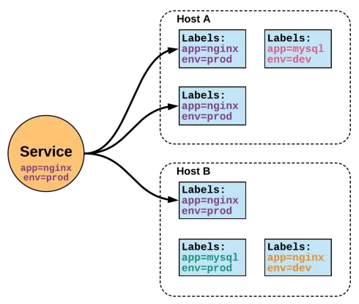
Services
Unified method of accessing the exposed workloads of Pods.
Durable resource (unlike Pods)
static cluster-unique IP
static namespaced DNS name
<svcName>.<namespace>.svc.cluster.local

Slide 11
Services
Target Pods using equality based selectors.
Uses kube-proxy to provide simple load-balancing.
kube-proxy acts as a daemon that creates local entries in the host’s iptables for every service.

Slide 12
Service Types
There are 4 major service types:
ClusterIP (default)
NodePort
LoadBalancer
ExternalName

Slide 13
ClusterIP
apiVersion: v1 kind: Service metadata:
name: example-prod
spec:
type: ClusterIP selector:
app: nginx env: prod ports:
- port: 80
targetPort: 80
apiVersion: v1 kind: Service metadata:
name: example-prod
spec:
type: NodePort selector:
app: nginx env: prod ports:
- nodePort: 32410 protocol: TCP port: 80
targetPort: 80
apiVersion: v1 kind: Service metadata:
name: example-prod
spec:
type: ExternalName spec:
externalName: example.com
Note: NodePort if not specified by default it takes within this range: 30000- 32767.

Slide 14
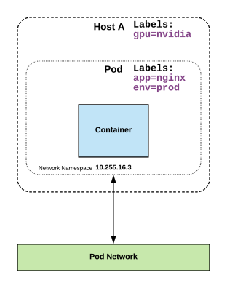
Labels
key-value pairs that are used to identify, describe and group together related sets of objects or resources.
* https://kubernetes.io/docs/concepts/overview/working-with-objects/labels/#syntax-and-character-set

Slide 15
Selectors
Selectors use labels to filter or select objects, and are used throughout Kubernetes.
apiVersion: v1 kind: Pod metadata:
name: pod-example labels:
app: nginx spec: template:
metadata: labels:
app: nginx spec: containers:
- name: nginx image: nginx
ports:
- containerPort:80
apiVersion: v1 kind: Service metadata:
name: example-prod
spec:
type: NodePort selector:
app: nginx env: prod ports:
- nodePort: 32410 protocol: TCP port: 80
targetPort: 80

Slide 16
Ingress
Concepts and Resources

Slide 17
Ingress – Name Based Routing
apiVersion: extensions/v1beta1 kind: Ingress
metadata:
name: name-virtual-host-ingress spec:
rules:
host: first.bar.com http:
paths:
backend:
serviceName: service1 servicePort: 80
host: second.foo.com http:
paths:
backend:
serviceName: service2 servicePort: 80
http:
paths:
backend:
serviceName: service3
servicePort: 80
An API object that manages external access to the services in a cluster
Provides load balancing, SSL termination and name/path- based virtual hosting
Gives services externally- reachable URLs

Slide 18
Ingress – Path Based Routing
apiVersion: extensions/v1beta1 kind: Ingress
metadata:
name: simple-fanout-example spec:
rules:
host: foo.bar.com http:
paths:
path: /foo backend:
serviceName: service1 servicePort: 4200
path: /bar backend:
serviceName: service2 servicePort: 8080

Slide 19
ReplicaSet
Deployment
DaemonSet
HealthChecks
Workloads
Concepts and Resources

Slide 20
Configuration
ConfigMap
Secret
Concepts and Resources

Slide 21
Configuration
Kubernetes has an integrated pattern for decoupling configuration from application or container.
This pattern makes use of two Kubernetes components: ConfigMaps and Secrets.

Slide 22
ConfigMap
Externalized data stored within kubernetes.
Can be referenced through several different means:
environment variable
a command line argument (via env var)
injected as a file into a volume mount
Can be created from a manifest, literals, directories, or
files directly.

Slide 23
ConfigMap
apiVersion: v1 kind: ConfigMap metadata:
name: manifest-example data:
state: Michigan city: Ann Arbor content: |
Look at this, its multiline!
data: Contains key-value pairs of ConfigMap contents.

Slide 24
Secret
Functionally identical to a ConfigMap.
Stored as base64 encoded content.
Encrypted at rest within etcd (if configured!).
Stored on each worker node in tmpfs directory.
Ideal for username/passwords, certificates or other sensitive information that should not be stored in a container.

Slide 25
Secret
apiVersion: v1 kind: Secret metadata:
name: manifest-secret
type: Opaque data:
username: ZXhhbXBsZQ== password: bXlwYXNzd29yZA==
type: There are three different types of secrets within Kubernetes:
docker-registry - credentials used to authenticate to a container registry
generic/Opaque - literal values from
different sources
tls - a certificate based secret
data: Contains key-value pairs of base64 encoded content.

Slide 26
Metrics server
HPA (horizontal pod autoscaler)
Fluentd (log shipping)
Metrics and Monitoring
Concepts and Resources

Slide 27
Metrics API Server
Metric server collects metrics such as CPU and Memory by each pod and node from the Summary API, exposed by Kubelet on each node.
Metrics Server registered in the main API server through Kubernetes aggregator, which was introduced in Kubernetes 1.7

Slide 28
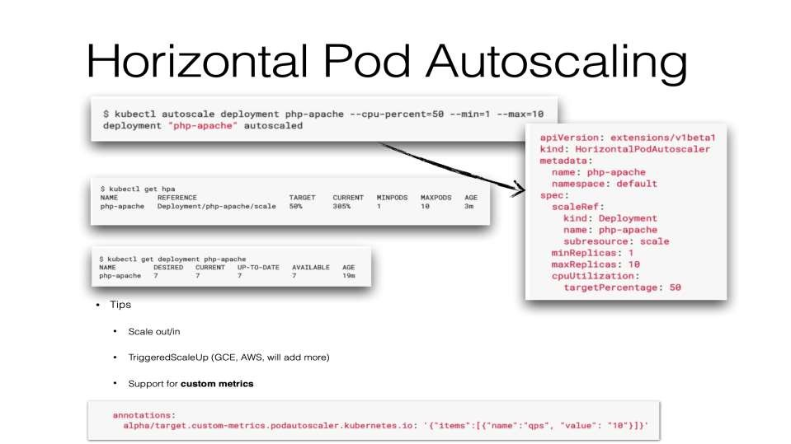
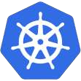

Slide 29
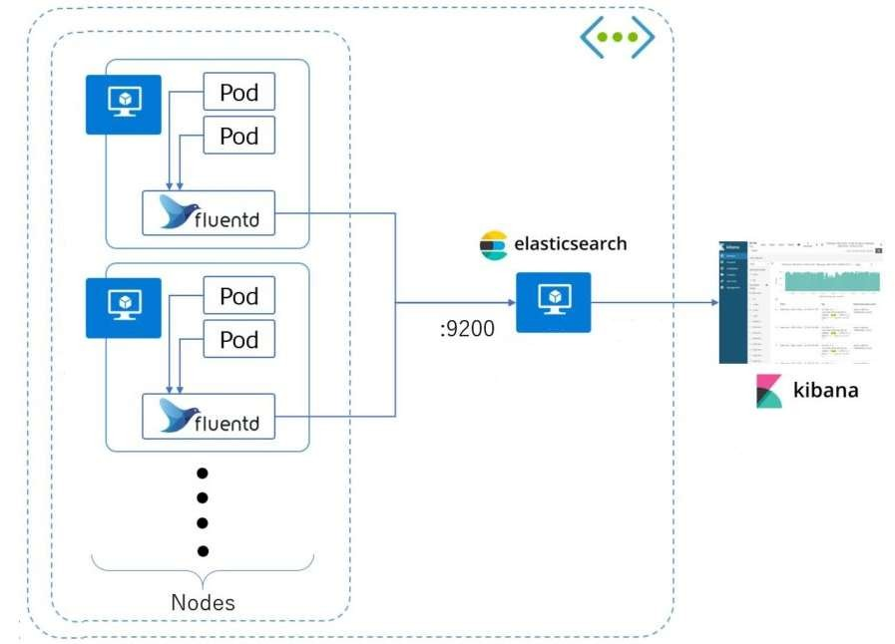

Slide 30

Summary

Slide 31
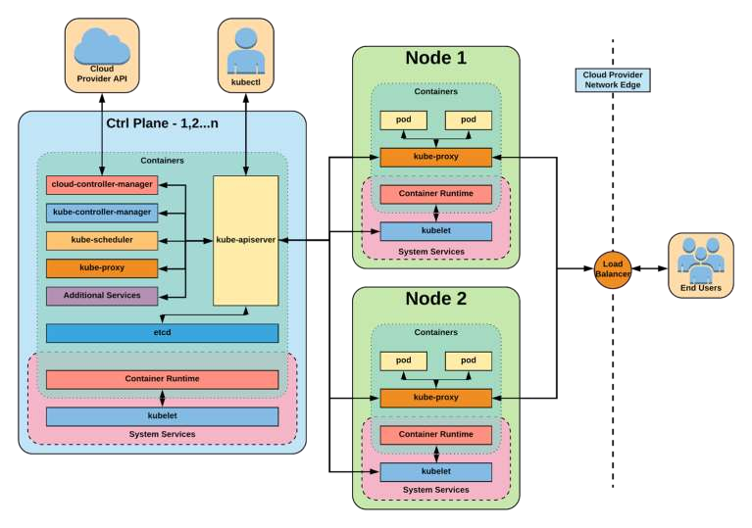

Slide 32
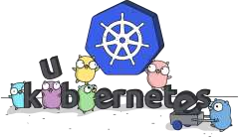
Links
Free Kubernetes Courses
https://www.edx.org/
Interactive Kubernetes Tutorials
https://www.katacoda.com/courses/kubernetes
Learn Kubernetes the Hard Way
https://github.com/kelseyhightower/kubernetes-the-hard-way
Official Kubernetes Youtube Channel
https://www.youtube.com/c/KubernetesCommunity
Official CNCF Youtube Channel
https://www.youtube.com/c/cloudnativefdn
Track to becoming a CKA/CKAD (Certified Kubernetes Administrator/Application Developer)
https://www.cncf.io/certification/expert/
Awesome Kubernetes
https://www.gitbook.com/book/ramitsurana/awesome-kubernetes/details

Slide 33
Questions?
- by Joe Beda (Gluecon 2017)
This presentation is licensed under a Creative Commons Attribution 4.0 International License.
See https://creativecommons.org/licenses/by/4.0/ for more details.

