Slide 1


CMR Technical Campus
UGC AUTONOMOUS
Accredited by NAAC with A Grade
Approved by AICTE, New Delhi and Affiliated to JNTU, Hyderabad
Department of Computer Science and Engineering
A
Mini Project on Detection of Cyber Attack in Network
Using Machine Learning Techniques
BATCH NO:4
Under the Guidance of
Dr.K.Maheswari
(Associate Professor)
Presented by
K.Vamshi Krishna,207R1A0584
K.Namitha,207R1A0583
B.Anudeep,207R1A0563

Slide 2
CONTENTS
Abstract
Existing System
Disadvantages of existing system
Proposed System
Advantages of proposed system
Hardware and software requirements
Novelty of project
Architecture
Modules
UML diagrams
Sample code
Results
Conclusion
Future scope
References
GitHub link

Slide 3
Abstract
Our main goal is that the task of finding attacks is fundamentally different from these other applications, making it significantly harder for the intrusion detection community to employ machine learning effectively.
Machine learning techniques have been applied for major challenges in cyber security issues like intrusion detection, malware classification and detection, spam detection and phishing detection.

Slide 4
Existing System
Cyber security may be a necessary thought for people and families alike, also for businesses, governments, and academic establishments that operate inside the compass of the world network or net.
With the facility of Machine Learning, we will advance the cyber security landscape.
When an IDS detects suspicious activity, the violation is typically reported to a security information and event management system where real threats are ultimately determined amid benign traffic abnormalities or other false alarms.

Slide 5
Disadvantages of Existing System
theft of corporate information.
theft of financial information ( bank details or payment card details)
theft of money.
disruption to trading

Slide 6
Proposed System
Machine Learning algorithms can be used to train and detect if there has been a cyber attack.
One example of a classification algorithm is Support Vector Machine (SVM) which is a supervised learning method that analyses data and recognizes patterns.

Slide 7
Advantages of Proposed System
Protection from malicious attacks on your network.
Detection and guaranteeing malicious elements within a preexisting network.
Prevents users from unauthorized access to the network.
Deny’s programs from certain resources that could be infected
Securing confidential information

Slide 8
Hardware Requirements
For developing the application the following are the Hardware Requirements:
Processor: Pentium IV or higher
RAM: 256 MB
Space on Hard Disk: minimum 512MB

Slide 9
Software Requirements
For developing the application the following are the Software Requirements:
Python
MySql
Django
WampServer

Slide 10
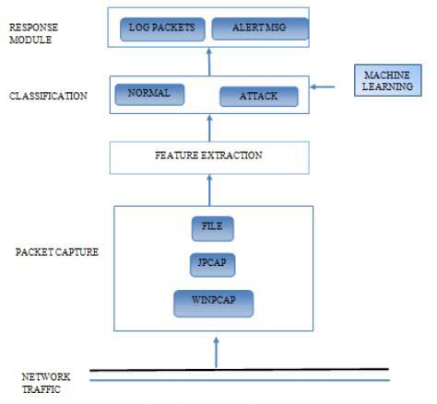
Architecture

Slide 11
Novelty of project
Traditional approaches to cyber security typically rely on rule based system like signature-based detection, but are limited in their ability for detecting new and emerging threats.
In this system we use machine learning techniques and algorithms on other hand it can analyze vast amount of data from network traffic
Identify the patterns, machine learning models can detect attacks in real-time and provide alerts to the security personnel

Slide 12
Modules
System level: Cumulative and per user CPU usage of real and virtual memory Amount of swap space currently available Amount of free memory I/O and disk usage.
User level: Type of user and user privileges Login/Logout period and location Access of resources and directories Type of software/programs use Key stroke pattern (use in future) Average number of packets sent and received Duration of the connection.
Process level: The number of processes and their types Relationship among processes.
Packet level: Average number of packets sent and received.

Slide 13
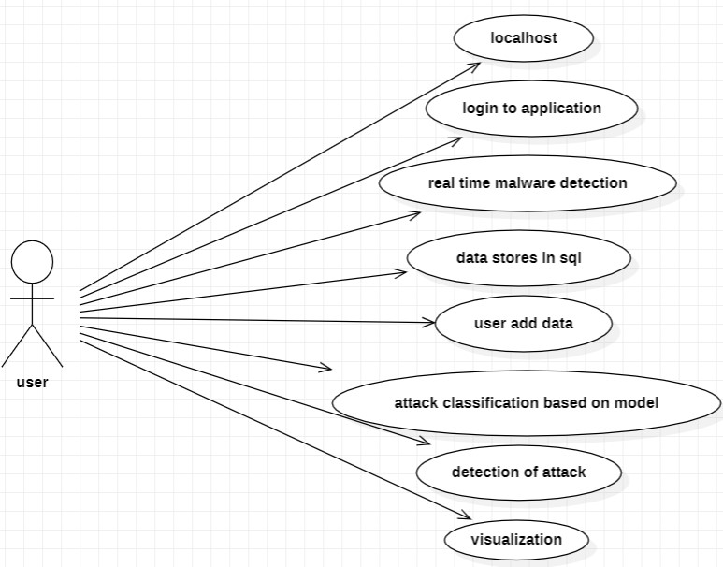
UML diagrams
USE CASE DIAGRAM:

Slide 14
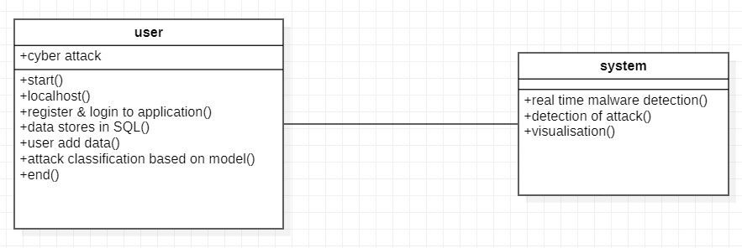
CLASS DIAGRAM:

Slide 15
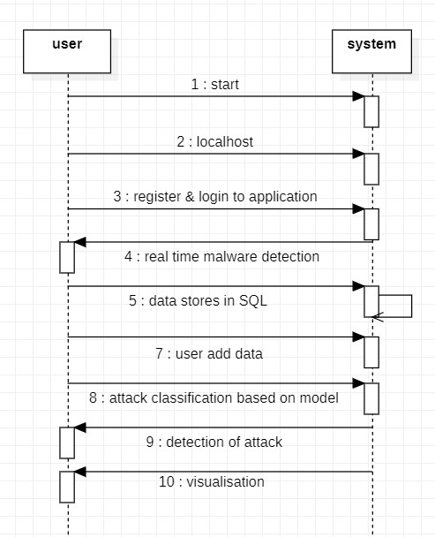
SEQUENCE DIAGRAM:

Slide 16
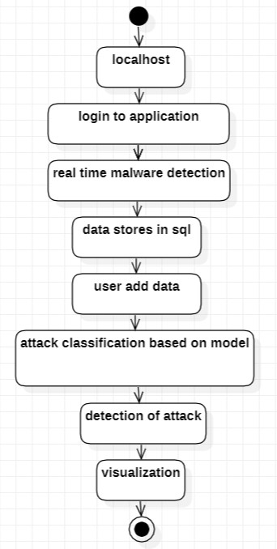
ACTIVITY DIAGRAM:

Slide 17
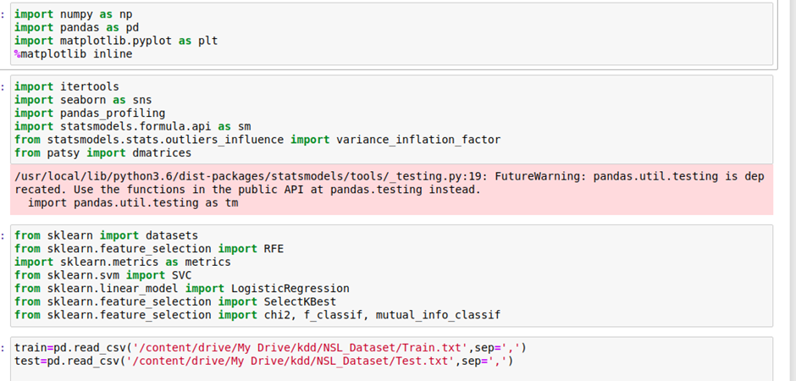
Sample code

Slide 18
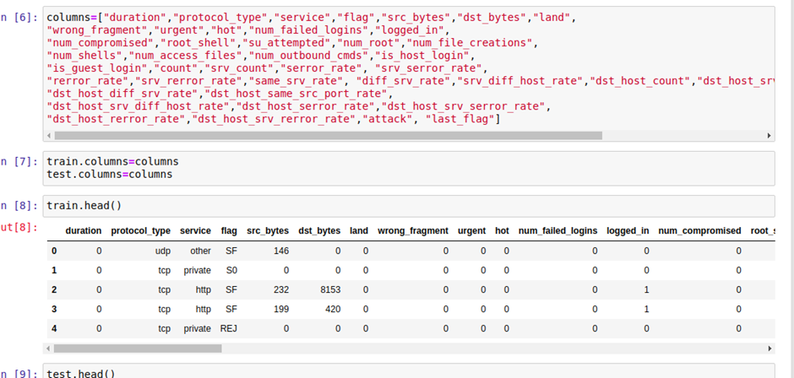

Slide 19
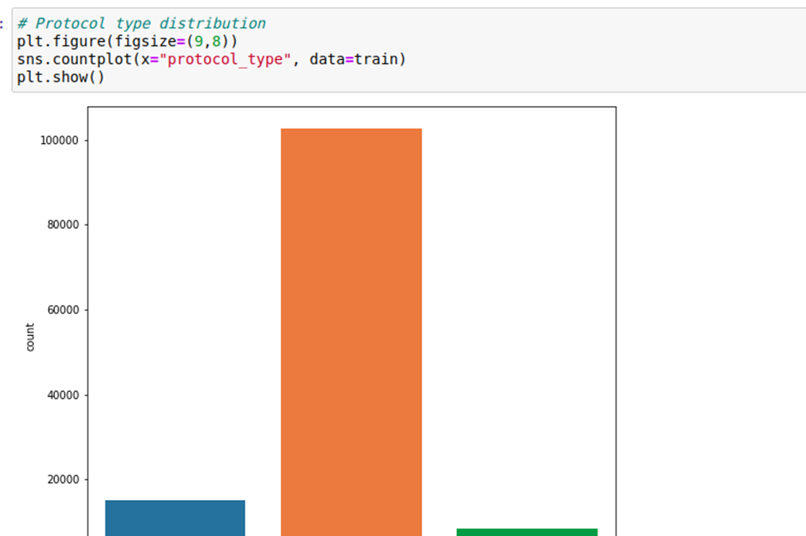
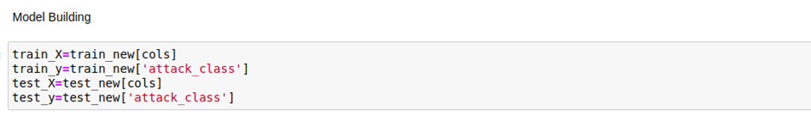

Slide 20
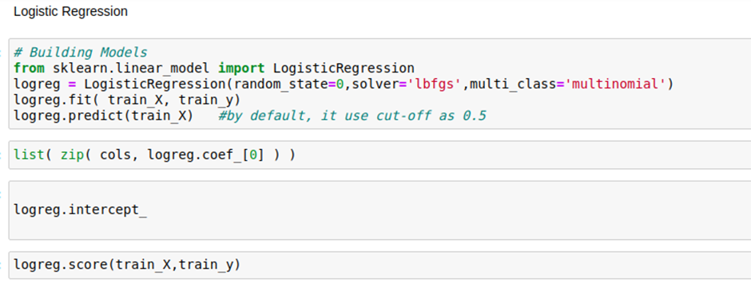
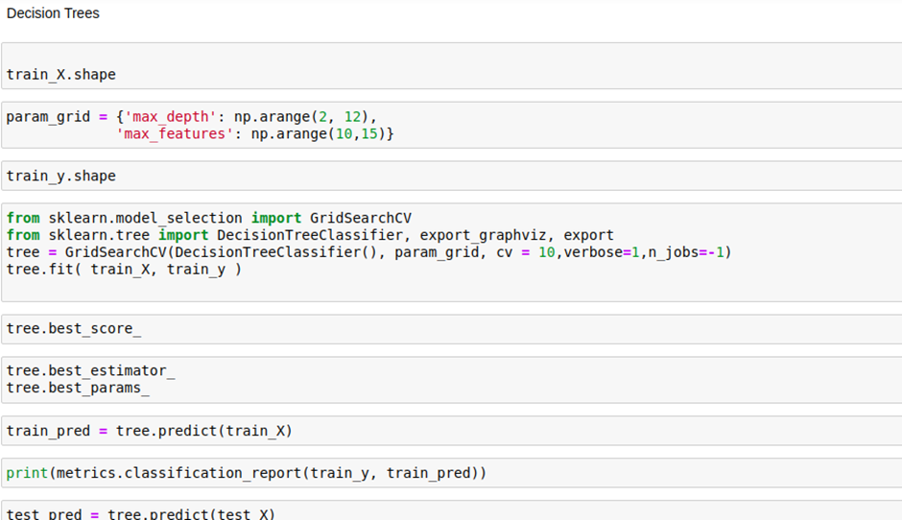

Slide 21
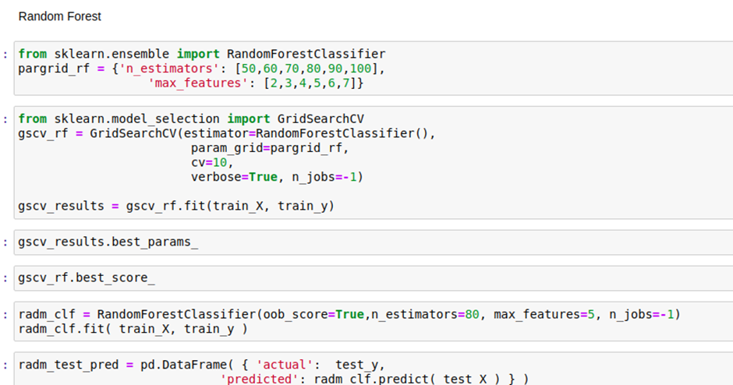

Slide 22
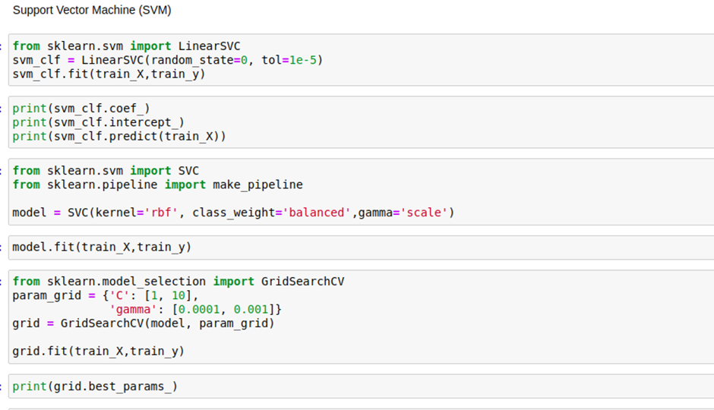

Slide 23
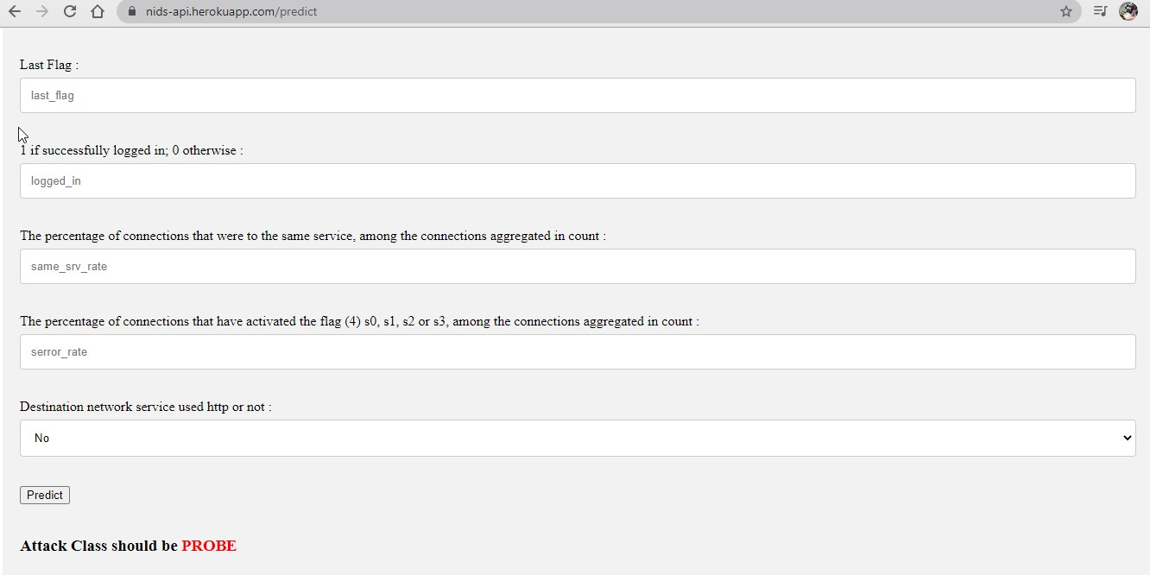
RESULTS

Slide 24
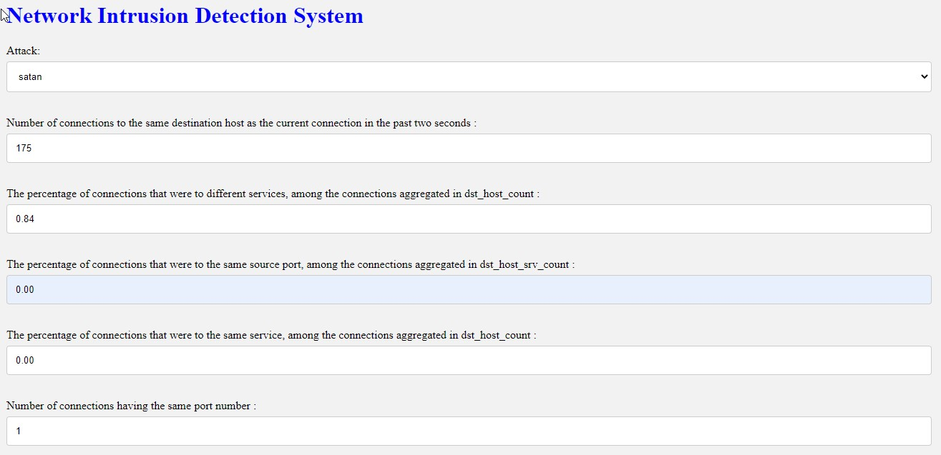

Slide 25
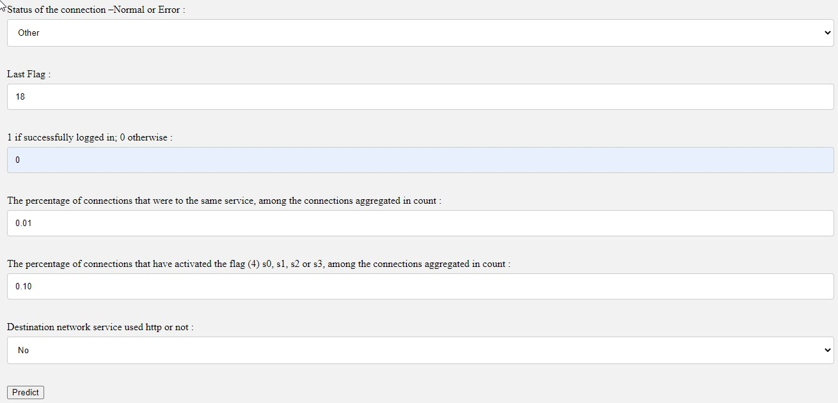

Slide 26
Conclusion
The new age of technology, while bringing us inventions and innovation of such to move the world forward also bring new threats which are more virtual than physical i.e cyber attack.
This system helps us achieve security with utter efficiency and effectiveness to identify those attacks.
This attain security on significant data security of put away information stages, accessibility of information and so forth.

Slide 27
Future scope
Human AI collaboration
Big data analytics
Real time defense

Slide 28
References
Dipankar Dasgupta. Immunity-based intrusion detection system: A general framework. In Proceedings of the 22nd National Information Systems Security Conference . Arlington, Virginia, USA, 1999.

Slide 29
GitHub link
vamshik-1/cyberbreache-detection-mini-project (github.com)

Slide 30
Thank you

