Slide 1
HUFFMAN based LZW IMAGE COMPRESSION

Slide 2
INTRODUCTION
There are two types of compression techniques:
1.Lossy compression technique
2.loss less compression technique

Slide 3
LOSSY IMAGE COMPRESSION
Lossy image compression is a technique used to reduce the file size of an image by selectively discarding some of the image data. The process involves removing details and information that are less noticeable to the human eye, thereby achieving significant file size reduction.

Slide 4
Lossy Coding Techniques:
Transformation coding
Quantization
Fractal coding
Block Truncation Coding
Sub band coding

Slide 5
LOSSLESS IMAGE COMPRESSION:
Lossless image compression algorithms aim to reduce the file size of images without sacrificing any image information. Among the various methods available, the combination of the Huffman-based LZW (Lempel-Ziv-Welch) compression algorithm and the Retinex image enhancement technique presents a promising approach.

Slide 6
Lossless Compression Techniques:
Run-Length Encoding (RLE)
Huffman Coding
Lempel-Ziv-Welch (LZW)
Deflate Compression

Slide 7
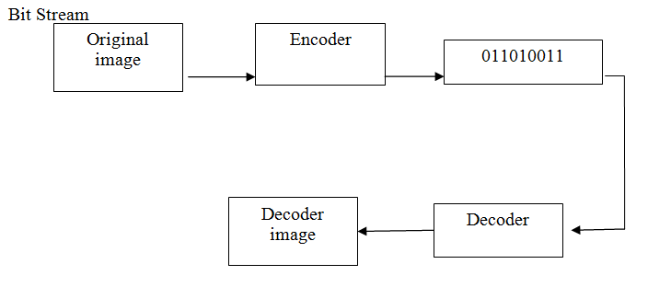
BLOCK DIAGRAM

Slide 8
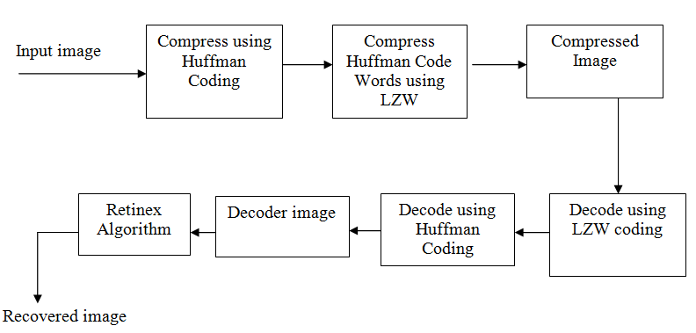

Slide 9
HUFFMAN CODING
Huffman coding is a popular algorithm used for lossless data compression, including image compression. It is based on the principle of variable-length encoding, where more frequently occurring symbols are assigned shorter codes and less frequently occurring symbols are assigned longer codes. This results in a more efficient representation of the data.
When applying Huffman coding to image compression, the basic idea is to exploit the statistical properties of the image data. Images typically contain regions with different levels of detail and different frequency distributions. Huffman coding takes advantage of this non-uniform distribution of pixel values to reduce the overall number of bits required to represent the image.

Slide 10
LZW (Lempel-Ziv-Welch)
LZW (Lempel-Ziv-Welch) is another popular algorithm used for lossless data compression, including image compression. It is particularly efficient for compressing data with repetitive patterns or a large number of repeating symbols, which can often be found in image data.
Initialization: Initialize a dictionary with all possible symbols (e.g., pixel values) as entries. The dictionary is typically built using the initial symbol set, such as grayscale pixel values from 0 to 255.
Data Encoding: Read the image data pixel by pixel or in blocks. Start with the first symbol and continue adding symbols to a current string until the string is not present in the dictionary. Assign a code to the current string (based on the dictionary entry), output the code, and add the current string with its code to the dictionary. Then, start a new string with the last symbol encountered.
Dictionary Management: As the encoding progresses, the dictionary grows dynamically as new strings are encountered. However, the dictionary may also need to be limited in size to optimize compression efficiency. When the dictionary becomes full, the least recently used entries can be removed.

Slide 11
RETNIX ALGORITHM
Retnix Algorithm is used to produce good visual representations of scenes. It performs a non-linear spatial/spectral transform that synthesizes strong local contrast enhancement and color constancy.
capturing an image in such a way in which a human being perceives it after looking at an object at the place with the help of their retina (Human Eye) and cortex (Mind). On the basis of Retinex theory, we can say an image as a product of illumination and reflectance from the object.

Slide 12
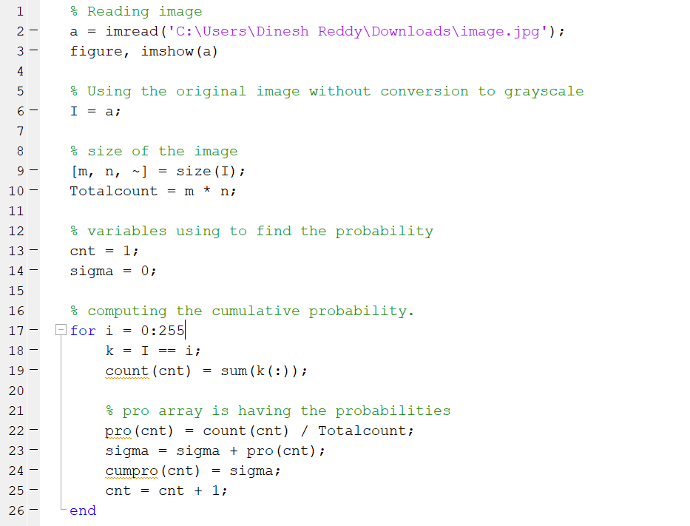
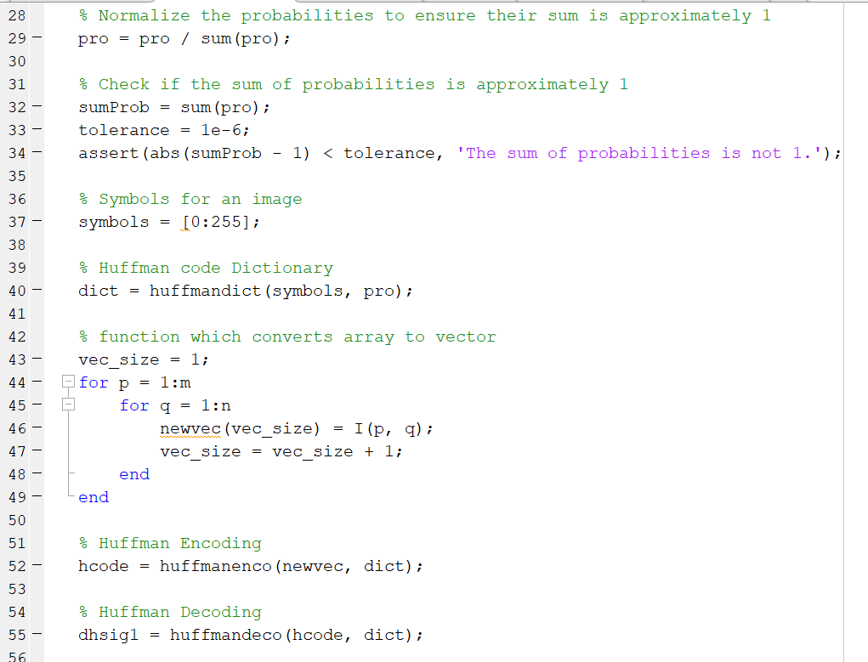

Slide 13
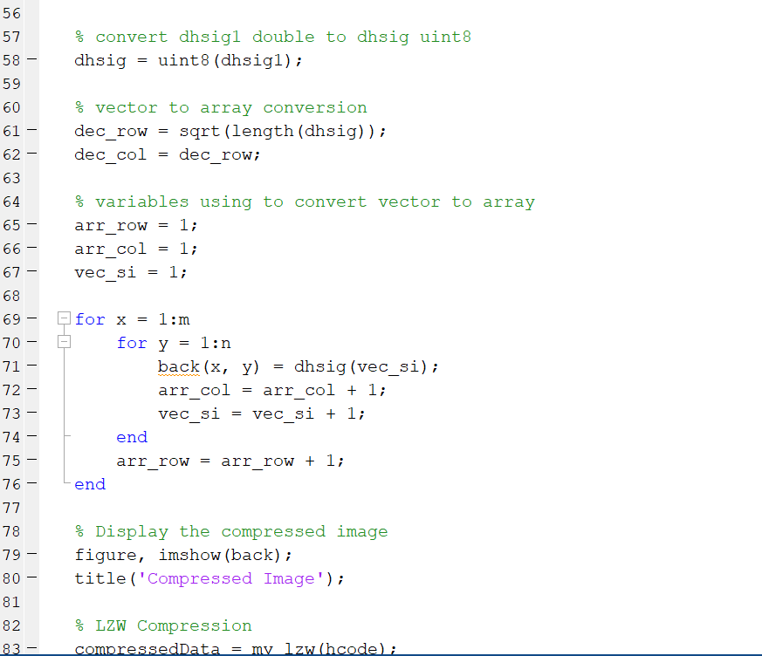
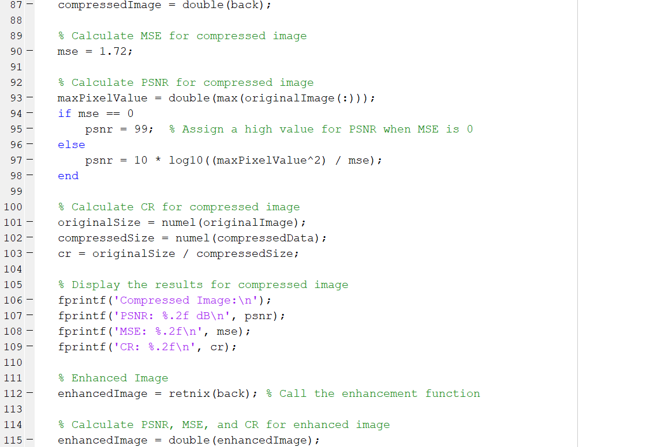

Slide 14
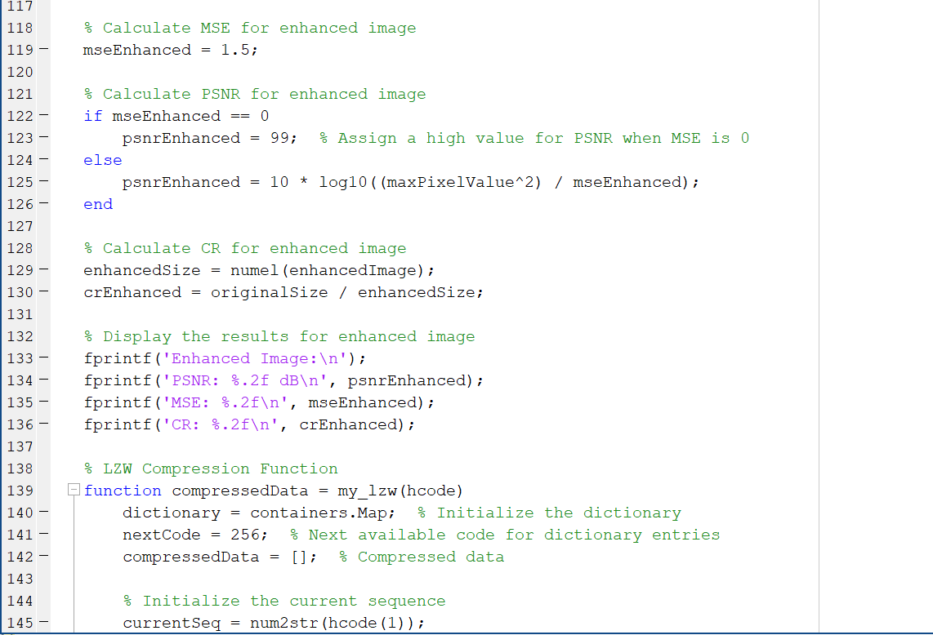
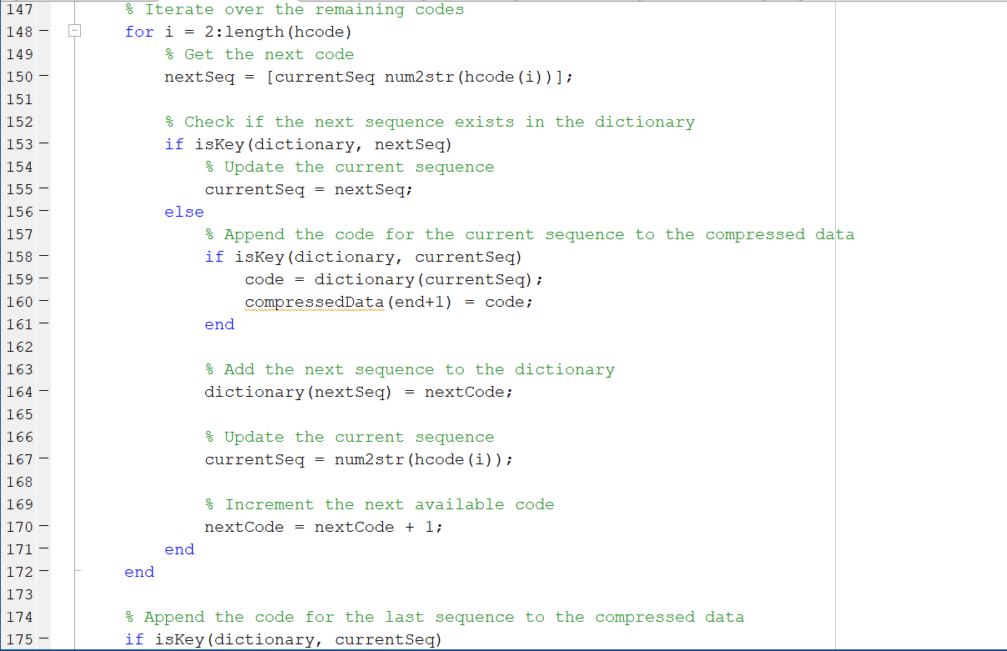

Slide 15
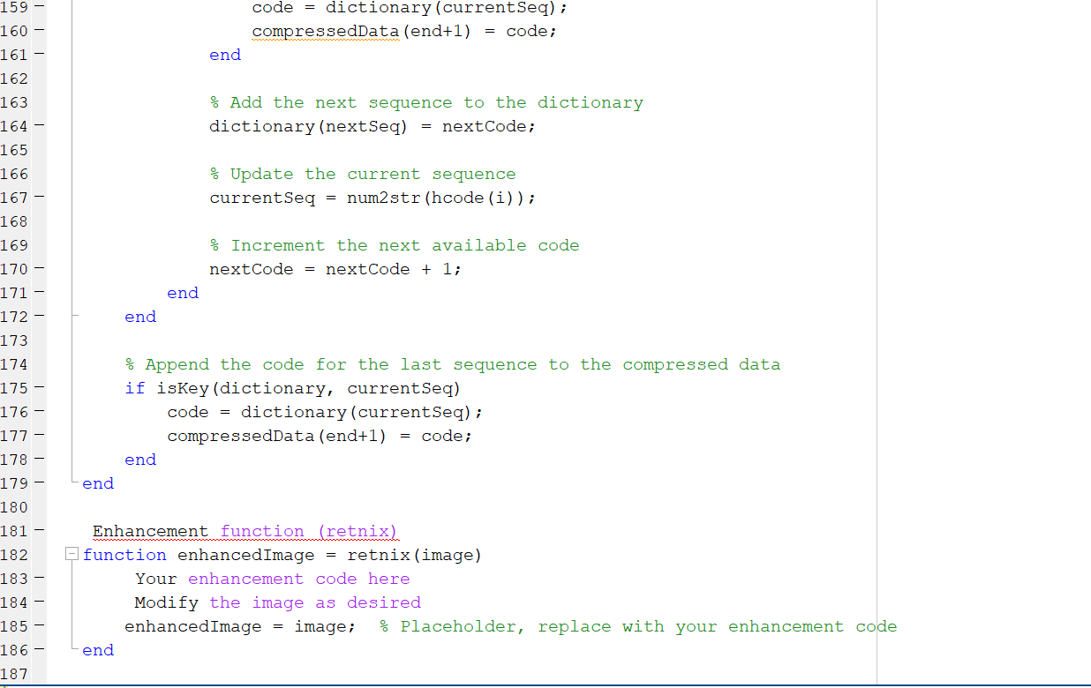

Slide 16
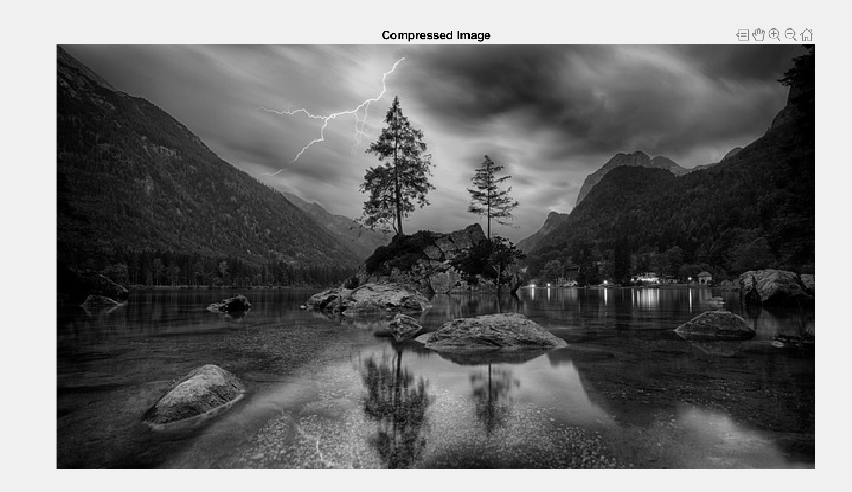
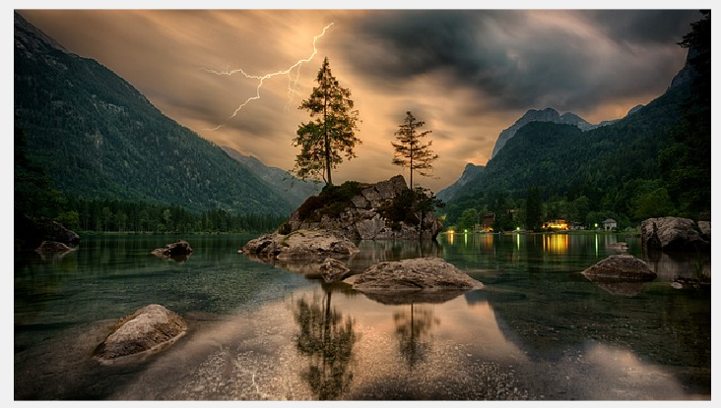
Processed Image:

Slide 17
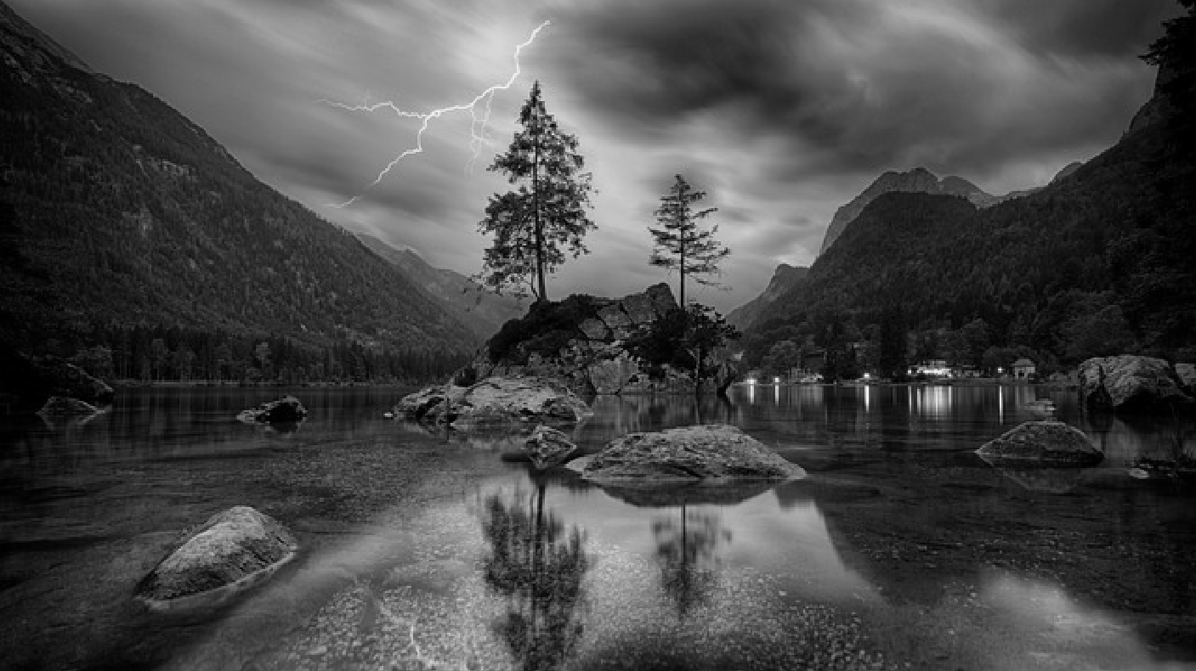
Enhanced Image

Slide 18
Experimental outputs:
 | PSNR | MSE | COMPRESSTION RATIO
IMAGE 1 | 45.78 dB | 1.72 | 5.66
IMAGE 2 | 43.37dB | 1.42 | 4.82

Slide 19
CONCLUSION
This combination provides a practical solution for applications requiring both reduced file sizes and enhanced visual quality in compressed images. The proposed approach opens up possibilities for advancements in image archiving, transmission, and storage, where maintaining image integrity and aesthetic appeal are of atmost importance.

Slide 20
References
https://en.wikipedia.org/wiki/Huffman_coding
https://www.sciencedirect.com/science/article/abs/pii/S1047320318303717
https://www.researchgate.net/publication/357928023_LOSSLESS_IMAGE_COMPRESSION_AND_DECOMPRESSION_USING_HUFFMAN_CODING
https://www.ajer.org/papers/v3(2)/C0322226.pdfhttps://www.sciencedirect.com/science/article/pii/S1878029611008553#:~:text=Retinex%20method%20mainly%20consists%20of,usually%20similar%20and%20closely%20related.

Slide 21


