Slide 1


Mobile Robotic Arm Project
21BEC1085 VAMSHI S HARI HARA KIRAN REDDY J

Slide 2
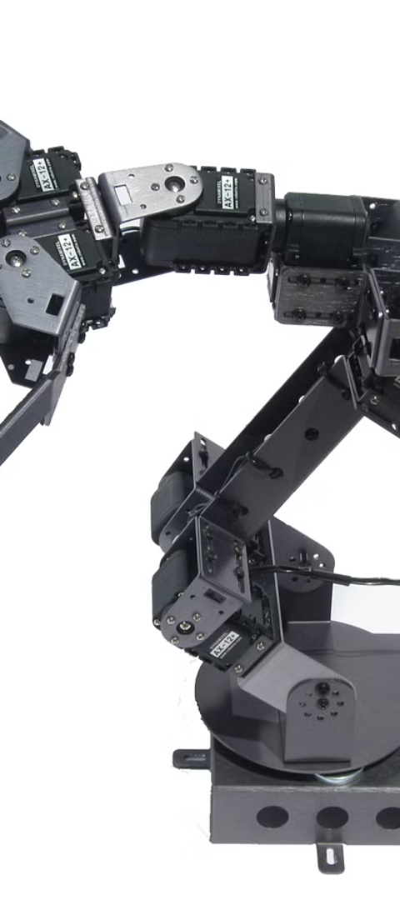
Abstract
This project is about building a mobile robotic arm.
The robotic arm will be mounted on a mobile base, which will allow it to move around and manipulate objects.
The robotic arm will be controlled by a microcontroller, which will be programmed to perform specific tasks.

Slide 3
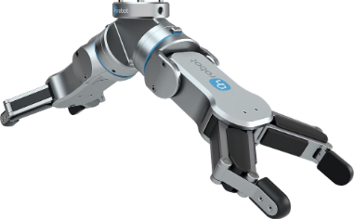
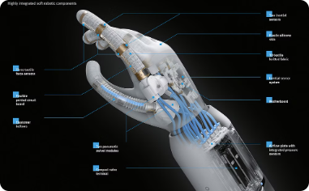
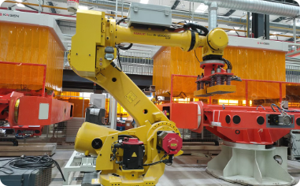
Features and Capabilities of the Robotic Arm
Precision Grip
Advanced Sensors
Versatile Applications
The robotic arm is equipped with a precision grip, allowing it to handle delicate objects with accuracy.
Integrated sensors provide precise feedback and enable the arm to adapt to different environments.
With its wide range of motion, the robotic arm can be used in industrial, medical, and research settings.

Slide 4
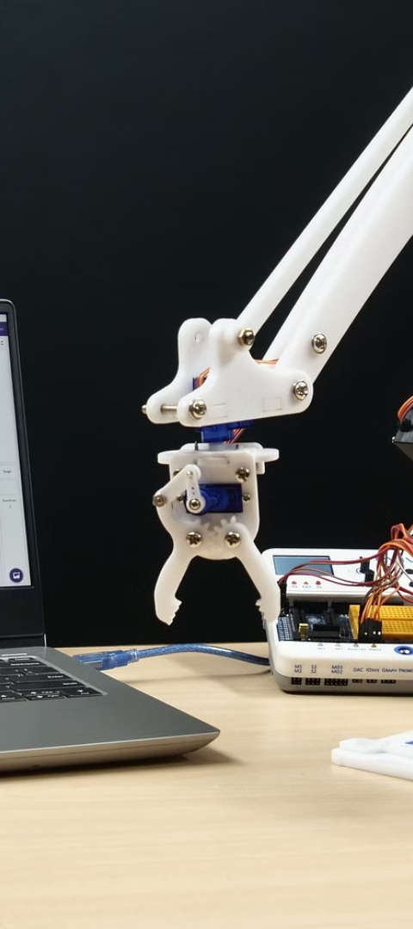
Design and Development Process
1
Conceptualization
The initial phase involved brainstorming sessions to conceptualize the functionality and design aesthetics.
2
Prototyping
Several prototypes were created and tested to refine the mechanical and electronic components of the arm.
3
Software Integration
Integrating software for precision control and feedback mechanisms was a crucial part of the development.

Slide 5
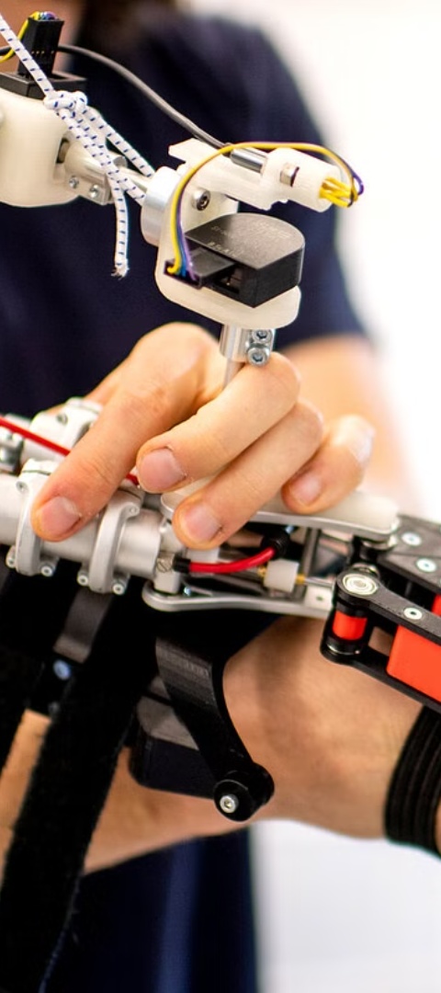



Demonstration of the Robotic Arm in Action
Task Execution
The robotic arm showcases its dexterity by performing complex tasks with speed and accuracy.
Precision Movements
Demonstration of the arm's precise movements and ability to handle fragile objects effectively.
Adaptability
Highlighting the arm's adaptability in various real-world scenarios, showcasing its versatility.

Slide 6
THANK YOU

