Slide 1
Zomato Market Expansion Analysis
Presented by: vamshikrishna kalluri
Batch: Ds July 2025

Slide 2
Introduction & Objectives
Zomato plans to expand its international footprint by opening new restaurants.
This project analyzes restaurant data across 15 countries to guide market entry.
Objective: Identify low-competition markets and provide data-backed strategies.

Slide 3
Data Overview
Tables Used: 2 (Raw Data, Country Description)
Attributes: 27 in Raw Data, 2 in Country Description
Categorical Columns: 14
Data Cleaning: Removed inconsistencies, trimmed spaces, standardized names.

Slide 4
Methodology
Tools: Google Sheets (Pivot Tables, Formulas, Conditional Formatting)
Functions Used: VLOOKUP, COUNTIFS, IF, LEFT, FIND, ARRAYFORMULA
Steps: Data Cleaning → Feature Engineering → Visualization & Insights

Slide 5
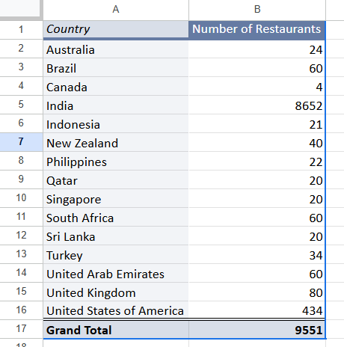
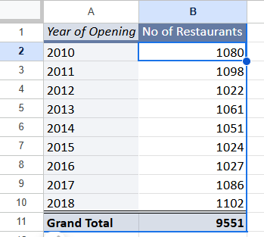
Market Size by Country & Year
Created Pivot Tables for country-wise and year-wise restaurant count.
India has the most restaurants; Brazil and Sri Lanka have fewer than 65.
Applied slicers for dynamic filtering.

Slide 6
Affordability & Online Delivery
Count of budget restaurants (Price Range 1, No Delivery, Cost ≤ ₹250): 1694
Average Rating (Price < 4 & Delivery = Yes): 3.27
Online services boost ratings and market penetration.

Slide 7
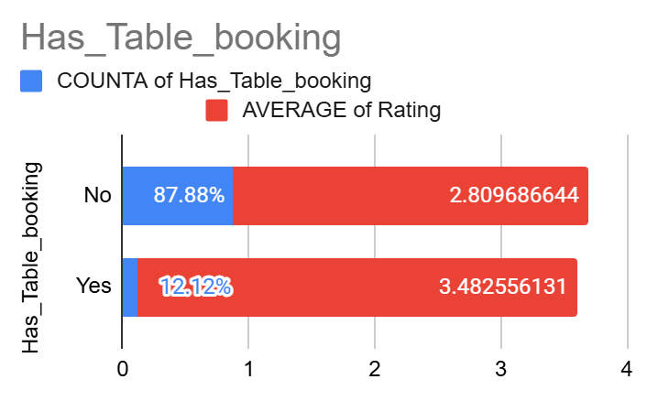
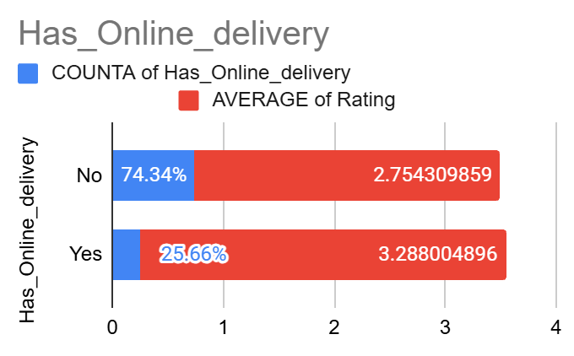
Service Impact on Ratings
Table Booking Avg Rating: 3.48 | Without: 2.80
Online Delivery Avg Rating: 3.28 | Without: 2.75
Recommendation: Enable both for improved customer experience.

Slide 8
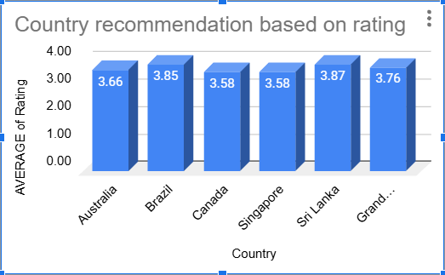
Suggested Markets for Expansion
Countries with Rating < 4 and Restaurant Count < 65:
🇨🇦 Canada | 🇧🇷 Brazil | 🇱🇰 Sri Lanka | 🇸🇬 Singapore
Low saturation and fair quality offer early-mover advantage.

Slide 9
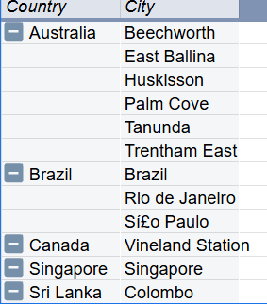
Recommended Cities
Filtered cities from selected countries based on same criteria as above.
🇨🇦 Toronto, Ottawa, Calgary | 🇧🇷 Brasília, Recife, Fortaleza
🇱🇰 Colombo, Kandy, Galle | 🇸🇬 Central, Bukit Timah, Jurong

Slide 10
Cuisine Preferences
Top-rated cuisines to focus on:
Italian, Cafe, Mediterranean, Modern Australian, Bar Food, Brazilian, Seafood, Desserts
These cuisines are correlated with higher ratings and engagement.

Slide 11
Strategic Recommendation 1
Focus on countries with < 65 restaurants and average rating < 4.
Helps Zomato dominate with limited competition.
Targets: Brazil, Sri Lanka, Singapore, Canada

Slide 12
Strategic Recommendation 2
Offer Online Delivery and Table Booking.
Both are positively correlated with higher ratings.
Improves customer convenience and reputation.

Slide 13
Strategic Recommendation 3
Converted cost to INR to analyze spending patterns.
Avg Cost (INR): Singapore – ₹1570, Brazil – ₹870, Canada – ₹690
Price offerings based on local affordability.

Slide 14
Dashboard & Visual Insights
Interactive Excel dashboard created with:
Year-wise & Country-wise slicers
Charts for rating, cost, restaurant count, competitors
Conditional formatting for expansion opportunities

Slide 15
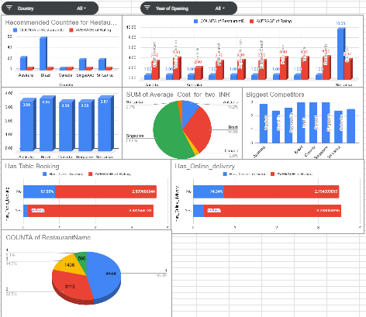

Slide 16
Conclusion
Zomato can expand into low-density countries with smart pricing and service models.
Cuisine selection and delivery/bookings influence ratings.
Dashboard supports dynamic decision-making.

Slide 17
References & Acknowledgements
Dataset: Zomato Restaurant Listings
Tools: Excel (Formulas, Pivot Tables, Dashboards)
Created by: vamshikrishna kalluri

