Slide 1
Trees
Non Linear Data Structure

Slide 2
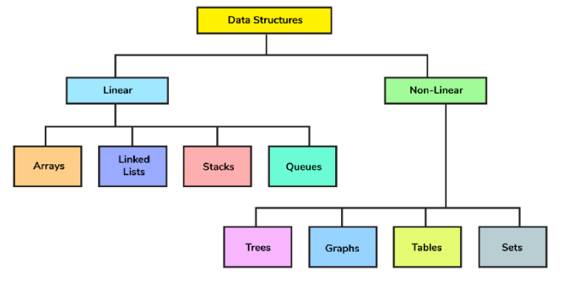

Slide 3
Non Linear Data Structure
Elements are not arranged sequentially
Organized in a hierarchical or interconnected manner
Complex relationships between elements.
Efficient Data Retrieval
Non-contiguous Memory Allocation
They are suitable for tasks like database indexing, network analysis, and managing hierarchical data.

Slide 4
Real Time Examples
Applications
File Explorer
Facebook Friends
Routing Algo aka Google Maps
Decision Making (AI)
Dictionary
Sets
Data Structure
Trees
Graphs
Graphs
Trees
Table
Sets

Slide 5
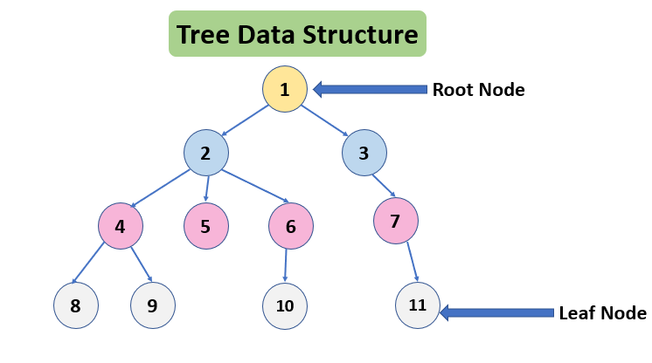
Trees
A tree is a non-linear abstract data type with a hierarchy-based structure. It consists of nodes (where the data is stored) that are connected via links. The tree data structure stems from a single node called a root node and has subtrees connected to the root.
Term | Definition
Root | Topmost node in a tree
Parent | A node that has branches to other nodes
Child | A node that descends from another node
Siblings | Nodes with the same parent

Slide 6
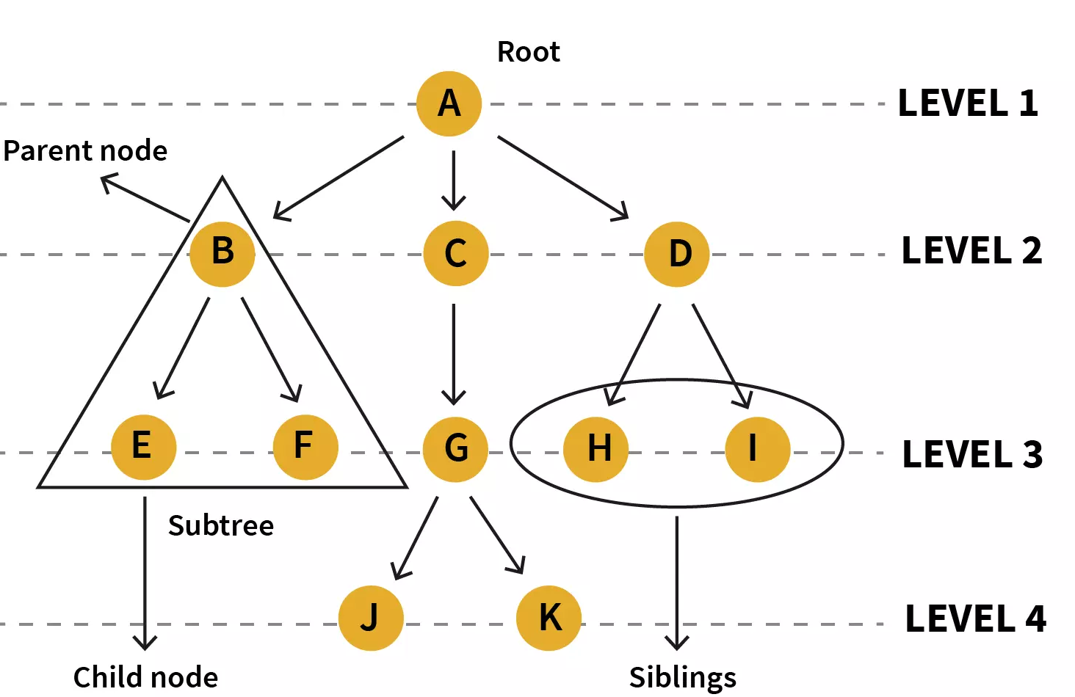
Leaf/External Node | node with no children
Internal Node | least one child
Subtree | A tree formed from a node and its descendants
Degree | No. of children a node has
Depth | Length of the path from root to the node
Height of a Node | Longest path from the node to a leaf
Height of a Tree | Height of the root node
Level | Distance from the root (root is at level 0)
Size | Total number of nodes in the tree
Ancestor | Any node on the path from root to the node
Descendant | A node that lies in the subtree of another node

Slide 7
Binary Trees
Definition
Properties
Types of Binary Trees
Representation
Applications
Example

Slide 8
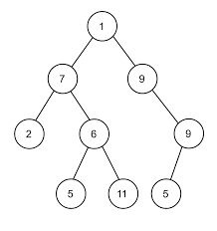
Defination
What is a Binary Tree?
A Binary Tree is a special type of tree data structure in which each node has at most two children, usually referred to as:
Left child
Right child
Each node can have:
0 children → Leaf Node
1 child → Single child
2 children → Internal node with both children

Slide 9
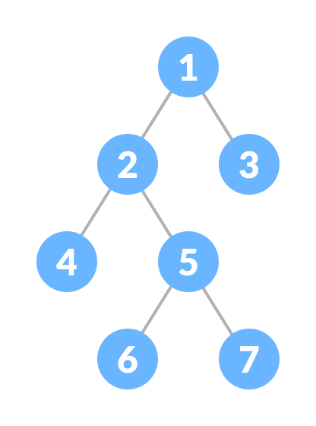
Full Binary Tree
A full Binary tree is a special type of binary tree in which every parent node/internal node has either two or no children.
Let, in = the number of internal nodes
n = be the total number of nodes
l = number of leaves
λ = number of levels
The number of leaves is in + 1.
The total number of nodes is 2in + 1.
The number of internal nodes is (n – 1) / 2.
The number of leaves is (n + 1) / 2.
The total number of nodes is 2l – 1.
The number of internal nodes is l – 1

Slide 10
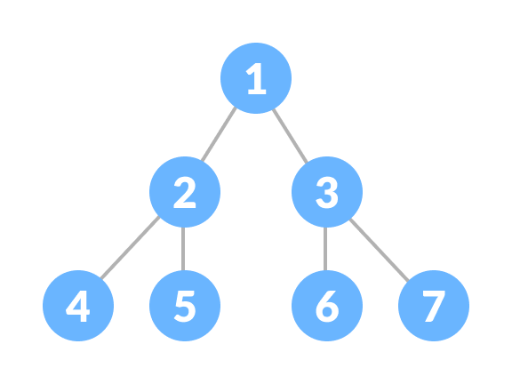
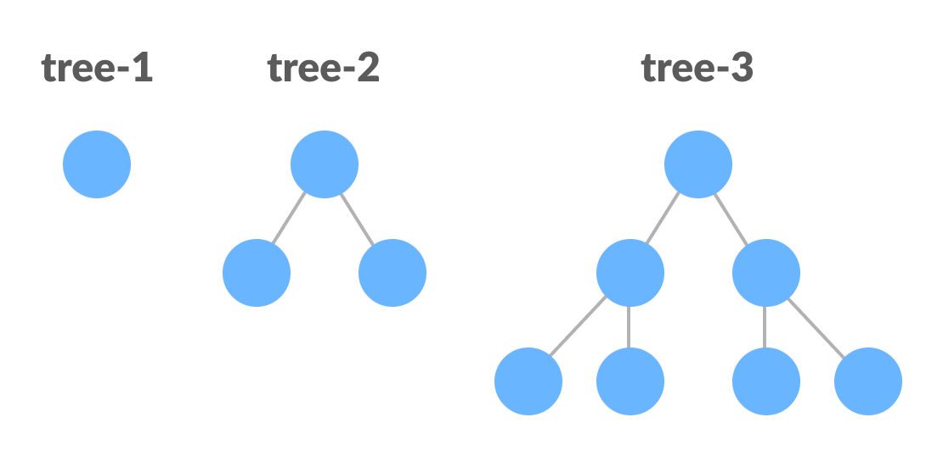
Perfect Binary Tree
A perfect binary tree is a type of binary tree in which every internal node has exactly two child nodes and all the leaf nodes are at the same level
Recursively, a perfect binary tree can be defined as:
If a single node has no children, it is a perfect binary tree of height h = 0,
If a node has h > 0, it is a perfect binary tree if both of its subtrees are of height h - 1 and are non-overlapping.

Slide 11
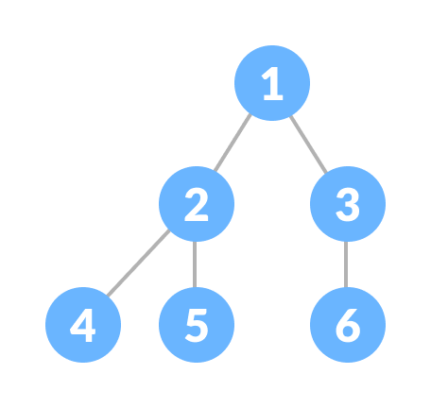
Complete Binary Tree
A complete binary tree is just like a full binary tree, but with two major differences
Every level must be completely filled
All the leaf elements must lean towards the left.
The last leaf element might not have a right sibling i.e. a complete binary tree doesn't have to be a full binary tree.

Slide 12
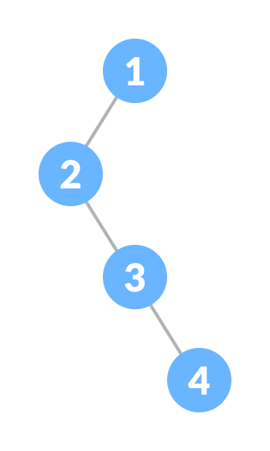
Degenerate or Pathological Tree
A degenerate or pathological tree is the tree having a single child either left or right.

Slide 13
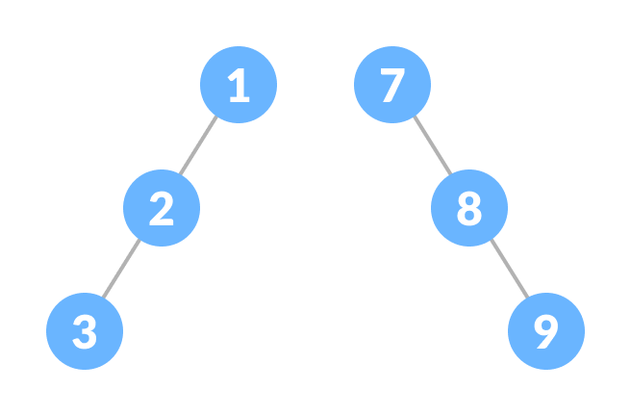
Skewed Tree
A skewed binary tree is a pathological/degenerate tree in which the tree is either dominated by the left nodes or the right nodes. Thus, there are two types of skewed binary tree: left-skewed binary tree and right-skewed binary tree.

Slide 14
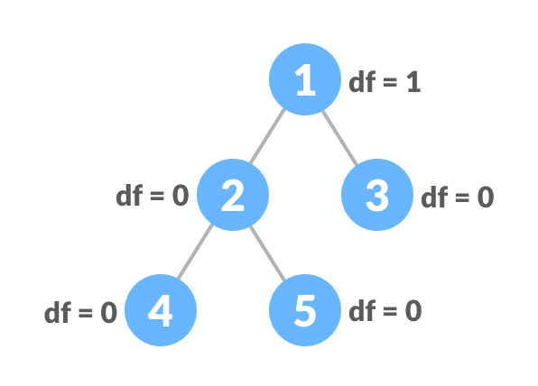
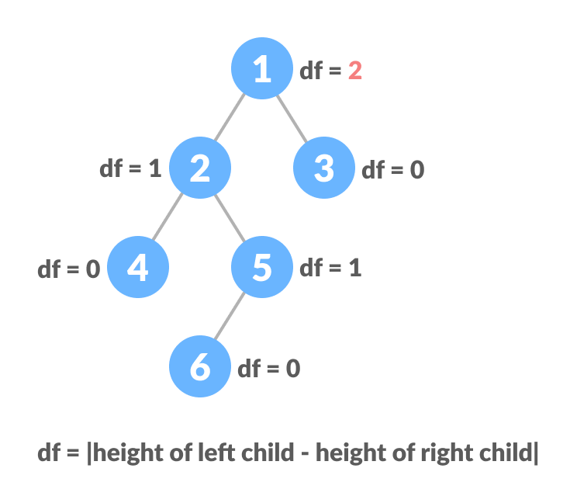
Balanced Binary Tree
It is a type of binary tree in which the difference between the height of the left and the right subtree for each node is either 0 or 1.
They maintain their structure in such a way that operations like search, insert, and delete remain efficient, typically O(log n) in time complexity.
When data is frequently inserted/deleted, balanced trees reorganize themselves to remain efficient.

Slide 15
Properties of a binary tree
N = number of nodes
E = number of edges
H = height of the tree (root at level 0)
L = number of leaf nodes
I = number of internal (non-leaf) nodes
k = level index (starting from 0)
1. Total number of edges = N - 1
(A tree with N nodes always has N - 1 edges)
2. Maximum nodes at level k = 2^k
3. Maximum number of nodes in a binary tree of height H = 2^(H+1) – 1
Height = Number of edges on the longest path from root to any leaf.So:
A tree with just the root node → height = 0
A skewed tree with 4 nodes in a chain → height = 3
4. Minimum possible height of a binary tree with N nodes = ⌊log₂(N)⌋
(Occurs in complete or perfect binary tree)
5. Maximum possible height = N - 1
(Occurs in skewed binary tree)
6. In a binary tree with L leaves, total nodes N = 2L - 1 (only in full binary trees)
7. Inorder traversal of a binary search tree always gives a sorted sequence.

Slide 16
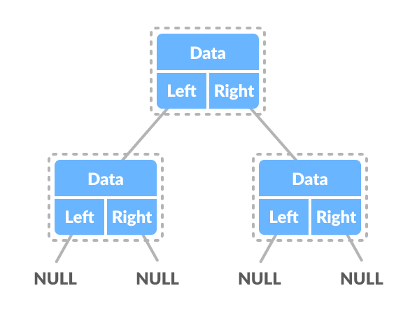
Construction of a binary tree
A node of a binary tree is represented by a structure containing a data part and two pointers to other structures of the same type.
Create a full binary tree with 3 levels
Create a complete binary tree with 3 levels
Create a skewed tree
Create a balanced tree with 2 levels

