Slide 1
UNIT -3
COMBINATIONAL LOGIC
COMBINATIONAL CIRCUITS ANALYSIS
&
DESIGN PROCEDURE

Slide 2
Digital logic circuits
There are two types of Digital circuits depending on their output and memory used:
  (i) Combinational circuit, and
  (ii) Sequential circuit

Slide 3
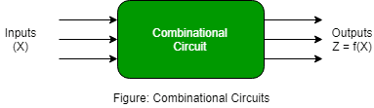
Combinational circuit
Combinational Logic Circuits are memoryless digital logic circuits whose output at any instant in time depends only on the combination of its inputs.
A combinational logic circuit is one whose output only depends on its current inputs

Slide 4
The outputs of Combinational Logic Circuits are only determined by the logical function of their current input state, logic “0” or logic “1”, at any given instant in time.
The result is that combinational logic circuits have no feedback, and any changes to the signals being applied to their inputs will immediately have an effect at the output
In other words, in a Combinational Logic Circuit, the output is dependent at all times on the combination of its inputs. Thus a combinational circuit is memoryless.
Combinational Logic Circuits are made up from logic gates( NAND, NOR or NOT) gates that are “combined” or connected together to produce more complicated switching circuits. These logic gates are the building blocks of combinational logic circuits

Slide 5
The three main ways of specifying the function of a combinational logic circuit are:
1.Boolean Algebra – This forms the algebraic expression showing the operation of the logic circuit for each
input variable either True or False that results in a logical output.
2.Truth Table – A truth table defines the function of a logic gate by providing a concise list that shows all
the output states in tabular form for each possible combination of input variable that the
gate could encounter.
3.Logic Diagram – This is a graphical representation of a logic circuit that shows the wiring and
connections of each individual .

Slide 6
Design Procedure:
A block diagram of a combinational circuit with n input binary variables come from an external source; the m output variables are produced by the internal combinational logic circuit and go to external destination.
For n input variables, there are 2^{n} possible binary input combinations.
For each possible input combination, there is one possible output value.

Slide 8
Design Procedure:
The procedure involves the following steps:
Determine the required inputs and outputs and assign a symbol to each.
Derive the truth table that defines the required relationship between inputs and outputs.
Obtain the simplified Boolean functions for each output as a function of the input variables.
Draw the logic diagram and verify the correctness of the design.

Slide 9
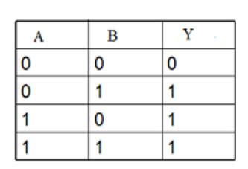
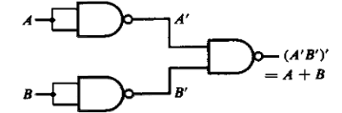
Given Function Y=(A’.B’)’
= A’’ + B’’
= A + B
So,Y= A + B
Input variables are A,B and Y is taken as output variable
Truth Table for the given function

Slide 10
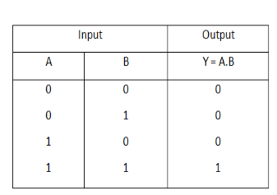

2)Given Function Y = ((A.B)’)’
Y = (A.B)
Truth Table:

Slide 11
For the given circuit diagram shown in figure
Write the Boolean expression corresponding to the circuit (straight from the gates).
Simplify the expression to the shortest SOP form.
Draw an equivalent circuit using only basic gates for the SOP form obtained.
Write truth table for Q=(A.B)’(A+B)’C

Slide 12
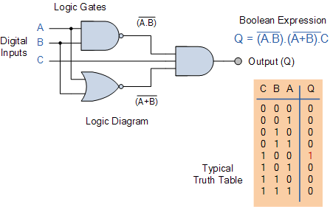

Slide 13
A | B | C | A·B | (A·B)' | A + B | (A + B)' | Q = (A·B)'·(A+B)'·C
0 | 0 | 0 | 0 | 1 | 0 | 1 | 1·1·0 = 0
0 | 0 | 1 | 0 | 1 | 0 | 1 | 1·1·1 = 1 ← only case Q=1
0 | 1 | 0 | 0 | 1 | 1 | 0 | 1·0·0 = 0
0 | 1 | 1 | 0 | 1 | 1 | 0 | 1·0·1 = 0
1 | 0 | 0 | 0 | 1 | 1 | 0 | 1·0·0 = 0
1 | 0 | 1 | 0 | 1 | 1 | 0 | 1·0·1 = 0
1 | 1 | 0 | 1 | 0 | 1 | 0 | 0·0·0 = 0
1 | 1 | 1 | 1 | 0 | 1 | 0 | 0·0·1 = 0

Slide 14
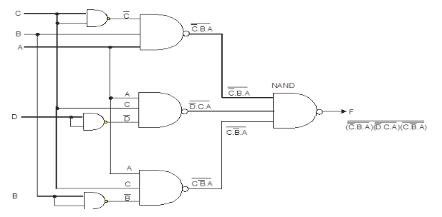
3)F=((C'.B.A)'(D'.C.A)'(C.B'.A)')'

Slide 15
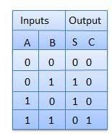
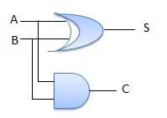
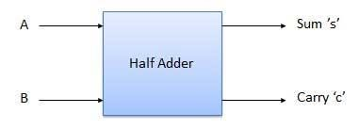
Half Adder:
It is the basic building block for addition of two single bit numbers.
Half adder is a combinational logic circuit with two inputs and two outputs.
The half adder circuit is designed to add two single bit binary number A and B and two outputs carry and sum .
Block diagram Truth Table Logic Diagram

Slide 16
Half adder sum and carry equation is
Sum( S ) =Σ m (1,2) = A ⊕ B =A’B+AB’
Carry( C ) = Σ m (3) =A.B

Slide 17
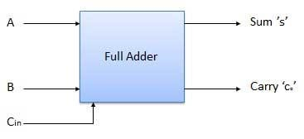
Full Adder:
Full adder is developed to overcome the drawback of Half Adder circuit. It can add two one-bit numbers A and B, and carry C_{IN}.
The full adder is a three input and two output combinational circuit.
              Block diagram

Slide 18
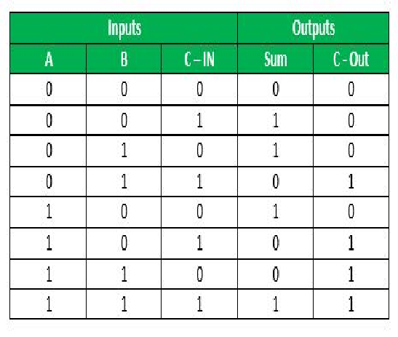
Truth Table of Full-Adder:

Slide 19
1.'A' and' B' are the input variables. These variables represent the two significant bits which are going to be added.
2.'Cin' is the third input which represents the carry.
From the previous lower significant position, the
carry bit is fetched.
3.The 'Sum' and 'Carry' are the output variables
that define the output values.
4.The eight rows under the input variable designate
all possible combinations of 0 and 1 that can
occur in these variables.

Slide 20
Logical Expression for SUM: =Σ m (1,2,4,7)
= A’ B’ C_{IN} + A’ B C’_{IN} + A B’ C’_{IN} + A B C_{IN}
Logical Expression for C-OUT: = Σ m (3,5,6,7)
=A B + B C_{IN} + A C_{IN}
From check board configuration
S=A⊕ B⊕ C_{IN}

Slide 21
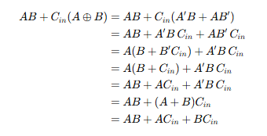

Logical Expression for C-OUT
F=AB+Cin​(A⊕B)
Law Used:
Redundant Law: $x+x^{′}y=x+y$

Slide 22
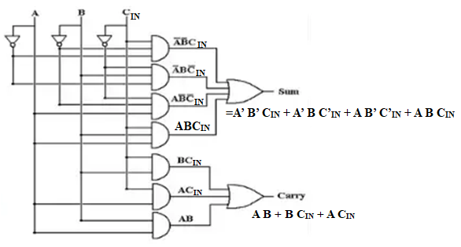
AOI Logic Diagram (AND-OR-Invert )

Slide 23
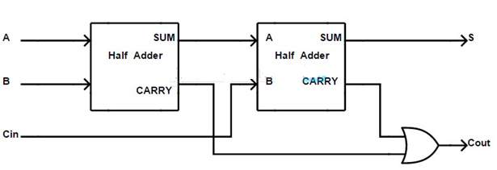
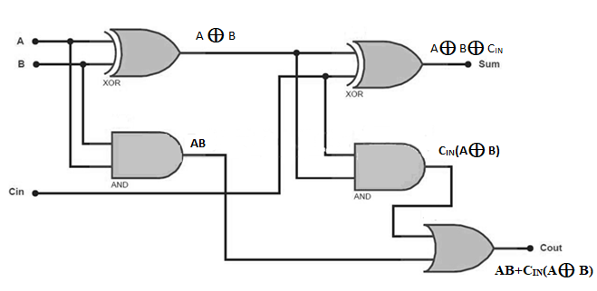
Implementation of Full Adder using Half Adders:
S=A⊕ B⊕ C_{IN}
S=A⊕ B
A.B
AB+Cin​(A⊕B)

Slide 24
The first half adder has two single-bit binary inputs A and B. As we know that, the half adder produces two outputs, i.e., Sum and Carry.
The 'Sum' output of the first adder will be the first input of the second half adder, and the 'Carry' input will be the second input of the second half adder.
The second half adder will again provide 'Sum' and 'Carry'. The final outcome of the Full adder circuit is the 'Sum' bit.
In order to find the final output of the 'Carry', we provide the 'Carry' output of the first and the second adder into the OR gate.
The output of the OR gate will be the final carry out of the full adder circuit.
The full adder logic circuit can be constructed using two 'AND' gates and two 'XOR' gates with an OR gate.

Slide 25
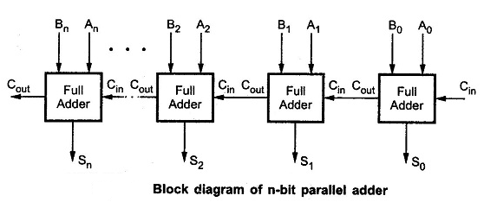
N-Bit Parallel Adder:
To add two n-bit binary numbers we need to use the n-bit parallel adder. It uses a number of full adders in cascade.
The carry output of the previous full adder is connected to carry input of the next full adder.

Slide 26
4-Bit Parallel Adder:
Parallel Adder is a digital circuit that efficiently adds more than 1-bit binary numbers. Parallel Adders are implemented using Full Adders.
The four-bit parallel adder is a very common logic circuit.
In the block diagram, A1 and B1 represent the .Here C0 has been permanently made 0. The rest of the connections are exactly same as that of n-bit parallel adder .

Slide 27
How does Parallel Adder Work:
To understand the working principle of Parallel Adder, Let us understand the construction of Parallel Adder as shown in the Figure.
4- bit Parallel Adder is designed using 4 Full Adders FA1, FA2, FA3, FA4 . Full Adder FA1 adds A1, B1 along with carry C0 to generate Sum S1 and Carry bit C1 and this Carry bit is connected to FA2.
FA2 accepts this Carry C1 and adds with its inputs A2 and B2 to generate Sum S2 and Carry C2. This bit C2 is connected to FA3.
FA3 accepts this Carry C2 and adds with its inputs A3 and B3 to generate Sum S3 and Carry C3. This bit C3 is connected to FA4.

Slide 28

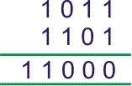
This process continues till the last Full Adder. FA₄ accepts the carry bit C₃ and adds with its input A₄ and B₄ to generate the final output S₄ along with the last carry bit C₄.
Let us examine the justification of the above circuit by taking an example of addition of two 4-bit binary numbers.
Let us add 1011 with 1101.

Slide 29

As there is no previous carry C0 = 0.
1
Therefore, final result of the addition would be

Slide 30
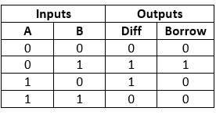
HALF SUBTRACTOR:
Half subtractor is a combinational circuit with two inputs and two outputs (difference and borrow).
It produces the difference between the two binary bits at the input and also produces an output (Borrow) to indicate if a 1 has been borrowed.
In the subtraction (A-B), A is called as Minuend bit and B is called as Subtrahend bit.Difference(d)=Σ m (1,2)= A′B+AB′ = A⊕B Borrow (b)=Σ m (1)A′B
Block diagram Truth Table Logic Diagram

Slide 31
Half subtractor is designed using an XOR gate together with a NOT gate and an AND gate.
In half subtractor , A and B are the inputs, d and b are the outputs. Where d indicates the difference and b indicates the borrow output.
The borrow output (b) is the signal that tells the next stage that a 1 has been borrowed.
From the logic circuit diagram of the half subtractor, it is clear that the difference bit (d) is obtained by the XOR operation of the two inputs A and B, and the borrow bit is obtained by AND operation of the compliment of the minuend (A') with the subtrahend (B).

Slide 32
Operation of Half Subtractor:
Half subtractor performs its operation to find the difference of two binary digits according to the rules of binary subtraction, which are as follows −
The output borrow ,b is zero (0) as long as the minuend bit (A) is greater than or equal to the subtrahend bit (B), i.e. A ≥ B.
The output borrow is a 1 when A = 0 and B = 1.

Slide 33
K-Map for Half Subtractor:
We can use the K-Map (or Karnaugh Map), a method for simplifying Boolean algebra, to determine equations of the difference bit (d) and the output borrow (b).
The difference bit (d) of the half subtractor is given by XORing the two inputs A and B.
Therefore, Difference(d)=Σ m (1,2)= A′B+AB′ = A⊕B
The borrow (b) of the half subtractor is the AND of A’ (compliment of A) and B. Therefore, Borrow (b)=Σ m (1)A′B

Slide 34
FULL SUBTRACTOR:
A full-subtractor is a combinational circuit that has three inputs A, B, B_{in} and two outputs D and B_{O}.
Where, A is the minuend, B is subtrahend, bin is borrow produced by the previous stage, D is the difference output and B_{O} is the borrow output.

Slide 35
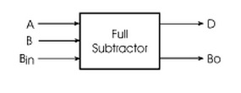
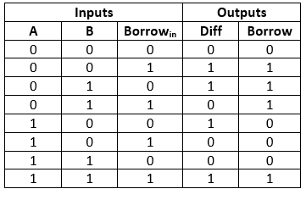
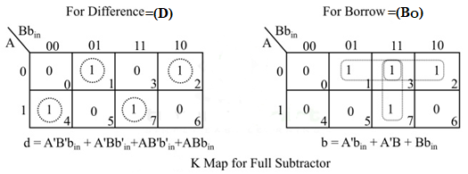
Block Diagram of Full-Subtractor:
Truth Table of Full-Subtractor:
Or =A⊕B⊕ bin

Slide 36
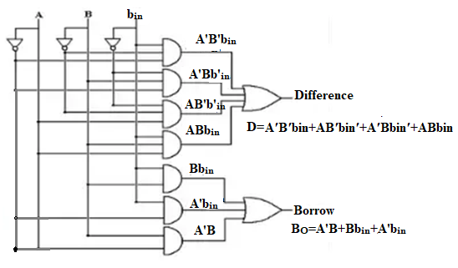
AOI Logic diagram:

Slide 37
Implementation of Full Subtractor using Half Subtractor:
Logic Diagram:We can realize the full-subtractor using two XOR gates, two NOT gates, two AND gates, and one OR gate.

Slide 38
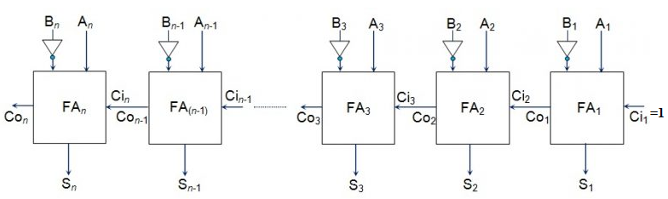
N-BIT PARALLEL SUBTRACTOR:
For example we can perform the subtraction (A-B) by adding 2's complement of B to A. That means we can use a binary adder to perform the binary subtraction.

Slide 39
The procedure of subtraction can be done by considering the addition of minuend with subtrahend’s 2’s complement. So that parallel subtraction can be done.
The 1’s complement of ‘B’ can be attained through the NOT logic gate & ‘1’ is added throughout the carry to get the 2’s complement of ‘B’. Further, this is added to ‘A’ to perform the arithmetic subtraction.
This procedure will continue till the final full adder like ‘FAn’ and it utilizes the carry bit ‘Cn’ to include with its i/p ‘An’ as well as 2’s complement of ‘Bn’ to produce the final output bit with final carry bit ‘Cout’.

Slide 40
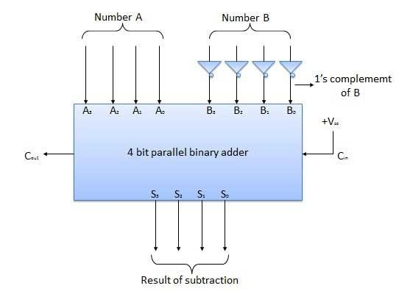
4 BIT PARALLEL SUBTRACTOR:
The number to be subtracted (B) is first passed through inverters to obtain its 1's complement.
The 4-bit adder then adds A and 2's complement of B to produce the subtraction. S3 S2 S1 S0 represents the result of binary subtraction (A-B) and carry output Cout represents the polarity of the result.
If A > B then Cout = 1 and the result is positive.
If A< B then Cout = 0 and the result is in the 2's complement form.

Slide 41
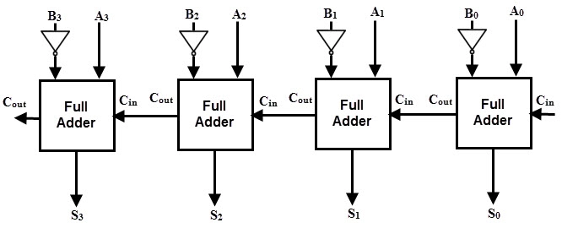
Logic diagram:
•
The minuend bits are given directly to the full adder.
The subtrahend bits are inverted or complemented by using a NOT gate and given to the full adder.
The carry input for the first full adder is set to ‘1’.
The sum output of each full adder S3 S2 S1 S0 corresponds to the difference output D3 D2 D1 D0 of each bit in a multi-bit binary number.
If there is any carry produced at the 4th block, it will be seen at C4.

Slide 42
DECIMAL ADDER

Slide 43
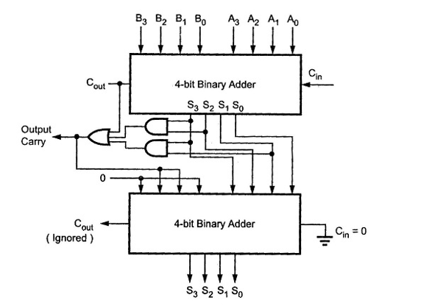
BCD Adder Block Diagram, as shown in the Fig below.

Slide 44
Digital Binary Multiplier
A Binary multiplier is a combinational logic circuit used for multiplying two binary numbers.
The two numbers are more specifically known as multiplicand and multiplier and the result is known as a product.

Slide 45
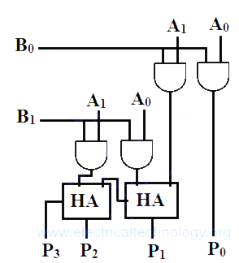
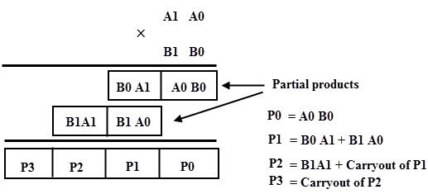
2×2 Bit Multiplier:
This multiplier can multiply two numbers having bit size = 2 i.e. the multiplier and multiplicand can be of 2 bits.
The product bit size will be the sum of the bit size of the input i.e. 2+2=4.

Slide 46
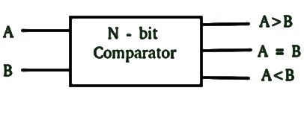
Magnitude Comparators

Slide 47
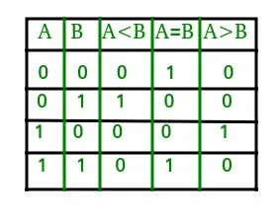
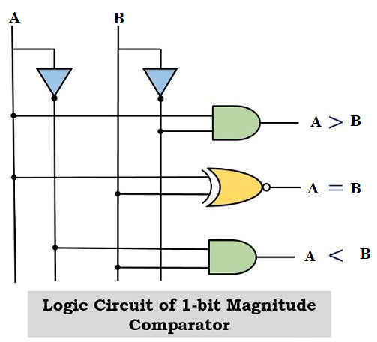
1-Bit Magnitude Comparator
A comparator used to compare two bits is called a single-bit comparator. .
From the truth table logical expressions for each output can be expressed as follows.
A>B: AB’
A<B: A’B
A=B: A'B' + AB

Slide 48
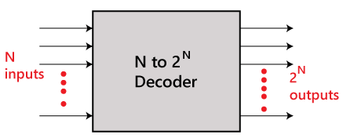
Decoder:
The combinational circuit that change the binary information into 2^{N} output lines is known as Decoders.

Slide 49
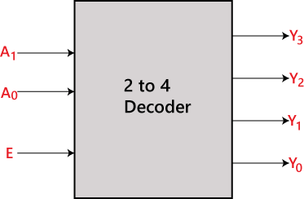
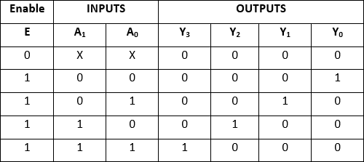
2 to 4 line decoder:
Block diagram Truth Table
The logical expression of the term Y0, Y1, Y2,
and Y3 is as follows:
Y3=E.A1.A0
Y2=E.A1.A0'
Y1=E.A1'.A0
Y0=E.A1'.A0'

Slide 50
2 to 4 line decoder:
The logical expression of the term Y0, Y1, Y2, and Y3 is as follows:
Y3=E.A1.A0
Y2=E.A1.A0'
Y1=E.A1'.A0
Y0=E.A1'.A0'

Slide 51
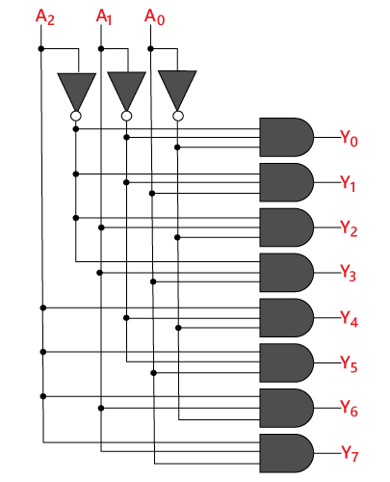
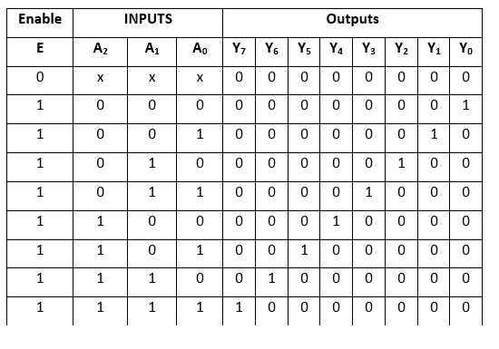
3 to 8 line decoder:
The logical expression of the term Y0, Y1, Y2, Y3, Y4, Y5, Y6, and Y7 is as follows:
Y0=A2'. A1'. A0'
Y1=A2'. A1'.A0
Y2= A2'.A1. A0'
Y3=A2'.A1 . A0
Y4=A2 .A1'. A0'
Y5=A2. A1’. A0
Y6= A2.A1.A0'
Y7=A2.A1 .A0

Slide 52
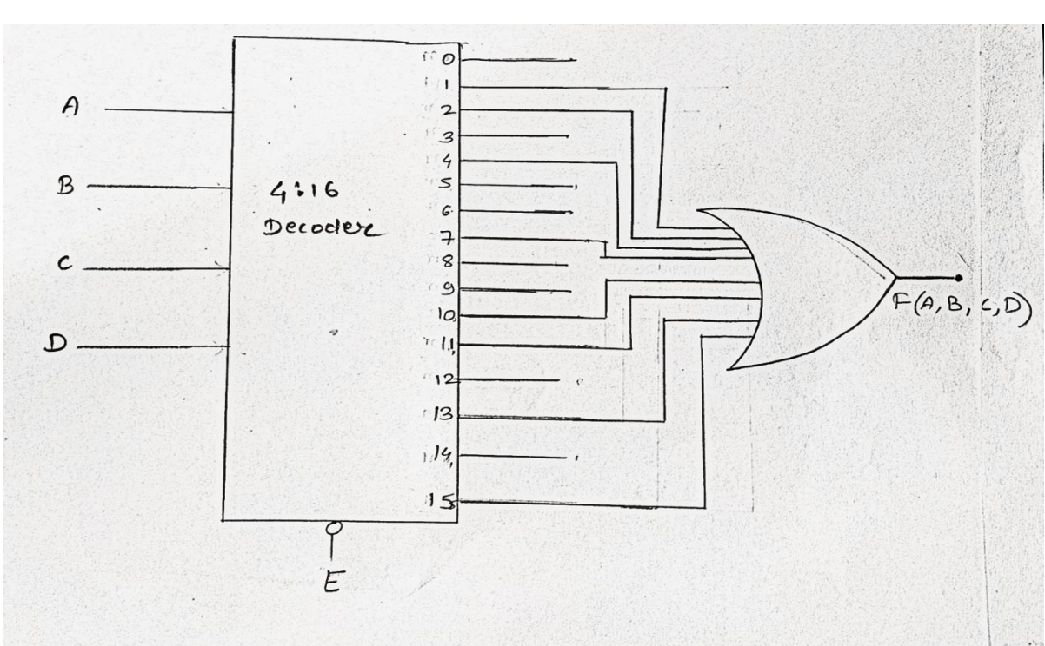
Implement the given Boolean function F(A,B,C,D)= (1,2,4,7,10,11,13,15) using Decoder?
Here the function have 4inputs- A,B,C,D .We will use a 4:16 decoder and an OR gate is used to
implement this function
Thus, the given Boolean function is implemented with decoder and OR gate.

Slide 53
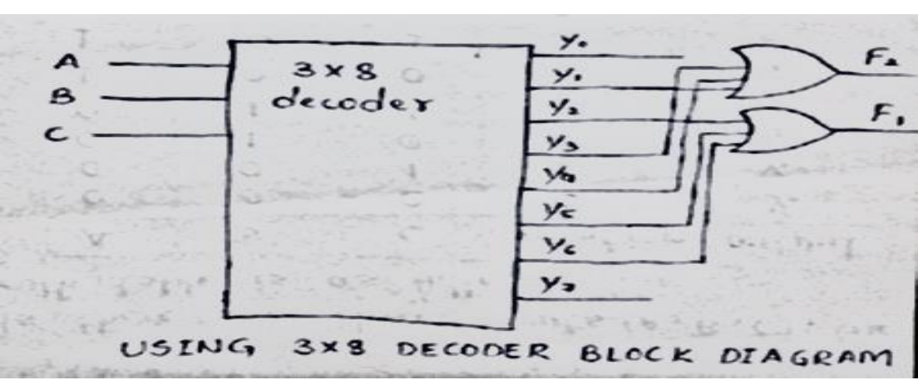
A combinational circuit is specified by the following Boolean function:
f1(A,B,C)=Σm(2,5,6),f2(A,B,C)=Σm(1,3,4).Implement the circuit with a 3x8 decoder and OR gates. Use block diagram for the decoder?

Slide 54
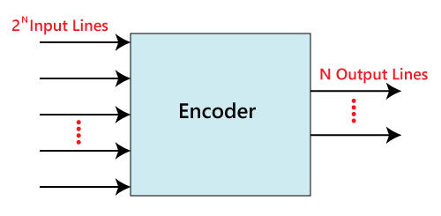
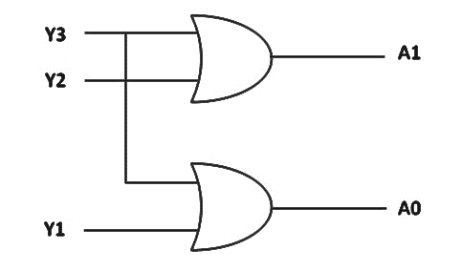
Encoders
The combinational circuits that change the binary information into N output lines are known as Encoders.
.
4 to 2 line Encoder:
Logical expression for A1 and A0
A1 = Y3 + Y2 A0 = Y3 + Y1

Slide 55
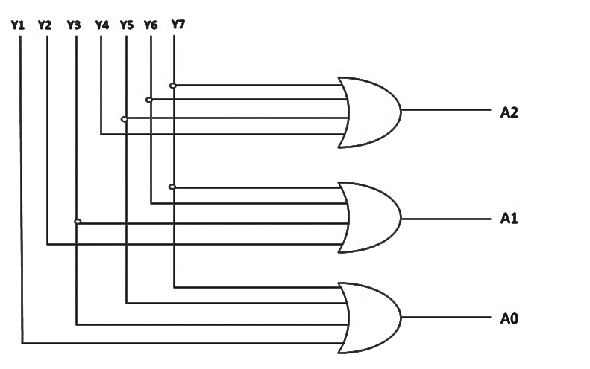
Octal to Binary Encoder (8 to 3 Encoder):
A2 = Y7 + Y6 + Y5 + Y4
A1 = Y7 + Y6 + Y3 + Y2
A0 = Y7 + Y5 + Y3 + Y1

Slide 56
Multiplexer:
Multiplexer is a combinational circuit that has maximum of 2^{n} data inputs, ‘n’ selection lines and single output line. One of these data inputs will be connected to the output based on the values of selection lines.
Multiplexers are also known as data selectors or Mux, many to one circuit.

Slide 57
Types of Multiplexers:
2-1 multiplexer (1select line)
4-1 multiplexer (2 select lines)
8-1 multiplexer (3 select lines)
16-1 multiplexer (4 select lines)

Slide 58
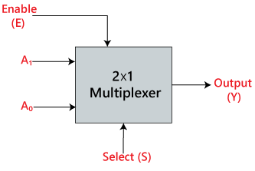
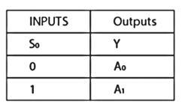
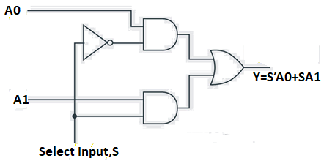
2X1 Multiplexer:
The 2X1 multiplexer’s block diagram and truth table are shown below
Block Diagram Truth Table
Y=S_{o}’A₀+S_{o}A₁

Slide 59
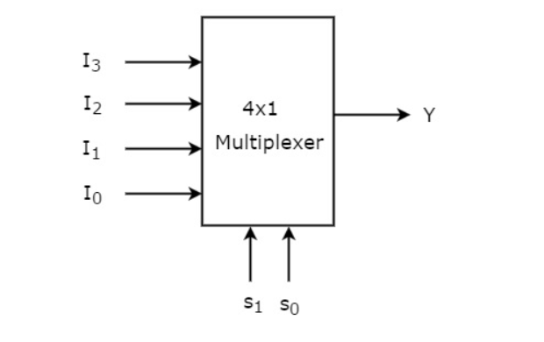
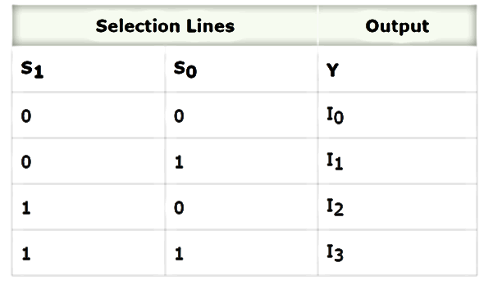
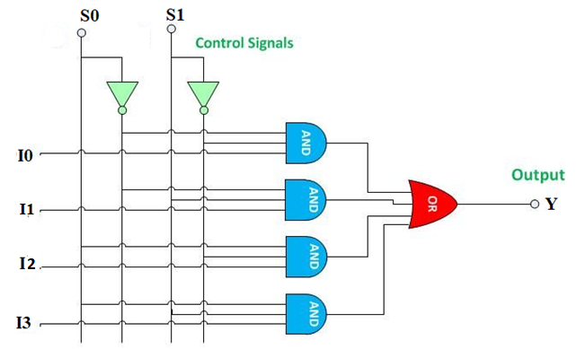
4x1 Multiplexer:
Block diagram Truth Table
Y=S1′S0′I0+S1′S0I1+S1S0′I2+S1S0I3

Slide 60
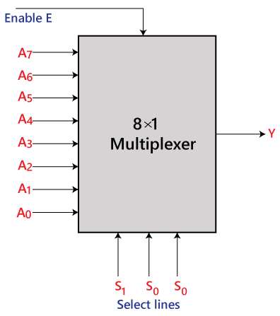
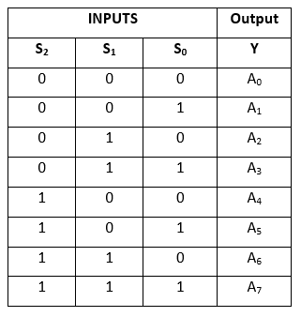
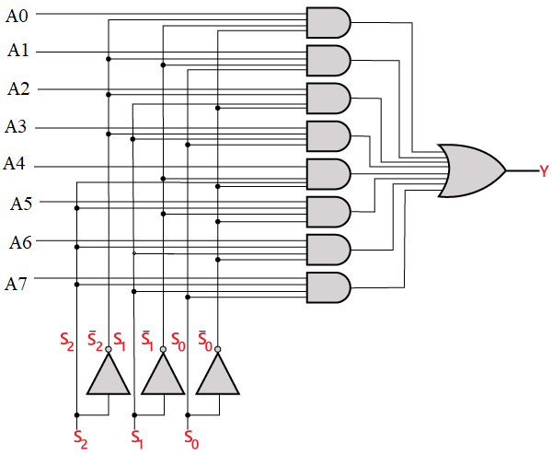
8x1 Multiplexer:
Block diagram Truth Table
Y=S₂'.S₁'.S₀'.A₀+ S₂'.S₁'.S₀.A₁+ S₂'.S₁.S₀'.A₂+ S₂'.S₁.S₀.A₃+ S₂.S₁'.S₀'.A₄+ S₂.S₁'.S₀.A₅+ S₂.S₁.S₀'.A₆+ S₂.S₁.S₀.A₇

Slide 61


Demultiplexer:
There are ‘n’ selection lines, there will be 2^{n} possible combinations of zeros and ones. So, each combination can select only one output. Demultiplexer is also called as De-Mux or Data Distributor.
1x4 Demultiplexer:
1x4 Demultiplexer has one input I, two selection lines, s1 & s0 and four outputs Y3, Y2, Y1 &Y0. The block diagram of 1x4 Demultiplexer is shown in the following figure.
Y0=S1'S0'A
Y1=S1'S0 A
Y2=S1 S0'A
Y3=S1 S0 A

Slide 63


1x8 Demultiplexer:
Block diagram
The logical expression of the term Y is as follows:
Y₀=S₂'.S₀'.S₁'.A Y₄=S_{2.}S₁'.S₀'.A
Y₁=S₂'.S₁'.S₀.A Y₅=S_{2.}S₁'.S_{0.}A
Y₂=S₂'.S₁.S₀'.A Y₆=S_{2..}S₁.S₀'.A
Y₃=S₂'.S₁.S₀.A Y₇=S_{2.}S₁.S₀.A

Slide 64
Truth Table:
The logical expression of the term Y is as follows:
Y₀=S₂'.S₀'.S₁'.A Y₄=S_{2.}S₁'.S₀'.A
Y₁=S₂'.S₁'.S₀.A Y₅=S_{2.}S₁'.S_{0.}A
Y₂=S₂'.S₁.S₀'.A Y₆=S_{2..}S₁.S₀'.A
Y₃=S₂'.S₁.S₀.A Y₇=S_{2.}S₁.S₀.A

Slide 65

Logical circuit:

Slide 66

Implement the function F(ABCD) = ∑m(2,3,4,5,8,9,12)
using a) 16:1 mux b) Using one 8: 1Mux
In the given Boolean expression, there are 4 variables.Hence, 16:1 multiplexer.
So, the mux has 16 input lines, 4 selection lines, and 1 output.
The inputs, corresponding to the min-terms (2,3,4,5,8,9,12) are connected to logic 1 and the
remaining terms to logic 0 (Grounded).
The given input variables are connected as 4 selection lines.
The 16:1 multiplexer can be drawn as follows:

Slide 67

Implementation with 8:1 MUX
In the given boolean expression, there are 4 variables.
Hence, we should use 16:1 multiplexer.
But as per the question, it is to be implemented with 8:1 mux.
For the 8:1 multiplexer, there should be 3 selection lines.
So from the given 4 variables, the 3 least significant variables(B, C, D) are used as selection line
inputs.
Let us derive the eight inputs of the 8:1 multiplexer using the Implementation Table.
The eight inputs are listed column-wise and all the minterms are written under the eight inputs in rows as shown below the implementation table:

Slide 68


