Slide 1
SUACC-IoT: secure unified authentication and access control system based on capability for IoT
BY,
VAMSHIKRISHNA M 191CS261
ANUPUM LAL 191CS209
SHUBANSHU SINGH 191CS250

Slide 2
Introduction
A study reveals the number of IoT devices worldwide would be more than 75 billion by the year 2025
The built-in authentication mechanism in IoT devices is not reliable
IoT have limitations in context-awareness, scalability, interoperability, and security

Slide 3
System
The proposed system, the capability token is generated in the authentication stage.
.The system is based on of capability token which holds the access rights granted to the entity holding it
The system uses only lightweight Elliptic Curve Diffie-Hellman Ephemeral (ECDHE), symmetric key encryption/decryption, message authentication code and cryptographic hash primitives

Slide 4
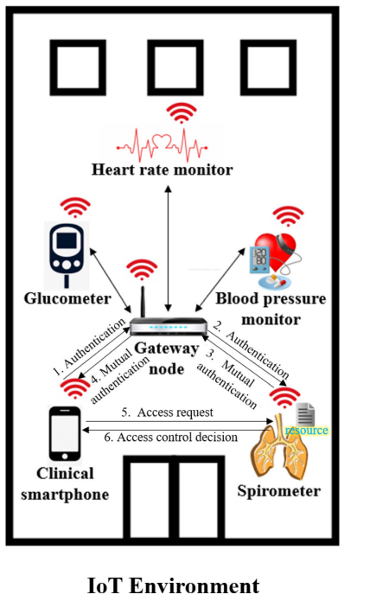
Network model
Two types of mutual authentication take place: 1) between
the device and gateway node and 2) between the devices.
The device (clinical smartphone) requests access to the
resource in the healthcare device. The healthcare device
then grants or denies access based on the access control
rule

Slide 5
proposed protocol is split into three stages:
Setup
Authentication
Access control

Slide 6
set up phase
. The participating entities D1, GWN, and D2 generate their EllipticCurveCryptography (ECC) private and public keys (Pr_Kd1, Pu_Kd1}, {Pr_Kgwn, Pu_Kgwn} and{Pr_Kd2, Pu_kd2}
D1 and GWN individually compute the shared secret key S1 as S1=Pr_Kd1*Pu_Kgwn and S1=Pr_Kgwn *Pu_Kd1. in the same manner GWN and D2 calculae the secret keys.

Slide 7
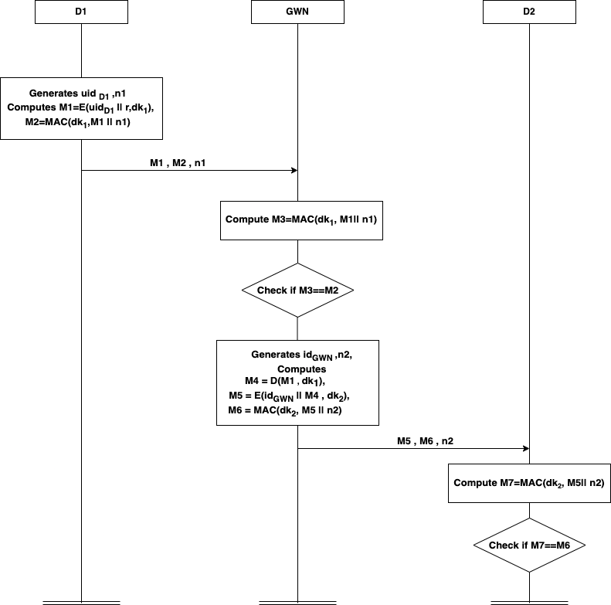
Authentication phase 1

Slide 8
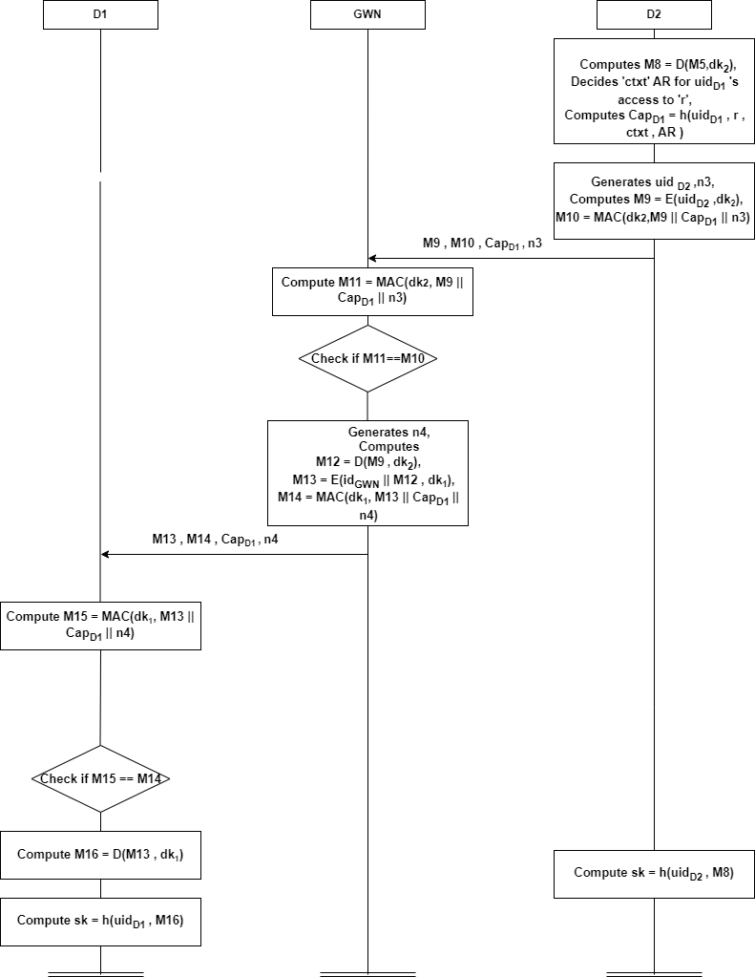
Authentication phase 2

Slide 9
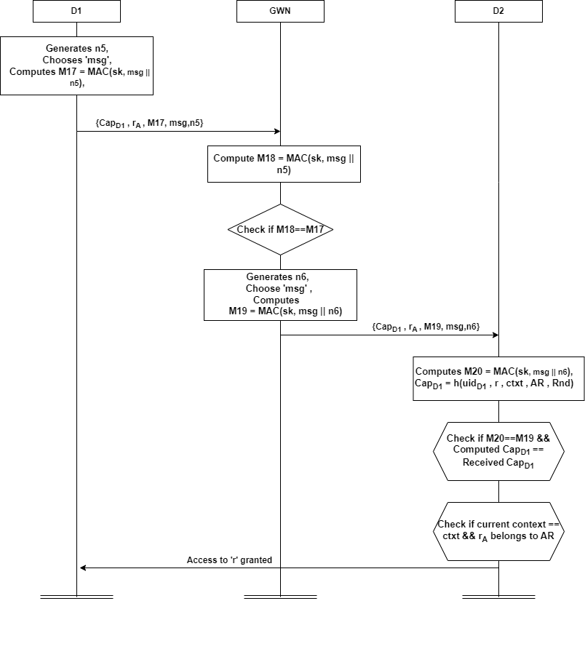
Access control

