Slide 1

DESIGN SENSITIZATION
TEAM: T-C4
Mentor name :NAVEEN REDDY
Mentor Name

Slide 2
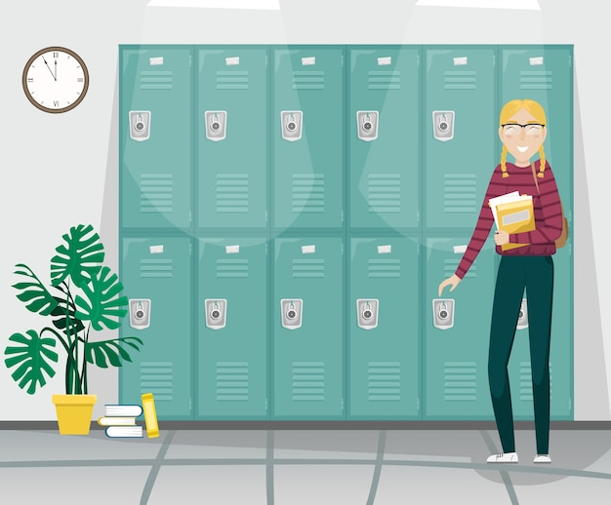
LOCKERS FACILITY

Slide 3
GROUP PICTURE
TEAM MEMBERS :
P.AISHWARYA - 21071A66B7 CSE-AIML B
SHAIK WASEEM AKRAM - 21071A66C2 CSE-AIML B
S.VAMSHI KRISHNA - 21071A05J2 CSE-C
M.SAI KARTHIK - 21071A1235 IT-A
M.GANESH SAI - 21071A1202 IT-A

Slide 4
MISSION STATEMENT
A LOCKER FACILITY IS A COMMON NEED TO EVERY STUDENT IN
THE COLLEGE. PROVIDING LOCKERS WILL BENEFIT MANY STUDENTS AS THEY CAN
STORE THEIR BOOKS , RECORDS AND OTHER IMPORTANT ITEMS IN THE LOCKER
PROVIDED TO THEM.
LOCKERS ARE AN EFFICIENT WAY TO STORE STUDENT’S BOOKS
SO THAT NO STUDENT CAN LOSE THEIR IMPORTANT RECORD AND CLASSWORKS AND
THE BURDEN TO CARRY ALL THE BOOKS IN THE BAG TO HOME AND COLLEGE DAILY WILL
BE REDUCED.

Slide 5
VALUE PROPOSITION
THIS WILL REDUCE THE BURDEN OF CARRYING HEAVY BAGS DAILY TO HOME AND
COLLEGE.
BY PLACINBY PLACING LOCKERS IN THE CAMPUS OF OUR COLLEGE WE CAN BUILD A
SAFER PLACE FOR THE STUDENTS OF NOT LOSING THEIR BOOKS.
G LOCKERS THERE WILL BE DECREASE IN THE NUMBER OF STUDENTS WHO\
LOSE THEIR RECORDS AND CLASSWORKS AT THE TIME OF SUBMISSION WHICH
EVENTUALLY LEADS TO DECREASE IN THE MARKS.
STUDENTS WHO ARE PLAYING SPORTS CAN ALSO STORE THEIR CLOTHES OR
SPORTS EQUIPMENT IN THE LOCKER PROVIDED TO THEM.

Slide 6
ASSUMPTIONS
STUDENTS IN THE CAMPUS ARE FACING PROBLEMS FOR MISPLACING THEIR
BOOKS AND RECORDS.
MANY PEOPLE KEEP THEIR BOOKS UNDER THE DESK OR SOMEWHERE IN THE
CLASS WHICH SOMETIMES LEADS TO STEALING.
STUDENTS CARRY HUGE WEIGHTS IN THEIR BAGS WHICH LEADS TO SHOULDER
AND BACK PAIN AND WITH TIME IT CAN INCREASE TO MAJOR PROBLEM.

Slide 7

STAKE HOLDERS
STUDENTS
PRINCIPLE
MANAGEMENT

Slide 8
USER EMPATHY
Research,Surveys & Interviews and Insights
RESEARCH:
WE SURVEYED AROUND 50-100 STUDENTS IN THE COLLEGE.
WE ASKED THEM ABOUT THE PROBLEMS THEY ARE FACING WITHOUT LOCKERS OR PROPER STORAGE FOR THEIR IMPORTANT ITEMS.
WE ALSO QUESTIONED THEM ABOUT THE IMPORTANCE OF LOCKER AND THE BENEFITS OF HAVING LOCKERS IN THE CAMPUS.

Slide 9
USER EMPATHY SURVEY :
WHAT DO YOU THINK OF PROVIDING LOCKERS FACILITY IN THE COLLEGE?
IF YOU REALLY NEED THIS HOW MUCH SPACE WILL BE SUFFICIENT FOR YOU TO STORE? WHAT CAN BE THE ADVANTAGES OF THIS?
WHAT ARE THE PROBLEMS YOU ARE FACING BECAUSE OF NO LOCKERS IN THE COLLEGE?
WHAT TYPE OF THINGS WILL U STORE IN THE LOCKERS PROVIDED TO YOU?
WHAT WOULD BE THE CONVINIENT LOCATION FOR THE LOCKERS?
ARE YOU FACING PROBLEMS CARRYING ALL THE BOOKS AND THINGS NEEDED DAILY IN YOUR BAG?
DO YOU THINK THERE ARE ANY DISADVANTAGES OF PROVIDING LOCKERS?
ARE THERE ANY SUGGESTIONS FROM YOUR END?

Slide 10
USER EMPATHY INSIGHTS :

Slide 14
LATENT NEEDS
LOCKERS WITH FINGER OR ELECTRONIC PASSWORD PROTECTION(SMART LOCKERS).
DIFFERENT SIZE OF LOCKERS BASED ON DIFFERENT WISHES OF THE STUDENTS.
HANGERS FOR HANGING ITEMS INSIDE THE LOCKERS TO STORE KEYCHAINS ETC.
LOCKERS OF DIFFERENT COLOR CHOICE.
LOCKERS TO STORE HELMETS FOR THE STUDENT WHO COME TO COLLEGE ON 2 WHEELERS.

Slide 15
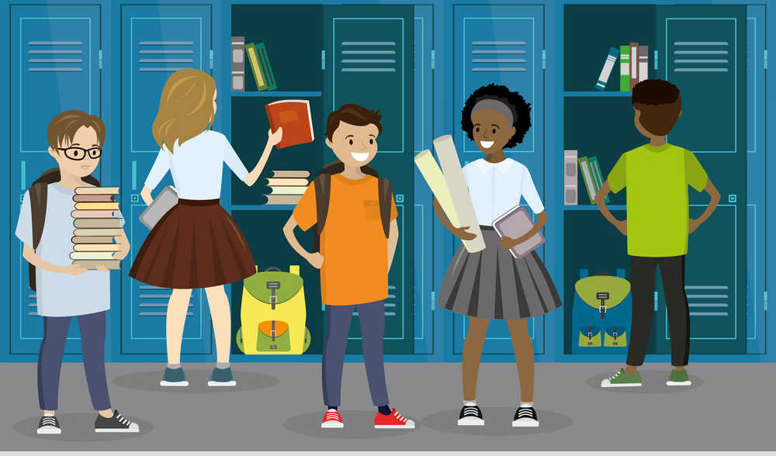

Slide 27


