Slide 1
DIFFIE-HELLMAN
TEAM MEMBERS:
P MADHULIKA - 21071A05H0
SK MAHIMOOD PASHA - 21071A05J1
T VARSHITHA - 21071A05J5
T THANMAYEE - 21071A05J9

Slide 2
INTRODUCTION:
The Diffie-Hellman key exchange algorithm, introduced by Whitfield Diffie and Martin Hellman in 1976, is a groundbreaking cryptographic protocol that addresses the challenge of secure key exchange over untrusted networks. Unlike traditional methods that require pre-shared keys, Diffie-Hellman enables two parties to establish a shared secret key over an insecure communication channel without prior knowledge of each other's keys. The brilliance of Diffie-Hellman lies in its ability to provide a secure means of key exchange, even in the presence of potential adversaries. By allowing parties to collaboratively generate a shared secret key without transmitting it directly, the algorithm ensures confidentiality and security in communication. This two-paragraph introduction sets the stage for exploring the key principles and significance of the Diffie-Hellman key exchange in the realm of contemporary cryptography.

Slide 3
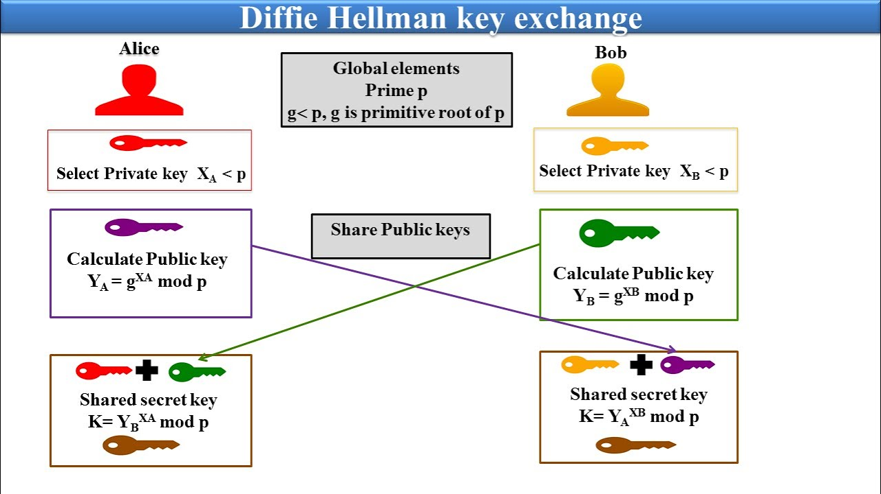
ALGORITHM:

Slide 4
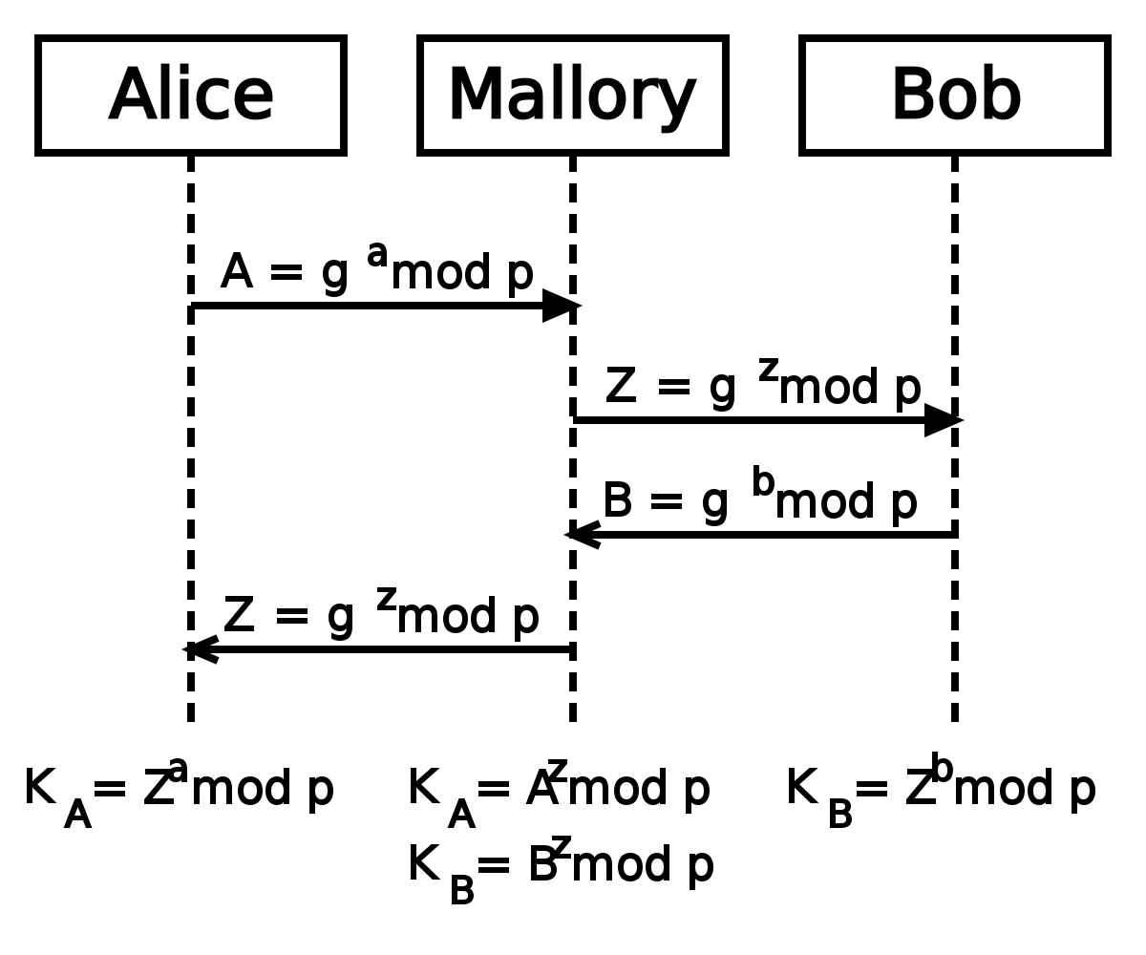
A MAN-IN-THE–MIDDLE-ATTACK

Slide 5
OBJECTIVE:
1.Secure Key Generation:
Facilitate the generation of a shared secret key between two parties in a way that is resistant to eavesdropping or interception.
2. Confidentiality Assurance:
Ensure that the exchanged secret remains confidential, even if intercepted, by using mathematical principles that make it challenging to reverse-engineer.
3. Elimination of Key Distribution Problem:
Provide a solution for secure key exchange without the need for pre-shared secret keys, addressing the challenges associated with key distribution.
4. Eavesdropping Resistance:
Guard against eavesdropping attacks by making it computationally infeasible for an unauthorized third party to deduce the shared secret or private keys.
5. Foundation for Secure Communication:
Establish a foundation for secure communication by enabling the creation of a shared secret key that can be used for subsequent encryption and decryption, ensuring the confidentiality of messages.

Slide 6
SCOPE:
1. Secure Key Exchange in Cryptography:
Diffie-Hellman ensures a secure method for two parties to exchange cryptographic keys over insecure channels, addressing challenges associated with key exchange in cryptography.
2. Confidential Communication in Public Networks:
Applied in public networks, Diffie-Hellman guarantees confidential information exchange, making it ideal for securing communication over potentially vulnerable channels.
3. Foundation for Public-Key Cryptography:
Serving as a cornerstone in public-key cryptography, Diffie-Hellman introduces the concept of independently generated public and private key pairs, influencing modern cryptographic protocols.
4. Key Establishment for Symmetric Encryption:
Diffie-Hellman facilitates the creation of shared secret keys, essential for symmetric encryption and ensuring the confidentiality and integrity of subsequent communication.
5. Influence on Cryptographic Protocols:
Diffie-Hellman's principles have left a lasting impact on various cryptographic protocols, playing a foundational role in secure communication across diverse digital applications.

Slide 7
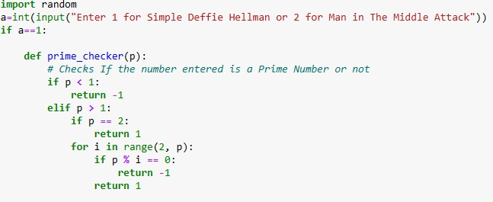
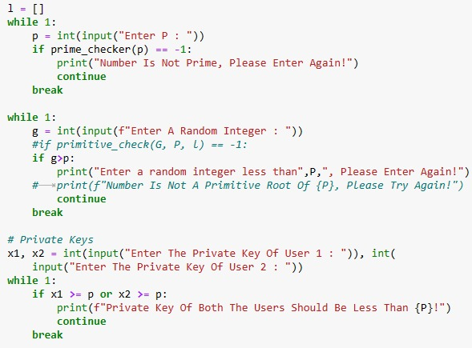
CODE

Slide 8
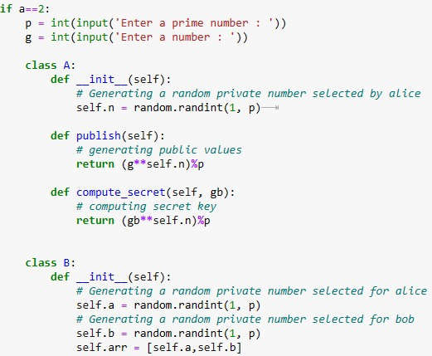
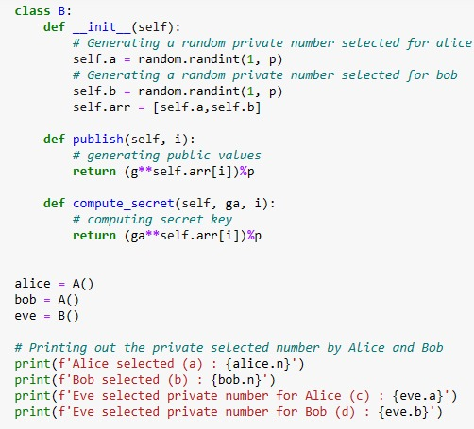
Man In Middle Attack

Slide 9
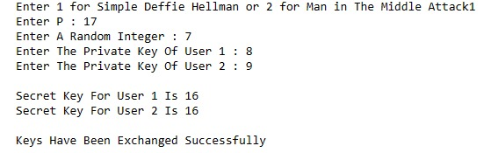
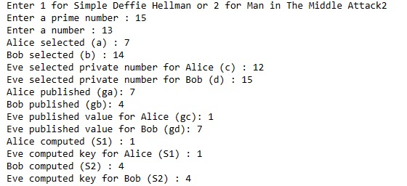
Results

Slide 10
CONCLUSION:
The Diffie-Hellman key exchange is like a secret code-making method for computers. It's super cool because two computers can create a secret code together, even if someone is trying to listen in. This helps keep our online conversations safe. The trick is that they can do this without having to share any secret codes beforehand. This method is so smart that it became a key part of how computers securely talk to each other on the internet. So, Diffie-Hellman is like a superhero for making sure our online chats stay private and secure!

Slide 11


