Slide 1

Dementia Severity Prediction Across Multiple Levels using ML Algorithms

Slide 2
Presentation Overview
Introduction
Problem statement
Business Understanding of the Predictive Model
Dataset Explanation
Dataset Preparation
Exploratory Data Analysis
Models of Decision
Modeling Process
Best Model Selection
Future Scope
‹#›

Slide 3
INTRODUCTION
Global Impact of Dementia
Diagnostic Complexity
Dementia is a prevalent and impactful condition, affecting millions of individuals worldwide.
Diagnosing dementia can be challenging, and there is currently no single definitive test.
Recognizing Dementia
Clinical Approach to Diagnosis
Common symptoms include memory loss, difficulty in communication, impaired judgment,
Healthcare professionals rely Melding Clinical, Medical, and Cognitive Assessments
‹#›

Slide 4
Problem Statement
Develop a predictive model to estimate dementia severity using clinical data. Recognizing the significant number of undiagnosed cases, there's a critical need to utilize machine learning algorithms for early detection. Simplify complex profiles to facilitate early intervention and support in healthcare settings.
‹#›

Slide 5
Business Understanding of the Predictive Model
Enhanced Diagnosis Precision
Reliable diagnostic tools reduce the likelihood of misdiagnoses, providing a more precise understanding of an individual's cognitive health status
Early Intervention & Treatment Planning
Resource Optimization
Efficient allocation of resources allows healthcare providers to focus on specific interventions tailored to individual patient needs.
This contributes to improved patient outcomes and enhances the quality of dementia care.
‹#›

Slide 6
Dataset
Overview
Oasis Cross-Sectional Studies dataset provided by
Open Access Series of Imaging Studies (OASIS)
‹#›

Slide 7
Dataset Explanation
Identification and Demographics
Educational and Socioeconomic Factors
ID: Unique identifier for each record or patient.
M/F: Gender of the patients (Male or Female).
Age: Age of the patients.
Educ: Level of education of the patients.
SES: Socioeconomic status of the patients.
‹#›
5

Slide 8
Dataset Explanation
Cognitive Assessment Scores
Neuroimaging Measures
MMSE: Mini Mental State Examination score is a brief and widely used cognitive screening tool to assess various aspects of cognitive function
eTIV : Estimated Total Intracranial Volume
nWBV : Normalized Whole Brain Volume
ASF : Atlas Scaling Factor
‹#›
5

Slide 9
Dataset Explanation
Dominant Hand Information
Dementia Severity Target
Hand : Represents the dominant hand of the patients (Right or Left)
CDR: Clinical Dementia Rating, the target variable indicating the severity of dementia
‹#›
5

Slide 10
Dataset Preparation
Data Collection
Data Cleaning
Data Transformation
Gather diverse MRI scans and clinical data from sources like the OASIS public archive to cover varying levels of dementia severity.
Address missing values and outliers to ensure data integrity and prevent bias in the model
Normalize/standardize numerical features for consistent model training.
‹#›

Slide 11
Dataset Preparation
Data Splitting
Data Encoding
Handling Imbalanced Data
Divide the dataset into training, validation, and testing sets for effective model evaluation.
Convert categorical variables using methods like one-hot encoding or label encoding for machine learning compatibility.
Mitigate imbalances in dementia severity distribution through techniques like oversampling or undersampling.
‹#›

Slide 12
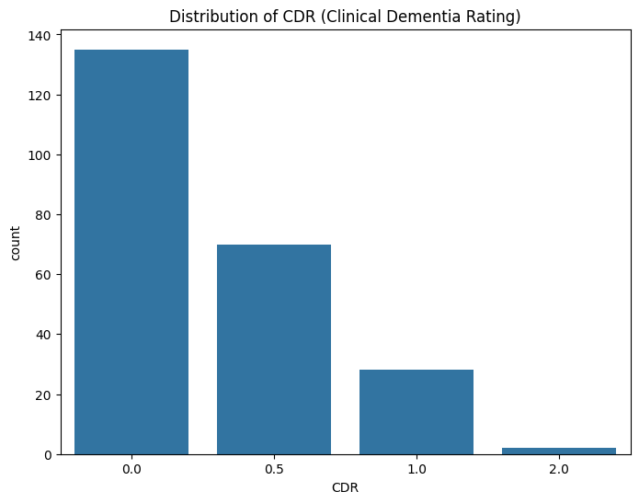
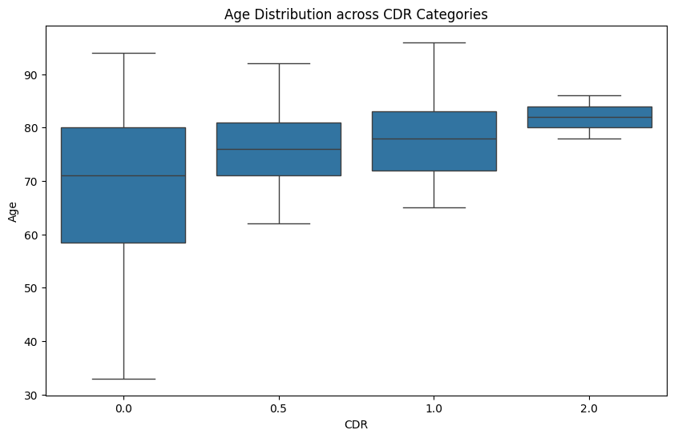
Exploratory Data Analysis
Histogram
Box Plot
‹#›

Slide 13
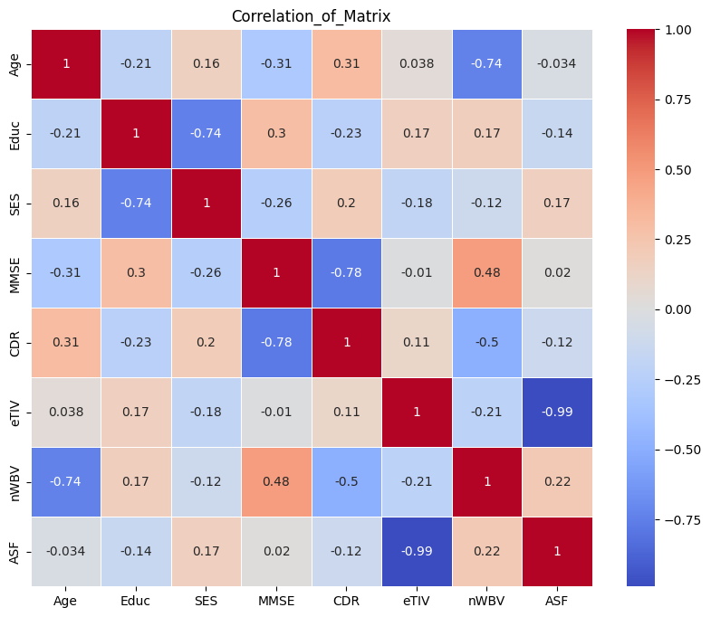
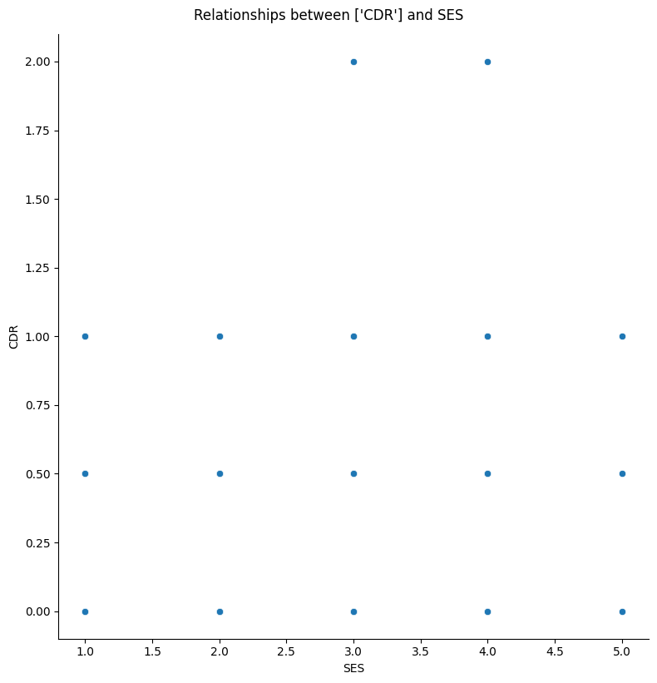
Exploratory Data Analysis
Correlation Matrix
Scatter Plot
‹#›

Slide 14

Bridging Data
and Decision
‹#›

Slide 15
Model’s of Decision
Random Forest Regressor
Linear Regression
Random Forest Classifier
Decision Tree Classifier
‹#›

Slide 16
Modeling Process
Data
Preprocessing
Exploratory Data Analysis
Data Scaling and Splitting
Random Forest Regressor
Linear Regression
Random Forest Classifier
Identify dependent and independent variables.
Analyze the correlation between different variables.
Visualize positive and negative relationships using plots.
Scale features using StandardScaler to standardize the dataset's features onto unit scale (mean = 0 and variance = 1).
Split the data into a training set (80%) and a testing set (20%).
Load data from a CSV file.
Handle missing values by replacing them with the mean of the respective column.
Encode categorical variables into numerical values.
Decision Tree Classifier
‹#›

Slide 17
Modeling Process
Model Selection and Training
Model Evaluation
Data Scaling and Splitting
Random Forest Regressor
Linear Regression
Random Forest Classifier
For Linear Regression: Calculate Mean Squared Error (MSE).
For Decision Tree Classifier: Calculate accuracy and generate a classification report.
Evaluate the results of each model.
Classify predicted values into various levels.
Determine the best model based on evaluation metrics (MSE, accuracy, classification report).
Select models for the task: Linear Regression, Decision Tree Classifier
Train each model using the
fit() function on the scaled
training data.
Decision Tree Classifier
‹#›

Slide 18
Findings in
Linear Regression
Mean Squared Error (MSE)
MSE of 0.0556 suggests a precise fit, aligning model
predictions closely with actual values.
Coefficients Interpretation
'Age' coefficient at -0.000692 indicates a slight negative correlation with Clinical Dementia Rating (CDR)
Intercept Value
Intercept at 5.1449 represents the
predicted CDR when all features are zero.
Protective Factors
Negative coefficients for 'Educ', 'SES', 'MMSE', 'eTIV', 'nWBV', 'ASF'
suggest potential shields against dementia.
‹#›

Slide 19
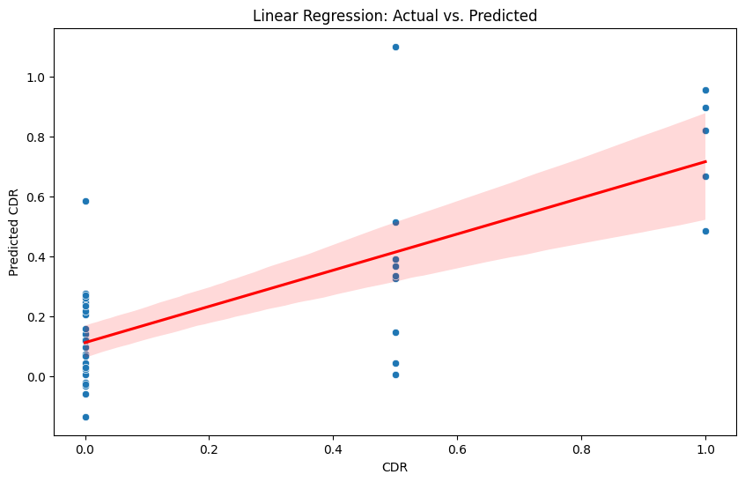
Findings in
Linear Regression
‹#›

Slide 20
Drawbacks in Linear Regression
Assumption of Linearity
Sensitivity to Outliers
Impact: Limits the model's ability to capture non-linear patterns in the data.
Impact: Outliers can disproportionately influence the model, affecting predictions.
‹#›

Slide 21
Findings in Decision Tree Classifier
Precision and Recall
Class-specific precision (e.g., 0.93 for CDR=0) and recall (e.g., 0.83 for CDR=0) provide detailed insights into model efficacy.
Model Accuracy
77% accuracy in predicting dementia severity class
showcases reliable performance
Recall Challenges
Support Analysis
Challenges arise with low recalls, especially for "Mild Dementia" (14%) and none for "Moderate Dementia," revealing limitations in identifying these cases.
Examining the support column reveals the actual occurrences of each class in the test set, providing additional context for model performance
‹#›

Slide 22
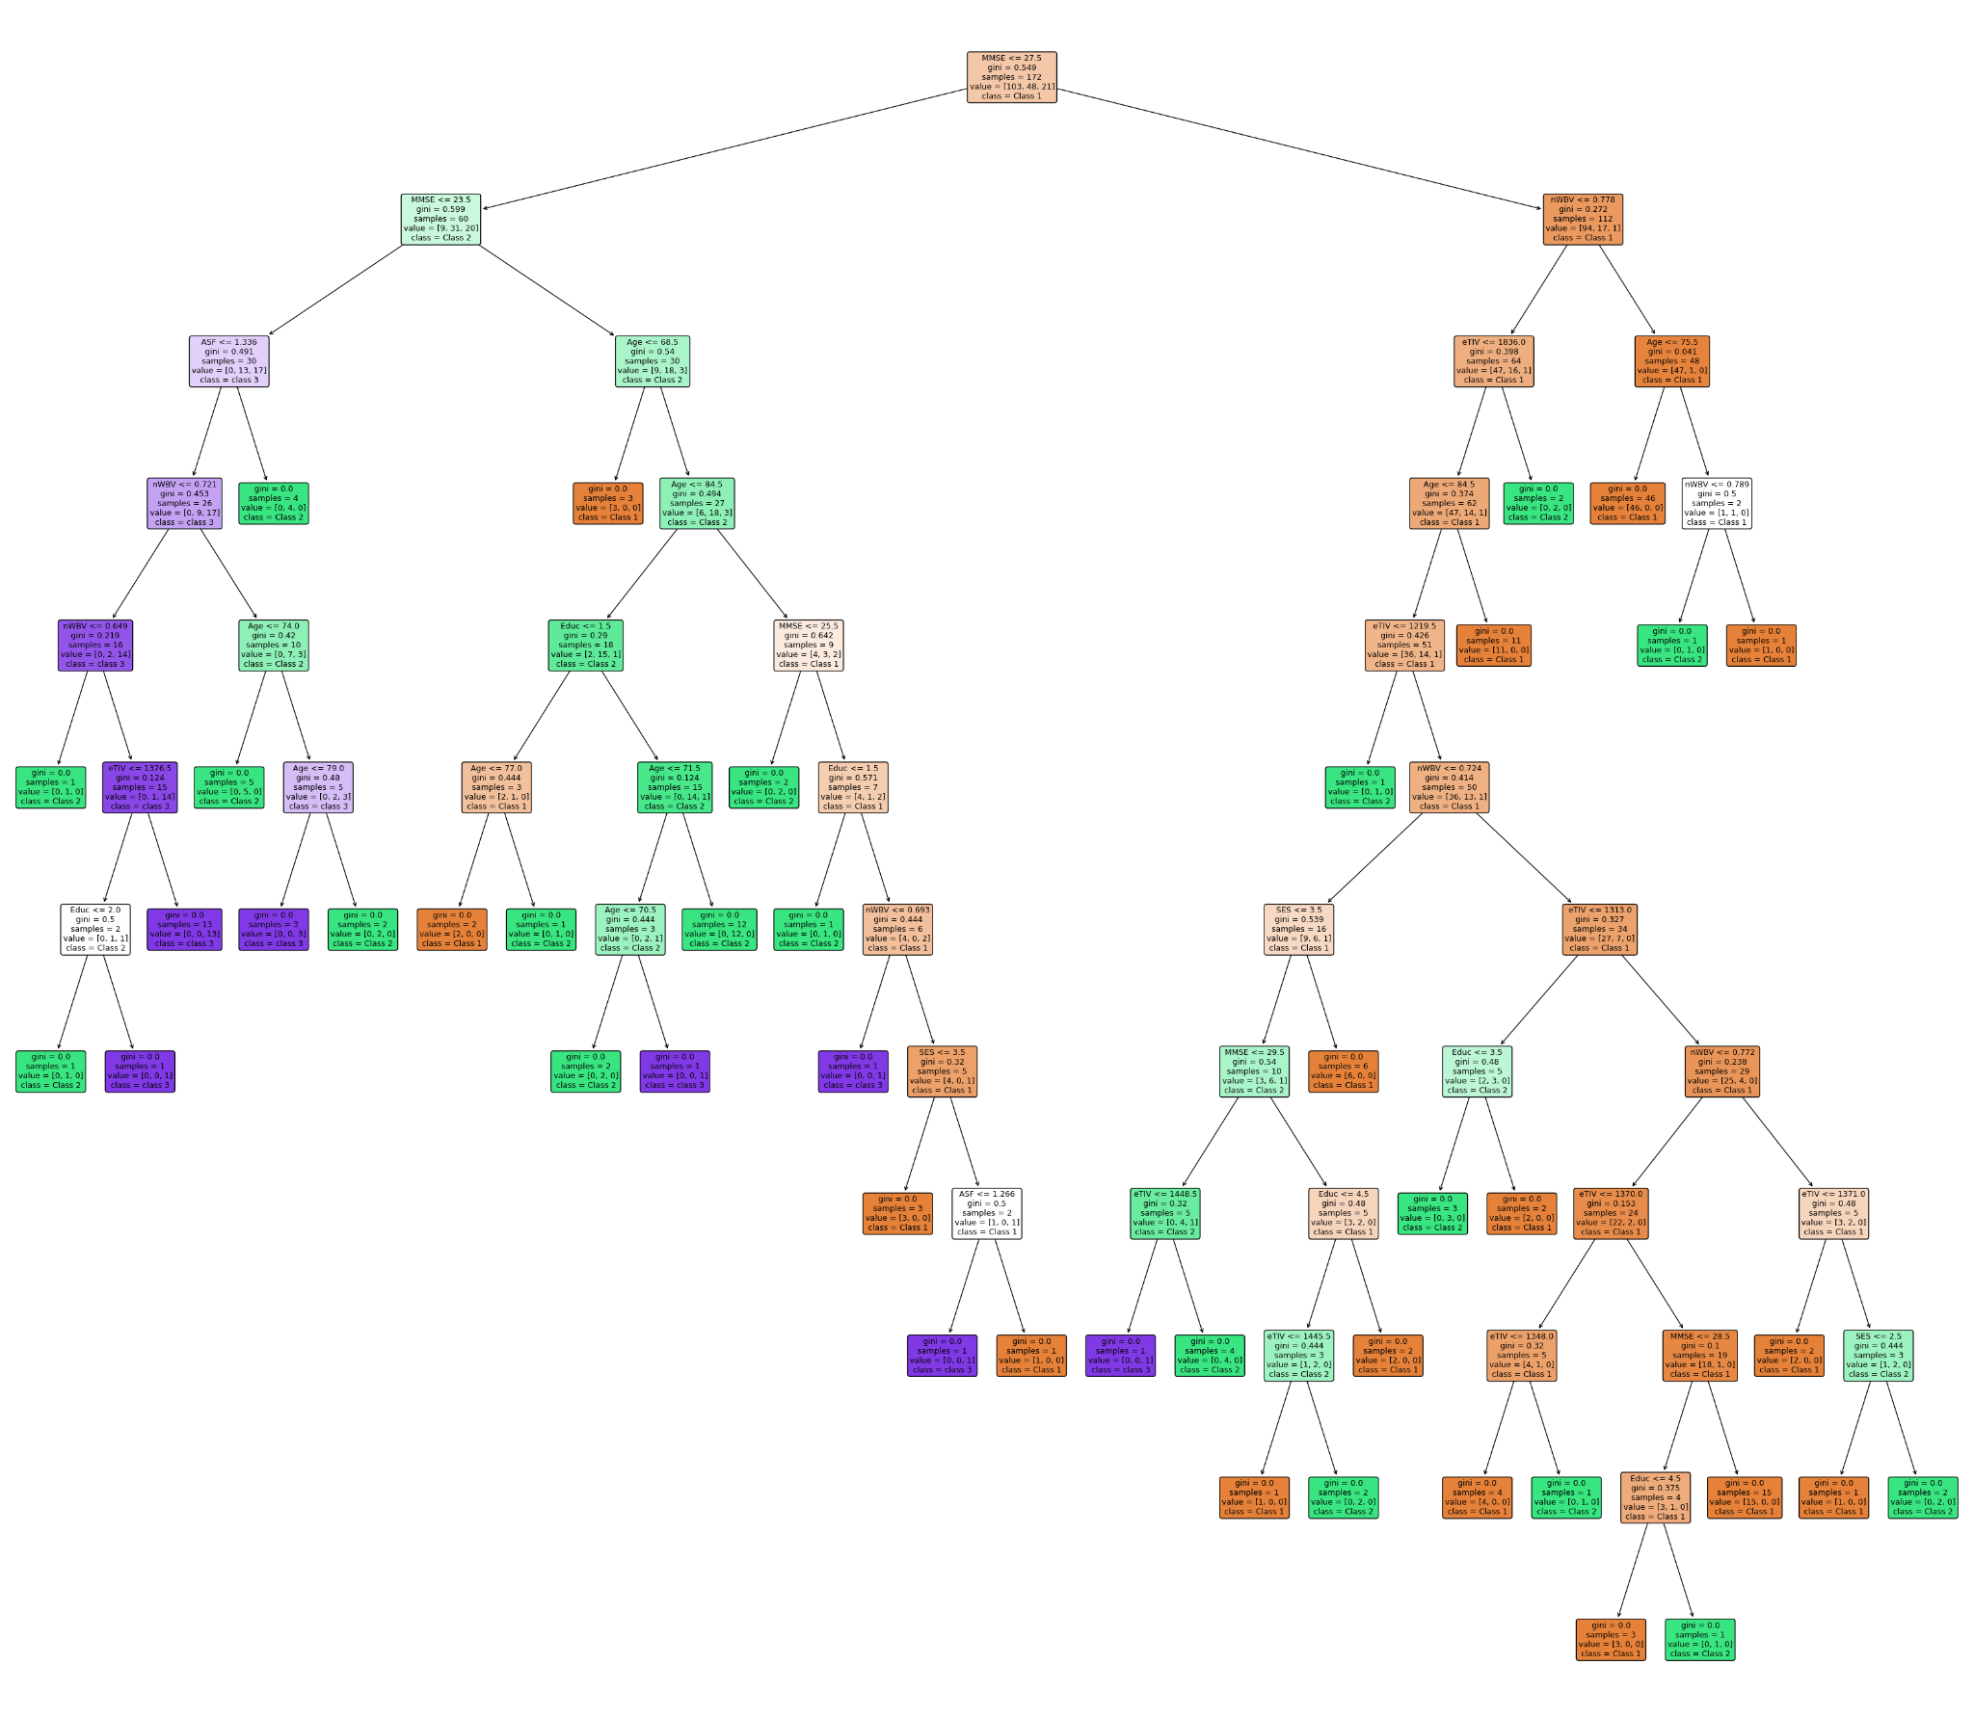
Findings in Decision Tree Classifier
‹#›

Slide 23
Drawbacks in Decision Tree Classifier
‹#›
Prone to Overfitting
Lack of Interpretability for Complex Trees
Impact: Captures noise in the data, reducing the model's generalizability to new, unseen data.
Impact: Difficulty in understanding and explaining intricate decision-making processes.

Slide 24
‹#›
Conclusion of Findings
Evaluation of models
Decision Tree Classifier
Linear
Regression
77% accuracy showcases reliable dementia severity class prediction performance.
A low MSE of 0.0556 indicating a strong fit

Slide 25
Best Model Selection
Decision Tree Classifier
Given the likely non-linear relationships in healthcare data, the Decision Tree Classifier is more suitable for predicting dementia severity in our use case.
‹#›

Slide 26

Future Scope
Collaboration with healthcare professionals to integrate advanced features positions the model for real-world impact.
Incorporating longitudinal data contributes to ongoing advancements in personalized medicine.
‹#›
‹#›

Slide 27
‹#›
THANK YOU
Any Questions?

Slide 28
TEAM MEMBERS AND ROLES
ADTA 5340
GROUP NO: 16
Vishnu Pasula
Data Visualization and exploratory data analysis
Chandana Vemula
Data preprocessing and Model evaluation
Vamshikrishna Thallapelli
Data Algorithms applications and prediction analysis
‹#›

