Slide 1
Fake News Classification
Shasank Reddy Pinnu 23b1015 Sree Vamshi Madhav Nenavath 23b1039
May 3, 2025

Slide 2
Introduction & Problem Statement
This Project of Fake news detection involves classifying articles as Real or
Fake based on their content.
Input Format: Textual content including the Title and Body of the article.
Output:
Real: Verified true news.
Fake: False or misleading news.
Fake News Subclassification: Further classification of fake news into categories.

Slide 3
Example
Input:
Title: The 9/11 Commission Didn’t Believe the Government...
Should We?
Body: 9/11 Commissioners Admit They Never Got the Full Story The 9/11 Commissioners publicly expressed anger at cover ups and obstructions of justice by the government into a real 9/11 investigation: ...
Output:
Classification: Fake
Fake News Subclassification: Conspiracy Theory
So Why

Slide 4
Motivation
Relevance:
The widespread growth of online misinformation and fake news undermines public trust and informed decision-making.
Why This Problem is Interesting:
Involves real-world impact combined with natural language processing. Addresses societal challenges using machine learning techniques.
Applications:
Fake news detection tools to assist media platforms and users. Automated fact-checking systems.
Educational platforms for promoting media literacy.

Slide 5
Prior Work and Inspiration
Paper: A Fake News Detection System based on Combination of Word Embedded Techniques and Hybrid Deep Learning Model
Authors: M. A. Ouassil et al. (IJACSA, 2022)
Summary:
Used a CNN-BiLSTM hybrid model for fake news detection. Combined CBOW and Skip-Gram Word2Vec embeddings.
Evaluated on WELFake dataset with 97.74% accuracy.
Inspiration for Our Approach:
Hybrid CNN-BiLSTM for learning local + sequential features.
Framework adaptable for subclassifying fake news (e.g., conspiracy, satire).

Slide 6
Dataset Overview
Data Format:
Each instance includes: type, title, content, and label
Type | Title (truncated) | Content (truncated) | Label
conspiracy | The 9/11 Commis- | 9/11 Commissioners Admit They | 1
 | sion Didn’t Believe... | Never...
clickbait | Former Watergate | 5545 SHARES Facebook Twit- | 1
 | Prosecutors:... | ter...
hate | Hindu Group Criti- | A Hindu group that regularly... | 1
 | cizes Toronto...
Dataset Statistics: Due to the large size of the dataset, we used a subset of the data for our experiments.
Total Samples: 110,000
Total classes: 11 (10 types of fake, 1 real ) 10,000 samples per class. Training samples: 99,000
Test samples: 11,000
Source: https://github.com/several27/FakeNewsCorpus/

Slide 7
Model Architecture
For the two tasks, we trained two separate models.
Primary Classifier: Classifies articles as Real or Fake. Secondary Classifier: Classifies Fake articles into 10 categories.
Both models share the same architecture with the following components:
GloVe Encoder: Converts text into 100-dimensional GloVe embeddings. CNN Layers: Extract local n-gram features from input embeddings.
BiLSTM: Captures sequential dependencies in both directions (forward and backward).
They only differ at the final Fully Connected (FC) layers, where the number of output classes varies.
The overview of the architecture is:
Content
GloVe Encoder |  | Conv. Layer |  | BiLSTM Layer |  | FC Layers
Label

Slide 8

Model Architecture
Token 1
Token 2
Token 3
Token n
e1
e2
e3
en
GloVe Embedding (frozen)
Conv1D (k=3)
Conv1D (k=5) Conv1D (k=7)
MaxPool + Concatenate
BiLSTM (last timestep)
Concatenate CNN + BiLSTM outputs
Output: 0 / 1
Dropout + Dense + ReLU
Figure: Architecture of CNN + BiLSTM model for Primary classification

Slide 9
Model Architecture Intuition
Two separate models are used to allow the LSTM layers to specialize in learning different feature patterns.
The primary model focuses on separating real and fake samples, capturing generic semantic cues.
The secondary model is trained only on fake samples, allowing it to specialize in distinguishing fine-grained patterns among fake types.
Training models separately ensures that each LSTM captures task-specific temporal dependencies without interference.
This setup improves feature disentanglement, reduces overfitting, and yields better generalization on both classification stages.

Slide 10
Implementation Details and Libraries
Libraries:
torch, torch.nn, torchtext – model and vocab handling
GloVe (6B, 100d) – static embeddings via torchtext.vocab
scikit-learn, seaborn – evaluation metrics (accuracy, F1, confusion matrix)
Model Design (Shared):
Embedding: GloVe-initialized, frozen
CNN: Three 1D conv layers (kernel sizes 3, 5, 7), 100 filters each
BiLSTM: Hidden size = hidden dim, bidirectional
Feature Vector: Concatenated CNN + LSTM outputs → 400-D

Slide 11
Results
Primary Classifier: Achieved a high accuracy of 98%.
Secondary Classifier: Achieved 86% accuracy in identifying one of the 10 fake news types.
Single Unified Model Attempt: We also experimented with a single model trained jointly to perform both tasks.
However, it could only reach around 80% accuracy.
This underperformance highlights the difficulty in jointly optimizing for both coarse (real/fake) and fine-grained (type) classification.

Slide 12
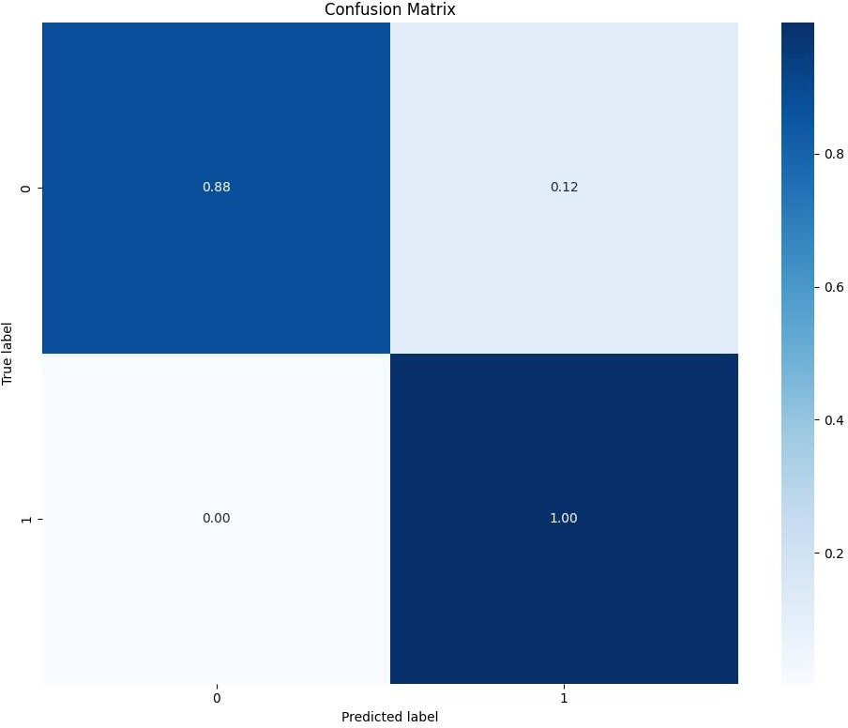
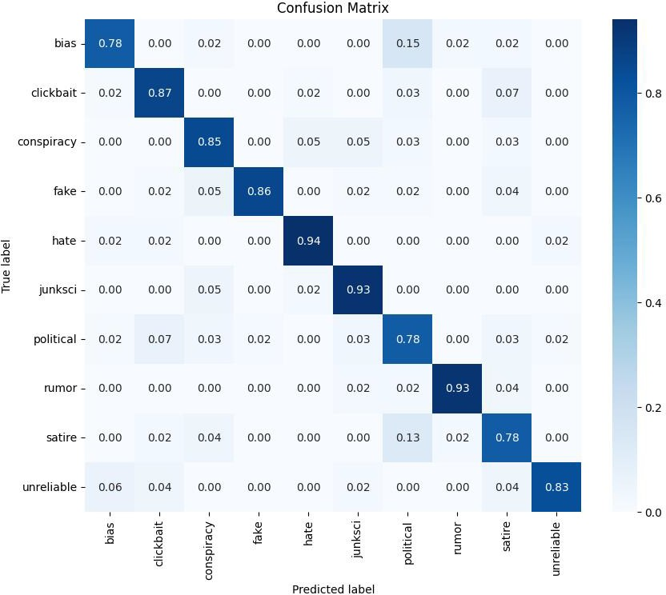
Confusion Matrices
Primary Classifier
Secondary Classifier

Slide 13
Model Analysis
Justification for Two Separate Models:
Primary Model: 97% accuracy
Secondary Model (Subclass Classification): 86% accuracy Combined accuracy of the two models:
1 10
100 − 12 ×
− 14 × = 86.7%
11 11
which is higher than 80%. This justifies the need for separate models as the features required for the primary classifier (real vs fake) and the secondary classifier (subcategories) may differ in the LSTM part.
Note: 1/11 and 10/11 represent the fraction of real and fake data respectively. 12% is the false negative accuracy of primary classsifer and 14% is the inaccuracy of secondary model

Slide 14
Model Analysis
Primary Classifier Confusion Matrix Analysis:
Some true news articles are misclassified as fake (12%) (False Negative).
This could be due to the skewed ratio of the training data. No false articles are classified as true (True Negatives).
This behavior is intentional, as the model is designed to be cynical and
err on the side of tagging content as fake.
Secondary Classifier Confusion Matrix Analysis:
The main source of inaccuracy in the secondary classifier is in classifying articles into political, bias, and satire categories.
These categories are more challenging for the model, as they share overlapping features and often involve subjective interpretation.

Slide 15
Model Analysis
The Primary classifier achieves an accuracy of ∼97%.
This roughly matches the performance reported in the original paper (on the WeLFake dataset).
Despite using a different dataset, similar results indicate strong generalization ability of the model.

Slide 16
Improvements Over Original Model
Baseline (Paper’s Model):
Performs only binary classification – detecting real vs fake. No capability to classify different types of fake samples.
Our Two-Stage Architecture:
Stage 1: Binary classifier (Primary) detects fake vs real.
Stage 2: Multi-class classifier (Secondary) classifies fake samples into subcategories.
Advantages:
Specialized models improve precision and generalization. Better handling of fake subcategories due to focused training. Achieved ∼97% accuracy in Stage 1 and ∼86% in Stage 2.

Slide 17
What We Learned
Understood the theory behind LSTMs and CNNs.
Gained experience on how to improve model performance through trial and error and analysis, like
testing SVM on the features from LSTM outputs,
trying a single model for all 11 classes (fake + real), which led to inferior accuracy compared to the two-stage approach
Got comfortable with PyTorch and torchtext for building NLP models. Used scikit-learn for evaluation; accuracy, F1, confusion matrix.
Built a simple UI with Streamlit to test the model live.

