Slide 1
DBSCAN – Density-Based Spatial Clustering of Applications with Noise
Reference:
M.Ester, H.P.Kriegel, J.Sander and Xu.
A density-based algorithm for discovering clusters in large spatial databases, Aug 1996

Slide 2
DBSCAN
Density-based Clustering locates regions of high density that are separated from one another by regions of low density.
  Density = number of points within a specified radius (Eps)
DBSCAN is a density-based algorithm.
  A point is a core point if it has more than a specified number of points (MinPts) within Eps
    These are points that are at the interior of a cluster
  A border point has fewer than MinPts within Eps, but is in the neighborhood of a core point

Slide 3
DBSCAN
  A noise point is any point that is not a core point or a border point.
  Any two core points are close enough– within a distance Eps of one another – are put in the same cluster
  Any border point that is close enough to a core point is put in the same cluster as the core point
  Noise points are discarded

Slide 4
Border & Core
Outlier
Border
Core
ε = 1unit
MinPts = 5

Slide 5
Concepts: ε-Neighborhood
ε-Neighborhood - Objects within a radius of ε from an object. (epsilon-neighborhood)
Core objects - ε-Neighborhood of an object contains at least MinPts of objects
ε-Neighborhood of p
ε
ε
ε-Neighborhood of q
q
p
p is a core object (MinPts = 4)
q is not a core object

Slide 6
Concepts: Reachability
Directly density-reachable
  An object q is directly density-reachable from object p if q is within the ε-Neighborhood of p and p is a core object.
q is directly density-reachable from p
p is not directly density- reachable from q?
ε
ε
q
p

Slide 7
Concepts: Reachability
Density-reachable:
  An object p is density-reachable from q w.r.t ε and MinPts if there is a chain of objects p₁,…,p_{n}, with p₁=q, p_{n}=p such that p_{i+1}is directly density-reachable from p_{i} w.r.t ε and MinPts for all 1 <= i <= n
q is density-reachable from p
p is not density- reachable from q?
Transitive closure of direct density-Reachability, asymmetric
q
p

Slide 8
Concepts: Connectivity
Density-connectivity
  Object p is density-connected to object q w.r.t ε and MinPts if there is an object o such that both p and q are density-reachable from o w.r.t ε and MinPts
P and q are density-connected to each other by r
Density-connectivity is symmetric
q
r
p

Slide 9
Concepts: cluster & noise
Cluster: a cluster C in a set of objects D w.r.t ε and MinPts is a non empty subset of D satisfying
  Maximality: For all p, q if p ∈ C and if q is density-reachable from p w.r.t ε and MinPts, then also q ∈ C.
  Connectivity: for all p, q ∈ C, p is density-connected to q w.r.t ε and MinPts in D.
  Note: cluster contains core objects as well as border objects
Noise: objects which are not directly density-reachable from at least one core object.

Slide 10
(Indirectly) Density-reachable:
p
p₁
q
Density-connected
p
q
o

Slide 11
DBSCAN: The Algorithm
  select a point p
  Retrieve all points density-reachable from p wrt ε and MinPts.
  If p is a core point, a cluster is formed.
  If p is a border point, no points are density-reachable from p and DBSCAN visits the next point of the database.
  Continue the process until all of the points have been processed.
  Result is independent of the order of processing the points

Slide 12
An Example
MinPts = 4
ε
C₁
C₁
ε
ε
C₁

Slide 13
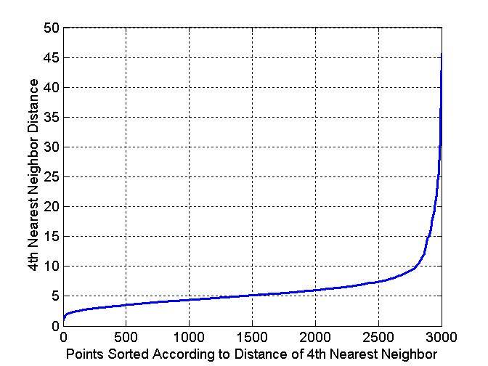
DBSCAN: Determining EPS and MinPts
Idea is that for points in a cluster, their k^{th} nearest neighbors are at roughly the same distance
Noise points have the k^{th} nearest neighbor at farther distance
So, plot sorted distance of every point to its k^{th} nearest neighbor

Slide 14
DBSCAN: Determining EPS and MinPts
Distance from a point to its k^{th} nearest neighbor=>k-dist
For points that belong to some clusters, the value of k-dist will be small if k is not larger than cluster size
For points that are not in a cluster such as noise points, the k-dist will be relatively large
Compute k-dist for all points for some k
Sort them in increasing order and plot sorted values
A sharp change at the value of k-dist that corresponds to suitable value of eps and the value of k as MinPts

Slide 15
DBSCAN: Determining EPS and MinPts
A sharp change at the value of k-dist that corresponds to suitable value of eps and the value of k as MinPts
  Points for which k-dist is less than eps will be labeled as core points while other points will be labeled as noise or border points.
If k is too large=> small clusters (of size less than k) are likely to be labeled as noise
If k is too small=> Even a small number of closely spaced that are noise or outliers will be incorrectly labeled as clusters

