Slide 1

NESTIFY
JAYA PRAKASH NARAYAN COLLEGE OF ENGINEERING
Presented by:
Under the guidance of
Miss.Noohi Sadiya
Zoha Zainab (22266-cs-032)CSE
V. Vamshi Raju (22266-cs-008)CSE
K. Sreenu Nayak (22266-cs-009)CSE
T. Anil Kumar (22266-cs-011)CSE
1

Slide 2
Contents
Abstract
Introduction
Existing System
Proposed System
Comparison of Existing and Proposed System
System Requirements
Concept Explanation
Application and Future Enhancement
Conclusion
References
Screenshots
Sample Coding
2

Slide 3
ABSTRACT
Nestify is a house rental platform designed to help students and professionals to find house and shared accommodations.
It provides secure, real-time, owner details with no brokers or subscription fees.
Nestify bridges the gap between landlords and tenants through a digital platform.
3

Slide 4
INTRODUCTION
Finding suitable accommodation is difficult due to high costs, limited access, and scams.
Nestify offers a simple, affordable, and secure solution for sellers, renters and buyers.
It is designed for students and young professionals who often move to new cities and need quick, safe, and affordable housing.
4

Slide 5
EXISTING SYSTEM
Platforms like NoBroker, 99acres, and MagicBricks help users find rental properties.
They provide filters, contact options, and some verification.
However, they are not always affordable, complete, or safe.
They charge amount per house to show property details in their platforms.
5

Slide 6
PROPOSED SYSYTEM
Nestify is a responsive platform for direct connection between tenants and landlords without middleman.
We offer many categories based on user requirement.
Features are providing full details, no-cost usage, and real-time availability.
Focus on Student hostels and Real estate deals.
6

Slide 7
COMPARISON OF EXISTING AND PROPOSED SYSTEM
EXISTING SYSTEM
PROPOSED SYSTEM
Subscription costs
Broker involvement
Outdated listings
Limited categories
No-cost usage
No-Brokerage
Real-time updates
More categories such as real estate & hostel
7

Slide 8
SYSTEM REQUIREMENTS
Frontend: HTML, CSS, JavaScript
Backend: PHP, MySQL
Server: Xampp Server
Browser: Chrome or Edge
OS: Windows
8

Slide 9
PROBLEM STATEMENT
Students and professionals face difficulty finding affordable, verified houses.
Existing platforms are more expensive and dominated by broker cost.
There is a clear need for a secure, broker-free, and user-friendly platforms.
9

Slide 10
ARCHITECTURE DIAGRAM
User
List Data
Fetch Data
Database
Display
10

Slide 11
METHODOLOGY AND ALGORITHM
User registration and login by data verification.
We use hashed password in user database.
Property list with owner details securely.
Website use basic SQL query Algorithms to fetch property data based on user input.
Property data is deleted from the database after confirmation of rent or purchase.
11

Slide 12
MODULES EXPLANATION
User Module – Registration, login, profile management
Rent Module – list or rent house directly
PropertyConnect – list or buy property effortlessly
Feedback Module – where user share their opinion.
12

Slide 13
APPLICATION & FUTURE ENHANCEMENT
Applications: Used by students, job seekers, and professionals for house searching and sellers.
Future Enhancements:
Mobile app integration
AI-based recommendations
Multi-language support
Online payment
13

Slide 14
CONCLUSION
Nestify simplifies sell, rent & buying a house by removing middlemen and reducing costs.
It offers a secure, accessible, and user-friendly platform for shared accommodation.
It facilitates the buying and selling of real estate, including land apartment and other residential properties.
14

Slide 15
REFERENCES
http://www.nobroker.in/
http://www.magicbricks.com/
http://www.JustDeal.com/
15

Slide 16
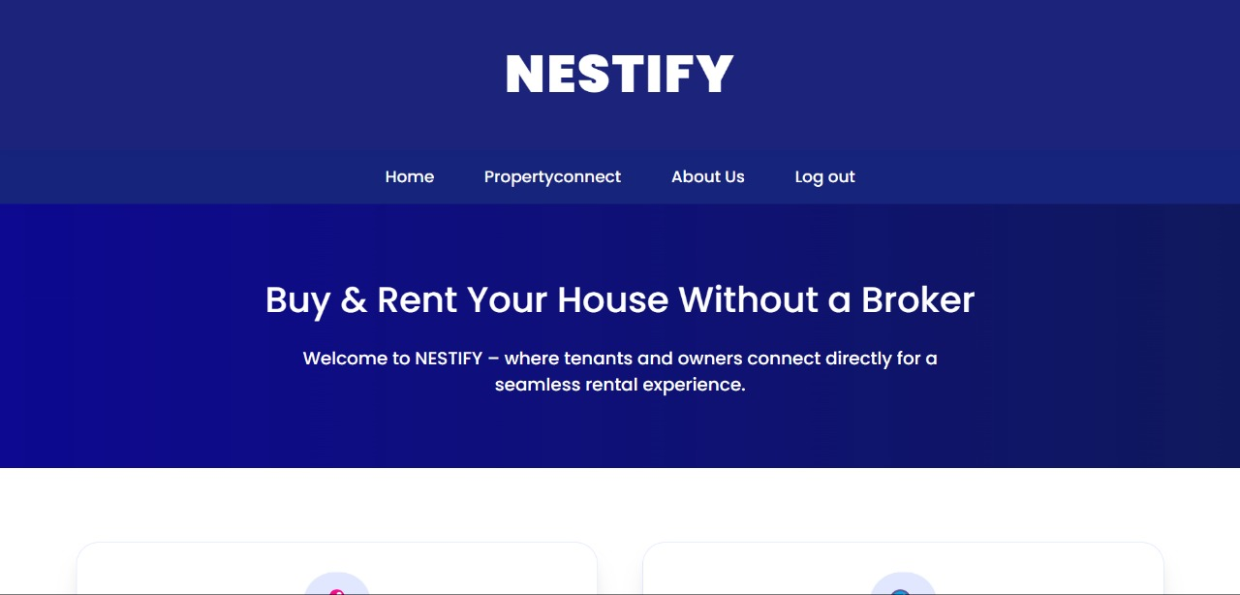
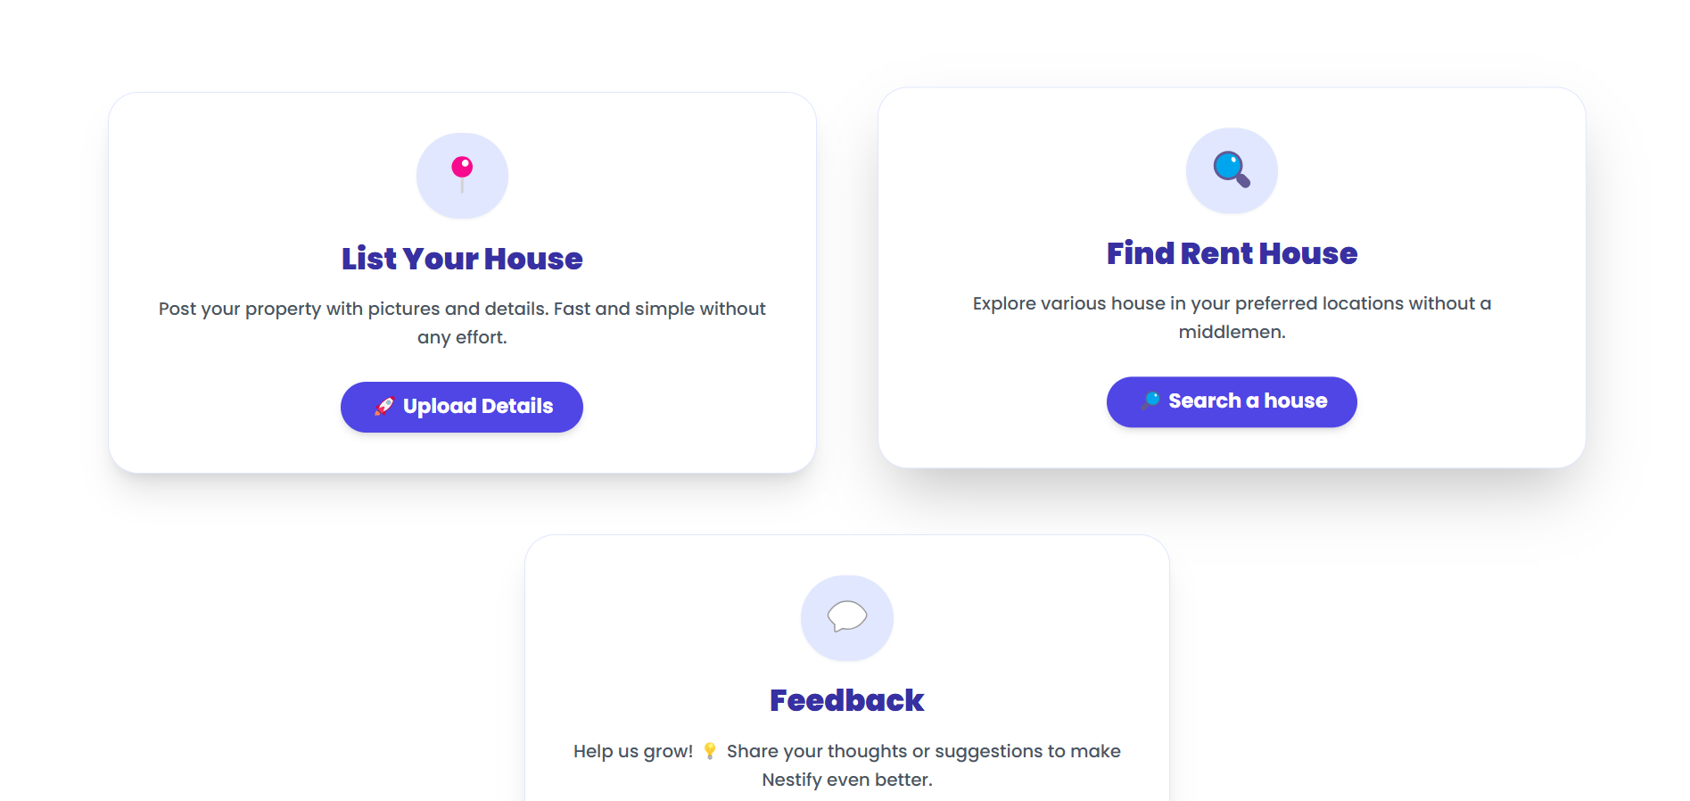
SCREENSHOTS
HOME PAGE
FEATURES
16

Slide 17
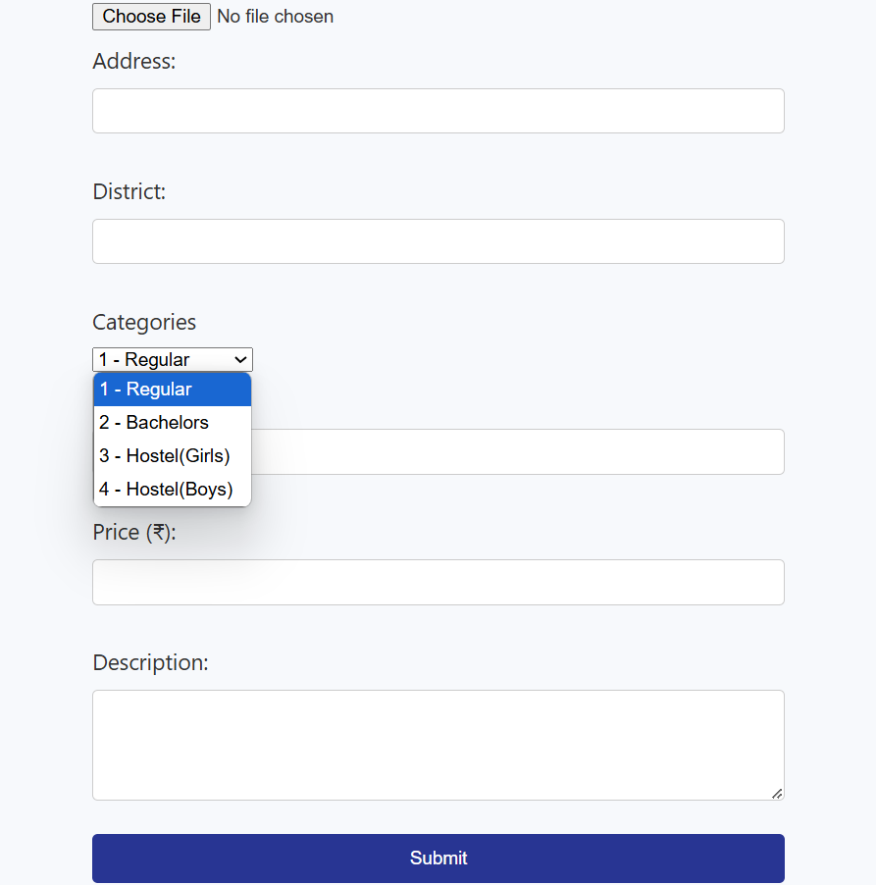
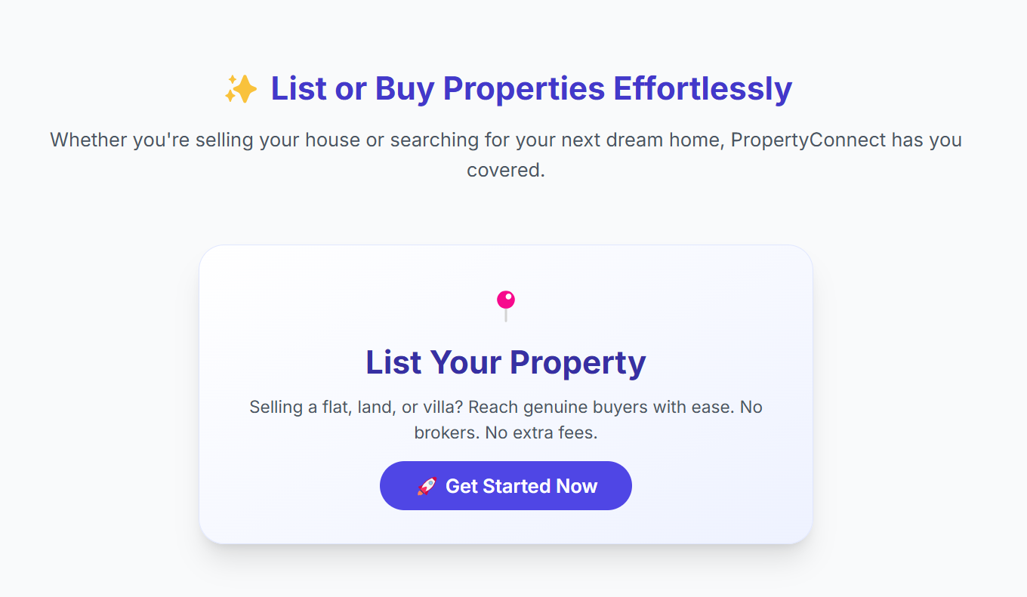
LISTING DETAILS
SUBMIT DETAILS
17

Slide 18
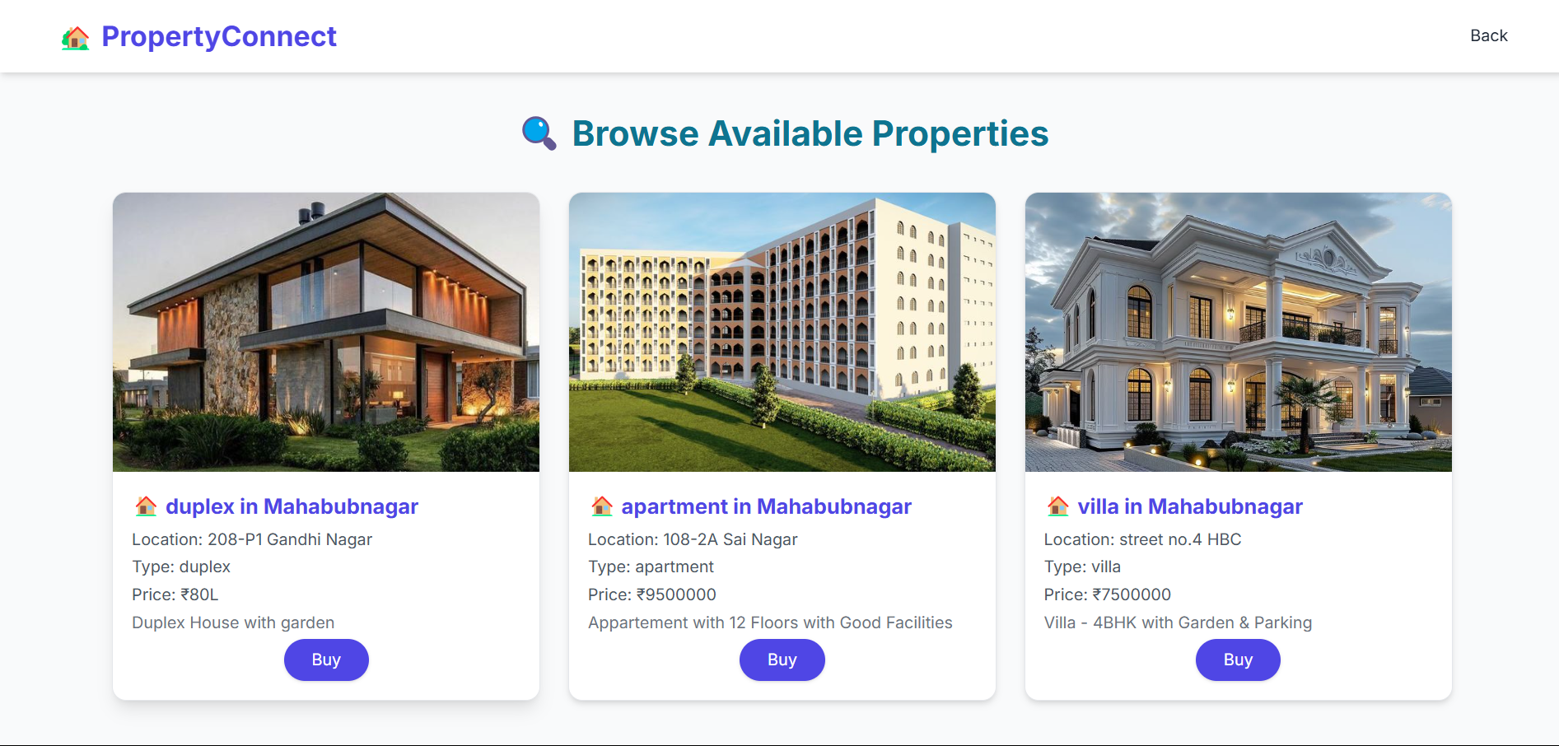
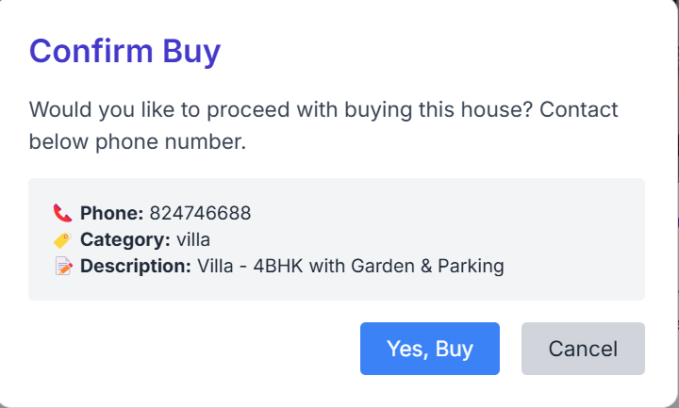
PROPERTY DETAILS
CONFIRM BUY
18

Slide 19
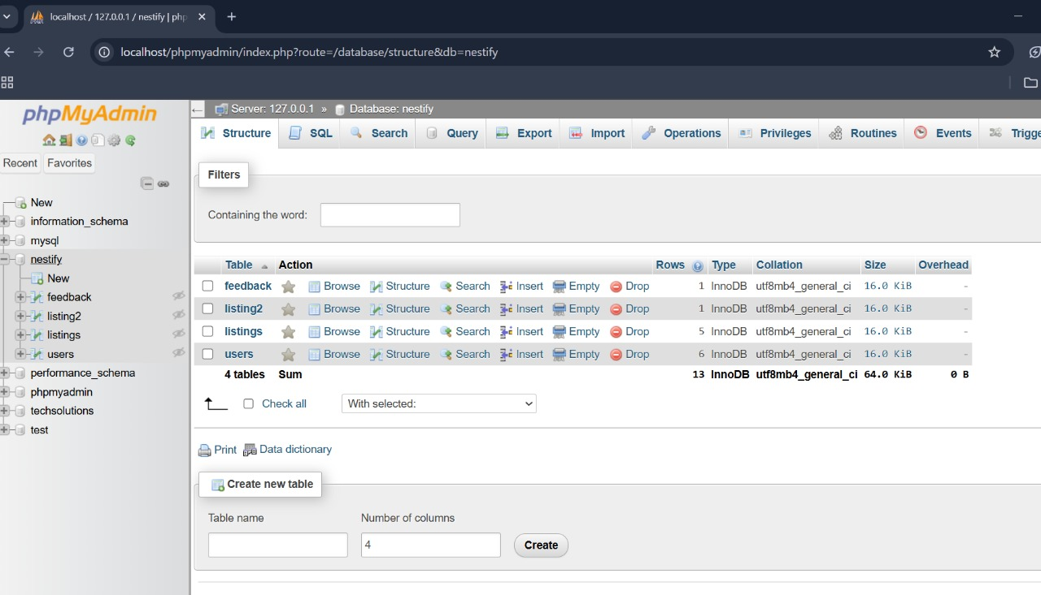
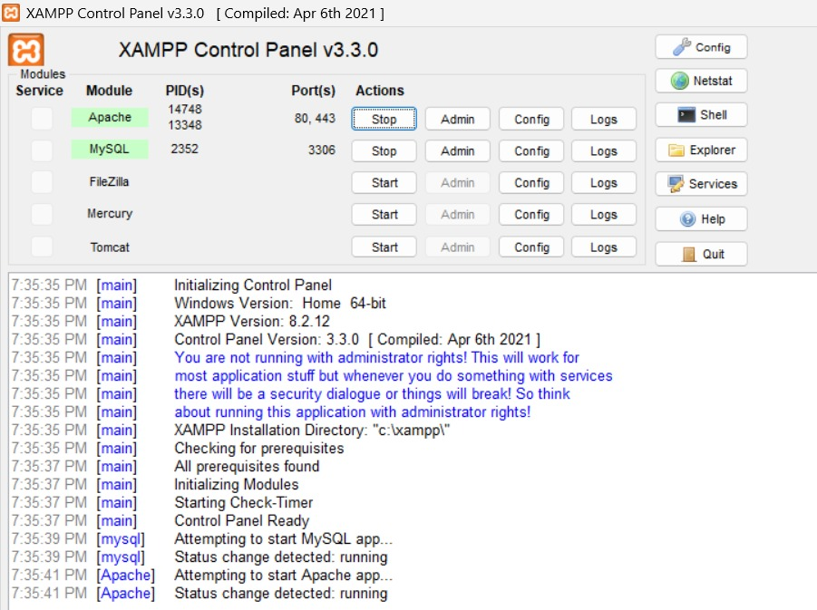
DATABASE
XAMPP CONTROL PANEL
19

Slide 20
SAMPLE CODING
LOGIN
<!DOCTYPE html>
<html lang="en">
<head>
<meta charset="UTF-8">
<meta name="viewport" content="width=device-width, initial-scale=1.0">
<title>Document</title>
<link rel="stylesheet" href="style.css">
</head>
<body>
<h1 class="form-title">Register</h1>
<div class="input-group">
<i class="fas fa-envelope"></i>
<input type="email" name="email" id="email" placeholder="Email" required>
<?php
if (isset($errors['email'])) {
echo '<div class="error">
<p>' . $errors['email'] . '</p>
</div>';
unset($errors['email']);
}
?>
</div>
</body>
</html>
20

Slide 21
Property listing
<?php
require_once 'dbConnect.php';
session_start();
if ($_SERVER["REQUEST_METHOD"] == "POST") {
$address = $_POST['address'];
$city = $_POST['city'];
$type = $_POST['type'];
$phone = $_POST['phone'];
$price = $_POST['price'];
$description = $_POST['description’];
else {
echo "<script>document.getElementById('message').innerText = 'Database error!';</script>";
}
}
?>
21

Slide 22
Database connection code to Xampp server
<?php
$host = "localhost";
$dbname = "nestify";
$username = "root";
$password = "";
try {
$pdo = new PDO(
"mysql:host=$host;dbname=$dbname;charset=utf8",
$username,
$password,
PDO::ATTR_ERRMODE => PDO::ERRMODE_EXCEPTION, // Enable error reporting
PDO::ATTR_DEFAULT_FETCH_MODE => PDO::FETCH_ASSOC, // Fetch results as an associative array
PDO::ATTR_EMULATE_PREPARES => false // Disable emulation for security
);
} catch (PDOException $e) {
die(" Database connection failed: " . $e->getMessage());
}
?>
22

Slide 23
THANK YOU
23

