Slide 1
Assisted Service Module
Presented by,
Vamshi Vushakola(082085)

Slide 2
Objective
Assisted Service Module (ASM)
What it is?
What does it do?
What it is for?
Why it is so cool?

Slide 3
THE ASM – WHAT IT IS?
It enables ASM employees to provide time customer sales support to the customer.
It allows a customer to finish remainder of their work, by pairing them with customer sales and service support personnel in real-time using the same storefront, with little additional effort.
For example, When a customer gets stuck with making a purchase their account, they contact customer sales and service support person and give them their cart ID number or account name.
In simple term, we can say it is set forms that are launched and set up on our storefront.

Slide 4
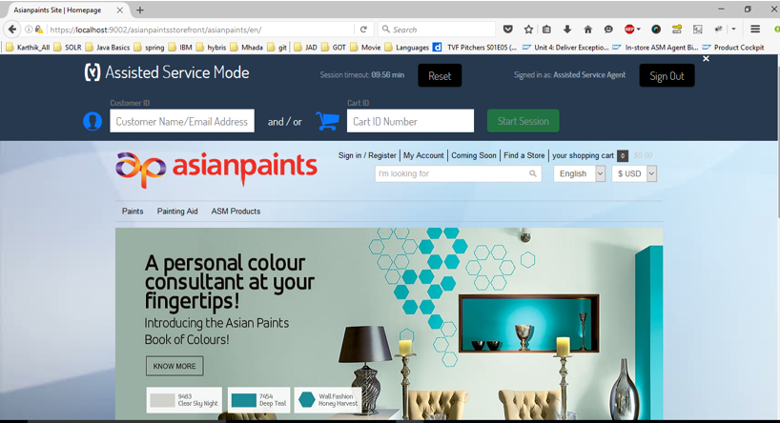
Cont..

Slide 5
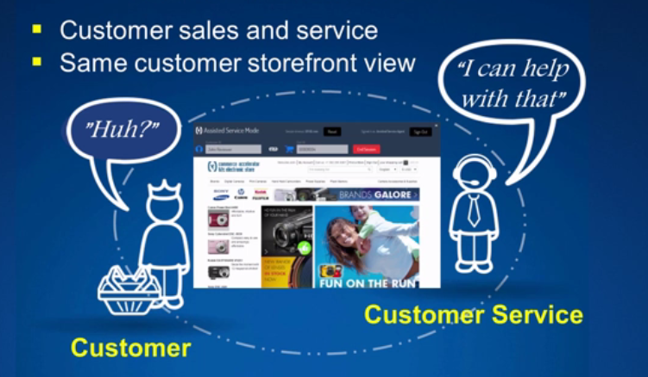
WHAT DOES IT DO?
It provides real time customer sales and service support using same storefront

Slide 6
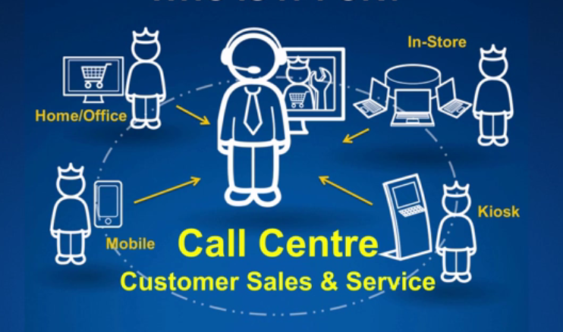
WHO IS IT FOR?
B2C

Slide 7
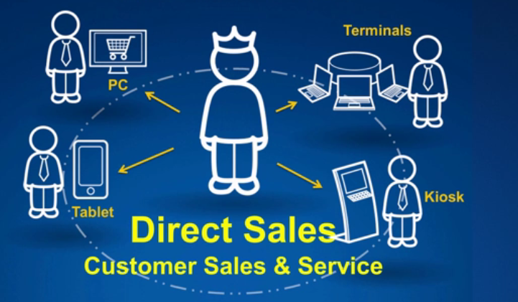
B2C

Slide 8
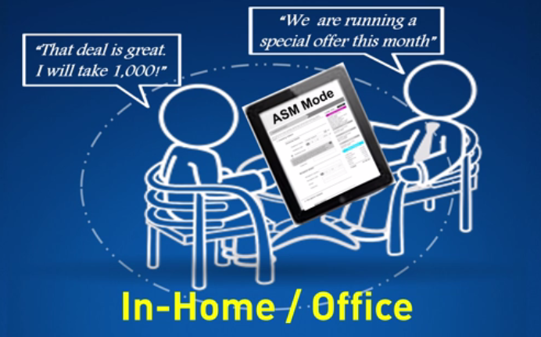
B2B

Slide 9
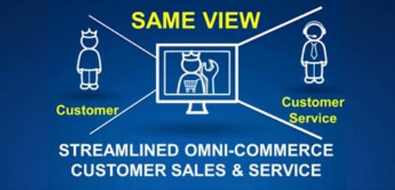
WHY IT IS SO COOL?
Firstly by providing sales and service support using same storefront view for customer users. Provides seamless Omni-commerce customer sales and service experience.

Slide 10
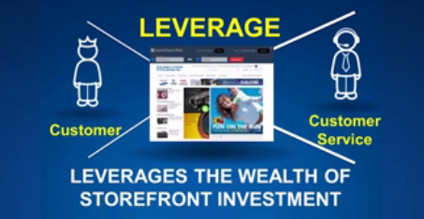
Cont..

Slide 11
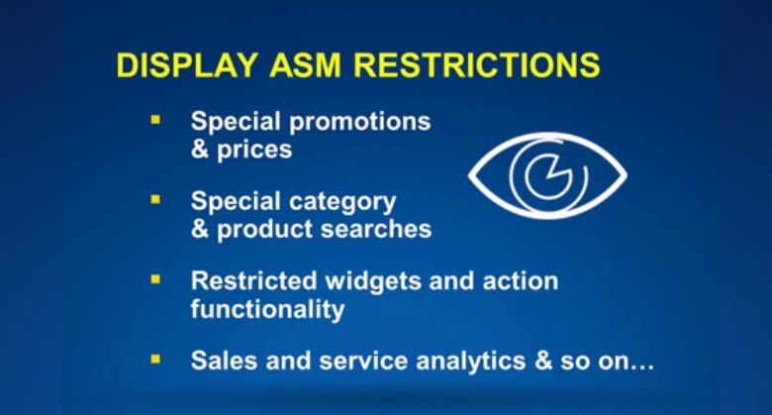
Cont..

Slide 12

ASM DEMO

Slide 13
SUMMARY
Extends self-service support
Create a new customer account on the customer's behalf
Reduces costs
Increased customer satisfaction
Makes easy flow of complex high-value product & purchase flow, sales & service

Slide 14
Thank You

