Slide 1

Hybris B2B Assets Specifications

Slide 2
Agenda
Overview of Hybris Assets:
Catalog Restrictions Module
Fast order Module
Multi cart Module
Advanced Cart/Order Search Module
Advanced Product Search Module
Responsive Theme Module
360° View of an Order Module
Image Resizing Module
Order Export Module
SAP Interfaces (asynchronous)

Slide 3
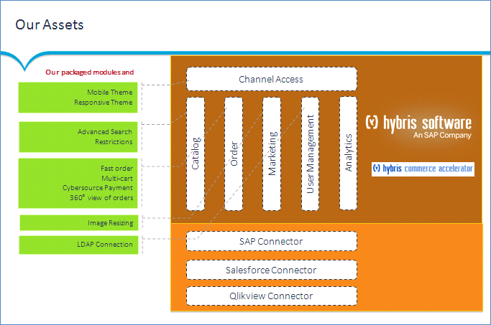
Overview of Hybris Assets
*
*
*
*
* Needs to be finalized

Slide 4
Cont..
Catalog Restrictions Module
A generic way to create assortments (providing a variety of products related to different B2B customers)
A generic B2B module to retrieve in Hybris all order types (Hybris Order, SAP Order, Fax Order, Email Order, Phone Order…)
360° View of an Order Module
Fast Order Module
Multi Cart Module
A generic B2B module to create easy ordering through a screen or a CSV import using SKU and quantity
A generic B2B module to allow several carts at the same time for the same B2B unit

Slide 5
Cont..
Advanced Search Module
A generic B2B module to search Products and Carts/Orders through different fields to be filled in (ID, SKU, date, buyer…)
A generic B2B module to resize the images automatically and without losing quality (with Hybris Accelerator expected sizes)
Image Resizing Module
Responsive Theme Module
SAP interfaces (asynchronous)
A generic B2B module in order to make B2B Accelerator Responsive
Multiple interfaces (customer, product, price, stock, order, product restrictions, order tracking…)

Slide 6
Catalog Restrictions Module
Catalog Restrictions Module
This module (a specific behavior that does not exist in Standard Hybris) helps to create various products assortments for different customers and also manage partial catalogs
Products are included in subsets that match customer assortments, it means there is a set of products that may be suggested to some customers and not to others
The products of these assortments may be common to many customers
Among the customer assortment products, some may be viewable or non-viewable

Slide 7
Cont..
Viewable: These are all products available to all users of a B2B unit
Product Field ("is viewable" provided by the MDM (* interface))
Non-Viewable: These are all products that are not available to all users of a B2B unit
Product Field ("is not viewable" provided by the MDM (* interface))

Slide 8
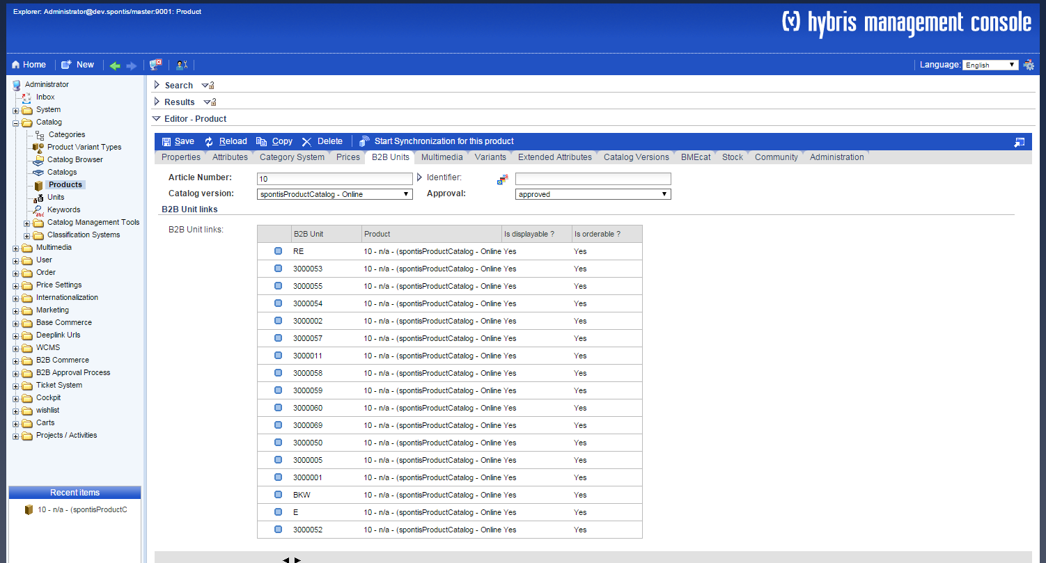
Cont..

Is Displayed: Yes for “Viewable” products and No for “Non- Viewable” products


Slide 9
Cont..
Functional Rules:
Display: Viewable products are displayed for all B2B unit users
Non-viewable products are not viewable for the B2B unit users
Import: The import is done through an asynchronous interface (CSV files)
Export: No export is available
Search: Viewable products are searchable, however non-viewable products are not searchable

Slide 10
Quick Order
Quick Order Module overview
A B2B module that helps to create easy ordering or quick ordering
The quick ordering can be done through a web page or a CSV import
The user can use only SKU and quantity of the products that he wants to order
Quick Order Management Process
Providing fast and reliable order processes regardless the products’ categories by filling in only two fields “SKU” and “Quantity”

Slide 11
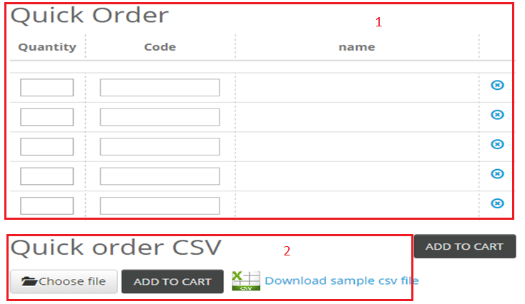
Cont..
❶ Quick Order table (SKU and Quantity Fields)
❷ Quick Order CSV

Slide 12
Cont..
Functional Rules
Display: The quick order table is presented in a component or in a whole page
Export: No export is available
Search: An autocompletion is possible to find the appropriate SKU

Slide 13
Multi Cart Module
Multi Cart Module overview
The Multi Cart functionality should allow the user to create and manage multiple carts at the same time
The users may share their carts with their B2B unit users
The current cart can be changed at any time through the order history page
The user can search on the order history page all his carts and also the carts belonging to his B2B unit users
There is a component up on the right side of the page that helps to switch from one cart to an other (check-box select)

Slide 14
Cont..
Multi Cart Management Process
The multi Cart Module helps the user to have access to all his B2B unit carts whether this cart is created by himself or by an other user who gave access to his cart in order to manage parallel carts

Slide 15
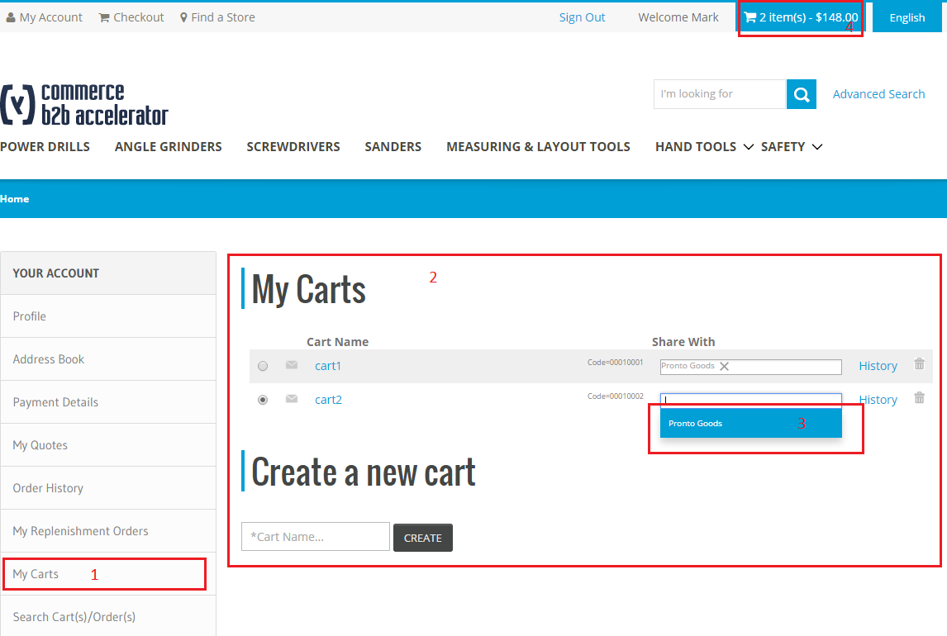
Cont..

Slide 16
Cont..
Multicart module available on my account section after login with b2b customer.
Create new cart and assign the name you can add products to that cart.
Share cart for available b2b units.
When you select any cart, the minicart component will automatically refresh the cart and shows the number of products contains.

Slide 17
Advanced Cart/Order Search Module
Advanced Cart/Order Search Module overview
The order history page displays all by using different search criteria
The order history is accessible via two links
Cart/Order search criteria
Here is the used search criteria list:
Cart Number (web order)
Cart Label
Product Number
Creation Date
User Name

Slide 18
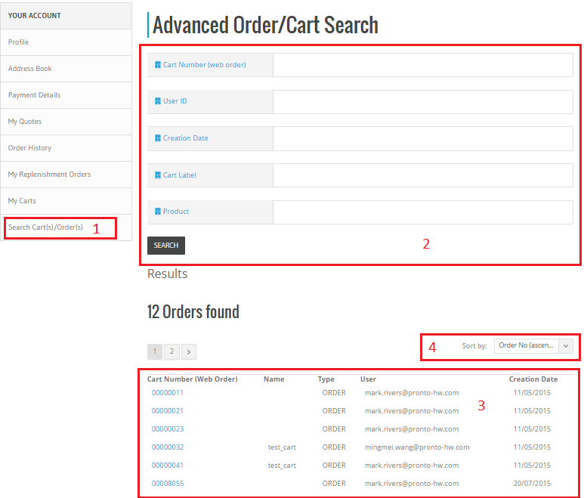
Cont..

Slide 19
Cont..
Advanced Cart/Order Search module available on my account section after login with b2b customer.
Advanced Cart/Order Search : Order search criteria fields.
Displays the results on search criteria.
Sort results section by ascending/descending order etc.

Slide 20
Cont..
Functional Rules
Display: The order advanced search module is presented in a page with several search criteria. Results are displayed in the same page with a pagination system
Import: No export is available
Export: No export is available
Search: Many search criteria fields are available

Slide 21
Advanced Product Search Module
Advanced Product Search Module overview
The product search page displays all products (viewable products for the B2B unit) by using different search criteria
The product search page is accessible via advanced search
Products’ search criteria
Here is the used search criteria list:
Designation
SKU
Product Name
Description
Summary

Slide 22
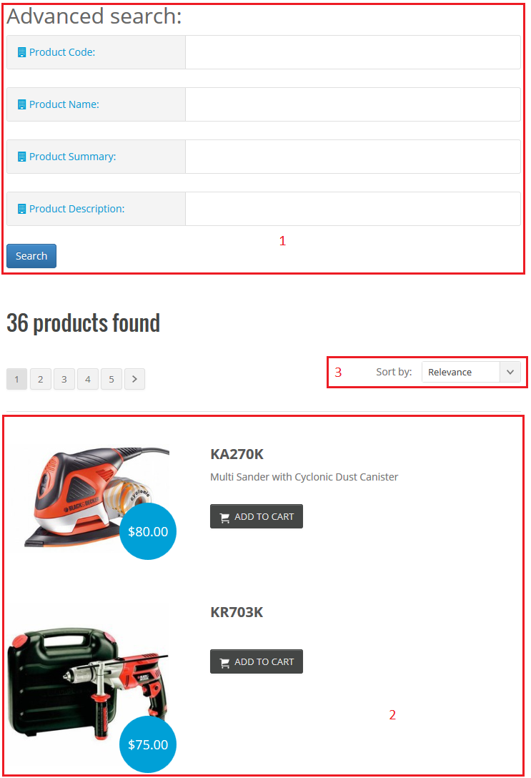
Cont..

Slide 23
Cont..
Advanced search: Product search criteria fields
Displays the results on search criteria.
Sort results section by relevance, top rated, etc.

Slide 24
Cont..
Functional Rules
Display: The order advanced search module is presented in a page with several search criteria. Results are displayed in the same page with a pagination system
Import: No export is available
Export: No export is available
Search: Many search criteria fields are available

Slide 25
Responsive Theme
Responsive Theme Module overview
Giving access to the site from multiple devices, different platforms, several browsers with many screen sizes
A responsive web design version is developed to fit each screen

Slide 26
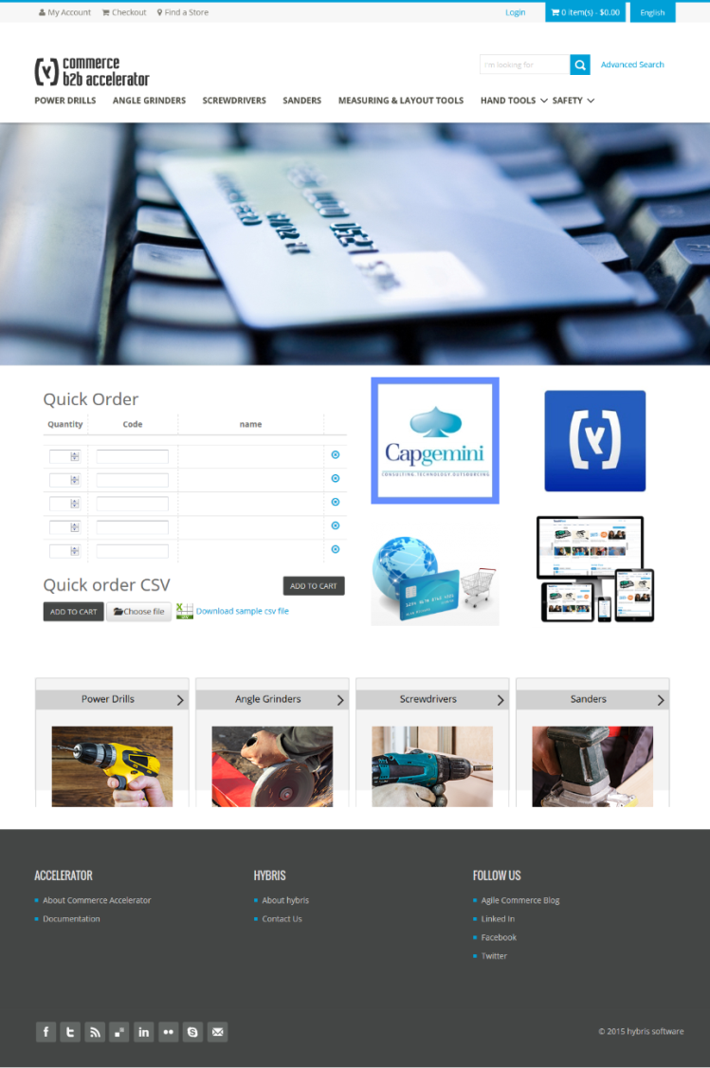
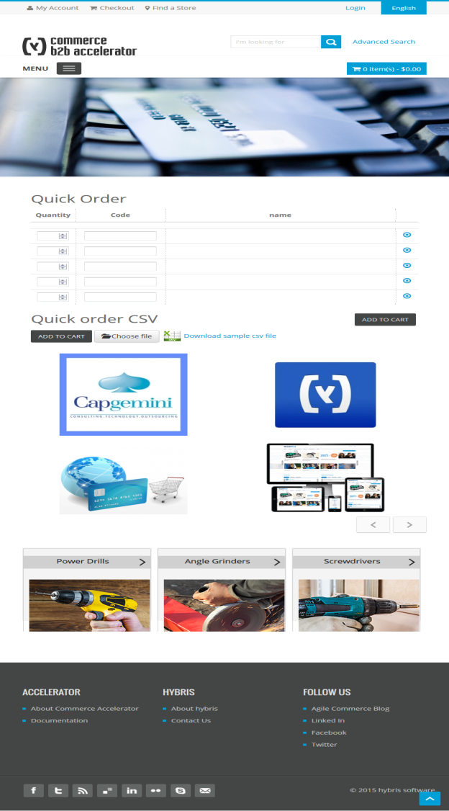
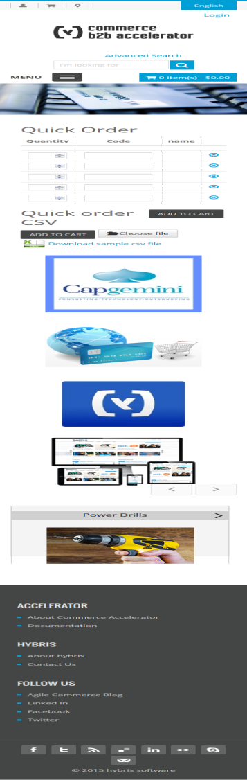
Cont..
Desktop
Tablet
Mobile

Slide 27
Cont..
Functional Rules
Display: The responsive design theme and all its components fit the chosen screen
Front Office: A full responsive theme for the store
Back Office: No responsive theme for the BO

Slide 28
360° View of an Order
360° View of an Order
This B2B module allows the user to check out in the order history page the origin of the order
Hybris Order
SAP Order
Fax Order
Email Order
Phone Order

Slide 29
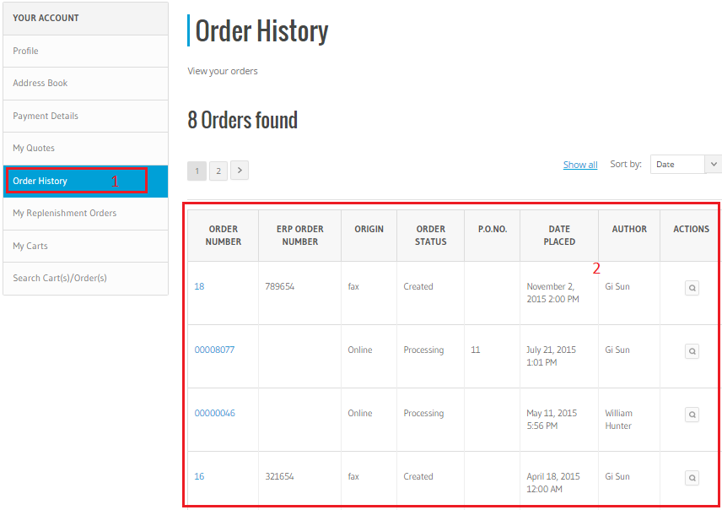
Cont..

Slide 30
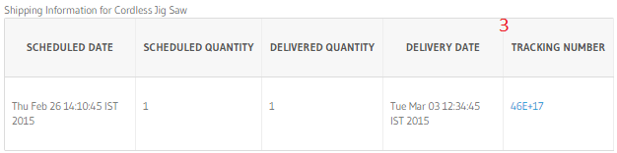
Cont..
360° view of order available my account section.
Order history List Page – this will show all the orders of a B2B unit for all the users including offline orders.
Order History Detail Page – This will show all the order details and below each order entry there will be tracking details (if any).

Slide 31
Cont..
Functional Rules
Display: The origin of the order is displayed in a column located in the order history table
Import: hot folder
Export: No export is available
Search: The order origin field in the order history page

Slide 32
Image Resizing
Image Resizing
This B2B module helps to resize the uploaded image in the appropriate formats
515Wx515H
300Wx300H
96Wx65H
65Wx65H
The image is uploaded via a hot folder
A CSV file links the name of the image to the product’s id

Slide 33
Cont..
Functional Rules
Display: The resized images are displayed in the appropriate formats
Quality: A high resolution is required before uploading the image
Import: Via a hot folder

Slide 34
Order Export Module
Order export
The interface is developed based on assumption that the external system will would accept the order details in CSV file format.
ExportOrderJob extends AbstractJobPerformable and has the business logic to extract orders which has order status as completed and extract status as not exported and write the csv file.

Slide 35
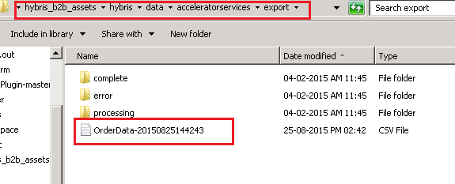
Cont..
Run cron job from hmc→System→Cronjob.
Navigate to hybris/data/acceleratorservices/export here the order csv file will be exported.

Slide 36
SAP Interfaces (asynchronous)
SAP interfaces (asynchronous)
These interfaces are based on impex with all native Hybris attributes with hot folder importing and configuration
The available interfaces are:
Product interface
Customer interface
Price interface
Product restriction interface
Stock interface
Order interface
Order tracking interface

Slide 37
Cont..
Product interface: The product interface represents both products and variants, a specific repository where the CSV files are dropped is created for this purpose
Customer interface: It helps to create customers’ profiles and manage customers’ details
Price interface: This interface helps to import products’ multiple prices. The prices might be different from a B2B unit to an other
Product restriction interface: It represents the assortments (providing a variety of products related to different B2B customers)

Slide 38
Cont..
Stock interface: It gives a view of inventory and stock level availability of your products’ network
Order interface: It enables the electronic sending and receiving
Order tracking interface: It represents all the information related to the order tracking since the creation of the cart

Slide 39
Cont..
Product interface OOB fields:
Code: The product’s ID
Name: The product’s title
Summary: The description displayed in the list of results when we search a product
Description: The full description displayed while we click on the searcheable product
Remarks: The notices added for each product

Slide 40
Cont..
Customer interface OOB fields:
UiD: The user’s code
Name: The user’s name (First Name & Last Name)
Email: The user’s valid email
DefaultB2BUnit: The name of the B2B unit to which the user belongs

Slide 41
Cont..
Price interface OOB fields:
Code: The product’s ID
Price: The product’s price
Currency: The product’s currency
PriceDate: The price is valid until the PriceDate
SequenceID: it links one or more B2B units to a list of prices

Slide 42
Cont..
Product restrictions interface OOB fields:
Product: The product’s code
B2BUnit: The B2B unit’s UiD
IsDisplayable: “Yes” if the product is viewable for the B2B Unit and “No” if the product is not viewable for the B2B Unit

Slide 43
Cont..
Stock interface OOB fields:
Available: An integer that shows the quantity of the stock
Product: The product’s ID
Warehouse: The warehouse’s ID

Slide 44
Cont..
Order interface OOB fields:
Code: The order’s ID
Currency: The order’s currency
Date: The creation date of the product
DeliveryAddress: The delivery address
DeliveryCost: The delivery cost
Entries: The list of the products contained in the order
PaymentAddress: The payment address
TotalPrice: The total price of the order

Slide 45
Cont..
Order tracking interface OOB fields:
OrderEntry: SAP Number + Entry Number
TrackingNumber: The order tracking identifier
Owner: The owner of the order
ScheduledDate: The scheduled date for the delivery
ScheduledQty: The scheduled quantity for the delivery
DeliveryDate: The delivery date
DeliveryQty: The effective delivered quantity

Slide 46
Cont..
Functional Rules
Import: Some excel files are dropped in some folders to be consumed and displayed with appropriate data on Front Office
Implementation: The data is built in Excel worksheets once the data models are validated with the customer

Slide 47
Sample CSV Files
SAP Interfaces | Sample CSV Files
Customer Interface
Product Interface
Price Interface
Product Restriction Interface
Stock Interface

Slide 48

Cont..
Order Interface
Order Tracking Interface
Image Resize Interface

Slide 49

Thank You

